Slide 1

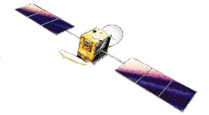

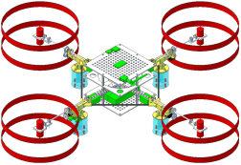
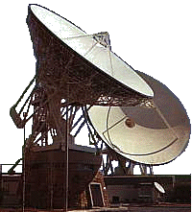

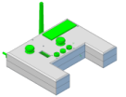
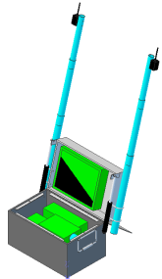
GPS Satellite
InmarSat Satellite
Zigbee
Wi-Fi
Cellular
SATCOM
900 MHz (Video)
Internet
Connectivity Diagram
Vehicle
WAN
Cellular Network
Ground Entry Point
RCU
GCS

Slide 2
GPS Satellite
InmarSat Satellite
Command/Control
Video
GPS
Services
Diagram
Vehicle
WAN
Cellular Network
Ground Entry Point
RCU
GCS

