Slide 1






David Gitz, EE, ICARUS Lead Engineer
I C A R U S
Notes:
Yo mama

Slide 2

Electrical Engineer at Scott AFB, IL – Predator UAV Full Motion Video Dissemination
22 Robotics Projects, including several 1st place awards
Mentored Robotics Teams for 5 years
Started SIU Robotics Club
IEEE St. Louis Section Secretary/Incoming Treasurer

Slide 3

Applications
System Description
Capabilities
Development Progress
Demonstrations
Get Involved!
Note: This Project is not affiliated with the US Air Force

Slide 4


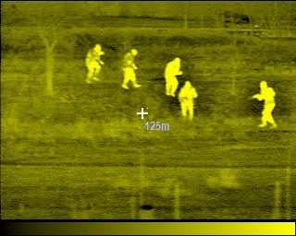
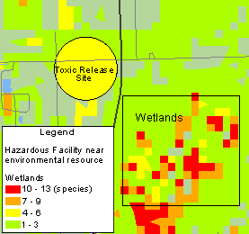

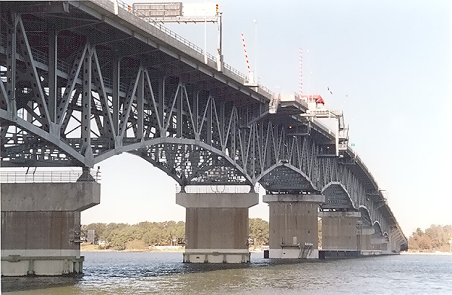

Slide 5

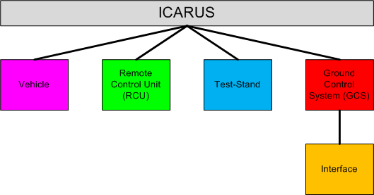
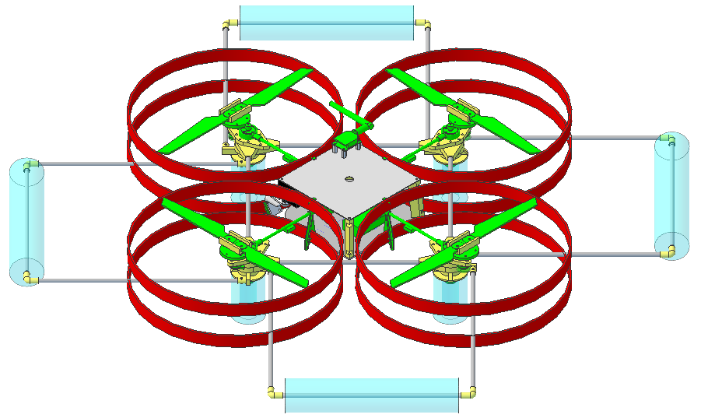
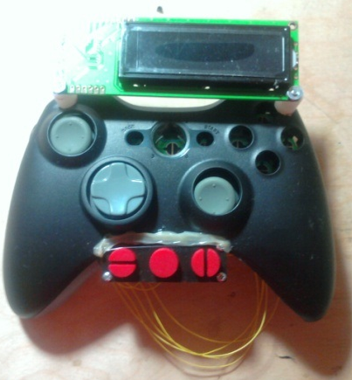
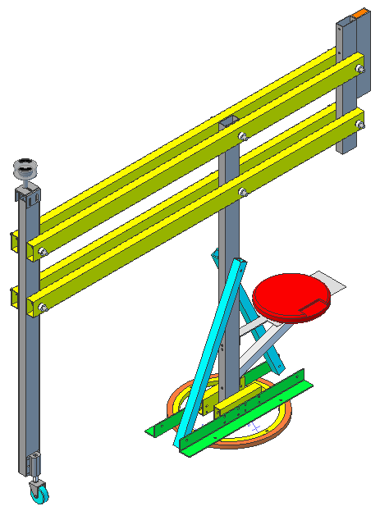
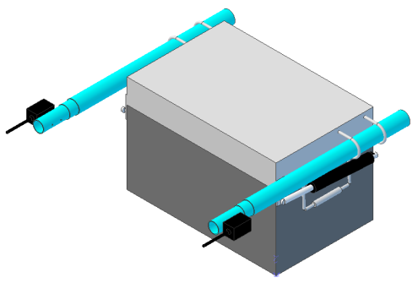
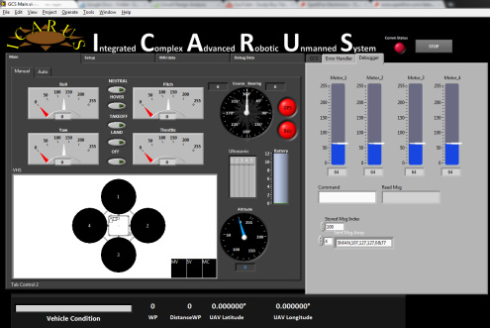

Slide 6

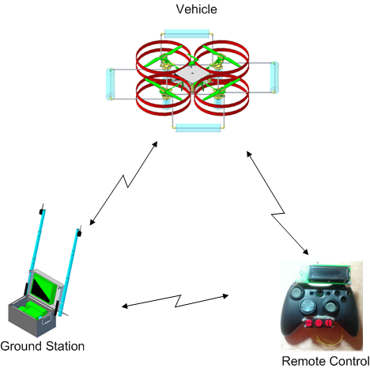
Using XBee API Mode, Vehicle, GCS and RCU all talk to each other
RCU and GCS can extend flight range of Vehicle due to API mesh network.

Slide 7
Vehicle

Slide 8

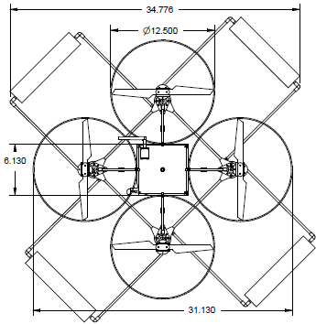
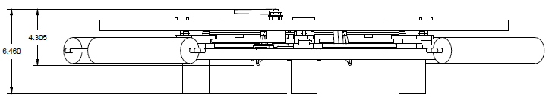
Quad-Rotor design – Offers simpler control system with fewer moving parts than a single rotor helicopter and minor reduction in lift capacity

Slide 9

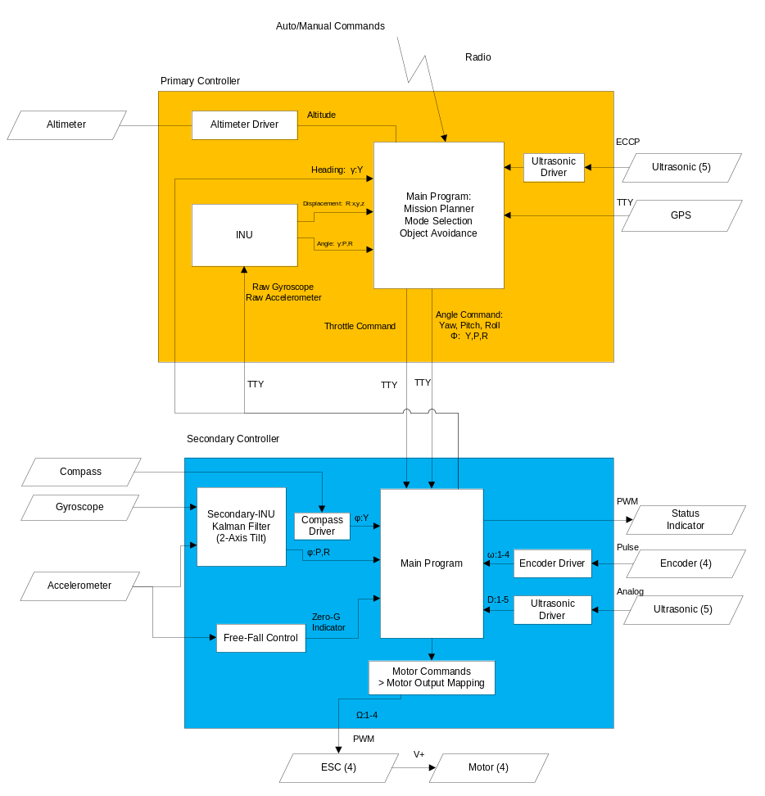
2 “Brains”, 1 SoM Board and
1 Parallax PropellerTM uC
SoM handles waypoint navigation, mission planning, vehicle health.
PropellerTM uC handles PWM generation, Kalman Filter.
In the event of an in-air mishap, PropellerTM uC can take over Vehicle and land safely.

Slide 10

Sensors: 3-Axis Accelerometer, 3-Axis Gyroscope, Digital Compass, Altimeter, GPS, 5 Ultrasonic Sensors, 4 Quadrature Encoders
Power: 4 DC 24 Watt Motors, 2 Lithium-Ion 11.1V 2.1Amp-Hours, 4 7A Electronic Speed Controllers, 5V and 3.3V Linear Voltage Regulators.
Control: SoM Controller (Primary), Propeller Controller (Secondary), custom PCB.
Communications: Xbee Radio for Command/Control, Video Transmitter, Wi-Fi (Field programming, tentative).
Fabrication: ~30% COTS, ~70% produced by MakerBot.

Slide 11






Pitch
CCW
CW
Roll
CW
CW
CW
CW
Yaw
CCW
CW
CW
Forward
CW: Puller
CCW: Pusher

Slide 12

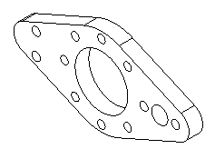
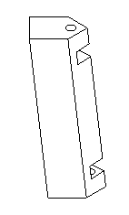
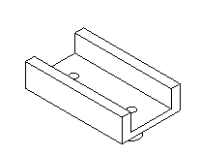
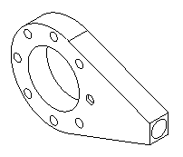
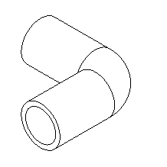

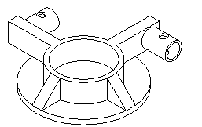
Encoder Mount x4
Gear Brace x4
Motor Coupler x8
Electrical Board
Support x3
Sonar Mount x4
Elbow x8
Encoder Pin x4

Slide 13


Custom PCB inside Xbox-360 Controller
Features Mode and Error Display, Vehicle Battery Indicator, Force-Feedback and 5 hours of continuous operation.

Slide 14

Communications: XBee Radio for Command/Control
Input/Output: 9 Switches/Buttons, 2 Dual-Axis Joysticks, GPS Sensor, 10-Segment LED, LCD Screen, Vibrating Motors.
Power: 2 Ni-Mh AA Batteries, 3.3 and 5V Boost Converters.

Slide 15

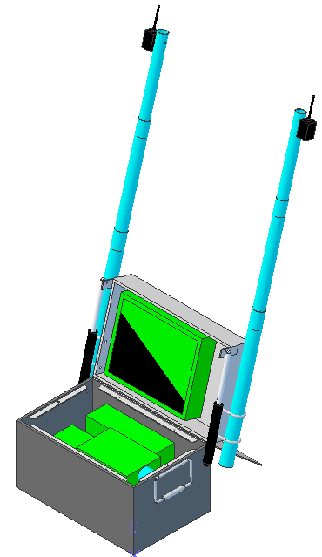
GCS
Includes computer, touch-screen monitor and batteries for field operation.
Communications Radio and Video Receiver
Heavy-duty field transportable case
12 V Batteries
Military Case

Slide 16


GCS offers extended range – up to 3 km
Interface designed in LabView
Google Earth integration with Internet connection

Slide 17

Software: National Instruments LabView integrated with Google Earth mapping software.
Power: 2 12V 26Amp-Hour Batteries, 120V AC Power Inverter, Vehicle battery fast charger.
Communications: XBee Radio for Command/Control, Video Receiver

Slide 18
Test-Stand
Used for Vehicle Calibration and Capacity measurements
Able to Pivot vertically, rotate continuously and pitch/yaw/roll on Test-Fixture Assembly
Power applied to Vehicle via Slip-Ring – No tangled wires

Slide 19

4 Command/Control Links
Assumptions:
Communications Channel will be “filled”.
No dropped packets
Follows ICARUS Communications Protocol
Link | Vehicle-RCU (Manual Mode, Wireless) |  | Vehicle-GCS (Manual Mode, Wireless) |  | RCU-GCS (Wireless) |  | Primary-Secondary (Wired)
Parameter | TX | RX | TX | RX | TX | RX | TX | RX
Selected Messages | ERR,MAN-# | ERR,STA-POWMV,STA-COND | ERR,MAN-# | ERR,SEN-INU,STA-POWMV,STA-POW5V,STA-POWMC,STA-BEAR,STA-DIST,STA-ALT,STA-GPSFIX,STA-INUFIX,STA-COND | ERR,STA-COND | ERR,STA-COND | ERR,MAN-#, | ERR,SEN-INU,
Traffic (Bytes) | 30 | 7.5 | 30 | 65.12 | 5.2 | 5.2 | 30 | 54
Baud Rate (bps) | 9600 |  | 9600 |  | 9600 |  | 115200
Update Freq (hz) | 40.00 | 160.00 | 40.00 | 18.43 | 230.77 | 230.77 | 480.00 | 266.67

Slide 20

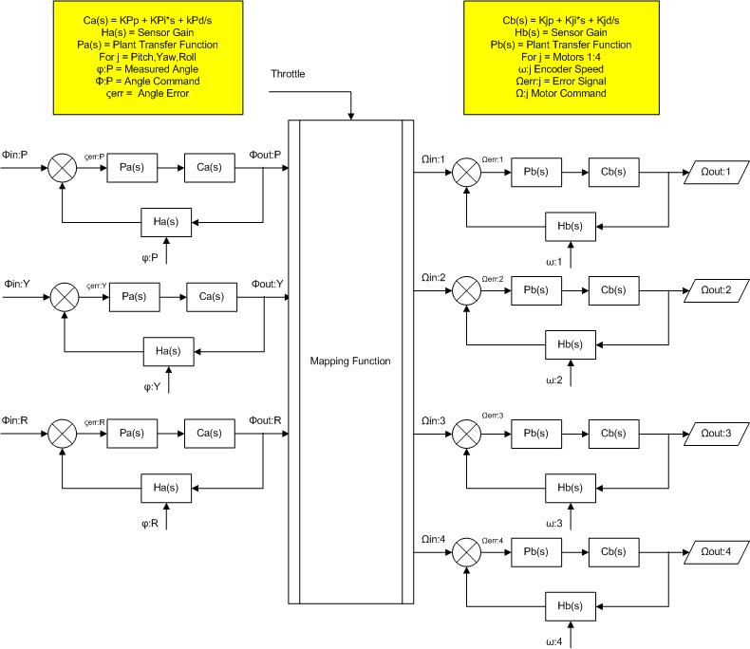

Slide 21

Capabilities - Planned
Manual Control via RCU or GCS | Simple Calibration and Testing via Test-Stand
Limited Autonomous Navigation via RCU | Error Display on RCU and GCS
Waypoint Navigation | Force-Feedback on RCU
Automatic Takeoff, Hover and Landing | Vehicle Health Reporting
Capabilities - Future
Real-Time Video Transmission to GCS | Image Capture
Wireless airborne programming | Advanced Hover modes
Vehicle Status Audio via RCU | Extended System Duration
Configurable Payloads | Terrain Following

Slide 22

Range: ~1.5 km LOS (~3km with Xbee Mesh Network)
Duration:
  Vehicle: ~20 min
  RCU: ~4-6 hrs
  GCS: ~4-6 hrs (including field charging Vehicle)
Speed: ~2 - 4 kph
Weight: < 3 lbs
Size: 35” x 35” x 7”
Propeller Rotation: Max: 2950 RPM
Vertical Thrust: > 4 lbs
Notes:
*Educated Guesses

Slide 23

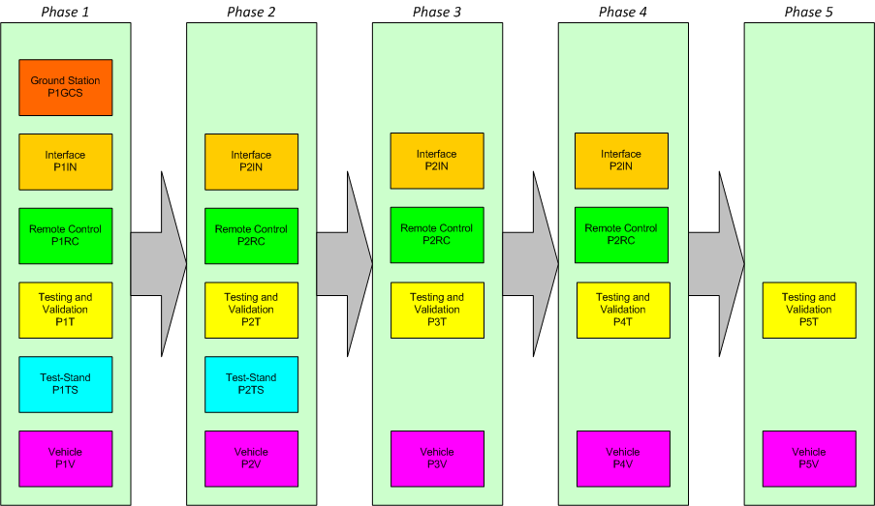

Slide 24
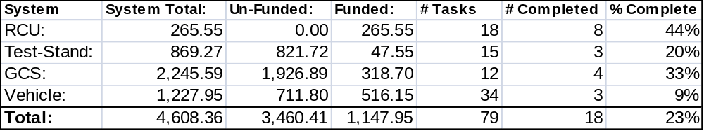
Cost: 25% of material/part cost invested.
Tasks: 23% of defined tasks completed.
Currently in Phase 1 with limited development in Phase 2.

Slide 25

Communications
Vehicle Power

Slide 26


Need People!
  Computer Engineer
  Computer Scientist
  Mechanical Engineer
  Project Manager
  Technical Writer
  Marketing/PR
  Aerospace Engineer

Slide 27


Contact:
  David Gitz: davidgitz@gmail.com
  Michael Welling: mwelling79@gmail.com

