Slide 1
On-Path Proxy Discovery Side meeting at IETF-121, Dublin Thursday, 7 November, 18:30-20:00, Wicklow Hall 2A
All material: https://github.com/mwelzl/oppd
Internet-draft: draft-welzl-panrg-oppd-00

Slide 2
Why OPPD?
Performance Enhancing Proxies (PEPs) did some useful things for TCP
E.g., improved communication over satellite
And they caused problems, because they were transparent
QUIC requires proxies to be non-transparent
So now, we can get them right: let the endpoint choose
This is good in general, also for TCP => but we talk about QUIC
Transparent proxies are inherently on-path
For QUIC, we have to discover them

Slide 3
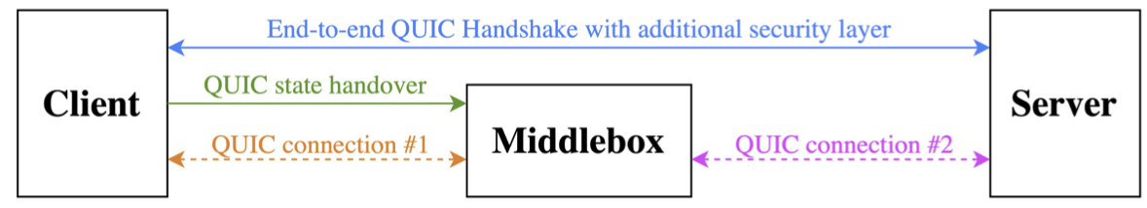
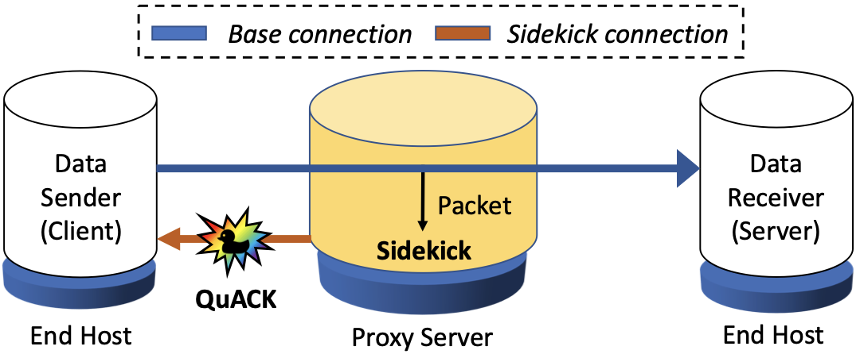
Two use cases: both need OPPD
Example 1: "Secure Middlebox-Assisted QUIC" (SMAQ) https://ieeexplore.ieee.org/document/10186363 Preprint: https://arxiv.org/abs/2307.08543
Example 2: "Sidekick: In-Network Assistance for Secure End-to-End Transport Protocols" https://www.usenix.org/conference/nsdi24/presentation/yuan
There can be more, of course: we want a generic solution.

Slide 4
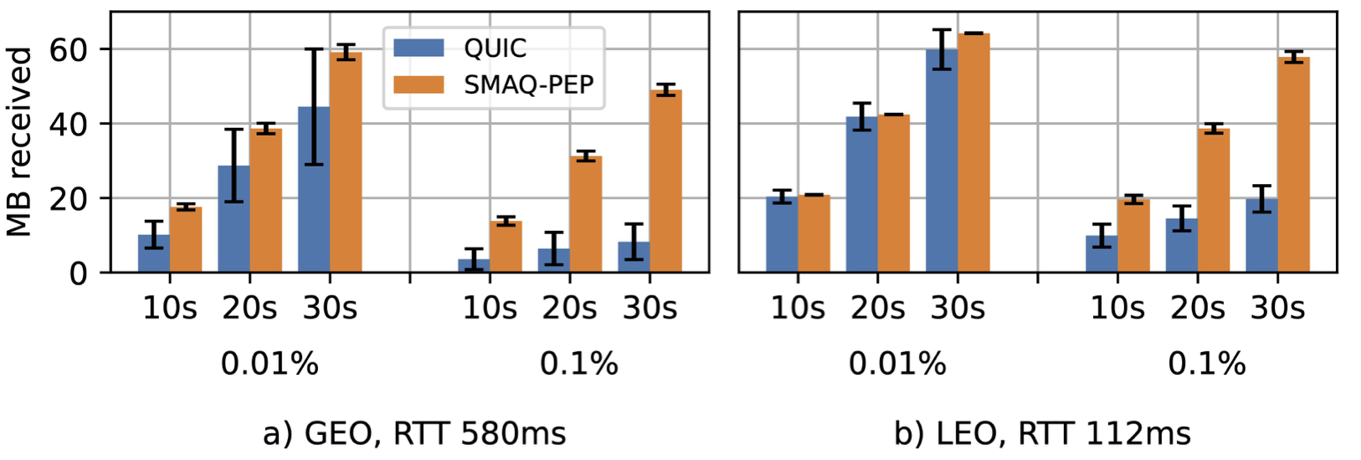
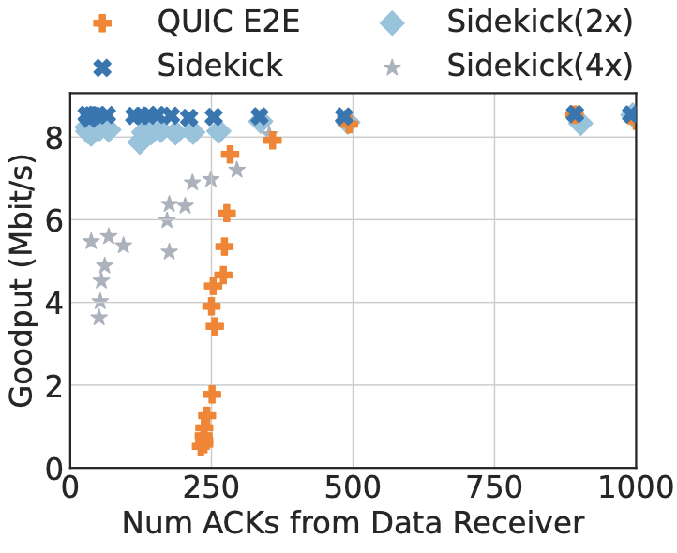
Is this really worthwhile?
SMAQ satellite tests show significant improvements
Sidekick: paper evaluated 3 use cases: earlier retransmission of packets lost due to noise, conn-splitting, ACK reduction
Reducing WiFi receiver ACKs for lower collisions. High goodput independent of e2e ACK frequency.
10 Mb upload

Slide 5
Why the "on-path" limitation?
Makes use of default routing
No need to involve the operator (e.g., proxy could be a WiFi AP)
Can be very lightweight
No penalty if there is nothing on the path (common case)
Should therefore be faster than other discovery schemes

Slide 6
Requirements
Needs to work through NATs, i.e. use same 5-tuple as base connection (the connection to be optimized)
Endpoints announce their interest
Else, potentially many unsolicited packets, and unclear for a proxy when to send one
Proxies answer in a way that proves that they've seen packets from the endpoint (think ICMP for a simple case)
The next step is out of scope for now
E.g., first packet from proxy could contain IP address + port number to use from now on

Slide 7
How could this work? draft-welzl-panrg-oppd identifies 3 signaling options (assuming: the same in both directions, for now, for simplicity)

Slide 8
1. a "special" packet
If a "special" packet from the sender arrives at the receiver, there, QUIC's crypto code will recognize it as an error and ignore it.
Pros:
Only change e.g. QUIC implementation + proxy
Cons:
Extra packets
A quite dirty hack
Proxy needs to spoof source address / port

Slide 9
2. TCP / UDP options
Pros:
No spoofing
No extra packets
Endpoint: ignored in the OS if not supported
Cons:
Changes to both QUIC and the OS
Can it even be done? UDP options must not be changed in transit
MTU problems?

Slide 10
3. QUIC transport option
In the beginning; decipherable by anybody because there's no established secret yet.
Pros:
No extra packets
In line with part of QUIC spec
Cons:
Specific to QUIC only (design per transport)
Heavier work for the proxy
Not suitable as a channel back from proxy in the general case (works for SMAQ)

Slide 11
Other considerations
Multiple proxies on the path
They can all announce their existence ("options" signaling: add themselves to a field, provided there's enough space, or insert a new option...)
Multipath
Nothing special to do here? This is per sub-path discovery.
Endpoints initiate OPPD for every sub-path where they want to use a proxy in case it's available.

Slide 12
What do we want from this?
Where should we do this work?
Where should we do following work on performance enhancing functions? (SMAQ / Sidekick / .. ?)
If time permits: design discussion of OPPD

