Slide 1
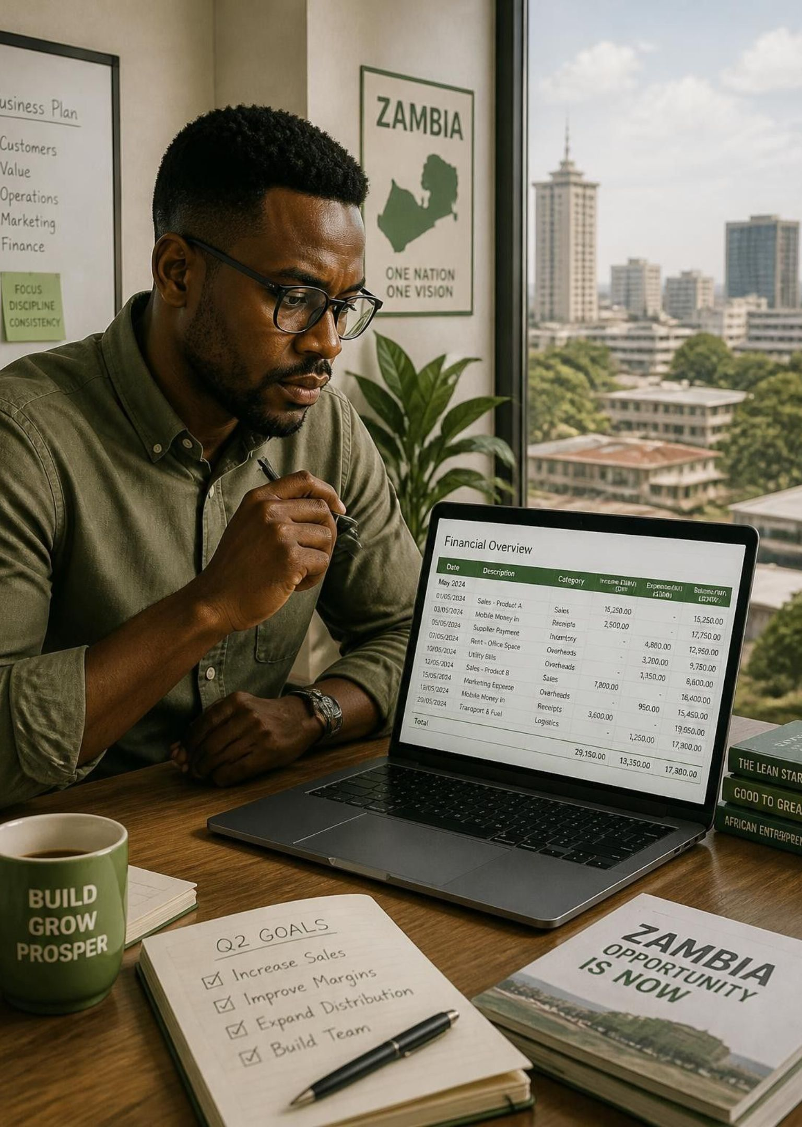
FundPath: from CDF loan to repayment
BIT 301 · E-BUSINESS AND ENTERPRISE SYSTEMS
A platform that closes the gap between borrowing and repayment in Zambia’s Constituency Development Fund
Chimwemwe Siyingwa · University of Lusaka
Notes:
Introduce the topic: Zambia lends CDF money to groups and SMEs, but repayment is the weak link. FundPath is a prototype that manages the whole path from discovery to repayment.

Slide 2
CDF funding per constituency grew 25-fold in five years
156
constituencies
K40m
each in the 2026 budget
≈K6.24bn
national total, 2026
Sources: Ministry of Local Government and Rural Development, “CDF increase to K40 million”; Presidential Delivery Unit. National total = 156 × K40m.
Notes:
2021 was K1.6m per constituency; 2026 is K40m. That is 25 times more money flowing through councils, which raises the stakes on how well loans are recovered.

Slide 3
In 2025 most CDF went to projects; loans were K421m
94%
of funds released (K5.26bn)
86%
utilisation by December 2025
6,694
loan beneficiaries approved
Source: Zambia Monitor, 27 Jan 2026, reporting a Ministry of Local Government briefing. Government figures as reported; loans are about 8% of K5.26bn released.
Notes:
Loans are a small part of the fund by value, but they are the only part that is supposed to come back and be lent again.

Slide 4
Each constituency’s loan pool is a small slice of its K40m
≈K4.8m in loans
About 60% of empowerment money, repaid into the constituency’s revolving loan account.
Loans
≈K8m for empowerment
Youth, women and community groups: grants (≈40%, K3.2m) and loans (≈60%, K4.8m).
Empowerment · 20%
K40m a year
Also community projects, bursaries and emergencies, approved by the CDF Committee.
Allocation · K40m
Sources: Zambian Economist, “How to apply for CDF grants and loans” (split is a reported estimate; councils vary); CDF Act 2024 (Act No. 1 of 2024), s.16(2)(b) revolving account.
Notes:
The 20/40/60 split is a reported estimate, not a figure in the Act. The Act requires each constituency to hold a loan revolving account, which is why recovery matters: repaid money funds the next borrowers.

Slide 5
The gap: CDF lends money, but too little comes back
K35 of every K100 lent since 2021 has been repaid (Sept 2026).
The 2026 loan component was suspended; new loans now depend on recoveries.
35%
Briefings differ: about 9% repayment in Jan 2026, 35% in Sept 2026.
“A loan is a loan and must be paid back.”
Local Government Minister, May 2025
Sources: Lusaka Times, 29 Sep 2026 (Ministry of Local Government and Rural Development, repayment since the 2021 expansion); Zambia Monitor, 27 Jan 2026 and 12 May 2025.
Notes:
This is the problem statement: a growing fund, and a revolving loan window that is frozen because recovery is weak. The 9% and 35% figures come from different briefings; the lack of one auditable number is part of the problem.

Slide 6
The published CDF loan route has six steps, none for repayment
1
2
3
4
5
6
Council opens an application window
Collect form from council or WDC
Write a proposal
WDC screens eligibility
CDF Committee appraises
Council approves and disburses
7 Repay and recover the stage FundPath adds: schedule, balance tracking, reminders
Disbursement often lands in a later quarter than approval.
The ministry has asked councils to explain loan terms to borrowers before disbursement.
Sources: Zambian Economist (application flow; WDC = Ward Development Committee); Zambia Monitor, 12 May 2025 (sensitisation directive).
Notes:
Walk through the six documented steps. The journey ends at approval and disbursement. Nothing in it manages the loan afterwards, which is where FundPath comes in.

Slide 7





FundPath adds the missing repayment stage to the CDF journey
Discover
Plan and score
Get advice
Apply
Repay
Browse CDF opportunities by constituency and sector.
Enter cash flows; get a feasibility score from 0 to 100.
Book a session with a verified advisor.
Submit once and follow each review stage live.
Repayment schedule, balance and reminders.
Administrator layer portfolio dashboard, review queue, advisor verification, opportunity management
Notes:
The first four steps mirror and improve the existing journey. The fifth, repayment tracking, is the stage that is missing today.

Slide 8
A transparent 0–100 score routes each application
Low
Medium
High
0
45
70
100
High, 70 and above
Strong margins and a proportionate request; fast-tracked to the committee.
Medium, 45 to 69
Viable idea that needs mentor revisions first.
Low, below 45
Oversized request or incomplete cash flow; routed to advisory.
Source: FundPath prototype scoring rules (deterministic, rules-based). Thresholds and weights are the prototype’s own design, not CDF policy.
Notes:
The score is rules-based, so every decision can be explained. Weights are 40% cost-to-revenue, 40% request versus pool, 20% completeness. These are prototype design choices, not official CDF rules.

Slide 9
A three-tier architecture keeps the platform modular
PRESENTATION
React web client
React 18, Vite, TypeScript, Tailwind. Separate views for applicants, advisors and admins.
BUSINESS LOGIC
Express REST API
14 route modules, including auth, applications, advisors and admin. Scoring lives here.
DATA
PostgreSQL on Neon
Accessed through Prisma. Stores applications, scores and repayment records.
Every API request passes through
CORS
Rate limit
JWT auth
Role check
Input validation
API and web client deploy to Render from the master branch; the database runs on Neon.
Notes:
Client, API and database are separate tiers. Roles are applicant, advisor and admin. Admin routes are guarded once at the router level.

Slide 10
Better recovery is the value: each 10 points recycles K42m
K42.1m
Applicants
A clear route and a stronger plan before they apply.
Advisors
Paid sessions and a rated reputation.
returned to revolving pools for every 10-point gain in recovery on the K421m of loans approved in 2025.
Administrators
One live view of backlog, disbursed, repaid and outstanding.
The fund
Tracked repayments keep money available to lend again.
Illustrative arithmetic, not a forecast.
Calculation: 10% × K421m (loans approved in 2025, Zambia Monitor, 27 Jan 2026) = K42.1m.
Notes:
The value proposition is recovery. The arithmetic is simple on purpose: 10 percent of K421 million is K42.1 million that can be lent again.

Slide 11
Empowerment reaches women and youth, mostly as grants
27,048 vs 3,063
grant-funded groups against loan-funded enterprises: about 9 to 1.
Recovery decides growth
Loans can reach more people only if repayments recycle.
FundPath’s case
Wider access for first-time borrowers, advice on skills, and visible decisions and repayments.
Source: Ministry of Local Government and Rural Development, “CDF increase to K40 million” (cumulative counts as reported). Loan priority groups: youth, women, persons with disabilities.
Notes:
Cumulative counts: 8,766 youth groups and 18,282 women groups received grants; 1,506 youth and 1,557 women enterprises received loans. Grants never come back, loans do, so repayment is what lets the loan side grow.

Slide 12
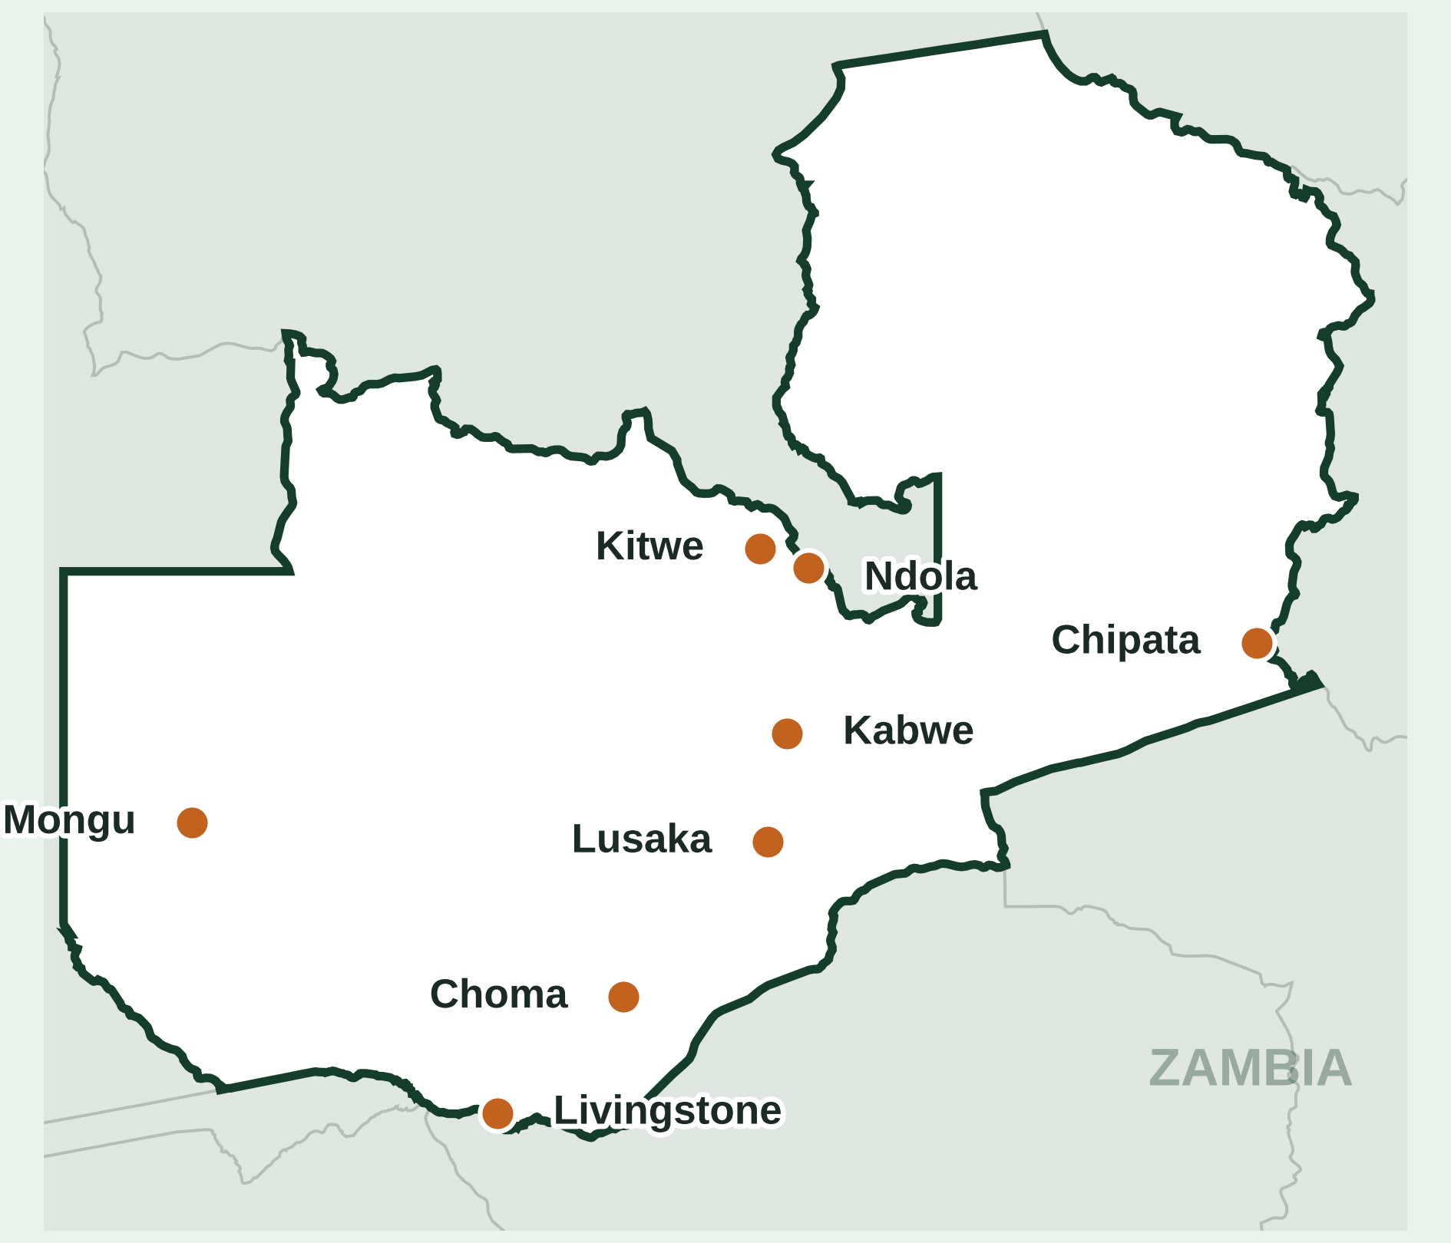
The prototype covers eight constituencies across Zambia
8
real constituencies seeded in the prototype
K320m
8 × K40m: the 2026 CDF allocation across them
0
real borrower records (demo data only)
Markers sit at each constituency’s town, not its boundary. Allocation: K40m per constituency, 2026 budget. Application data in the prototype is seeded for demonstration.
Notes:
The constituencies are real places; the applications and repayments in the prototype are demo data. Every constituency receives the same K40m allocation.

Slide 13
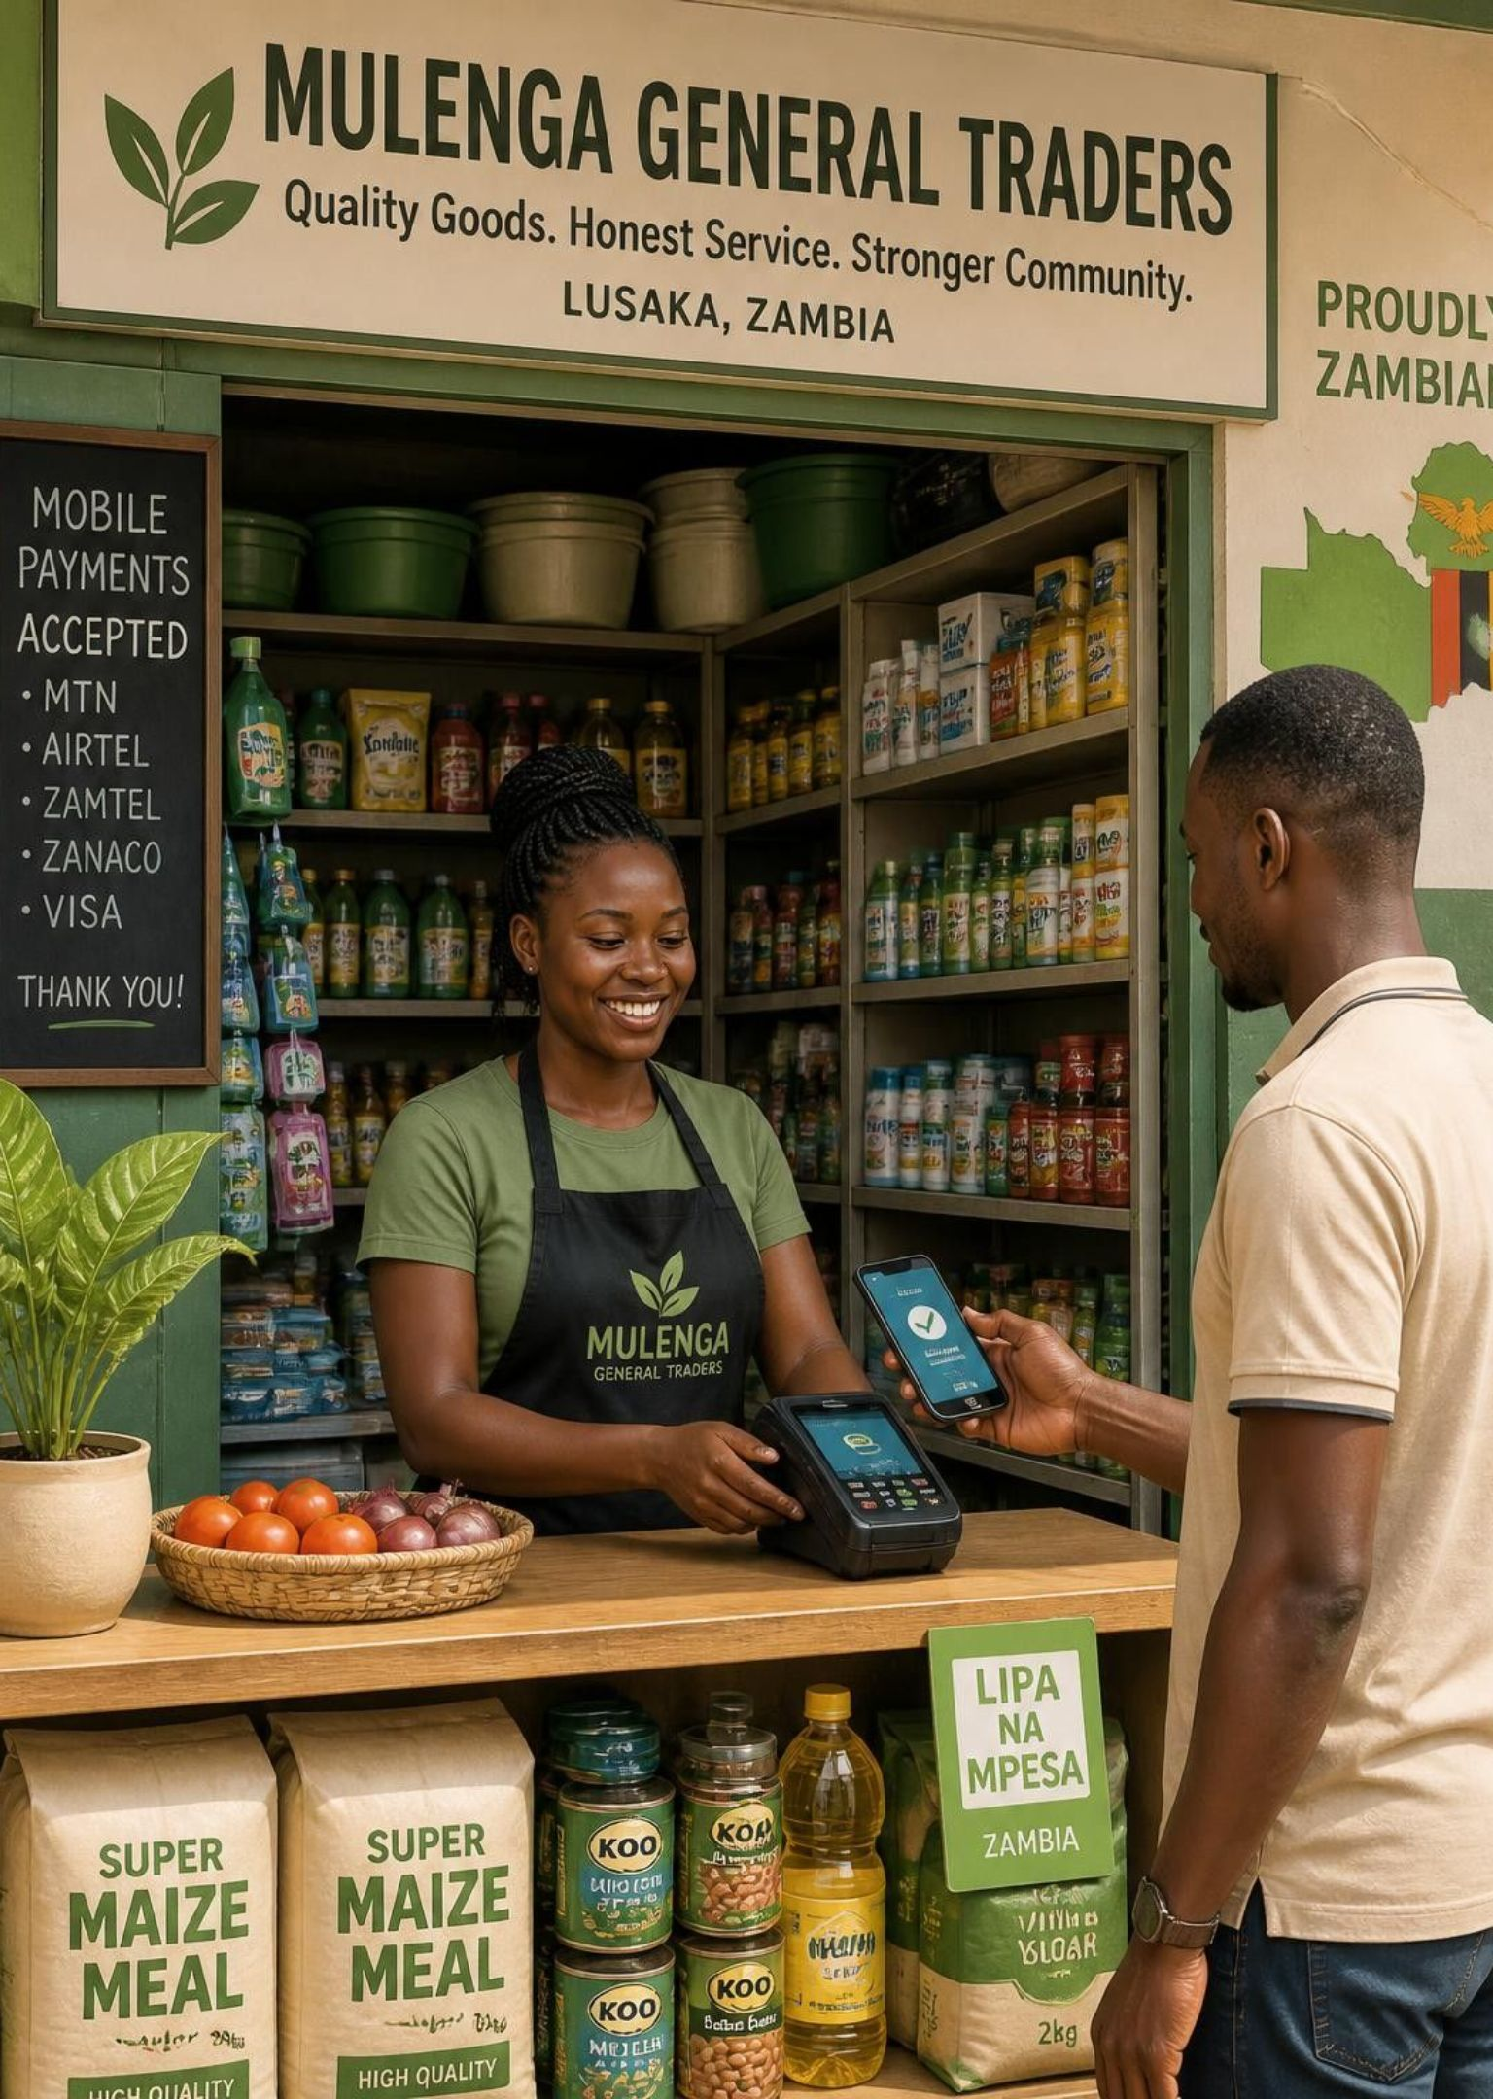
A clearer path turns good plans into repaid capital
CDF now puts K40m into each of 156 constituencies.
Only 35% of loans made since 2021 has been repaid.
FundPath adds scoring, advice, tracking and repayment.
Thank you. Questions?
Notes:
Close on the three takeaways, then take questions. The photos are AI-generated illustrations, not real people or businesses.

Slide 14
References
Ministry of Local Government and Rural Development (2026). CDF increase to K40 million: what it means for Zambia’s communities. https://www.mlgrd.gov.zm/?p=34032
Zambia Monitor (27 Jan 2026). Govt claims K5.26 billion released under CDF, reports 86% utilisation in 2025. zambiamonitor.com
Lusaka Times (29 Sep 2026). CDF empowerment loans frozen after borrowers repay only 35 percent. lusakatimes.com/2026/09/29/
Zambia Monitor (12 May 2025). Local Government Minister Sialubalo warns CDF loan beneficiaries to pay back. zambiamonitor.com
Zambian Economist. How to apply for CDF grants and loans in Zambia. https://zambianeconomist.com/how-to-apply-cdf-grants-loans-zambia/
Republic of Zambia (2024). Constituency Development Fund Act, 2024 (Act No. 1 of 2024). https://zambialii.org/akn/zm/act/2024/1/eng@2024-04-18/source
Presidential Delivery Unit. Constituency Development Fund. https://www.pdu.gov.zm/cdf
Siyingwa, C. (2026). FundPath prototype source code. https://github.com/mwemmz/cdf-project
Figures are as reported by government and media; check against primary sources before citing formally.

