Slide 1
CDF lends, but too little comes back
PROBLEM
35%
Repaid
Not yet repaid
of CDF loans since 2021 have been repaid
Each dot is K1 of every K100 lent
1
Repayment is weak
The 2026 loan window was suspended.
2
Applicants decide blind
Terms come late; little help with the plan.
3
Sellers lack market data
Little information on who buys what, at what price.
Sources: Zambia Monitor, 27 Jan 2026 and 12 May 2025; Lusaka Times, 29 Sep 2026; Zambian Economist. Seller gap: team assumption.
Notes:
Say: CDF now puts K40m into every one of 156 constituencies, but loans are only recovered if borrowers repay. About 35% of loans since 2021 have been repaid, and the 2026 loan window was suspended (Lusaka Times, 29 Sep 2026). Each dot is K1 of every K100 lent. Two causes we can address: applicants decide with little help (the Ministry itself asked councils to explain loan terms before disbursement, Zambia Monitor, 12 May 2025), and small sellers lack market information. The seller point is our team's assumption, not a sourced finding. We do not claim to know why borrowers default.

Slide 2







FundPath: information at every step
SOLUTION
FUNDPATH SUPPLIES THE INFORMATION
AND REPAY
Discover
Find opportunities
Plan
Get a 0–100 score
Advise
Book an advisor
Apply
Submit and track
Council decides
Approves, disburses
Repay
Schedule and reminders
FundPath is not the lender. The council and CDF Committee decide and disburse.
Sellers get the marketplace too: verified listings and a market assessment of their plan.
Notes:
Say: FundPath sells information at each step: opportunities and real loan terms, a 0 to 100 feasibility score, advisor sessions, and a tracked application. The council and CDF Committee still decide and disburse, and FundPath never handles loan money. Sellers also get a marketplace with verified listings and a market assessment of their plan.

Slide 3
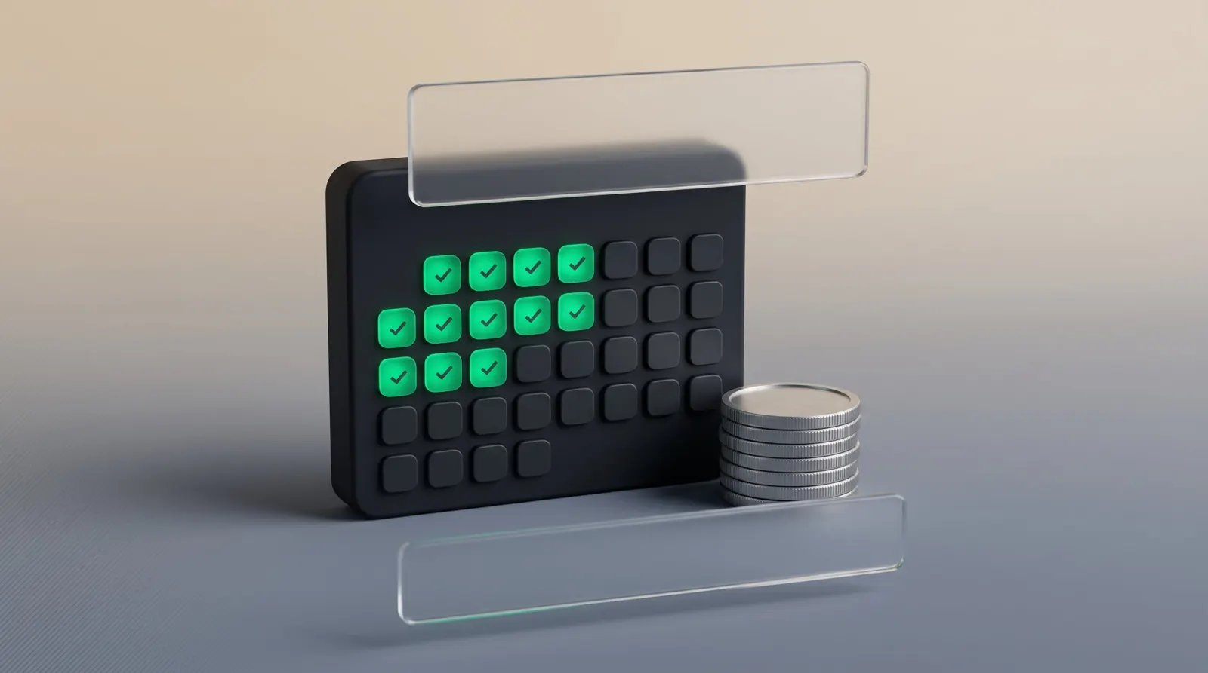
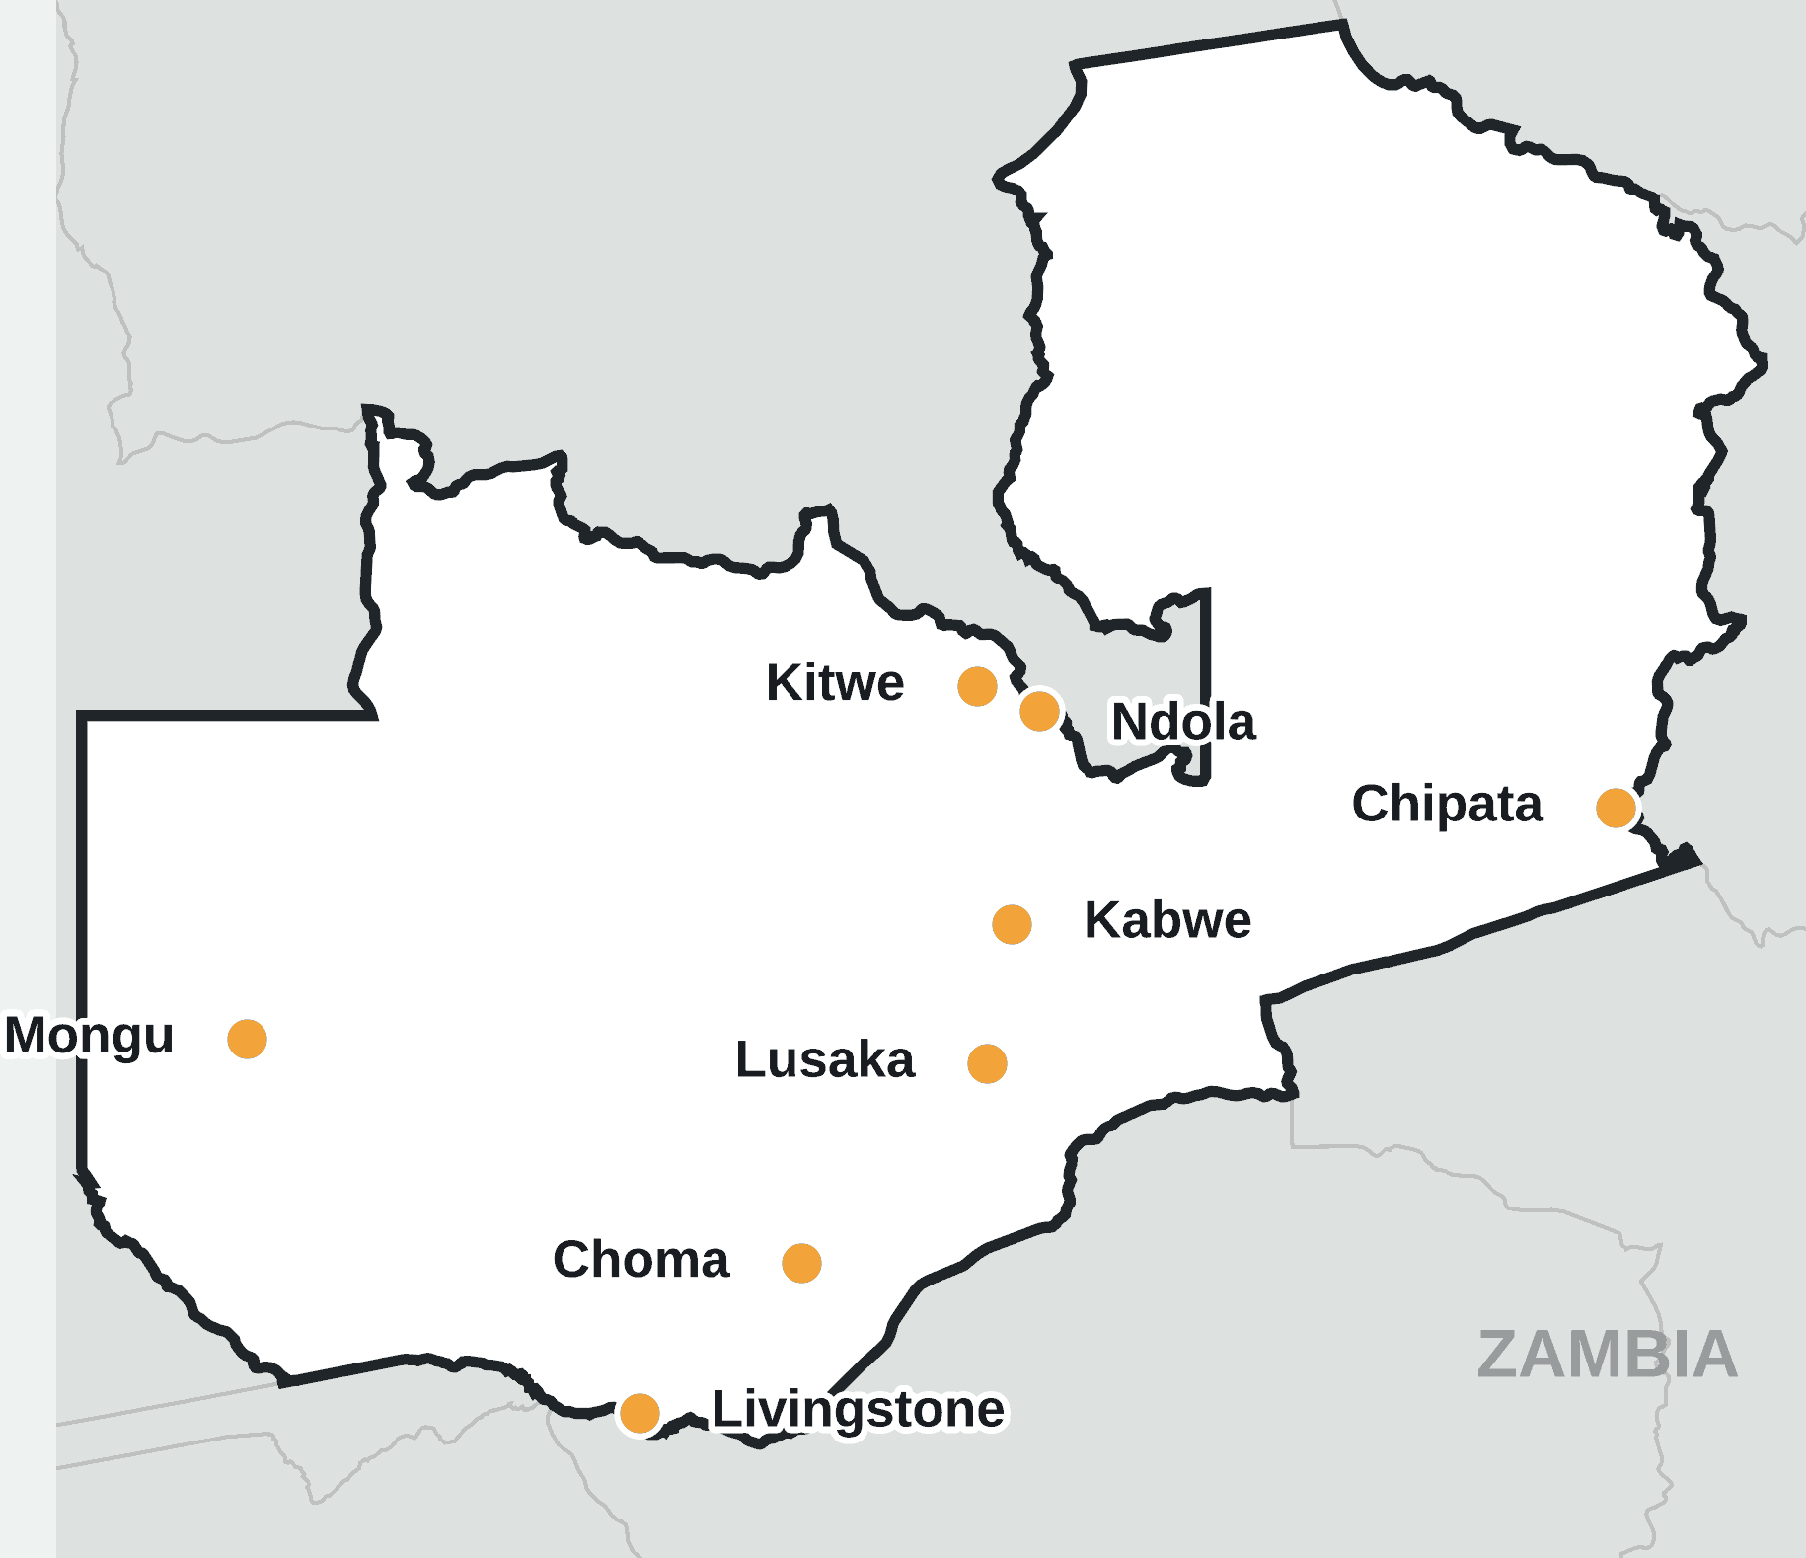
Repayment lets CDF reach more people
IMPACT AND VALUE
9 to 1
grant-funded groups to loan-funded enterprises (27,048 vs 3,063)
K42.1m
back in revolving pools for every 10-point gain in repayment on 2025’s K421m of loans (illustrative)
Sources: Ministry of Local Government and Rural Development; Zambia Monitor, 27 Jan 2026. K42.1m = 10% × K421m. Whether better information raises repayment is for a pilot to test. Map: the 8 prototype constituencies.
Notes:
Say: Loans reach far fewer people than grants today: 27,048 grant-funded groups against 3,063 loan-funded enterprises, about 9 to 1. Loans can only reach more people if repayments recycle. As an illustration, every 10-point gain in repayment on 2025's K421m of loans would return K42.1m to revolving pools. That is arithmetic about the stake, not a forecast. Whether better information raises repayment is what a pilot would test.

Slide 4







Information helps four groups
WHO BENEFITS
Allocate funds
Prepare and apply
Decide and disburse
Run, sell and grow
Plan your repayment
Treasury
FundPath
Council, committee
Borrower
FundPath
Applicants
Advisors
Sellers
Communities
Clear terms and a stronger plan.
Paid sessions, rated reputation.
Verified listings, more buyers.
Repaid money funds the next borrower.
Notes:
Say: Four groups gain. Applicants get clear terms and a stronger plan. Advisors earn from paid sessions and build a rated reputation. Sellers get verified listings and more buyers. Communities benefit when repaid money funds the next borrower. FundPath sits at two steps of the chain: prepare and apply, and plan repayment. Treasury, the council and committee, and the borrower keep their roles.

Slide 5
Three revenue streams, no lending
BUSINESS MODEL
B2C · Applicants pay
B2B2C · Advisors earn
B2C · Sellers pay
K150 per plan
Plan, risk and market assessment. Applying stays free.
15% commission
A share of each paid advisory session.
8% on sales
Marketplace fee, taken from the seller’s sale.
We never handle loan money. Next step: a pilot in one constituency.
Rates are assumptions to test in a pilot, not agreed terms. Payments are simulated in the prototype.
Notes:
Say: Three streams. Applicants pay K150 per plan for plan, risk and market assessment, but applying itself stays free. Advisors earn a 15% commission on paid sessions, and the marketplace takes an 8% fee on sales. These rates are our assumptions to test, and payments are simulated in the prototype. We never handle loan money. Ask: a pilot in one constituency, measuring application quality and on-time repayment.

