Slide 1

Non-profit organization that enables people to lend money to enterprenuers in underserved parts of the world
Works with field partners to administer loans - microfinance institutions, schools, social businesses, non-profit organizations
Kiva members(lenders) raise money for posted loans
A loan can be funded by one or more lenders – minimum $25 contribution
Lenders don't charge interest but field partners can to cover their operation cost

Slide 2
Data
Downloaded snapshot of loan data from Kiva.org
Retrieved lender data for the loans from Kiva lenders API
JSON format
Used Python to parse

Slide 3
Data – useful features
Loan ID | Posted date
Borrower Name | Funded date
Status – fundraising, funded, disbursed, paid, defaulted, expired, refunded | Scheduled pay date
Loan amount | Paid date
Sector e.g. agriculture, retail, clothing | Amount funded
Deliquent | Borrower gender
Field partner ID | Number of borrowers (for group loans)
Town/City & Country | Lender count – if loan was funded by multiple people
Loan description: text length, number of languages | Translator – if borrower doesn’t speak english
Loss liability: Partner or Lender | Data for partner who posted the loan: rating, duration as member, default rate, total loans posted, total amount raised, …

Slide 4
Basic Statistics
Loans by Gender of the borrower:
Female 67,144
Male 22,348
Average loan amount (in USD) for each Gender:
Female 730.86
Male 858.92
Loan amount aggregates in US dollars:
Mean 762.84 Median 550 Stdev 761.78
Min 25 Max 49800
Repayment rate: number of loans paid / (loans defaulted + loans paid):
97.19%
Reported Kiva repayment rate for all loans to date (from Kiva.org website):
99.01%

Slide 5
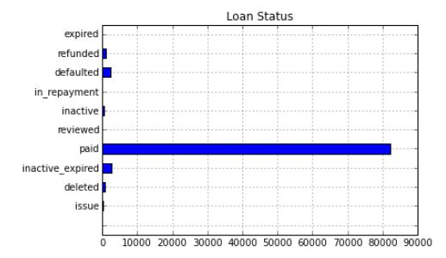
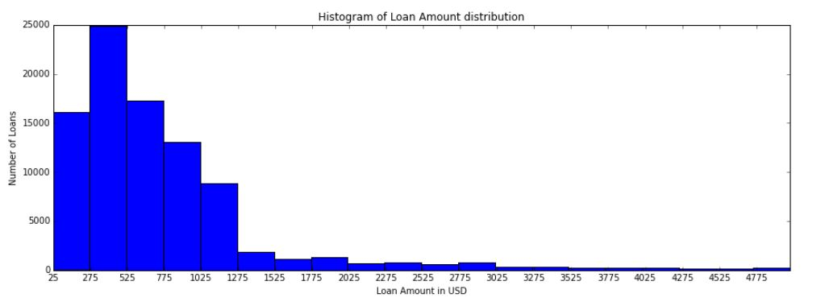
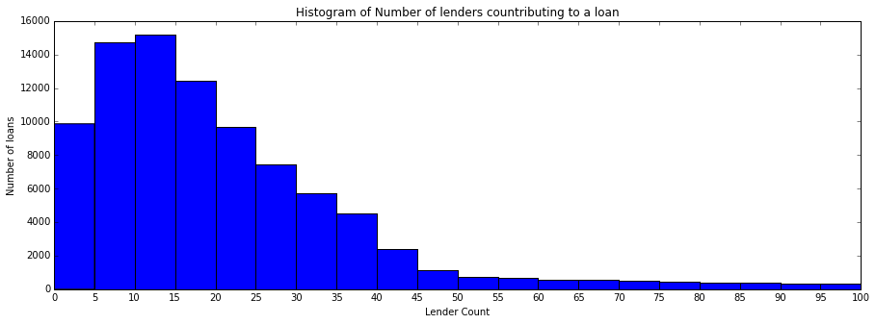
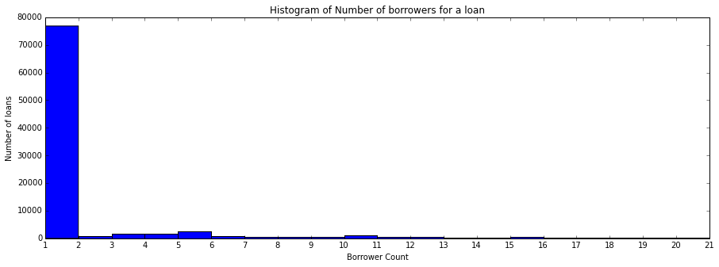
Basic Statistics
Loan Amount
Lender count
Number of borrowers

Slide 6
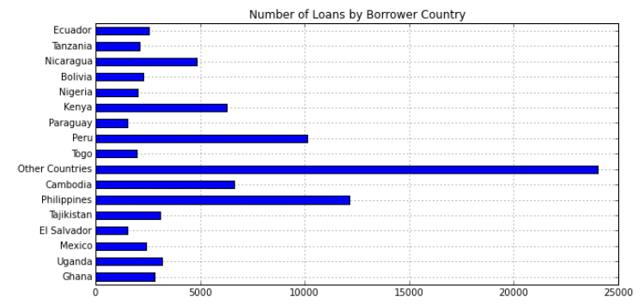
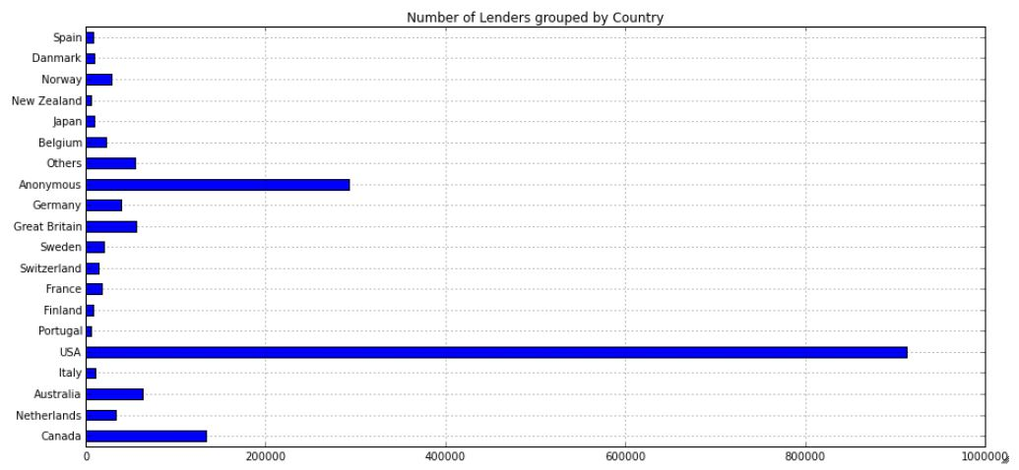

Slide 7
Hypotheses
The probability of defaulting on a loan is positively correlated to loan amount.
Loan applications with longer descriptions are more likely to be funded
Are some sectors such as agriculture more likely to be funded that others?
Loan application that required a translator are less likely to be funded – loans not posted in English.
Does 'tone' of loan description correlate with getting funded?

Slide 8
Logistic Regression: funded?
Feature | Coefficient
(sector) Arts base=Agriculture | 0.588
(sector) Education | 0.401
(sector) Health | 0.416
(sector) Manufacturing | 0.662
(sector) Retail | -0.446
(continent) Asia base=Africa | -0.229
(continent) Latin America | -0.038
Loan description length | 0.418
Loan description: Number of languages | -0.459
Loan description: Number of adjectives | 0.725
Loan amount | -1.046
Number of borrowers (per loan) | 0.791
Borrower gender | 0.585
Loss liability: partner? | 0.806
Partner currently active? | 0.464
Partner: Number of days as member | 0.601

Slide 9
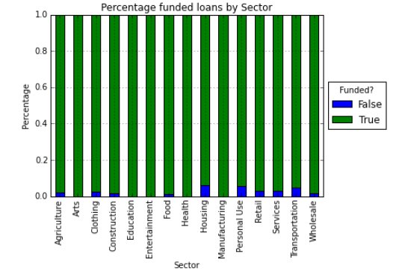
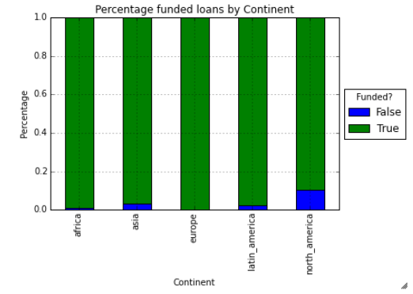

Slide 10
Logistic Regression: paid/defauted?
Feature | Coefficient
Sectors | about the same
(continent) Asia base=Africa | 0.693
(continent) Latin America | 0.225
loan_amount | 0.355
lender_count | -0.396
translator | -0.628
Loss liability: partner? | 0.877
Partner currently active? | 0.468
Partner: Default rate | -1.067
Partner: Total amount raised | 0.306
Partner: Number of loans posted | 0.598

Slide 11
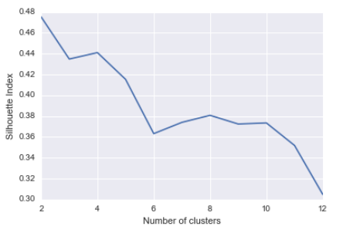
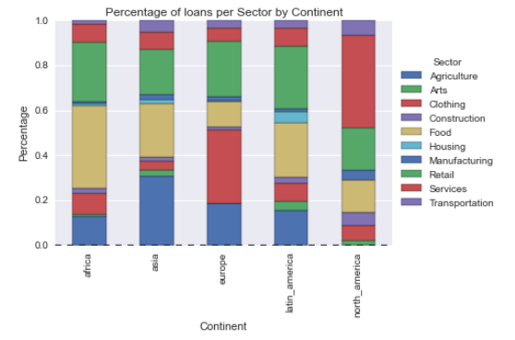
Clustering: No good clusters found
Top 3 sectors by percentage of loans, for each continent
Africa: Food, Retail, Agriculture
Asia: Agriculture, Food, Retail
Latin America: Retail, Food, Agriculture

