Slide 1
INTRODUCTION TO Statistical Learning
MATH 441: Topic 01

Slide 2
Outline
What Is Statistical Learning?
Why estimate f?
How do we estimate f?
The trade-off between prediction accuracy and model interpretability
General modeling problems and methods
Supervised versus unsupervised learning
Regression versus classification
Common methods of assessing model accuracy
Basic methods for data exploration, data checking and validation
Notes:
F = response and exponential values

Slide 3
What is Statistical Learning?
Statistical learning refers to a set of tools and techniques used for understanding and modeling complex data sets. This area of statistics has seen a remarkable development in recent years due to the expansion of “Bid data” and developments in computer science and machine learning.
Techniques used include, but are not limited to, regression, classification, tree-based methods, clustering, principal component analysis, and support vector machines.

Slide 4
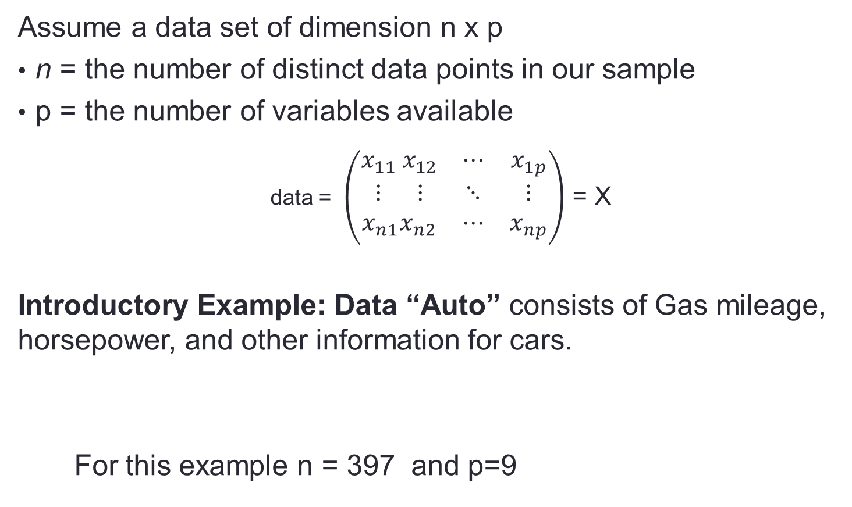
Statistical Learning: Notation
Assume a data set of dimension n x p
n = the number of distinct data points in our sample
p = the number of variables available
data = $\left(\begin{matrix}x_{11} x_{12} & ⋯ & x_{1p} \\ ⋮ ⋮ & ⋱ & ⋮ \\ x_{n1}x_{n2} & ⋯ & x_{np}\end{matrix}\right)$ = X
Introductory Example: Data “Auto” consists of Gas mileage, horsepower, and other information for cars.
For this example n = 397 and p=9
Auto=read.csv("Auto.csv",header=T,na.strings="?")
dim(Auto)
[1] 397 9

Slide 5
Statistical Learning: function f
In general, we observe and for
We believe that there is a relationship between Y and at least one of the X’s.
We can model the relationship as
where f is an unknown function and ε is a random error with mean zero.

Slide 6
A Simple Example
ε_{i}
f

Slide 7
Why Do We Estimate f?
Statistical Learning is all about how to describe and estimate f.
The term statistical learning refers to using the data to “learn” f.
Why do we care about estimating f?
There are 2 reasons for estimating f,
Prediction and
Inference.

Slide 8
Why Do We Estimate f ? 1) Prediction
If we can produce a good estimate for f (and the variance of ε is not too large) we can make accurate predictions for the response, Y, based on a new value of X.

Slide 9
Example: Direct Mailing Prediction
Interested in predicting how much money an individual will donate based on observations from 90,000 people on which we have recorded over 400 different characteristics.
Don’t care too much about each individual characteristic.
Just want to know: For a given individual should I send out a mailing?

Slide 10
Why Do We Estimate f ? 2. Inference
Alternatively, we may also be interested in the type of relationship between Y and the X’s.
For example,
Which particular predictors actually affect the response?
Is the relationship positive or negative?
Is the relationship a simple linear one or is it more complicated etc.?

Slide 11
Example: Housing Inference
Wish to predict median house price based on 14 variables.
Probably want to understand which factors have the biggest effect on the response and how big the effect is.
For example how much impact does a river view have on the house value etc.

Slide 12
Statistical Learning: How Do We Estimate f?
We will assume we have observed a set of training data
We must then use the training data and a statistical method to estimate f.
Statistical Learning Methods:
Parametric Methods
Non-parametric Methods

Slide 13
Parametric Methods
Statistical Learning: How Do We Estimate f?
It reduces the problem of estimating f down to one of estimating a set of parameters.
They involve a two-step model based approach
STEP 1:
Make some assumption about the functional form of f, i.e. come up with a model. The most common example is a linear model i.e.
However, we will also examine several non-linear flexible, models for f.
In a sense the more flexible the model the more realistic it is.

Slide 14
Parametric Methods (cont.)
STEP 2:
Use the training data to fit the model i.e. estimate f or equivalently the unknown parameters such as β₀, β₁, β₂,…, β_{p}.
The most common approach for estimating the parameters in a linear model is ordinary least squares (OLS).
However, this is only one way.
We will see that there are often superior approaches.

Slide 15
Non-parametric Methods
Statistical Learning: How Do We Estimate f?
They do not make explicit assumptions about the functional form of f.
Advantages: They accurately fit a wider range of possible shapes of f.
Disadvantages: A very large number of observations is required to obtain an accurate estimate of f

Slide 16
Tradeoff Between Prediction Accuracy and Model Interpretability
Why not just use a more flexible method if it is more realistic?
There are two reasons
Reason 1: Easy interpretation
A simple method such as linear regression produces a model which is much easier to interpret (the Inference part is better).
For example, in a linear model, β_{j} is the average increase in Y for a one unit increase in X_{j} holding all other variables constant.

Slide 17
Reason 2: Satisfactory predictions
It is often possible to get satisfactory or more accurate predictions with a simple, instead of a complicated model.
This seems counter intuitive but has to do with the fact that it is harder to fit a more flexible model.

Slide 18
General modeling problems and methods Supervised vs. Unsupervised Learning
We can divide all learning problems into Supervised and Unsupervised situations
Supervised Learning:
Supervised Learning is where both the predictors, X_{i}, and the response, Y_{i}, are observed.
Typical examples are Linear Regressions.

Slide 19
General modeling problems and methods Supervised vs. Unsupervised Learning
Unsupervised Learning:
Here, only the X_{i}’s are observed.
We need to use the X_{i}’s to guess what Y would have been and build a model from there.
A common example is market segmentation where we try to divide potential customers into groups based on their characteristics.
A typical approach is clustering.

Slide 20
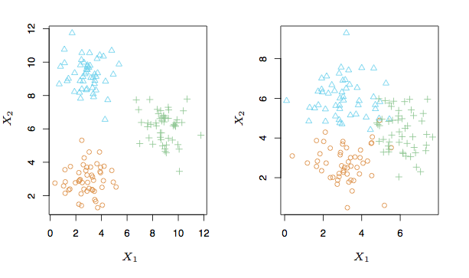
A Simple Clustering Example

Slide 21
Regression vs. Classification
General modeling problems and methods
Supervised learning problems can be further divided into regression and classification problems.
Regression covers situations where Y is continuous/numerical. e.g.
Predicting the value of the Dow in 6 months.
Predicting the value of a given house based on various inputs.
Classification covers situations where Y is categorical e.g.
Will the Dow be up (U) or down (D) in 6 months?
Is this email a SPAM or not?

Slide 22
Different Approaches
We will deal with both types of problems in this course.
Some methods work well on both types of problem e.g. Neural Networks
Other methods work best on Regression, e.g. Linear Regression, or on Classification, e.g. k-Nearest Neighbors.

Slide 23
Assessing model accuracy
Topic 1 – Part II

Slide 24
Outline
Assessing Model Accuracy
Measuring the Quality of Fit
The Bias-Variance Trade-off
The Classification Setting

Slide 25
Measuring Quality of Fit
Suppose we have a regression problem.
One common measure of accuracy is the mean squared error (MSE) i.e.
Where is the prediction our method gives for the observation in our training data.

Slide 26
A Problem
In either case our method has generally been designed to make MSE small on the training data we are looking at e.g. with linear regression we choose the line such that MSE is minimized.
What we really care about is how well the method works on new data. We call this new data “Test Data”.
There is no guarantee that the method with the smallest training MSE will have the smallest test (i.e. new data) MSE.

Slide 27
Training vs. Test MSE’s
In general the more flexible a method is the lower its training MSE will be i.e. it will “fit” or explain the training data very well.
Side Note: More Flexible methods (such as splines) can generate a wider range of possible shapes to estimate f as compared to less flexible and more restrictive methods (such as linear regression). The less flexible the method, the easier to interpret the model. Thus, there is a trade-off between flexibility and model interpretability.
However, the test MSE may in fact be higher for a more flexible method than for a simple approach like linear regression.

Slide 28
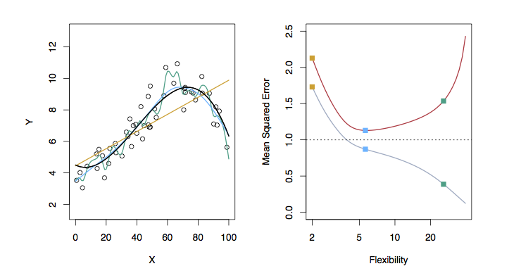
Examples with Different Levels of Flexibility: Example 1
LEFT
Black: Truth
Orange: Linear Estimate
Blue: smoothing spline
Green: smoothing spline (more flexible)
RIGHT
RED: Test MSE
Grey: Training MSE
Dashed: Minimum possible test MSE (irreducible error)

Slide 29
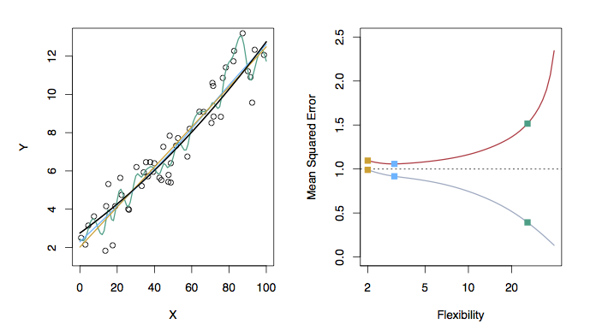
Examples with Different Levels of Flexibility: Example 2
LEFT
Black: Truth
Orange: Linear Estimate
Blue: smoothing spline
Green: smoothing spline (more flexible)
RIGHT
RED: Test MSE
Grey: Training MSE
Dashed: Minimum possible test MSE (irreducible error)

Slide 30
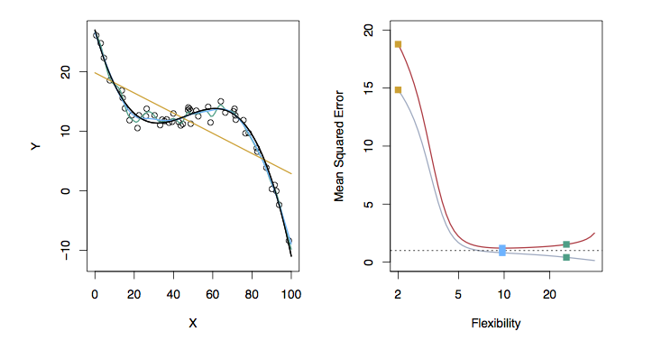
Examples with Different Levels of Flexibility: Example 3
LEFT
Black: Truth
Orange: Linear Estimate
Blue: smoothing spline
Green: smoothing spline (more flexible)
RIGHT
RED: Test MSE
Grey: Training MSE
Dashed: Minimum possible test MSE (irreducible error)

Slide 31
Bias/ Variance Tradeoff
The previous graphs of test versus training MSE’s illustrates a very important tradeoff that governs the choice of statistical learning methods.
There are always two competing forces that govern the choice of learning method i.e. bias and variance.

Slide 32
Bias of Learning Methods
Bias refers to the error that is introduced by modeling a real life problem (that is usually extremely complicated) by a much simpler problem.
For example, linear regression assumes that there is a linear relationship between Y and X. It is unlikely that, in real life, the relationship is exactly linear so some bias will be present.
The more flexible/complex a method is the less bias it will generally have.

Slide 33
Variance of Learning Methods
Variance refers to how much your estimate for f would change by if you had a different training data set.
Generally, the more flexible a method is the more variance it has.

Slide 34
The Trade-off
It can be shown that for any given, X=x₀, the expected test MSE for a new Y at x₀ will be equal to
What this means is that as a method gets more complex the bias will decrease and the variance will increase but expected test MSE may go up or down!

Slide 35
Basic methods for data exploration, data checking and validation
Topic 1 – Part III
Lab
We will use an example

