Slide 1
Parallel and Distributed Robot Framework Tests
Merel Foekens, Trainee

Slide 2
Agenda
01
02
03
04
Introduction
Context
Design
Demo
Notes:
Introduce each point

Slide 3
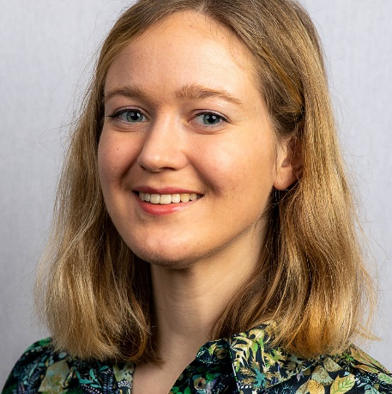

Introduction
Merel Foekens
Software Engineering student
Graduation project at CGI since February 2023
Internship supervisor: Eric Hendriks
Technical supervisor: Pieter Wesseling
RFF supervisor: Many Kasiriha
/in/mwfoekens
Notes:
Explain RF
Explain current problem
Explain that current solution isn’t desirable

Slide 4

Context
Robot Framework
Problem
CGI sponsors Robot Framework
Test execution requires a lot of time
Current Solution
Local parallelisation exists (Pabot)
Not distributed
Notes:
Explain RF
Explain current problem
Explain that current solution isn’t desirable

Slide 5
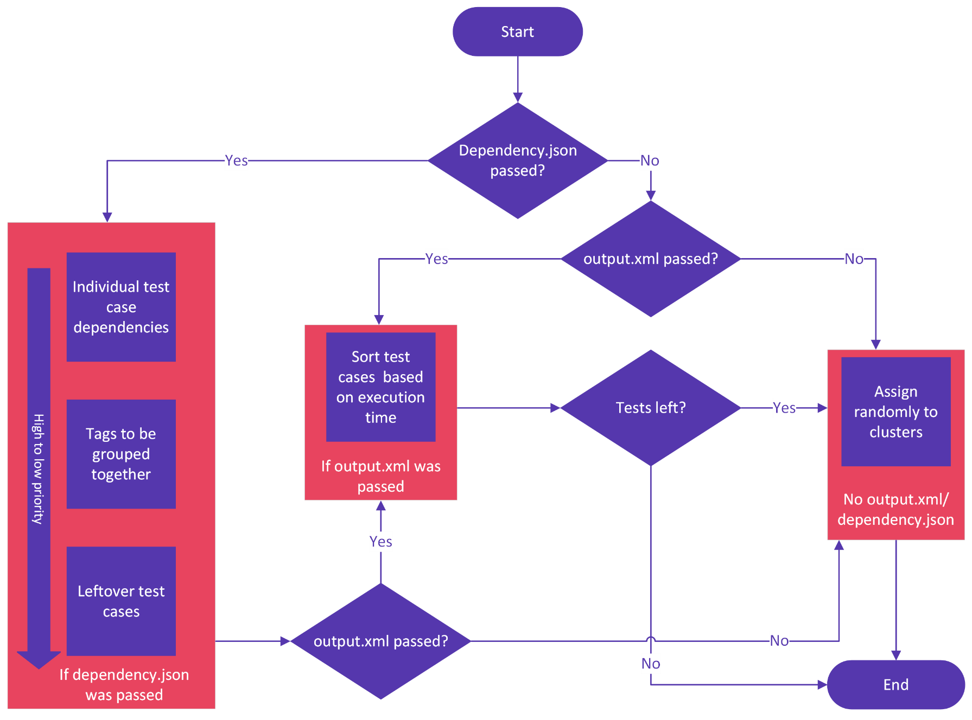
Design
{ "dependencies": [ [ "Test Case D 1.1.1", "Test Case D 1.1.2" ], [ "Test Case D 1.2.1", "Test Case D 1.2.2", "Test Case D 2.2.3" ] ], "tags": [ "GroupingTagA", "GroupingTagB" ] }
Notes:
Priority of how to deal with dependencies and tests
Individual dependencies
Tags
Execution Time
Random

Slide 6
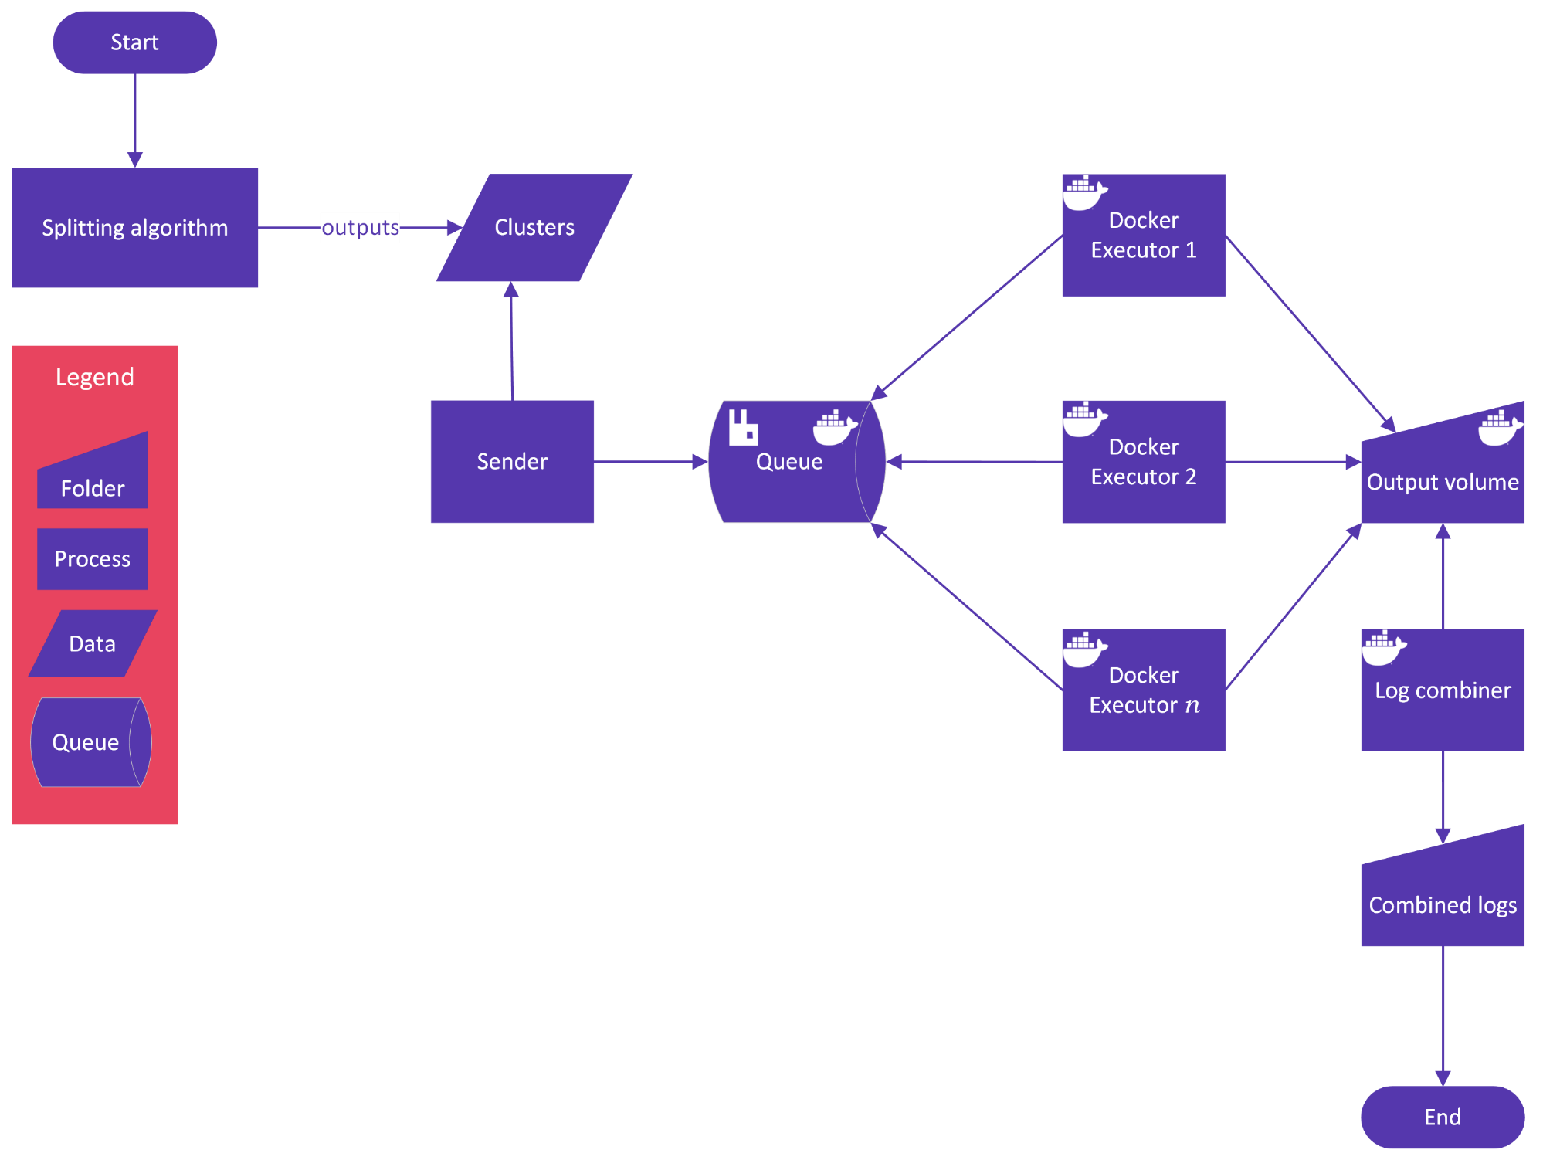
Design
Notes:
Overall design of the entire product

Slide 7
Demo
Notes:
In Kubernetes is also possible

Slide 8
Thank you!
Any Questions?
GitHub: mwfoekens/Probot

