Slide 1
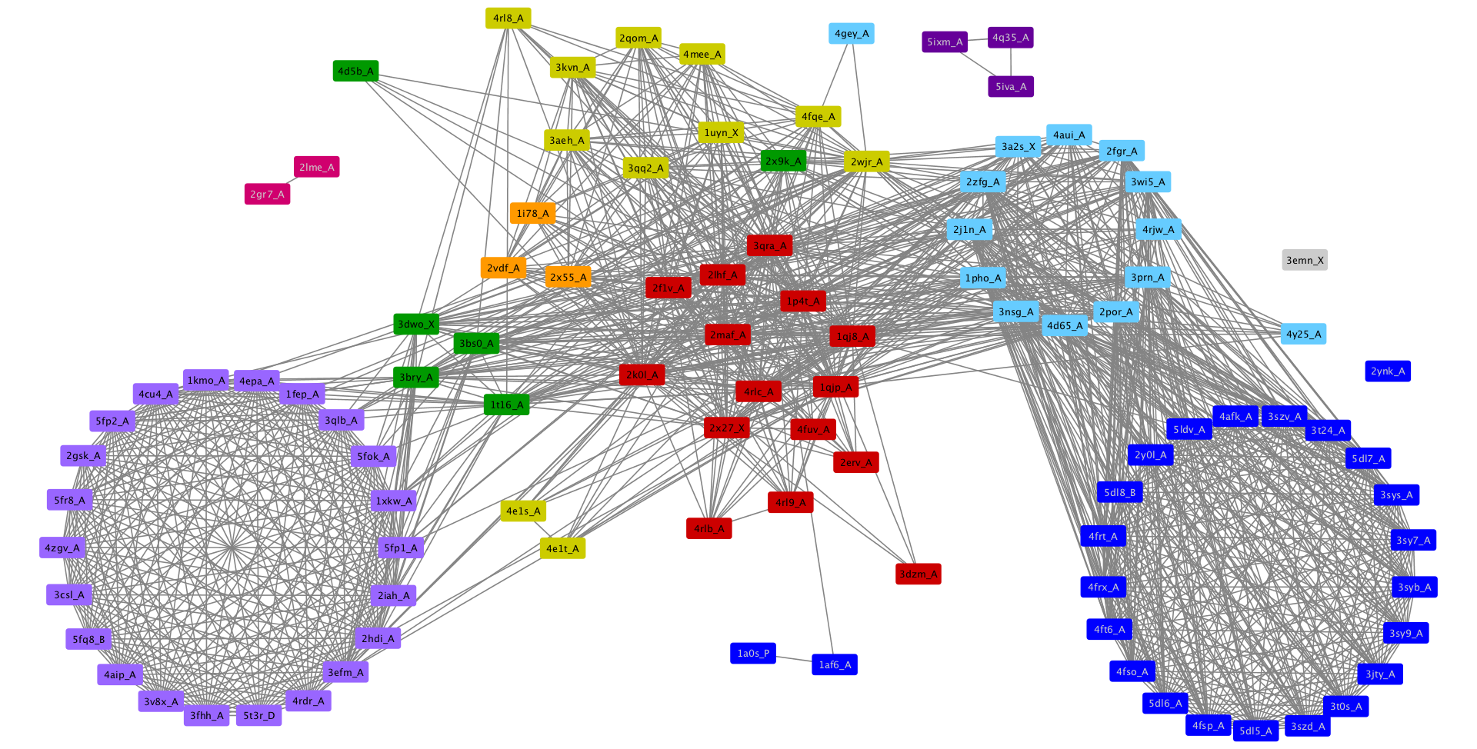
E-value <= 1e-2

Slide 2
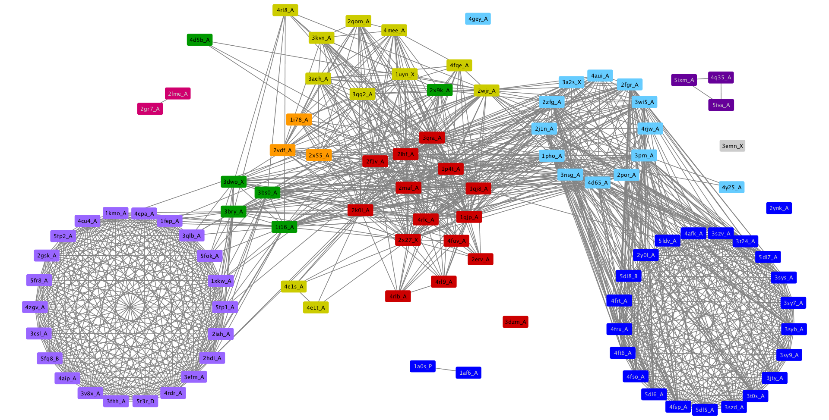
E-value <= 1e-3

Slide 3
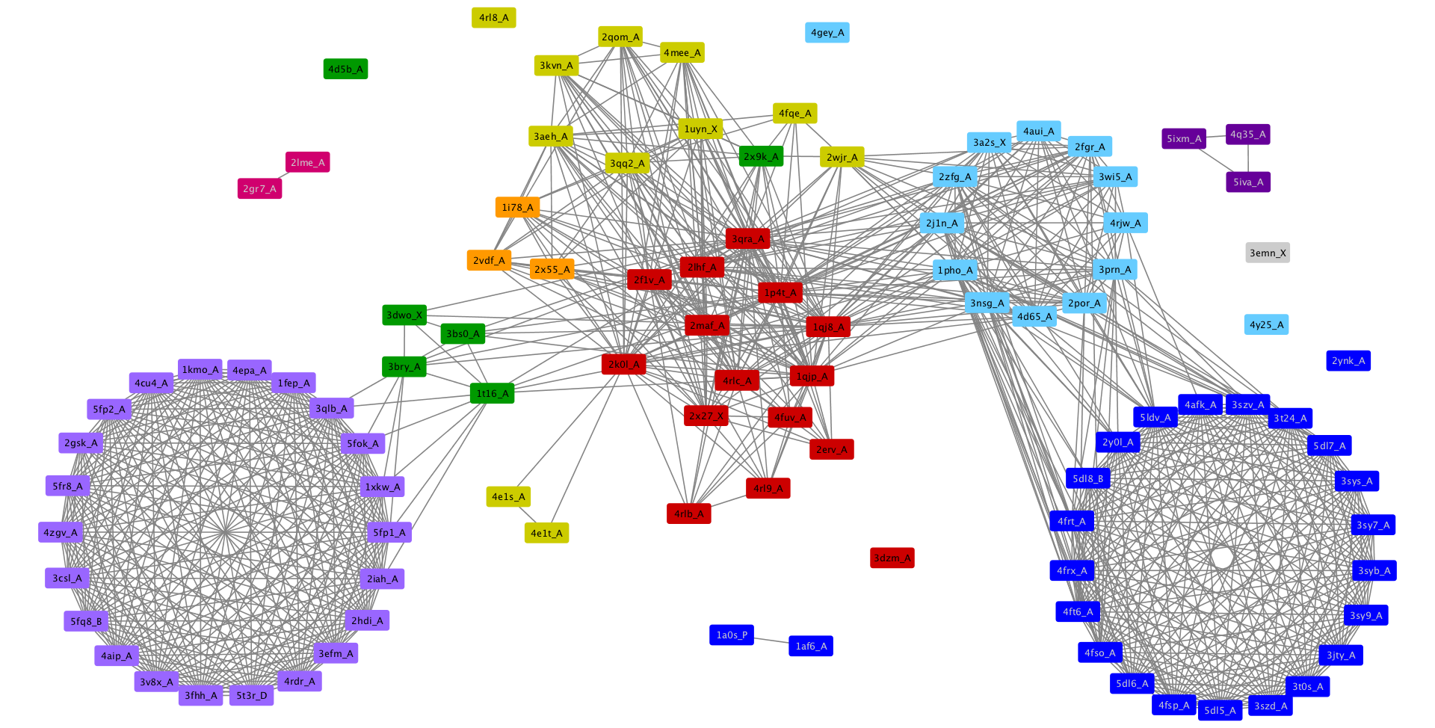
E-value <= 1e-4

Slide 4
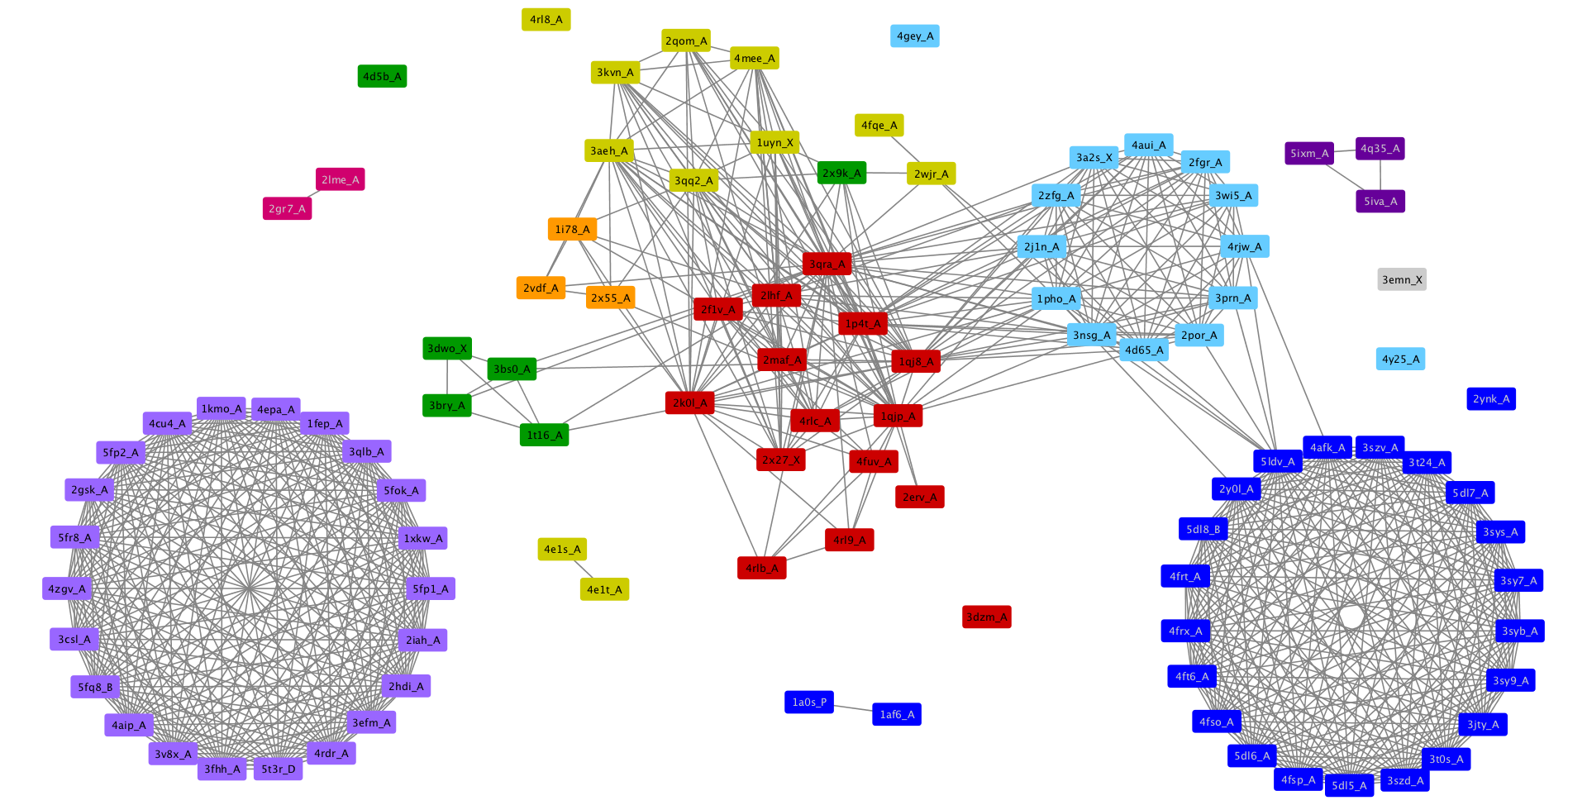
E-value <= 1e-5

Slide 5
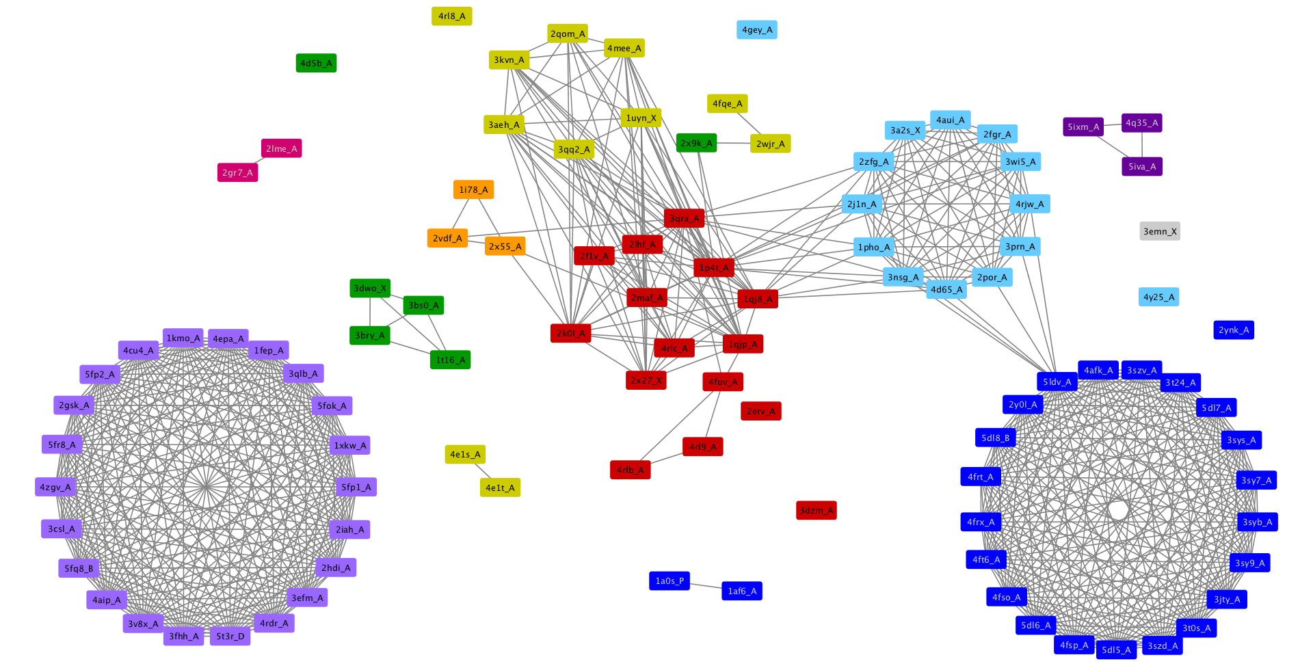
E-value <= 1e-6

Slide 6

E-value <= 1e-7

Slide 7

E-value <= 1e-8

