Slide 1
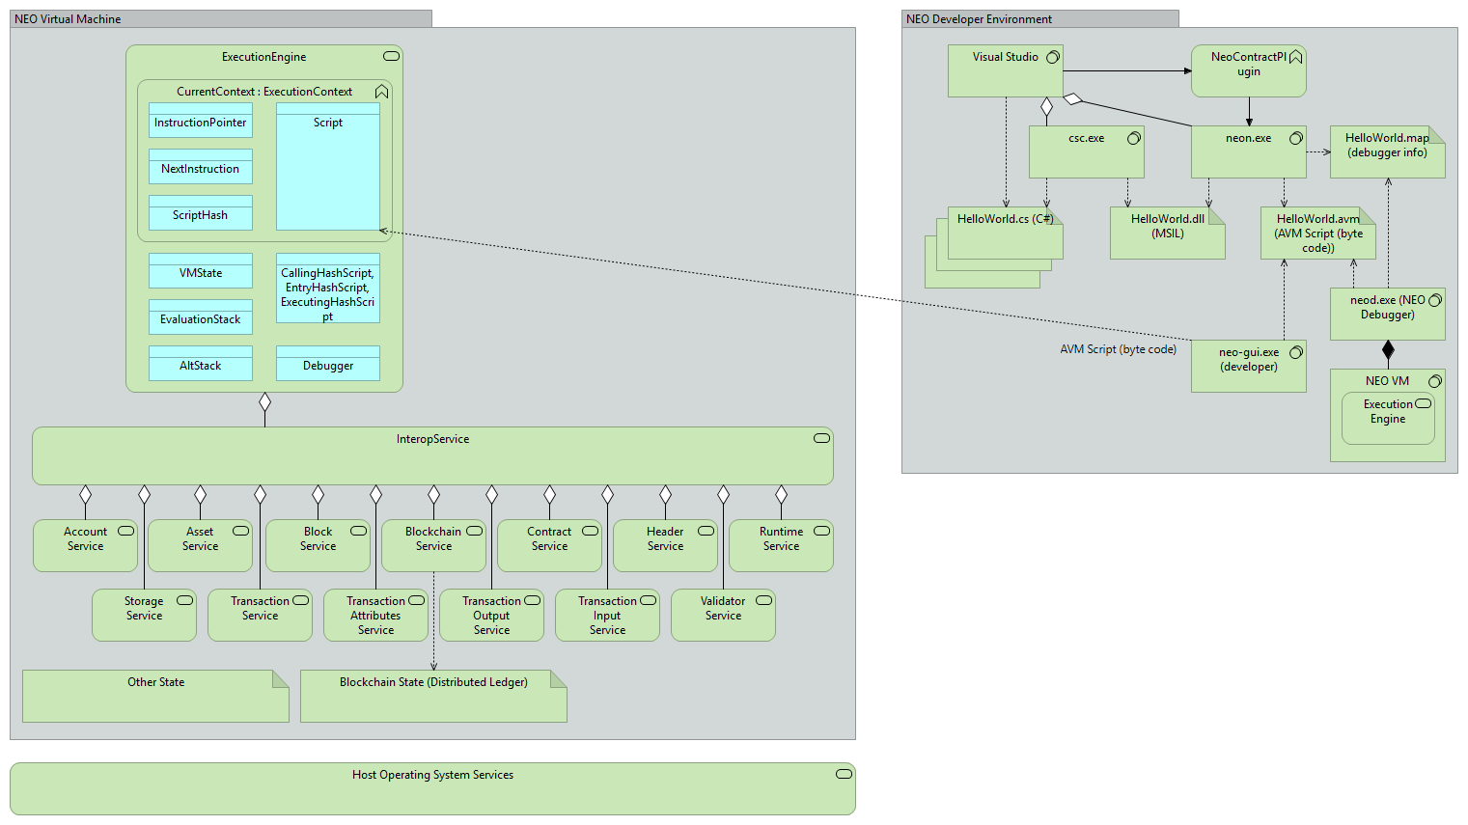
G
H
V
K
I
B
D
J
A
C
E
L
M
F
W
N
O
P
Q
R
S
T
U
X
Y
Z

Slide 2
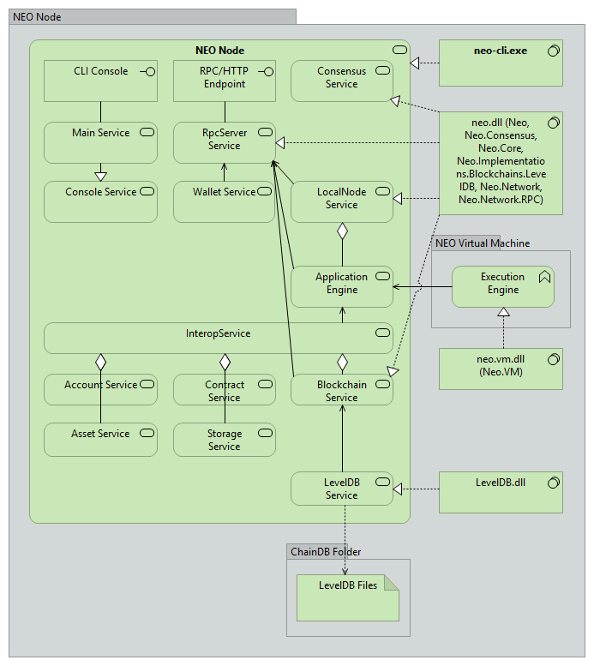
A
D
V
B
E
C
F
W
G
H
O
P
T
S
Q
X

Slide 3
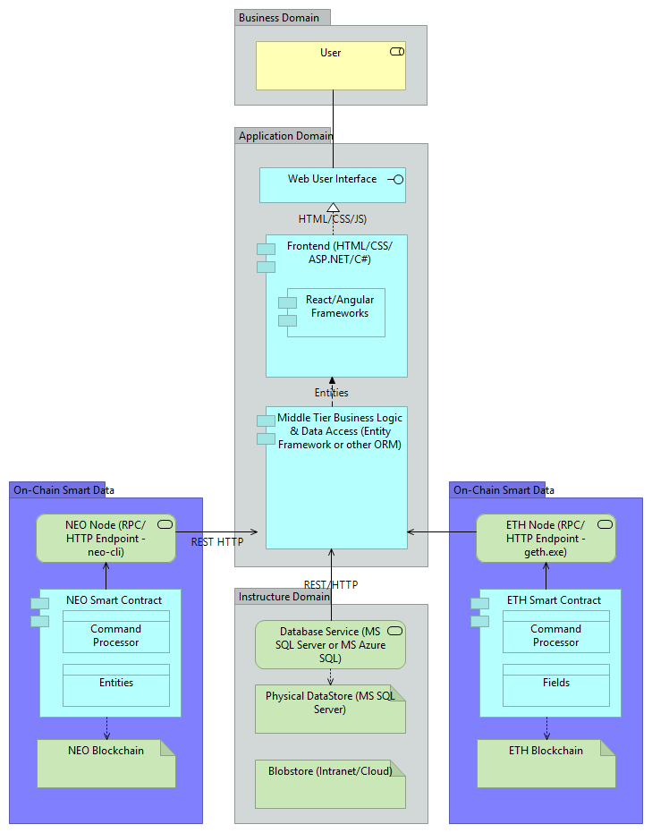
NEO
Ethereum

Slide 4
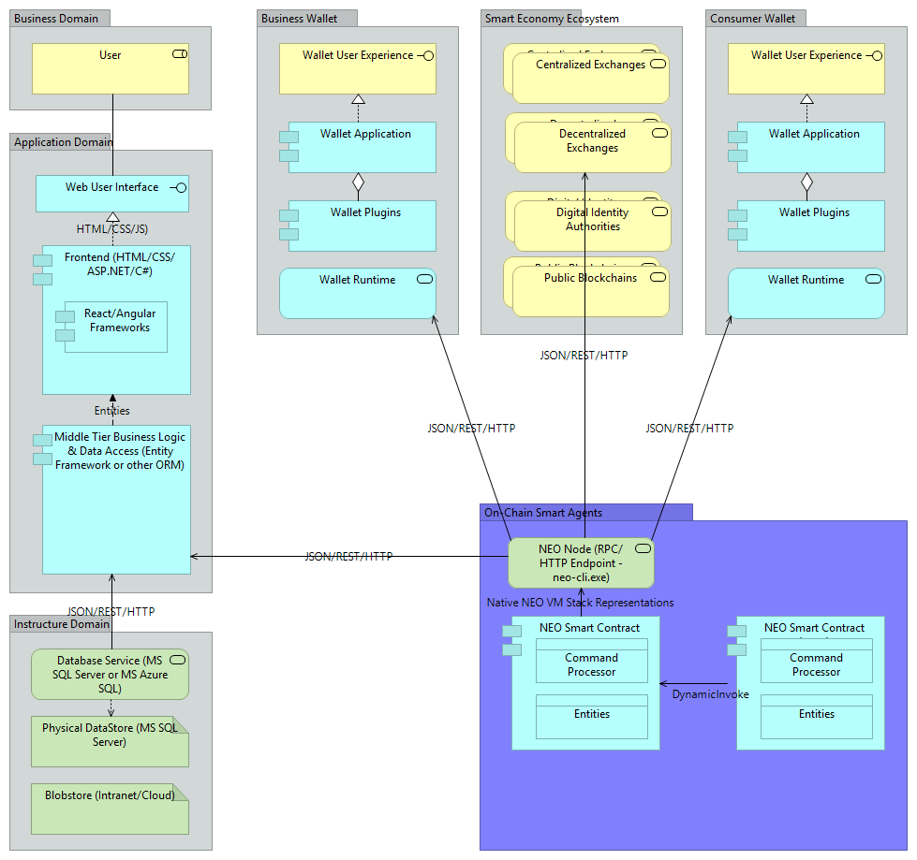
OLD
JSON/RPC/HTTP
Native NEO VM Stack Representations

Slide 5
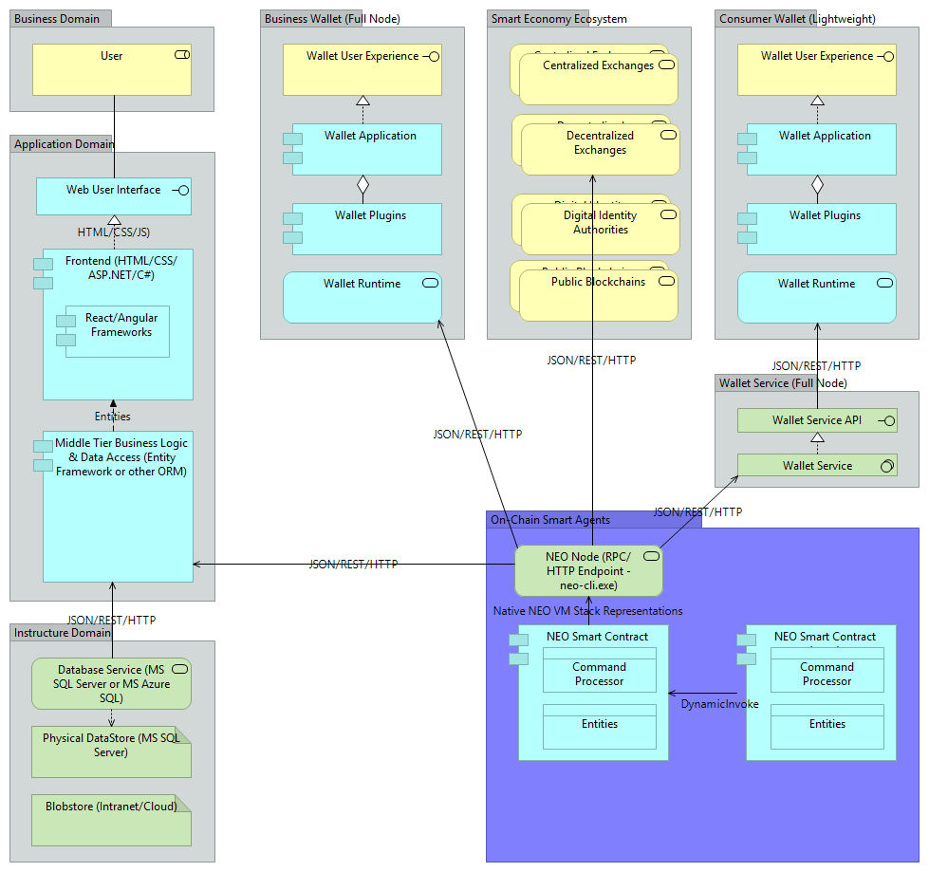
JSON/RPC/HTTP
Native
NEO VM Stack Representations

Slide 6
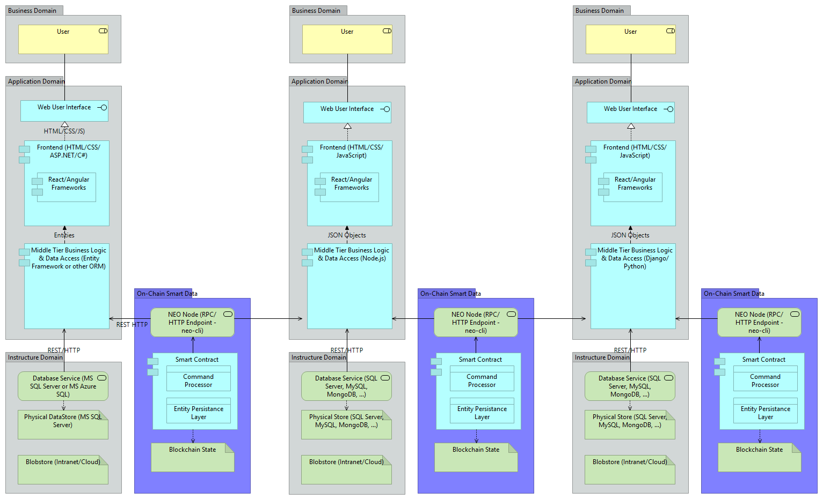
ASP.NET
EF
SQL Server
React/JS
Node.js
MySQL
React/JS
Django/Python
MongoDB

