Slide 1


Empirical Security & Privacy, for Humans
UPenn CIS 7000-010
11/04/2025
What Are the Chances? Explaining the
Epsilon Parameter in Differential Privacy

Slide 2
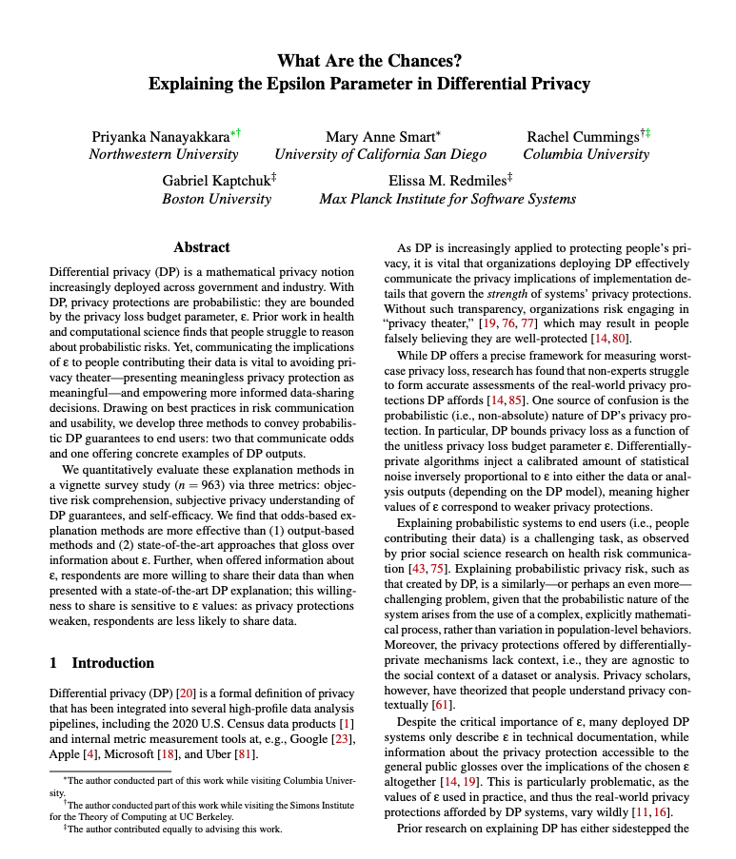
Reading

Slide 3
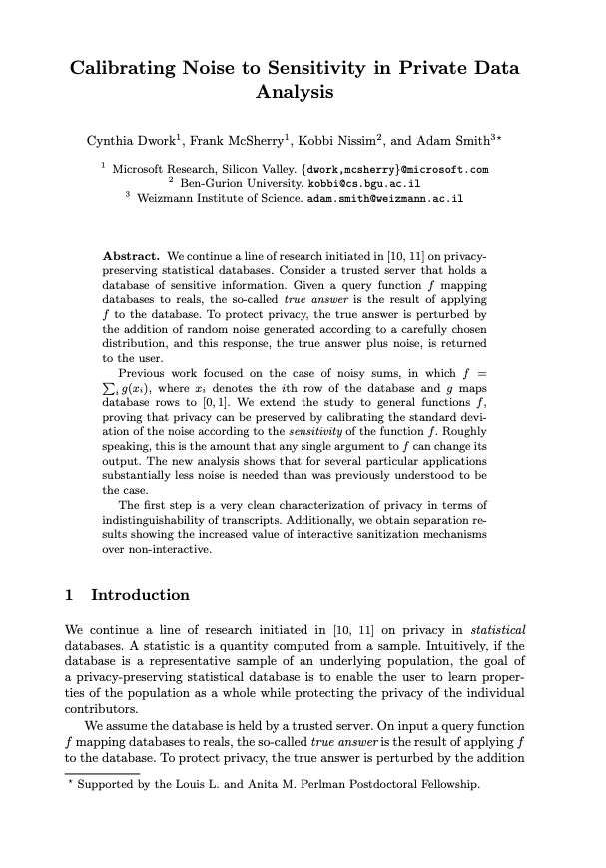
What is differential privacy?
Aims to increase individual’s privacy within a collective data analysis
Many high profile uses
2020 U.S. Census data products
Internal metric measurement tools at Google, Apple, Microsoft, and Uber
Notes:
TCC 2006 paper
Relative, not absolute guarantee, of privacy.
DP bounds privacy loss as a function of the unitless privacy loss budget parameter ε

Slide 4
What is differential privacy? Definition
A randomized algorithm A : D → R is ε-differentially private if
for every pair of databases D,D′ ∈ D
that differ in at most one entry and
for every subset S ⊆ R ,
Pr[A(D) ∈ S] ≤ e^{ε} · Pr[A(D′) ∈ S]
Notes:
TCC 2006 paper
Relative, not absolute guarantee, of privacy.
DP bounds privacy loss as a function of the unitless privacy loss budget parameter ε

Slide 5
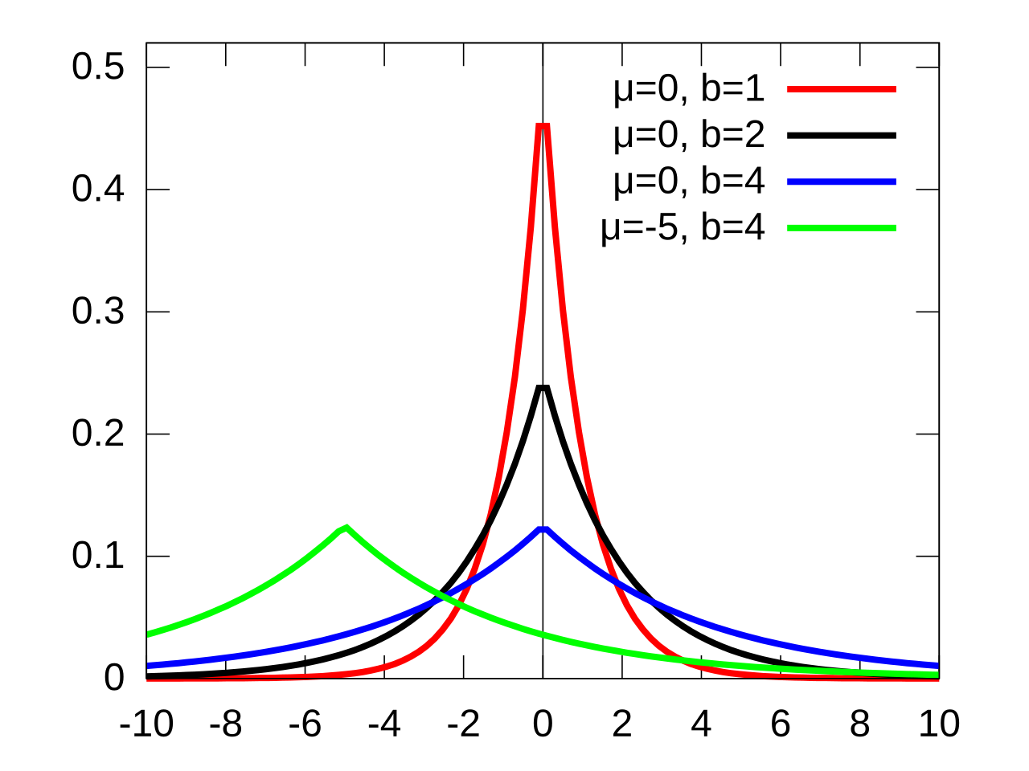
What is differential privacy? Example
A (D) = count-ones(D) + Lap(0, ¹/_{ε})
Suppose D = [0,0,0,0]
Suppose D = [0,0,0,0,1]
ε = 0.1 | ε = 0.5 | ε = 2 | ε = 4
4.0 | 0.8 | 0.2 | 0.1
-12.2 | -2.4 | -0.6 | -0.3
2.4 | 0.5 | 0.1 | 0.1
23.7 | 4.7 | 1.2 | 0.6
-13.5 | -2.7 | -0.7 | -0.3
ε = 0.1 | ε = 0.5 | ε = 2 | ε = 4
7.1 | 2.2 | 1.3 | 1.2
3.4 | 1.5 | 1.1 | 1.1
-14.8 | -2.2 | 0.2 | 0.6
-23.0 | -3.8 | -0.2 | 0.4
0.0 | 0.8 | 1.0 | 1.0
More accuracy
Less privacy
More accuracy
Less privacy

Slide 6
Challenge: Communicating DP protections
Difficult to explain probabilistic guarantees to most people
DP bounds privacy loss as a function of the unitless parameter ε
Paper offers three explanation methods
Odds-Text
Odds-Vis
Sample Reports
Methods apply to an individual choosing whether to participate in a DP-protected data analysis, with ε accounted for

Slide 7
Scenario proposition
Imagine you work on a team with four other people. All five of you report to the same manager. The company is requiring each of you to participate in a survey. The survey asks the following yes/no question:
Do you feel adequately supported by your manager?
You have had negative experiences with your manager and want to answer no. However, you don’t want your manager to find out you responded no. Your manager may retaliate if they believe you responded no. For example, they might give you a negative performance review, assign you extra work, or try to get you fired.
You must decide how to respond to the survey question.
You can participate and respond ‘no’ truthfully, or say you would prefer not to participate.

Slide 8
Scenario, further context
Based on lunchtime conversations, it is obvious to your manager that all your other teammates will respond yes, indicating they feel adequately supported by your manager.
On the other hand, your manager has no idea how you will respond.
Your manager will receive a report on the results of the survey. This report will say the total number of people who responded no.
Even though the report will keep your names anonymous, once your manager gets the report, they can still use it to guess your response. For example, imagine the report shows that there was one no response. Your manager will believe it was you because they believe your other teammates all responded yes.
Ends here, when using deterministic control

Slide 9
Baseline [when privacy method used]
Your company will not report exactly how many employees on your team responded NO.
Instead, they will generate many potential reports by using a statistical method to modify the total number of NO responses.
So, each potential report may show a number somewhat lower or higher than the actual number of NO responses. Only ONE report will be randomly sent to your manager.

Slide 10
Alternative [when paper’s expl. meth. used]
However, your company will use a privacy protection method to help prevent your manager from correctly guessing anyone’s response.
Your company will not report exactly how many employees on your team responded no. Instead, they will generate many potential reports by using a statistical method to modify the total number of no responses. So, each potential report may show a number somewhat lower or higher than the actual number of no responses.
Only ONE report will be randomly sent to your manager. Note that due to the privacy method, it is possible that
the specific report your manager receives will lead them to believe that you responded no regardless of what you respond on the survey.

Slide 11

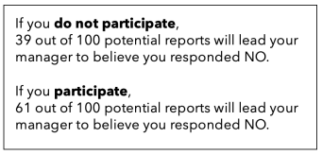
Odds-Text
Notes:
Drawing on best practices from the literature in health risk communication [22,39,49], we develop explanation methods that focus on explaining the odds of a negative event occurring by contextualizing privacy guarantees in terms of outcomes. . In line with research [75] finding that people reason more effectively about the odds of a risk when framed as frequencies versus percentages …
The manager compares posterior probabilities of the employee’s response given the DP output to determine a maximum likelihood estimate (MLE). Let the output of the DP mechanism be r. The manager compares Pr[E = r | E ∼ Lap(µ = 1,b = 1 ε )] with Pr[E = r | E ∼ Lap(µ = 0,b = 1 ε )], respectively corresponding to when the employee: reports truthfully/participates and lies/do not participate, and then guesses the action corresponding to a higher posterior probability. We compute a threshold value rthreshold where Pr[E = rthreshold | E ∼ Lap(µ = 1,b = 1 ε )] = Pr[E = rthreshold | E ∼ Lap(µ = 0,b = 1 ε )] a

Slide 12
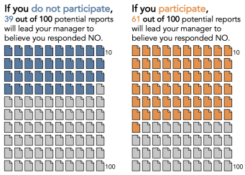
Odds-Vis
Notes:
Research has found that icon arrays—a frequency-framed visualization approach (Figure 1b)— sometimes help people with low-numeracy skills

Slide 13
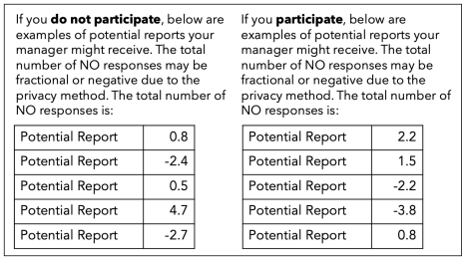
Sample reports
Notes:
Drawing on prior work in S&P showing that concrete examples improve user comprehension of privacy enhancing technologies and secure behavior
Marian Harbach, Markus Hettig, Susanne Weber, and Matthew Smith. Using personal examples to improve risk communication for security & privacy decisions. In Proceedings of the SIGCHI Conference on Human Factors in Computing Systems, pages 2647–2656, 2014.

Slide 14
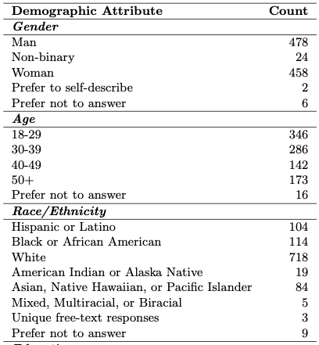
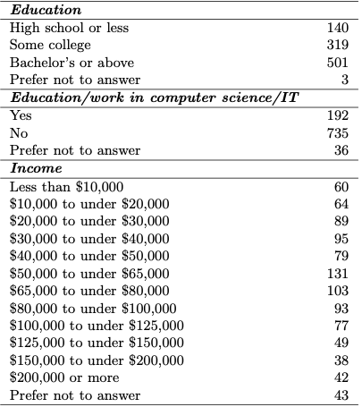
Study
Explanation method | Epsilon value | optional/mandatory
3x4x2 between-subjects vignette survey study (n = 963)
Controls: No privacy, Det. explanation
Participants recruited from Prolific
Notes:
Explanation method x Epsilon value x optional/mandatory

Slide 15
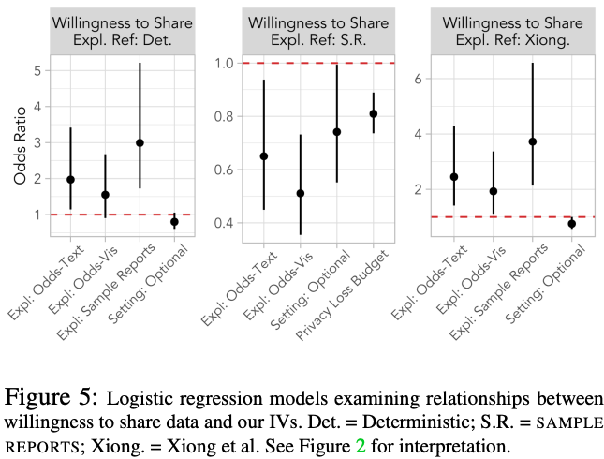
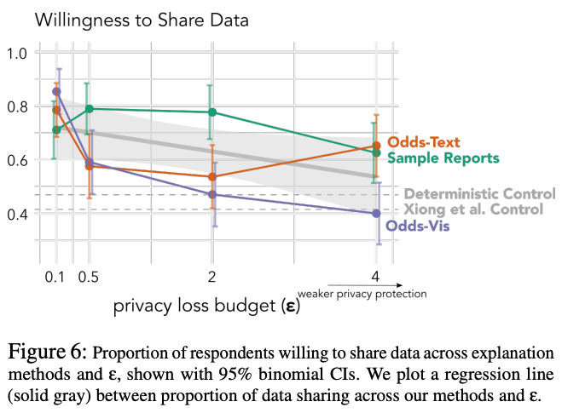
Willingness to Share
Based on the scenario and description of privacy protection, would you respond no (i.e., respond truthfully) to the survey question? (Yes/No/I prefer not to answer this question.)
Notes:
Compared to the Xiong et al. Control, over 2x, nearly 2x, over 4x as likely to share data when given Odds-Based Text, Odds-Based Visual, & Example-Based respectively
Decreased willingness to share as privacy strength decreases

Slide 16
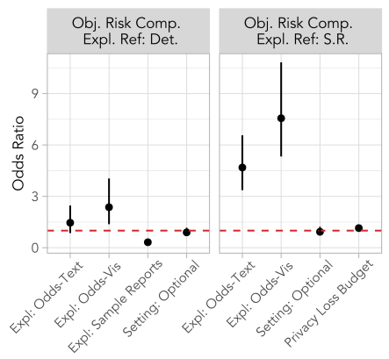
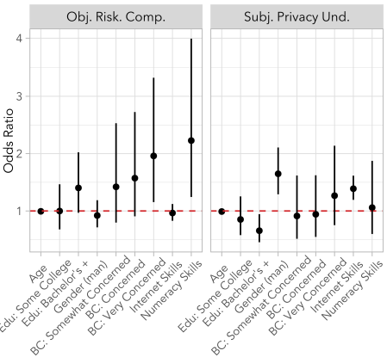
Objective Risk Comprehension
My manager is more [than twice as] likely to believe I responded no if I respond no (i.e., respond truthfully) to the survey question than if I respond yes (i.e., respond untruthfully) to the survey question. (True/False/I don’t know/I prefer not to answer this question.)
Notes:
Over 2x as likely to answer an additional objective risk comprehension question correctly with Odds-Based Visual vs. Deterministic Control
Negative effect of our Sample Reports (O.R. = 0.32)
No significant effect of Odds-Based Text

Slide 17
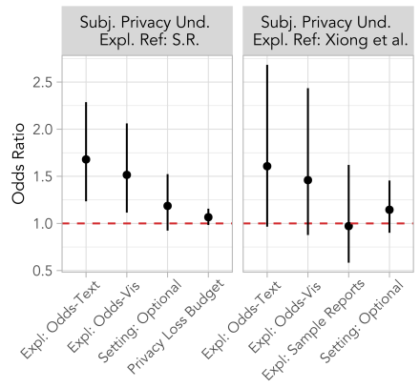
Subjective Privacy Understanding
Based on the scenario and description of the privacy protection, how confident are you that you understand the privacy protection applied to the survey results? (Not at all confident/ Somewhat confident/Confident/Very confident/I prefer not to answer this question.)
Notes:
Compared to Sample Reports, Odds-Based Text and Odds-Based Visual improved subjective privacy understanding (O.R. = 1.7; 1.5)

Slide 18
Self Efficacy
Based on the scenario and description of the privacy protection, how confident are you that you have enough information to decide whether to respond no (i.e., respond truthfully) to the survey question? (Not at all confident/Somewhat confident/Confident/Very confident/I prefer not to answer this question.)
What further information, if any, would you like to have to help you decide whether you would respond no (i.e., respond truthfully) to the survey question? (open-text response)
Based on the scenario and the description of the privacy protection, how confident are you in deciding whether to respond no (i.e., respond truthfully) to the survey question? (Not at all confident/Somewhat confident/Confident/Very confident/I prefer not to answer this question.)

Slide 19
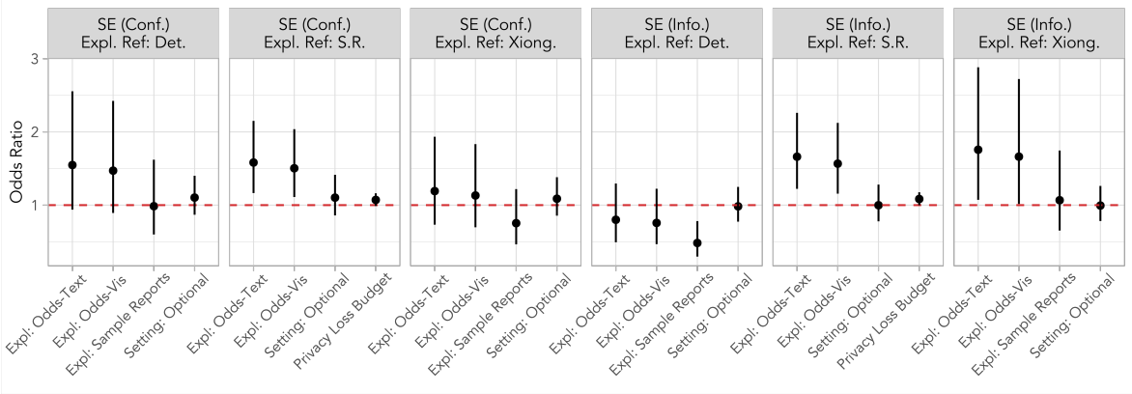
Self Efficacy
Notes:
Compared to the Xiong et al. Control, Odds-Based Text and Odds-Based Visual improved self-efficacy (enough info) (O.R. = 1.8; 1.7)
No significant effect of Sample Reports

Slide 20
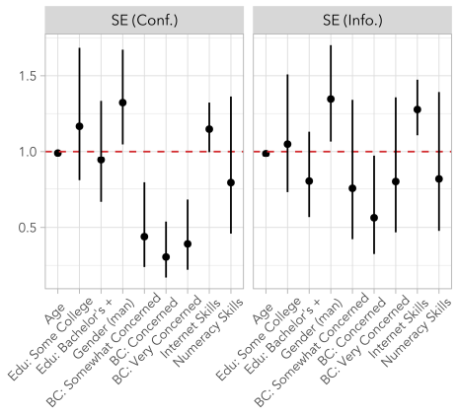
Self Efficacy

Slide 21
Summary of results
Compared to Sample Reports, Odds-Based Text and Odds-Based Visual improved:
Objective risk comprehension (O.R. = 4.7; 7.6)
Subjective privacy understanding (O.R. = 1.7; 1.5)
Self-efficacy (enough info) (O.R. = 1.7; 1.6)

Slide 22
Takeaways
Odds-based methods are promising for explaining 𝜺 to end users
Explanations should include 𝜺 information, since it supports self-efficacy
People’s willingness to share data is sensitive to changes in 𝜺
Explanation methods can support auditing & public deliberation over differential privacy deployments

Slide 23
Discussion
What do you think about the generality of this approach?
When could it broadly apply to other scenarios?
This method targets users where privacy may be the key concern. What about utility, which may be a concern of adopters?
Can you think of other explanatory methods that might be better?
E.g., show analysis with/without DP entirely, or with varying epsilon

