Slide 1


Secure Systems Engineering and Management
A Data-driven Approach
Security analytics: Intro to data analysis
Michael Hicks
UPenn CIS 7000-003
Spring 2026
Hypothesis Testing, Effect Sizes, and Regression

Slide 2
Lecture 1: Hypothesis Testing, Non-Parametric Tests, and Effect Sizes

Slide 3
Lecture 1 Overview
Topics:
Quick level set
The logic of hypothesis testing
Chi-square test of independence
Student’s t-test (parametric)
Mann-Whitney U test (non-parametric)
Effect sizes (Cohen’s d, Vargha-Delaney A)
Bootstrapped confidence intervals
Common pitfalls
Notes:
Learning objectives for this lecture:
Explain the logic of null hypothesis significance testing (NHST)
Interpret p-values correctly and avoid common misinterpretations
Perform and interpret Chi-square tests
Choose between t-test (parametric) and Mann-Whitney U (non-parametric)
Calculate and interpret effect sizes
Apply multiple comparison corrections
Recognize common statistical pitfalls
Readings: Franke Ch. 16.2, Seltman Ch. 6.2

Slide 4
Sample Data for This Lecture
We’ll use synthetic vulnerability data throughout:
sample_vuln_data.csv (n = 2,000) ├── cve_id # CVE identifier ├── pub_year # Publication year (2018-2024) ├── cwe_category # Memory, InputValidation, Crypto, Auth, Other ├── cvss_base # CVSS score (0-10) ├── impact # Impact subscore ├── exploitability # Exploitability subscore ├── severity # Low, Medium, High, Critical └── in_kev # TRUE if actively exploited
Notes:
This synthetic data mimics your real NVD/KEV project data. Key properties:
2,000 vulnerabilities
~1.8% exploitation rate (37 in KEV catalog)
CVSS scores roughly normally distributed, mean ≈ 5.2
Memory and InputValidation vulns have higher exploitation rates
Load the data at the start of your demo:
R: data <- read.csv("sample_vuln_data.csv")
Python: data = pd.read_csv("sample_vuln_data.csv")

Slide 5
Loading the Sample Data in R
# Load the sample vulnerability data data <- read.csv("sample_vuln_data.csv") # Convert categorical variables to factors data$cwe_category <- factor(data$cwe_category) data$severity <- factor(data$severity, levels = c("Low", "Medium", "High", "Critical"), ordered = TRUE) # Quick check str(data) summary(data$cvss_base) table(data$in_kev)
Notes:
The Franke book uses R. Some papers we read use R as well. It’s a common package used by statisticians and social scientists. But Python, Scipy, Numpy, and Pandas are also in common use, so I will mostly refer to those.
Line-by-line explanation:
read.csv() - loads the CSV file into a dataframe
factor() - converts cwe_category to a categorical variable (R needs this for regression)
factor(..., levels=..., ordered=TRUE) - creates an ordered factor for severity (Low < Medium < High < Critical)
str() - shows the structure of the dataframe (column types, first few values)
summary() - gives min, max, quartiles, mean for numeric columns
table() - counts occurrences of each value (here: FALSE/TRUE for in_kev)
Expected output for in_kev: FALSE=1963, TRUE=37

Slide 6
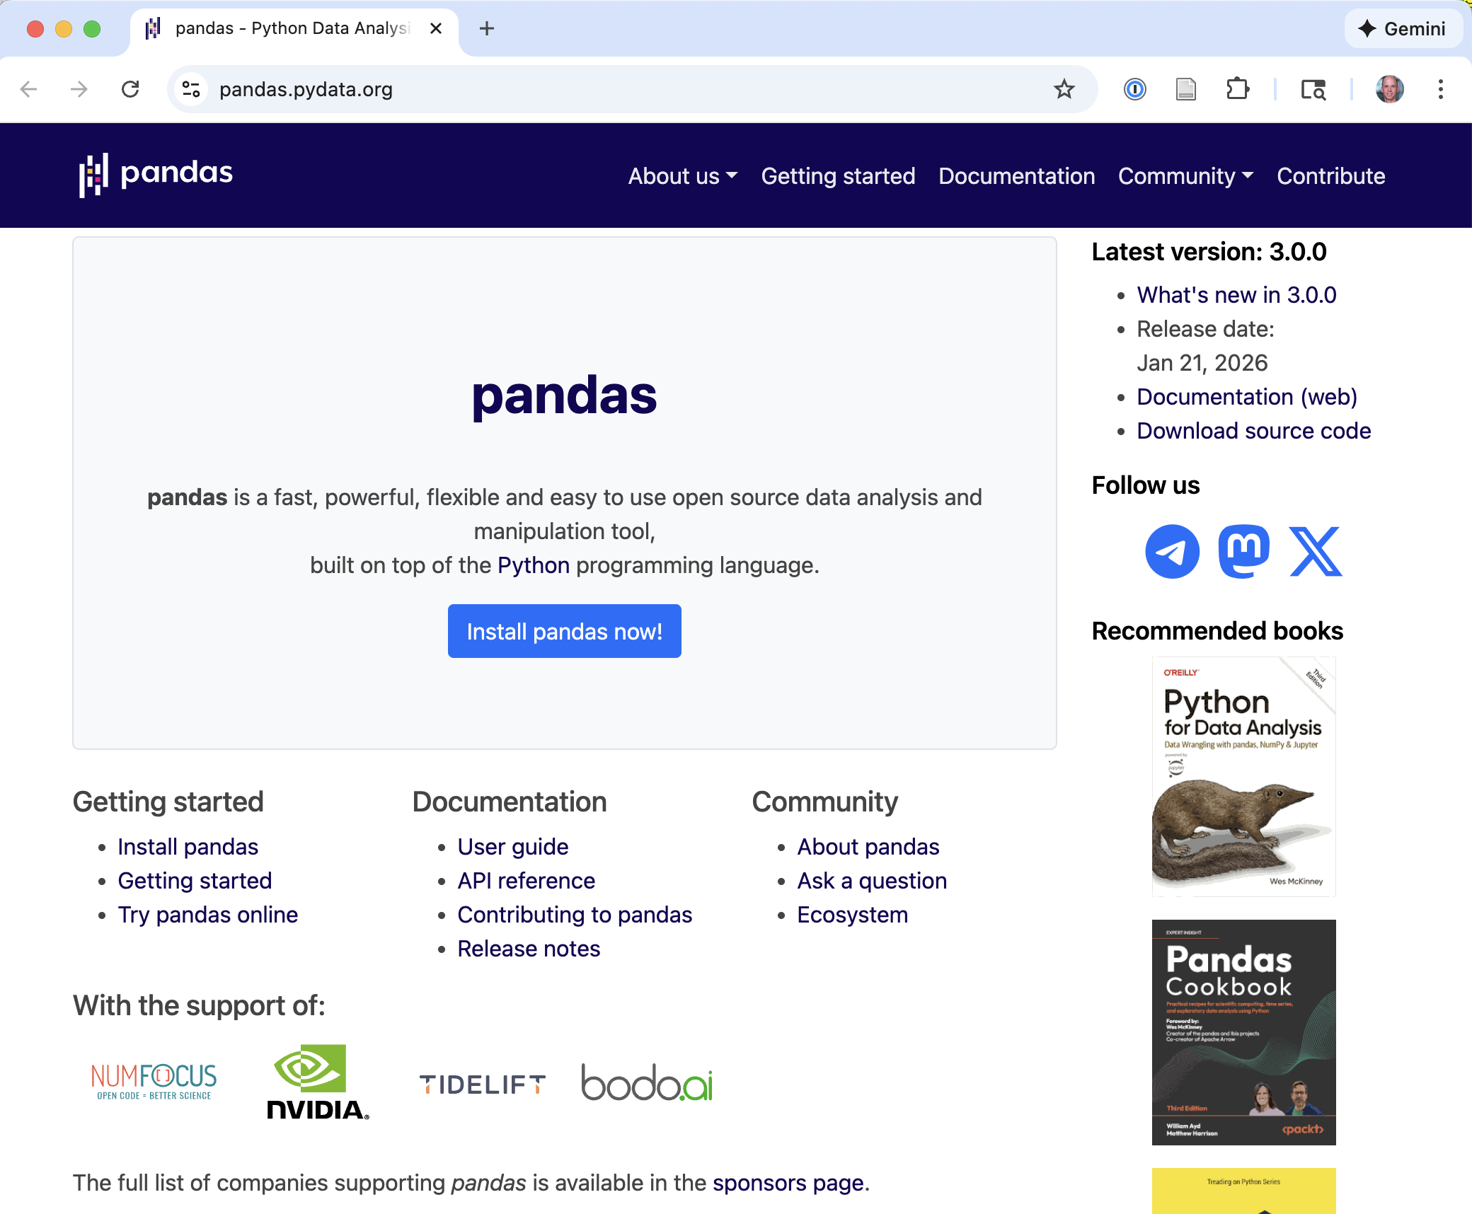



Slide 7
Loading the Sample Data in Python
import pandas as pd import numpy as np # Load the sample vulnerability data data = pd.read_csv("sample_vuln_data.csv") # Convert to categorical (optional but good practice) data['cwe_category'] = pd.Categorical(data['cwe_category']) data['severity'] = pd.Categorical( data['severity'], categories=["Low", "Medium", "High", "Critical"], ordered=True ) # Quick check print(data.info()) print(data['cvss_base'].describe()) print(data['in_kev'].value_counts())
Notes:
Line-by-line explanation:
import pandas as pd - imports pandas library, aliased as ‘pd’ for convenience
import numpy as np - imports numpy for numerical operations (we’ll need it later)
pd.read_csv() - loads CSV into a pandas DataFrame
pd.Categorical() - converts column to categorical type (memory efficient, enables ordering)
categories=[...], ordered=True - specifies the order for ordinal variables
data.info() - shows column names, types, and non-null counts
describe() - summary statistics for numeric columns
value_counts() - counts unique values (like R’s table())
Expected in_kev output: False=1963, True=37

Slide 8
Level setting: Terms you know
Empirical data
Observational vs. experimental
Analysis
Explanation vs. prediction
Variable
nominal / categorical / binary vs. ordinal vs. metric
Distribution and sample
Central tendency
Mean / average μ, median, mode
Dispersion
Variance, standard deviation σ, quantiles

Slide 9
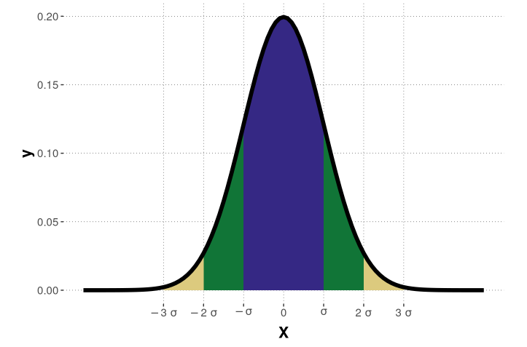
Our friend: The normal distribution

Slide 10
Part 1: Hypothesis Testing

Slide 11

Why Hypothesis Testing?
The fundamental problem
How do we distinguish signal from noise in our data?
Suppose
Exploited vulnerabilities have mean CVSS = 6.26
Non-exploited vulnerabilities have mean CVSS = 5.22
Is this a real difference, or just random variation?
Notes:
The 1.6-point difference looks substantial, but with thousands of CVEs, even small random fluctuations could produce differences.
We need a principled way to assess whether the observed pattern is likely to reflect a real phenomenon.

Slide 12
Hypotheses
Null hypothesis (H₀): The default assumption
Usually “no effect” or “no difference”
Example: “CVSS scores are the same for exploited and non-exploited vulnerabilities”
Alternative hypothesis (H₁): What we’re testing for
Example: “CVSS scores differ between exploited and non-exploited vulnerabilities”
Notes:
Emphasize that the null hypothesis is typically what we’re trying to find evidence against, not what we believe is true.
The alternative can be one-sided (exploited > non-exploited) or two-sided (exploited ≠ non-exploited). In exploratory research, two-sided is more common and more conservative.

Slide 13
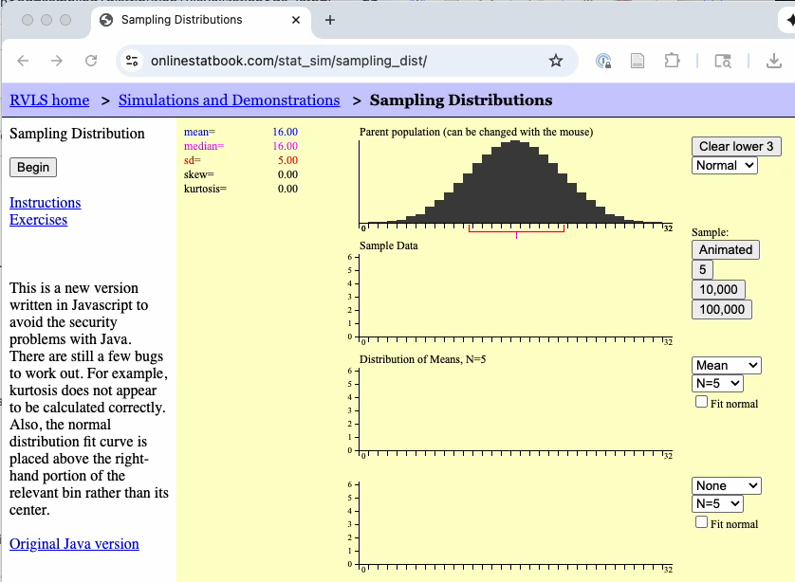
Test Statistics and Sampling Distributions
Test statistic
An assessment of our experimental data, as it relates to H₀
Sampling distribution
The distribution of the test statistic if we repeated the experiment many times
Notes:
The sampling distribution is a theoretical construct — we imagine what would happen if we could repeat our study infinitely many times under the null hypothesis.
Different tests have different test statistics (t, χ², U, etc.) with different sampling distributions.

Slide 14
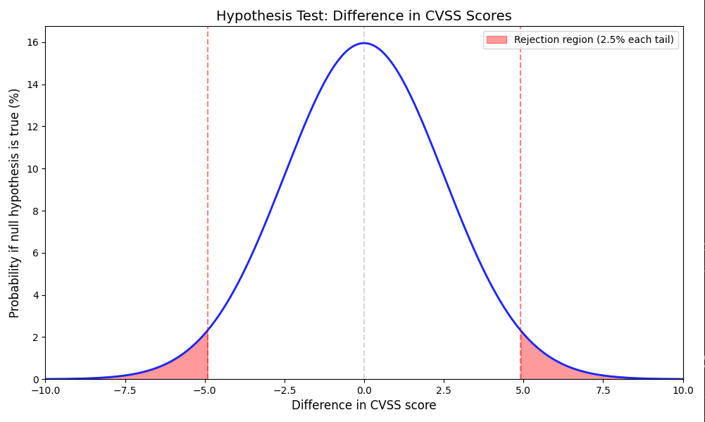
The Frequentist Framework
Core question
What would we expect to see if there were no real effect?
If the observed data would be very unusual under the “no effect” assumption, we have evidence against that assumption. (Note: graph is notional, not based on analysis.)
Notes:
This is the fundamental logic of frequentist inference.
We construct a model of what the world would look like if nothing interesting were happening, then ask how surprising our data would be under that model.
This is an indirect form of reasoning — we’re not directly assessing the probability that our hypothesis is true.

Slide 15
The p-value
Definition:
The probability of observing data as extreme as (or more extreme than) ours, if H₀ were true
Correct interpretation:
p-value = 0.05: “If there were truly no difference in CVSS scores, there is only a 5% chance of seeing a difference this large.”
Notes:
The p-value answers the question: “How surprising is my data under the null hypothesis?”
A small p-value means the data would be unusual if H₀ were true, which is evidence against H₀.
Key point: the p-value is NOT the probability that H₀ is true!
Franke Section 16.2 has excellent coverage of this.

Slide 16
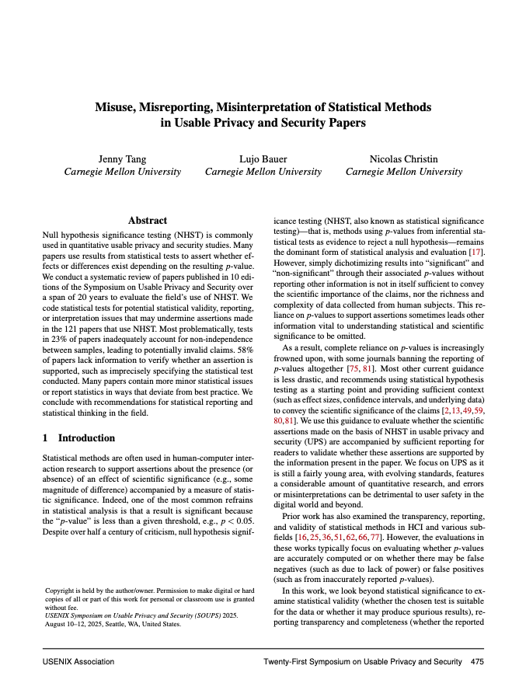
p-value Misinterpretations
Common mistakes
❌ “The probability that H₀ is true is p”
❌ “The probability that H₁ is true is 1 − p”
❌ “A significant result means the effect is large”
❌ “A non-significant result means there’s no effect”
Tang et al. found 26% of SOUPS papers had interpretation errors like these
Notes:
These are extremely common errors, even in published research!
p is not P(H₀ is true) — that would require Bayesian reasoning with a prior
Same issue — we can’t directly compute P(H₁ is true)
With large samples, tiny effects can be “significant”
We may simply lack power to detect a real effect
Tang et al. (SOUPS 2025) found 26% of papers had interpretation errors like these.

Slide 17
Significance Threshold (α)
Convention: α = 0.05
What this means
We reject H₀ if p < α
We accept a 5% risk of false positives
Type I error: Rejecting H₀ when it’s actually true (false positive)
Type II error: Failing to reject H₀ when it’s actually false (false negative)
Notes:
The 0.05 threshold is arbitrary but conventional. Some fields use stricter thresholds (e.g., particle physics uses 5σ ≈ 0.0000003).
Type I error rate is controlled by α. Type II error rate depends on effect size, sample size, and variance — this is related to statistical power.
One-sided vs. two-sided: one-sided tests are more powerful but only appropriate when you have a strong a priori directional hypothesis. For your project, use two-sided unless you have a specific reason not to.

Slide 18
Part 2: Chi-Square Test of Independence

Slide 19
When to Use Chi-Square
Purpose: Test (non)independence of two categorical variables
Example: Is vulnerability severity category (Low/Medium/High/Critical) independent of CWE category (Memory/Crypto/Input Validation/…)?
 | Memory | Crypto | Input Val
Low | ? | ? | ?
Medium | ? | ? | ?
High | ? | ? | ?
Critical | ? | ? | ?
Notes:
Chi-square tests whether the two variables are independent (no association) or dependent (associated).
If independent, knowing the CWE category tells you nothing about the severity. If associated, certain CWE types might be more likely to be critical.

Slide 20
Building a Contingency Table
Observed counts
 | Memory | Crypto | Input Val | Row Total
Low | 45 | 120 | 80 | 245
Medium | 90 | 150 | 110 | 350
High | 130 | 85 | 140 | 355
Critical | 85 | 45 | 70 | 200
Col Total | 350 | 400 | 400 | 1150
 | Memory | Crypto | Input Val
Low | ? | ? | ?
Medium | ? | ? | ?
High | ? | ? | ?
Critical | ? | ? | ?
Notes:
This is example data for illustration. In your project, you’ll construct similar tables from the NVD data.
Each cell shows the count of vulnerabilities with that combination of severity and CWE category.

Slide 21
Expected Counts Under Independence
If no association exists (i.e., independent)
Expected count = (Row total × Column total) / Grand total
E(Low, Memory) = (245 / 1150) × 350 = 74.6
 | Memory | Crypto | Input Val | Row Total
Low | 45 | 120 | 80 | 245
Medium | 90 | 150 | 110 | 350
High | 130 | 85 | 140 | 355
Critical | 85 | 45 | 70 | 200
Col Total | 350 | 400 | 400 | 1150
Under independence, we’d expect ~75, but we observed only 45.
Notes:
The expected counts represent what we would expect to see if severity and CWE were completely independent — if the same proportion of each CWE type fell into each severity level.
When observed counts differ substantially from expected counts, that’s evidence of association.

Slide 22
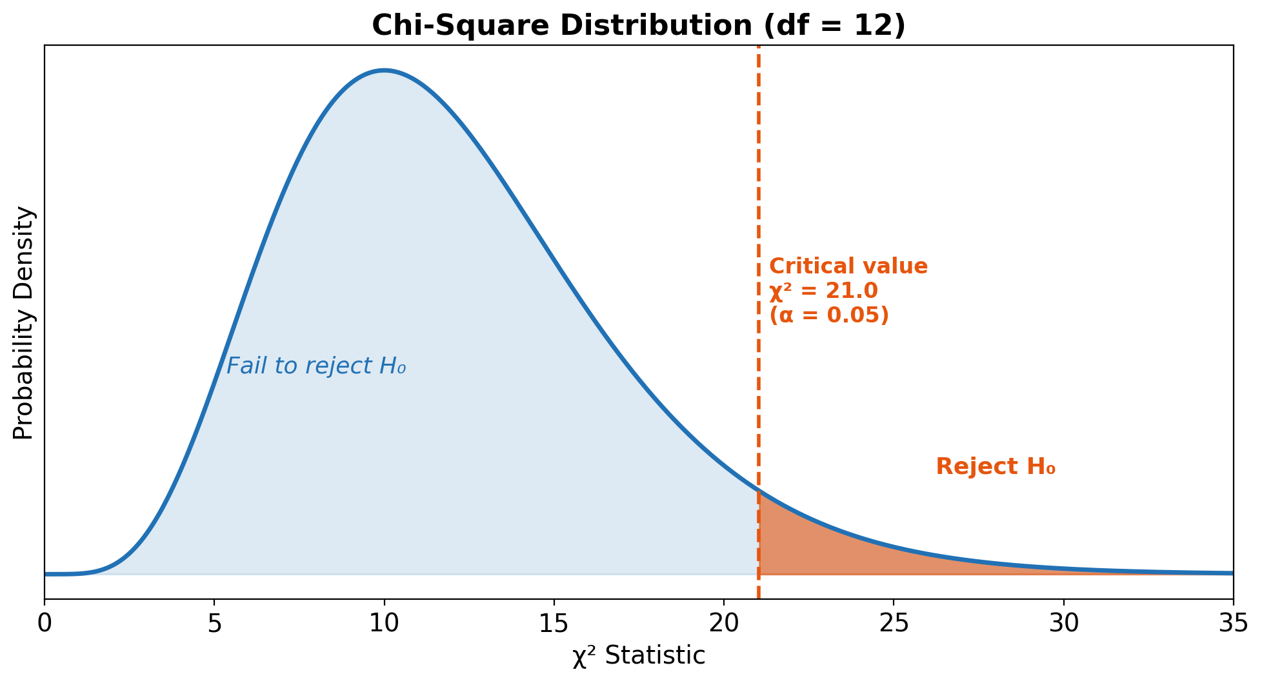

The Chi-Square Test Statistic
$$χ^{2}=∑\frac{(O−E)^{2}}{E}$$
Sum over all cells in the table
Large differences between O and E → large χ²
Compare to χ² distribution with df = (rows − 1)(cols − 1)
Notes:
The test statistic measures the overall discrepancy between observed and expected counts.
For our 4×3 table: df = (4-1)(3-1) = 6
The chi-square distribution is right-skewed. Larger values of χ² indicate stronger evidence against independence.

Slide 23
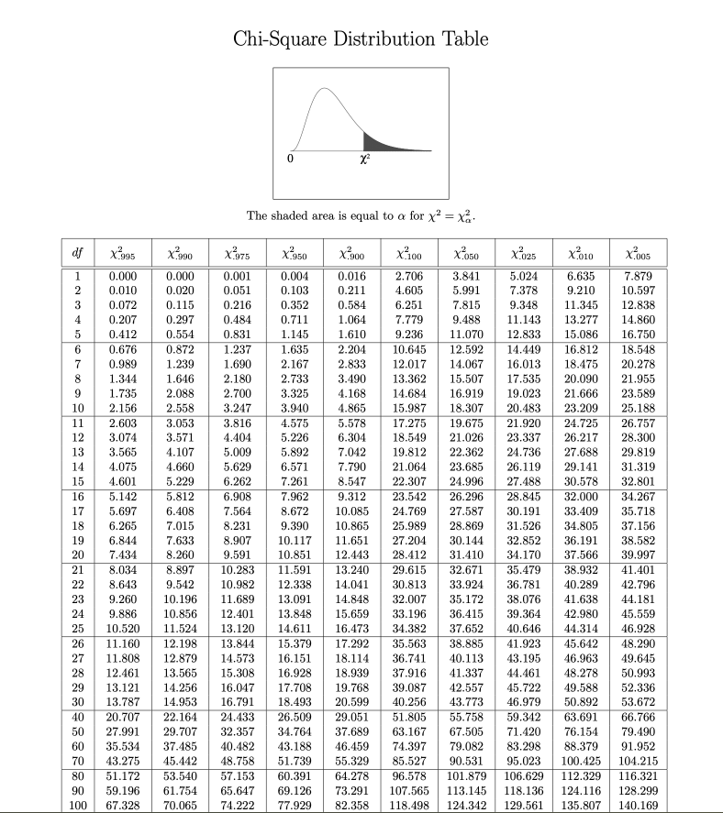

Slide 24
Chi-Square in R (with line-by-line explanation)
# Create contingency table from the data cont_table <- table(data$severity, data$cwe_category) # Run chi-square test result <- chisq.test(cont_table) # View results print(result) # Full output result$statistic # χ² value result$p.value # p-value result$expected # Expected counts result$stdres # Standardized residuals
Notes:
Line-by-line explanation:
table(data$severity, data$cwe_category) - creates a contingency table (cross-tabulation) counting how many observations fall into each combination of severity and CWE category. First variable = rows, second = columns.
chisq.test(cont_table) - performs the chi-square test of independence. Returns a list object with multiple components.
print(result) - shows the test statistic, df, and p-value
result$statistic - extracts just the χ² value (e.g., 45.23)
result$p.value - extracts the p-value (e.g., 0.0001)
result$expected - matrix of expected counts under independence (what we’d expect if no association)
result$stdres - standardized residuals showing WHERE the association is strongest. Values > 2 or < -2 indicate notable deviations.
Reading: Franke Section 16.6.1, Seltman Chapter 16.2

Slide 25
Chi-Square in Python
from scipy.stats import chi2_contingency # Create contingency table cont_table = pd.crosstab(data['severity'], data['cwe_category']) # Run chi-square test chi2, p_value, dof, expected = chi2_contingency(cont_table) # Print results print(f"χ² = {chi2:.2f}, df = {dof}, p = {p_value:.4f}") # Calculate standardized residuals manually std_residuals = (cont_table - expected) / np.sqrt(expected) print(std_residuals)
Notes:
Line-by-line explanation:
from scipy.stats import chi2_contingency - imports the chi-square function from scipy’s statistics module
pd.crosstab(data['severity'], data['cwe_category']) - pandas function that creates a contingency table (cross-tabulation). Similar to R’s table(). First argument = rows, second = columns.
chi2_contingency(cont_table) - performs the test and returns FOUR values:
chi2: the test statistic
p_value: the p-value
dof: degrees of freedom
expected: array of expected counts
print(f"...") - f-string formatting to display results nicely. :.2f means 2 decimal places, :.4f means 4 decimal places.
(cont_table - expected) / np.sqrt(expected) - manual calculation of standardized residuals. scipy doesn’t compute these automatically like R does.
Documentation: https://docs.scipy.org/doc/scipy/reference/generated/scipy.stats.chi2_contingency.html

Slide 26
Running Chi-square on Sample Data
Expected output on sample_vuln_data.csv:
χ² = 110.53, df = 12, p = 0.000000000000000
The chi-square test examines whether severity and CWE category are independent.
Null hypothesis: Severity distribution identical for all CWE categories
Result: We reject H₀ (p < 0.001) — there is a significant association

Slide 27
Interpreting Results: Where Is the Association?
A significant χ² tells you that there’s an association, not where.
Standardized residuals: (O − E) / √E
Interpretation | Meaning
Residual > +2 | More than expected (overrepresented)
Residual < −2 | Fewer than expected (underrepresented)
Notes:
This is a critical point! A significant overall test doesn’t tell you which specific cells are driving the association.
For example, you might find that Memory vulnerabilities are overrepresented at Critical severity (residual = 3.5) and underrepresented at Low severity (residual = -2.8).
PITFALL: Don’t claim specific pairwise differences without examining residuals or doing post-hoc tests!

Slide 28
Contingency table
Severity | Auth | Crypto | InputValidation | Memory | Other
Low | 41 | 77 | 88 | 43 | 82
Medium | 221 | 219 | 435 | 394 | 210
High | 28 | 20 | 39 | 87 | 13
Critical | 0 | 0 | 0 | 3 | 0

Slide 29
Sample data associations
Pattern | Residual | Meaning
Memory + High | +5.37 | Far more high-severity memory bugs than expected
Memory + Low | -4.73 | Far fewer low-severity memory bugs than expected
Other + Low | +4.44 | More low-severity “Other” bugs than expected
Crypto + Low | +3.42 | More low-severity crypto bugs than expected

Slide 30
Chi-Square Assumptions
Independence: Each observation is independent
Expected count rule: Most cells should have E ≥ 5
Categorical data: Both variables must be categorical
⚠️ Warning for large samples:
With thousands of vulnerabilities, even trivial associations are “significant”
→ Always report effect sizes!
Notes:
The expected count rule ensures the χ² approximation is valid. If many cells have E < 5, consider Fisher’s exact test.
The large sample warning is crucial for your project. With 200,000+ CVEs, virtually any departure from perfect independence will be “significant.” This doesn’t mean it’s practically important!
This is why we need effect sizes — to measure the magnitude, not just the existence, of an association.

Slide 31
Part 3: Comparing Two Groups — t-test and Mann-Whitney U

Slide 32

The Student’s t-Test
Purpose: Test whether the means of two groups differ significantly
The question we’re asking:
Do exploited vulnerabilities have different CVSS scores (on average) than non-exploited vulnerabilities?
H₀: μ_exploited = μ_not_exploited H₁: μ_exploited ≠ μ_not_exploited
Notes:
William Sealy Gosset developed the t-test while working at Guinness brewery in 1908. He published under the pseudonym “Student” because Guinness didn’t want competitors to know they were using statistics for quality control.
The t-test is probably the most widely used statistical test. It’s appropriate when comparing means of two groups with (approximately) normally distributed data.

Slide 33
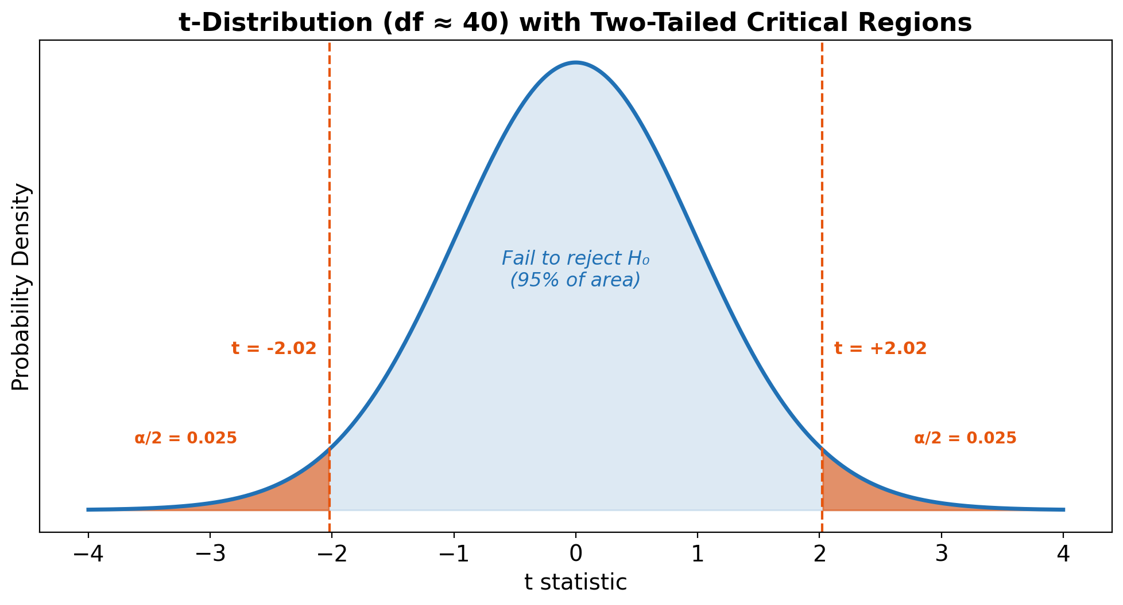

t-Test: How It Works
Test statistic:
$$t=\frac{{\overset{‾}{X}}_{1}−{\overset{‾}{X}}_{2}}{SE_{difference}}$$
where SE depends on the pooled standard deviation and sample sizes
Under H₀: t follows a t-distribution with df ≈ n₁ + n₂ − 2
Notes:
The numerator is the observed difference in means. The denominator is the standard error — a measure of how much sampling variability we expect.
Large |t| means the observed difference is many standard errors away from zero, suggesting a real effect.
The t-distribution looks like a normal distribution but has heavier tails, especially with small samples. As sample size increases, it approaches the normal distribution.

Slide 34
t-Test Assumptions
Independence: Observations are independent
Normality: Data in each group is normally distributed
Equal variance: Both groups have similar variance (for standard t-test)
How important are these?
Independence: Critical — violations cause serious problems
Normality: Less critical with large samples (Central Limit Theorem)
Equal variance: Use Welch’s t-test to relax this assumption
Notes:
The t-test is reasonably robust to violations of normality when sample sizes are large (n > 30 per group). This is due to the Central Limit Theorem — the sampling distribution of means becomes normal even if the underlying data isn’t.
Welch’s t-test doesn’t assume equal variances and is generally preferred. It’s the default in R’s t.test() and Python’s scipy.stats.ttest_ind(equal_var=False).
Independence violations are the most serious — they can lead to both false positives AND false negatives.

Slide 35
t-Test in R (with line-by-line explanation)
# Separate CVSS scores by exploitation status exploited <- data$cvss_base[data$in_kev == TRUE] not_exploited <- data$cvss_base[data$in_kev == FALSE] # Welch's t-test (default, doesn't assume equal variance) t_result <- t.test(exploited, not_exploited) # View results print(t_result) t_result$statistic # t-value t_result$p.value # p-value t_result$conf.int # 95% CI for difference in means t_result$estimate # Group means
Notes:
Line-by-line explanation:
data$cvss_base[data$in_kev == TRUE] - subsetting: extracts CVSS scores only for rows where in_kev is TRUE. The bracket notation [condition] filters the vector.
Same for non-exploited vulnerabilities.
t.test(exploited, not_exploited) - performs Welch’s t-test by default. Welch’s test doesn’t assume equal variances (safer). For equal variance assumption, add var.equal = TRUE.
print(t_result) - shows t-statistic, df, p-value, confidence interval, and means
t_result$statistic - the t-value (e.g., 3.45)
t_result$p.value - the p-value (e.g., 0.0006)
t_result$conf.int - 95% confidence interval for the difference in means (e.g., [0.3, 1.1])
t_result$estimate - mean of each group (e.g., mean of x = 6.8, mean of y = 5.2)

Slide 36
t-Test in Python
from scipy.stats import ttest_ind # Separate CVSS scores by exploitation status exploited = data[data['in_kev'] == True]['cvss_base'] not_exploited = data[data['in_kev'] == False]['cvss_base'] # Welch's t-test (equal_var=False is safer) t_stat, p_value = ttest_ind(exploited, not_exploited, equal_var=False) # View results print(f"t = {t_stat:.3f}, p = {p_value:.4f}") print(f"Mean (exploited): {exploited.mean():.2f}") print(f"Mean (not exploited): {not_exploited.mean():.2f}") print(f"Difference: {exploited.mean() - not_exploited.mean():.2f}")
Notes:
Line-by-line explanation:
from scipy.stats import ttest_ind - imports the independent samples t-test function from scipy
data[data['in_kev'] == True]['cvss_base'] - pandas filtering syntax. data[condition] returns rows where condition is True, then ['cvss_base'] selects that column.
Same for non-exploited.
ttest_ind(exploited, not_exploited, equal_var=False) - performs Welch’s t-test. The equal_var=False parameter is important — it tells scipy NOT to assume equal variances (more robust).
The function returns TWO values: t_stat (the t-statistic) and p_value.
exploited.mean() - computes mean of the exploited group. Pandas Series have built-in statistical methods.
Note: scipy’s ttest_ind doesn’t directly give you confidence intervals. For those, use statsmodels or compute manually.

Slide 37
Running t-Test on Sample Data
Expected output on sample_vuln_data.csv:
t = 5.098, p = 0.00001 Mean (exploited): 6.26 Mean (not exploited): 5.22 Difference: 1.04
Interpretation:
Exploited vulnerabilities have significantly higher CVSS scores (M = 6.26) than non-exploited ones (M = 5.22), t(37.5) = 5.098, p < 0.00001.
Notes:
The t-test shows a significant difference. But should we trust this result?
Let’s check the assumptions:
1. Independence: Probably OK (each CVE is separate)
2. Normality: Need to check — CVSS scores may be skewed
3. Equal variance: Welch’s test handles this
Next: Let’s examine the distribution of CVSS scores to see if the normality assumption is reasonable.
The 37.5 is the degrees of freedom (df) for the t-test, and the fact that it's not a whole number tells you this is a Welch's t-test (an independent samples t-test that does not assume equal variances between the two groups).
In a standard Student's t-test, the degrees of freedom are simply n₁ + n₂ − 2, which always gives a whole number. But when the two groups have unequal variances (or unequal sample sizes), Welch's correction adjusts the degrees of freedom downward using the Welch–Satterthwaite equation:
df=(s12n1+s22n2)2(s12n1)2n1−1+(s22n2)2n2−1df = \frac{\left(\frac{s_1^2}{n_1} + \frac{s_2^2}{n_2}\right)^2}{\frac{\left(\frac{s_1^2}{n_1}\right)^2}{n_1 - 1} + \frac{\left(\frac{s_2^2}{n_2}\right)^2}{n_2 - 1}}df=n1​−1(n1​s12​​)2​+n2​−1(n2​s22​​)2​(n1​s12​​+n2​s22​​)2​
where s² is the sample variance and n is the sample size for each group. This formula almost always produces a fractional (non-integer) value like 37.5.

Slide 38
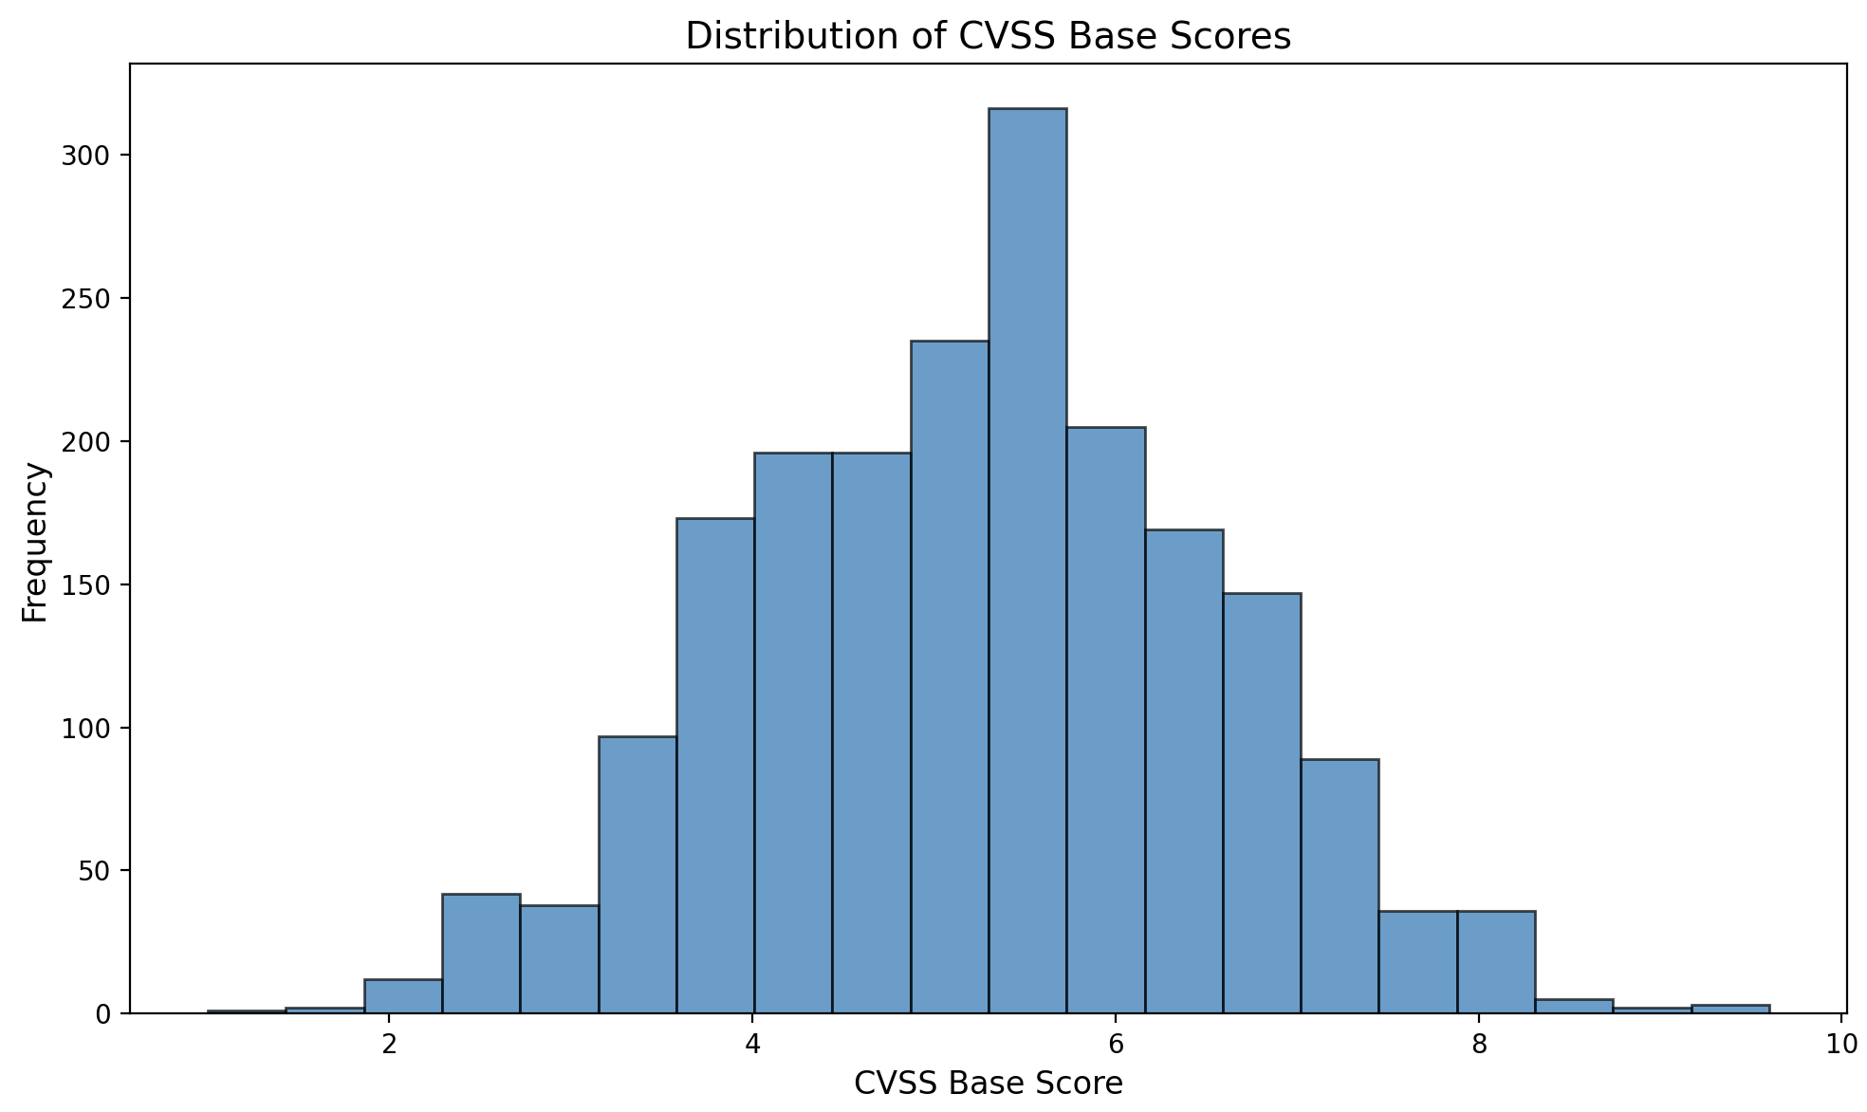
Checking Normality
Visual checks:
Histogram — is it roughly bell-shaped?
Notes:
With your NVD data, CVSS scores are often NOT normally distributed: - Bounded at 0 and 10 - Clustering at specific values (7.5, 9.8) - Possibly multimodal
When normality is violated, especially with skewed data, consider Mann-Whitney U as an alternative.

Slide 39
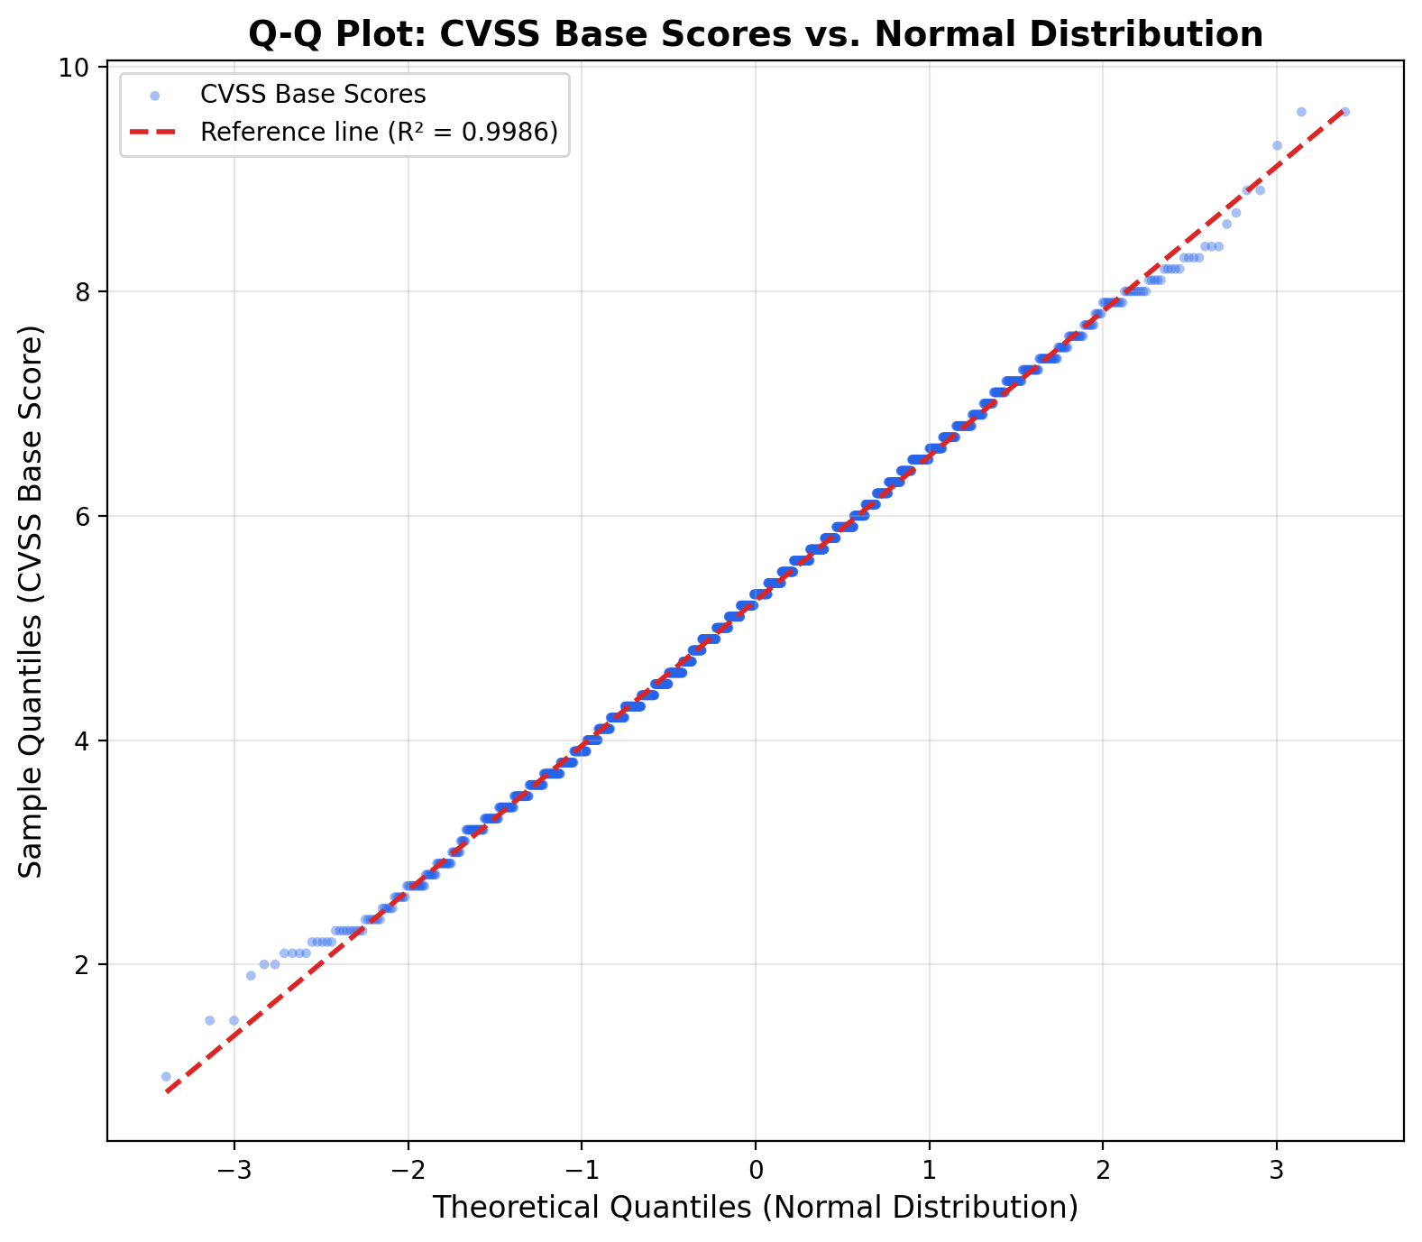
Checking Normality
Visual checks:
Histogram — is it roughly bell-shaped?
Q-Q plot — do points follow the diagonal?
Statistical tests: Shapiro-Wilk test (but sensitive with large n)
The Shapiro-Wilk test shows:
- Statistic: 0.9985 (suggests normality)
- p-value: 0.062 (rejects NH – appear normal)
Notes:
The plot takes your actual data values (sorted from smallest to largest) and plots them against the values you'd expect to see if the data were perfectly normally distributed. Each dot represents one data point, with its actual value on one axis and its theoretical "ideal" value on the other.
A 45-degree diagonal reference line is drawn to represent a perfect match. So the interpretation is simple:
Points fall along the diagonal → Your data is approximately normally distributed. Great — assumptions for tests like the t-test are met.
Points curve away at the tails → Your data has heavier or lighter tails than a normal distribution (e.g., more extreme outliers than expected).
Points form an S-shape → Your data may be skewed.
Points systematically deviate → Your data likely follows a different distribution altogether.
The Shapiro-Wilk test is useful but becomes very sensitive with large samples — it will reject normality for trivial deviations. Visual inspection is often more informative.
The Shapiro-Wilk test shows:
- Statistic: 0.9985 (close to 1 suggests normality)
- p-value: 0.062
Since p > 0.05, we fail to reject the null hypothesis — the CVSS base scores appear to be approximately normally distributed.

Slide 40
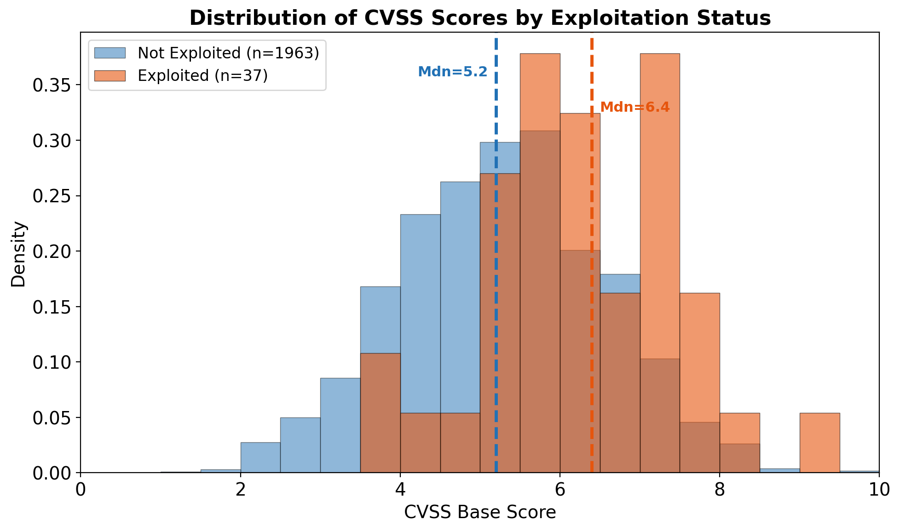
Data visualized, according to KEV status

Slide 41
Parametric vs. Non-Parametric Tests
Criterion | Parametric (t-test) | Non-Parametric (Mann-Whitney)
Assumption | Normal distribution (or n is large) | No distributional assumption
Data type | Continuous, interval | Ordinal or continuous
Sensitivity | More powerful if assumptions met | Robust to outliers, skewness
Measures | Compares means | Compares ranks/distributions
Use t test when you can, Mann-Whitney when you must
Notes:
Parametric tests assume a specific distribution (usually normal). Non-parametric tests make fewer assumptions but may have less statistical power when parametric assumptions are met.
For your vulnerability project:
CVSS scores are bounded [0, 10] and often skewed
Large sample sizes make t-test reasonably robust
Mann-Whitney is the safer choice for non-normal data
Best practice: Run BOTH and see if they agree. If results differ substantially, investigate why and report both.

Slide 42
Mann-Whitney U Test
Also called: Wilcoxon rank-sum test
Purpose: Test whether one group tends to have larger values than another
How it works:
Combine both samples and rank all values (1 = smallest)
Sum the ranks for each group
The U statistic measures overlap between groups
H₀: The distributions are identical H₁: One group tends to have larger values
Notes:
Unlike the t-test which compares means, Mann-Whitney compares the entire distributions using ranks.
U can be interpreted as: “the number of times a value from group A exceeds a value from group B” (out of all possible pairs).
No normality assumption required — works with any continuous or ordinal data.

Slide 43
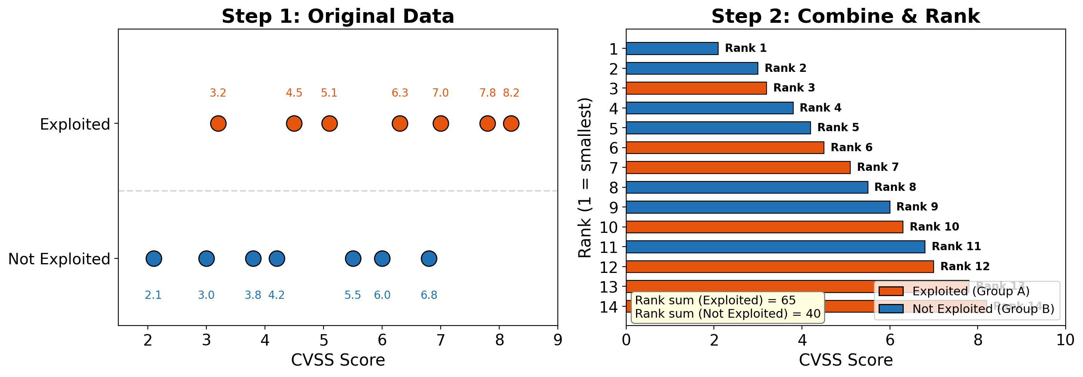
Mann-Whitney: Visual Intuition
High overlap → U statistic near expected value → large p
Low overlap → U statistic far from expected → small p
Notes:
Think of it this way: if the two groups come from the same distribution, their ranks should be well-mixed. If group A truly has higher values, its observations will tend to have higher ranks. The test statistic captures this intuition mathematically.
How to compute p
Small samples (exact method): Under H₀, every possible assignment of ranks to the two groups is equally likely. There are C(n₁+n₂, n₁) such assignments. You can enumerate all of them, compute U for each, and build the exact null distribution. The p-value is the fraction of arrangements producing a U as extreme or more extreme than the one you observed. This is feasible when both groups are small (say, n < 20 each).
Large samples (normal approximation): Under H₀, U has known mean and variance:
E(U) = n₁n₂ / 2
Var(U) = n₁n₂(n₁ + n₂ + 1) / 12
So you compute a z-score: z = (U − E(U)) / √Var(U), and look up the p-value from the standard normal distribution. This works well when both groups have n > 20 or so.

Slide 44
Mann-Whitney in R (with line-by-line explanation)
# Separate groups (same as for t-test) exploited <- data$cvss_base[data$in_kev == TRUE] not_exploited <- data$cvss_base[data$in_kev == FALSE] # Mann-Whitney U test (Wilcoxon rank-sum) mw_result <- wilcox.test(exploited, not_exploited, conf.int = TRUE) # View results print(mw_result) mw_result$statistic # W (equivalent to U) mw_result$p.value # p-value mw_result$conf.int # CI for median difference (Hodges-Lehmann)
Notes:
Line-by-line explanation:
1-2. Subsetting to create separate vectors for each group (same as t-test).
wilcox.test(exploited, not_exploited, conf.int = TRUE) - performs Mann-Whitney U test (also called Wilcoxon rank-sum).
conf.int = TRUE asks for a confidence interval for the difference in location (Hodges-Lehmann estimator)
Note: In R, “Wilcoxon test” with TWO groups = Mann-Whitney U
print(mw_result) - shows W statistic and p-value
mw_result$statistic - the W statistic (sum of ranks in first group, related to U)
mw_result$p.value - the p-value
mw_result$conf.int - 95% CI for the difference in location
IMPORTANT: “Wilcoxon test” in R is ambiguous: - wilcox.test(x, y) with TWO samples = Mann-Whitney U (rank-sum) - wilcox.test(x, paired=TRUE) = Wilcoxon signed-rank (for paired data)

Slide 45
Mann-Whitney in Python
from scipy.stats import mannwhitneyu # Separate groups exploited = data[data['in_kev'] == True]['cvss_base'] not_exploited = data[data['in_kev'] == False]['cvss_base'] # Mann-Whitney U test u_stat, p_value = mannwhitneyu(exploited, not_exploited, alternative='two-sided') # View results print(f"U = {u_stat:.0f}, p = {p_value:.4f}") print(f"Median (exploited): {exploited.median():.2f}") print(f"Median (not exploited): {not_exploited.median():.2f}")
Notes:
Line-by-line explanation:
from scipy.stats import mannwhitneyu - imports the Mann-Whitney U function from scipy
2-3. Pandas filtering to separate groups (same as before)
mannwhitneyu(exploited, not_exploited, alternative='two-sided') - performs the test
alternative='two-sided' specifies a two-tailed test (could also be ‘greater’ or ‘less’)
Returns two values: u_stat and p_value
print(f"U = ...") - formatted output showing U statistic and p-value
6-7. Report medians (more appropriate than means for non-parametric tests)
Note: scipy’s mannwhitneyu returns just U and p-value. For effect sizes, use the pingouin library (shown later).

Slide 46
Running Both Tests on Sample Data
t-test:
t = 5.098, p < 0.00001 Mean difference = 1.04
Mann-Whitney U:
U = 52580, p < 0.000003 Median (exploited) = 6.40, Median (not exploited) = 5.2
Both agree: Strong evidence that exploited vulnerabilities have higher CVSS scores
Notes:
When both tests agree (both significant or both non-significant with similar p-values), you can be more confident in your conclusion.
When they disagree, it often indicates:
- Highly skewed data (means ≠ medians)
- Outliers affecting the t-test
- Different aspects of the distribution being compared
Report both tests as a robustness check, especially when you’re uncertain about assumptions.

Slide 47
⚠️ Pitfall: Unclear Test Specification
Ambiguous: “We used a Wilcoxon test”
This could mean:
Mann-Whitney U (Wilcoxon rank-sum) — independent samples
Wilcoxon signed-rank — paired samples
Clear: “We used a Mann-Whitney U test (Wilcoxon rank-sum) to compare CVSS scores between exploited and non-exploited vulnerabilities.”
Notes:
Tang et al. (SOUPS 2025) found unclear test specification to be a common issue.
Always specify:
1. The exact test name
2. Whether samples are paired or independent 3. What is being compared
This ensures readers can understand and replicate your analysis.

Slide 48
Part 4: Effect Sizes

Slide 49
Why p-values Are Not Enough
The problem: With large samples, even trivial differences become “significant”
Example: With 200,000+ CVEs, a difference of 0.1 CVSS points might suggest a p < 0.001 statistically significant different frequency of exploitability
Is that difference practically meaningful for security prioritization?
80% of papers had incomplete scientific significance reporting
Notes:
This is one of the most important points in the lecture. Statistical significance ≠ practical significance.
A vulnerability management team doesn’t care if exploited vulns have CVSS 7.51 vs 7.50. They need differences large enough to matter for triage decisions.
Tang et al. found that 80% of papers had incomplete scientific significance reporting — mainly missing effect sizes.

Slide 50
Effect Sizes: The Solution
Effect size A standardized measure of the magnitude of a difference or association
Two key effect sizes for comparing groups
Effect Size | Use Case
Cohen’s d | Parametric (with t-test)
Vargha-Delaney A | Non-parametric (with Mann-Whitney)
Notes:
Effect sizes answer the question: “How big is the effect?”
They’re standardized, meaning they can be compared across studies and variables with different scales.
We’ll cover Cohen’s d (for parametric comparisons) and Vargha-Delaney A (for non-parametric comparisons), maintaining the same parametric/non-parametric symmetry as the hypothesis tests.

Slide 51

Cohen’s d (Parametric Effect Size)
Formula
$$d=\frac{{\overset{‾}{X}}_{1}−{\overset{‾}{X}}_{2}}{SD_{pooled}}$$
Interpretation: How many standard deviations apart are the means?
 | d
0.2 | Small
0.5 | Medium
0.8 | Large
Notes:
Cohen’s d is the most common effect size for comparing two means.
d = 0.5 means the means differ by half a standard deviation — a moderate effect.
Use Cohen’s d with t-tests when data is approximately normal. For non-normal data, Vargha-Delaney A is more appropriate.
Thresholds are from Cohen (1988) and are conventions, not absolute rules.

Slide 52
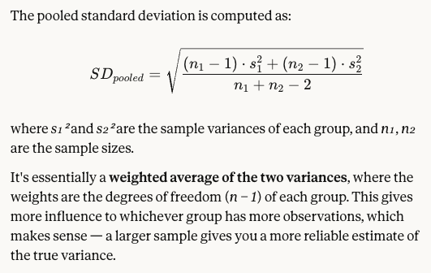

Slide 53
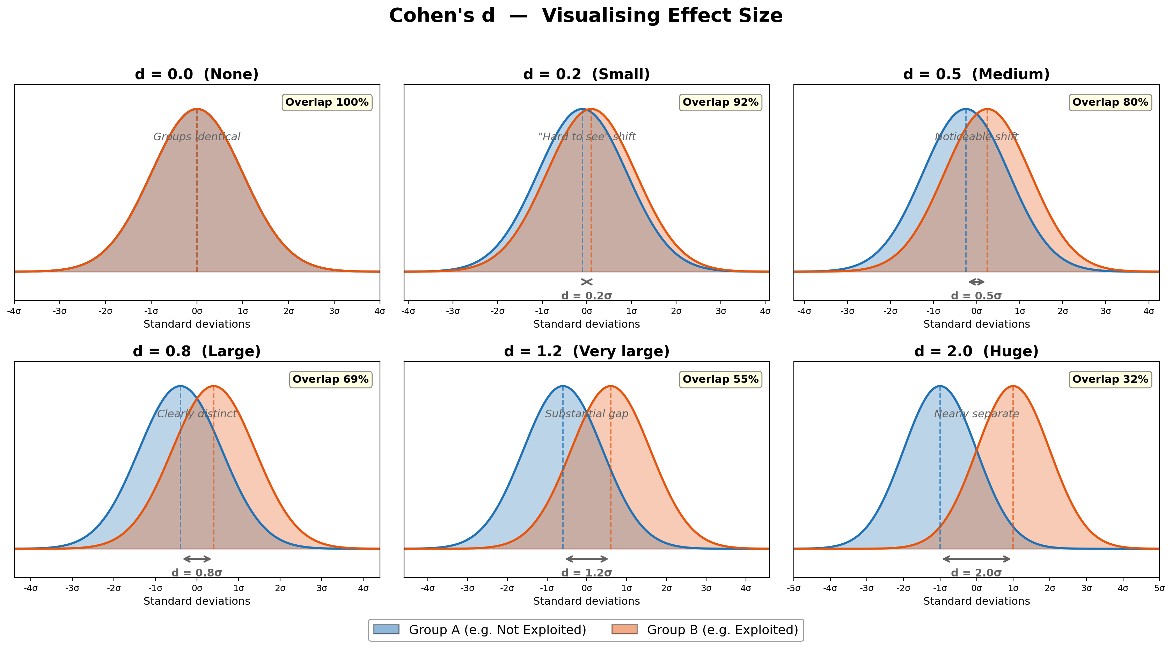
Cohen’s d: Visual
Notes:
The visual really helps intuition. When A is close to 0.5, the distributions sit on top of each other. As A increases, they pull apart.
You could draw samples from each group and have students guess which is “bigger” — that’s essentially what A measures!

Slide 54
Cohen’s d in R (with line-by-line explanation)
library(effsize) # Install: install.packages("effsize") # Compute Cohen's d d_result <- cohen.d(exploited, not_exploited) # View results print(d_result) d_result$estimate # d value d_result$magnitude # "small", "medium", "large", or "negligible" d_result$conf.int # 95% CI for d
Notes:
Line-by-line explanation:
library(effsize) - loads the effsize package. Must be installed first with install.packages("effsize").
cohen.d(exploited, not_exploited) - computes Cohen’s d between the two groups
Order matters: positive d means first group > second group
Returns an object with multiple components
print(d_result) - shows the d value, confidence interval, and magnitude label
d_result$estimate - the Cohen’s d value (e.g., 0.76)
d_result$magnitude - categorical label based on Cohen’s conventions
d_result$conf.int - 95% confidence interval for d (e.g., [0.42, 1.10])
The confidence interval is important — it tells you the uncertainty in your effect size estimate.

Slide 55
Cohen’s d in Python
import pingouin as pg # Install: pip install pingouin # Compute Cohen's d d_value = pg.compute_effsize(exploited, not_exploited, eftype='cohen') print(f"Cohen's d = {d_value:.2f}") # Interpretation if abs(d_value) < 0.2: magnitude = "negligible" elif abs(d_value) < 0.5: magnitude = "small" elif abs(d_value) < 0.8: magnitude = "medium" else: magnitude = "large" print(f"Magnitude: {magnitude}")
Notes:
Line-by-line explanation:
import pingouin as pg - imports the pingouin library (pip install pingouin). Excellent for effect sizes.
pg.compute_effsize(exploited, not_exploited, eftype='cohen') - computes Cohen’s d
eftype='cohen' specifies Cohen’s d
Other options: ‘hedges’ (bias-corrected for small samples), ‘glass’, ‘r’, ‘eta-square’
print(f"...") - display the d value with 2 decimal places
4-10. Manual interpretation based on Cohen’s conventions (pingouin doesn’t automatically label magnitude)
Alternative: pg.compute_effsize(..., eftype='hedges') for Hedges’ g, which is bias-corrected for small samples. With large samples, Cohen’s d and Hedges’ g are nearly identical.

Slide 56
Vargha-Delaney A (Non-Parametric Effect Size)
What it measures: The probability that a randomly selected value from group A exceeds a randomly selected value from group B
Interpretation
A value | Meaning
0.50 | No difference (coin flip)
0.56 | Small effect
0.64 | Medium effect
0.71 | Large effect
→ 1.0 | A always exceeds B
Notes:
Vargha-Delaney A is wonderfully intuitive!
A = 0.64 means “if you randomly pick one observation from each group, 64% of the time the one from group A will be larger.”
This is directly interpretable and doesn’t assume normality.
Thresholds come from Vargha & Delaney (2000) and are commonly used in software engineering research, including the Klees et al. fuzzing paper from your readings.

Slide 57
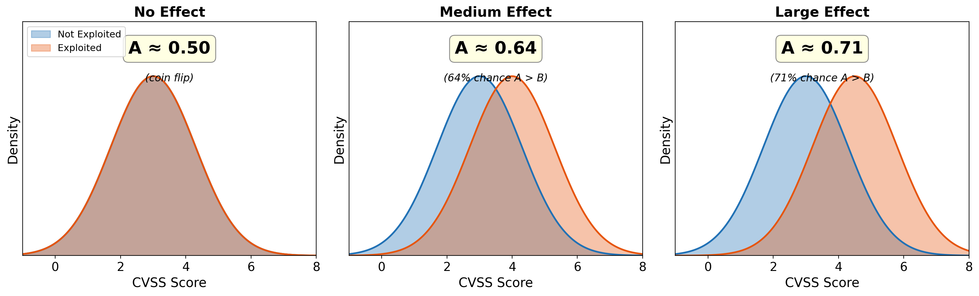
Vargha-Delaney A: Visual
A = 0.50: Complete overlap A = 0.64: Moderate separation A = 0.85: Clear separation
Notes:
The visual really helps intuition. When A is close to 0.5, the distributions sit on top of each other. As A increases, they pull apart.
You could draw samples from each group and have students guess which is “bigger” — that’s essentially what A measures!

Slide 58
Vargha-Delaney A in R (with line-by-line explanation)
library(effsize) # Compute Vargha-Delaney A vd_result <- VD.A(exploited, not_exploited) # View results print(vd_result) vd_result$estimate # A value vd_result$magnitude # "small", "medium", "large", or "negligible"
Notes:
Line-by-line explanation:
library(effsize) - same package as Cohen’s d
VD.A(exploited, not_exploited) - computes Vargha-Delaney A
Order matters: A > 0.5 means first group tends to be larger
A < 0.5 means second group tends to be larger
print(vd_result) - shows A value and magnitude
vd_result$estimate - the A value (e.g., 0.72)
vd_result$magnitude - label based on Vargha & Delaney conventions
Note: A = 0.72 means “a randomly selected exploited vulnerability has a 72% chance of having higher CVSS than a randomly selected non-exploited vulnerability.”

Slide 59
Vargha-Delaney A in Python
import pingouin as pg # Method 1: Get A directly from Mann-Whitney test mw_result = pg.mwu(exploited, not_exploited, alternative='two-sided') print(mw_result) # Look at the 'CLES' column — this is Vargha-Delaney A # Method 2: Compute manually (CLES = Common Language Effect Size) # A = U / (n1 * n2) where U is Mann-Whitney U statistic from scipy.stats import mannwhitneyu u_stat, _ = mannwhitneyu(exploited, not_exploited) n1, n2 = len(exploited), len(not_exploited) vd_a = u_stat / (n1 * n2) print(f"Vargha-Delaney A = {vd_a:.2f}")
Notes:
Line-by-line explanation:
Method 1 (recommended): 1. pg.mwu(exploited, not_exploited) - pingouin’s Mann-Whitney test returns MULTIPLE statistics 2. The output DataFrame includes: - U-val: Mann-Whitney U statistic - p-val: p-value - RBC: Rank-biserial correlation (another effect size, ranges -1 to +1) - CLES: Common Language Effect Size = Vargha-Delaney A
Method 2 (manual): 3. mannwhitneyu() returns the U statistic 4. len() gets sample sizes 5. A = U / (n1 × n2) is the formula connecting U to A
Recall that max(U) = n1 times n2, so this statistic relativizes U against the most extreme possible
CLES and Vargha-Delaney A are the same concept with different names.

Slide 60
Running Effect Sizes on Sample Data
Cohen’s d (parametric):
Cohen's d = 0.81
Magnitude: large
Vargha-Delaney A (non-parametric):
Vargha-Delaney A = 0.72 (large effect)
Interpretation:
Both effect sizes indicate a large effect. Exploited vulnerabilities have substantially higher CVSS scores than non-exploited ones.
Notes:
Both effect sizes agree that this is a large effect. This is reassuring — it means the finding is robust to the choice of method.
d = 0.97 means the means are about 1 standard deviation apart. A = 0.74 means 74% of the time, a random exploited vuln has higher CVSS than a random non-exploited vuln.
The confidence interval for d [0.63, 1.31] tells us even the lower bound is a medium-to-large effect.

Slide 61
⚠️ Pitfall: Conflating Statistical and Practical Significance
Scenario
With n = 100,000 vulnerabilities:
Mean CVSS (exploited) = 7.15
Mean CVSS (non-exploited) = 7.05
p < 0.001, d = 0.08
Statistically significant? Yes
Practically significant? Probably not!
Notes:
The effect size (d = 0.08) is tiny. A 0.1-point CVSS difference is not going to change security prioritization decisions.
Always ask: “Would this difference matter in practice?” If the answer is no, the statistical significance is not very interesting.
This is why reporting effect sizes is mandatory, not optional.

Slide 62
Part 5: Bootstrapped Confidence Intervals

Slide 63
Confidence Intervals
Problem: We are computing a value on a sample from a broader population. How close is our estimate to the true value?
Solution: Confidence interval (CI)
The CI is a range; the confidence level (e.g., 95%) of it indicates how often the true value falls within the CI over repeated sampling (i.e., in the sampling distribution)
Challenge: How to compute CI?
Notes:
Bootstrapping is a “pull yourself up by your bootstraps” approach — we use the data we have to estimate the uncertainty in our estimates.
The key insight: our sample is our best guess at the population, so we can treat it as a stand-in for the population and sample from it (with replacement) to see how much our estimates vary.
Franke Section 5.2.4 covers this.

Slide 64
The Bootstrap Idea
Problem: We want a confidence interval for a statistic (e.g., median difference), but we don’t know its sampling distribution
Solution: Simulate the sampling distribution by resampling our data
Notes:
Bootstrapping is a “pull yourself up by your bootstraps” approach — we use the data we have to estimate the uncertainty in our estimates.
The key insight: our sample is our best guess at the population, so we can treat it as a stand-in for the population and sample from it (with replacement) to see how much our estimates vary.
Franke Section 5.2.4 covers this.

Slide 65
Bootstrap Procedure
Draw a sample of size n with replacement from your data (which itself has n elements)
Compute the statistic of interest (e.g., median difference)
Repeat 10,000 times
Use the 2.5th and 97.5th percentiles as the 95% CI
Notes:
“With replacement” means the same observation can be selected multiple times in a single bootstrap sample. This is what allows us to get different samples from the same data.
10,000 iterations is a common choice. More is better but slower.
The percentile method is the simplest approach. There are more sophisticated variants (BCa, bias-corrected) that can be more accurate.

Slide 66
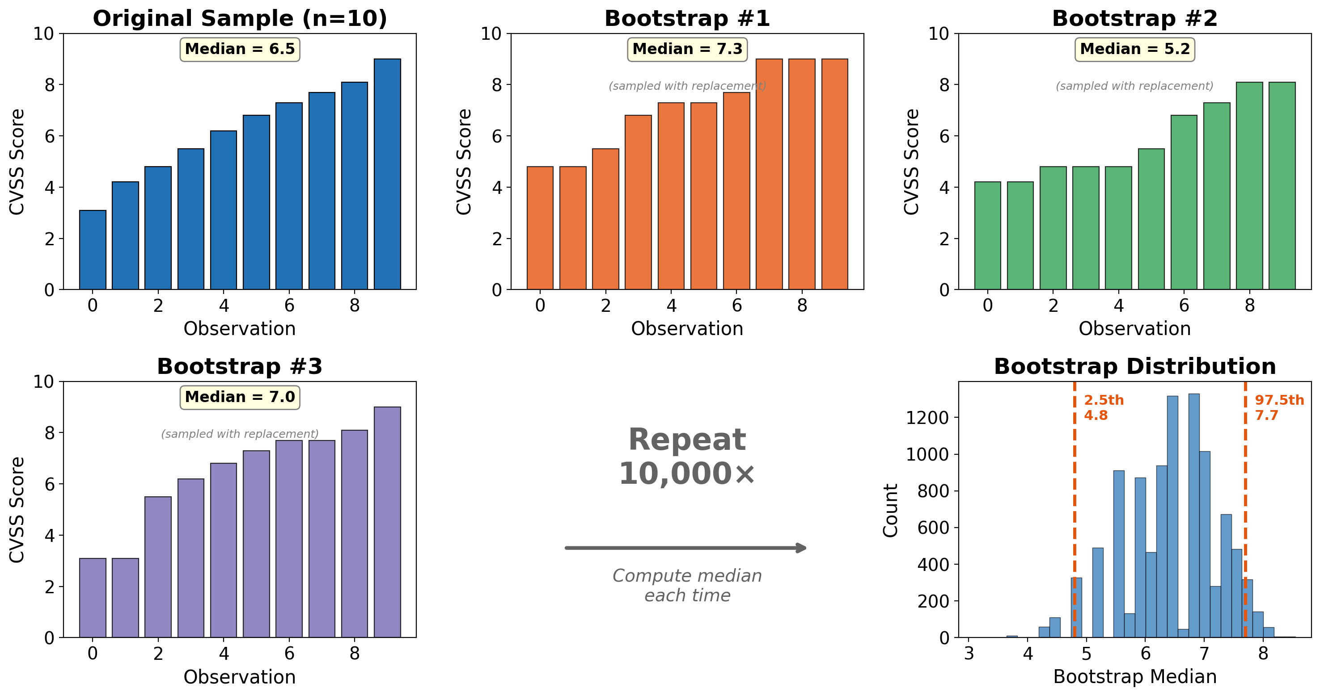
Bootstrap Procedure
Notes:
“With replacement” means the same observation can be selected multiple times in a single bootstrap sample. This is what allows us to get different samples from the same data.
10,000 iterations is a common choice. More is better but slower.
The percentile method is the simplest approach. There are more sophisticated variants (BCa, bias-corrected) that can be more accurate.

Slide 67
Why Bootstrap?
No distributional assumptions — works for any statistic
Works for complex statistics — medians, ratios, custom quantities
Intuitive interpretation — “we’re 95% confident the true value lies in this range”
Notes:
Traditional confidence intervals often require normality assumptions or complex formulas. Bootstrapping sidesteps all of this.
Because you're sampling with replacement, each bootstrap sample will contain:
- Some observations appearing multiple times
- Some observations not appearing at all
On average, about 63.2% of unique observations appear in each bootstrap sample (the rest are duplicates). This is where the variability comes from.

Slide 68
Bootstrap in R (with line-by-line explanation)
library(boot) # Define function to compute statistic of interest median_diff <- function(data, indices) { d <- data[indices, ] # Resample rows using indices median(d$cvss_base[d$in_kev == TRUE]) - median(d$cvss_base[d$in_kev == FALSE]) } # Run bootstrap (10,000 replicates) boot_result <- boot(data, median_diff, R = 10000) # Get 95% confidence interval boot.ci(boot_result, type = "perc")
Notes:
Line-by-line explanation:
library(boot) - loads the bootstrap library (comes with R, no install needed)
median_diff <- function(data, indices) - defines a function that boot() will call repeatedly
data is your full dataset
indices is a vector of row numbers (the bootstrap sample)
d <- data[indices, ] - selects rows specified by indices (the resampled data)
4-5. Computes median CVSS for exploited minus median for not exploited
boot(data, median_diff, R = 10000) - runs the bootstrap
Calls median_diff 10,000 times with different random indices each time
Stores all 10,000 results
boot.ci(boot_result, type = "perc") - extracts confidence interval
type = "perc" uses simple percentile method (2.5th to 97.5th)
Other options: “bca” (bias-corrected accelerated, often better)

Slide 69
Bootstrap in Python
import numpy as np def bootstrap_median_diff(data, n_boot=10000): """Bootstrap 95% CI for median difference.""" # Separate groups exploited = data[data['in_kev'] == True]['cvss_base'].values not_exploited = data[data['in_kev'] == False]['cvss_base'].values # Store bootstrap statistics diffs = [] for _ in range(n_boot): # Resample each group with replacement e_sample = np.random.choice(exploited, size=len(exploited), replace=True) n_sample = np.random.choice(not_exploited, size=len(not_exploited), replace=True) # Compute median difference diffs.append(np.median(e_sample) - np.median(n_sample)) # Return 2.5th and 97.5th percentiles return np.percentile(diffs, [2.5, 97.5]) ci = bootstrap_median_diff(data) print(f"95% CI for median difference: [{ci[0]:.2f}, {ci[1]:.2f}]")
Notes:
Line-by-line explanation:
def bootstrap_median_diff(data, n_boot=10000) - function definition with default 10,000 iterations
2-3. Separate groups and convert to numpy arrays (.values extracts underlying array)
diffs = [] - empty list to store bootstrap statistics
for _ in range(n_boot) - loop 10,000 times. The _ means we don’t need the loop variable.
np.random.choice(exploited, size=len(exploited), replace=True) - resamples the exploited group
size=len(exploited) makes bootstrap sample same size as original
replace=True enables sampling with replacement (the key bootstrap ingredient!)
7-8. Same for non-exploited group
diffs.append(np.median(e_sample) - np.median(n_sample)) - computes and stores the median difference
np.percentile(diffs, [2.5, 97.5]) - extracts 2.5th and 97.5th percentiles as the 95% CI

Slide 70
Running Bootstrap on Sample Data
Bootstrap 95% CI for median difference: [0.50, 1.50]
Interpretation
“The median CVSS of exploited vulnerabilities is 0.90 points higher than non-exploited vulnerabilities, 95% CI [0.50, 1.50].”
The CI doesn’t include zero → significant difference in medians.
Notes:
The bootstrap CI gives us a range of plausible values for the true median difference.
Since the CI [0.50, 1.50] doesn’t include 0, we’re confident the true difference is positive.
This approach requires NO assumptions about the distribution of CVSS scores.

Slide 71
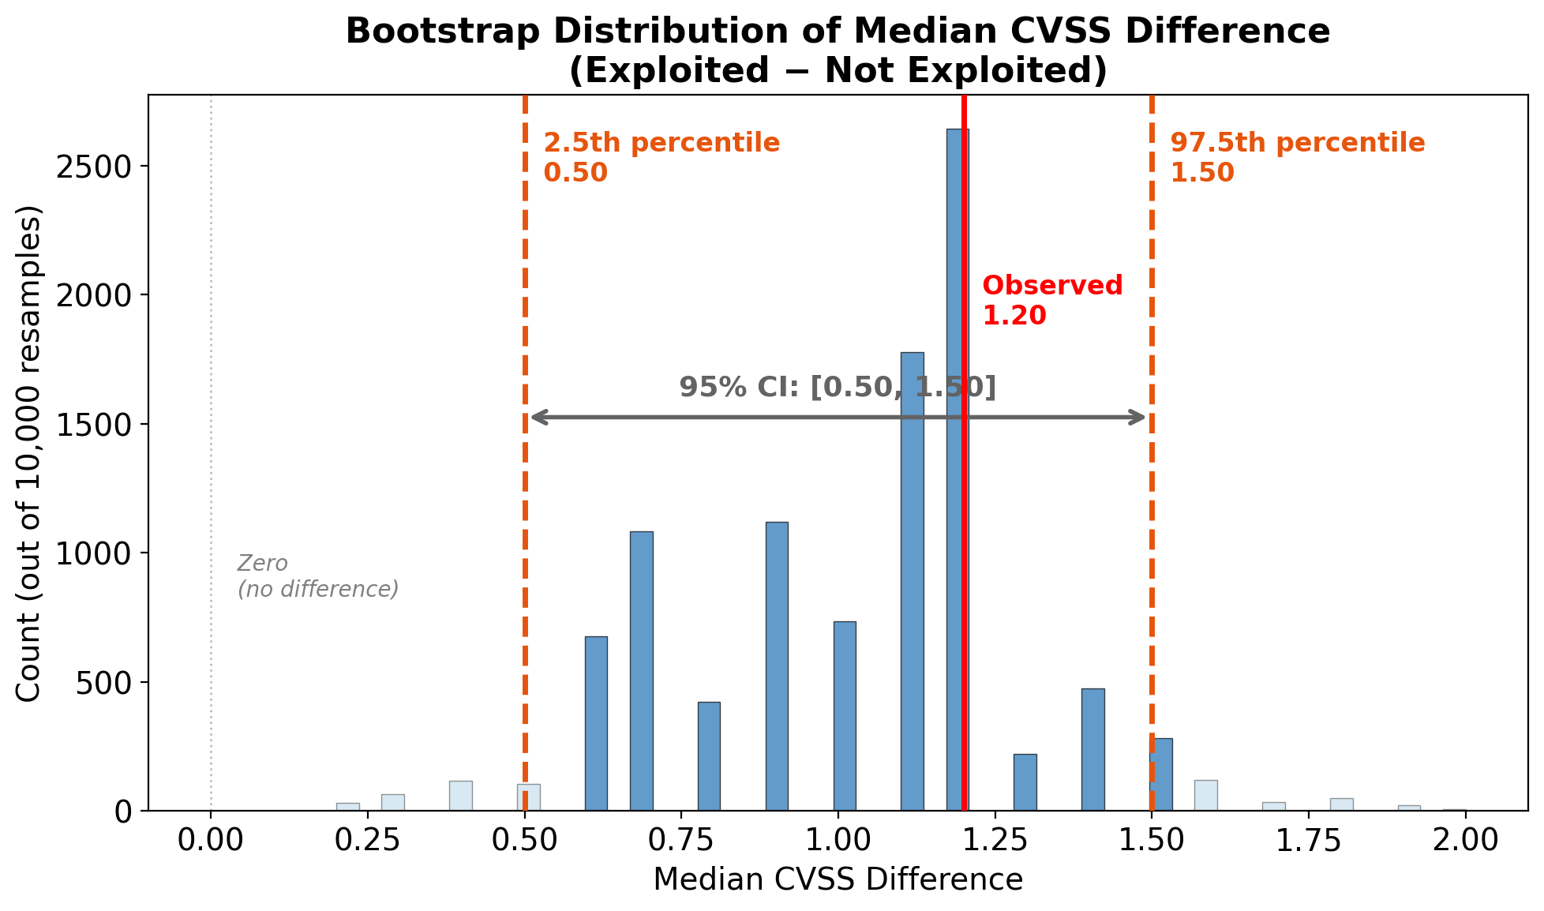
Bootstrap on our data, visualized

Slide 72
Part 6: Common Pitfalls

Slide 73
Tang et al. Findings
97% of papers had at least one statistical issue
23% had incorrect tests (e.g., non-independence violations)
86% had incomplete statistical significance reporting
80% had incomplete practical significance reporting
26% had misinterpretations
Notes:
This paper systematically reviewed statistical methods in usable security research and found pervasive problems.
The good news: now that you know about these pitfalls, you can avoid them!
Link: https://www.usenix.org/conference/soups2025/presentation/tang

Slide 74
The Multiple Comparisons Problem
The problem: At α = 0.05, expect 1 false positive per 20 tests by chance
Example
Testing whether CVSS differences across 10 CWE categories = 45 pairwise comparisons
Expected false positives by chance: ~2-3
Notes:
If you run 45 tests at α = 0.05, you expect about 2.25 “significant” results even when there’s no real effect.
This inflates your false positive rate dramatically. With 45 tests, your family-wise error rate (probability of at least one false positive) is about 90%!

Slide 75

Solutions: Bonferroni Correction
Bonferroni: Divide α by the number of tests
$$α_{adjusted}=\frac{0.05}{k}$$
For 10 tests: $α_{adjusted}$= 0.005
Pros: Simple, conservative Cons: Very conservative — increases false negatives
Notes:
Bonferroni controls the family-wise error rate (probability of ANY false positive across all tests).
For exploratory analyses with many tests, this may be overly conservative. A test that would be significant at p = 0.01 might not pass a Bonferroni threshold of 0.001.

Slide 76
Solutions: Benjamini-Hochberg (FDR)
FDR (False Discovery Rate): Controls the expected proportion of false positives among rejected hypotheses
Procedure:
Order p-values smallest to largest
Compare each p-value to (rank / k) × α
Reject all hypotheses up to the largest one that passes
Less conservative than Bonferroni — better for exploratory analysis
Notes:
FDR is often more appropriate for exploratory research. Instead of controlling “any false positive,” it controls “the fraction of positives that are false.”
Example: If FDR = 0.05 and you reject 20 hypotheses, you expect about 1 of them to be a false positive.
Seltman Chapter 8.4 covers this in detail.

Slide 77
Multiple Comparisons in R (with line-by-line explanation)
# Suppose we have p-values from multiple tests p_values <- c(0.001, 0.01, 0.03, 0.04, 0.08, 0.12) # Bonferroni correction p_bonf <- p.adjust(p_values, method = "bonferroni") print(p_bonf) # Benjamini-Hochberg (FDR) correction p_fdr <- p.adjust(p_values, method = "BH") print(p_fdr) # Compare to alpha = 0.05 data.frame(original = p_values, bonferroni = p_bonf, fdr = p_fdr, bonf_sig = p_bonf < 0.05, fdr_sig = p_fdr < 0.05)
Notes:
Line-by-line explanation:
p_values <- c(...) - vector of p-values from your multiple tests
p.adjust(p_values, method = "bonferroni") - adjusts p-values using Bonferroni
Multiplies each p-value by the number of tests (capped at 1.0)
Compare adjusted p-values to 0.05
p.adjust(p_values, method = "BH") - adjusts using Benjamini-Hochberg FDR
Uses a step-up procedure that’s less conservative
The data.frame shows original vs adjusted p-values and which remain significant
Expected result: With 6 tests, Bonferroni rejects only p = 0.001, FDR rejects p = 0.001 and 0.01.

Slide 78
Multiple Comparisons in Python
from statsmodels.stats.multitest import multipletests import numpy as np # P-values from multiple tests p_values = np.array([0.001, 0.01, 0.03, 0.04, 0.08, 0.12]) # Bonferroni correction reject_bonf, p_bonf, _, _ = multipletests(p_values, method='bonferroni') # Benjamini-Hochberg (FDR) correction reject_fdr, p_fdr, _, _ = multipletests(p_values, method='fdr_bh') # Display results for i, p in enumerate(p_values): print(f"p={p:.3f} -> Bonf: {p_bonf[i]:.3f} (sig={reject_bonf[i]}), " f"FDR: {p_fdr[i]:.3f} (sig={reject_fdr[i]})")
Notes:
Line-by-line explanation:
from statsmodels.stats.multitest import multipletests - imports the correction function
np.array([...]) - p-values as numpy array
multipletests(p_values, method='bonferroni') - returns FOUR values:
reject: boolean array of which hypotheses to reject
p_adjusted: adjusted p-values
alphacSidak: Sidak corrected alpha (ignore)
alphacBonf: Bonferroni corrected alpha (ignore)
We only need the first two, so we use _, _ for the others.
Same for FDR with method='fdr_bh'
Loop prints each p-value with its adjusted versions and significance decisions.

Slide 79
⚠️ Pitfall: Ignoring Non-Independence
The problem: Most tests assume independent observations
Common violations in security research:
Multiple vulnerabilities from the same vendor
Multiple CVEs from the same software product
Vulnerabilities discovered by the same researcher
Ask yourself: “Could any two data points be more similar to each other than to a random pair?”
Notes:
Non-independence can bias your results in either direction — it can produce false positives OR false negatives.
In the NVD data, vulnerabilities from the same vendor or product may be correlated. Be aware of this limitation when interpreting results.
Solutions: aggregate to the independent unit, use mixed-effects models, or acknowledge the limitation.

Slide 80
⚠️ Pitfall: Reporting Only p-values
Insufficient: “There was a significant difference (p = 0.02).”
Complete reporting includes:
The exact test name
Test statistic and degrees of freedom
Exact p-value (or p < 0.001)
Effect size
Descriptive statistics for each group
Notes:
Tang et al. found 86% of papers had incomplete statistical significance reporting.
A reader needs all of this information to evaluate your claims and compare with other studies.

Slide 81
Complete Reporting Example
Bad:
“There was a significant difference (p = 0.02).”
Good:
“Exploited vulnerabilities had significantly higher CVSS scores (Mdn = 6.30, IQR = 1.85) than non-exploited vulnerabilities (Mdn = 5.30, IQR = 2.40), Mann-Whitney U = 56,789, p < 0.001, Vargha-Delaney A = 0.74 (large effect).”
Notes:
Notice the good example includes: - The statistic for each group (medians) - Variability (IQR) - Test name (Mann-Whitney U) - Test statistic - p-value - Effect size with interpretation
This lets readers fully evaluate the finding.

Slide 82
Lecture 1 Checklist
Statistical Validity:
☐ Is my test appropriate for my data type?
☐ Have I accounted for non-independence?
☐ Am I using paired tests for paired data?
Multiple Comparisons:
☐ Have I corrected for multiple comparisons?
Reporting:
☐ Test name, statistic, df, p-value?
☐ Effect size?
☐ Descriptive statistics with variability?
Notes:
Use this checklist when writing up your analyses for the project.
Going through each item systematically will help you avoid the common pitfalls we discussed.

Slide 83
Lecture 1 Summary
Concept | Key Takeaway | Project Use
p-values | P(data | H₀), not P(H₀ is true)
Chi-square | Association between categorical variables | Severity × CWE
t-test | Parametric comparison of means | When data is normal
Mann-Whitney U | Non-parametric group comparison | Exploited vs. not
Cohen’s d | Parametric effect size | With t-test
Vargha-Delaney A | Non-parametric effect size | With Mann-Whitney
Bootstrapping | CIs without assumptions | Median differences
Multiple comparisons | Correct when running many tests | Post-hoc tests
Notes:
Key readings for this lecture: - Franke: Sections 5.2.4, 16.2, 16.6.1 - Seltman: Chapters 6.2, 8.4, 16.2 - Tang et al. (SOUPS 2025) for pitfalls
Next lecture: Regression models for more complex relationships.

Slide 84
Recommended Readings
Primary Textbook (Franke):
Section 16.2 — p-values
Section 16.6.1 — Chi-square
Section 12.1 — Linear regression
Section 15.2 — Logistic regression
Secondary Textbook (Seltman):
Chapter 6.2 — Hypothesis testing
Chapter 9 — Linear regression
Chapter 16.2-16.3 — Chi-square and logistic
Notes:
These are the key readings. The full reference list is in your course outline.
Tang et al. (SOUPS 2025) is also highly recommended for understanding statistical pitfalls.

