Slide 1
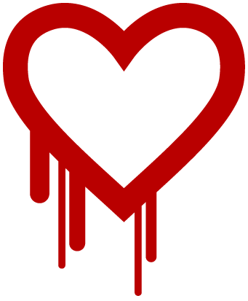
Empirical Security & Privacy, for Humans
UPenn CIS 7000-010
11/13/2025
The Matter of Heartbleed

Slide 2
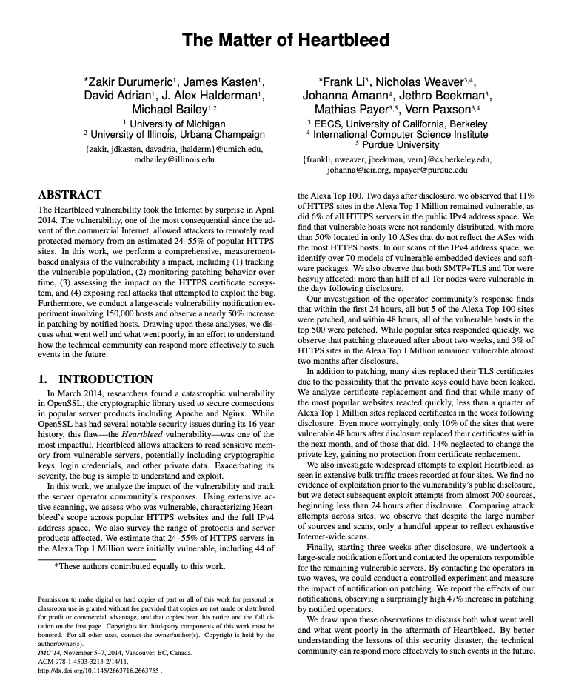
Reading

Slide 3
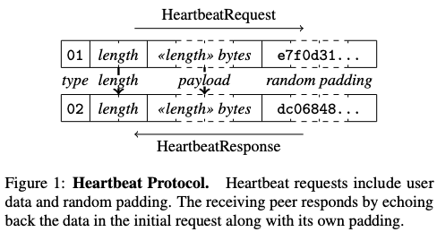
OpenSSL and the Heartbleed vulnerability
OpenSSL is a popular open-source cryptographic library, started in 1998, that implements the SSL and TLS protocols. Widely used.
Heartbeat: Server echoes back N bytes provided in the client packet, where N is the given length
Bug: Server trusts N! If N > actual packet size, server will read (“bleed”) and return its own memory
Risk: Bled memory could contain secrets like cryptographic keys
And: Easy to exploit the bug!

Slide 4
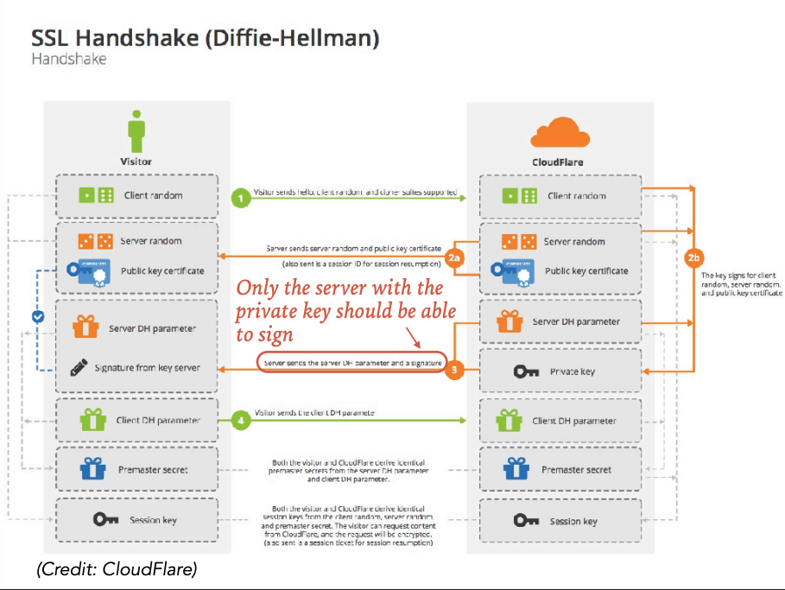
How are keys used with TLS?
Notes:
when a client first connects, the client and server complete a TLS handshake during which the server presents an X.509 digital certificate, which is used to help identify and authenticate the server to the client. This certificate includes the identity of the server (e.g. website domain), a temporal validity period, a public key, and a digital signature provided by a trusted third party. The client checks that the certificate’s identity matches the requested domain name, that the certificate is within its validity period, and that the digital signature of the certificate is valid. The certificate’s public key is then used by the client to share a session secret with the server in order to establish an end-to-end cryptographic channel.

Slide 5
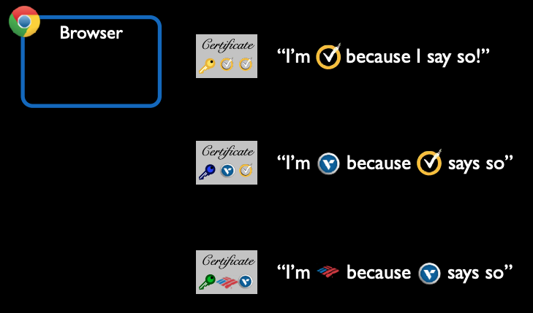
Verifying certificates
Certificates like these issued by Certificate Authorities (CAs)

Slide 6
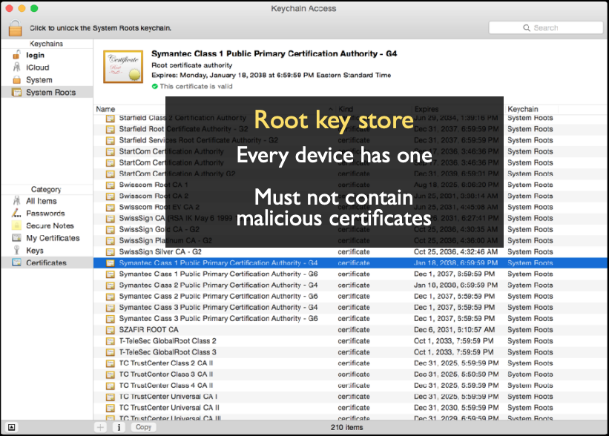
Verifying certificates
Certificate authorities included here

Slide 7
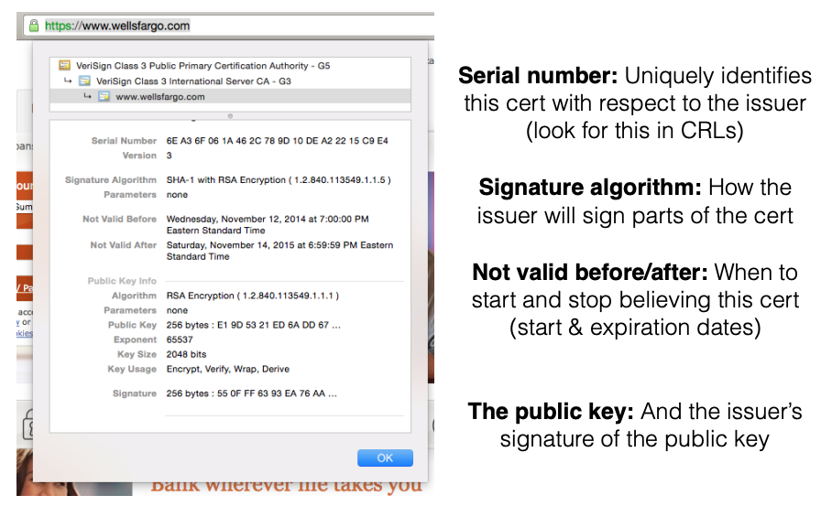
Verifying certificates
Notes:
This certificate includes the identity of the server (e.g. website domain), a temporal validity period, a public key, and a digital signature provided by a trusted third party.

Slide 8
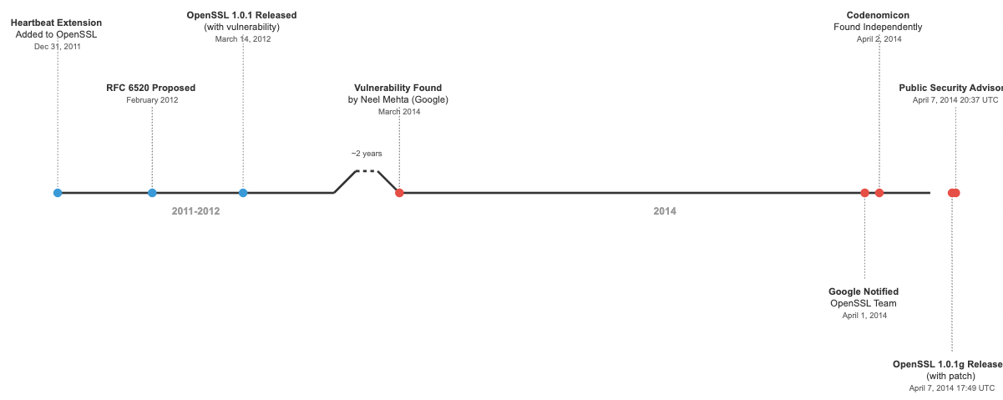
Heartbleed timeline

Slide 9
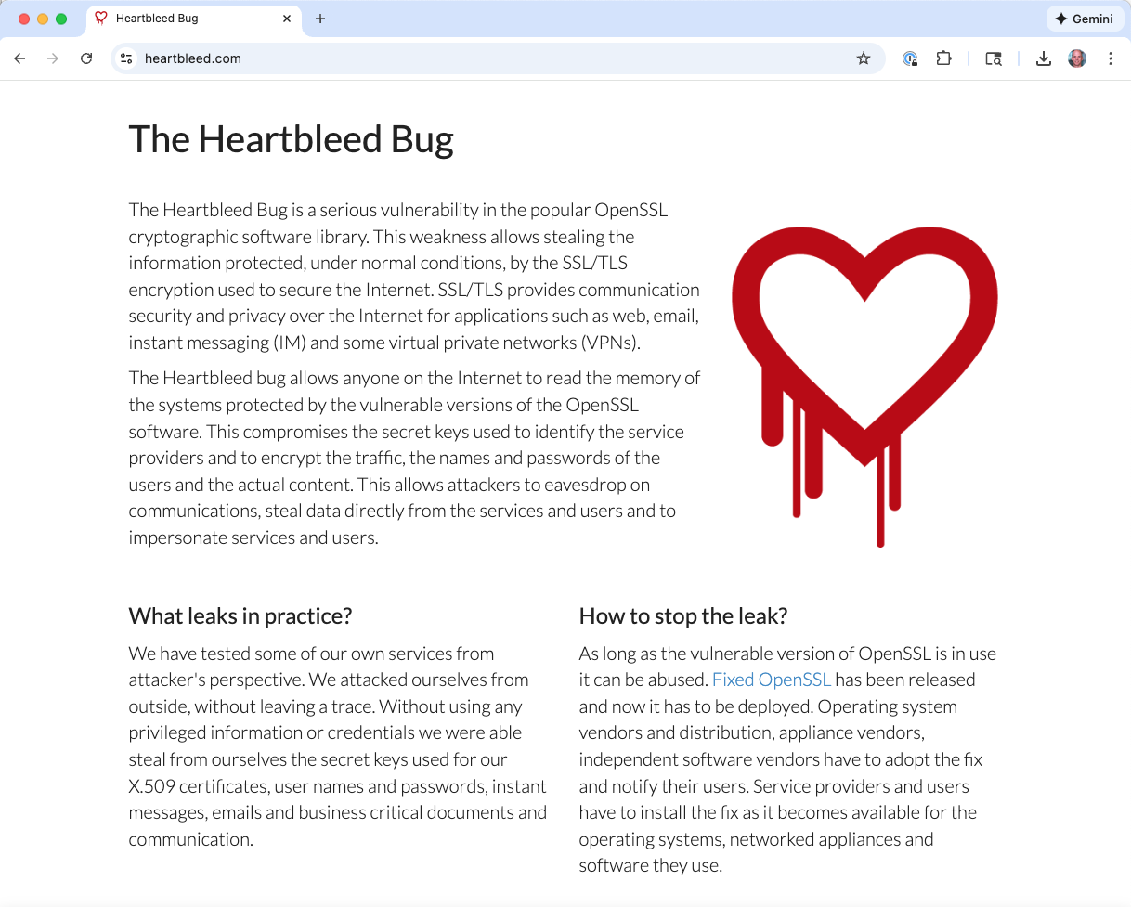
Recommended responses to Heartbleed
Patch the server
“Reissue” a new public key (get a new one and load it on your servers)
Revoke the old key
Notes:
Harder options to patching:
Could recompile without heartbeat extension, but that’s challenging
Could roll back to pre-March 2012 release
Could switch to different TLS software

Slide 10
So what happened?

Slide 11
Research questions
Which software was vulnerable?
Which sites were vulnerable?
When were they patched?
When were certificates replaced?
Was there evidence of attempted exploitation?
Did patching rates improve after a notification campaign?

Slide 12
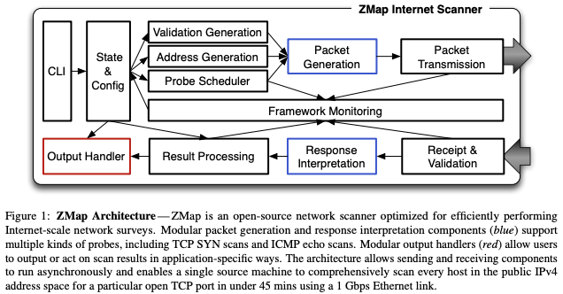
Primary method: ZMap scans
Durumeric, Wustrow, and Halderman: ZMap: Fast Internet-Wide Scanning and its Security Applications, USENIX Security 2013
Notes:
One mid-range machine running ZMap is capable of scanning for a given open port across the entire public IPv4 address space in under 45 minutes—over 97% of the theoretical maximum speed of gigabit Ethernet—without requiring specialized hardware or kernel modules. What what about NAT’ed devices?
No throttling: Assumes random scan so no worries about saturating links; assumes source host sufficiently provisioned. send probes as quickly as the source’s NIC can support, skipping the TCP/IP stack and generating Ethernet frames directly
No connection states, no retransmissions: Random scans using stateless protocols; no need for memory. Receiver of probes independent of sender.
Can do TCP SYN scans, ICMP echo request scans, and application-specific UDP scans, and it can interface easily with user-provided code to perform follow-up actions on discovered hosts.

Slide 13
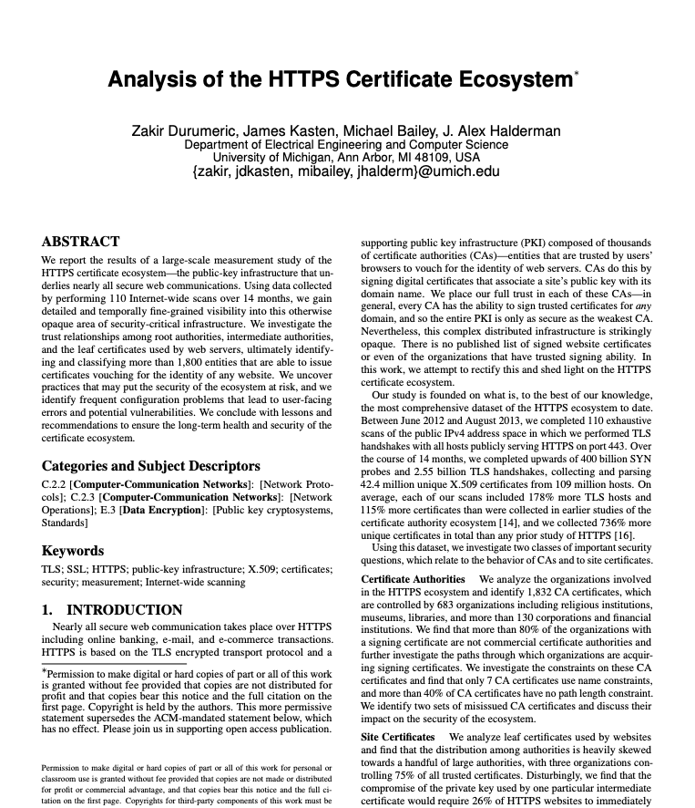
Primary method: ZMap scans
Durumeric, Wustrow, and Halderman: ZMap: Fast Internet-Wide Scanning and its Security Applications, USENIX Security 2013
Connect to host via TLS
Send Heartbeat message with size 0
If response received, then vulnerable
Notes:
Each scan consists of three stages: (1) discovering hosts with port 443 (HTTPS) open by enumerating the public address space, (2) completing a TLS handshake with responsive addresses and collecting the presented certificate chains, and (3) performing certificate parsing and validation.
Presumably the Heartbeat stuff comes after this; maybe it skips step (3) at first?

Slide 14
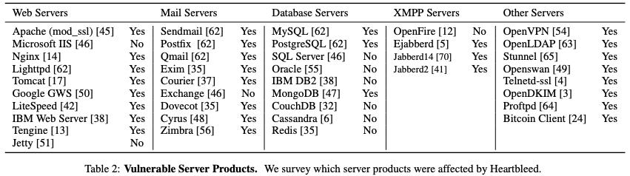
Which software was vulnerable?
Used TLS implemented by OpenSSL:

Slide 15
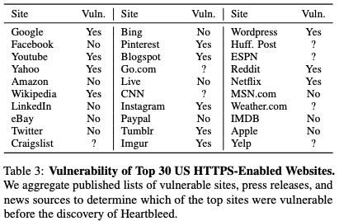
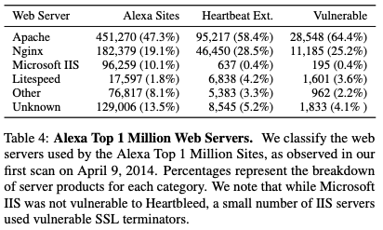
Which sites were vulnerable?
11.5% of HTTPS-enabled sites were vulnerable at their first scan. Between 24–55% of the Alexa Top 1 Million HTTPS websites vulnerable at the time of disclosure
All of the Alexa Top 100 websites were patched within 48 hours of disclosure—prior to the start of the authors’ scans
Notes:
Also: Surprisingly, 10 ASes accounted for over 50% of vulnerable HTTPS hosts but represented only 8.6% of all HTTPS hosts
Also impacted mail servers, bitcoin clients, tor servers & clients, and others, both software-based services and embedded devices.

Slide 16
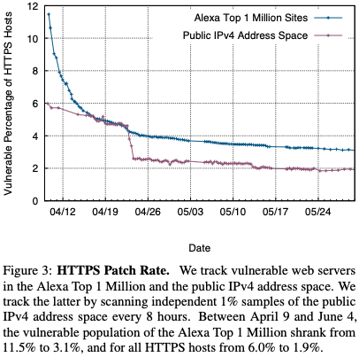
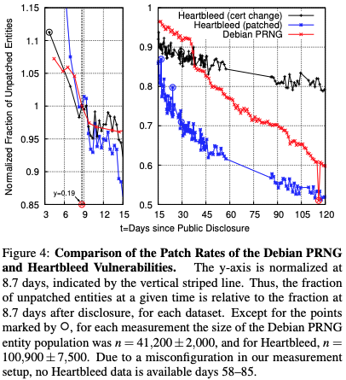
When were they patched?
Notes:
the patch rate quickly dropped after two weeks, with only a very modest decline between April 26 and June 4, 2014.
between April 22, 14:35 EDT and April 23, 14:35 EDT, during which the total number of vulnerable hosts fell by nearly a factor of two, from 4.6% to 2.6%. This dropoff occurred because several heavily affected ASes patched many of their systems within a short time frame.
--
2008, a bug was discovered in the Debian OpenSSL package, in which the generation of cryptographic keys had a severely limited source of entropy, reducing the space of possible keys to a few hundred thousand. The lack of entropy allowed attackers to fully enumerate the SSL and SSH keys generated on Debian systems, thus making it vital for Debian OpenSSL users to generate fresh replacement keys.
Some methodological challenges with the second chart: ‘do the comparison by framing the basic unit of “did an affected party respond” in terms of aggregate entities very likely controlled by the same party (and thus will update at the same time). … Heartbleed IPv4 dataset (labelled “patch”), we deem an entity as “fixed” if all servers presenting the same certificate are now no longer vulnerable’
Entities vulnerable to Heartbleed patched somewhat more quickly than in the Debian scenario. But

Slide 17
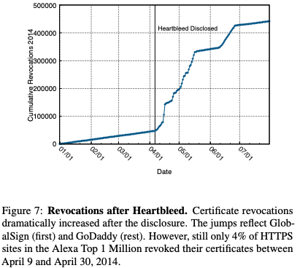
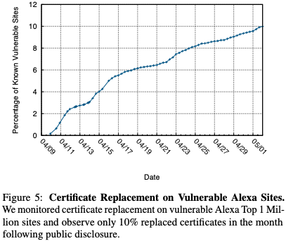
When were certificates reissued and revoked?
Notes:
23% of all HTTPS sites in the Alexa Top 1 Million replaced certificates and 4% revoked their certificates between April 9 and April 30, 2014.
When a certificate or key can no longer be trusted, sites can request the issuing CA to revoke the certificate. CAs accomplish this by publishing certificate revocation lists (CRLs) and supporting the Online Certificate Status Protocol (OCSP) for live queries.
Only 19% of the vulnerable sites that did replace their certificates also revoked the original certificate in the same time frame, and even more striking that 14% re-used the same private key, thus gaining no actual protection by the replacement.
Revoking such a large number of certificates burdens both clients and servers. Clients must download large CRLs, which CAs must host. GlobalSign’s CRL expanded the most, from 2 KB to 4.7 MB due to CloudFlare’s revocations.

Slide 18
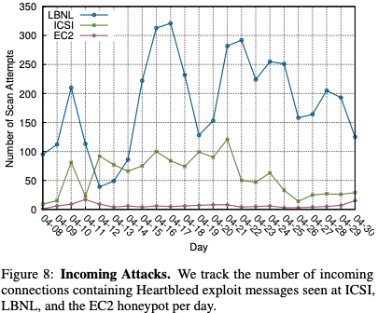
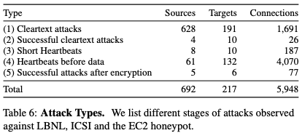
Was there evidence of attempted exploitation?
Notes:
examining network traffic collected from passive taps at Lawrence Berkeley National Laboratory (LBNL), the International Computer Science Institute (ICSI), and the National Energy Research Scientific Computing Center (NERSC), as well as a honeypot operated by a colleague on Amazon EC2. Extended the Bro’s SSL/TLS analyzer to recognize Heartbeat messages
No evidence of any exploit attempt up through April 7, 2014.
Detected vulnerability scans from potential attackers within 22 hours, and it is likely that popular sites were targeted before the onset of large, indiscriminate scans.
In total, we observed 5,948 attempts to exploit the vulnerability from 692 distinct hosts

Slide 19
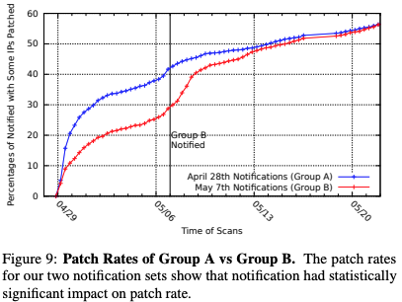
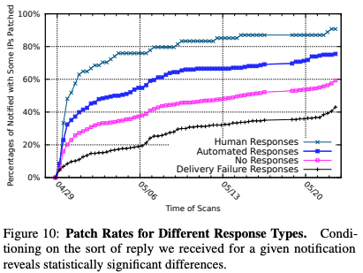
Did patching rates improve after notification?
Notes:
we performed WHOIS lookups for the IP address of each vulnerable host appearing in our April 24, 2014 scan of the full IPv4 address space. We used the “abuse” e-mail contact extracted from each WHOIS record as our point of notification.
remaining 212,805 hosts corresponded to 4,648 distinct abuse contacts. Excluded 30x Amazon hosts.
We sent notifications to the first half (Group A) on April 28, 2014, and the second half (Group B) on May 7, 2014.
We conducted regular scans of the known vulnerable hosts every eight hours.
We did, however, find statistically significant differences between each of the categories of responses
Survey responses: When we asked why might the hosts we detected still be vulnerable, the most common responses were that they did not have direct control over those servers, or their own scans must have missed those hosts. It appears ignorance of the vulnerability and its threat did not play a factor in slow patching

Slide 20
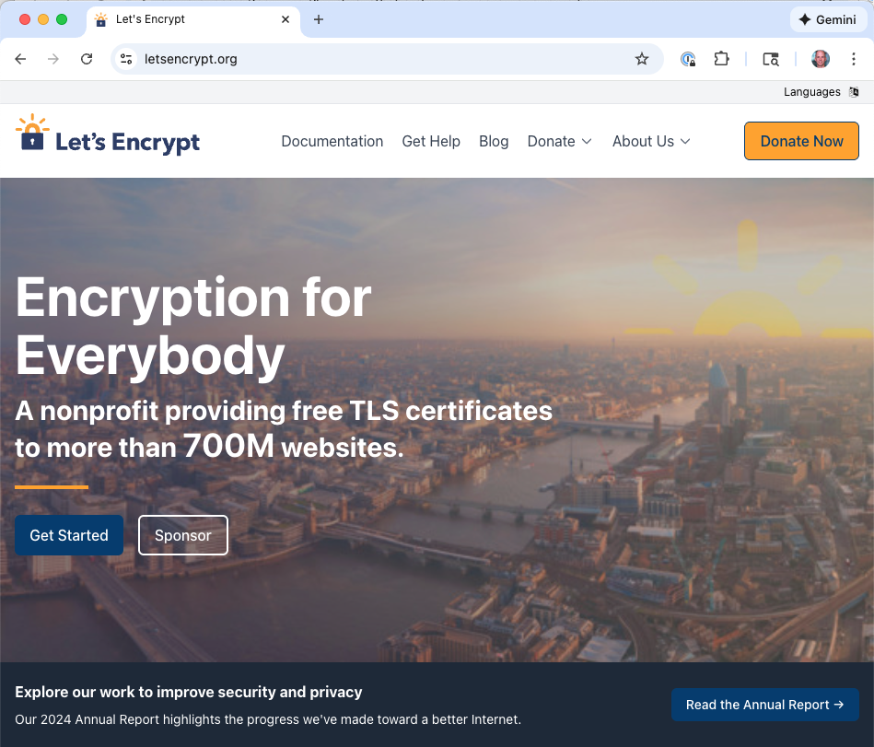
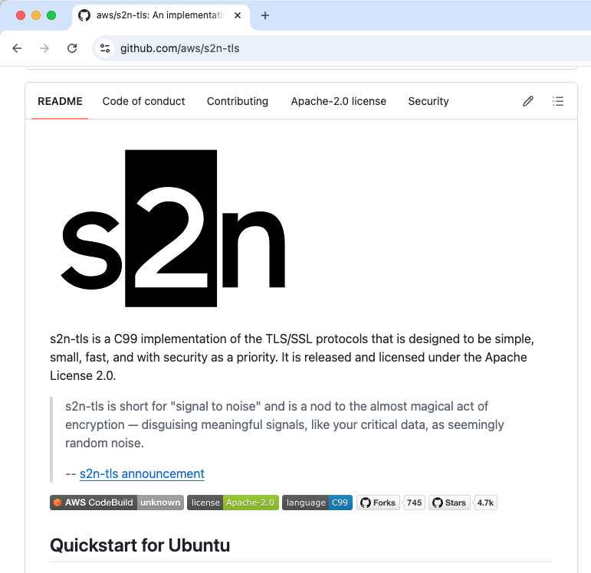
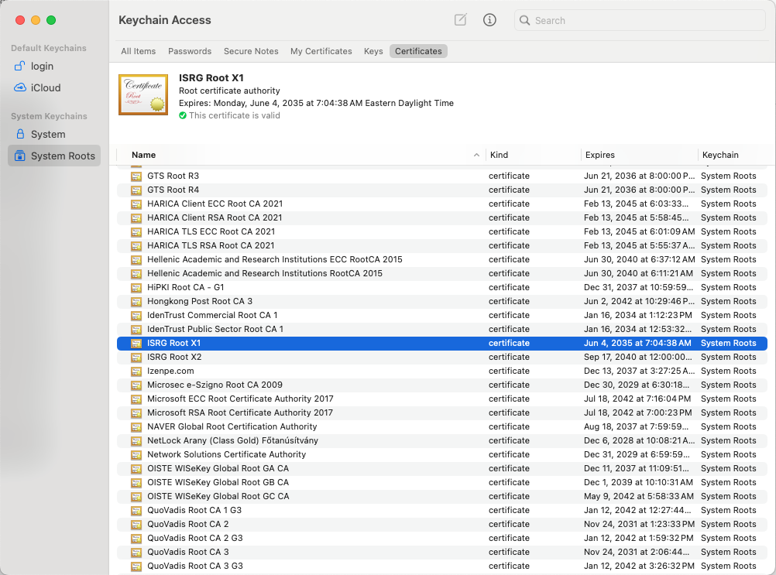
Notes
Forward secrecy: Heartbleed highlights its importance
But: only 44% of the connections observed by the ICSI Notary in May 2014 used it
Then, certificate management mostly manual
Today: Let’s Encrypt!
Then: Only 45% of Alexa top 1M used HTTPS
In 2019: 71.67% (couldn’t find more recent)
OpenSSL = common point of trust
E.g., galvanized AWS’ s2n TLS implementation
Whole affair highlighted the need for a robust notification system

Slide 21
Discussion
What do you think about the outcomes of this study?
Have learned something worthwhile?
Did the study, along with the event, precipitate positive change?
What do you think about the methodology of the study?
Are the methods sound (enough)?
Is this the way Internet-wide assessments are best done?
What other sorts of questions might we have liked the answers to?

