Slide 1


Empirical Security & Privacy, for Humans
UPenn CIS 7000-010
10/23/2025
The Economics of Information
Security Investment

Slide 2
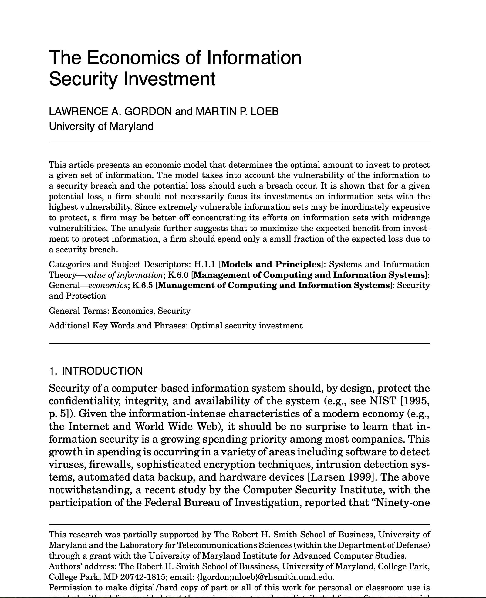
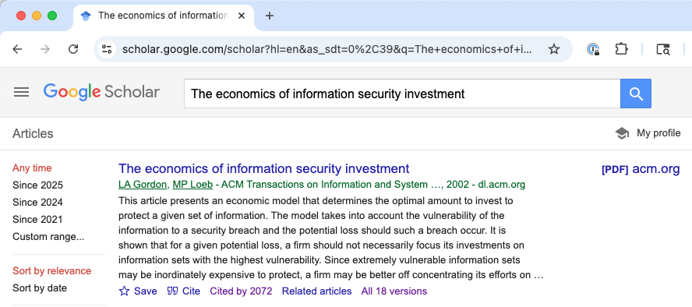
Reading
Highly influential: Cited > 2000 times

Slide 3
Model parameters
One-period model: No game theory
Assumes defender is risk-neutral
Core parameters
λ | Monetary loss of a breach
t ∈ [0, 1] | Threat: probability of an attack
v ∈ [0, 1] | Vulnerability: baseline probability an attack is successful
Shorthands, bounds
Security investments
vtλ | Expected loss
L = tλ | Potential loss
M > λ | Catastrophic loss
z > 0 | Security investment
S(z, v) | Security breach prob. function: effective vulnerability starting from v, given an investment z

Slide 4
Security breach prob. function requirements
Security investments
z > 0 | Security investment
S(z, v) | Security breach prob. function: effective vulnerability starting from v, given an investment z
A1: S(z, 0)=0 for all z
A2: For all v, S(0, v) = v
A3: For all v ∈ (0, 1), and all z, S_{z}(z, v) < 0 and S_{zz}(z, v) > 0
I.e., as the investment in security increases, the information is made more secure, but at a decreasing rate
Assume for all v ∈ (0, 1), lim S(z, v) → 0, as z → ∞

Slide 5
Optimizing investment
Security investments
z > 0 | Security investment
S(z, v) | Security breach prob. function: effective vulnerability starting from v, given an investment z
EBIS(z) = [v−S(z, v)] L | Expected benefits of an investment
ENBIS(z) = EBIS(z) − z | Expected net benefits of an investment
z* = argmax ENBIS(z) | Optimal investment

Slide 6
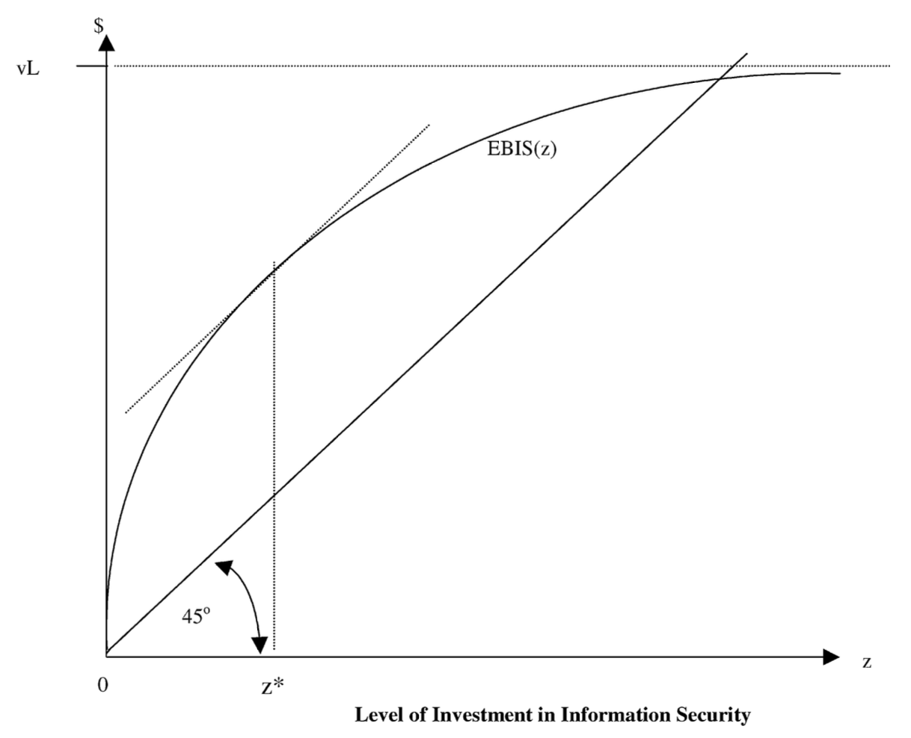

Benefits vs. cost of investment
= EBIS(z)
– z
z* = argmax ENBIS(z)
= [v−S(z, v)] L – z
= z where –S_{z}(z,v)L = 1
since ENBIS is strictly concave in z
= 0 when
Notes:
The optimal investment, z∗, is where the difference between benefits and costs are maximized, and at that point the tangent to EBIS(z∗), has a slope, representing the marginal benefits, equal to the marginal cost of one.
The optimal level of investment in information security equals zero if the marginal benefits at z =0 are less than or equal to the marginal costs of such investment.

Slide 7
Modeling scenarios
Who
Cloud provider
Hospital
Bank
Local government
Retailer
University
…
Resource
Computing / storage
Company’s sensitive data
Customers’ sensitive data
Security investment
MFA, passkeys
IDS or A/V
Pen testing
…
When might we have different vulnerability, and a different form of investment, for different resources?

Slide 8
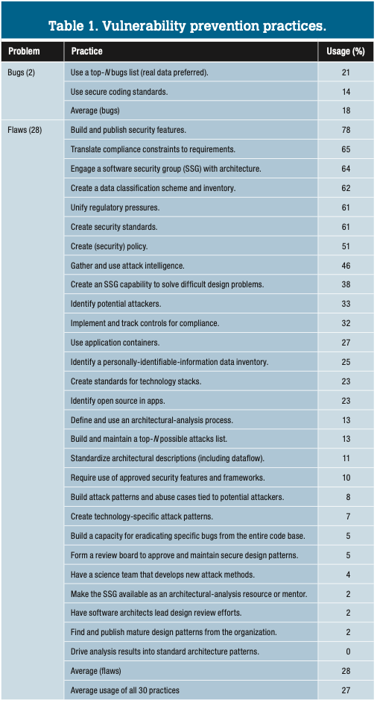
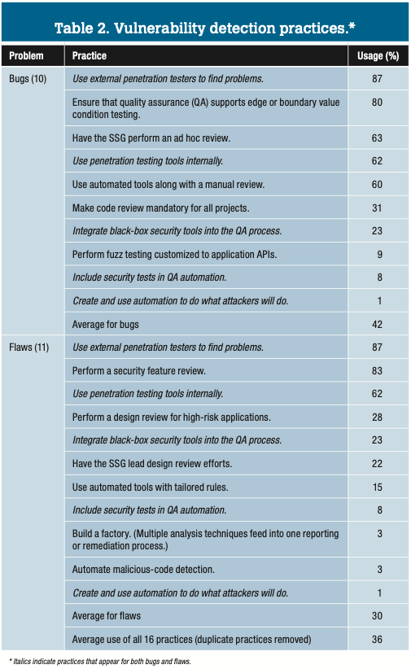
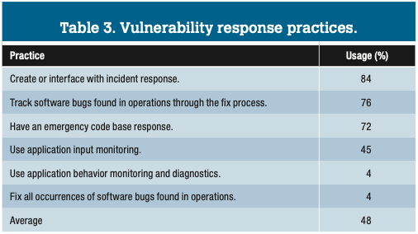
Possible investments: BSIMM8
7 prevention practices are used by more than half the firms; more motivated by compliance than impact? Could firms better use their SSG for for prevention?
Pen testing, external and internal, extremely popular
In general, more activities followed for detection rather than prevention – implies reactive rather than proactive security?
For response, few firms use app behavior monitoring – missed opportunity?

Slide 9
Function S(z,v): how to interpret it?
A3: For all v ∈ (0, 1), and all z, S_{z}(z, v) < 0 and S_{zz}(z, v) > 0
I.e., as the investment in security increases, the information is made more secure, but at a decreasing rate
Assume for all v ∈ (0, 1), lim S(z, v) → 0, as z → ∞
Consider scenarios outlined above; which of them look like this?
Fixed investment cost (no incremental fixed costs)
Continuous reduction in vulnerability with investment cost increase
Can you imagine a “lumpy” cost function instead? What other shapes?

Slide 10
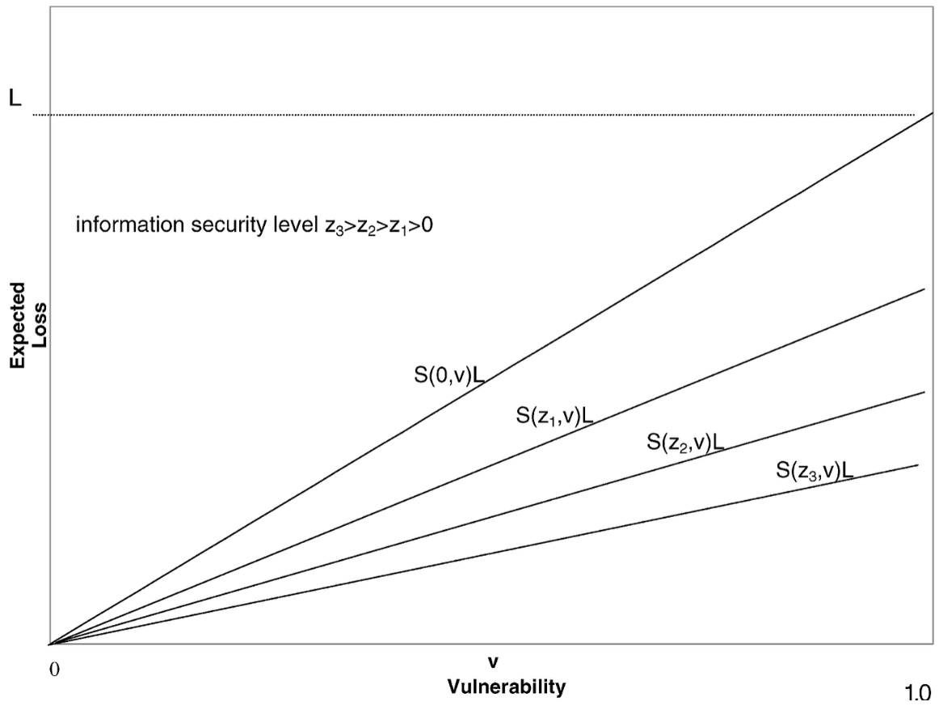
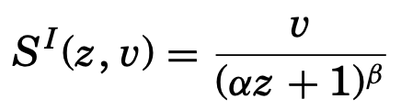
S: class I

Slide 11
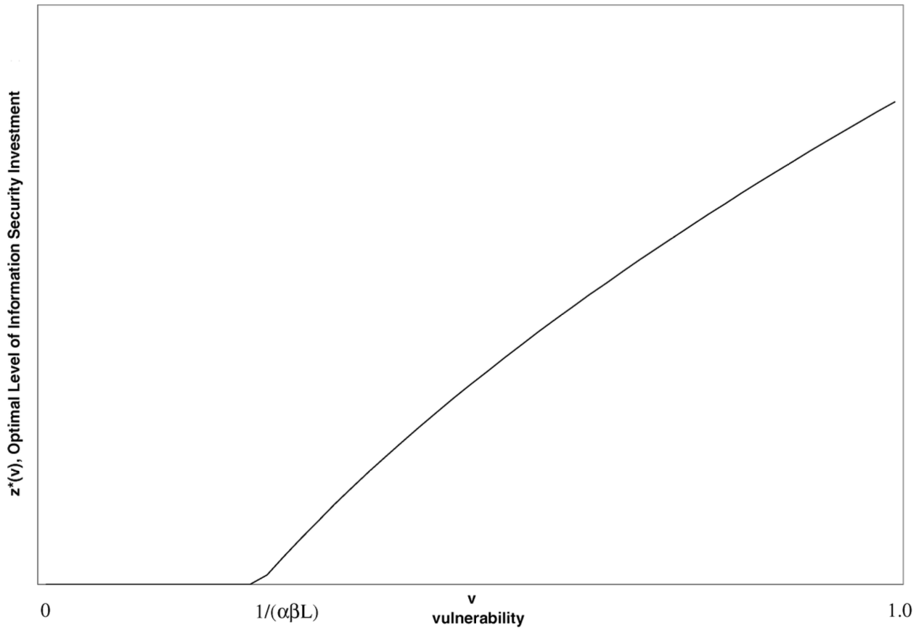
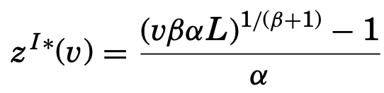
Optimal value of investment, class I
No investment
Notes:
Must assume a ≠ 0 and b ≠ -1
–S_{z}(z,v)L = 1
- (d/dz (v * (az + 1)^b))L = 1
- (-abv / (az + 1)^(b+1)) L = 1 (take derivative)
abvL = (az + 1)^(b+1) (take b+1th root of both sides)
(abvL)^(1/(b+1)) = az + 1
(abvL)^(1/(b+1)) - 1 = az
so
z = ((abvL)^(1/(b+1)) – 1) / a

Slide 12
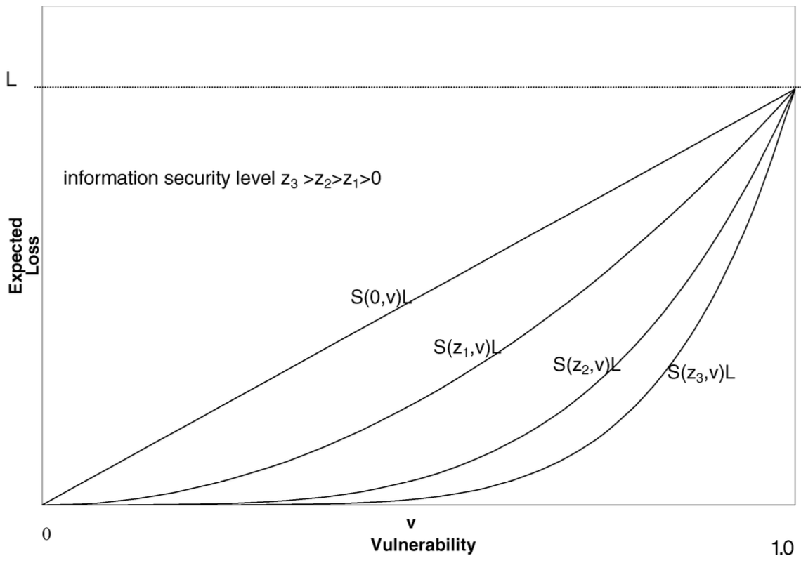

S: class II
Notes:
These functions are strictly concave (for α>0).

Slide 13
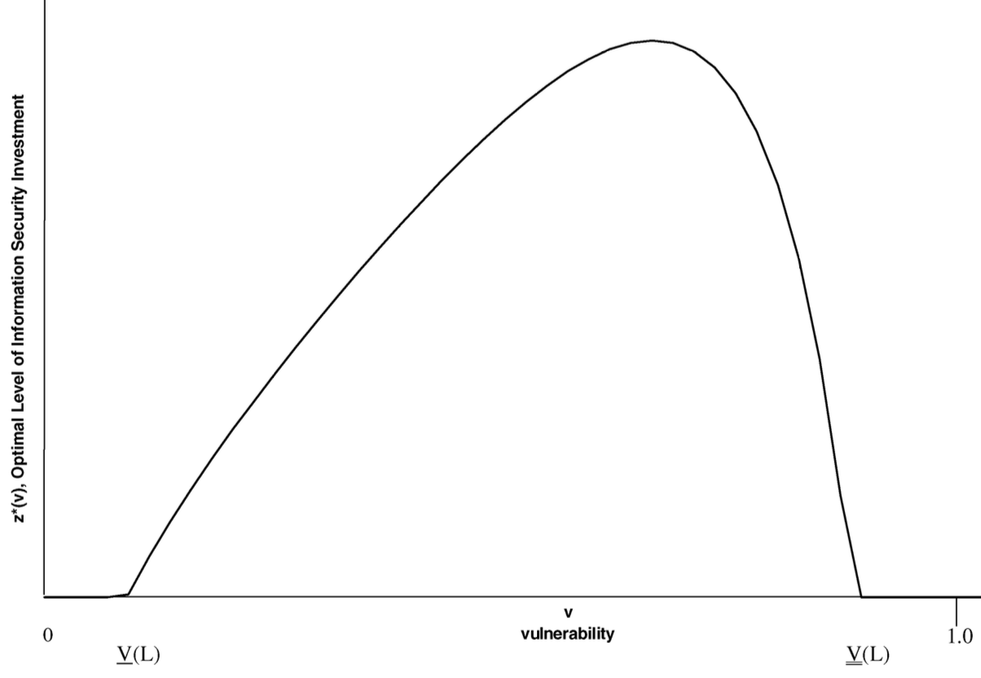
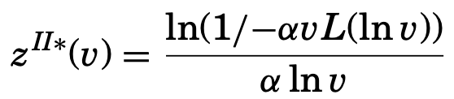
Optimal value of investment, class II
Optimal level of investment does not weakly increase as vulnerability increases
No inv
No inv
Notes:
–S_{z}(z,v)L = 1
- (d/dz v^(az+1))L = 1
I asked Claude code to solve this and I didn’t get the same answer as above
Thus: For the second class of security breach probability functions, the area of zero investment, for a given L, should be two tailed rather
than one tailed.
the marginal benefit from investment in information security for low vulnerability information sets does not justify the investment since the security of such information is already good.

Slide 14
Some takeaways
The key in analyzing information security decisions is not the vulnerability v (or the expected loss without the investment vL), but the reduction in expected loss [v-S(z,v)]L with the investment z
The optimal investment amount z* could be well below the expected loss vL
Theorem: If the breach probability function S(z,v) is either of class I or class II, then z∗ < (1/e) vL = .3679vL
For class I, there are scenarios where z* < .25vL
What does this mean for our modeled scenarios?

Slide 15
Discussion
Do you think CISOs use the 37% rule in practice?
Beyond what we’ve already discussed, what are limitations of this model?
What about one company’s security affecting another (hello, AWS outage on Monday …)?
What improvements might you want to make to the model, to get to the point that you could use it for decisionmaking?
How does it relate to the Simpson uncertainty paper?
How might the results change if the model considered time, e.g., ongoing attacks over time, instead of just one period?
Notes:
Seems like t is really not needed. Just use L.

