Slide 1


Secure Systems Engineering and Management
A Data-driven Approach
Michael Hicks
Threat Modeling
UPenn CIS 7000-003
Spring 2026

Slide 2
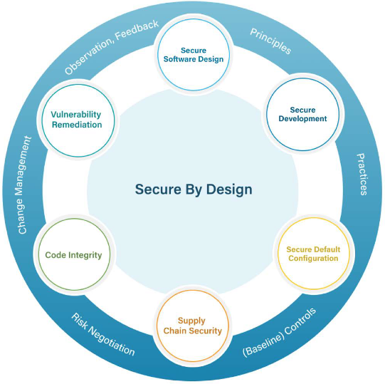
Six Considerations: Overview
Threat modeling and secure architecture design
Secure Software Design
Secure Development
Secure Default Configuration
Supply Chain Security
Code Integrity
Vulnerability Remediation

Slide 3
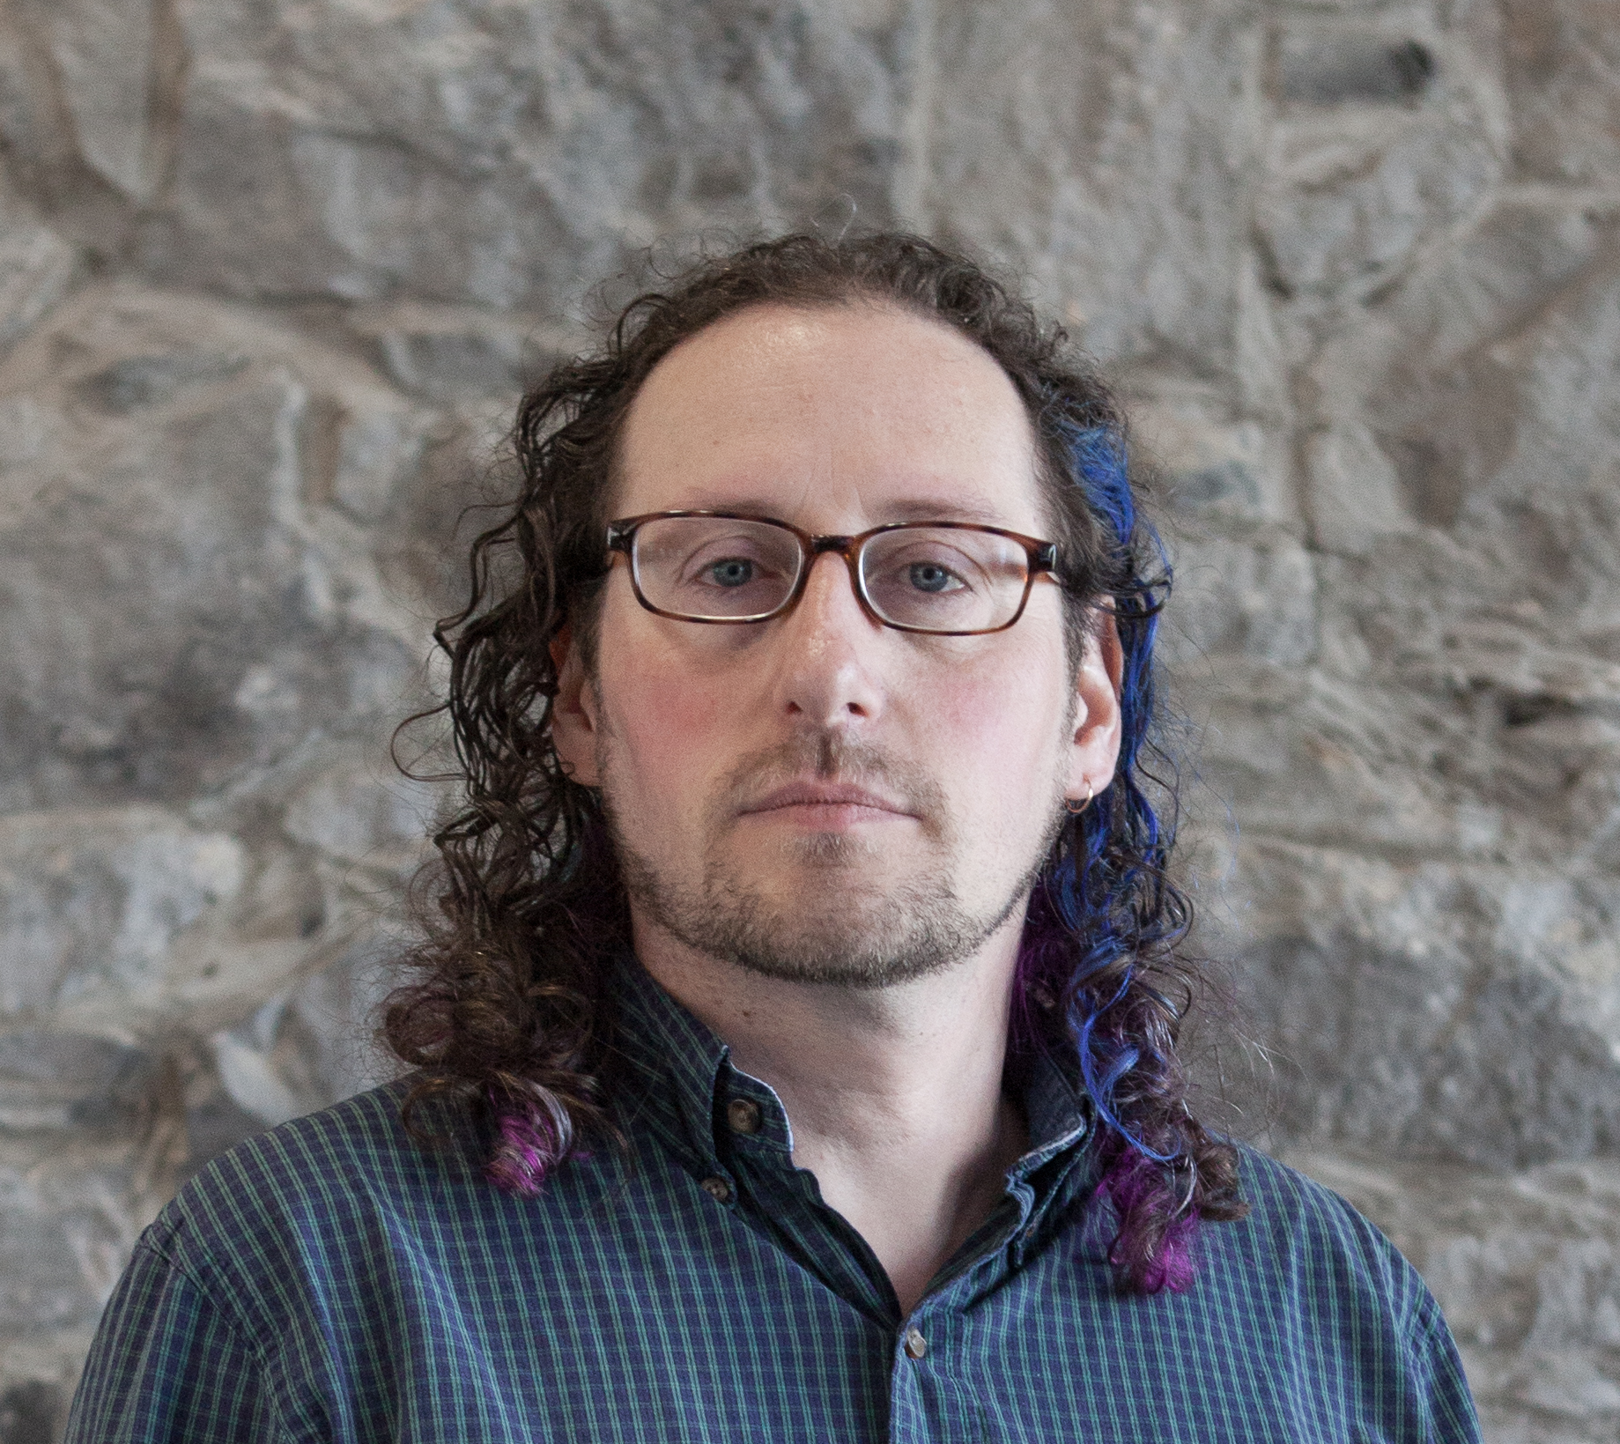
Why Threat Modeling?
Secure design requires systematically identifying threats
Not just intuition or experience – a structured, repeatable process
Asking “What could go wrong?” before writing code
“Threat modeling is a family of structured, repeatable processes that allow you to make rational decisions to secure applications, software, and systems.”
– Adam Shostack
Notes:
Transition from the Secure by Design lecture: “We ended by saying that secure design requires systematically identifying threats. But what does ‘systematically’ actually mean? It means we need a process – not just intuition, not just experience, but a structured, repeatable way to ask: what could go wrong?”
SAFECode defines the aim as: “to identify and eliminate design issues: to identify security weaknesses or arrive at a set of security needs that must be built.”
Key emphasis: the output is actionable – security requirements, not just a list of fears.
Threat modeling vs. risk management (Shostack): threat modeling identifies what can go wrong; risk management addresses trade-off decisions and response strategies. They are complementary but distinct.
SAFECode (2017) calls threat modeling “one of the best ‘return on investment’ activities with respect to identifying and addressing design flaws before their implementation into code.”
Historical note: The 1999 Kohnfelder & Garg paper at Microsoft introduced STRIDE and recommended all product teams adopt it during design. Nearly 27 years later, it remains the most widely used threat classification framework – a testament to its practicality.

Slide 4
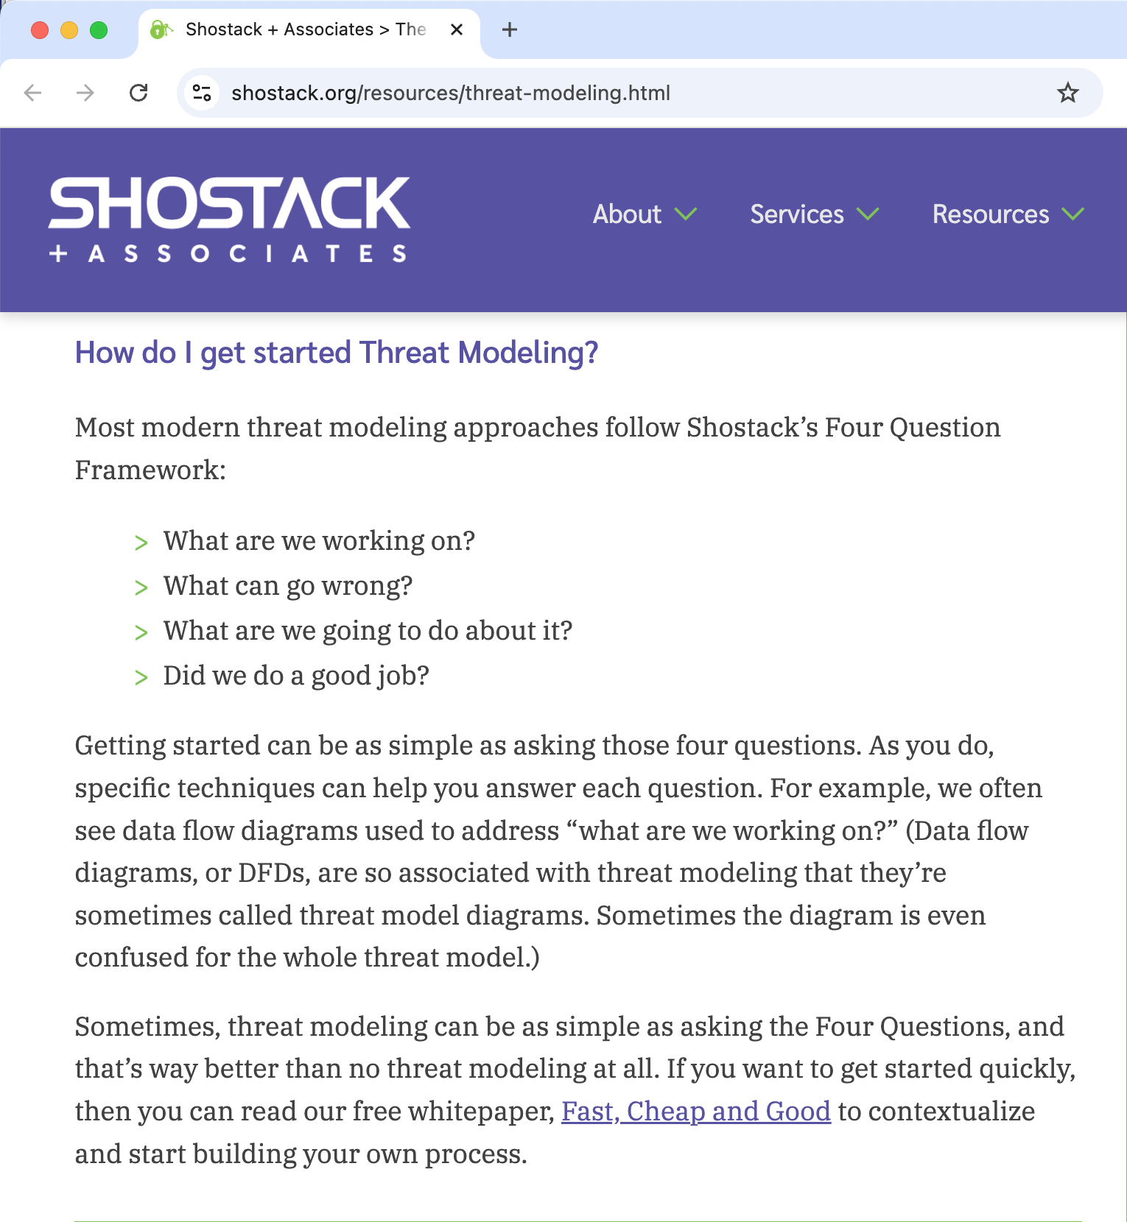
The Four Questions of Threat Modeling
Shostack’s four-question framework
What are we working on? Describe the system
What can go wrong? Identify threats
What are we going to do about it? Mitigate, accept, transfer, eliminate
Did we do a good job? Validate the analysis

Slide 5
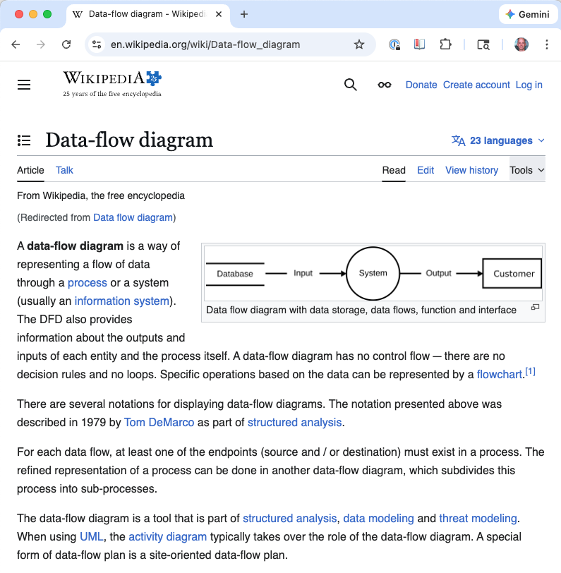
What are we working on? Data Flow Diagrams
Depicts the flow of data (indirectly: control) in a system
For threat modeling –
Level 0 diagram identifies the system and external entities that interact with it
Level 1 diagram further identifies system components and flows between them

Slide 6
What are we working on? Data Flow Diagrams
Trust boundary
Threat
Process
External entity
msg
msg
Storage
resp
resp
Threat
Threat
(threats part of step 2)
Notes:
You cannot find threats in a system you don’t understand. The description must be accurate enough to reason about security, but it doesn’t need to be exhaustive.
SAFECode: the description can range from “drawings on the back of an envelope to specification documents” – but it must accurately depict the system.
DFDs are the standard visual tool for threat modeling. The trust boundary is the critical addition beyond standard DFDs – wherever the level of trust changes, we draw a dashed line. These boundaries are where we should be especially suspicious, because data crossing a trust boundary may not be trustworthy.
DFDs are the most common format, but architecture diagrams, sequence diagrams, and even informal sketches can work. The SAFECode paper emphasizes that the format matters less than the accuracy and completeness of the representation.

Slide 7
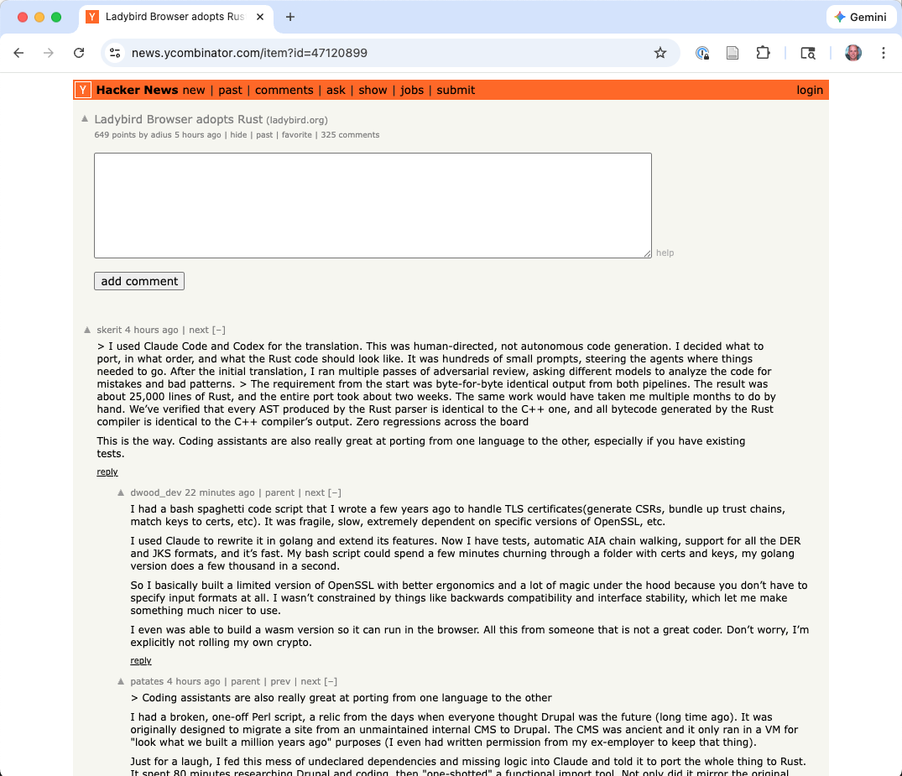
Example DFD: Web Feedback System
Adaptation of SAFECode paper’s Figure 2
Tampering (LDAP injection)
Elevation of privilege
Authn / authz provider
Verify privilege
LDAP
Verified
Verified
Auth?
Tampering (SQL injection)
Spoofing
Process
login
External entity
SQL Insert
Browser client
leave comments
Storage
Web app
SQL DB
send credentials
Success
/ comments saved
Spoofing
Notes:
This is adapted from the SAFECode paper’s Figure 2. Walk through the elements:
The Browser Client is an external entity
The Web Application is a process that handles user requests
The SQL Database and LDAP are data stores
Trust boundaries separate the browser from the server, and the server from the database tier
Threats have been annotated at specific points: Spoofing at the browser and web app, Tampering at the database, Elevation of Privilege at the authorization provider
Note how the DFD makes the system’s structure visible and highlights where trust changes occur. This is what makes threats identifiable.

Slide 8
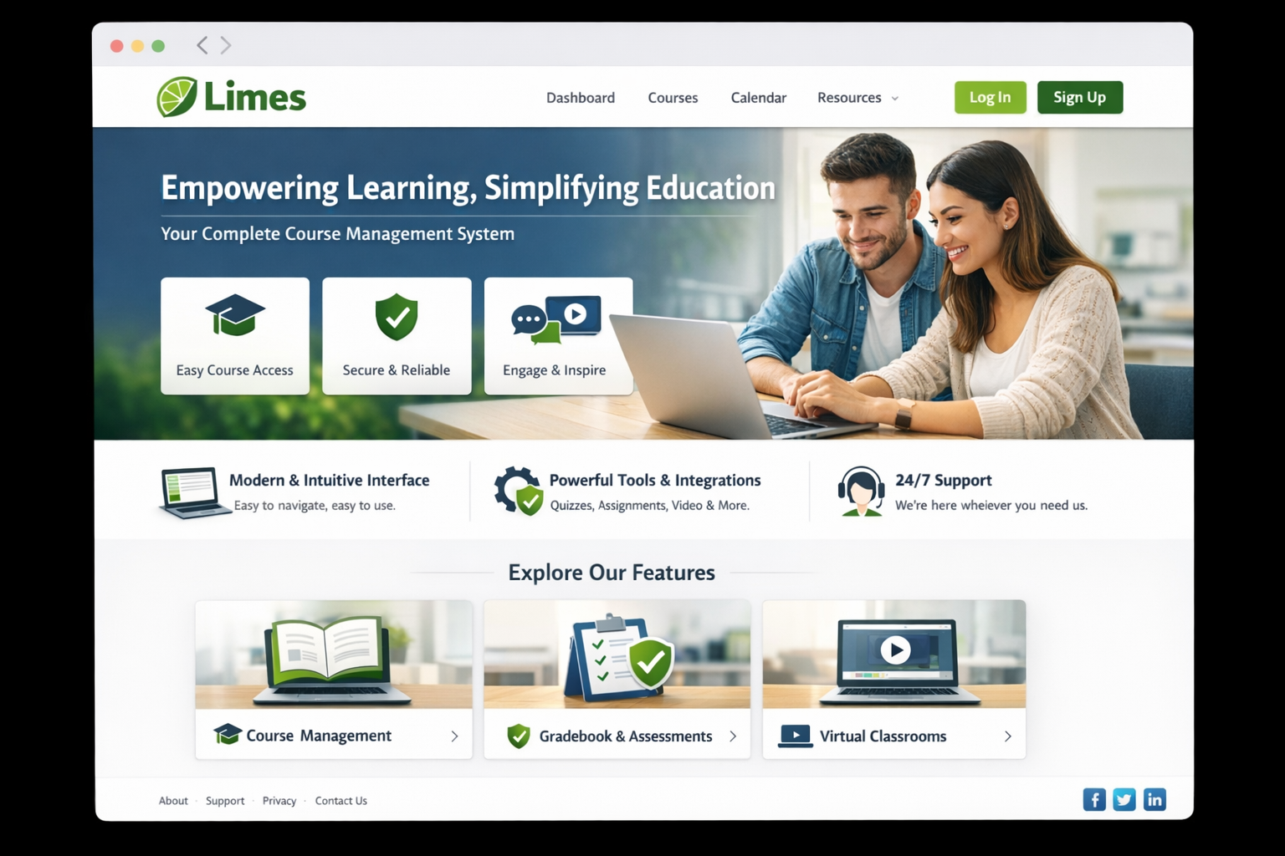
Recall Our Running Example: Limes
A university course management system (Canvas, Blackboard, …)
Users: Students, TAs, instructors, admins
Data: Grades, submissions, personal records (FERPA)
Features: File upload, discussion forums, quizzes, video integration
Integrations: SSO, plagiarism detection, LTI plugins, email
Notes:
Point out the richness of the security surface:
Confidentiality: student records, grades, FERPA compliance
Integrity: grades and submissions must not be tampered with
Availability: must be up during registration, midterms, finals
Multiple trust levels: a student shouldn’t see another student’s grades; a TA for one section shouldn’t see another section’s data
Third-party code everywhere: LTI plugins, video conferencing SDKs, plagiarism APIs
File handling: students upload assignments, instructors upload materials – file upload is a classic attack vector
This is a system complex enough to illustrate every concept we’ll cover, but familiar enough that students can reason about it immediately.

Slide 9
DFD: CMS Assignment Submission (Level 0)
Student browser
view grades / submit assignment
Process
Instructor browser
grade submission
Email
send notif.
Web app
Notes:
Walk through the elements: “The student is an external entity. Their request crosses a trust boundary – the internet – and reaches the web application process. The instructor is another external entity with different privileges. Each dashed line is a trust boundary – a place where we should be especially suspicious.”

Slide 10
DFD: CMS Assignment Submission (Level 1)
Authn provider
verify creds
User session store
Student browser
view grades / submit assignment
authn?
store/retrieve files
File Storage
Process
Instructor browser
grade submission
r/w grades
Grades DB
Web app
Not. svc
Email
send notif.
Notes:
Now we expand the CMS single process into components:
Student Browser and Instructor Browser on the left, outside the Internet trust boundary
Web Application in the center, connected to Auth Service
Grades DB, File Storage, User/Session Store on the right, behind the App Server / DB trust boundary
Notification Service connects to Student Email (external entity)
This is our running example. We’ll apply STRIDE to it next.

Slide 11
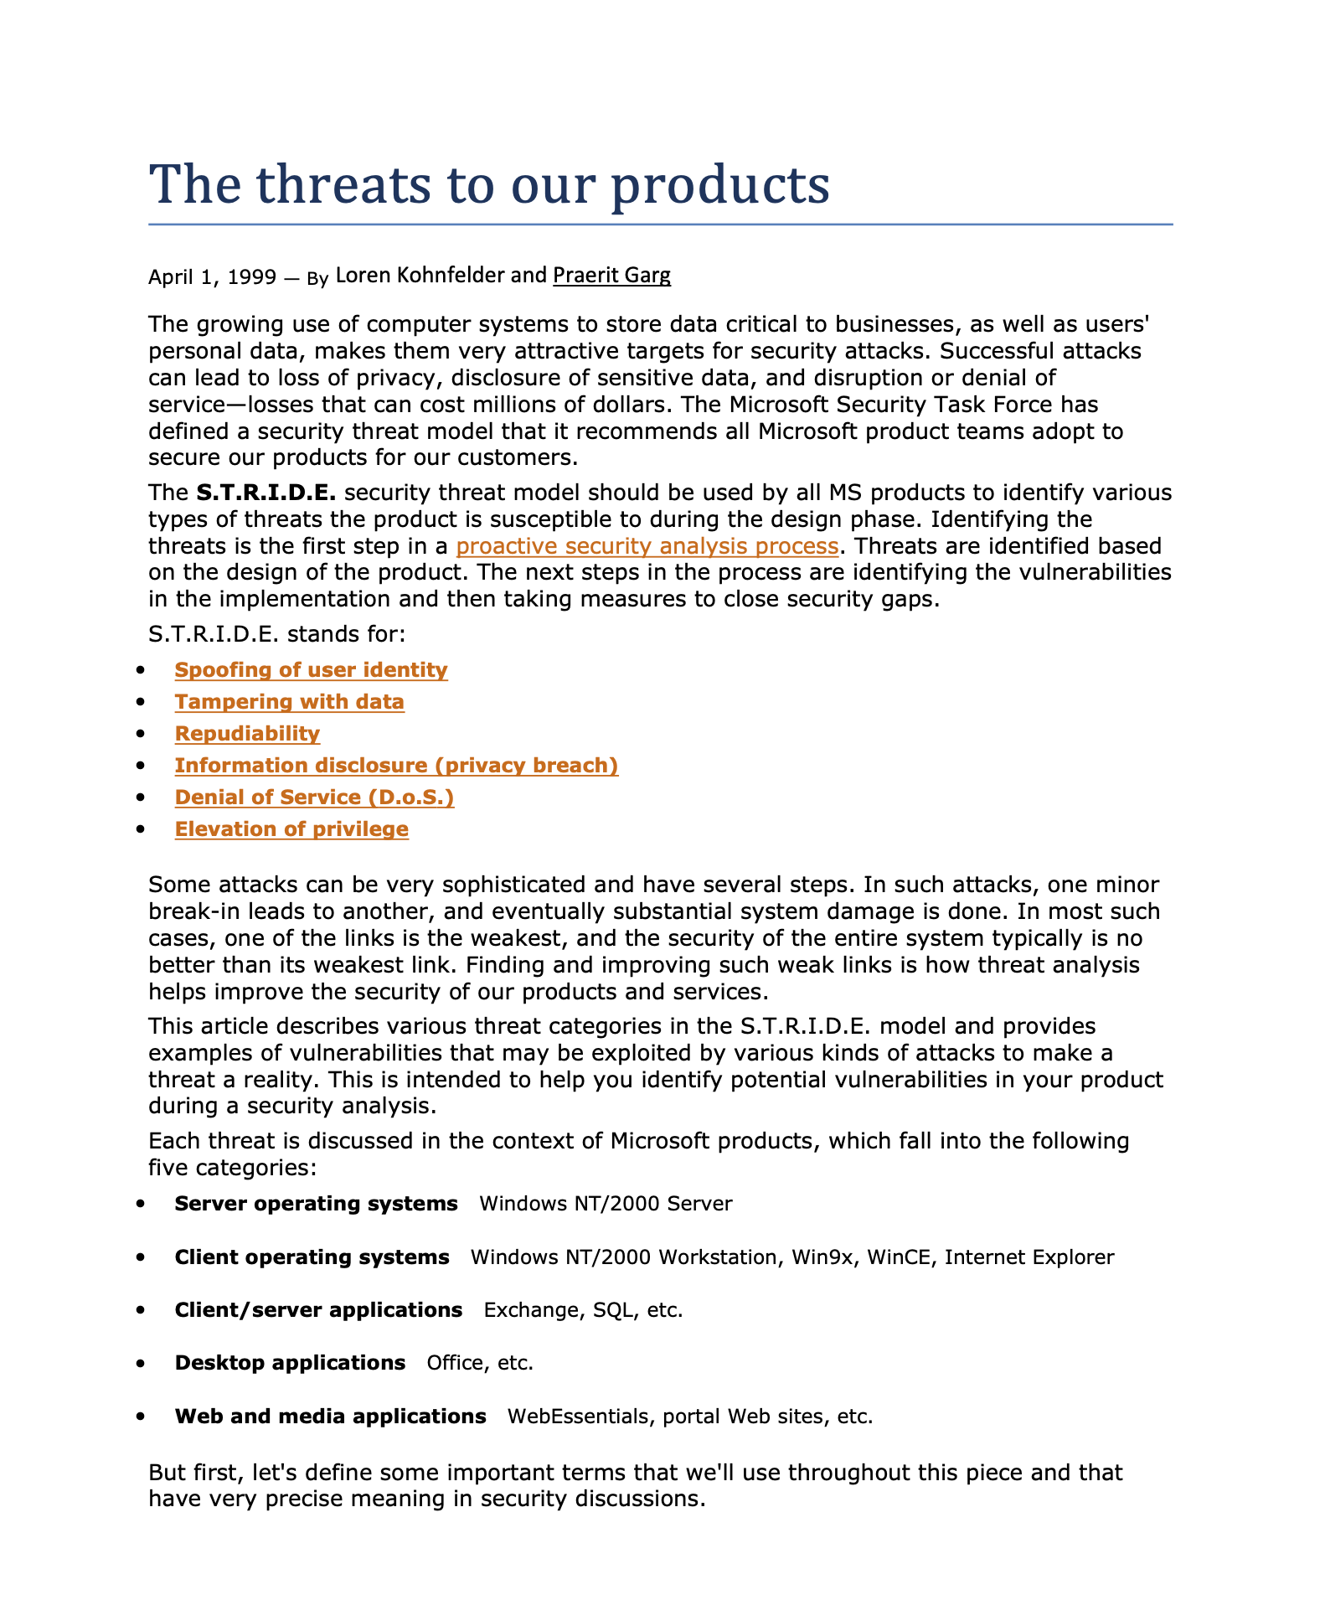
What can go wrong?
Want to identify possible threats systematically
1999 paper: Identified the STRIDE approach to threat modeling
For each element or data flow in the DFD, you ask a set of questions

Slide 12
STRIDE: A Systematic Way to Find Threats
Threat | Violates | Ask yourself…
Spoofing | Authentication | Can someone pretend to be another user or system?
Tampering | Integrity | Can data be modified without detection?
Repudiation | Non-repudiation | Can someone deny performing an action?
Information Disclosure | Confidentiality | Can unauthorized parties access data?
Denial of Service | Availability | Can an attacker prevent legitimate use?
Elevation of Privilege | Authorization | Can someone gain permissions they shouldn’t have?
Notes:
From the original 1999 Kohnfelder & Garg paper at Microsoft: these categories were chosen because they map directly to security properties, giving each threat a concrete defensive goal.
STRIDE is systematic: for each element or data flow in the DFD, you ask all six questions. This means no threat category is “obvious” – you check every one.
The key insight is the mapping to security properties: if you know the threat category, you know what defense to build. Spoofing -> strengthen authentication. Tampering -> strengthen integrity checks. And so on.
Complementary approaches exist: - Kill chains (attacker progression: delivery -> exploitation -> persistence -> objective) - LINDDUN (privacy-focused variant – useful when FERPA/GDPR is a concern) - Threat libraries / Top-X lists (OWASP Top 10, CWE Top 25)
SAFECode’s key point: “there is not one single perfect way” – choose what’s repeatable, manageable, and finds threats. STRIDE is a good default because it’s systematic and comprehensive.

Slide 13
STRIDE: A Systematic Way to Find Threats
Threat | Violates | Ask yourself…
Spoofing | Authentication | Can someone pretend to be another user or system?
Tampering | Integrity | Can data be modified without detection?
Repudiation | Non-repudiation | Can someone deny performing an action?
Information Disclosure | Confidentiality | Can unauthorized parties access data?
Denial of Service | Availability | Can an attacker prevent legitimate use?
Elevation of Privilege | Authorization | Can someone gain permissions they shouldn’t have?
Notes:
From the original 1999 Kohnfelder & Garg paper at Microsoft: these categories were chosen because they map directly to security properties, giving each threat a concrete defensive goal.
STRIDE is systematic: for each element or data flow in the DFD, you ask all six questions. This means no threat category is “obvious” – you check every one.
The key insight is the mapping to security properties: if you know the threat category, you know what defense to build. Spoofing -> strengthen authentication. Tampering -> strengthen integrity checks. And so on.
Complementary approaches exist: - Kill chains (attacker progression: delivery -> exploitation -> persistence -> objective) - LINDDUN (privacy-focused variant – useful when FERPA/GDPR is a concern) - Threat libraries / Top-X lists (OWASP Top 10, CWE Top 25)
SAFECode’s key point: “there is not one single perfect way” – choose what’s repeatable, manageable, and finds threats. STRIDE is a good default because it’s systematic and comprehensive.

Slide 14
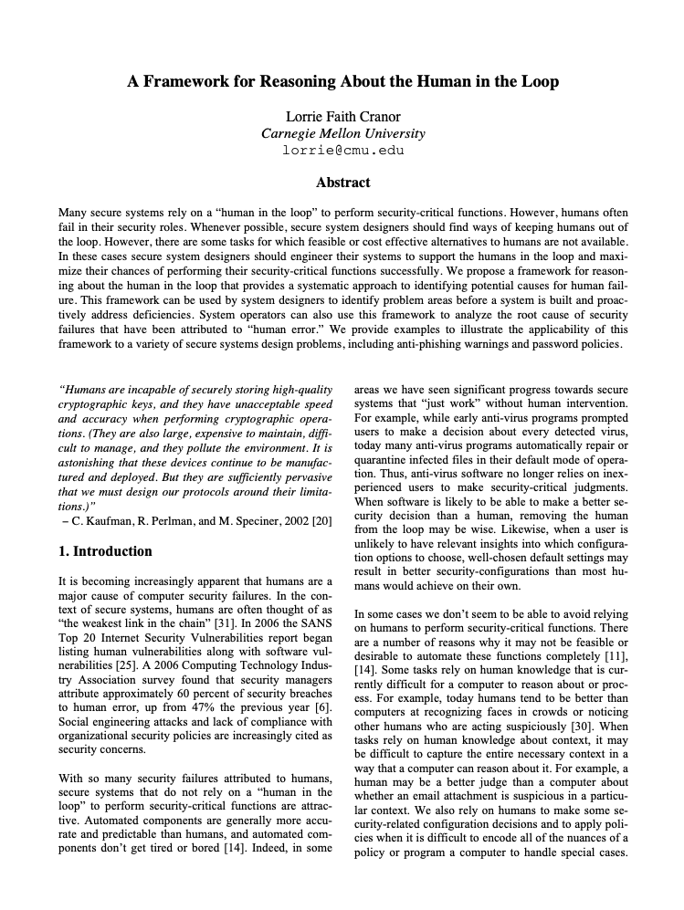
Special Mention: The Human in the Loop
What are we trusting users to do?
Pick a strong, unique password (or enroll in MFA)
Not share their credentials
Recognize phishing / fraudulent requests
Review transaction notifications and spot unauthorized activity
Keep their device and app updated
How confident are we that real users will actually do these things? Part of the risk calculation
Notes:
Point to the external entities on the DFD (Sender, Receiver): “We drew trust boundaries around our system – the network is untrusted, the bank API is a separate trust domain. But look at the users. We’re not just trusting a data channel here. We’re trusting a person to carry out security-critical tasks.”
The evidence from decades of usable security research: - People reuse passwords across accounts – credential stuffing succeeds regularly - People choose predictable passwords despite complexity requirements - Phishing success rates remain high even among technically sophisticated users - Security warnings are routinely dismissed (habituation)
The design implication: treat the human as a component with known failure modes, not as an idealized actor who always follows policy. If our security depends on a human doing something reliably and the evidence says they won’t, that is a threat – and the mitigation may need to be a design change, not a policy change.
Payment app examples: - If security depends on strong passwords -> design should support/require MFA - If security depends on users spotting fraud -> implement cooling-off periods, transaction limits, anomaly detection - If security depends on users reviewing notifications -> the design needs to degrade gracefully when they don’t
Lorrie Faith Cranor’s framework: when we place a human in a security-critical role, we need to evaluate whether the task is one that humans can reliably perform. If it isn’t, the system design itself needs to compensate.
This enriches the STRIDE analysis that follows – students will now think about human failure modes when they encounter Spoofing (credential theft), Repudiation (user claims they didn’t authorize), etc.

Slide 15
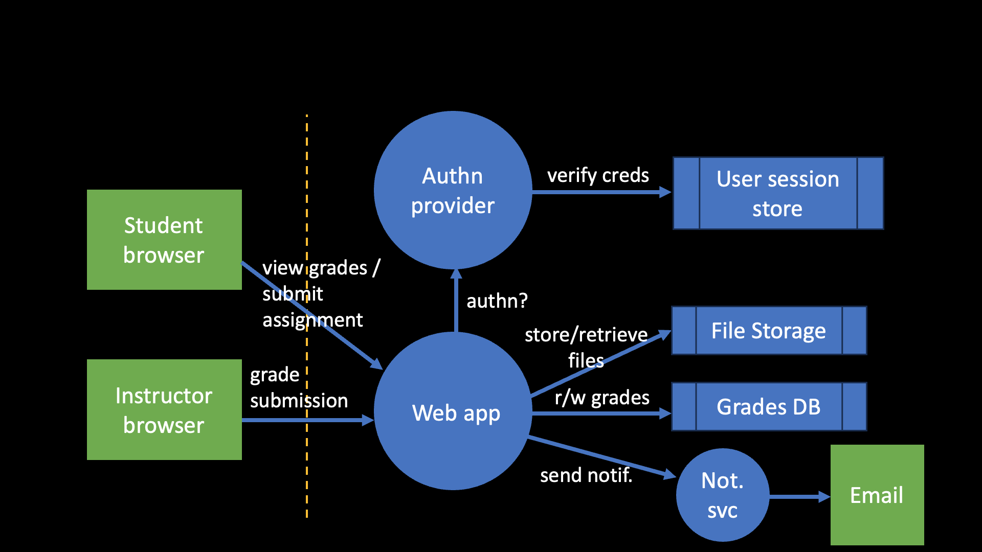
Data flow: Student submits assignment via browser to web application
S: Submit as another student
Stolen session cookie, weak/stolen credentials
T: Submission modified improperly
MITM without TLS; authz bypass to modify submission post-deadline
R: “I never submitted that”
No logging of timestamps or content hashes
I: Other students view submission
Broken access control, IDOR (forged DB object ref) on download URLs
D: Deadline flood crashes server
No rate limiting; malicious file upload
E: Student gains instructor role
Parameter tampering on role field
Notes:
IDOR = Insecure Direct Object Reference
Walk through each row. Make the threats concrete and relatable.
For the Information Disclosure row: “We identified that a broken file download URL could let anyone access any submission. Think back to the SbD lecture – which of Saltzer & Schroeder’s principles does this violate?” Answer: complete mediation – every access must be checked, not just relying on obscurity of the URL.
For Tampering: there are two aspects – modification in transit (network-level, mitigated by TLS) and modification after submission (application-level, needs timestamp/hash verification).
For Denial of Service: consider both volumetric attacks (many requests) and semantic attacks (one malicious file upload that crashes the parser).
For Elevation of Privilege: if the role is stored in a user-controllable parameter (e.g., a hidden form field or cookie), a student could change it.
This demonstrates the power of systematic analysis: even a simple-seeming data flow yields six distinct threat categories, each requiring a different defense.

Slide 16
STRIDE Applied to CMS Example (generally)
Attack Class | Intent | CMS Example
Spoofing | Impersonate a user or system | Faking a login as another student
Tampering | Unauthorized modification | Changing a grade in transit
Repudiation | Deny having performed an action | Instructor denies changing a grade
Information Disclosure | Unauthorized access to data | Viewing another student’s submissions
Denial of Service | Disrupt system operation | Overwhelming the system during finals
Elevation of Privilege | Gain unauthorized capabilities | Student gaining instructor access
Notes:
Spoofing: An attacker logs in as another student or instructor. Countermeasures: strong authentication (SSO with MFA), session management.
Tampering: An attacker modifies data in transit or at rest – changing a grade, altering a submission timestamp, modifying course content. Countermeasures: TLS for data in transit, integrity checks, access controls on data at rest, audit logging.
Repudiation: An instructor claims they didn’t change a grade, or a student claims they submitted an assignment that they didn’t. Countermeasures: immutable audit logs, cryptographic evidence (digital signatures on grade changes, submission receipts).
Information Disclosure: A student views another student’s grades, submissions, or personal information. Or internal system details (stack traces, configuration) leak through error messages. Countermeasures: authorization checks on every data access, proper error handling, data classification.
Denial of Service: The system is made unavailable during critical periods. Could be an intentional attack or an unintentional result of poor capacity planning. Countermeasures: rate limiting, resource quotas, capacity planning, CDN, graceful degradation.
Elevation of Privilege: A student gains TA or instructor privileges. A TA gains admin access. Countermeasures: robust authorization model, input validation (to prevent injection that bypasses access controls), principle of least privilege.

Slide 17
STRIDE Applied to CMS Example (generally)
Attack Class | Intent | CMS Example
Spoofing | Impersonate a user or system | Faking a login as another student
Tampering | Unauthorized modification | Changing a grade in transit
Repudiation | Deny having performed an action | Instructor denies changing a grade
Information Disclosure | Unauthorized access to data | Viewing another student’s submissions
Denial of Service | Disrupt system operation | Overwhelming the system during finals
Elevation of Privilege | Gain unauthorized capabilities | Student gaining instructor access
Notes:
STRIDE is from the paper’s Appendix D (p.27). It was developed at Microsoft in the late 1990s and remains the most widely-used framework for categorizing threats.
Walk through each category briefly with the CMS example:
Spoofing: An attacker logs in as another student or instructor. Countermeasures: strong authentication (SSO with MFA), session management.
Tampering: An attacker modifies data in transit or at rest – changing a grade, altering a submission timestamp, modifying course content. Countermeasures: TLS for data in transit, integrity checks, access controls on data at rest, audit logging.
Repudiation: An instructor claims they didn’t change a grade, or a student claims they submitted an assignment that they didn’t. Countermeasures: immutable audit logs, cryptographic evidence (digital signatures on grade changes, submission receipts).
Information Disclosure: A student views another student’s grades, submissions, or personal information. Or internal system details (stack traces, configuration) leak through error messages. Countermeasures: authorization checks on every data access, proper error handling, data classification.
Denial of Service: The system is made unavailable during critical periods. Could be an intentional attack or an unintentional result of poor capacity planning. Countermeasures: rate limiting, resource quotas, capacity planning, CDN, graceful degradation.
Elevation of Privilege: A student gains TA or instructor privileges. A TA gains admin access. Countermeasures: robust authorization model, input validation (to prevent injection that bypasses access controls), principle of least privilege.
This is a preview – the second half of the lecture will use STRIDE systematically against a data flow diagram of the CMS.

Slide 18



What Are We Going to Do About It?
Four response strategies for each identified threat:
Mitigate – Implement a control that reduces the risk (most common)
Eliminate – Remove the feature or component that creates the threat
Transfer – Shift risk to another party (insurance, outsourcing, user accepts ToS)
Accept – Acknowledge and document the decision not to act
Notes:
These are the only four options. Every identified threat must be addressed by one of them.
“Accept” is a valid response – but it must be deliberate and documented, not accidental. “We didn’t think about it” is not acceptance. A documented acceptance decision includes: what the threat is, why we’re not mitigating it (e.g., extremely low likelihood, cost of mitigation outweighs impact), and who made the decision.
“Eliminate” is powerful but underused. Example: if a feature creates a significant threat and provides marginal value, removing the feature eliminates the threat entirely. The social feed in a payment app is a good example – if it creates major privacy risks, is it worth having?
“Transfer” is common in business contexts: cyber insurance, using a third-party payment processor (PCI compliance transfers to them), or ToS that shift liability.
Most of the time, you’ll mitigate. The next slide shows how to structure a mitigation as a security requirement.

Slide 19
From Threats Mitigations to Security Requirements
Structure each requirement in three parts (SAFECode):
The Problem:
Unauthorized access to another student’s submitted file (CWE-639: IDOR)
The Control:
All file download requests must verify that the requesting user is authorized to access the specific file
Implementation Guidance:
Use indirect references (per-session token mapped to file path); validate enrollment and role on every request
Notes:
SAFECode structures each security requirement as three parts: - The problem: the weakness being addressed (map to CWE where appropriate) - The control: what needs to be done (technology-agnostic acceptance criteria) - Implementation guidance: how to achieve it in the specific technology stack
This structure is powerful because:
1. The problem is traceable (back to the threat model, forward to CWE)
2. The control is testable (it becomes an acceptance criterion)
3. The guidance is actionable (developers know what to build)
Each security requirement derived from the threat model feeds directly into:
- Design review (are the controls designed correctly?)
- Test plan (are we testing for the threats we identified?)
- The “bug bar” from the SbD lecture (which threat-derived bugs block release?)

Slide 20
Threat Modeling in the SDLC
Security Strategy
Architecture Assessment
Threat Model
Design Review
Test Plan
The threat model’s security requirements feed into:
Design review: Are the controls designed correctly?
Test plan: Are we testing for the threats we identified?
Bug bar: Which threat-derived bugs block release?
Notes:
This flow is adapted from SAFECode Figure 1 (originally from Schoenfield, “Applying the SDL Framework to the Real World,” Core Software Security, 2014).
SAFECode: “threat modeling delivers its best, most useable results when performed early, before implementation has begun.”
The threat model sits between architecture assessment (do we understand the system’s structure?) and design review (are the security controls correctly designed?). It’s the bridge that translates architectural understanding into security requirements.
Note this is not the complete SDLC – it’s the design-phase security activities. Threat modeling also connects to later phases: the security requirements inform the test plan, and when vulnerabilities are found in production, the threat model should be updated.
It does not matter what form of development life cycle is used: Agile, Waterfall, Continuous Evolution. The security requirements must be determined before the product can be built.

Slide 21
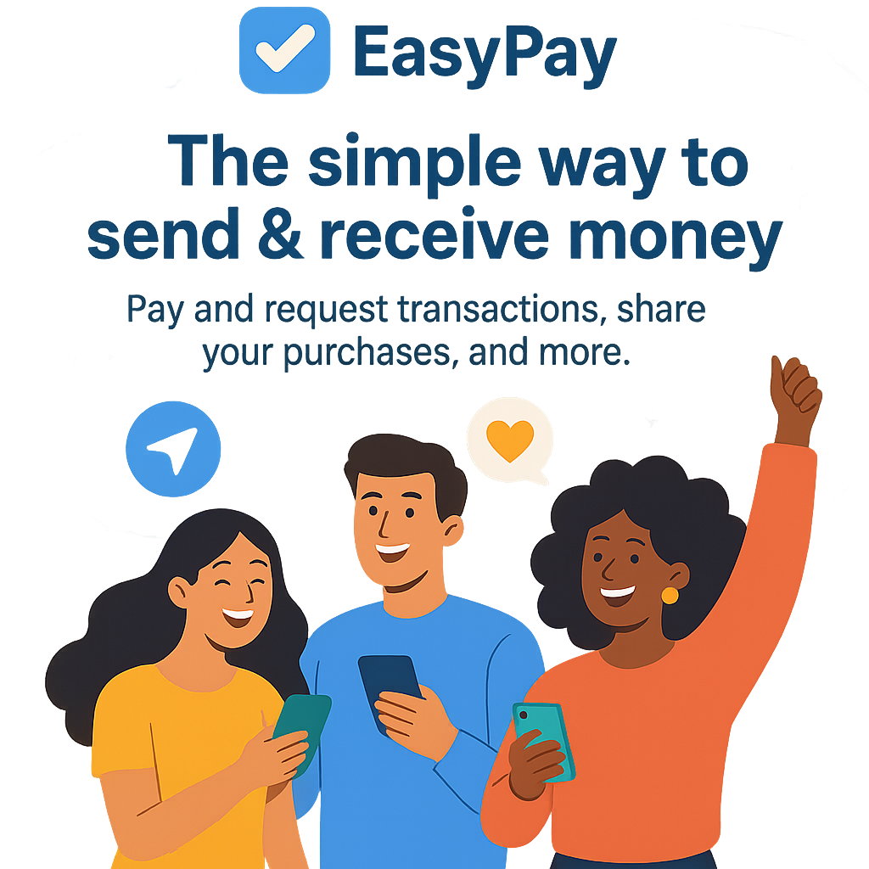
Today’s Exercise: Payment App
System scope:
Users create accounts, link a bank account or debit card
Send money to other users, request money
View transaction history
Social feed showing transactions (with privacy settings)
Authentication via username/password + optional MFA
External banking/payment processor API
Our job: figure out what could go wrong before we write the code.
Notes:
https://app.diagrams.net/
“Today we’re going to threat model a peer-to-peer payment app. Think of Venmo.”
Define the system together. This slide provides the starting point, but the class should discuss and refine.
Key features to emphasize:
- The social feed is a distinctive feature that creates interesting privacy questions
- The link to an external bank/payment processor creates a critical trust boundary
- MFA is “optional” – what does that mean for our threat model?
- “We are the development team building this.”
Why a payment app:
- Every student uses one (Venmo, Zelle, Cash App)
- High-value assets: money, financial credentials, PII
- Clear trust boundaries that naturally emerge
- Rich enough for interesting threats, simple enough for one session

Slide 22
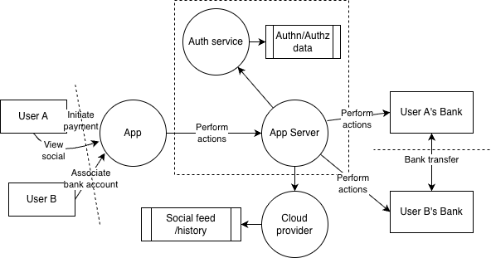

Slide 23
STRIDE Reference Card
 | Threat | Violates | Ask…
S | Spoofing | Authentication | Who are you, really?
T | Tampering | Integrity | Has the data been changed?
R | Repudiation | Non-repudiation | Can they deny it?
I | Info Disclosure | Confidentiality | Who can see this?
D | Denial of Service | Availability | Can they shut it down?
E | Elev. of Privilege | Authorization | Should they be allowed to do that?
Keep this visible as we work through the DFD.
Notes:
This is the template for the collaborative threat analysis. Use the whiteboard or a shared document.
Key threats to elicit (instructor doesn’t need to cover all – the goal is for students to discover them):
AUTH SERVICE:
S: Credential stuffing; phishing; session hijacking
T: Attacker modifies auth token in transit
R: User denies authorizing a payment (“I didn’t log in”)
I: Password hash leak; session token exposure in logs
D: Brute-force login attempts lock out legitimate users
E: Bypass MFA; exploit auth flaw to access admin functions
PAYMENT PROCESSING:
S: Attacker initiates payment as another user
T: Modify payment amount or recipient in transit; race condition to double-spend
R: Sender disputes a payment they actually authorized
I: Transaction details visible to unauthorized users
D: Flood payment system to prevent legitimate transactions
E: Bypass transaction limits; access another user’s linked bank account
APP SERVER <-> BANK API:
S: App server impersonated to bank; bank API impersonated to app
T: Man-in-the-middle modifies transfer instructions
R: Bank denies receiving a valid transfer request
I: Financial data exposed in transit or in logs
D: Bank API unavailable; our system doesn’t handle it gracefully
E: Exploit bank API integration to move money to unintended accounts
SOCIAL FEED / HISTORY:
S: View another user’s private history by manipulating request
T: Modify displayed transaction amounts or parties
I: Privacy leak: “default public” feed reveals financial behavior
E: Access admin view of all transactions
After completing the table, step back and assess coverage (~3 min): “Are there any STRIDE categories underrepresented? Any parts of the DFD we haven’t examined?”

Slide 24
Prioritize: Impact x Likelihood
 | Low Likelihood | Medium Likelihood | High Likelihood
High Impact | Medium | High | Critical
Medium Impact | Low | Medium | High
Low Impact | Informational | Low | Medium
As a class, pick the top 5 threats from our table.
Impact: How bad is it? (Financial loss, privacy breach, downtime)
Likelihood: How easy to exploit? (Anyone on the internet, or requires insider access?)
Notes:
Use a simple High/Medium/Low approach. Don’t introduce CVSS here – the goal is to develop intuition for prioritization.
Mention that formal scoring systems exist for organizational scale: - CVSS (Common Vulnerability Scoring System) – the industry standard for vulnerability severity - FAIR (Factor Analysis of Information Risk) – quantitative risk analysis framework
The simple grid is sufficient for our exercise and teaches the core skill: not all threats are equal, and you need a principled way to decide where to invest your limited mitigation resources.
Guide the class to select 5 threats. For a payment app, likely candidates: 1. Attacker initiates payment as another user (S on Payment Processing) – HIGH impact, MEDIUM likelihood 2. Modify payment amount or recipient (T on Payment Processing) – HIGH impact, LOW-MEDIUM likelihood 3. Credential stuffing / session hijacking (S on Auth) – HIGH impact, HIGH likelihood 4. Privacy leak from default-public social feed (I on Social Feed) – MEDIUM impact, HIGH likelihood 5. Bypass transaction limits (E on Payment Processing) – HIGH impact, MEDIUM likelihood

Slide 25
Developing Mitigations
For each top threat, define:
Problem: What weakness are we addressing?
Control: What must be done? (technology-agnostic)
Implementation Guidance: How do we build it?
For each mitigation, also ask: “Is the mitigation itself introducing new attack surface?”
Notes:
Work through the top 5 threats as a class, using the SAFECode three-part format.
Example worked mitigation:
THREAT: Attacker initiates payment as another user (Spoofing on Payment Processing)
Problem: Insufficient verification that the authenticated user is the one authorizing the payment.
Control: Every payment request must re-verify the user’s identity through a second factor (e.g., PIN, biometric, or MFA challenge) tied to the specific transaction.
Implementation guidance: Use a per-transaction confirmation token; do not rely solely on the session cookie; require step-up authentication for transactions above a threshold.
For each mitigation, also ask: “Is the mitigation itself introducing new attack surface?” For example, if we add SMS-based 2FA, we’ve now introduced a dependency on the phone network (SIM-swapping attacks, SMS interception).
Connection to development (~2 min): “Each of these mitigations is now a security requirement. They go into the backlog alongside functional requirements. They inform the test plan: we now know we need to test that payment requests without re-authentication are rejected. This is the bridge from threat modeling back into the development process that we discussed in the SbD lecture.”

Slide 26
Did We Do a Good Job?
Collect your responses into security requirements, and a new DFD
Helps you see the whole, not just the parts
Now ask: What did we miss?
Insider threats? (rogue employee with database access)
Supply chain? (compromised push notification SDK)
Device as threat vector? (malware on the phone, rooted device)
Regulatory/compliance? (PCI-DSS, state money transmitter laws)
Threat modeling is iterative – you don’t get everything on the first pass, and that’s OK.
Notes:
Guide a reflective discussion. The instructor can point out areas the class didn’t cover.
This demonstrates that threat modeling is iterative. The SAFECode paper lists specific triggers for updating the threat model: new data flows, changes to authentication/authorization, new components, changes to cryptography, etc.
Also ask: “What did we do well? What was hard? What would you do differently next time?”
This self-assessment discipline is essential for maturing the practice. Section 8 of SAFECode: “A general rule of thumb is that the threat model is complete when all the attack surfaces whose compromise could affect the organization or the product in some significant manner have been enumerated.”

Slide 27
Common Failures in Threat Modeling
Mindset failures (SAFECode Section 6):
“We already do pen testing, so we don’t need threat modeling”
“The system is already deployed, so there’s no reason”
“We did it once; we don’t need to do it again”
“Threat modeling is too complicated”
“We don’t have security experts, so we can’t do it”
Process failures:
Failing to control scope (“boiling the ocean”)
Focusing only on areas the team already knows well
Not defining what “success” looks like
Notes:
Quick poll of the class: “Which of these do you think is the most dangerous?”
These mindset failures are barriers of entry – they try to stop threat modeling from happening or justify it away.
Process failures are more subtle: - Scope: “It is rare that the team has as much time as needed or desired, so there needs to be control over what will actually be analyzed.” You can’t model everything at once. - Comfort zone: “It has been observed that cryptography gurus devoted considerable time digging into the nuances of crypto, even though the use of crypto may be unnecessary.” People gravitate to what they know. - Success criteria: “When building out a threat-modeling program, you must define what ‘success’ looks like. Is it the identification of a defect that could not be found through your penetration testing and code review efforts?”
Also important: failures of communication. SAFECode describes “Eureka moments” where a developer says “wait, that’s not how it actually works” – revealing that the team had different assumptions about the system. This is actually a success of the process, not a failure.

Slide 28
Key Takeaways
Threat modeling is:
A team sport – diverse perspectives find more threats
Iterative – you refine it as the system evolves
A living document – update when the system changes
High-ROI – cheaper to find flaws in design than in production
A practical skill you can develop with practice
“You can walk into a design meeting, draw a DFD on a whiteboard, and systematically ask ‘what can go wrong?’ using STRIDE.”
Notes:
Connect to SAFECode guidance:
Team sport (Section 7): “In practical terms, at least some people in the group should have experience and knowledge in ‘how to break software.’” In our exercise, different students noticed different things – that diversity is the point.
Scope matters (Section 8): We scoped to one app with clear boundaries. For a complex system, you’d decompose and model components separately (Section 11).
Living document (Section 4): If we later add cryptocurrency support, or integrate with a new bank, the threat model needs updating.
It doesn’t have to be perfect to be valuable (Section 6): Even an imperfect threat model is dramatically better than none.
Agile integration (Section 15): Threat modeling doesn’t require waterfall. In agile, you threat model new features/stories as they’re designed, and revisit the system-level model periodically.
Broader connections: - Threat modeling is Consideration #1 (Secure Software Design) from the SbD lecture in action - Informs Consideration #2 (Secure Development – test plan), #3 (Secure Defaults – what should the payment app’s default privacy setting be?), and #6 (Vulnerability Remediation – when a vulnerability is found, update the threat model) - Organizations assess maturity through artifacts (SSDF/BSIMM): “Did you produce a threat model? Is it current? Does it cover the system’s attack surface?”
Closing: “You now have a practical skill. That ability – to think like an attacker during design – is the single highest-leverage security practice you can adopt.”

Slide 29
References
Assigned reading:
Shostack, A. “Threat Modeling.” https://shostack.org/resources/threat-modeling
SAFECode. “Tactical Threat Modeling.” 2017.
Kohnfelder, L. & Garg, P. “The Threats to Our Products.” Microsoft, 1999.
Further reading:
Cranor, L.F. “A Framework for Reasoning About the Human in the Loop.” UPSEC, 2008.
OWASP Threat Modeling Cheat Sheet
Microsoft Threat Modeling Tool (free)
Notes:
Additional references mentioned in the SbD lecture (for continuity): - CIS/SAFECode “Secure by Design” paper - NIST SP 800-218 (SSDF) - Saltzer & Schroeder, “The Protection of Information in Computer Systems” (1975)
The Shostack book is the definitive reference. The Cranor paper is optional reading for students interested in the human-in-the-loop discussion from Lecture 2.
The Microsoft Threat Modeling Tool is free and includes DFD drawing with auto-generated STRIDE threats – students may want to try it for their course projects.
The OWASP cheat sheet is a good quick reference: https://cheatsheetseries.owasp.org/cheatsheets/Threat_Modeling_Cheat_Sheet.html

