Slide 1


Secure Systems Engineering and Management
A Data-driven Approach
Michael Hicks
Secure by Design:
Overview
UPenn CIS 7000-003
Spring 2026

Slide 2
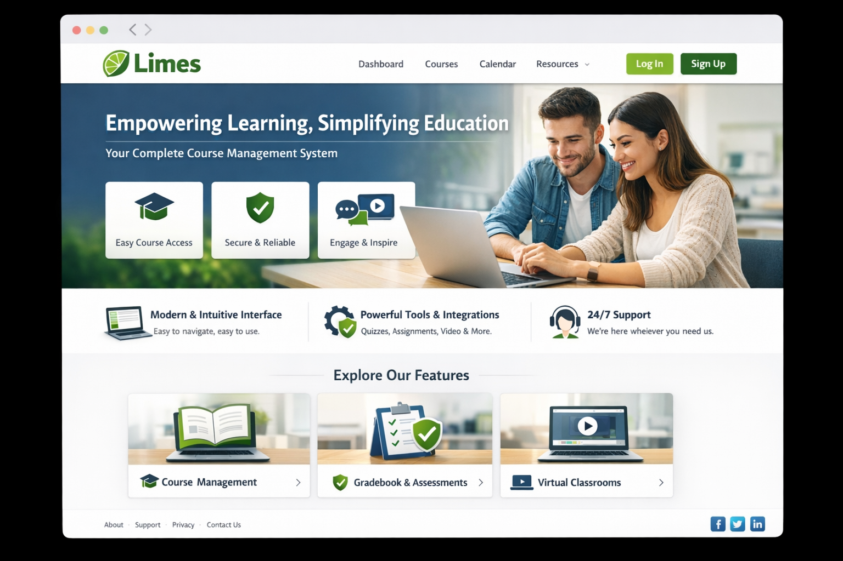
You Know the Attacks. Now What?
Scenario: You’re hired to build the university’s new course management system.
You’ve studied the CWE Top 25:
Buffer overflows, SQL injection, XSS, path traversal, …
Question: How do you make sure none of those end up in production?
(not real! Drawn by CoPilot)
Notes:
Open with this question and let 2-3 students answer. They’ll likely say things like “use prepared statements,” “use a memory-safe language,” “do code review.” All correct, but insufficient.
The point to draw out: each of those is a specific technique for a specific vulnerability. But a real system has hundreds of components, multiple developers, third-party dependencies, ongoing maintenance for years. You need a systematic process, not a checklist of individual tricks.
This is the transition from “I know security” to “I can engineer secure software.”

Slide 3
Our Running Example: Limes
A university course management system (Canvas, Blackboard, …)
Users: Students, TAs, instructors, admins
Data: Grades, submissions, personal records (FERPA)
Features: File upload, discussion forums, quizzes, video integration
Integrations: SSO, plagiarism detection, LTI plugins, email
We’ll use this system throughout to ground every concept
Notes:
Point out the richness of the security surface:
Confidentiality: student records, grades, FERPA compliance
Integrity: grades and submissions must not be tampered with
Availability: must be up during registration, midterms, finals
Multiple trust levels: a student shouldn’t see another student’s grades; a TA for one section shouldn’t see another section’s data
Third-party code everywhere: LTI plugins, video conferencing SDKs, plagiarism APIs
File handling: students upload assignments, instructors upload materials – file upload is a classic attack vector
This is a system complex enough to illustrate every concept we’ll cover, but familiar enough that students can reason about it immediately.

Slide 4
The Reactive Security Trap
Most of cybersecurity grew up reacting to insecure systems:
Patch management
Configuration hardening
Malware detection
Incident response
. . .
“Frequent security bulletins and advisories, disruptive patching, complex configuration management, malware analysis and detection, and vulnerability disclosure may have created more security ‘fatigue’ than progress.”
– CIS/SAFECode, Secure by Design (2025)
Notes:
This quote is from the paper’s introduction (p.3). The key insight: we’ve built an enormous industry around reacting to insecure software – firewalls, antivirus, SIEM, SOCs, patch management – rather than building software that doesn’t need all that in the first place.
An analogy: it’s like building cars without seatbelts or crumple zones, then investing heavily in ambulances and trauma surgeons. You need the ambulances too, but wouldn’t it be better to also make the cars safer?
Connect to the students’ experience: they’ve probably done a lab or project where security was an afterthought – “we’ll add authentication later.” That’s the pattern we’re trying to break.

Slide 5
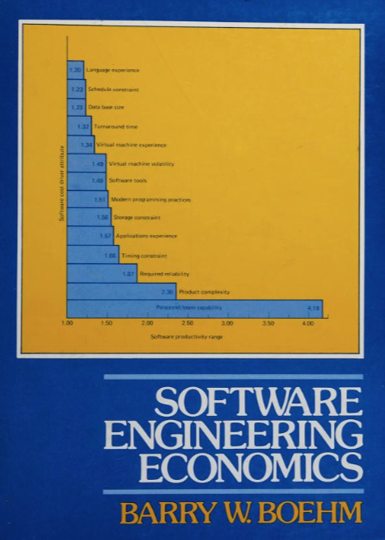
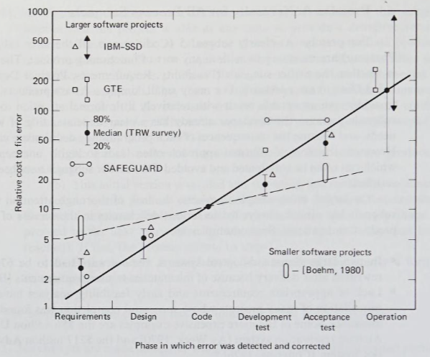
The Cost of Finding Bugs Late
Published 1981
Notes:
This is the classic insight from Barry Boehm’s work and IBM Systems Sciences Institute research. A security flaw caught during design review costs almost nothing to fix – you change the design document. The same flaw caught in production costs 30-100x more: incident response, emergency patch, customer notification, reputation damage, potential regulatory fines.
Concrete example with our CMS: Suppose we design the system so that assignment submission URLs are predictable (e.g., /submissions/12345). During design review, someone says “we need authorization checks on every submission access.” Cost: one line in the design doc, a few lines of code later. But if this ships to production and a student discovers they can view anyone’s submissions by incrementing the ID? That’s a FERPA violation, potential news story, emergency patch, and audit.
This is the economic argument for Secure by Design: it’s not just more secure, it’s cheaper.

Slide 6
What Does “Secure by Design” Mean?
Secure by Design = building security in from the start, as a first-class design constraint
Not a binary state. A continuum of risk management.
Three foundational truths:
Perfect security is impossible. The goal is to manage risk.
Not all security practices are equal. Prioritize.
“Secure” is never finished. It’s a continuous feedback loop.
Notes:
These come from the paper’s “basic tenets” (p.5). Emphasize each:
Perfect security is impossible: “No software system can approach a zero risk of loss” (p.4). This is liberating, not depressing – it means we can reason about acceptable risk rather than chasing an impossible ideal. Students may think “secure” means “unhackable.” It doesn’t. It means “the residual risk is understood and acceptable.”
Prioritization is essential: not every piece of code is equally security-critical. The authentication module matters more than the color theme picker. Development resources are finite. Frameworks like the CIS Controls and SSDF help prioritize.
Continuous feedback: security isn’t something you achieve once at launch. New vulnerability classes are discovered, dependencies get compromised, threat actors evolve. The process must be ongoing.
This is also now a major policy priority: CISA’s Secure by Design initiative (2023), the EU Cyber Resilience Act, US Executive Orders 14028 and 14306. Governments are telling software vendors: you bear responsibility for the security of what you ship.

Slide 7
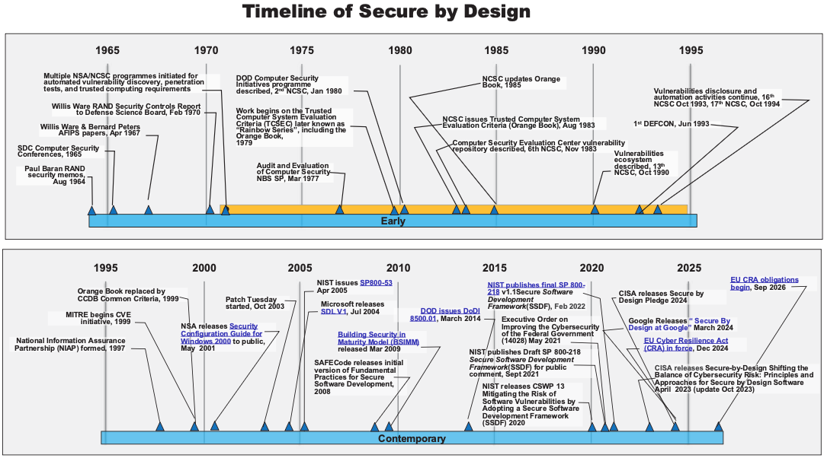
The problem is recognized
Government solution attempt: certification
Internet: Boom
Process-oriented approaches develop and mature
Notes:
Walk through the highlights of the timeline figure from p.5 of the paper. Don’t read every item – hit the key inflection points:
1964-1970: The problem is recognized. Paul Baran at RAND realizes that networked systems have fundamental vulnerabilities. Willis Ware’s 1970 DOD report (“Security Controls for Computer Systems”) establishes the essential elements for security by design. These are not recent ideas.
1970s-1980s: The government tries to solve it with certification. The Orange Book (TCSEC, 1983) tried to rank systems from D (minimal security) to A (verified design). Good idea, but too rigid, too expensive, and designed for mainframes. Only a handful of systems ever achieved high ratings, and they found limited markets.
1990s-2000s: The internet explodes the problem. New vulnerability classes discovered constantly. MITRE starts CVE (1999). Microsoft’s Patch Tuesday (2003) becomes a monthly ritual. The reactive model dominates. But also: SAFECode publishes fundamental practices (2008), BSIMM starts measuring security programs.
2010s-2020s: Process-oriented approaches mature. NIST SSDF (2020, updated 2022). Executive Order 14028 (2021) – the White House tells federal suppliers to follow the SSDF. CISA Secure by Design initiative (2023). Google publishes their approach (2024). EU CRA (2024). And now this CIS/SAFECode paper (2025) synthesizing it all.
Key narrative: the principles haven’t changed much in 60 years. What’s changed is that we now have practical, assessable frameworks to implement them. That’s progress.

Slide 8
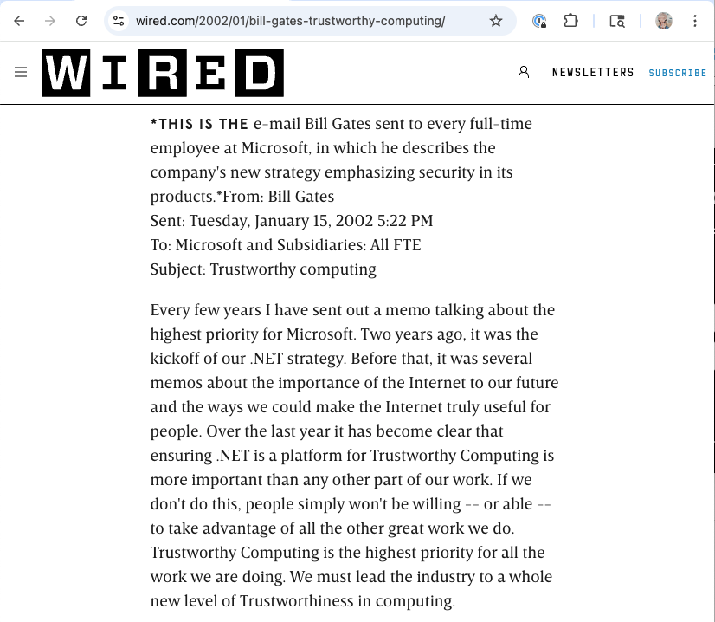
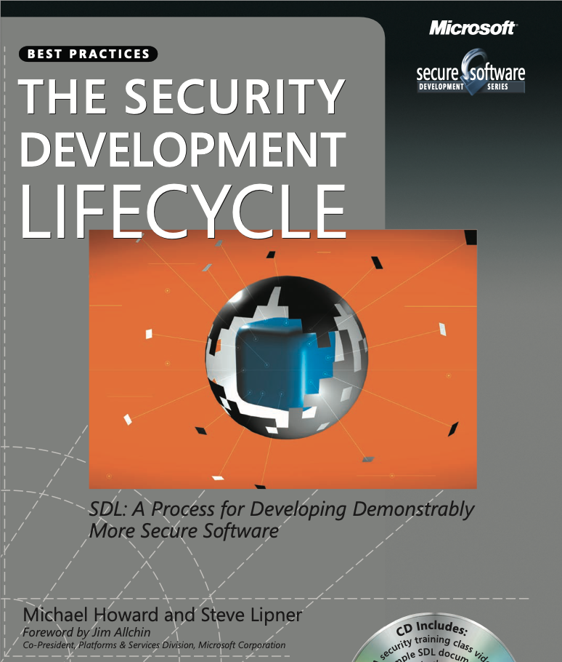
Microsoft was a target, then became a leader
January 2002
July 2006

Slide 9
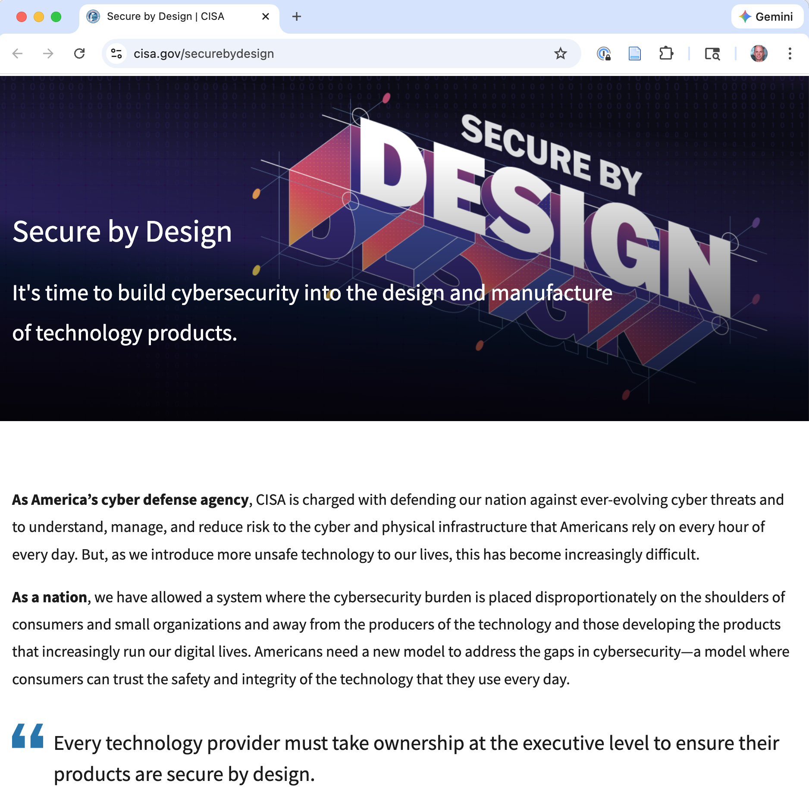
2023
“prioritize the security of customers as a core business requirement” and “implement
Secure by Design principles to significantly decrease the number of exploitable flaws.”

Slide 10
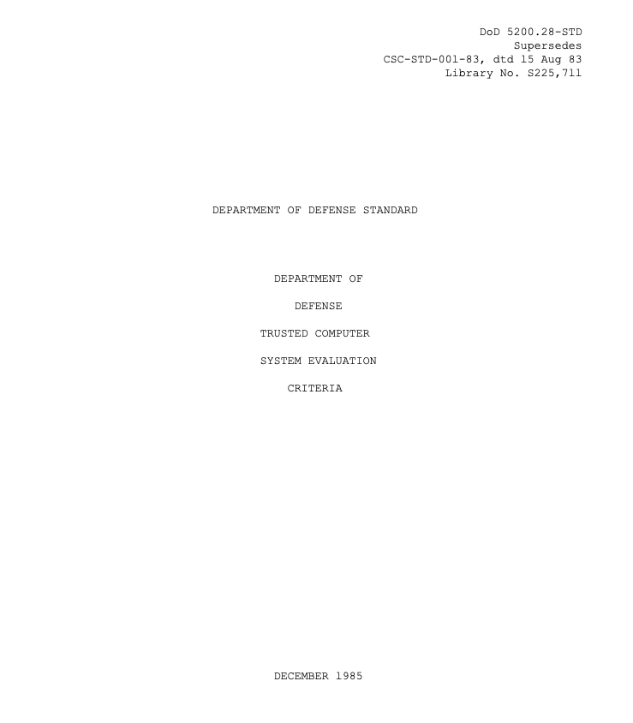
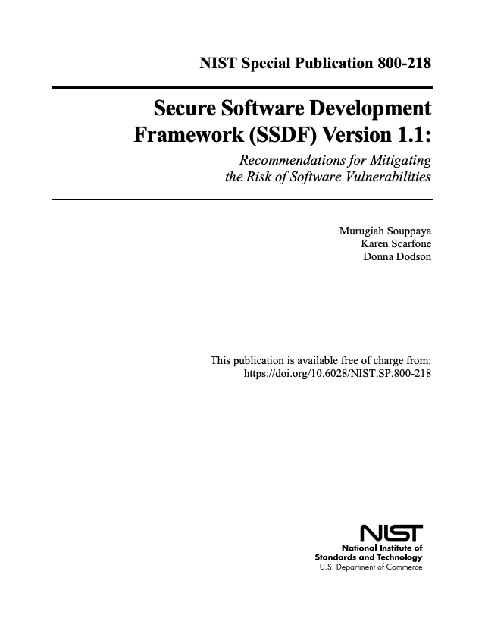
Lessons from History
Principles understood since the 1960s-70s
Early approaches (Orange Book) were too rigid to scale
The Internet era outpaced security processes
Microsoft pivoted to catch up
Modern frameworks (SSDF, CIS Controls) aim for the sweet spot: practical, evaluable, adaptable
The CIS/SAFECode paper builds on the NIST SSDF to create independent, practical, and actionable guidance – bridging broad principles and concrete practices.
Notes:
The Orange Book story is instructive for students: the DoD tried to solve security by having the government certify systems against strict criteria. It largely failed – the process was too slow, too expensive, and the criteria didn’t match the rapidly evolving commercial computing landscape. By the late 1990s it was supplanted by the Common Criteria, which is more flexible but still has limitations.
The lesson: you can’t solve software security through certification alone. You need practices that are woven into how software is actually built, by organizations of different sizes and maturity levels.
The CIS/SAFECode paper explicitly addresses this by defining three “Development Groups” (DG1, DG2, DG3) with different expectations based on organizational maturity. Not every team needs to do everything – but every team needs to do something.
Mention Appendix B of the paper for students who want the full history.

Slide 11
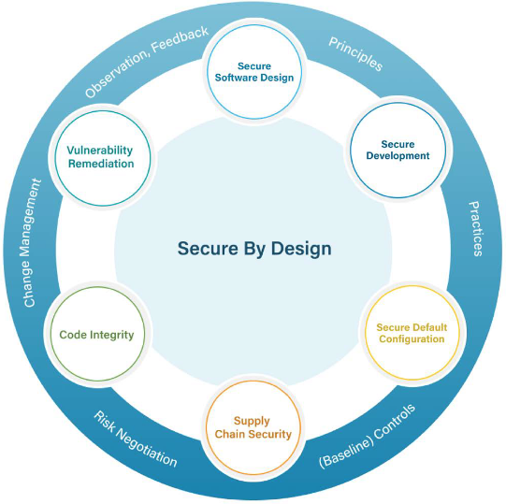
Six Considerations: Overview
Secure Software Design
Secure Development
Secure Default Configuration
Supply Chain Security
Code Integrity
Vulnerability Remediation
Notes:
Show the circle diagram from p.9 of the paper. This is the organizing framework for the next 20 minutes.
Point out the structure: the six considerations aren’t independent – they form a cycle. The connecting arcs matter too: - Principles flow from design into development - Practices flow from development into configuration - Baseline controls connect configuration to supply chain - Risk negotiation connects supply chain to code integrity - Change management connects code integrity to vulnerability remediation - Observation and feedback connect vulnerability remediation back to design
This is a continuous improvement loop, not a one-time checklist.
Tell students: “We’re going to walk through each of these six, using our CMS example. By the end, you’ll see how they fit together into a coherent process.”

Slide 12
Consideration 1: Secure Software Design
Design begins with security objectives:
Requirement | Definition
Confidentiality | Protect information from unauthorized disclosure
Integrity | Protect information from unauthorized modification
Availability | Provide access when required
Accountability | Non-repudiation via permanent audit records
Notes:
These are the fundamental security requirements from the paper (p.9). Every system needs to think about all four, but the relative priority depends on the system.
For our CMS:
- Confidentiality is critical: student grades, FERPA-protected records, personal information. A breach here has legal consequences.
- Integrity is critical: if grades can be tampered with, the academic system breaks down. This includes both malicious tampering (a student changing their grade) and accidental corruption.
- Availability matters especially at peak times: during registration, exam periods, assignment deadlines. A system that goes down during finals week has real consequences.
- Accountability is essential: if a grade is changed, there must be an immutable record of who changed it and when. This protects both students and instructors.
For a different system – say, a hospital monitoring system – availability might dominate (lives depend on it). For a voting system, integrity is paramount. The priorities shape everything that follows.

Slide 13

Secure Design: Security Features
These objectives are typically achieved through:
These must be correctly implemented and impossible to bypass.
Feature | Intent
Authentication | Reliably identifying users (passwords, MFA, SSO)
Authorization | Granting access based on roles and rights
Auditing | Creating reliable, immutable records of actions
Au
Au
Au
“The gold standard”

Slide 14
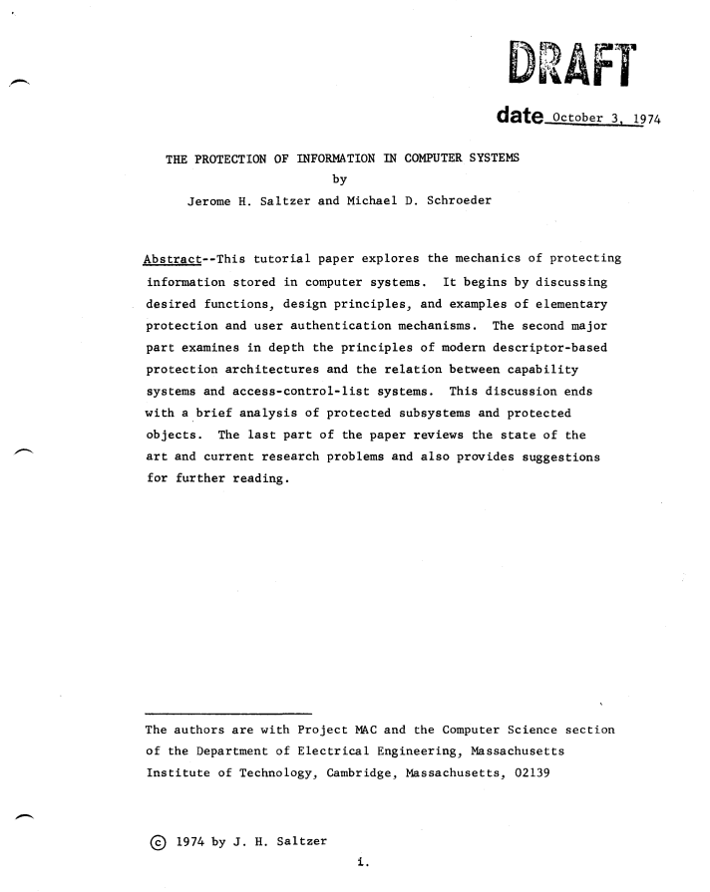

Slide 15
Secure Design: Saltzer & Schroeder’s Principles
Classic design principles (1975) that remain essential:
Least privilege: Grant minimum access needed for the task
Fail-safe defaults: If in doubt, deny access
Complete mediation: Check every access to every object
Economy of mechanism: Keep security-critical code simple
Separation of privilege: Require multiple conditions for access
Notes:
These are from Saltzer and Schroeder’s landmark 1975 paper “The Protection of Information in Computer Systems.” The paper is cited in the CIS/SAFECode guide (p.10). These principles are nearly 50 years old and still show up as the root cause when they’re violated.
Walk through each with CMS examples:
Least privilege: A TA grading Section 001 should not have access to Section 002’s submissions. The system shouldn’t give TAs instructor-level access “just in case.” If the CMS runs with a database account, that account should only have permissions on the tables it needs – not be a database superuser.
Fail-safe defaults: If the authorization check throws an exception or times out, the answer is “access denied,” not “access granted.” If a new user role is created, it starts with zero permissions, not all permissions.
Complete mediation: Every request to view a grade, download a file, or read a forum post must be checked against the user’s permissions. Not just the first time – every time. This is where a lot of access control bugs live: the check is on the UI but not on the API endpoint, or it’s cached and becomes stale.
Economy of mechanism: The authentication and authorization code should be small, centralized, and well-tested. If every controller implements its own permission check slightly differently, that’s a recipe for bugs. Use a single middleware layer.
Separation of privilege: Require both role AND course enrollment to access course materials. An admin changing a final grade might require a second administrator’s approval.
Many of the CWE Top 25 vulnerabilities the students have studied are violations of these principles. CWE-862 (Missing Authorization) is a complete mediation failure. CWE-269 (Improper Privilege Management) is a least privilege failure.

Slide 16
Secure Design: The Confused Deputy
The confused deputy problem: a program with elevated privileges is tricked into misusing them on an attacker’s behalf.
CMS example: The server-side PDF renderer runs with system privileges to read uploaded files. A malicious “assignment” triggers it to read /etc/passwd instead.
Confused deputies appear everywhere: CSRF, SSRF, insecure deserialization, …
Notes:
The confused deputy (term coined by Norm Hardy, 1988) is a powerful concept that unifies several vulnerability classes students have already studied:
- CSRF: the browser is the deputy – it has the user’s session cookie and is tricked into making requests the user didn’t intend
- SSRF: the server is the deputy – it has access to internal networks and is tricked into making requests to internal services
Insecure deserialization: the application is the deputy – it has execution privileges and is tricked into running attacker-controlled code during deserialization
For the CMS example: imagine the system has a feature that converts uploaded documents to PDF for consistent viewing. The conversion service runs server-side with access to the file system. An attacker uploads a crafted document that exploits the converter to read arbitrary files or make network requests. The converter is acting with its own privileges but on the attacker’s behalf – it’s a confused deputy.
The design fix isn’t just “sanitize the input” (though that helps). It’s: - Run the converter in a sandbox with no access beyond the specific uploaded file - Use process isolation (containers, VMs, or OS-level sandboxing) - Apply least privilege to the converter process itself
This is a design-level decision, not a coding-level fix. This is why secure design matters – some problems can only be properly solved at the architecture level.
Also mention: this naturally leads into threat modeling. How do you systematically find confused deputies in your design? By analyzing data flows and trust boundaries. That’s coming in the second half of the lecture.

Slide 17
Secure Design Requires Threat Modeling
“Secure system design teams in industry frequently rely on a process called threat modeling to review their designs.”
– CIS/SAFECode, Secure by Design
Analyze data flows to identify where an attacker might strike
Identify countermeasures for each threat
Supported by frameworks, tools, and training
We’ll do this for our CMS in the second half of today’s lecture.
Notes:
This is the bridge that connects Consideration 1 (Secure Software Design) to the second half of the class. The paper discusses threat modeling on p.10 and references STRIDE in Appendix D.
The key point: secure design isn’t just about following principles – it requires a systematic process for identifying threats specific to your system. Two different systems will have different threats even if they use the same technology stack. A CMS faces different threats than a banking app, even if both are web applications.
Threat modeling is that systematic process. It’s the design-phase activity that makes “think about security” concrete and actionable. Rather than relying on individual developers to think of everything, it provides a structured approach.
Don’t go deeper here – just establish that it’s coming. The students should be curious and primed for the second half.
Mention that the paper emphasizes (p.10): in modern Agile/DevSecOps development, “design” isn’t just the initial architecture. Every feature increment, every enhancement, every configuration choice is a design decision that should consider threats.

Slide 18
Consideration 2: Secure Development
The process of writing, testing, and maintaining code securely.
A secure development process must include:
A “bug bar”: which security bugs block release?
Coding standards: memory-safe languages, approved libraries, safe patterns
Security tooling: static analysis, dynamic analysis, dependency scanning
Code review focused on security-critical paths
Security testing beyond functional tests (regression and pen testing)
Developer training on secure coding
Notes:
This is from the paper’s discussion on pp.10-11. The paper gives a detailed list of what a secure development process must include.
Walk through each briefly:
Bug bar: The organization defines categories of security errors that are unacceptable. For our CMS: any SQL injection, any authentication bypass, any XSS, any IDOR vulnerability = no ship. This creates a clear, shared understanding across the team.
Coding standards: The paper specifically calls out “using only ‘safe’ runtime libraries, memory-safe languages, and approved encryption software.” For a web CMS, this means: use a framework with built-in CSRF tokens, auto-escaping templates (like Django, Rails with ERB, React), parameterized queries. Mandate that no raw SQL string concatenation is ever used.
Security tooling (we’ll look at this more on the next slide).
Code review: Human review specifically looking at security-critical paths: authentication, authorization, file handling, any place user input touches a database or command. This isn’t just general code review – it’s review by someone with security training, looking for security-specific issues.
Security testing: Not just “does the feature work” but “can it be abused?” Penetration testing, fuzz testing, regression tests for previously fixed vulnerabilities. The paper emphasizes regression testing: if you fixed an XSS in the assignment submission page, you need a test that ensures it never comes back.
Training: This class! Developers need to know what they’re defending against. The paper mentions this across all Development Groups.

Slide 19
The Secure Development Toolchain
Tool Class | What It Does | When
SAST (Static Analysis) | Scans source code for vulnerability patterns | During coding & CI
SCA (Software Composition Analysis) | Checks dependencies for known CVEs | Build time
DAST (Dynamic Analysis) | Tests running application for vulnerabilities | Testing/staging
Fuzzing | Feeds unexpected inputs to find crashes | Testing
Code Review | Human analysis of security-critical code | Before merge
Notes:
These tool classes are discussed in the paper (pp.11, 28) and Appendix E.
The key insight for students: none of these alone is sufficient. Static analysis catches some things but misses others. Dynamic analysis finds runtime issues but can’t cover every code path. Code review is powerful but expensive and doesn’t scale to every line. The combination provides defense in depth in the development process itself.
For our CMS:
- SAST: run a tool like Semgrep, CodeQL, or SonarQube on every pull request. It catches things like SQL injection via string concatenation, missing authorization decorators, hardcoded credentials.
- SCA: tools like Dependabot, Snyk, or OWASP Dependency-Check automatically alert when a dependency has a known vulnerability. Critical for a system with dozens or hundreds of npm/pip packages.
- DAST: tools like OWASP ZAP or Burp Suite test the running CMS for XSS, injection, misconfiguration. Run these against a staging environment before release.
- Fuzzing: feed random/malformed data to file upload handlers, API endpoints, the document parser. Looking for crashes, hangs, or unexpected behavior.
- Code review: every change to authentication, authorization, or grade calculation code gets a security-focused review.
Point to Appendix E of the paper for lists of specific tools and references.
Also mention the paper’s point about legacy code (p.11): the process must also include a policy for updating legacy code to meet security requirements imposed after it was released. Security is never “done.”

Slide 20
Consideration 3: Secure Default Config
Ship it locked down. Users opt out of security, not in.
The 80% rule: If a feature, privilege, or interface is not needed by 80% of users, disable it by default.
CMS examples:
New courses: all content private by default
File uploads: restricted file types (.pdf, .docx – not .exe, .html)
API access: disabled by default
Admin panel: not accessible from public internet
Session timeout: reasonable default (not “forever”)
Notes:
From the paper, pp.11-12. This is the “Secure by Default” concept, which is the companion to Secure by Design.
The core insight: many users and administrators accept default settings. If the defaults are insecure, the majority of deployments will be insecure. The software developer bears responsibility for choosing secure defaults.
The anti-examples are instructive: for years, databases (MySQL, MongoDB, Redis) shipped with no authentication by default. Routers shipped with admin/admin. IoT cameras with hardcoded credentials. These aren’t bugs in the traditional sense – the software worked as “designed.” But the design was insecure by default, and millions of deployments were compromised as a result.
The paper also discusses attack surface: “the set of exposed interfaces and functions in a software product” (p.11). Every enabled feature, every open port, every accessible endpoint is part of the attack surface. Secure defaults minimize it.
The 80% rule is a practical heuristic from the paper: “if a feature, privilege, or interface is not required by 80% of users, it must be disabled by default.”
Walk through the CMS examples:
- Private by default: when an instructor creates a new course, the content is invisible to anyone not enrolled. If they want to make it public (e.g., open courseware), they can opt in – but the safe default protects courses where instructors forget to set permissions.
- File type restrictions: students uploading assignments probably need to upload .pdf, .docx, .zip, .py, .java. They almost certainly don’t need to upload .exe, .html, .svg (which can contain scripts), or .php. Restricting by default prevents a whole class of attacks.
- API access: many CMS installations will never use the API. Leaving it enabled by default creates attack surface for no benefit.

Slide 21
Consideration 4: Supply Chain Security
Modern software is mostly code you didn’t write.
Each dependency is a trust decision:
Is it actively maintained?
Has it been audited for security?
What happens when a vulnerability is found in it?
Notes:
From the paper, pp.12-13. This is one of the most practically important considerations for students entering the workforce.
Start with the scale of the problem: a typical modern web application might have 10-20 direct dependencies and hundreds or thousands of transitive dependencies. Our CMS might directly depend on Django/Rails/Express, an ORM, a PDF library, a Markdown renderer, an email library, an authentication library, and each of those pulls in their own dependencies.
Each of those dependencies is an implicit trust decision: you’re trusting that the author wrote secure code, that the package repository hasn’t been compromised, that the dependency’s own dependencies are also secure.
The paper makes a strong point: “Software development organizations that integrate third-party code assume responsibility for ensuring that software does not undermine the security of their integrated product” (p.12). You can’t say “it was a library bug, not our fault.” If you ship it, you own it.
Practical measures:
- Maintain an approved component list - Use SCA tools to monitor for known vulnerabilities in dependencies
- Generate and maintain a Software Bill of Materials (SBOM) so you know exactly what’s in your software
- Have a plan for what happens when a critical vulnerability is found in a dependency (like Log4Shell)
- For critical dependencies, consider auditing the source code, or at least evaluating the project’s security practices

Slide 22
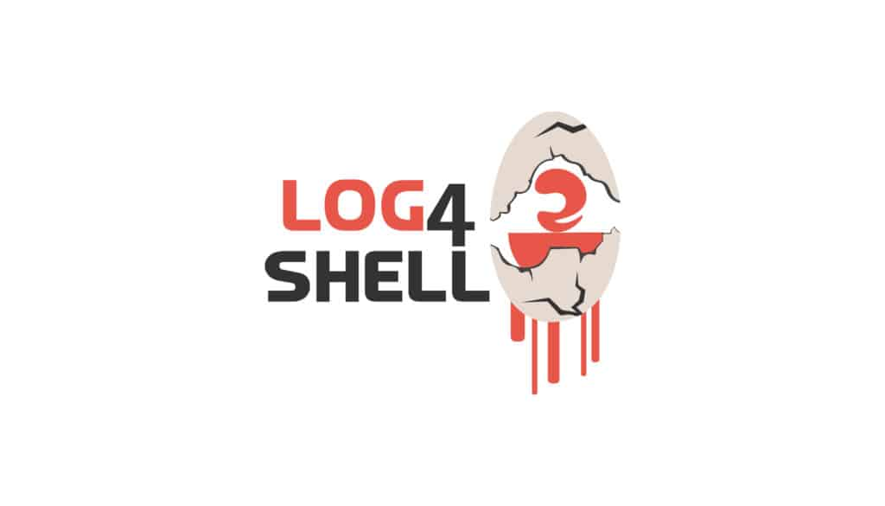
Supply Chain: Log4Shell as Case Study
December 2021: CVE-2021-44228 in Apache Log4j
A logging library used by thousands of Java applications
Remote code execution via a simple log message
Many organizations didn’t know they were using it
Key lesson: You must know what’s in your software (SBOM) so you can respond when a dependency is compromised.
Notes:
Log4Shell is the perfect case study for supply chain security because it illustrates every dimension of the problem:
A widely-used library with a critical vulnerability
Most organizations didn’t know they depended on it (it was often a transitive dependency, pulled in by other libraries)
The vulnerability was trivial to exploit – just craft a log message
Patching was complicated because the library was embedded everywhere
The organizations that responded fastest were those that had SBOMs – they could immediately query “do any of our applications use Log4j?” and know the answer. Organizations without SBOMs had to manually audit every application.
This connects to the SBOM concept from the paper (p.12): “An SBOM specifies the specific version of a software component and its origin. End users/organizations sometimes request access to products’ SBOMs to gain confidence in the software they are acquiring.”
For our CMS: if we’re building it in Java, Log4j could be a direct or transitive dependency. If we’re building it in Python or JavaScript, we have analogous risks – the event-stream npm package compromise (2018), the ua-parser-js compromise (2021), the XZ Utils backdoor (2024).
The XZ Utils backdoor is another powerful example: a maintainer who had spent years building trust in the community was discovered to have inserted a backdoor into a widely-used compression library. This isn’t just about technical vulnerabilities – it’s about trust and the social dynamics of open source maintenance.

Slide 23
Consideration 5: Code Integrity
Ensuring the software delivered to users is what you intended to build.
Threat: Malicious code inserted during development or delivery
Real-world attacks:
SolarWinds (2020): Build system compromised; malicious update sent to 18,000 organizations
XZ Utils (2024): Backdoor inserted by a trusted maintainer into a core Linux library
CodeCov (2021): CI/CD tool compromised; credentials stolen from thousands of repos
Notes:
From the paper, pp.12-13. Code integrity is about the development and delivery pipeline itself being trustworthy.
The threat model here is different from the others: the attacker isn’t trying to exploit a vulnerability in your application. They’re trying to modify your application to include their own malicious code, either during development or during delivery to users.
SolarWinds is the canonical example: attackers compromised the build system of SolarWinds’ Orion product. The code in the source repository was clean, but the build process injected malicious code into the compiled binary. The signed, legitimate-looking update was sent to ~18,000 organizations, including US government agencies. This is a supply chain attack on code integrity.
XZ Utils is more recent and arguably scarier: a person using the pseudonym “Jia Tan” spent two years building trust as a contributor to the XZ compression library (used in virtually every Linux distribution), then inserted a sophisticated backdoor targeting SSH authentication. It was discovered by accident.
Protections:
- Version control with access controls, branch protection, required reviews
- Code signing: binaries are signed so users can verify authenticity
- Reproducible builds: anyone can build the source code and get the exact same binary, proving nothing was inserted during the build
- Least privilege in the development environment: developers don’t have access to the build system or signing keys
- CI/CD pipeline security: the build pipeline itself is a critical trust boundary
For our CMS: if we’re distributing it as open source or as a product, we need code signing and reproducible builds. If we’re running it as a service, we need to secure the deployment pipeline.

Slide 24
Consideration 6: Vulnerability Remediation
No software ships bug-free. The question is: what happens when bugs are found?
Three phases:
Immediate remediation: Fix the reported vulnerability, ship a patch
Variant analysis: Search for similar vulnerabilities elsewhere in the codebase
Process improvement: Update tools, training, and practices to prevent recurrence
Notes:
From the paper, pp.13-14. This consideration is about the ongoing lifecycle after release.
Emphasize that vulnerability remediation is not just “fix the bug.” It’s a three-phase learning loop:
Phase 1 is what most people think of: someone reports a vulnerability, you fix it, you release a patch. Essential, but not sufficient.
Phase 2 is where good organizations separate from average ones: when you fix an IDOR vulnerability in the grade viewing endpoint, do you also search for IDOR vulnerabilities in every other endpoint? The specific bug is data about a class of bugs. If one endpoint was vulnerable, others probably are too.
Phase 3 is the most important for long-term improvement: root cause analysis. Why did this vulnerability exist in the first place?
- Was the developer not trained on this vulnerability class?
- Does the framework not make the secure pattern easy?
- Did code review miss it? Why?
- Should we add a SAST rule to catch this pattern automatically?
The paper stresses: “Software development organizations must not only fix the vulnerabilities that are reported to them but also search for other similar vulnerabilities that have not yet been discovered and use the results of root cause analysis as input to process improvement” (p.13).
This also connects to vulnerability disclosure programs and bug bounties: the paper says organizations “must encourage vulnerability researchers to report and should consider sponsoring ‘bug bounties’” (p.13).
CMS example: a researcher reports that they can access another student’s submitted files by guessing the URL. Fix it (phase 1). Search every file-serving endpoint for the same pattern (phase 2). Discover that the authorization middleware isn’t applied to the file download routes – add it and add a test. Update the development checklist and SAST rules to catch missing authorization on new routes (phase 3).

Slide 25
The Remediation Learning Loop
Every vulnerability is data about your process.
Repeated XSS findings → rethink your templating approach
Repeated authz bugs → redesign your authorization model
Repeated dependency vulns → improve your vetting process
Notes:
This is the key takeaway from Consideration 6: every vulnerability is not just a bug to fix, it’s information about a systemic weakness in your development process.
If you keep finding the same class of vulnerability, the fix isn’t to keep patching individual instances – it’s to change the process so that class of vulnerability becomes structurally impossible or much less likely.
Examples: - If you keep finding XSS, maybe you need to switch to a framework that auto-escapes by default, or add a Content-Security-Policy header, or both. - If you keep finding SQL injection, maybe you need to ban raw SQL queries entirely and require the ORM for all database access. - If you keep finding authorization bypass bugs, maybe your authorization model is too complex and needs to be simplified, or maybe you need a centralized authorization middleware rather than per-endpoint checks. - If you keep finding vulnerabilities in third-party dependencies, maybe you need to reduce your dependency count, improve your vetting process, or invest in SCA tooling.
This connects to the SSDF practice RV.3 (Analyze Vulnerabilities to Identify Their Root Causes) and especially RV.3.4: “Review the SDLC process and update it if appropriate to prevent (or reduce the likelihood of) the root cause recurring.”
The paper also mentions Coordinated Vulnerability Disclosure and frameworks like CSAF (Common Security Advisory Framework) and CVSS for communicating vulnerabilities and their severity.

Slide 26
AI and Secure Software Development
Four intersections of AI/ML with software security:
# | Intersection | Implication
1 | AI components in your software | Their security must be assured
2 | AI tools used to write code | AI-generated code needs the same security scrutiny
3 | AI tools to find vulnerabilities | Emerging aid for threat modeling and analysis
4 | Adversaries using AI to attack | Offensive capabilities evolving rapidly
Notes:
From the paper, pp.13-14. This section should be brief but is important for 2026 students who are almost certainly using AI coding tools.
Walk through each:
AI in your software: If our CMS integrates an AI tutoring chatbot or an AI-powered plagiarism detector, we need to threat-model those components. Risks include prompt injection (a student crafting an assignment that manipulates the AI grader), training data poisoning, model stealing, and data leakage (the chatbot revealing information from other students’ interactions). NIST has released SP 800-218A, an SSDF profile specifically for AI/ML components.
AI writing code: Research (cited in the paper from Communications of the ACM) shows that AI-generated code has significant security risks. The paper’s recommendation: “apply the practices defined in the SSDF to AI/ML-generated software just as they would to software written by human developers.” In other words, AI doesn’t get a pass on code review, SAST, testing, etc. If anything, it needs more scrutiny because it can produce plausible-looking but subtly vulnerable code.
AI finding vulnerabilities: This is the promising side. AI tools for threat modeling (like IriusRisk), vulnerability discovery, and code analysis are emerging. They can augment human security expertise. But they’re not a replacement – they’re a tool in the toolchain.
AI attacking: Adversaries will use AI to find vulnerabilities faster, craft more convincing phishing, and automate attacks. The paper notes this is “a likely outgrowth of work to enable detection and exploitation of vulnerabilities for defensive purposes.” The best countermeasure? Implementing the SSDF practices so there are fewer vulnerabilities to find.
Keep this section brief – 2-3 minutes. The key takeaway: AI changes the tools on both sides (offense and defense) but doesn’t change the fundamental principles. The SSDF practices still apply.

Slide 27

It’s Not Just Technical – It’s Organizational
“An organizational culture that prioritizes security must underlie implementation of engineering and operational practices for SbD.”
– CIS/SAFECode, Secure by Design
Security by Design requires:
Management commitment and budget
Defined roles and responsibilities
Training for all development staff
Security champions embedded in teams
Artifacts produced naturally by the process
Notes:
From the paper, pp.6-7, 15. This is an important shift in the lecture: from technical practices to organizational requirements.
Students tend to think of security as a technical problem. It is, but it’s also an organizational one. You can have the best SAST tool in the world, but if management won’t give developers time to fix the findings, it doesn’t matter.
The paper makes this point strongly: “An organizational culture that prioritizes security must underlie implementation of engineering and operational practices for SbD” (p.6). Culture, commitment, and organizational structure matter as much as tools and techniques.
BSIMM: Initial research study of top companies about how they do security: What practices, and what organizational roles.
Key organizational elements:
- Management commitment: Upper management must authorize and fund secure development. The paper’s SSDF practice PO.2.3 specifically calls for “obtaining upper management or authorizing official commitment.”
- Defined roles: Who is responsible for what? The paper’s Appendix F lists roles: CISO team, SDL team, architects, software engineers, test engineers, security response engineers. Students entering the workforce need to know these roles exist.
- Training: Not just “take a security course once.” Continuous, role-based training. Developers need to know the specific threats relevant to their technology stack.
- Security champions: Developers within each team who have extra security training and serve as the team’s security point of contact. This scales security knowledge without requiring a massive central security team.
- Artifacts: The paper repeatedly stresses that evidence of SbD should be a natural byproduct of the development process – threat models, code review records, tool outputs, bug tracking entries – not documentation created solely to satisfy an auditor.

Slide 28
The NIST SSDF: Four Practice Groups
Practice Group | Focus
Prepare the Organization (PO) | Define process, assign roles, train people, choose tools
Protect the Software (PS) | Access control on code, code signing, release integrity
Produce Well-Secured Software (PW) | Design, code, test, and configure securely
Respond to Vulnerabilities (RV) | Identify, assess, remediate, and learn
Notes:
The NIST Secure Software Development Framework (SP 800-218) is the backbone that the CIS/SAFECode paper builds on. It divides secure development into four practice groups.
Walk through briefly:
PO - Prepare the Organization: This is the foundation. Before you write a line of code, you need: security requirements defined, roles assigned, people trained, tools selected, and management commitment obtained. This is where the organizational culture piece lives.
PS - Protect the Software: This is about protecting the development environment and the software artifacts themselves. Store code with access controls based on least privilege. Sign releases. Archive each release with its provenance data. Secure the development and build environments. This addresses code integrity.
PW - Produce Well-Secured Software: This is the biggest group – it covers design (threat modeling, security requirements), coding (secure coding practices, code review, static analysis), testing (dynamic analysis, fuzzing, penetration testing), third-party components (supply chain security), and default configuration. Practices PW.1 through PW.9.
RV - Respond to Vulnerabilities: Accept vulnerability reports, analyze and fix them, do root cause analysis, update the process. This is the feedback loop.
The paper maps each of its Six Considerations to specific SSDF practices and tasks (the table on p.8). Students don’t need to memorize this mapping, but they should understand that there’s a concrete, assessable framework behind the principles.
The SSDF is also now referenced by US Executive Orders – federal software suppliers are expected to attest to following it.

Slide 29
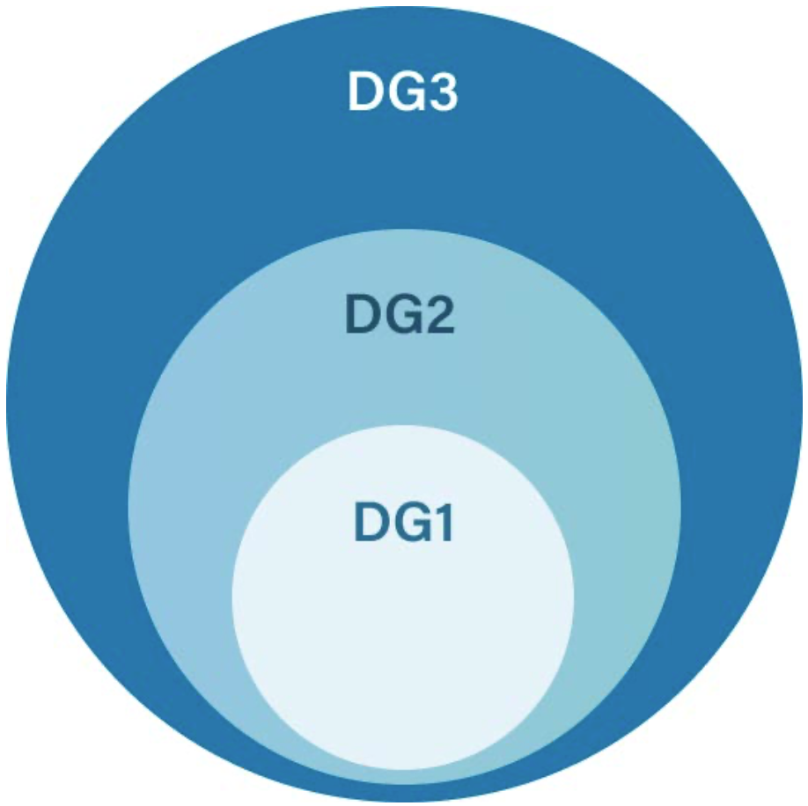
Development Groups: Not One Size Fits All
Group | Description | CMS example
DG1 | Largely uses off-the-shelf / open source software | A university deploying Canvas
DG2 | Custom apps integrated with third-party components | A university building a custom CMS add-on
DG3 | Major investment in custom software | Instructure building Canvas
Different maturity → different expectations, but every group has responsibilities.

Slide 30
Assessment: How Do You Know It’s Working?
“Secure by Design” doesn’t mean “vulnerability-free.”
It means the organization has addressed the six considerations with evidence.
Evidence comes from artifacts naturally produced by development:
Threat models and design documents
Code review records and tool outputs
Bug tracking history (including security bugs)
Test results (including security tests)
Vulnerability response records
“Evidence created solely to satisfy an assessor should be considered with great suspicion.”
Notes:
From the paper, pp.15-18. This is a crucial point about what “secure” means in practice.
No one can guarantee that software is vulnerability-free. That’s impossible (foundational truth #1). What “secure by design” means is that the organization has systematically addressed each of the six considerations and can demonstrate this through evidence.
The paper makes a strong distinction between authentic evidence and performative evidence: - Authentic evidence: threat models that are actually used to guide design decisions, code review comments that show security issues being found and fixed, bug tracking entries showing security bugs being triaged and resolved, SAST tool outputs showing issues trending downward over time. - Performative evidence: documentation created solely to check a compliance box, threat models that are written once and never updated, security policies that exist on paper but aren’t followed in practice.
The quote at the bottom is from p.15 of the paper and is worth emphasizing: if the only evidence of security practices is documentation created for an auditor, that’s a red flag.
For students, this connects to software engineering practices they already know: version control, code review, issue tracking, CI/CD. The argument is that if you’re already doing these things well, the security artifacts should be a natural extension, not a separate bureaucratic process.
The paper also discusses the role of testing vs. formal verification: “Testing is insufficient to confirm that a system is free from exploitable errors – any finite amount of testing can confirm the presence of errors, but not their absence” (p.16). This is a foundational concept in computer science (echoing Dijkstra) applied to security.

Slide 31
How Does Your Experience Compare?
Think about a software project you’ve worked on:
A class project, internship, open source contribution, personal project
Which of the six considerations did you address?
Secure Design
Secure Development
Secure Default Configuration
Supply Chain Security
Code Integrity
Vulnerability Remediation
Which did you completely ignore?
Notes:
This is the interactive moment. Give students about 30-60 seconds to think, then ask for 2-3 volunteers to share.
Expected patterns:
- Most class projects address almost none of these
– maybe some basic input validation, maybe using a framework that provides some security features by default, but no threat modeling, no security testing, no dependency management.
- Internship experiences vary widely: some companies have mature SDL practices (especially larger tech companies), while others don’t.
- Open source projects might have some of these (especially vulnerability remediation if they use GitHub’s security features), but often lack formal threat modeling or security testing.
The point isn’t to shame anyone – it’s to show the gap between what they’ve experienced and what professional secure development looks like. This is what the rest of their education and career is about bridging.
If a student mentions a positive experience (“at my internship, we had SAST in the CI pipeline and security code reviews”), highlight it and ask them to elaborate. Real-world examples from peers are powerful.
You might also ask: “For the considerations you ignored – what could have gone wrong?” This connects the abstract framework to concrete consequences.

Slide 32
Putting It All Together
We’ve seen that secure software requires:
Secure Design: Architecture that resists attack (CIA, access control, least privilege)
Secure Development: Practices and tools throughout the coding process
Secure Defaults: Ship locked down; minimize attack surface
Supply Chain Security: Know and vet what you depend on
Code Integrity: Protect the development and delivery pipeline
Vulnerability Remediation: Find, fix, and learn from bugs continuously
All of this rests on organizational commitment and the SSDF framework.
Notes:
Ask: “Can someone name the six considerations?” as a quick check.
Emphasize the interconnections:
- Secure design informs what secure development practices are needed
- Secure development produces the evidence that assessment relies on
- Secure defaults reduce the attack surface that supply chain risks compound
- Code integrity protects everything you’ve built
- Vulnerability remediation feeds back into all the others
Also emphasize the continuous nature: this isn’t a waterfall process where you “do security” once. In modern Agile/DevSecOps environments, every sprint, every feature, every configuration change is an opportunity to get security right or wrong. The process must be woven into how work gets done every day.

Slide 33
Further Reading
Assigned:
CIS/SAFECode, Secure by Design: A Guide to Assessing Software Security Practices (2025)
See also: Appendix A of the paper for a comprehensive resource list.
Foundational:
Saltzer & Schroeder, “The Protection of Information in Computer Systems” (1975)
NIST SP 800-218, Secure Software Development Framework
Practical:
Google, “Secure by Design at Google” (2024)
CISA Secure by Design resources
Notes:
The paper’s Appendix A (pp.21-22) has an extensive list of resources.
For students who want to go deeper: - Saltzer & Schroeder is the classic paper on design principles. It’s readable and foundational.
- The NIST SSDF (SP 800-218) is the framework that the CIS/SAFECode paper builds on. Available free online.
Google’s “Secure by Design at Google” whitepaper (Christoph Kern, 2024) is a great case study of how a large organization implements these principles in practice.
The CISA Secure by Design website has pledge signatories, case studies, and practical guidance.

