Slide 1


Secure Systems Engineering and Management
A Data-driven Approach
Michael Hicks
Coverage-guided Fuzzing
UPenn CIS 7000-003
Spring 2026

Slide 2

What is Fuzzing?
A kind of random testing
Goal: make sure certain bad things don’t happen, no matter what
Crashes, thrown exceptions, non-termination
These can lead to security vulnerabilities
Complements functional testing
Test features (and lack of misfeatures) directly
Normal tests can be starting points for fuzz tests
Notes:
Define fuzzing: an automated testing technique that generates inputs to find bugs — crashes, hangs, memory safety violations, assertion failures. Emphasize that “bugs” here overwhelmingly means the kinds of memory corruption errors students already understand from earlier in the course (buffer overflows, use-after-free, etc.). Fuzzing is surprisingly effective despite being conceptually simple — it has found more real-world vulnerabilities than arguably any other automated technique. Mention AFL’s “trophy case” of hundreds of CVEs as a motivating example.

Slide 3
Context: Quality Gates for Secure Software
Gate | When | What
Compiler | Every build | Type errors, warnings
Tests + linting | Check-in / CI | Functional correctness, bug patterns
Fuzzing | Post check-in / nightly | Bugs that tests miss
Release fuzzing | Before shipping | Extended campaign (days/weeks)
A kind of “penetration testing”
Notes:
Now that students know what fuzzing is, place it in the quality assurance pipeline they’re familiar with. Each stage is a “gate” — code must pass to proceed.
Compiler: the first gate. You can’t even run your code if it doesn’t compile. The compiler catches type errors, syntax errors, and (with warnings enabled) some suspicious patterns. This is instantaneous and mandatory.
Unit tests + linting/analysis: triggered on check-in (CI). Fast functional tests verify expected behavior. Linters and lightweight static analyzers catch common mistakes — dead code, unused variables, simple security issues. This gate runs in minutes and blocks merging if it fails.
Post check-in fuzzing: after code lands, run fuzzing campaigns overnight or continuously. This targets the changed code and its neighbors. The goal is to find bugs that functional tests miss — edge cases, unexpected input combinations, memory safety issues that only manifest with specific inputs. Tools like OSS-Fuzz and ClusterFuzz automate this as continuous fuzzing infrastructure.
Release fuzzing: before shipping a release, run extended fuzzing campaigns (days to weeks). This is analogous to penetration testing — a final adversarial check. No new release unless the fuzzing campaign is clean. Microsoft’s Security Development Lifecycle (SDL) explicitly requires fuzzing as a verification activity before release.
REFERENCES:
- Microsoft SDL: “Microsoft Security Development Lifecycle Practices” — fuzzing is a required verification activity (see SDL Practice #10: Dynamic Analysis). https://www.microsoft.com/en-us/securityengineering/sdl/practices
- Google’s approach to continuous fuzzing: Kostya Serebryany, “Continuous Fuzzing with libFuzzer and AddressSanitizer,” IEEE SecDev 2016.
- The Fuzzing Book (fuzzingbook.com) by Andreas Zeller, Rahul Gopinath, Marcel Böhme, Gordon Fraser, and Christian Holler — Chapter 1 provides an excellent interactive introduction to fuzzing in the context of software testing.

Slide 4

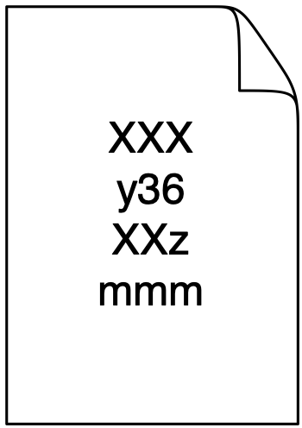
The Fuzzing Loop
Start with some seed inputs
Pick one to mutate
Feed the mutated input to the program
If something “interesting” happened, keep it
Repeat
Notes:
Present this as the informal, intuitive version. Every fuzzer implements this loop — what differs is how they answer each step. Don’t introduce formal names yet; those come in Section 3b. Emphasize that this is deceptively simple and that the choices within each step are what separate a good fuzzer from a bad one. Foreshadow: the rest of the lecture is about what “interesting” means, how to pick inputs, and how many mutations to try.

Slide 5
The Key Questions
What counts as “interesting”?
Which input do you mutate next?
How many mutations do you generate?
Different answers → dramatically different results
Notes:
These three questions frame the entire lecture. Black-box fuzzers: interesting = crash, pick randomly, generate as many as possible. Coverage-guided (greybox): interesting = new code coverage, pick strategically, allocate effort based on how explored a path is. White-box: interesting = new path constraint, pick via solver, generate one precisely targeted input. We’ll see how AFL answers each, and how AFLFast improves those answers.

Slide 6
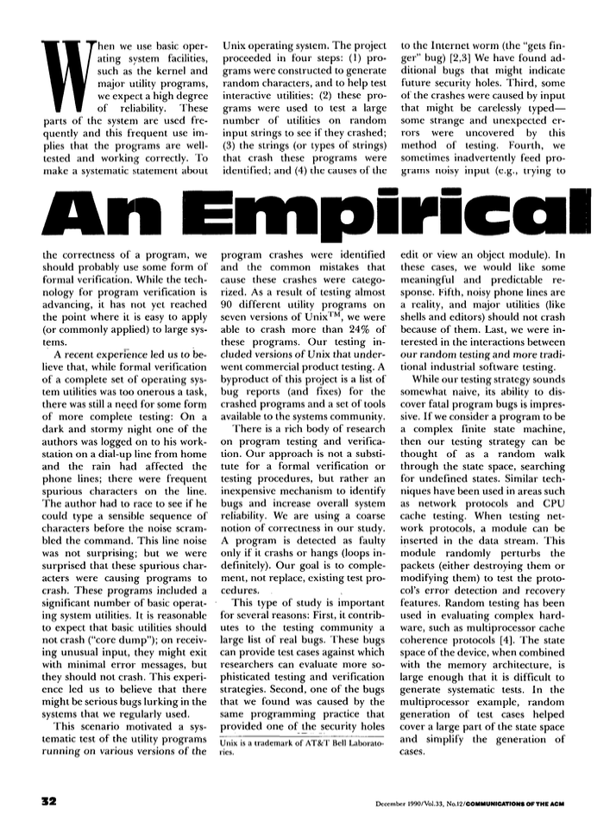
Fuzzing Starts in 1990
Miller et al. piped random strings into UNIX utilities
Crashed 25–33% of them
Notes:
Barton Miller’s 1990 study: students generated random inputs and fed them to standard UNIX command-line utilities. A quarter to a third crashed.
This was pure black-box fuzzing — no knowledge of the program, no feedback.
The finding was shocking at the time and arguably launched the field.
The key limitation: purely random, no way to guide the search toward interesting behavior.
You’re just hoping to get lucky. But the sheer number of bugs found by such a simple technique was the wake-up call.

Slide 7

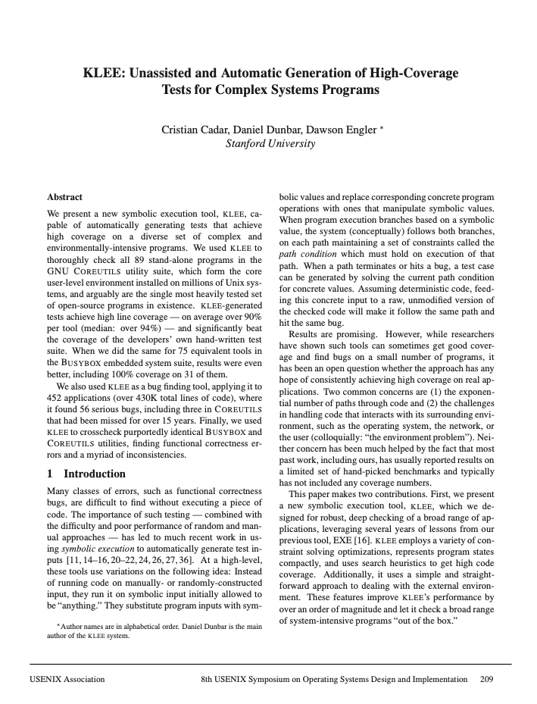
2000s: Smarter Input Generation
Grammar-based: SPIKE, Peach, Sulley — Encode format knowledge to generate valid-ish inputs
Symbolic execution: SAGE, KLEE — Solve path constraints to explore systematically
“white box” as compared to Miller’s “black box” approach
Notes:
Two responses to the limitations of pure random testing.
Grammar/generational fuzzers: if you know the input format (e.g., HTTP, PDF, PNG), you can generate inputs that are structurally valid but contain interesting variations. Very effective but requires significant manual effort to write the grammar/spec for each target.
Symbolic execution (white-box): treat the program as a set of path constraints, use an SMT solver to generate inputs that exercise each path.
- SAGE at Microsoft found ~1/3 of all security bugs in Windows 7 file parsers.
- KLEE generates high-coverage test suites automatically.
The problem: path explosion, solver timeouts, doesn’t scale to large programs. These are “heavyweight” — they require deep program analysis.

Slide 8
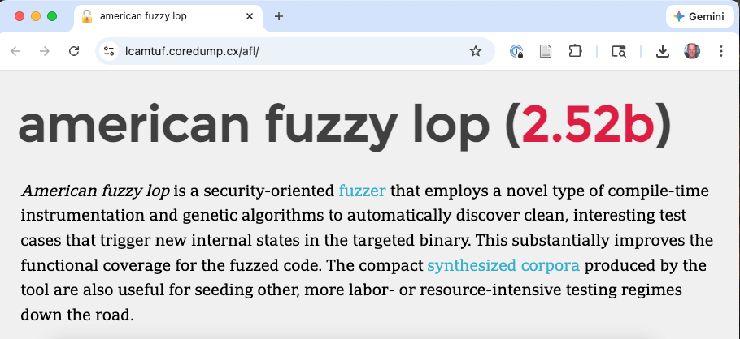
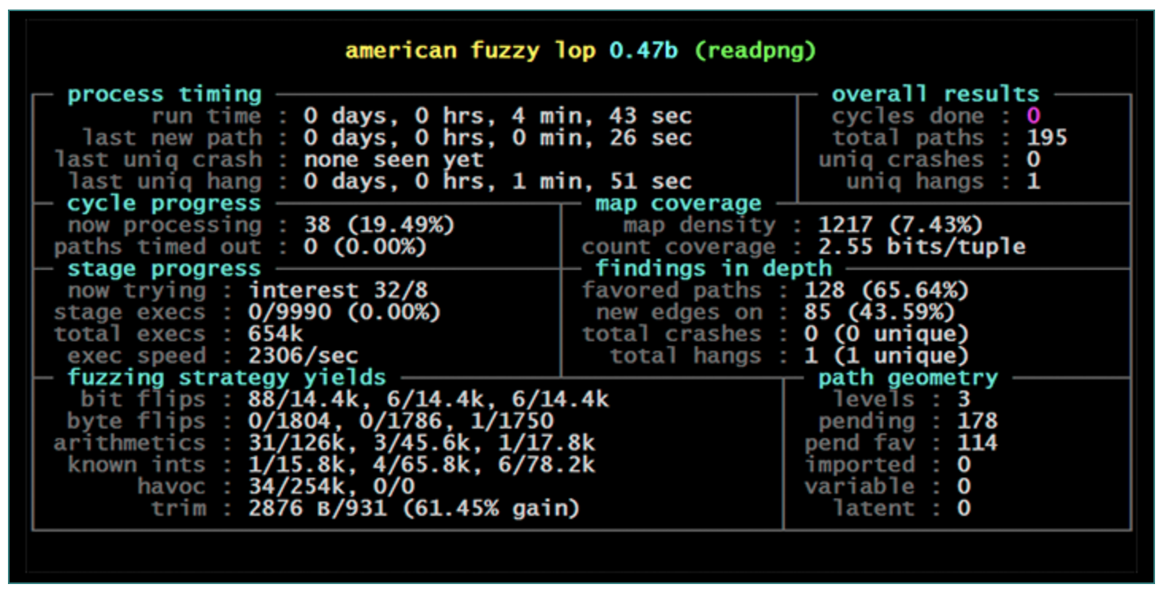
2013: AFL Changes Everything
Michal Zalewski (lcamtuf)’s insight: lightweight instrumentation gives coverage feedback without program analysis
Greybox = black-box speed + white-box intelligence
Notes:
AFL (American Fuzzy Lop) by Michal Zalewski (lcamtuf). The key insight: you don’t need full symbolic execution or grammar knowledge. Just add a tiny bit of instrumentation to track which code edges are hit, and use that as feedback to guide mutation.
This is “greybox” — more information than black-box (you see coverage), less than white-box (no path constraints or program analysis). AFL is fast (thousands of executions per second), requires no program analysis, scales to real-world programs, and has been extraordinarily successful. The rest of the lecture explores how this works in detail.

Slide 9
Blackbox fuzzing (e.g., Radamsa)
Initial Seed
RNG
Random bits
Repeatedly mutate an initial (binary) seed
Mutator
Mutated
input
Fuzzer
Binary Input
x 1,000,000
Program Under Test
Crash?
Report to User

Slide 10
Coverage-guided fuzzing (AFL)
Initial Seed
RNG
Random bits
Only mutate seeds that induced new execution paths
Mutator
Mutated
input
Binary Input
Fuzzer
Seed Pool
x 1,000,000
Yes
No
Instrumentation
Program Under Test
New
Paths?
Throw away
Crash?
Report to User
Coverage info

Slide 11
AFL’s Instrumentation
a
1
b
2
c
4
3
d

Slide 12
AFL’s Instrumentation
cur_location = <COMPILE_TIME_RANDOM>; shared_mem[cur_location ^ prev_location]++; prev_location = cur_location >> 1;
a
1
b
Edge | Index
1 | b^(a>>1)
2 | c^(b>>1)
3 | d^(c>>1)
4 | d^(b>>1)
…
2
c
4
3
d
Notes:
Show Listing 1 from AFLFast paper. Explain each line:
cur_location: a random ID assigned to each basic block at compile time (or by binary instrumentation via QEMU).
shared_mem[cur_location ^ prev_location]++: XOR of current and previous block IDs gives an edge identifier. The shared_mem array is a 64KB bitmap — each byte counts how many times a particular edge (A→B) was traversed during this execution.
prev_location = cur_location >> 1: the right-shift ensures that edge (A,B) has a different index than edge (B,A) — directionality is preserved.
This is injected at every branch point in the instrumented binary. The overhead is tiny — a few percent at most. After execution, AFL reads this 64KB bitmap to determine what the input did.

Slide 13
Edge Coverage, Not Block Coverage
Edges capture control flow transitions, not just “which code ran”
After each run, hit counts are bucketed: 1, 2, 4, 8, 16, 32, 64, 128+
a
1
b
Edge | Index | P1 | P2
1 | b^(a>>1) | 1 | 1
2 | c^(b>>1) | 1
3 | d^(c>>1) | 1
4 | d^(b>>1) |  | 1
…
2
c
4
3
d
Notes:
Why edges, not basic blocks? Two inputs might hit the same set of blocks but take different paths through them (e.g., a loop body executed once vs. twice). Edge coverage captures this.
The shared_mem bitmap stores hit counts, but AFL “buckets” them into powers of two. So hitting an edge 3 times vs. 4 times looks the same, but 1 time vs. 2 times is different. This manages “path explosion” — without bucketing, every different loop iteration count would look like a new path. With bucketing, you get a coarse but useful signal. An input is “interesting” if it produces a new edge OR a new hit-count bucket for an existing edge.
Important clarification on when bucketing happens — this is a two-stage process:
1. DURING execution: the instrumentation code (Listing 1) simply increments shared_mem[] with ++. The bitmap collects raw hit counts for this single run.
2. AFTER execution: AFL applies a `classify_counts` function that maps raw counts into coarse buckets: 1, 2, 3, 4–7, 8–15, 16–31, 32–127, 128+. It then compares the bucketed per-run bitmap against the global coverage map. If any byte falls into a bucket not previously seen in the global map, the input is "interesting" (this is the ISINTERESTING check in Algorithm 1).
So the shared_mem code on the previous slide is the complete instrumentation — it's intentionally minimal for speed. The intelligence is in the post-execution comparison, not in the instrumentation itself.

Slide 14
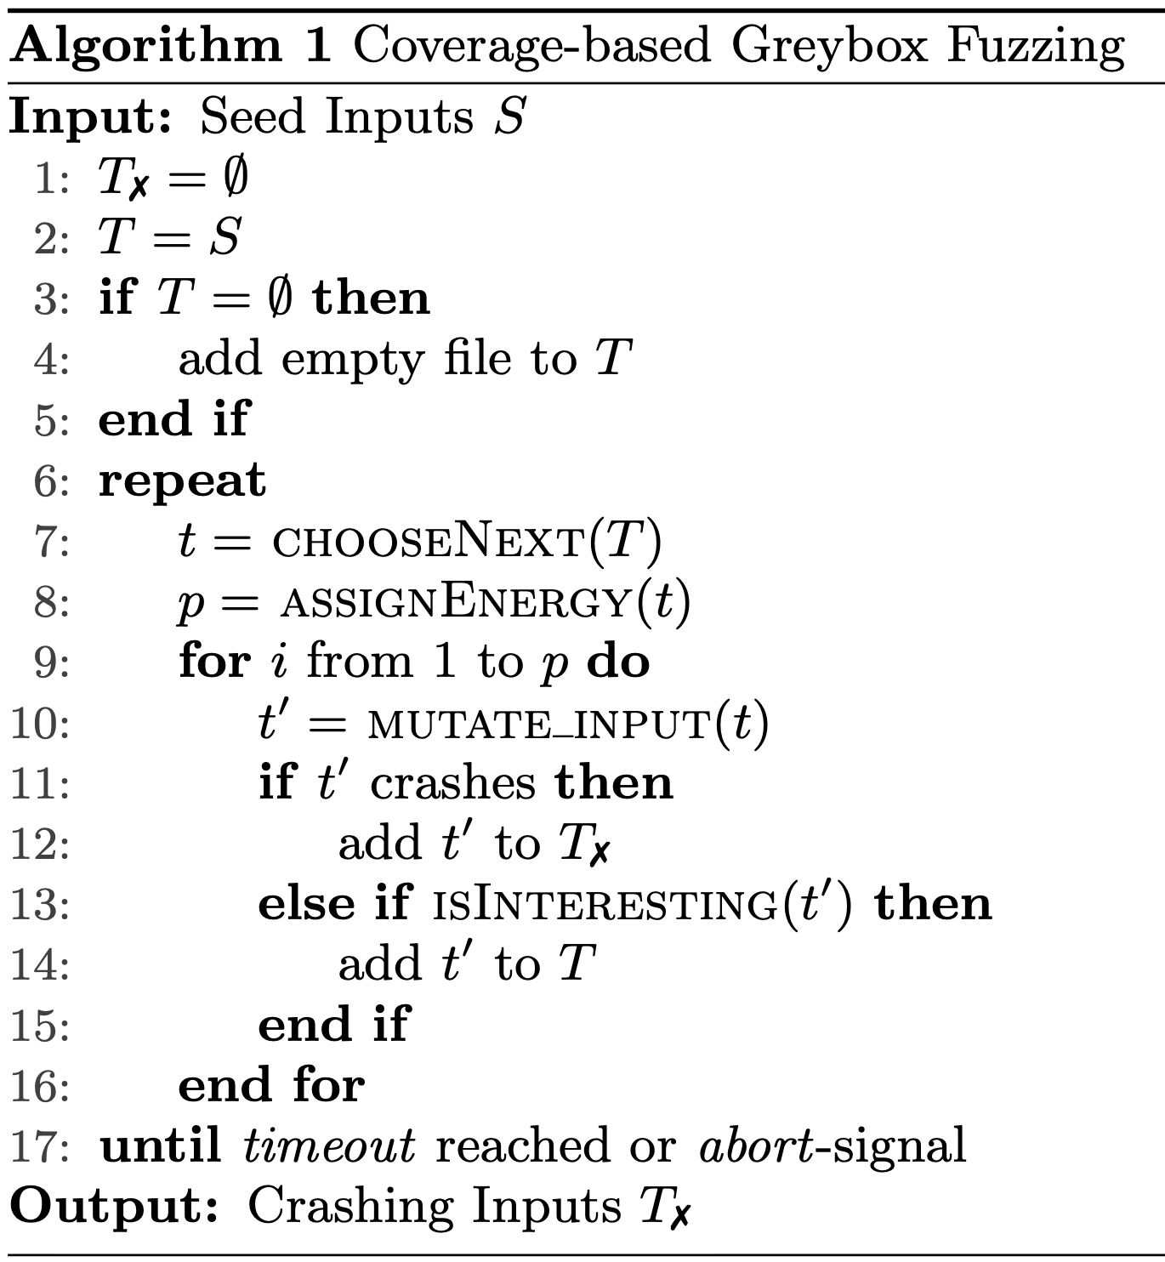
The Fuzzing Loop
Start with some seed inputs
Pick one to mutate
Feed the mutated input to the program
If something “interesting” happened, keep it
Repeat
Notes:
We introduced the informal loop earlier. Now we map each step to AFL’s specific implementation using Algorithm 1 from the AFLFast paper.
Bucketing, mentioned on previous slide, happens during “isInteresting”

Slide 15
Choose and Allocate
Pick an input: CHOOSENEXT
Circular queue, favorites first
How many mutations? ASSIGNENERGY
~80K per seed (~1 min)
Notes:
CHOOSENEXT: AFL maintains a circular queue of seeds. It processes them in order, but marks certain seeds as “favorites” — the fastest and smallest input for each edge. Non-favorites are mostly skipped. This is the first place where scheduling matters, and where AFLFast will propose changes.
ASSIGNENERGY: This is the “power schedule.” AFL computes how many mutations to generate from this seed based on execution time, coverage, and creation time. In practice, AFL assigns fairly constant high energy — about 80K inputs per seed, taking roughly one minute. This addresses “rapid mixing” (getting the queue seeded quickly) but has downsides we’ll see shortly.

Slide 16
Mutate and Evaluate
Mutate the input: MUTATE_INPUT:
bit flips, arithmetic, boundary values, block splice
Evaluate
Run instrumented binary, read bitmap
Interesting? ISINTERESTING
new edge or new hit-count bucket → keep
Notes:
MUTATE_INPUT: AFL’s mutation operators are simple but effective. Deterministic stage: sequential bit flips (1, 2, 4 bits), sequential arithmetic (+/- small values), sequential interesting values (0, 1, MAX_INT, etc.). Havoc stage: random combinations of bit flips, arithmetic, block deletion/insertion, splicing with other seeds. These operators are NOT changed by AFLFast — the improvement comes entirely from scheduling, not mutation.
Evaluation: run the binary with the mutated input, wait for it to finish (or timeout/crash), read the shared_mem bitmap.
ISINTERESTING: compare the bitmap to the global coverage map. If any byte is in a new bucket (e.g., an edge was hit for the first time, or hit 2 times when we’ve only seen 1), the input is “interesting” — add it to the queue as a new seed. If the program crashed, save the input to the crashes directory. Otherwise, discard it.
The queue grows over time as new coverage is discovered. Each new seed becomes a starting point for future mutation.

Slide 17
A Simple Target Program
void crashme (char* s) { if (s[0] == 'b') if (s[1] == 'a') if (s[2] == 'd') if (s[3] == '!') abort(); }
How would a blackbox fuzzer behave on this program?
How would AFL behave?
Notes:
Show Listing 2 from AFLFast paper. This takes a 4-character input and crashes only on “bad!”. There are 5 execution paths based on how deep you get:
Path 0 (****): doesn’t start with ‘b’ — the vast majority of random inputs
Path 1 (b***): starts with ‘b’ but second char isn’t ‘a’
Path 2 (ba**): starts with “ba” but third char isn’t ‘d’
Path 3 (bad*): starts with “bad” but fourth char isn’t ‘!’
Path 4 (bad!): the crash — only one input out of ~4 billion
This is a toy example but it perfectly illustrates the real problem: most random inputs exercise the same shallow path.

Slide 18
A Simple Target Program
void crashme (char* s) { if (s[0] == 'b') if (s[1] == 'a') if (s[2] == 'd') if (s[3] == '!') abort(); }
void crashme2 (char* s) { if (*(int *)s == 0x2a1646162)
abort(); }
How about this program?
Notes:
Show Listing 2 from AFLFast paper. This takes a 4-character input and crashes only on “bad!”. There are 5 execution paths based on how deep you get:
Path 0 (****): doesn’t start with ‘b’ — the vast majority of random inputs
Path 1 (b***): starts with ‘b’ but second char isn’t ‘a’
Path 2 (ba**): starts with “ba” but third char isn’t ‘d’
Path 3 (bad*): starts with “bad” but fourth char isn’t ‘!’
Path 4 (bad!): the crash — only one input out of ~4 billion
This is a toy example but it perfectly illustrates the real problem: most random inputs exercise the same shallow path.

Slide 19
Interlude: AFL++ Demo

Slide 20
Five Paths, Wildly Different Probabilities
Path | Pattern | Probability
0 | **** | ~255/256
1 | b*** | ~1/256 × 255/256
2 | ba** | ~1/65K
3 | bad* | ~1/16M
4 | bad! | ~1/4B
Notes:
For a random 4-character string from the full ASCII range (256 values per byte): the probability of starting with ‘b’ is 1/256, then ‘a’ is another 1/256, etc. Path 0 captures essentially everything — it’s the “high-density region.” Path 4 (the crash) has probability roughly 1/4 billion from a purely random input. This is why pure black-box fuzzing is hopeless for this kind of bug. But even coverage-guided fuzzing has a subtler problem, which we’ll see next.

Slide 21
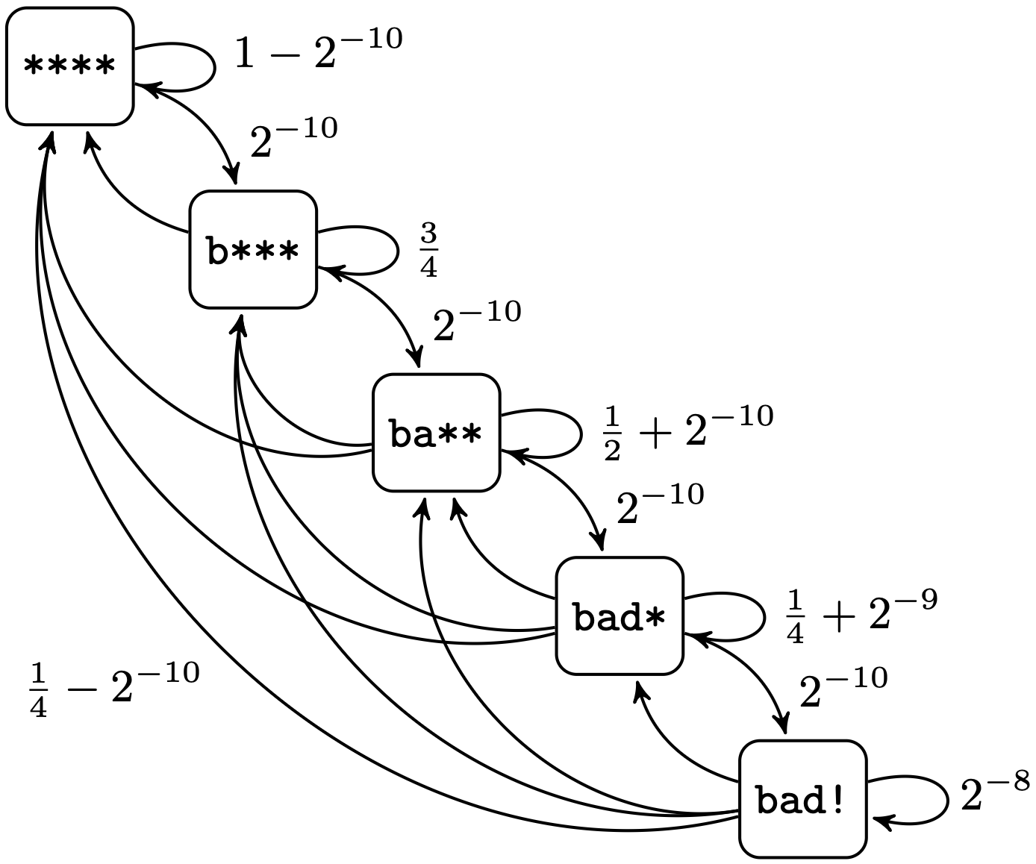
Modeling as a Markov Chain
Notes:
Walk through it: If the current input is “bill” (state b), the fuzzer randomly changes one of the 4 characters. The probability of transitioning to ba is 2^{-10} (need to pick position 1, pick ‘a’, from 256 choices). The probability of staying in b** is about 3/4. The probability of going back to **** is about 1/4.
The key insight: from state ****, the probability of reaching b*** is also about 2^{-10}. So the random walk keeps returning to the high-density state ****. This is “rapid mixing” — the Markov chain quickly converges to a stationary distribution heavily concentrated on ****.
Don’t belabor the Markov chain formalism. The intuition is: think of the fuzzer as a random walk on this graph, and notice that it spends almost all its time at the top.

Slide 22
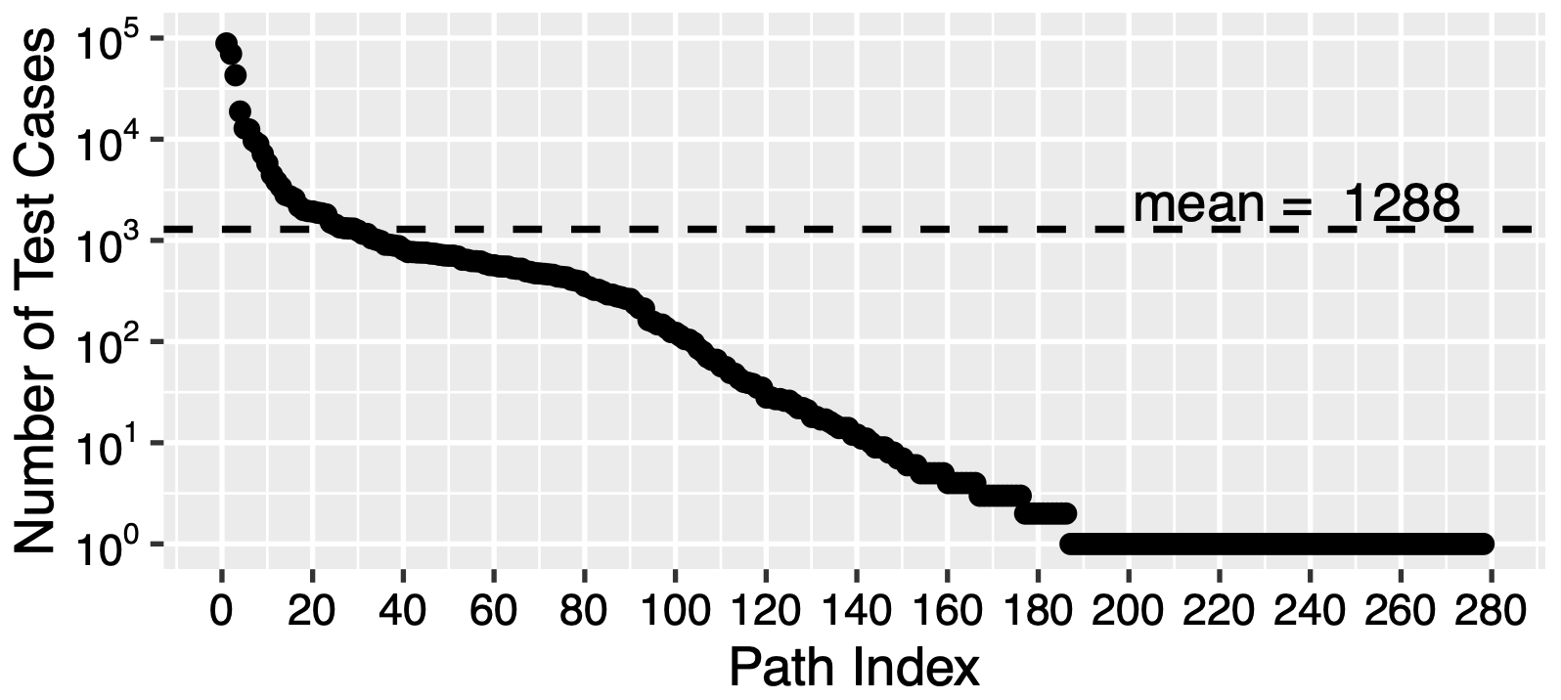
The Long Tail of Path Frequency
Notes:
FIGURE: Display Figure 1 from the AFLFast paper — the log-scale distribution of #fuzz per path after running AFL for 10 minutes on the nm tool.
Key observations to highlight:
- The Y axis is log scale — the distribution spans 5 orders of magnitude
- 30% of paths are exercised by just a single generated input
- 10% of paths are exercised by 1K to 100K inputs
- The mean is 1,288 but the distribution is wildly skewed
This is the same phenomenon as the crashme example, but in a real program: a few paths are “attractors” that receive enormous amounts of fuzz, while many paths are barely touched. This motivates the need for smarter scheduling.

Slide 23
AFL’s Two Scheduling Problems
More energy than needed on well-explored paths
Too much energy in high-density regions of the path space
Notes:
Summarize the Markov chain analysis.
Problem 1: AFL assigns constant high energy (~80K mutations per seed). For seeds that exercise well-explored paths, most of those mutations will produce inputs we’ve seen before — wasted work. The “minimum energy” to discover the next new path might be much less.
Problem 2: As the queue grows, many seeds exercise high-frequency paths. Each gets the same high energy. So the fuzzer spends most of its time generating variants that all land in the same dense region of the path space, when it should be exploring the sparse regions where undiscovered bugs hide.

Slide 24
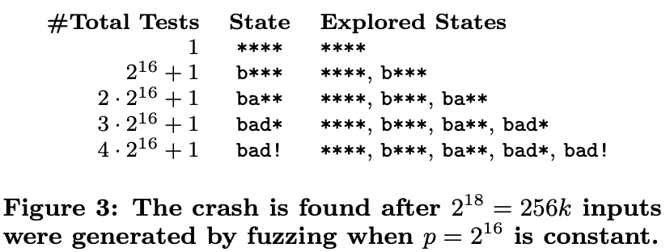
The Waste: 256K Inputs to Find One Crash
Notes:
FIGURE: Display Figure 3 and/or Figure 4 from the AFLFast paper — the table showing how AFL with constant energy p=2^16 explores the crashme example.
Walk through the example step by step:
- Start with seed “ball” → state ba
- Cycle 1: fuzz “ball” with 2^16 inputs. About 1/4 exercise ** and 1/4 exercise b. Two new seeds discovered.
- Cycle 2: fuzz first discovered seed (state ). All fuzz exercises path . No new seeds.
- Cycle 3: fuzz second discovered seed (state b). 1/4 exercises **** and 3/4 exercises b. No new seeds.
- Cycle 4: back to “ball” (state ba). Still generating mostly *** and b**.
- This continues for many cycles…
- Eventually bad is discovered, then finally bad!
- Total: 4 × 2^16 = 256K inputs to find the crash
The problem is visible in Figure 4: in every row, the **** column dominates. The fuzzer keeps pouring energy into the highest-frequency path.

Slide 25
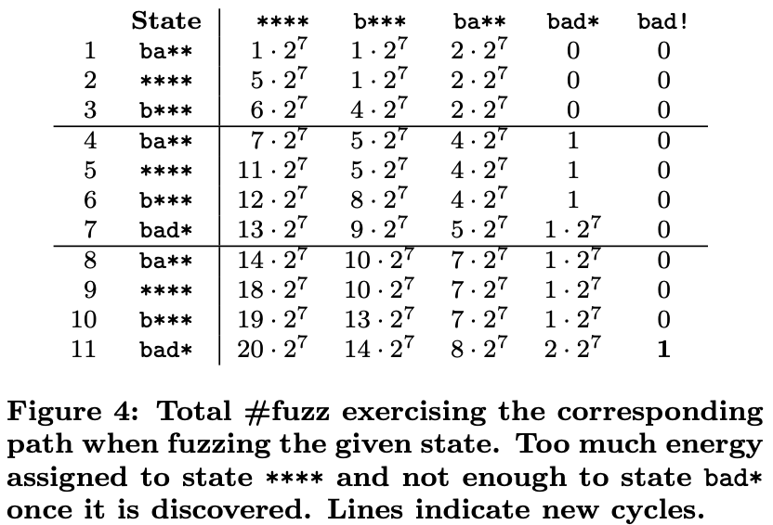
The Waste: 256K Inputs to Find One Crash
Notes:
FIGURE: Display Figure 3 and/or Figure 4 from the AFLFast paper — the table showing how AFL with constant energy p=2^16 explores the crashme example.
Walk through the example step by step:
- Start with seed “ball” → state ba
- Cycle 1: fuzz “ball” with 2^16 inputs. About 1/4 exercise ** and 1/4 exercise b. Two new seeds discovered.
- Cycle 2: fuzz first discovered seed (state ). All fuzz exercises path . No new seeds.
- Cycle 3: fuzz second discovered seed (state b). 1/4 exercises **** and 3/4 exercises b. No new seeds.
- Cycle 4: back to “ball” (state ba). Still generating mostly *** and b**.
- This continues for many cycles…
- Eventually bad is discovered, then finally bad!
- Total: 4 × 2^16 = 256K inputs to find the crash
The problem is visible in Figure 4: in every row, the **** column dominates. The fuzzer keeps pouring energy into the highest-frequency path.

Slide 26
Power Schedules: The Key Idea
ASSIGNENERGY decides how many mutations to generate from seed t_i
Three variables control the decision:
s(i): times seed t_i has been chosen from the queue
f(i): total fuzz generated that exercises path i
α(i): AFL’s quality score for the seed
Notes:
Set up the next three slides. The power schedule is implemented by the ASSIGNENERGY function in Algorithm 1. It returns p(i) — the number of inputs to generate by mutating seed t_i. All three schedules use the same variables but combine them differently.
α(i) is AFL’s original judgment of seed quality based on execution time, coverage, and creation time — AFLFast doesn’t change this.
Also mention M (~160K), the upper bound on inputs per fuzzing iteration, which caps all schedules.
μ is the mean number of generated inputs per discovered path: μ = (Σ f(i)) / |S+|.

Slide 27
Schedule 1: AFL’s Default (EXPLOIT)
function ASSIGNENERGY(t_i): return α(i)
Energy is constant — same amount every time t_i is chosen
Notes:
AFL’s default schedule (Equation 1 in the paper). α(i) is computed by AFL’s calculate_score function based on three factors:
(1) execution time — faster seeds score higher (more throughput),
(2) edge coverage — seeds hitting more edges in the bitmap score higher, and
(3) creation time / depth — newer seeds and seeds deeper in the mutation chain score higher (more likely on the exploration frontier).
The base score starts at 100 and is multiplied up or down by factors comparing each property to the queue average.
Crucially, α(i) is a static judgment — it doesn’t change as s(i) and f(i) grow. AFLFast leaves α(i) untouched; it only changes how α(i) is scaled by the schedule. That’s why the paper says AFLFast affects efficiency (paths explored per unit time) but not effectiveness (which paths are reachable) — the mutation operators and transition probabilities are unchanged.
In practice, AFL generates about 80K inputs per seed, taking about one minute. This means every seed gets the same effort regardless of whether its path has been fuzzed 10 times or 10,000 times. The problem: after the initial “burn-in” period, many seeds exercise high-frequency paths. Each one gets 80K mutations, most of which land on paths we’ve already thoroughly explored. This is the “more energy than needed” and “too much energy in high-density regions” problem from Section 3.3.
The constant schedule does have a benefit: rapid mixing. Assigning high energy to initial seeds quickly discovers their neighbors. But after the queue grows, it becomes wasteful.

Slide 28
Schedule 2: Cut-Off Exponential (COE)
function ASSIGNENERGY(t_i): if f(i) > μ: return 0 else: return min(α(i)/β · 2^s(i), M)
Path is above-average frequency; skip it entirely
Skip high-frequency paths; exponentially increase energy for rare ones
Notes:
Equation 3 in the paper. Two key ideas combined:
The cut-off: if path i has received more fuzz than the mean (f(i) > μ), assign ZERO energy. Don’t fuzz this seed at all this round. This aggressively avoids wasting time on high-frequency paths. As other paths receive more fuzz, μ rises, and eventually the cut-off paths become eligible again.
Exponential growth: for eligible seeds, energy starts low (α(i)/β, where β > 1 shrinks the initial energy) and doubles every time the seed is chosen (2^s(i)). This means: first time a new seed is picked, generate very few inputs — just enough to scout the neighborhood. Each subsequent pick, invest more. This is conservative early (when we don’t know if this is a useful region) and aggressive later (when repeated selection suggests it’s in a low-density region worth exploring).
The min with M prevents energy from growing unboundedly.
This is the schedule used in the crashme example (Figure 5) that achieved 4K inputs vs. 256K.

Slide 29
Schedule 3: FAST (AFLFast’s Default)
function ASSIGNENERGY(t_i): if f(i) > μ: return 0 else: return min(α(i)/β · 2^s(i) / f(i), M)
Like COE, but also divides by f(i) — less energy for well-fuzzed paths
Notes:
Equation 4 in the paper. This is the schedule AFLFast actually uses — it extends COE with one crucial change: dividing by f(i), the total amount of fuzz that exercises path i.
Why does f(i) in the denominator matter? Even among paths below the cut-off (f(i) ≤ μ), some have received more fuzz than others. Dividing by f(i) further penalizes paths that have already been well-explored, even if they’re below average. The energy is now inversely proportional to the density of the stationary distribution — this is the key connection to the Markov chain model.
Walk through the intuition with concrete numbers: suppose two seeds both have s(i) = 3 and α(i)/β = 1.
- Seed A exercises a path with f(i) = 8: energy = 2^3 / 8 = 1
- Seed B exercises a path with f(i) = 1: energy = 2^3 / 1 = 8
Seed B gets 8× more energy because its path is 8× less explored. This is exactly the behavior we want: concentrate effort on low-density regions.
The FAST schedule outperforms all other schedules in the evaluation (Figure 10 in the paper). After 24 hours on nm, FAST and COE find ~50% more unique crashes than the linear, quadratic, and explore schedules.

Slide 30
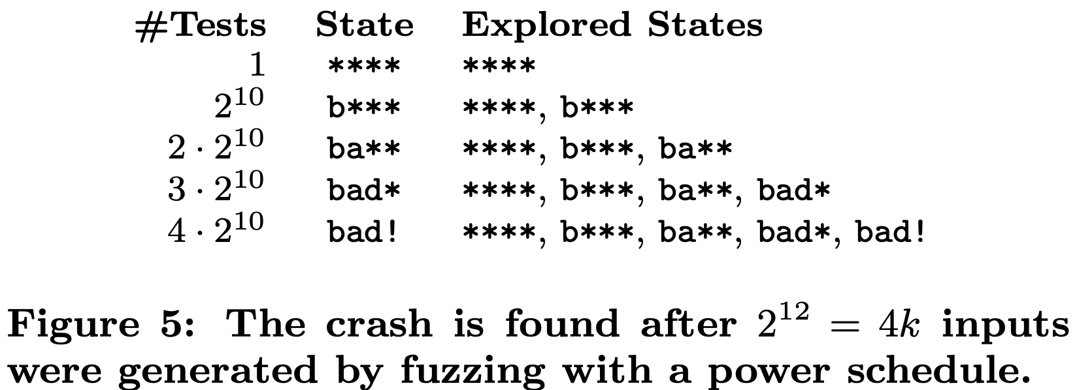
The Payoff: 4K Inputs Instead of 256K
Notes:
FIGURE: Display Figure 5 from the AFLFast paper — the table showing how the COE power schedule with α(i)/β = 1 explores the crashme example.
Walk through the contrast with Figure 3:
- Start with random input → state ****
- Energy is only 2^10 = 1024 (vs. 2^16 = 65K for AFL)
- First iteration: discover b
- Second iteration: discover ba
- Third iteration: discover bad
- Fourth iteration: discover bad!
- Total: 4 × 2^10 = 4K inputs (vs. 256K for AFL) — a 60× improvement
The key difference is visible in the table: energy is allocated much more evenly, and the fuzzer doesn’t waste huge amounts of effort on the **** path.
AFLFast also changes the search strategy: instead of cycling through the queue in order, it prioritizes seeds that (a) have been chosen the fewest times and (b) exercise paths that have received the least fuzz. This further biases exploration toward low-density regions.

Slide 31
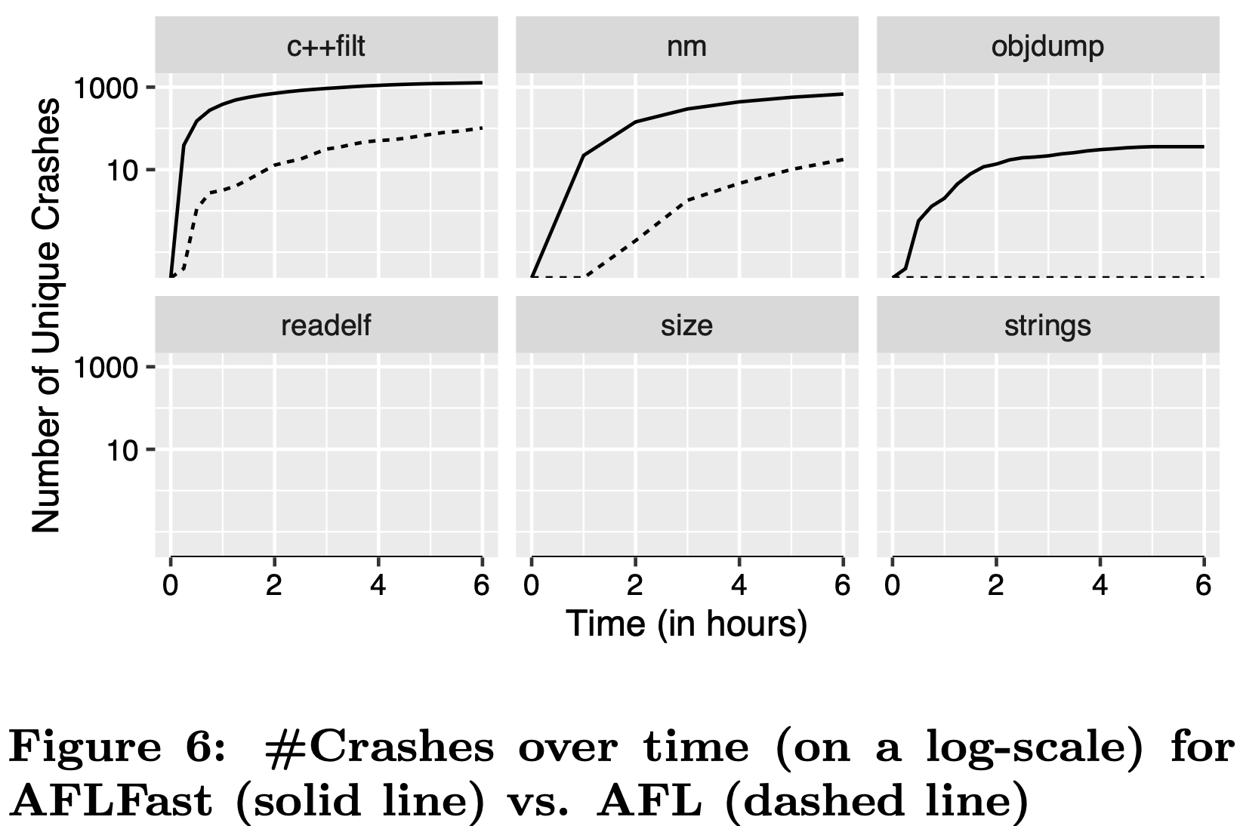
AFLFast Results
9 CVEs in GNU binutils (previously unreported)
7× faster than AFL at exposing known vulnerabilities
3 CVEs not found by AFL in 24 hours at all
Used by Team Codejitsu → 2nd place at DARPA Cyber Grand Challenge
Notes:
Brief summary of the evaluation from Section 5 of the AFLFast paper. The results are impressive: testing GNU binutils (nm, objdump, strings, size, c++filt, readelf), AFLFast found 9 vulnerabilities now listed as CVEs in the National Vulnerability Database. It exposed known CVEs 7× faster on average. Three CVEs were never found by AFL even after 24 hours (8 runs each). AFLFast also reported an order of magnitude more unique crashes.
Team Codejitsu used AFLFast in their bot “Galactica” at the DARPA Cyber Grand Challenge, placing 2nd in terms of number of bugs found across 150 benchmark binaries. On those benchmarks, AFLFast was 19× faster than AFL on average.
But — foreshadow — we should ask: how robust are these results? This leads us to the evaluation section.

Slide 32
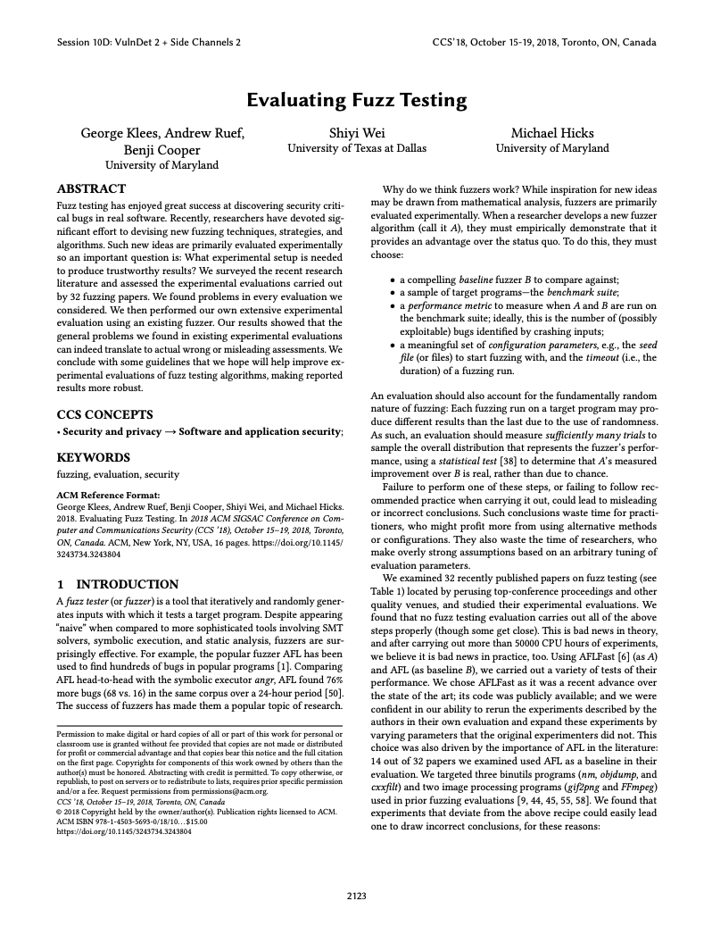
Evaluating Fuzzing Results
Won NSA Best Scientific Cybersecurity Paper Award, Sep. 2019
We looked at 32 published papers from 2012-2018
We found that most papers did some things right, but none were perfect
Carried out experiments on AFLFast that demonstrated the (real) costs of not doing so
Raises questions about the strength of published results
Notes:
Section header. Transition: Those AFLFast results look great. But the Klees et al. “Evaluating Fuzz Testing” paper (CCS 2018) examined 32 fuzzing papers and found problems in every single evaluation — including AFLFast’s. This connects directly to what students learned in the data analysis and cybersecurity science units. The lesson is about scientific methodology, not just fuzzing.
Context for students: Klees et al. specifically chose AFLFast as their case study because it was the state of the art, its code was available, and they could reproduce and extend its evaluation. They ran over 50,000 CPU hours of experiments.

Slide 33
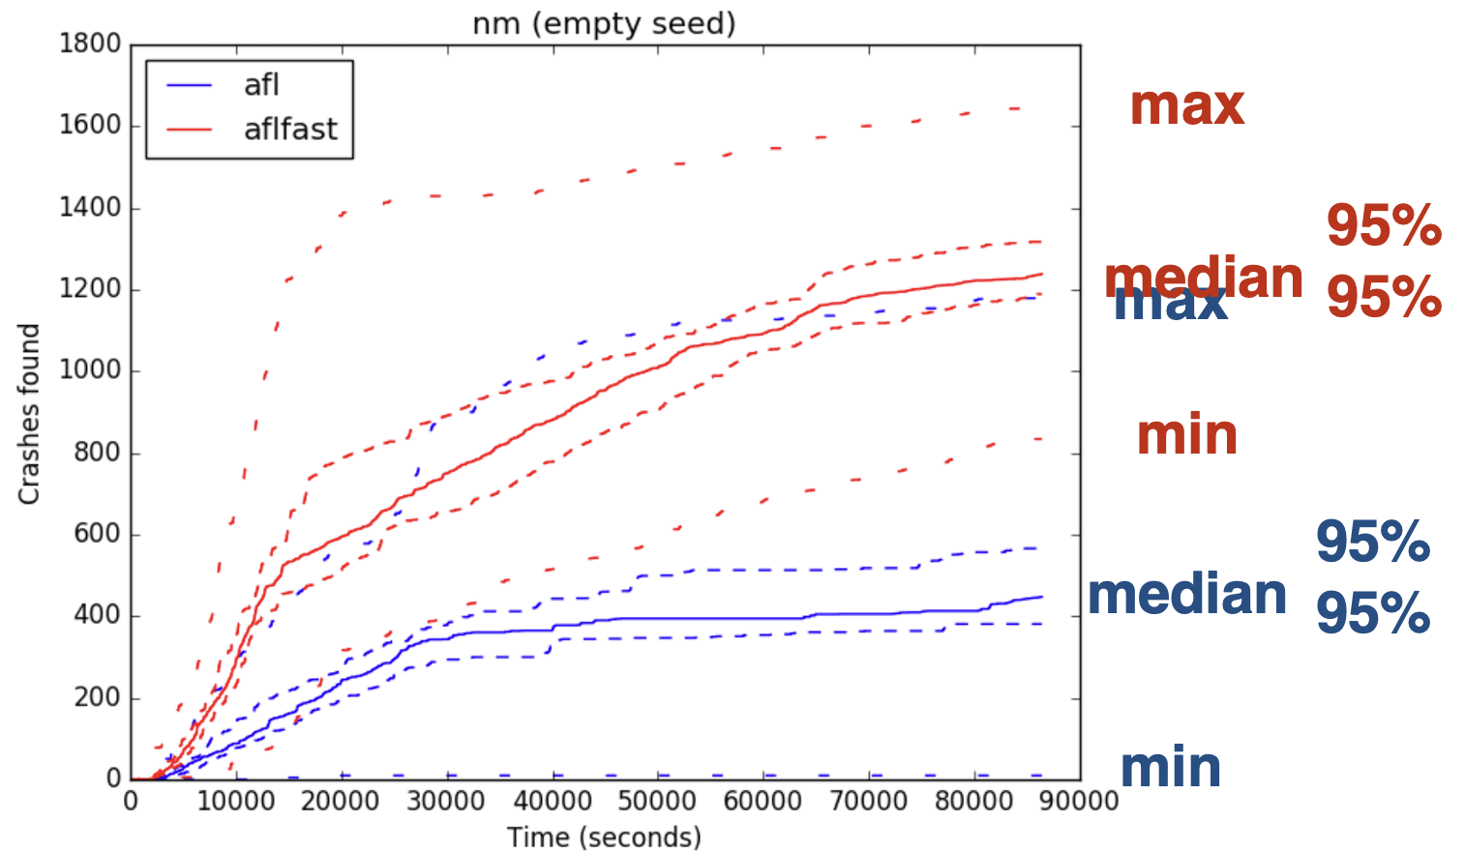
Fuzzing is Random: One Run Proves Nothing
17/32 papers said nothing about multiple trials
Notes:
Crashes found over time for nm, for 30 runs. The solid line is the median, dashed lines are confidence intervals and min/max.
Key point: look at the enormous spread between min and max for each configuration.

Slide 34
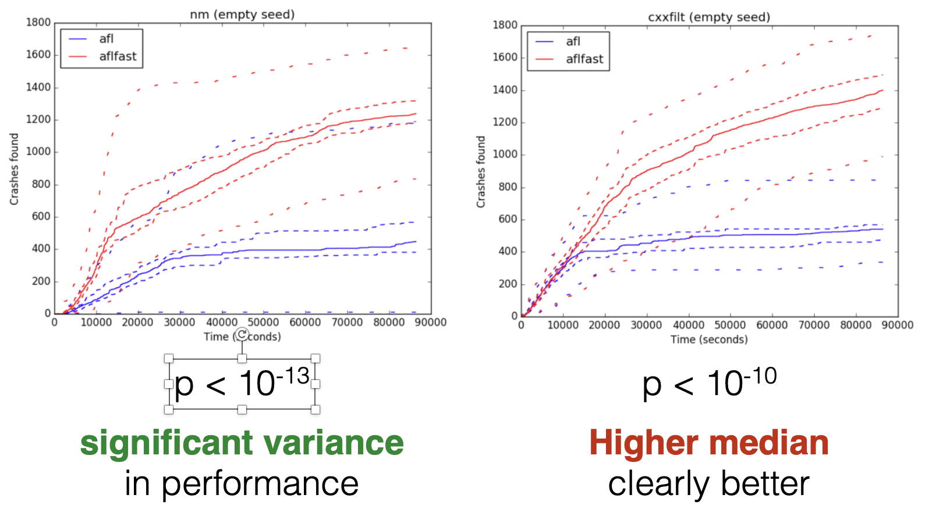
Hypothesis testing: Need Mann Whitney U
Notes:
This is why you need multiple trials and statistical tests. 18 out of 32 fuzzing papers they surveyed ran only a single trial. Connect to hypothesis testing from earlier in the course: Mann-Whitney U test on 30 trials gives meaningful p-values. On nm (empty seed), AFLFast is clearly better (p < 10^-13). But on FFmpeg (p = 0.379) and gif2png (p = 0.068) — no statistically significant difference (next slide).

Slide 35
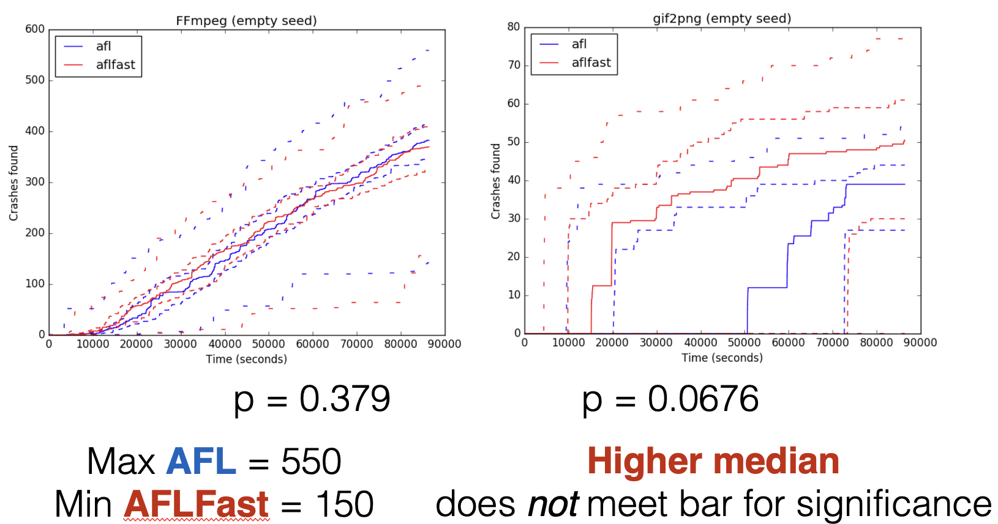
Hypothesis testing: Need Mann Whitney U
Notes:
For FFmpeg, one AFL run found 550 crashes while another found ~50. One AFLFast run found ~150 while another found ~400. If you happened to compare AFL’s best run to AFLFast’s worst run, you’d conclude AFL is much better — the exact opposite of the truth (or at least the median).

Slide 36
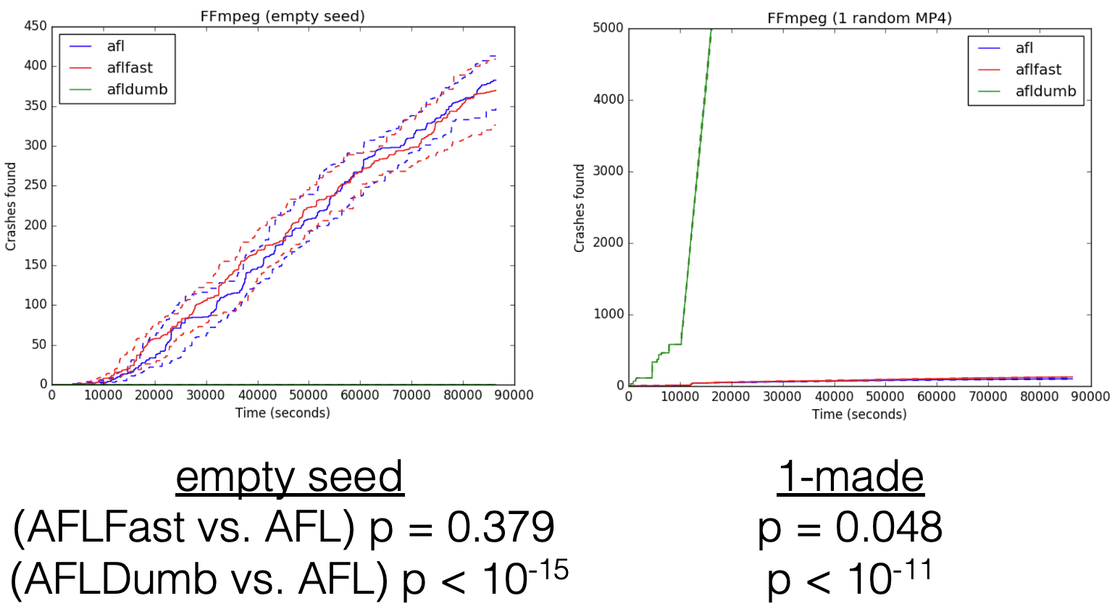
Seeds Have a Big Impact
30/32 papers used non-empty seed
10 say nothing else (N)
9 used valid seed but no details (V)
Notes:
Seed sensitivity: With the empty seed (matching AFLFast’s original evaluation), AFLFast looks good. But with a single valid made seed, AFLNaive (AFL with coverage tracking turned OFF — essentially a black-box fuzzer) produces 5000 crashes vs. AFLFast’s 129. The advantage not only disappears — it reverses. Different seeds interact with different algorithms in surprising ways.

Slide 37
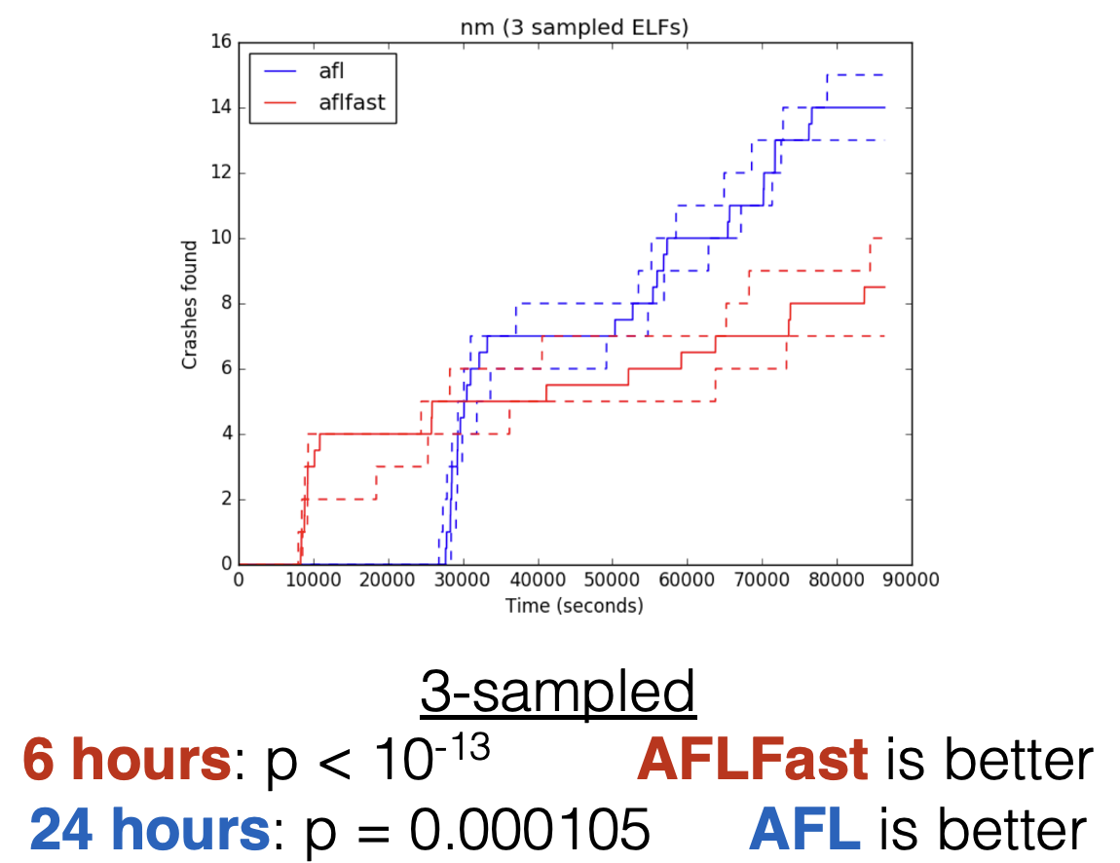
Timeouts too
10/32 papers ran 24 hours
7/32 papers ran 5 or 6 hours
Others less, or much more
Notes:
Timeout sensitivity: Reference Figure 4 from Klees et al. — on nm with sampled ELF seeds, AFLFast dominates at 6 hours (matching AFLFast paper’s 6h timeout) but AFL is significantly better at 24 hours. Relative performance can flip depending on how long you run. 11 of 32 papers used timeouts of 5-6 hours; the AFLFast paper used both 6h and 24h but drew its headline results from the shorter runs.

Slide 38
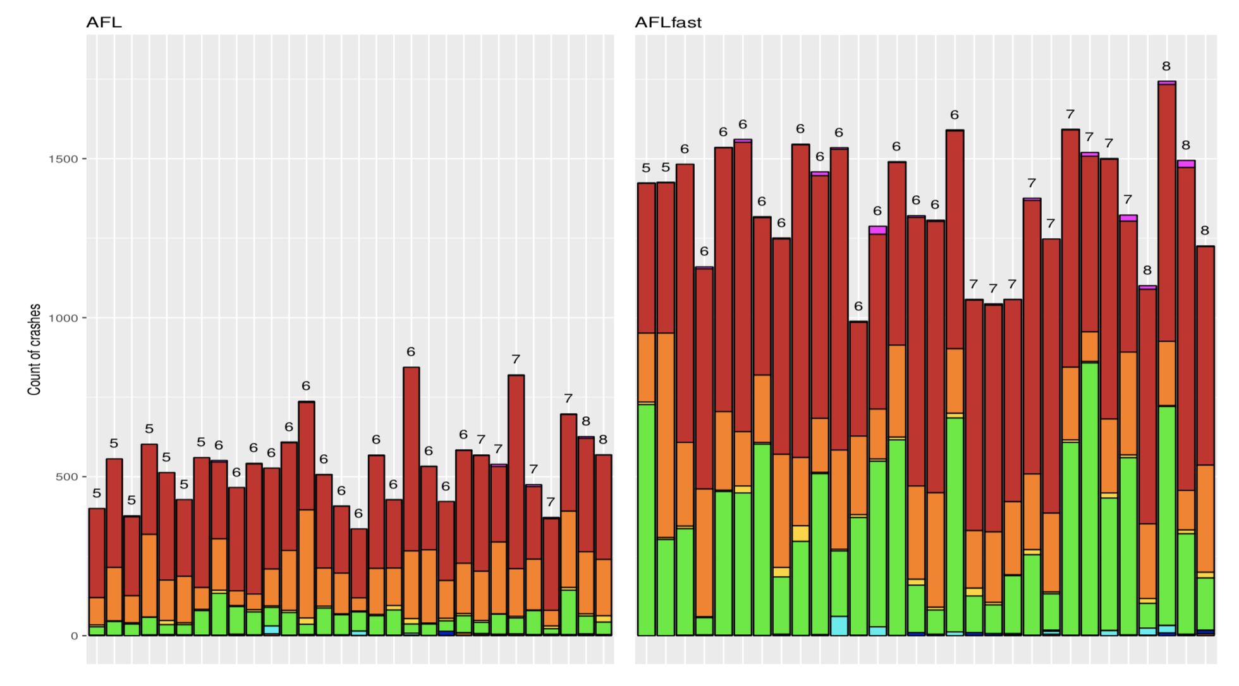
“Unique Crashes” is a Broken Metric
57,142 “unique” crashes in cxxfilt → 9 actual bugs
That’s a 6,339× inflation
Notes:
FIGURE: Display Figure 6 from Klees et al. — the stacked bar chart showing crashes per run for cxxfilt, colored by actual root-cause bug.
This is perhaps the most impactful finding. AFL’s coverage-based deduplication considers two crashes “unique” if they have different edge coverage profiles. But many different inputs can trigger the same underlying bug with slightly different coverage. Klees et al. did painstaking ground-truth analysis: they applied all patches to cxxfilt, built 812 versions, ran every crashing input against each version, and identified which patch fixed which crash. Result: 57,142 coverage-unique crashes mapped to only 9 distinct bugs.
Stack hashing (the other popular dedup method, used by 7 papers) is better but still problematic: ~16% of hashes for one bug were shared by crashes from another bug, and in 5 cases a distinct bug was found by only one crash whose hash was non-unique — so it would have been “deduplicated” away.
Figure 6 shows that AFLFast finds more “unique crashes” per run (taller bars) but the number of actual bugs (number above each bar) is only slightly higher — and the difference is not statistically significant (p = 0.066).
The lesson: if your evaluation metric (unique crashes) is inflated by 3-4 orders of magnitude, apparent improvements on that metric may be illusory. This is a general lesson about measurement that connects to the security measurements unit.

Slide 39
Recommendations
1. Multiple trials (≥30) with statistical tests (Mann-Whitney U) to account for randomness
2. Diverse seeds including the empty seed — report seed details
3. Timeouts of at least 24 hours with performance plotted over time
4. Measure actual bugs found (ground truth), not “unique crashes”
5. Test on a diverse benchmark suite, not just a few hand-picked programs
Notes:
No paper they surveyed met all these criteria.
The AFLFast results largely held up on the binutils programs it was originally tested on, but the advantage disappeared or weakened on additional programs (FFmpeg, gif2png). This doesn’t mean AFLFast is bad — it means the evidence for its superiority is weaker and more nuanced than originally claimed.
Connect back to the course: this is exactly the cybersecurity science methodology you’ve studied. The tools (hypothesis testing, effect sizes, controlling variables) apply directly to evaluating security tools.

Slide 40
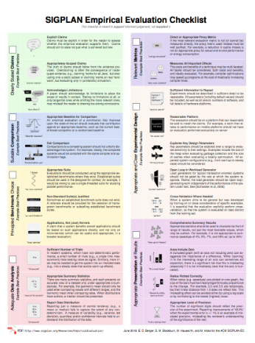

Don’t researchers know better?
Yes, many do. Even so, experts forget or are nudged away from best practice by culture and circumstance
Especially when best practice is more effort
Solution: List of recommendations
And identification of open problems
Inspiration for effort to provide checklist broadly
SIGPLAN Empirical Evaluation Guidelines
https://sigplan.org/Resources/EmpiricalEvaluation/

Slide 41
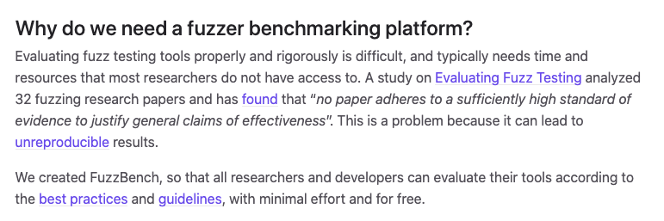
Influence: FuzzBench
Our paper
SIGPLAN Guidelines
https://github.com/google/fuzzbench

Slide 42
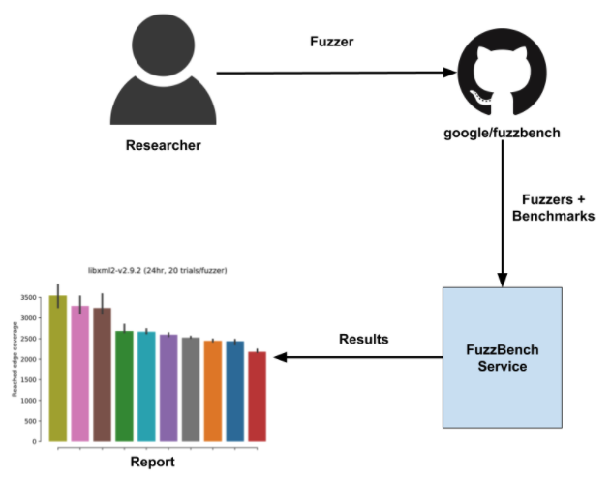
Influence: FuzzBench
https://github.com/google/fuzzbench

Slide 43


Slide 44
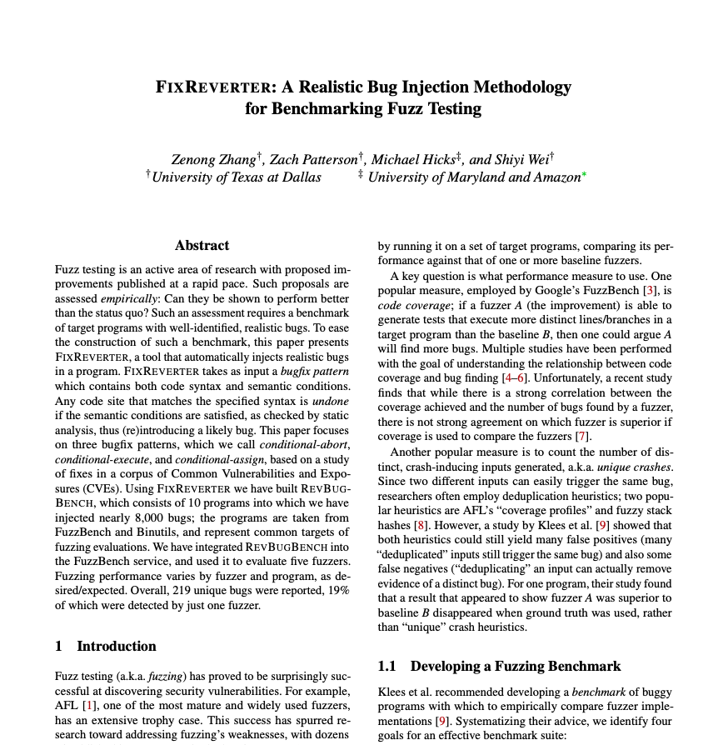

Slide 45
libFuzzer
Fuzzing from 2013 to today:
extern "C" int LLVMFuzzerTestOneInput(
const uint8_t* data, size_t size) {
// 1. build a typed Expr from raw fuzzer bytes.
FuzzedDataProvider fdp(data, size);
Expr e;
e.op = fdp.PickValueInArray<char>({'+', '-', '*', '/'});
e.a = fdp.ConsumeIntegral<int32_t>();
e.b = fdp.ConsumeIntegral<int32_t>();
// 2. CALL — invoke the function under test.
int64_t result;
try {
result = EvalExpr(e);
} catch (const std::invalid_argument&) {
return 0; // unknown op — ignore gracefully
}
// 3. ASSERT — check always-true property
if (e.op == '+') {
assert(result - e.b == e.a);
}
return 0; // non-zero = treat input as uninteresting
}
struct Expr {
char op; // '+', '-', '*', '/’
int32_t a; // left operand
int32_t b; // right operand
};
// Evaluates the expression
int64_t EvalExpr(const Expr& e);
Notes:
libFuzzer (part of LLVM) runs in the same process as the target — no fork overhead, very fast.
# Compile everything with the fuzzer and AddressSanitizer
clang++ -fsanitize=fuzzer,address -std=c++17 expr.cpp fuzz_expr.cpp -o fuzz_expr
# Run — libFuzzer will find the crash almost instantly
./fuzz_expr
# Typical output after ~1 second:
# SUMMARY: AddressSanitizer: FPE ... in EvalExpr (division by zero) # artifact_prefix='./'; Test unit written to ./crash-<hash>
FuzzedDataProvider is libFuzzer's standard utility for consuming bytes into typed values — PickValueInArray ensures op is always one of the four valid operators, and ConsumeIntegral reads the correct number of bytes for each operand. This is the canonical pattern for structured inputs.

Slide 46
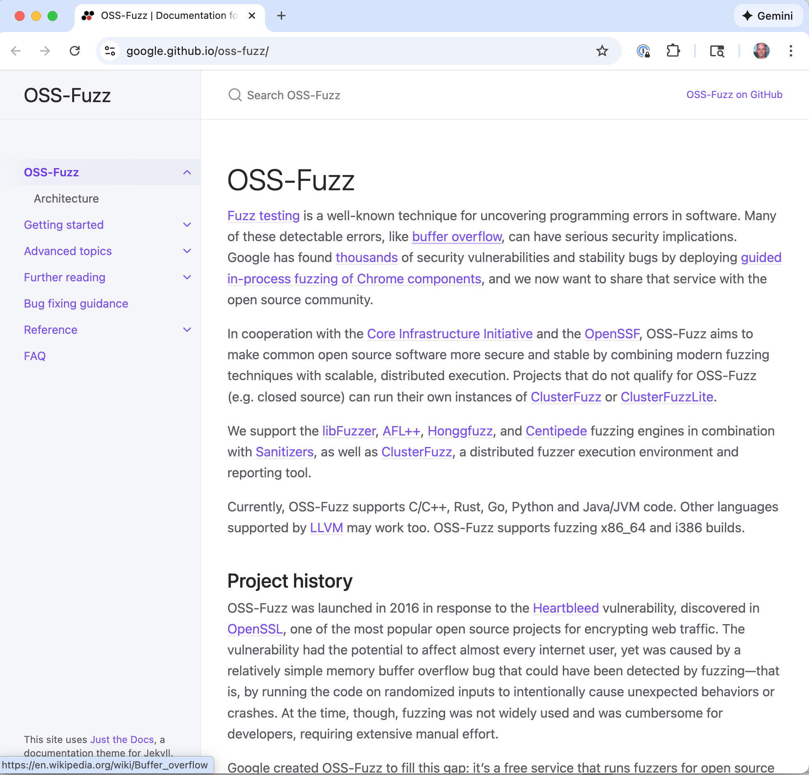
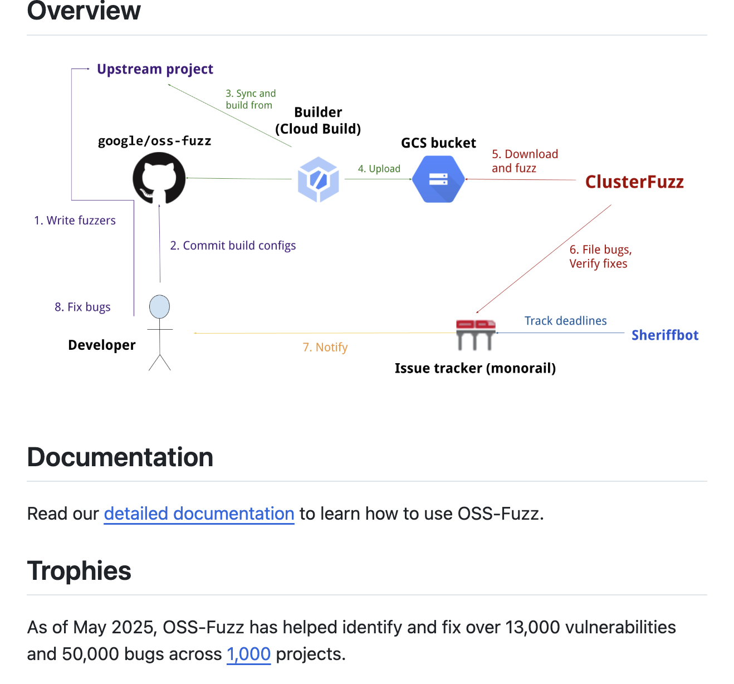
OSS-Fuzz
Notes:
Google’s OSS-Fuzz provides continuous fuzzing as a free service for important open-source projects. Projects write fuzzing harnesses; OSS-Fuzz runs them continuously on Google’s infrastructure and files bugs automatically. As of 2024, it has found over 10,000 bugs in projects like Chrome, OpenSSL, FFmpeg, and hundreds more. ClusterFuzz is the underlying infrastructure.
The key shift: fuzzing moved from “a thing security researchers do” to “a standard part of the software development pipeline.” Many organizations now require fuzz testing for security-critical code. This is relevant to the “secure software engineering and management” framing of this course.

Slide 47
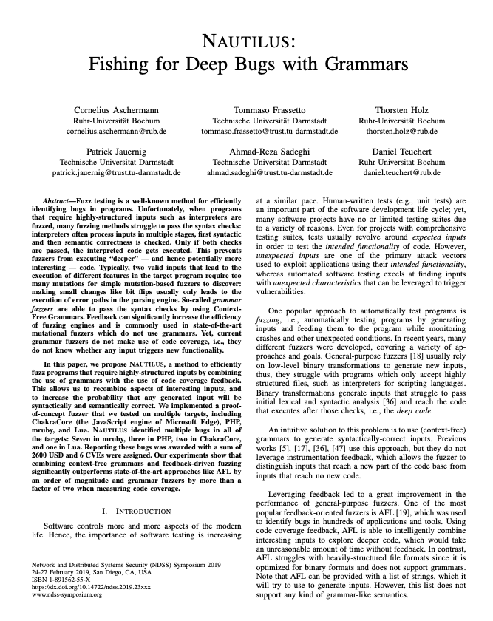
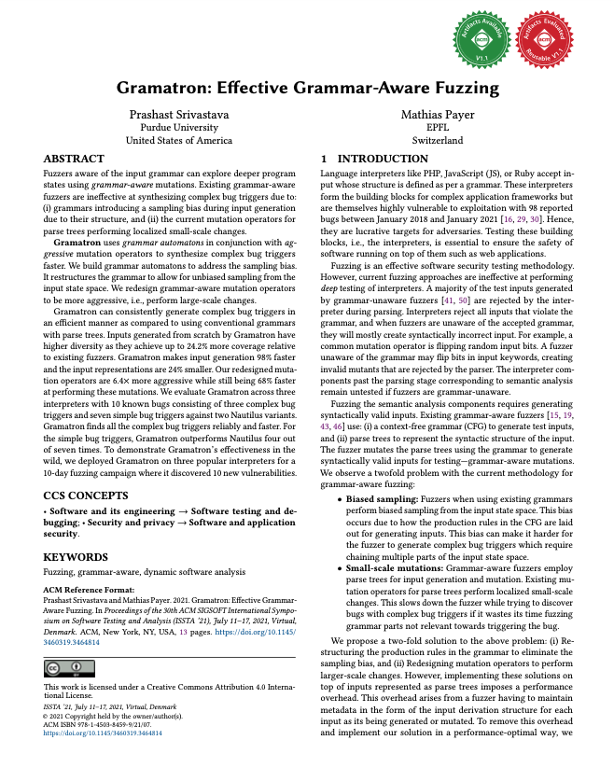
Structure-Aware Fuzzing
Mutation-based fuzzing struggles with highly structured inputs
Grammar-aware mutators preserve structure while exploring content
Notes:
Problem: AFL’s byte-level mutations (bit flips, arithmetic) destroy the structure of complex inputs. Fuzzing a compiler? Most mutated inputs won’t even parse. Fuzzing a protocol? Most mutations produce invalid messages that are rejected immediately. You spend all your time in error-handling code.
Solutions:
- libprotobuf-mutator: define your input format as a protobuf, mutate at the structured level
- Nautilus (2019): learns a grammar from examples, generates grammar-aware mutations
- Gramatron: uses grammar automata for efficient grammar-based coverage-guided fuzzing
- AFL++ custom mutators: the modern fork of AFL allows pluggable mutation strategies, so you can write a custom mutator that understands your input format while still using AFL’s coverage feedback and scheduling
This combines the coverage-guided feedback of AFL with the structural awareness of older grammar-based fuzzers — best of both worlds.

Slide 48
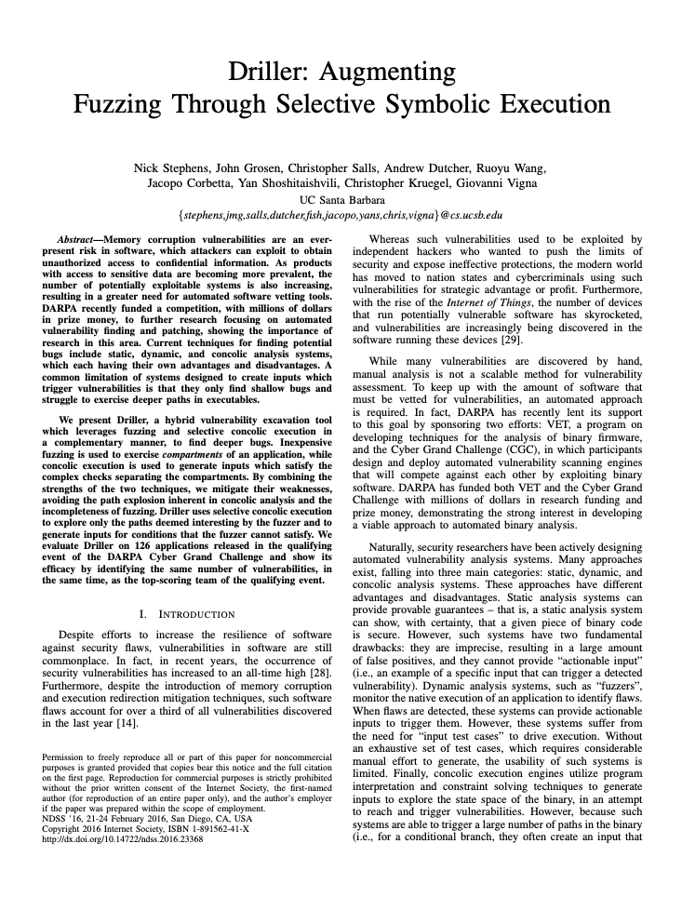
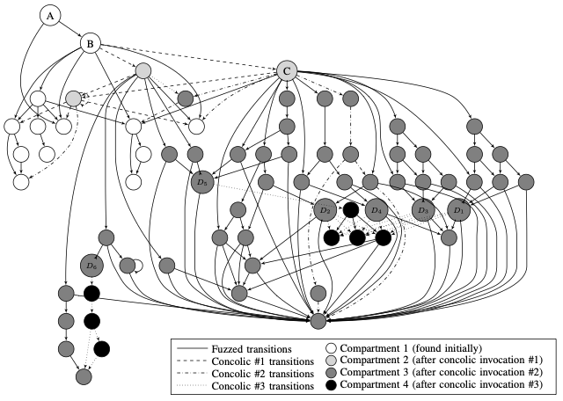
Hybrid Fuzzing
Fuzzing for breadth + symbolic execution for depth
Notes:
Remember from the history slide: symbolic execution is effective but doesn’t scale. Fuzzing scales but struggles with “magic values” (e.g., if (x == 0xdeadbeef)). Hybrid approaches combine them.
Driller (Stephens et al., NDSS 2016): monitors AFL’s progress. When coverage plateaus (no new edges for a while), it launches the Angr concolic execution engine on the stuck seeds. Angr solves the path constraints to get past the blocking condition, generates a new input, and feeds it back to AFL as a new seed. AFL then continues fuzzing from there.
QSYM (Yun et al., USENIX Security 2018): makes concolic execution fast enough to run continuously alongside fuzzing, not just as a fallback. Uses native execution with dynamic binary translation instead of full symbolic emulation.
Interesting connection to AFLFast: the COE power schedule explicitly assigns zero energy to high-frequency paths, which effectively “saves” those cycles. The authors suggest this saved time could be used for symbolic execution on stuck paths — the same insight as Driller, from the scheduling side.
FIGURE: Consider a diagram showing the feedback loop: AFL → stuck → symbolic executor → new seed → AFL continues.

Slide 49
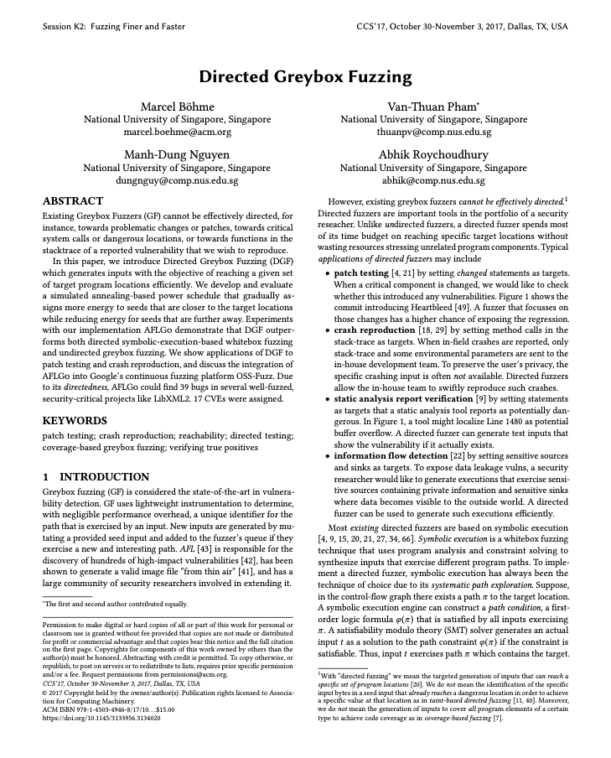
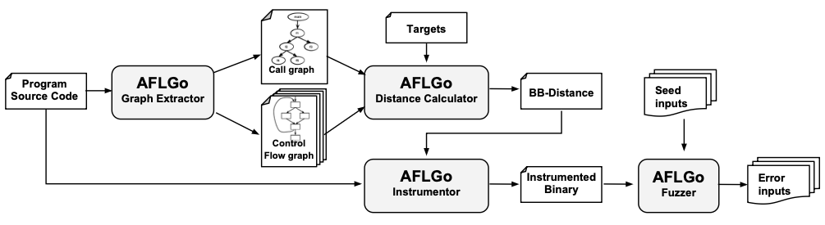
Directed & Differential Fuzzing
Directed: guide fuzzing toward specific code locations — AFLGo, Hawkeye — e.g., fuzz recently patched code
Differential: compare multiple implementations of the same spec — Find semantic bugs, not just crashes
Notes:
Directed fuzzing: instead of maximizing coverage everywhere, focus on reaching specific target locations. Use cases: you have a patch and want to test it, you have a known-vulnerable function and want to find triggering inputs, you want to test a specific feature. AFLGo (Böhme et al., CCS 2017 — same first author as AFLFast) uses distance to target in the call graph to guide seed scheduling. Hawkeye (Chen et al., CCS 2018) is a similar idea with a different distance metric.
Differential fuzzing: run the same input through multiple implementations that should behave identically (e.g., different TLS libraries, different JSON parsers, different compilers). Any difference in output indicates a bug in at least one implementation. This finds semantic/logic bugs that don’t cause crashes — a class of bugs that traditional crash-based fuzzing completely misses. Examples: comparing different browsers’ rendering, comparing different crypto libraries’ output.
FIGURE: For directed fuzzing, consider a CFG with a highlighted target node and arrows showing the fuzzer being guided toward it. For differential fuzzing, a diagram showing one input being fed to two implementations with outputs compared.

Slide 50
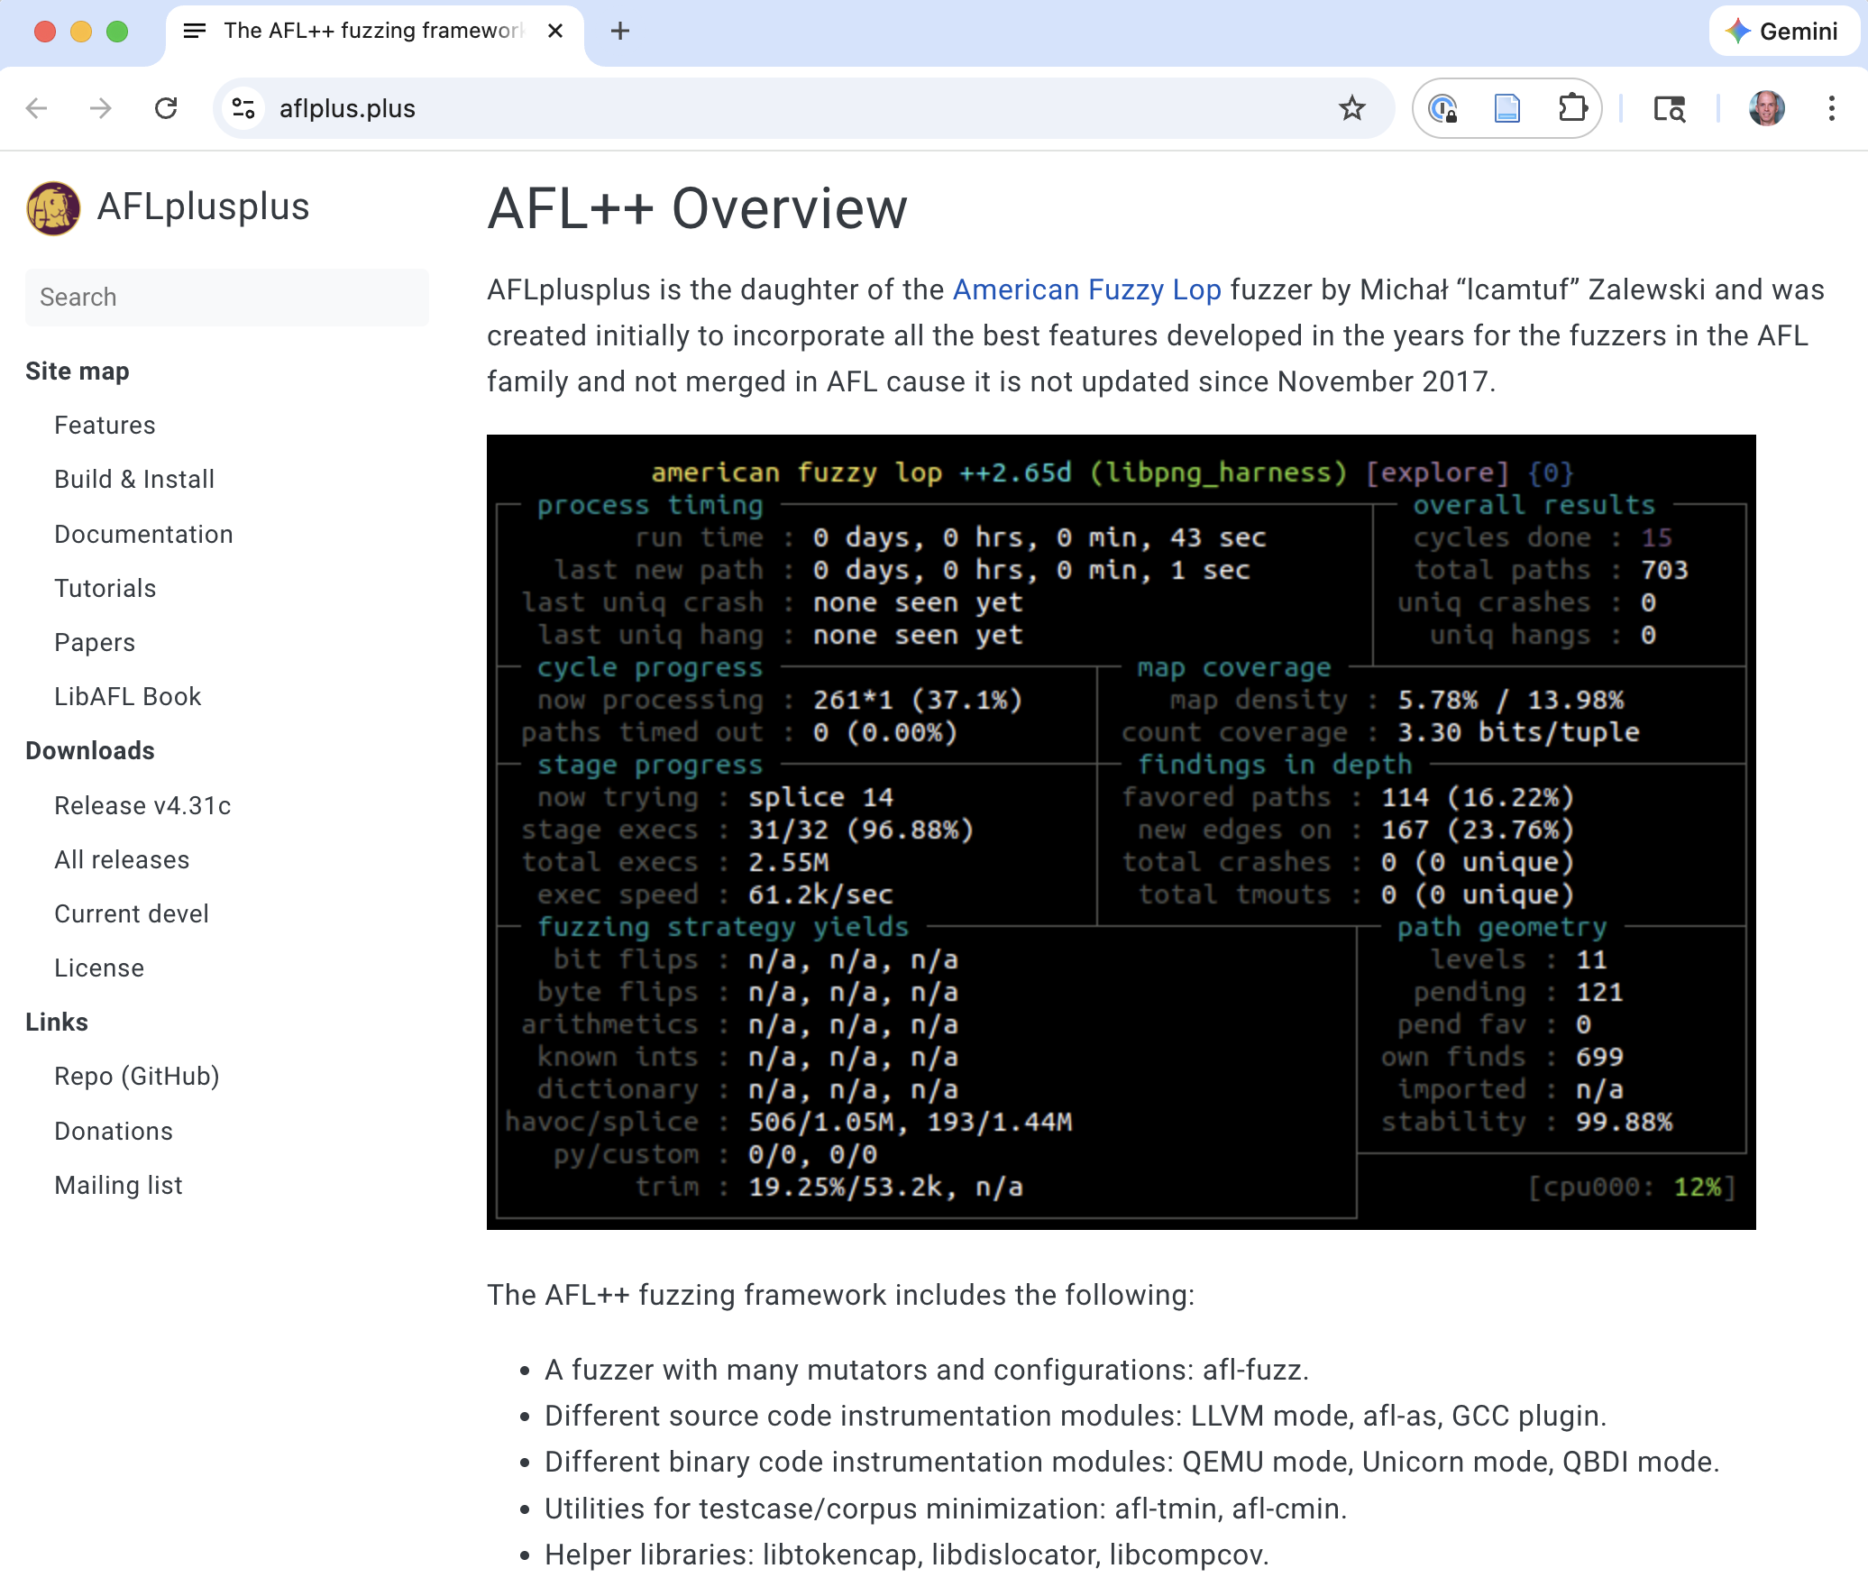
The Modern Ecosystem: AFL++
Community fork of AFL
better mutators, CMPLOG, persistent mode
custom mutator API — plug in domain knowledge
Regularly performs the best on FuzzBench baseline evaluations
Notes:
AFL++ (started 2019, actively maintained) is the modern successor to AFL, which Zalewski stopped actively developing. Key improvements:
Better mutators: MOpt (mutation scheduling), CMPLOG (automatically solving magic-byte comparisons by logging strcmp/memcmp arguments — addresses a key AFL weakness without needing full symbolic execution)
Persistent mode: instead of fork()+exec() for each test case, keep the target running and reset its state. Much faster.
Custom mutator API: write a shared library that AFL++ calls for mutations. This is how structure-aware fuzzing integrates with AFL++.
Better power schedules: AFLFast’s ideas were incorporated into AFL and then further refined in AFL++.
AFL++ is now the standard baseline for fuzzing research. Most new papers compare against it.
Beyond AFL++: fuzzing has expanded to many languages and domains: - go-fuzz, cargo-fuzz (Rust), Jazzer (Java/Kotlin), Atheris (Python) - syzkaller: grammar-based coverage-guided fuzzing for OS kernels (Linux, Windows, etc.) - kAFL: hardware-assisted (Intel PT) feedback for kernel fuzzing without source code

Slide 51
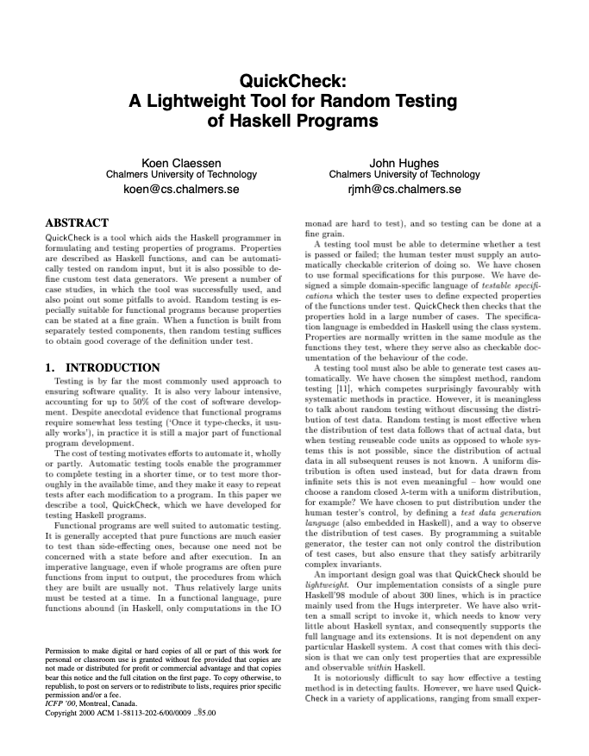
Properties to Test: Beyond Crashes
Sanitizers
AddressSanitizer (buffer overflows, use-after-free)
MemorySanitizer (uninitialized reads)
UndefinedBehaviorSanitizer
…
Property-based testing
QuickCheck
But also: See what we were doing with libFuzzer

Slide 52
Property-based testing (PBT)
Generate random structures;
check general properties
RNG
Random bits
x 1,000,000
How to combine PBT with fuzzing?
Generator
Random
structured
data
Program + Property Under Test
Success/Discard
Failure?
Report to User

Slide 53
Parameterized coverage-guided fuzzing (PCGF)
Generate structures from bits, which are mutated by the fuzzer
Initial Seed
RNG
Random bits
x 1,000,000
Mutator
Binary Input
Fuzzer
Seed Pool
Generator
Yes
Instrumentation
Program + Property Under Test
No
New
Paths?
Throw away
Failure?
Report to User
Coverage info

Slide 54
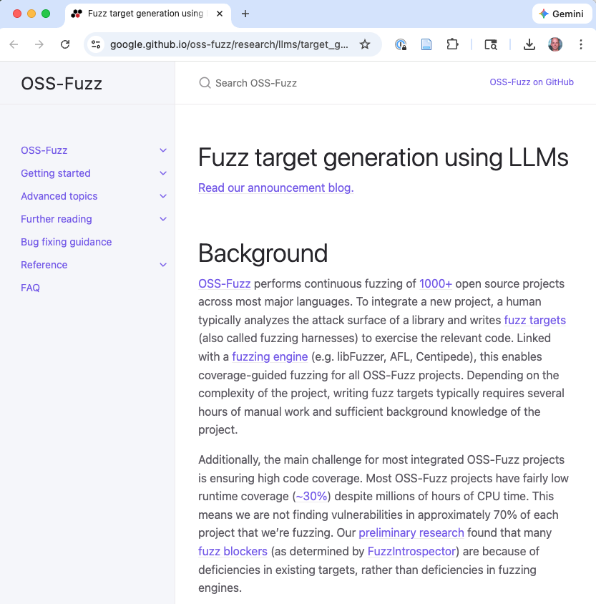

LLM-Assisted Fuzzing
Write fuzzing harnesses automatically
Generate seed inputs that understand the format
Produce targeted mutations informed by code understanding
Notes:
This is the newest development and still an active research area. Several directions:
Seed generation: LLMs can generate structurally valid inputs for complex formats (XML, JSON, protocol messages) without writing a grammar. You describe the format or provide examples, and the LLM generates diverse valid seeds.
Harness generation: writing a fuzzing harness (the glue code that feeds fuzz input to the target function) is often the hardest part of setting up fuzzing. LLMs can generate candidate harnesses from API documentation or code context. Google has been exploring this with OSS-Fuzz.
Targeted mutation: instead of random byte-level mutations, use an LLM’s understanding of the input semantics to make “smart” mutations. E.g., for a JSON input, mutate values while preserving structure; for a protocol message, create semantically interesting but unusual field combinations.
Open questions: Can LLMs help with triage (understanding and deduplicating crashes)? Can they help with the hardest part of directed fuzzing (identifying what to target)? How do the costs compare to running more fuzzing iterations?
This is speculative but worth flagging for students as a direction they might work on.

Slide 55
Key Takeaways
Coverage feedback is the key ingredient — transforms random testing into guided exploration
Scheduling matters — how you allocate effort across seeds can yield orders-of-magnitude improvement
Evaluation is hard — randomness, seeds, timeouts, and broken metrics can mislead
Fuzzing is now infrastructure — a baseline expectation, not a research curiosity
Notes:
Leave these on screen as the final summary. Each point maps to a section of the lecture: 1. Section 3a-3b (AFL instrumentation and loop) 2. Section 3c-3d (AFLFast’s Markov chain model and power schedules) 3. Section 4 (Klees et al. evaluation critique) 4. Section 5 (modern ecosystem)
If time permits, mention that students who want to go deeper can look at the FuzzBench project (Google’s standardized fuzzing benchmark), the AFL++ documentation, or set up a fuzzing run themselves using the instructions in the AFL++ README.

