Slide 1


Secure Systems Engineering and Management
A Data-driven Approach
Measuring Secure Development Practices
Michael Hicks
UPenn CIS 7000-003
Spring 2026

Slide 2
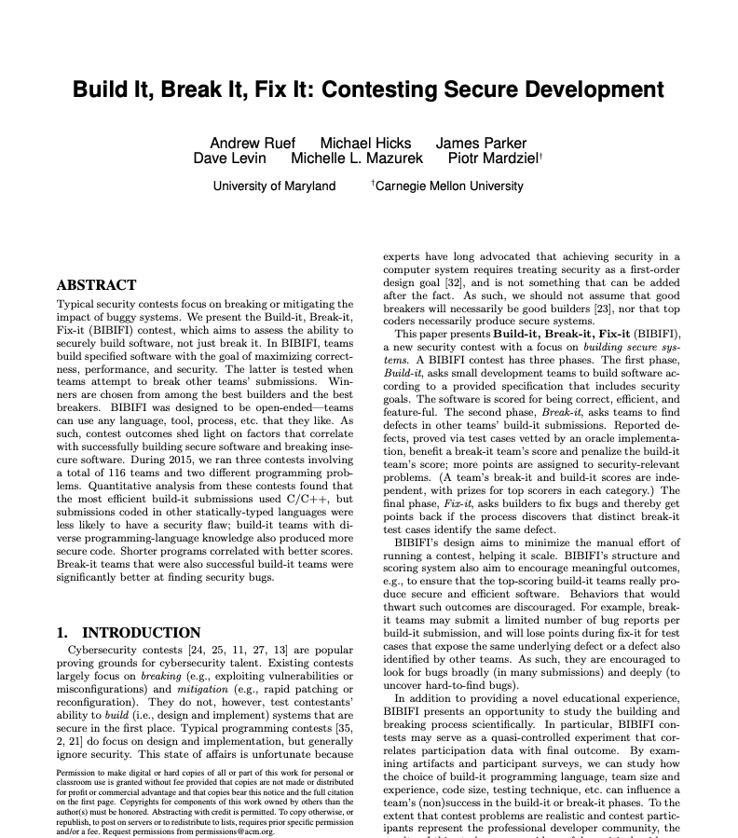
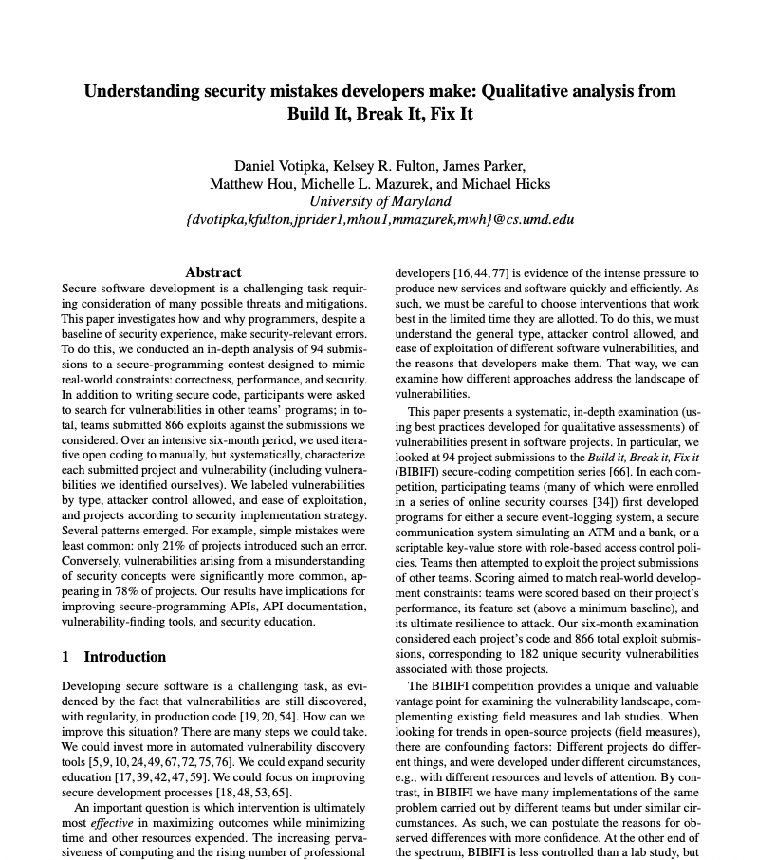
Readings
(optional)

Slide 3
Readings

Slide 4
Overview
Round 1: Build-it
Teams build software to specification
Round 2: Break-it
Teams report
bugs in submissions
Round 3: Fix-it
Teams fix bugs found in their software
2 weeks
2 weeks
1 week
Must satisfy
basic correctness
requirements; optional features and good performance for more points
Bug reports are (failing) executable test cases, including exploits
Doing so may wipe out many bug reports in one go: all count as the same bug
Last: Judges tally final results

Slide 5
Scoring System
Build-it Score
Break-it Score
Winners in both categories
Gains points for good performance
Gains points for implementing optional features
Loses points for unique bugs found
More points for (obviously) security-relevant bugs
Build-it Score
Break-it Score
Gains points for unique bugs found
Scaled by how many other teams found the same bug

Slide 6
Build-it Round
Build software according to the posted specification
Make it correct, feature-ful, efficient, and secure
The first three are assessed by (our) test cases (build-it round score)
The last is assessed by Break-it teams in round 2
For many elements of the task, teams may choose
The software’s internal design and algorithms
Which optional features to implement
What programming language to use
What development and testing tools to use
How to divide tasks among team members, etc.

Slide 7
Break-it Round
Find bugs and vulnerabilities in submitted code
Provide an exploit, as defined by particular problem
Teams will be given access to the source code
We provide scripts that teams can use to test projects against the standard tests, using a VM
How teams go about this task is up to them, e.g.,
How to divide up the task among team members, and
whether (or how much) testing to use,
manual code reviews,
automated dynamic/static analysis, etc.

Slide 8
Fix-it Round
Different teams may submit different test cases that identify the same underlying bug
Build-it teams should only lose points for each bug, not for each test case that reveals it
How to tell that test cases are “the same” ?
void foo(char *str) {
char buf[10];
strcpy(buf,str);
}
str = “this is too long”
str = “this is too long too”
str = “and so is this string”

Slide 9
Fix-it Round
Teams will receive the test cases during the fix-it round, and they can then fix each bug identified
All test cases that pass are unified to be the same underlying bug
Judges consider whether the fix is to a single bug
If not, the affected test cases will be scored individually
void foo(char *str) {
char buf[10];
strlcpy(buf,str,10);
}
str = “this is too long”
str = “this is too long too”
str = “and so is this string”
void foo(char *str) {
char buf[10];
strcpy(buf,str);
}
str = “this is too long”
str = “this is too long too”
str = “and so is this string”

Slide 10
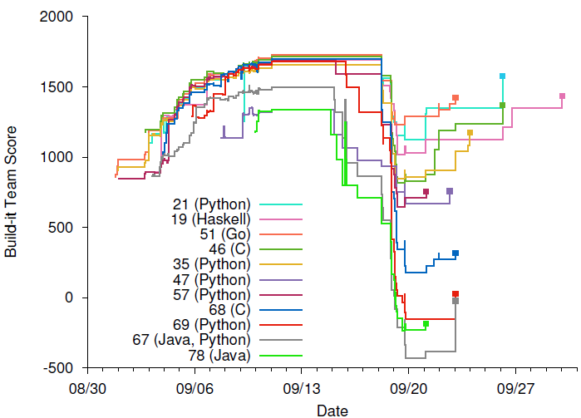
Builder score, as the contest progresses
Build-it
Break-it
Fix-it
Notes:
And here are the builders scores, visualized, during a contest run. We have 11 teams implementing in a variety of languages. The x-axis represents time over the entire contest, while the y-axis is the teams current build-it score.
There is some incentive for fix it here: some teams went from really bad, to only kind of bad

Slide 11
BIBIFI incentives approximate the real world
Build-it teams are incentivized to
meet near-term requirements (correctness and performance)
Under time pressure, and ”no points for no submission” pressure
but while not neglecting security
Which will soon matter
Break-it teams are incentivized to
find unique security bugs (more points than correctness)
Duplicate submissions consume exploit budget
that are hard to find or in neglected submissions
no point sharing if others miss
Upshot: Aim to cover all submissions, in depth
But only bugs that are exploitable via contest infrastructure

Slide 12
Contest problems
Secure log of events at an art gallery
Commands to append records and query the log contents
Threat model:
Attacker has access to the log
Should be tamperproof and protect confidentiality
Secure ATM
ATM communicates with Bank server to carry out transactions
Threat model: MITM can observe, send, drop messages, and simulate the ATM
Multi-user DB [in extended version of paper]
Scriptable key-value store with RBAC policies with delegation
Threat model: Attacker as client; writes scripts to try to break RBAC implementation

Slide 13
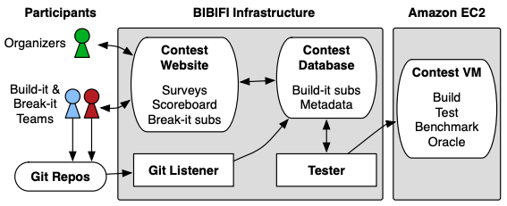
Contest implementation
Website written in Yesod, Haskell-based web framework
www.yesodweb.com
Extended with a custom version of LIO, for security enforcement

Slide 14
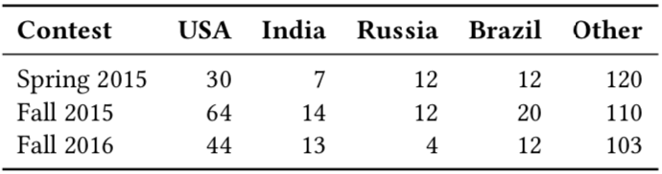
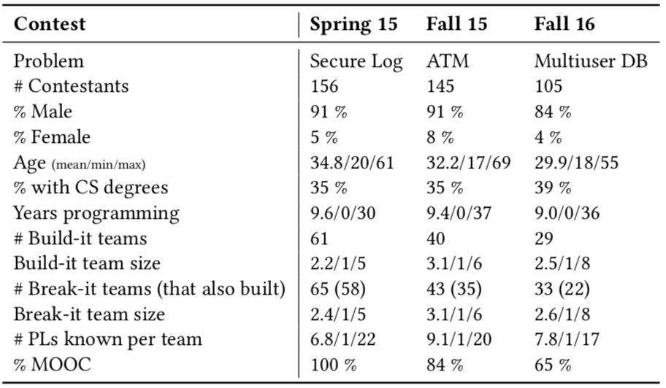
Participant demographics
Worldwide participant pool (mostly non-US)
156 teams, 406 people
Average 9 years programming experience
1/3 have CS degree
Most participants part of MOOC
Four courses of security training
Average team size: ~2

Slide 15
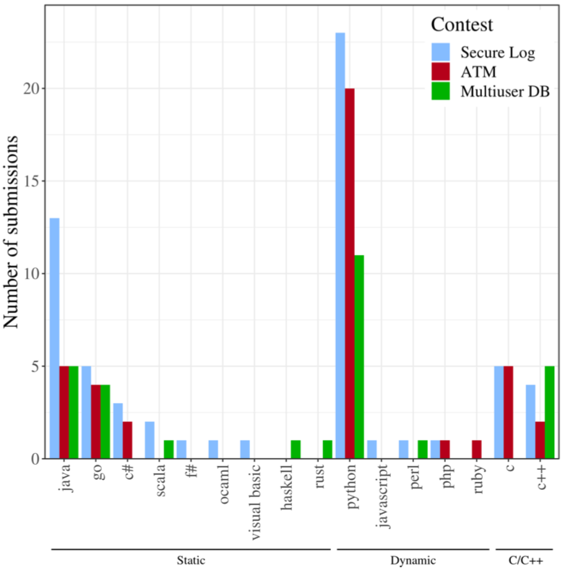
Submission features
Count by language
Grouped by category
Statically type-safe (49)
Dynamically typed (60)
54 are Python!
C/C++ (21)

Slide 16
The Four Core Analyses
# | Outcome Variable | Model Type | Table
1 | Ship score (continuous) | Linear regression | Table 5
2 | Security bug found? (binary) | Logistic regression | Table 7
3 | Break-it score (continuous) | Linear regression | Table 10
4 | Security bug count (continuous) | Linear regression | Table 11
All four use the same general approach: select candidate factors, test all subsets, pick the best model via AIC

Slide 17
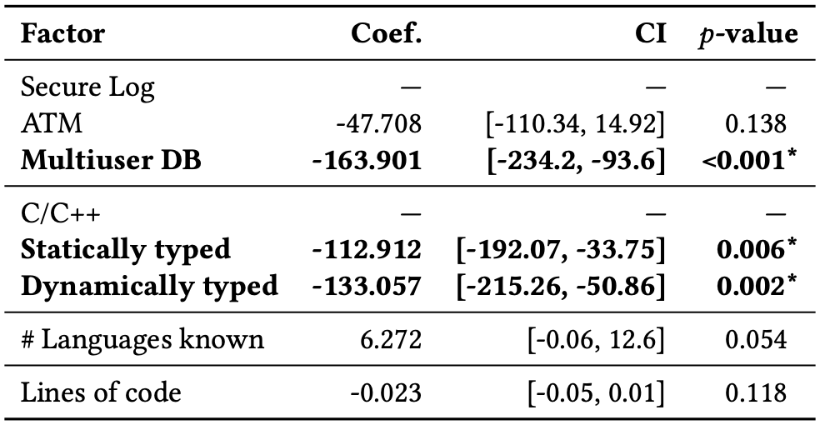
Ship Score Model (Table 5)
Outcome: Build-it team’s ship score (continuous, points-based)
C/C++ teams scored ~113–133 points higher than other language categories
R² = 0.232
Notes:
This is a straightforward application of the linear regression we learned. Note the explicit reference levels for categorical predictors — exactly what we emphasized in Lecture 2. The coefficients tell us how many points each factor adds relative to the baseline. R² = 0.232 means the model explains about 23% of the variance, which is modest but reasonable for an uncontrolled environment. Notes:
Dummy coding with explicit baselines — C/C++ is the reference for language category; Secure Log is the reference for contest
Interpreting coefficients relative to reference — “Statically typed scored 112.9 points lower than C/C++”
Confidence intervals reported for every coefficient
R² reported as measure of model fit
All coefficients reported, not just significant ones — # Languages known (p = 0.054) and Lines of code (p = 0.118) are included
Factors excluded in model construction not reported; discussed later

Slide 18
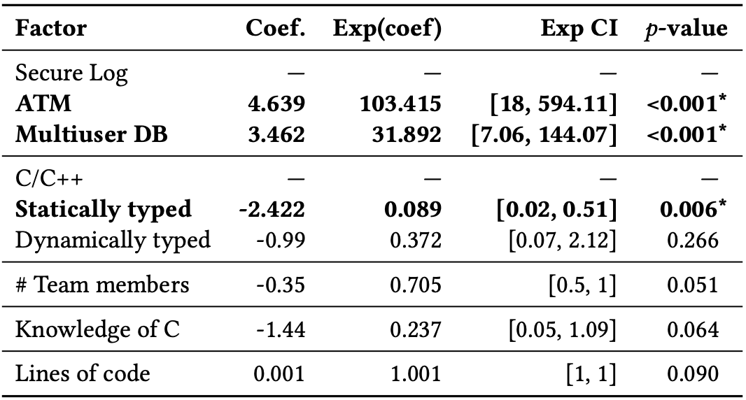
Security Bug Model (Table 7)
Outcome: Was a security bug found in this team’s submission?
So: logistic regression
ATM contest: vastly more security bugs than Secure Log
C/C++ submissions were ~11× more likely to have a security bug (1/0.089 ≈ 11.2)
Nagelkerke R² = 0.619
Notes:
The paper reports both the log-odds coefficient AND the exponentiated coefficient (odds ratio), which is exactly what we learned to do. They also invert the odds ratio to express the comparison in the more natural direction (C/C++ vs. statically typed rather than the other way around). The 11× figure is one of the paper’s headline findings.

Slide 19
Odds Ratios and Exponential Coefficients
Recall:
Odds ratios (e^{β}) — The paper reports Exp(coef) and Exp CI columns: exponentiated coefficients and their confidence intervals
Interpreting direction — Exp(coef) < 1 means lower likelihood
Confidence intervals on odds ratios — Statically typed: [0.02, 0.51], entirely below 1, confirming the protective effect
Recall our pitfall: “Higher CVSS increases exploitation by 0.52” ❌
The paper correctly says “11× more likely” and not the raw coefficient
Notes:
The paper avoids the scale-confusion pitfall we discussed. They convert to odds ratios and report the multiplicative effect on likelihood. The CI for statically typed [0.02, 0.51] does not cross 1, so the effect is significant — consistent with p = 0.006.

Slide 20
Break-it Models (Tables 10 and 11)
Two more linear regressions, now for the breaking phase
R² = 0.15 and R² = 0.203 respectively
Model | Key Significant Factors
Break-it score (Table 10) | More team members (+387 pts each, p = 0.028); ATM teams scored lower
Security bug count (Table 11) | More team members (+1.2 bugs each, p = 0.006); Build participants found +4 more bugs (p = 0.045)

Slide 21
Factors That Didn’t Make the Cut
Notably absent from final models:
Advanced techniques (fuzzing, static analysis) — dropped during model selection, not significant
MOOC participation — security education didn’t significantly help
But: Non-significant results are still informative! The paper discusses these:
“Making use of advanced analysis techniques did not factor into the final model… such techniques tend to find generic errors such as crashes, bounds violations… Security violations for our problems are more often semantic”
Notes:
This is a good example of the lecture principle about reporting all results, not just significant ones. The paper explains why advanced techniques may not have helped — the security bugs were semantic, not the kind of memory errors that fuzzing finds. This is more informative than just saying “not significant.”

Slide 22
Model Selection via AIC (new)
What the paper does: “We test models with all possible combinations of our chosen potential factors and select the model with the minimum Akaike Information Criterion (AIC)”
AIC is an information-theoretic criterion: AIC = 2k − 2 ln(L), where k = number of parameters and L = likelihood
Lower AIC = better balance of fit and parsimony
In lecture, we used likelihood-ratio (LR) tests to compare nested models (reduced vs. full)
Key difference: LR tests compare two specific nested models; AIC can be used to rank any set of models, including non-nested ones
Notes:
AIC is adjacent to the LR test approach we covered. Both address the question “does adding more predictors improve the model enough to justify the complexity?” LR tests answer this for one pair of models at a time; AIC lets you rank many candidate models at once. The paper tests ALL possible subsets of their candidate factors and picks the one with lowest AIC — a more exhaustive but computationally intensive approach than the sequential model comparison we practiced.

Slide 23
The Iterative Model-Building Process
Select candidate factors based on domain knowledge (Tabs 4 and 9)
Limit the number of factors based on power analysis
Test all possible combinations of factors
Select the model with minimum AIC
Report the final model
Notes:
The all-subsets approach is sometimes called “best subsets regression.” It’s more comprehensive than stepwise approaches (forward/backward selection), which can miss the globally optimal model. The key discipline here is that they limited candidate factors before searching — they didn’t mine hundreds of variables looking for significance.
This is more systematic than what we covered, but the pieces connect:
Step 1 → our discussion of choosing predictors thoughtfully
Step 2 → related to our discussion of effect sizes (Cohen’s conventions)
Step 4 → an alternative to our LR test for nested models
Step 5 → follows our reporting checklist

Slide 24
What Is Power Analysis?
Problem: How many factors can we include in our model without overfitting?
Statistical power = the probability of detecting a real effect if one exists (i.e., correctly rejecting H₀)
Convention: aim for power ≥ 0.75 or 0.80
Recall: failing to reject H₀ when it’s false = Type II error
Power = 1 − P(Type II error)
Power depends on three things:
Factor | Effect on Power
Sample size (N) | Larger N → more power
Effect size (f²) | Larger effect → easier to detect
Number of parameters (k) | More parameters → less power per parameter
Notes:
Power analysis is the formal link between sample size, effect size, and model complexity. We touched on this idea in Lecture 1 when discussing Type II errors and the distinction between statistical and practical significance — power analysis makes it quantitative. The intuition is: with a fixed sample size, every parameter you add to a regression “uses up” some of your statistical power. If you include too many factors relative to your N, you won’t be able to detect anything.

Slide 25
How the Paper Uses Power Analysis
Power analysis in the paper:
Given: N = 130 build-it teams
Goal: “medium” effect size or Cohen’s f² = 0.15 (equivalent to R² ≈ 0.13)
Goal: power = 0.75,
Result: We are limited to 10 degrees of freedom (i.e., k = ~10 parameters)
So we pre-commit to a small set of factors (Table 4) before looking at results — this prevents overfitting and data mining (“p hacking”)
Contrast with a naïve approach:
❌ Throw 30 variables into a regression with 130 observations → spurious results
✅ Power analysis says: with N = 130, you can responsibly test ~10 factors for medium effects
Notes:
This is the discipline that makes the AIC model selection trustworthy. Without the power analysis constraint, searching all subsets of 30 candidate factors would almost certainly find spurious “significant” results. By limiting to ~10 factors based on power, the paper ensures that any effects found are plausibly real at a medium effect size. Note the paper also shows that adding Multiuser DB data (N = 101 → 130) actually improved their prospective f² from 0.154 to 0.122 — more data lets you detect smaller effects or include more factors. This connects directly to our lecture discussion of “with large samples, even tiny effects become significant” — power analysis is the flip side of that coin.

Slide 26
A Different Effect Size: Cohen’s f²
From our lectures: Cohen’s d for comparing two group means
In the paper: Cohen’s f² for regression effect sizes
“Our modeling was designed for a prospective effect size roughly equivalent to Cohen’s medium effect heuristic, f² = 0.15”
This corresponds to R² = 0.13 — the model needs to explain at least 13% of variance to be detectable
Measure | Context | “Medium” threshold
Cohen’s d | Two-group comparison | 0.5
Cohen’s f² | Regression models | 0.15

Slide 27
Pseudo-R² Variants
From our lectures: McFadden’s pseudo-R² for logistic regression
In the paper: Nagelkerke R² = 0.619 for the security bug model
. . .
Why different variants exist:
Traditional R² doesn’t apply to logistic regression (no sum of squared residuals)
Multiple approximations exist, each with tradeoffs
McFadden’s (our lecture) is based on log-likelihood ratios
Nagelkerke’s adjusts Cox-Snell R² to have a maximum of 1.0
. . .
The paper acknowledges this: “R² as traditionally understood does not make sense for a logistic regression. There are multiple approximations… each of which have various pros and cons.”
Notes:
This is a subtle point but worth knowing. When you see a pseudo-R² reported, check which variant it is. Nagelkerke and McFadden can give quite different values for the same model. The paper’s Nagelkerke R² = 0.619 sounds high, but McFadden’s for the same model would likely be lower. The important thing is that they report it and name the variant — exactly the transparency our lecture pitfalls section demands.

Slide 28
Pitfalls avoided
Correlation ≠ Causation
“This was not a completely controlled experiment (e.g., we do not use random assignment), so our models demonstrate correlation rather than causation.”
Independent samples
Build it and Break it participants overlap (Ok – not combined in analysis)
Overlap in participants between contests? Added ”Contest” as factor
Honest about limitations
Resilience score issue, limitations of self reported data
Notes:
This is the regression ≠ causation pitfall from our Lecture 2. Teams self-select into languages. Maybe teams that choose C/C++ are optimizing for performance and deprioritize security? Maybe they have less experience with cryptographic libraries? We can’t untangle these from the language effect itself. The paper’s “quasi-controlled experiment” framing is honest about this limitation.
But temptation lurks: The 11× finding is easy to misread as “using C/C++ causes security bugs.” The paper is careful to note that the language effect “may involve confounds” — e.g., teams choosing C/C++ may differ in other unmeasured ways
Potential violations in the paper: Break-it teams’ bug reports against the same build-it submission are not independent
a more rigorous approach might use mixed-effects models with random intercepts per participant.
“Some participants [may be] exaggerating about which programming languages they know… minor deviations, distributed across the population, act like noise and have little impact on the regression outcomes”

Slide 29
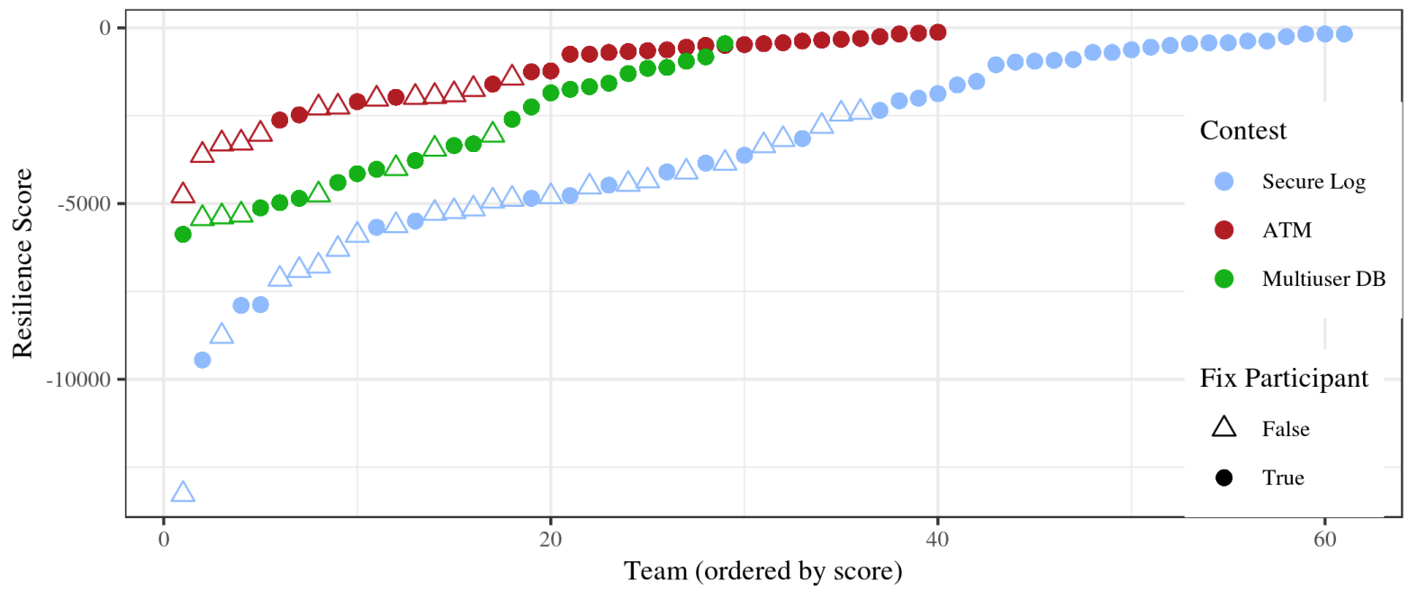
Survivor Bias in Resilience Scores
A measurement problem the paper discovered:
Resilience scores depend on teams fixing bugs during the fix-it phase
But most teams didn’t fix any bugs — especially low-scoring teams
Consequence: The paper abandons resilience score as an outcome variable and switches to the binary “any security bug found?” model instead
Lesson: Sometimes your planned outcome variable doesn’t work, and you need to adapt
So: The paper abandons resilience score as an outcome variable
Notes:
This is a great example of being honest about data limitations rather than forcing a flawed analysis. The paper had planned to use resilience scores, but the fix-it participation problem made those scores unreliable. Rather than pretending the data was fine, they pivoted to the binary logistic model — which doesn’t depend on fix-it participation. This connects to our lecture discussion about choosing appropriate outcome variables and checking assumptions before proceeding.

Slide 30
Pitfall: Multiple Models, No Correction
From our lecture: Running many tests inflates false positive rates
The paper fits four separate regression models, each testing multiple factors
No explicit correction for multiple comparisons across models
The all-subsets AIC approach tests many model specifications within each analysis
Mitigating factors:
AIC inherently penalizes model complexity (acts as a soft correction)
The factors were pre-specified based on domain knowledge, not data-mined
Power analysis limits the number of factors tested
But: with enough model combinations, some “significant” factors may be false positives
Notes:
The paper doesn’t apply Bonferroni or FDR corrections across its four main analyses. This is common in exploratory research — the AIC selection process provides some protection against overfitting within each model, and the pre-registration of candidate factors limits fishing. But strictly speaking, the family-wise error rate across all analyses is uncontrolled. This is a judgment call, and the paper is transparent about the exploratory nature of the work.

Slide 31
Mapping to Our Lectures
Lecture Topic | Used in Paper? | Where
Linear regression | ✅ | Tables 5, 10, 11
Logistic regression | ✅ | Table 7
Dummy coding / reference levels | ✅ | Language category, Contest
Odds ratios (e^β) | ✅ | Table 7
Confidence intervals | ✅ | All tables
R² / model fit | ✅ | All models
Effect sizes (Cohen’s d) | ⚠️ Variant (f²) | Power analysis
LR test (model comparison) | ⚠️ AIC instead | Model selection
Pseudo-R² | ⚠️ Nagelkerke, not McFadden | Table 7
Multiple comparisons | ❌ Not applied | —
Notes:
Green checks are direct applications of what we learned. Yellow warnings are related but different variants. The red X is a notable absence — the paper doesn’t correct for multiple comparisons across its analyses. Overall, the paper is a strong example of applying regression methods to security data with appropriate caveats and transparency about limitations.

Slide 32
Readings
(optional)

Slide 33
Approach
Examined each project and vulnerability in detail
94 projects
Breaker-identified (866 submitted exploits) and researcher-identified (manual analysis)
In total, 182 distinct vulnerabilities
Iterative open and axial coding
Qual and quant analysis on resulting categories

Slide 34
What Is Qualitative Coding?
A code is a word or short phrase that captures the meaning of a piece of data — it is “primarily an interpretive act” (Saldaña, Ch. 1)
Coding is cyclical: first cycle codes emerge from the data, then get refined, reorganized, and consolidated into categories and themes through second cycle coding
The BIBIFI paper used iterative open coding (codes emerge from data, not predetermined) and axial coding (grouping codes into higher-level types)

Slide 35


Further reading: Saldaña, The Coding Manual for Qualitative Researchers, Ch. 1; Strauss & Corbin, Basics of Qualitative Research (1990)

Slide 36
How BIBIFI Applied It
Two researchers cooperatively examined 11 projects (42 vulnerabilities) to build an initial codebook
Then coded independently in rounds of ~30 breaks, meeting after each round to discuss disagreements and refine the codebook
Process continued for ~6 months until inter-rater reliability exceeded α > 0.80 (Krippendorff’s α) on all variables
Remaining 34 projects divided and coded separately
Result: 182 unique vulnerabilities coded across four variables (Type, Attacker Control, Discovery Difficulty, Exploit Difficulty)
Notes:
Krippendorff's alpha (α) is a statistical measure of how much agreement exists between two or more independent coders who are each assigning labels to the same data. It's designed to answer: if I give the same data to different people with the same codebook, do they produce the same codes?
What makes it particularly well-regarded is that it accounts for agreement that would happen purely by chance. If you have a binary variable (say, "full" vs. "partial" attacker control), two coders will agree roughly 50% of the time just by guessing randomly. Krippendorff's α adjusts for this, so α = 0 means agreement is no better than chance, and α = 1 means perfect agreement. It can even go negative if coders agree less than chance would predict.

Slide 37
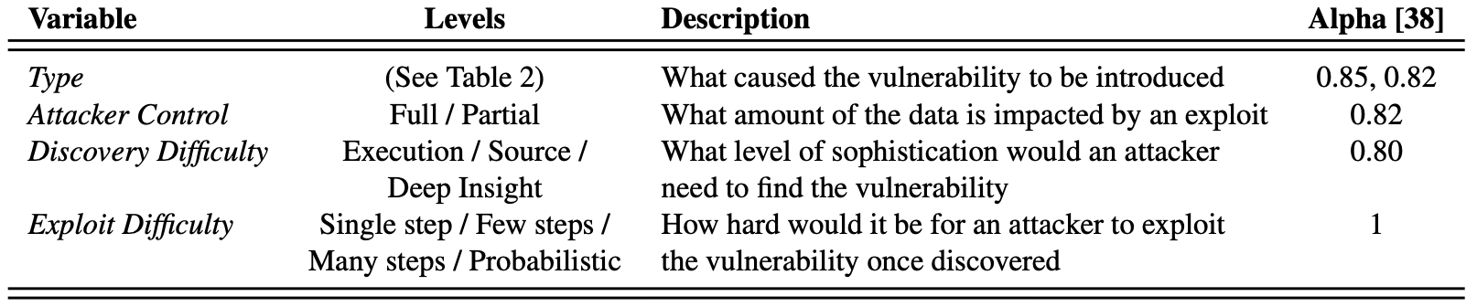
The Codebook
Each vulnerability was labeled on four variables with defined levels:
Axial coding then grouped the 23 specific issues into three high-level types:
No Implementation — didn’t attempt a necessary security mechanism
Misunderstanding — attempted it but made a conceptual error
Mistake — had the right idea but made a programming slip

Slide 38
Why This Approach?
Qualitative coding lets researchers systematically characterize unstructured data (source code, exploits) in a reproducible way
The codebook with inter-rater reliability ensures findings aren’t just one person’s opinion
Coded categories then become variables for quantitative analysis (Chi-squared tests, Poisson regression) — the two approaches are complementary
Saldaña (Ch. 1): “Quantitative analysis calculates the mean. Qualitative analysis calculates meaning.”

Slide 39
Vulnerability classes
No Implementation
Misunderstanding
Mistake
Bad Choice
Conceptual Error
Intuitive
Unintuitive

Slide 40
Vulnerability classes
Missed something “Intuitive”
No encryption
No access control
No Implementation
Intuitive

Slide 41
Vulnerability classes
Missed something “Unintuitive”
No MAC
Side channel leakage
No replay prevention
45% of projects
No Implementation
Unintuitive

Slide 42
Vulnerability classes
Made a “bad choice”
Weak algorithms
Homemade encryption
strcpy()
Misunderstanding
Bad Choice

Slide 43
Vulnerability classes
Misunderstanding
Made a “conceptual error”
Insufficient randomness
Disabling default protections
44% of projects
Conceptual Error

Slide 44
Vulnerability classes
Made a programming “mistake”
Control flow error
Skipped algorithmic step
21% of projects
Mistake

Slide 45
Summary of data analysis
No implementation & misunderstanding more common (78%) than mistake (21%)
Mistake: control error, skipped step
Unintuitive requirements missed or implemented incorrectly much more often (45%) than intuitive ones
Unintuitive: MAC; avoiding side channels and/or replays
Intuitive: Encryption for privacy; access control
Implementation complexity breeds mistakes
Failure to localize functionality, minimize TCB, completely mediate
Mistakes readily exploited
Almost always result in contestant attacks

Slide 46
Recommendations
Simplify API design
Build in security primitives and focus on common use-cases
Indicate security impact of non-default use in API documentation
Explain the negative effects of turning off certain things
Expand capabilities of vulnerability analysis tools
More emphasis on design-level conceptual issues

Slide 47
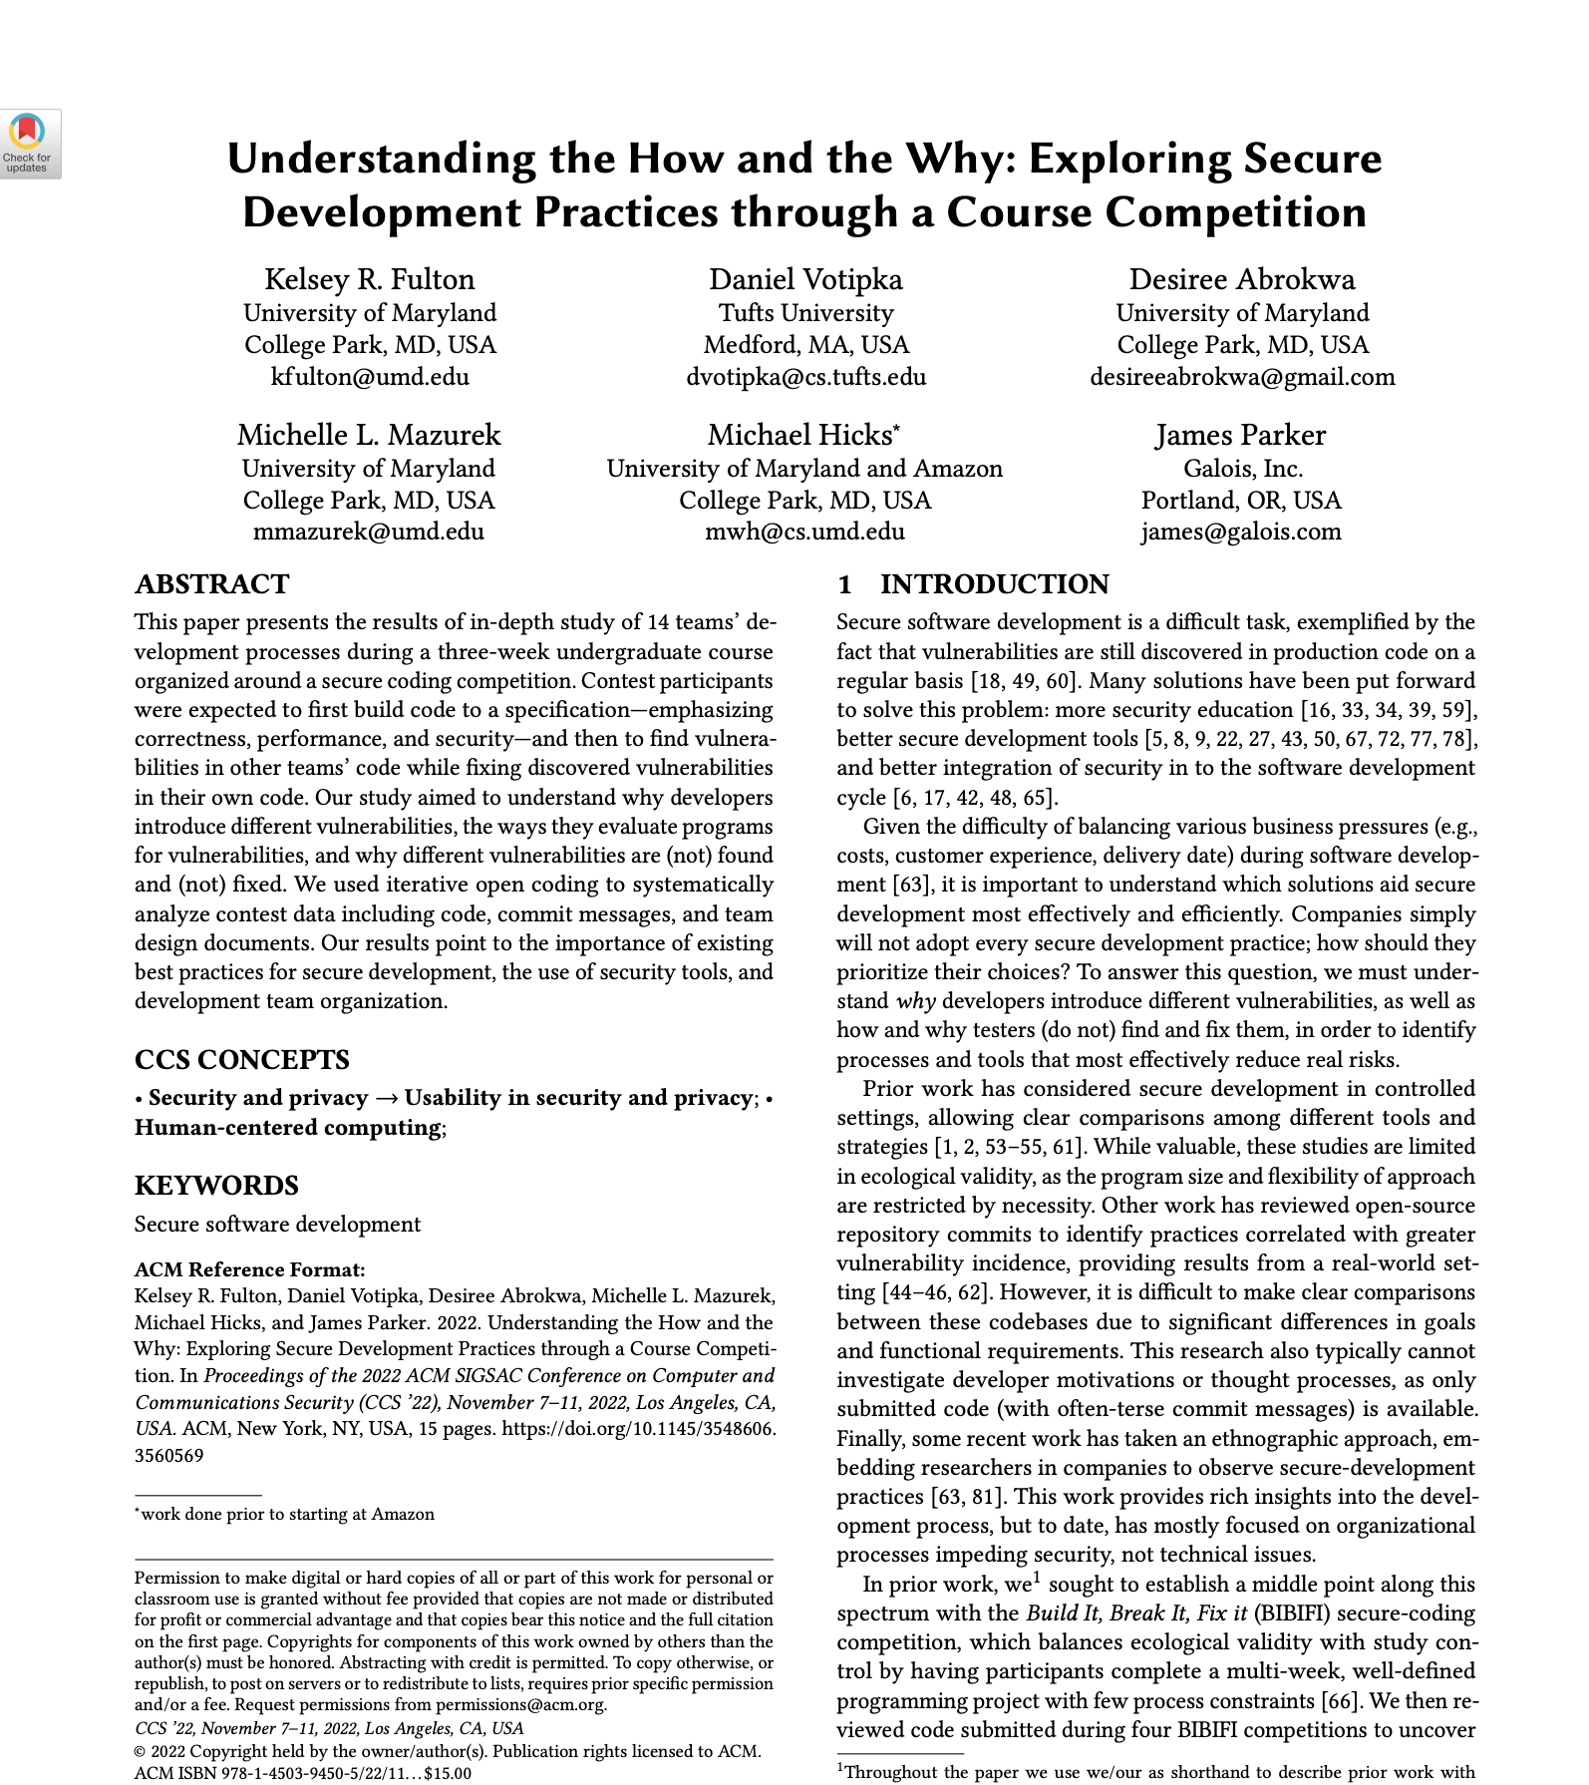
Discussion
What is your take on what the data seems to be saying?
What sort of follow-on studies could we do to support or refute the stated conclusions?
How does this study’s results speak to the big picture of securing software?
What technical next steps do you think might be worth pursuing, to improve the state of affairs?
One more paper in this series!

