Slide 1


Secure Systems Engineering and Management
A Data-driven Approach
Measuring Direct and Indirect Outcomes
Michael Hicks
UPenn CIS 7000-003
Spring 2026

Slide 2
Evidence-based security
Analysis
What are the (still) successful vectors of attack?
Where is risk (still) greatest?
What interventions could be deployed cost-effectively?
Outcomes
Hosts compromised,
Vulnerabilities exploited,
Revenue lost, …
Intervention
Engineering,
Operations,
Policy,
Education, …

Slide 3
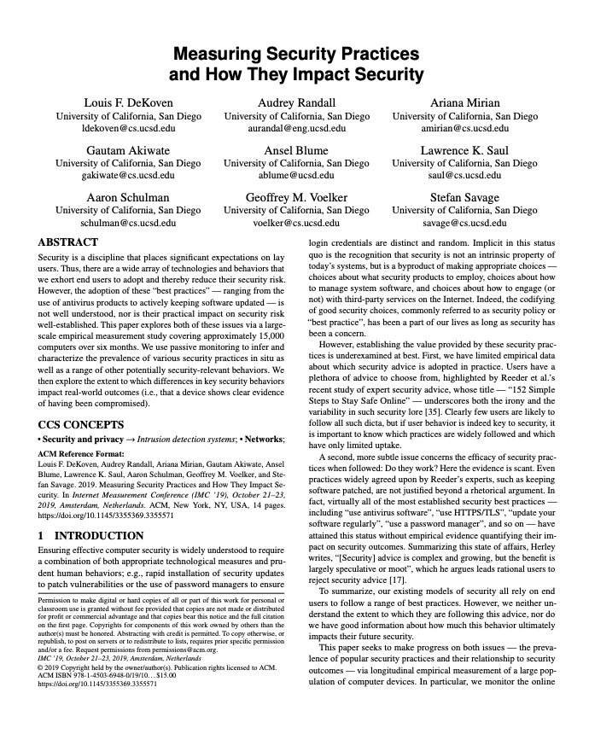
What to measure?
Outcomes
Hosts compromised,
Vulnerabilities exploited,
Revenue lost, …
Intervention
Engineering,
Operations,
Policy,
Education, …

Slide 4
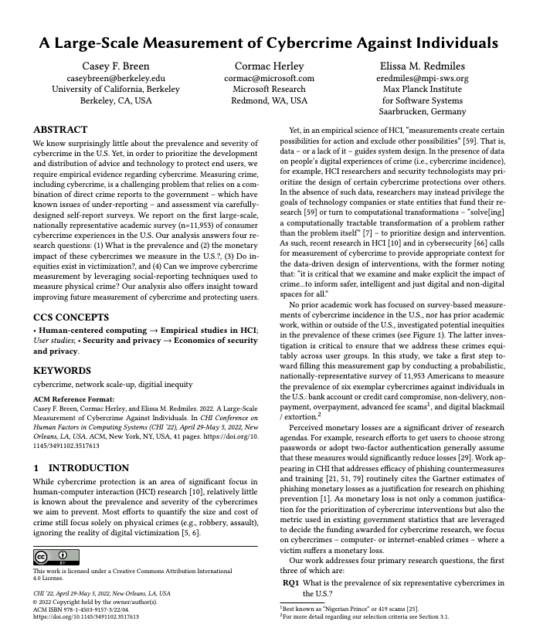
What to measure?
Outcomes
Hosts compromised,
Vulnerabilities exploited,
Revenue lost, …
Intervention
Engineering,
Operations,
Policy,
Education, …

Slide 5
Two Papers, One Question: How Bad Is It?
 | DeKoven et al. | Breen et al.
Analogy | “Does the medicine work?” | “How sick are the patients?”
Measures | Whether security practices reduce compromise | Prevalence, cost, and demographics of cybercrime
Approach | Passive network monitoring | Probability-based survey
Complementary: Network monitoring sees what users can’t report; surveys capture the human experience that network data cannot.

Slide 6
Side-by-Side Overview
Dimension | DeKoven et al. (IMC 2019) | Breen et al. (CHI 2022)
What was done | Monitored ~15K devices on a university network for 6 months | Surveyed ~12K U.S. adults via probability panel
How analyzed | Non-parametric tests, LASSO logistic regression | Survey-weighted proportions, logistic regression, NSUM
What was learned | Behavioral factors (web activity, gaming) predict compromise more than security tools | Banking fraud ~12% annualized; most losses modest; rare crimes need large samples
Causal claims? | No (observational) | No (observational)
Notes:
Key contrast in data source: DeKoven uses behavioral data with no self-report bias but limited to what an IDS can detect. Breen uses self-report data that is nationally representative but subject to recall/recognition bias.
Key contrast in population: DeKoven studies university undergrads (non-representative). Breen studies U.S. adults via a probability-based panel (representative).
Both find that evidence-based security is hard — confounders are everywhere and randomized experiments are difficult or impossible.

Slide 8
Research Questions and Security Outcomes
Prevalence: To what extent are common security “best practices” actually adopted by real users?
Efficacy: When adopted, do these practices actually reduce the likelihood of compromise?
Notes:
The outcome variable is binary: was the device compromised during the observation period, as detected by the campus IDS?
This is narrower than it first appears. The paper does NOT measure: - Harm resulting from compromise (data theft, financial loss) - Near-misses or attacks that were successfully blocked - Compromise that the IDS failed to detect
Discussion question: Is “compromise detected by IDS” a good proxy for the security outcome we actually care about? What are the implications of this narrow definition?

Slide 9
Why This Matters
Security advice is complex, growing, and largely unvalidated (Herley’s critique)
Reeder et al.: “152 Simple Steps to Stay Safe Online” — the absurdity of what we ask users to do
Aspiration: evidence-based security, analogous to evidence-based medicine
Can we ground security advice in empirical data rather than folk wisdom?
Notes:
Security is unusual as a discipline: it places enormous expectations on lay users. We tell people to use unique passwords, enable 2FA, keep software updated, run antivirus, avoid suspicious links, use a VPN, etc. — but the benefit of most of this is largely speculative.
The paper’s goal is to bring the evidence-based medicine mindset to security: measure outcomes, test whether interventions work, and stop recommending things without evidence.

Slide 10
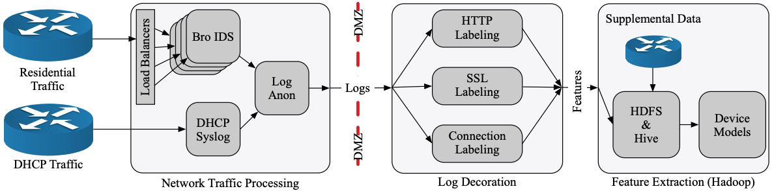
Measurement Setup
~15,000 desktop/laptop devices on a university residential network
6 months of observation (June–December 2018)
Notes:
The campus network provides a natural observation point. All residential traffic passes through a monitoring tap. The Bro/Zeek IDS processes this into structured logs. Passive monitoring of 4–6 Gbps bidirectional traffic
Traffic → structured logs (HTTP, SSL/SNI, DNS, connections) → anonymized
Key engineering challenges they had to solve:
- DHCP aliasing: devices get dynamic IPs (15-min leases), so they maintain a DHCP cache mapping IPs to anonymized MACs
- DNS caching: DNS traffic comes from the local resolver, not individual devices, so they replay DNS logs to build an IP-to-domain mapping
- Device filtering: separating laptops/desktops from phones, IoT, printers using UA heuristics, OUI vendor lists, and behavioral patterns
CDN traffic (Netflix, YouTube, Akamai) is filtered before reaching their system.

Slide 11
Inferring Device Features from Traffic
68 custom network signatures infer a device profile from traffic alone:
Traffic Signal | Inferred Feature
Host: avast-update.com | Antivirus: Avast
User-Agent: ... Windows NT 10.0 | OS: Windows 10
DNS: tracker.torproject.org | Tor usage
Version change in UA string | Software update event
IAB Content Taxonomy match | Website categories visited
Notes:
Tradeoffs and trustworthiness:
- Validation is limited: 100 devices manually labeled for device filtering (found 1 FN, 4 FP — reasonable but small). Spot-checks on OS classification.
- The 68 network signatures are NOT systematically validated for precision/recall. How often does a signature fire when the software isn’t present, or fail to fire when it is? –
User-Agent strings can be spoofed or absent. Authors note this but don’t quantify the scope.
- CDN filtering removes Netflix/YouTube/Akamai traffic before analysis — could this affect feature extraction?
Bottom line: The inferences are plausible and the authors are thoughtful, but ground truth validation is limited to small spot-checks rather than comprehensive accuracy measurement.

Slide 12
Inferring Device Features from Traffic
68 custom network signatures to detect:
Antivirus products, password managers
P2P clients, Tor, Flash
OS and browser versions (via User-Agent strings)
Software update events
Website categories (IAB Content Taxonomy, 404 categories)
Notes:
This is an ingenious but imperfect approach. The authors infer what software a device is running entirely from network traffic patterns.
Tradeoffs and trustworthiness:
- Validation is limited: 100 devices manually labeled for device filtering (found 1 FN, 4 FP — reasonable but small). Spot-checks on OS classification.
- The 68 network signatures are NOT systematically validated for precision/recall. How often does a signature fire when the software isn’t present, or fail to fire when it is?
- User-Agent strings can be spoofed or absent. Authors note this and attempt to control for it, but the scope of the problem isn’t quantified.
- CDN filtering removes some traffic before analysis — could this affect feature extraction?
Bottom line: The inferences are plausible and the authors are thoughtful, but ground truth validation is limited to small spot-checks rather than comprehensive accuracy measurement.

Slide 13
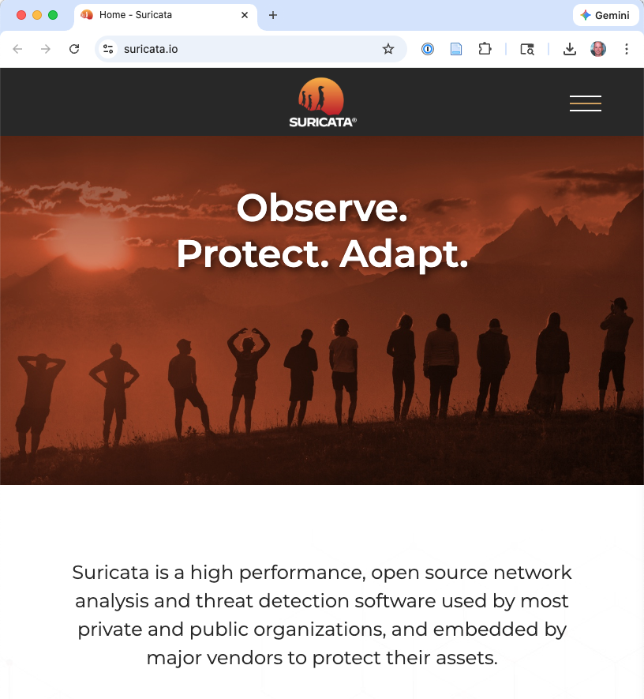
Detecting Compromise
Campus Suricata IDS
Restricted to post-infection behavior (e.g., C&C communication), not pre-compromise activity
Rules manually curated to remove frequent false-positive triggers
Overall compromise rate: 4.5% (682 of 15,291 devices)
Notes:
Why prefer false negatives?
- False positives (labeling a clean device as compromised) would create spurious correlations between practices and “compromise” — potentially making good practices appear harmful.
- False negatives (missing real compromise) add noise but bias toward null results — they make it harder to find real correlations, but don’t create fake ones.
- So the authors accept that they’ll miss some real compromises to keep the “compromised” label trustworthy.
The bigger concern with false negatives:
- The IDS can only detect malware that communicates in ways matching known signatures. Sophisticated malware, zero-days, encrypted C&C channels are missed entirely. And attacks that match pre-compromise rules are blocked

Slide 14
Key Results: Individual Security Practices
Finding | Detail | Verdict
OS matters | Windows 3.9× more likely compromised than macOS | ✅ Robust
Risky software | Thunderbird 33%, P2P 13%, Tor 12%, Adobe AIR 10% | ✅ Robust
Web activity volume | More traffic → more compromise (“miles driven”) | ✅ Robust
Gaming / hobby sites | Strongest content predictor of compromise | ✅ Robust
Updates don’t help (much) | No significant protective effect; compromised devices updated faster | ⚠️ Surprising
AV doesn’t help (in this data) | AV users: 7% compromised vs. non-AV: 4% | ⚠️ Survivorship bias
Password managers | 8% compromise (vs. 4% baseline) | ⚠️ Confounded by user profile
Notes:
ROBUST results — large effects, statistically significant, plausible mechanisms: 1. OS matters: Windows ≈ 3.9× more compromised than macOS. Large sample, large effect. Caveat: IDS rule set is likely more Windows-targeted. 2. Specific risky software: Thunderbird has 420 CVEs in CVE Details — the 33% rate is plausible. P2P and Tor expose users to untrusted content. These are direct risk factors. 3. Web activity volume: compromised devices generate significantly more traffic (Figure 5). The “automobile miles driven” analogy: more exposure → more risk. 4. Content categories: gaming and hobby sites strongly associated with compromise.
SURPRISING / DESERVE SKEPTICISM: - Updating: where differences exist, compromised devices updated FASTER. This is likely a response to compromise (IT intervention, user alarm), not a cause. The before/after analysis using Wilcoxon signed-rank confirms devices update faster post-compromise. - AV: confounded by survivorship bias. The IDS only detects malware that got through — AV’s successes are invisible. All compromised-by-malware devices are, by definition, ones where AV failed. - Password managers: not harmful — they signal a technically sophisticated, risk-taking user profile. Same for remote DNS users (6% vs 2% baseline). These are indirect indicators, not direct risk factors. - Flash use NOT strongly associated with higher compromise — the authors call this a “community success story.” - Feature importance rankings from §6 depend on the specific IDS, rule set, and population — generalizability is unclear.

Slide 15
Statistical Methods Used
Test | Paper’s Use | What It Tests
Mann-Whitney U | OS/browser update speed | Two independent groups, same distribution?
Wilcoxon signed-rank | Before/after compromise updates | Paired observations differ?
Kolmogorov-Smirnov | Web content categories | Two distributions differ in any way?
Chi-Square | Software features vs. compromise | Association between categorical variables
Bonferroni | Applied to KS, Chi-Square | Controls family-wise error rate
LASSO logistic regression | Feature importance ranking (§6) | Binary classification + variable selection
Notes:
This table maps the paper’s statistical methods to what students have seen in class. Mann-Whitney U, Chi-Square, and Bonferroni were covered in Lecture 1. Logistic regression was covered in Lecture 2. Wilcoxon signed-rank was mentioned but not covered in depth. KS test and LASSO are new.
Each test is chosen for a reason tied to the data structure: paired vs. independent, categorical vs. continuous, location shift vs. distributional difference.

Slide 16
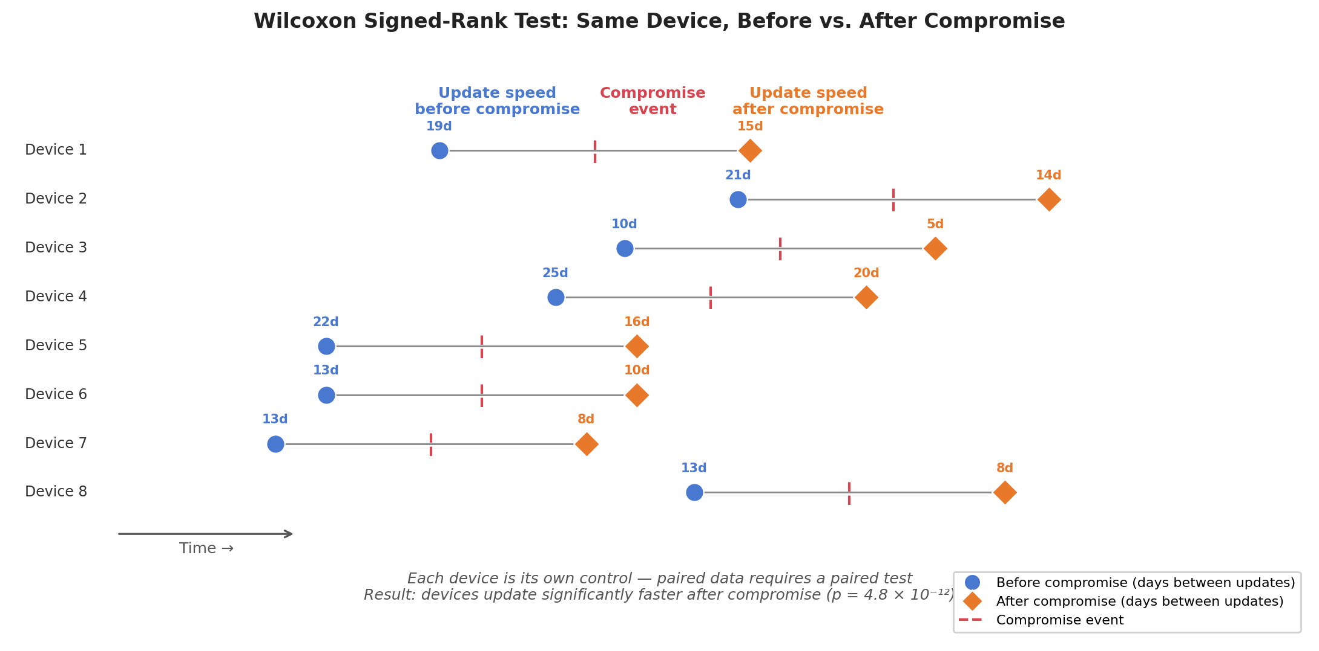
Wilcoxon Signed-Rank Test
Notes:
Why use this instead of Mann-Whitney U? Because the two groups (before-compromise and after-compromise measurements) are NOT independent — they come from the same device. Each device serves as its own control. Mann-Whitney U assumes independent samples and would be inappropriate here.
The finding: devices update faster after compromise. This is likely a response (IT intervention, user alarm), not a cause. The statistical test confirms the pattern is real; the interpretation requires causal reasoning beyond what the test can provide.

Slide 17
Wilcoxon Signed-Rank Test
The paired-data cousin of Mann-Whitney U
Procedure:
Compute difference for each pair
Rank the absolute differences
Compare rank sums of positive vs. negative differences
Null hypothesis: Differences are symmetric around zero
Paper’s use: Devices update significantly faster after compromise than before (p = 4.8 × 10⁻¹²)
Notes:
Why use this instead of Mann-Whitney U? Because the two groups (before-compromise and after-compromise measurements) are NOT independent — they come from the same device. Each device serves as its own control. Mann-Whitney U assumes independent samples and would be inappropriate here.
The finding: devices update faster after compromise. This is likely a response (IT intervention, user alarm), not a cause. The statistical test confirms the pattern is real; the interpretation requires causal reasoning beyond what the test can provide.

Slide 18
Which features matter most when considered together?
Approach: LASSO (L1 regularization) logistic regression
Why?
Outcome is binary (compromised or not)
Hundreds of features → need automatic variable selection
Penalty shrinks unimportant coefficients to exactly zero
Why AUC-ROC? With 4.5% base rate, accuracy is misleading
95.5% by always predicting “clean”
Notes:
LASSO adds a penalty proportional to the absolute value of each coefficient. As the penalty increases, less important coefficients are driven to zero. This performs automatic variable selection — the model itself decides which features to include.
Tuned via 10-fold cross-validation across 200 candidate values
AUC (Area Under the ROC Curve) answers: “If I pick one compromised and one clean device at random, how often does the model assign a higher risk score to the compromised one?” It ranges from 0.5 (random) to 1.0 (perfect) and is insensitive to class imbalance, unlike accuracy.
The authors also check VIF (Variance Inflation Factor) for multicollinearity — all values below 10, so no concern there.

Slide 19
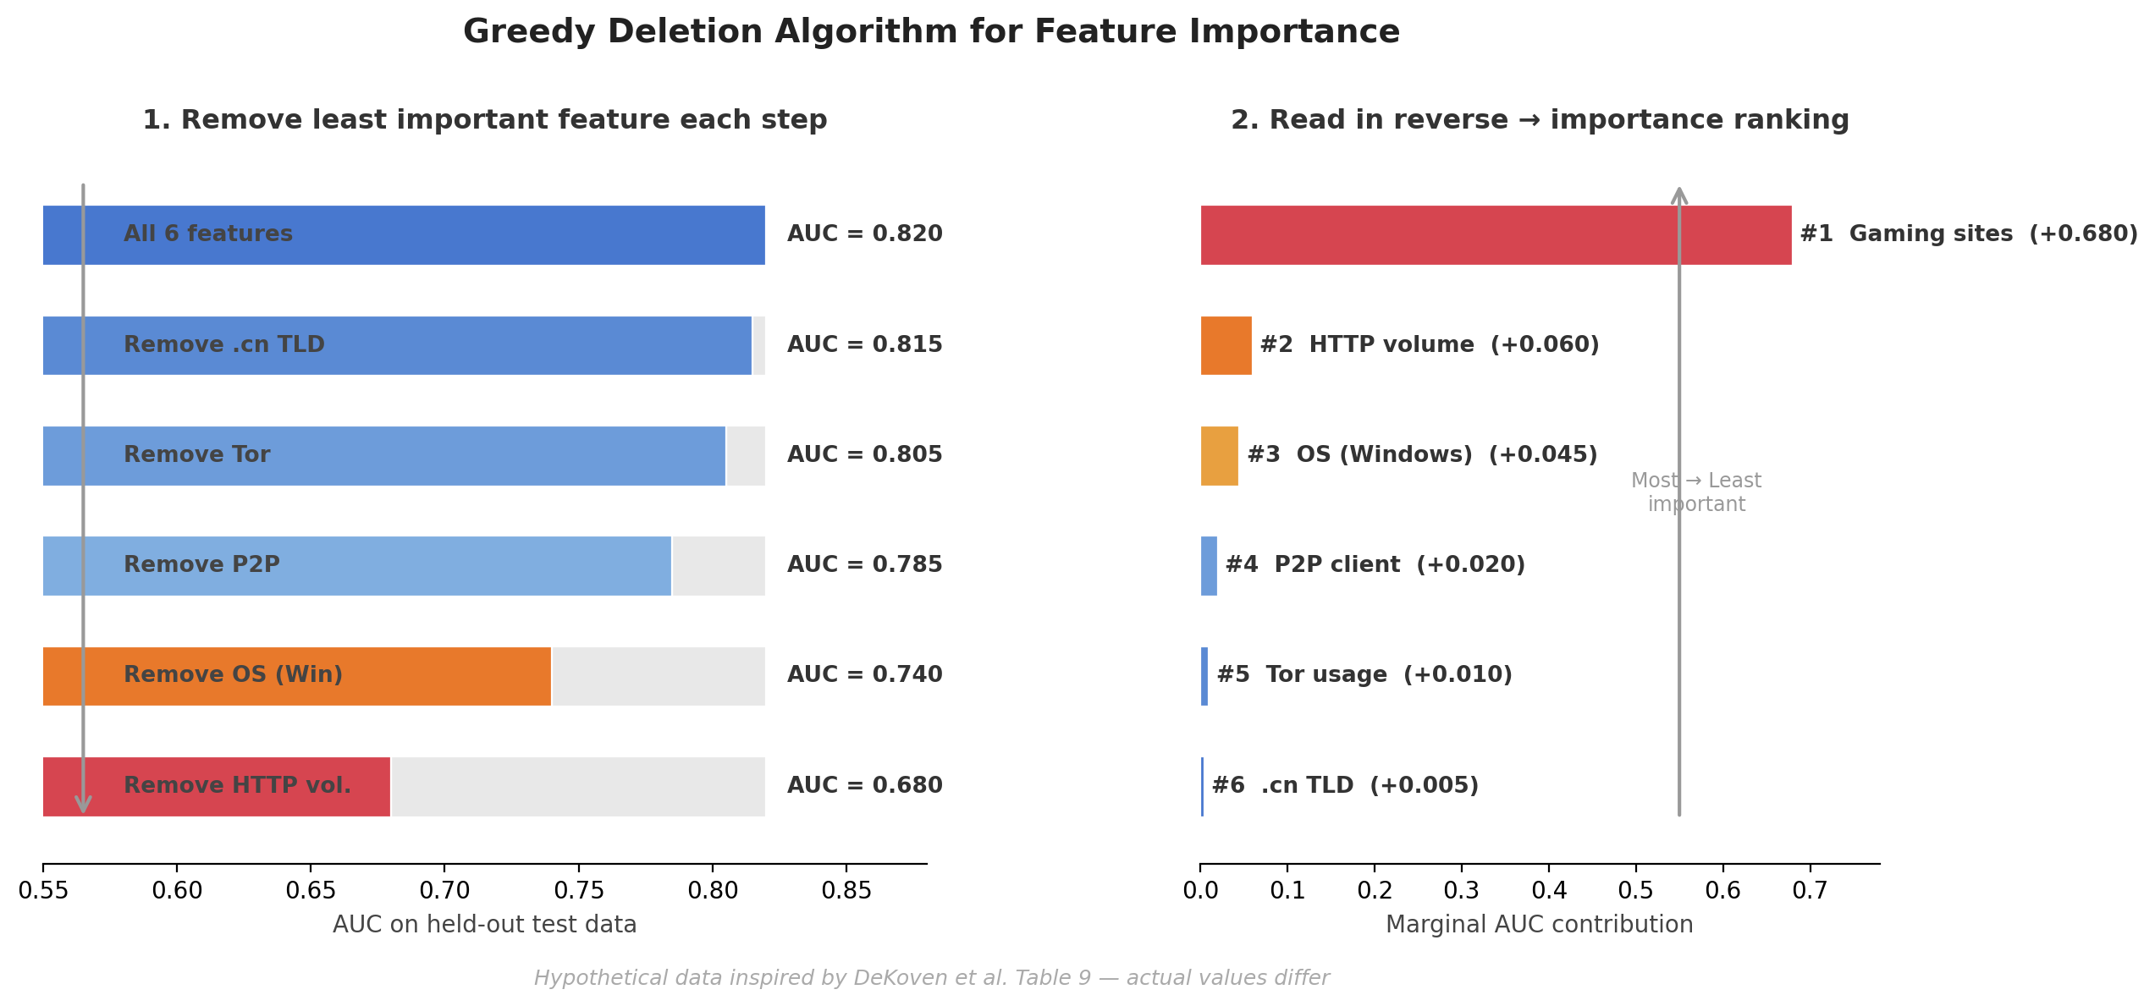
Feature Ranking: Greedy Deletion
Notes:
Start with N features selected by the best LASSO model
Remove the feature whose absence hurts AUC least
Repeat until one feature remains — this is the most important predictor
Read in reverse: first feature back contributes the most AUC
This is backward stepwise selection evaluated using out-of-sample AUC.
Why do they need training and test data for what they say is an explanatory (not predictive) analysis?
Two reasons: 1. LASSO with cross-validation is inherently a predictive procedure. The regularization parameter is chosen to maximize predictive performance (AUC on validation folds). Without held-out data, you can’t properly tune regularization and risk overfitting. 2. The greedy deletion algorithm evaluates importance via AUC. Reporting both validation and test AUC (Table 9) lets the reader verify that rankings aren’t artifacts of overfitting.
Even though the goal is explanation, the method involves model selection, and model selection requires held-out evaluation to be trustworthy.

Slide 20
Why Not Multiple Linear Regression with AIC?
 | LASSO + Greedy Deletion | MLR with AIC
Complexity penalty | Aggressive; built-in variable selection | Penalizes complexity, but less aggressively
Evaluation | Out-of-sample performance (AUC) | In-sample fit
Scalability | Handles hundreds of features well | Combinatorial explosion with many features
Output | Clear feature ranking with AUC contributions | AIC values across candidate models
Notes:
AIC-based stepwise selection evaluates in-sample fit; LASSO + greedy deletion evaluates out-of-sample performance, which is more robust to overfitting.
AIC is designed for comparing a small number of candidate models. With hundreds of features, the combinatorial space is too large for exhaustive AIC comparison, while LASSO scales well.
The greedy deletion algorithm gives a clear ranking of feature importance with quantified AUC contributions, which is arguably more interpretable than comparing AIC values across models.
Both are valid approaches, but LASSO is better suited to this high-dimensional, rare-event setting.

Slide 21
Key Results from LASSO Analysis
Behavioral features dominate — web content and traffic volume matter more than security software
Visiting gaming sites is the single strongest predictor of compromise (+68–76% AUC contribution)
HTTP traffic to .cn TLD is a strong signal for macOS devices
IE User-Agent string is an artifact — actually reflects QQ chat and Qihoo 360 usage, not Internet Explorer
Notes:
The “IE User-Agent” finding is a cautionary tale about cursory feature extraction. What looked like “Internet Explorer usage predicts compromise” was actually a proxy for Chinese chat applications that happen to use IE’s UA string. Without digging into the feature, you’d draw the wrong conclusion.
The dominance of behavioral features over security tools is a striking finding: what you DO online matters more than what security software you run. This supports the “miles driven” analogy — more exposure means more risk, regardless of the safety features in your car.

Slide 22
Broader Lessons from DeKoven et al.
Evidence-based security is hard — confounders everywhere, randomized experiments nearly impossible
Correlation ≠ causation is especially tricky — Tor users are more compromised, but is Tor the cause?
Best practices may signal more than they protect — password manager users aren’t compromised because of the tool
Volume of activity is the strongest predictor — more web activity → more exposure → more risk
Notes:
Methodological contributions: demonstrates that passive network monitoring at scale is feasible for security measurement; provides a template for inferring software features from network traffic; shows how to combine observational behavioral data with security outcome data.
Limitations: population is university undergrads (not representative); IDS detection is incomplete; 6 months may be too short; no causal claims possible.
Future questions: Can this be replicated in corporate environments? With the shift toward encrypted traffic (more TLS, less HTTP), how viable is this approach today? How would results change with endpoint detection rather than network IDS?

Slide 24
Four Research Questions
Prevalence — What is the prevalence of various cybercrimes against U.S. individuals?
Monetary Impact — What is the financial cost?
Inequities — Do demographic disparities exist in who is victimized?
NSUM — Can the network scale-up method improve cybercrime measurement?
What are past approaches and their problems?
Notes:
RQ1 and RQ2 are the headline questions: how common is cybercrime and how much does it cost? These seem basic, but we actually don’t have good answers — existing data sources are deeply flawed.
RQ3 asks about equity: are some demographic groups victimized more than others? This has direct policy implications.
RQ4 is a methodological experiment: can a technique borrowed from public health (NSUM) help capture cybercrime that victims don’t self-report? Spoiler: it doesn’t work well here, but the failure is informative.
The paper surveys multiple crime types: identity theft/banking fraud, phishing, nondelivery scams, nonpayment, overpayment, extortion, and advance-fee fraud. These are crimes experienced by individuals, not organizations.

Slide 25
Past Approaches and Their Problems
Data Source | Problem
FBI IC3 reports | Relies on victims filing complaints — massive under-count
Industry reports (Norton, McAfee) | Opt-in convenience samples; implausibly large cost estimates
Academic surveys | Small-scale, non-representative, narrow crime types

Slide 26
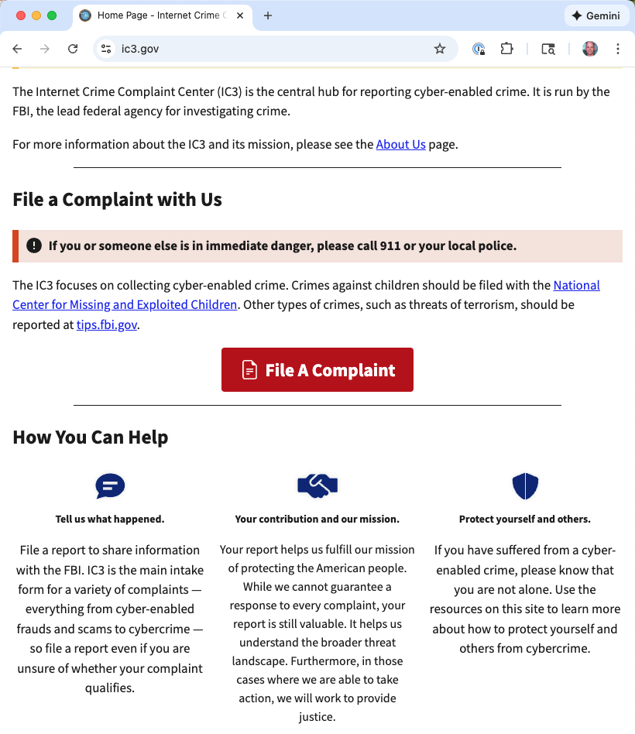
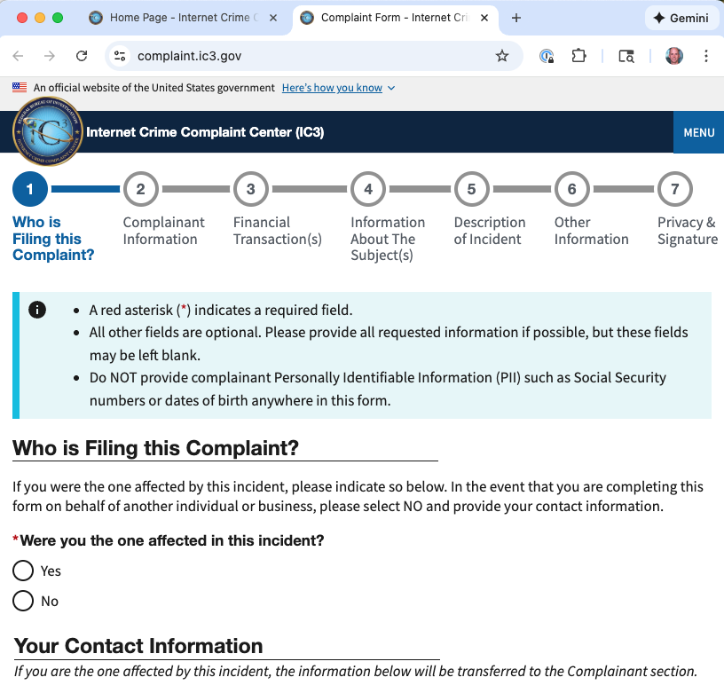
Source: FBI Internet Crime Complaint Center (IC3)
FBI IC3 estimates that only 10-12% of cybercrimes are reported
Victims of crime volunteer information
Last 5 years: 2000 per day
Notes:
FAQ: Who should file a complaint with the Internet Crime Complaint Center (IC3)?
Anyone who believes they are affected by a cyber-enabled crime may file a complaint with the IC3, including citizens of another country or who may be reporting a subject in another country. You may also file on behalf of another person you believe has been affected by a cyber-enabled crime.
Asks that they include the following (along with evidence like transaction receipts)
Financial loss and transaction information
Account information, transaction date and amount, who received the money.
Total amount of loss to the complainant.
For cryptocurrency transactions, refer to the IC3 Cryptocurrency page for more important information to provide.

Slide 27
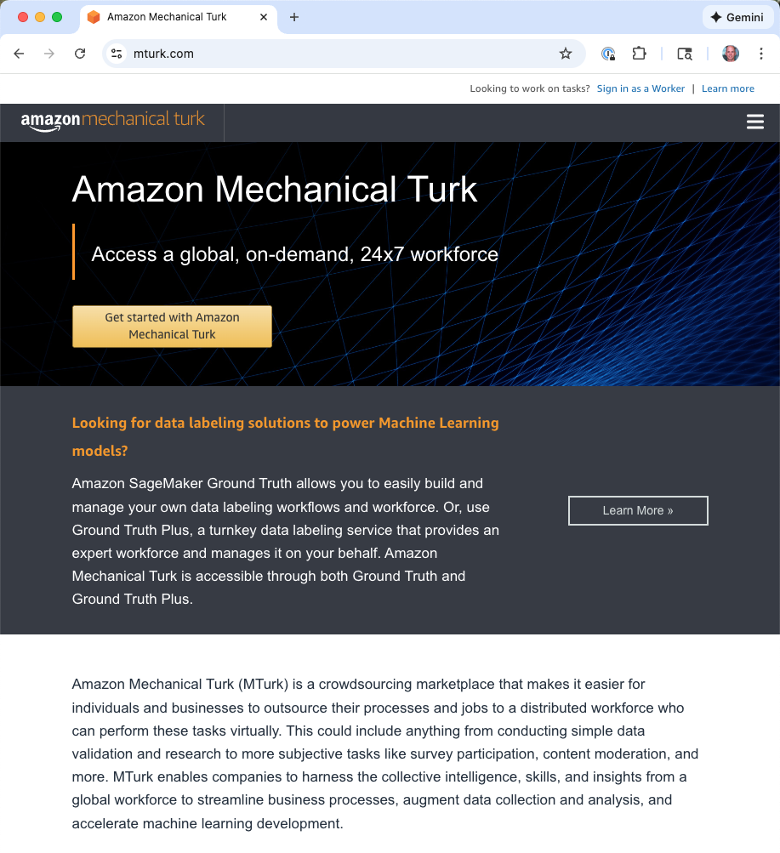
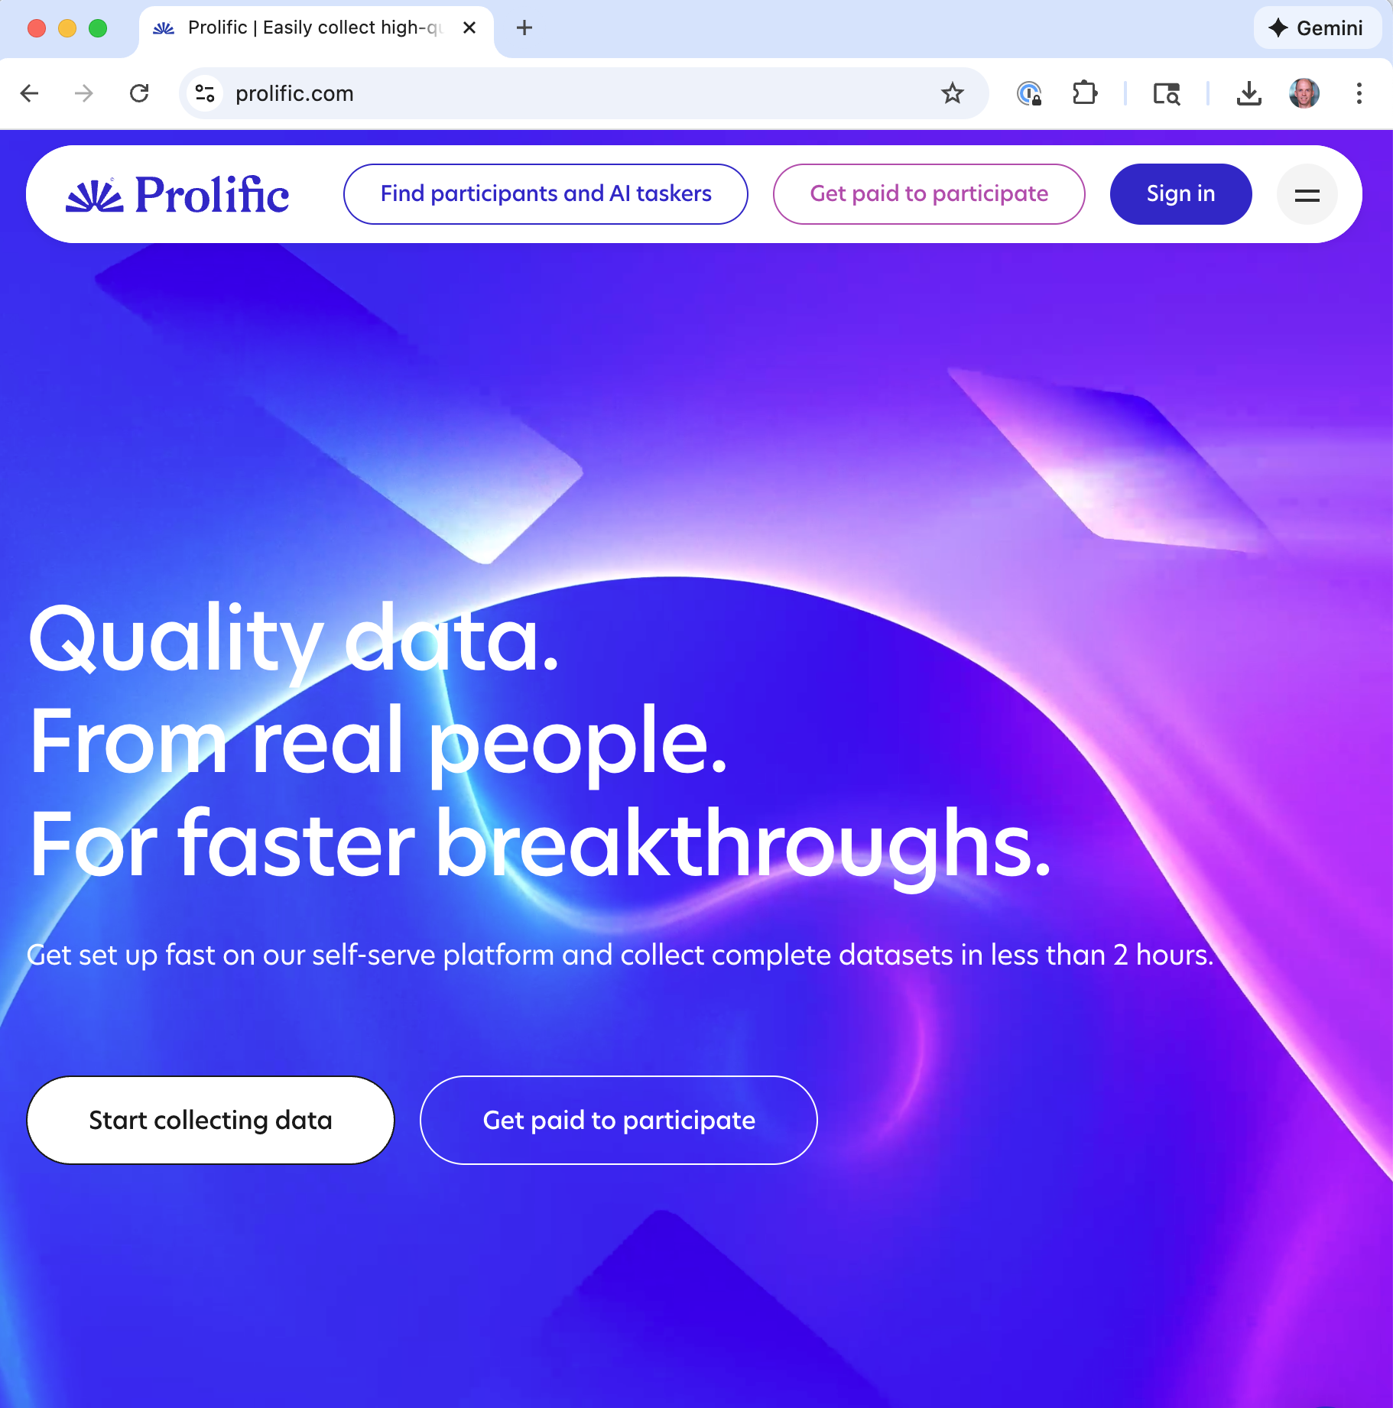
Source Recruiting paid participants on-line
Does not represent whole US population (e.g., younger, more Internet-savvy)
Notes:
Convenience samples (MTurk, Qualtrics panels, opt-in web surveys):
People who opt in differ systematically from those who don’t
Younger, more internet-savvy, more educated
Cannot make valid population-level inferences

Slide 28
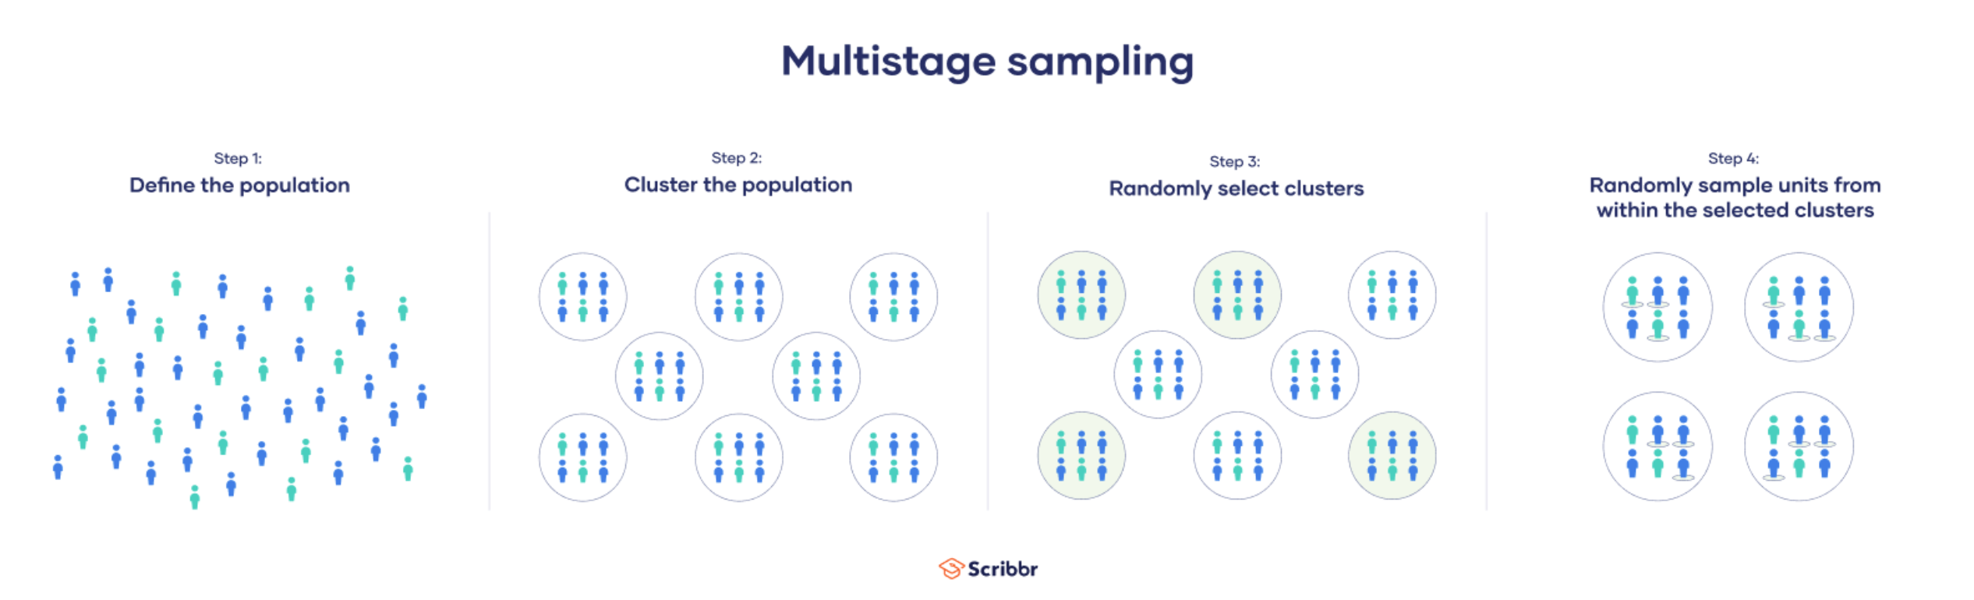
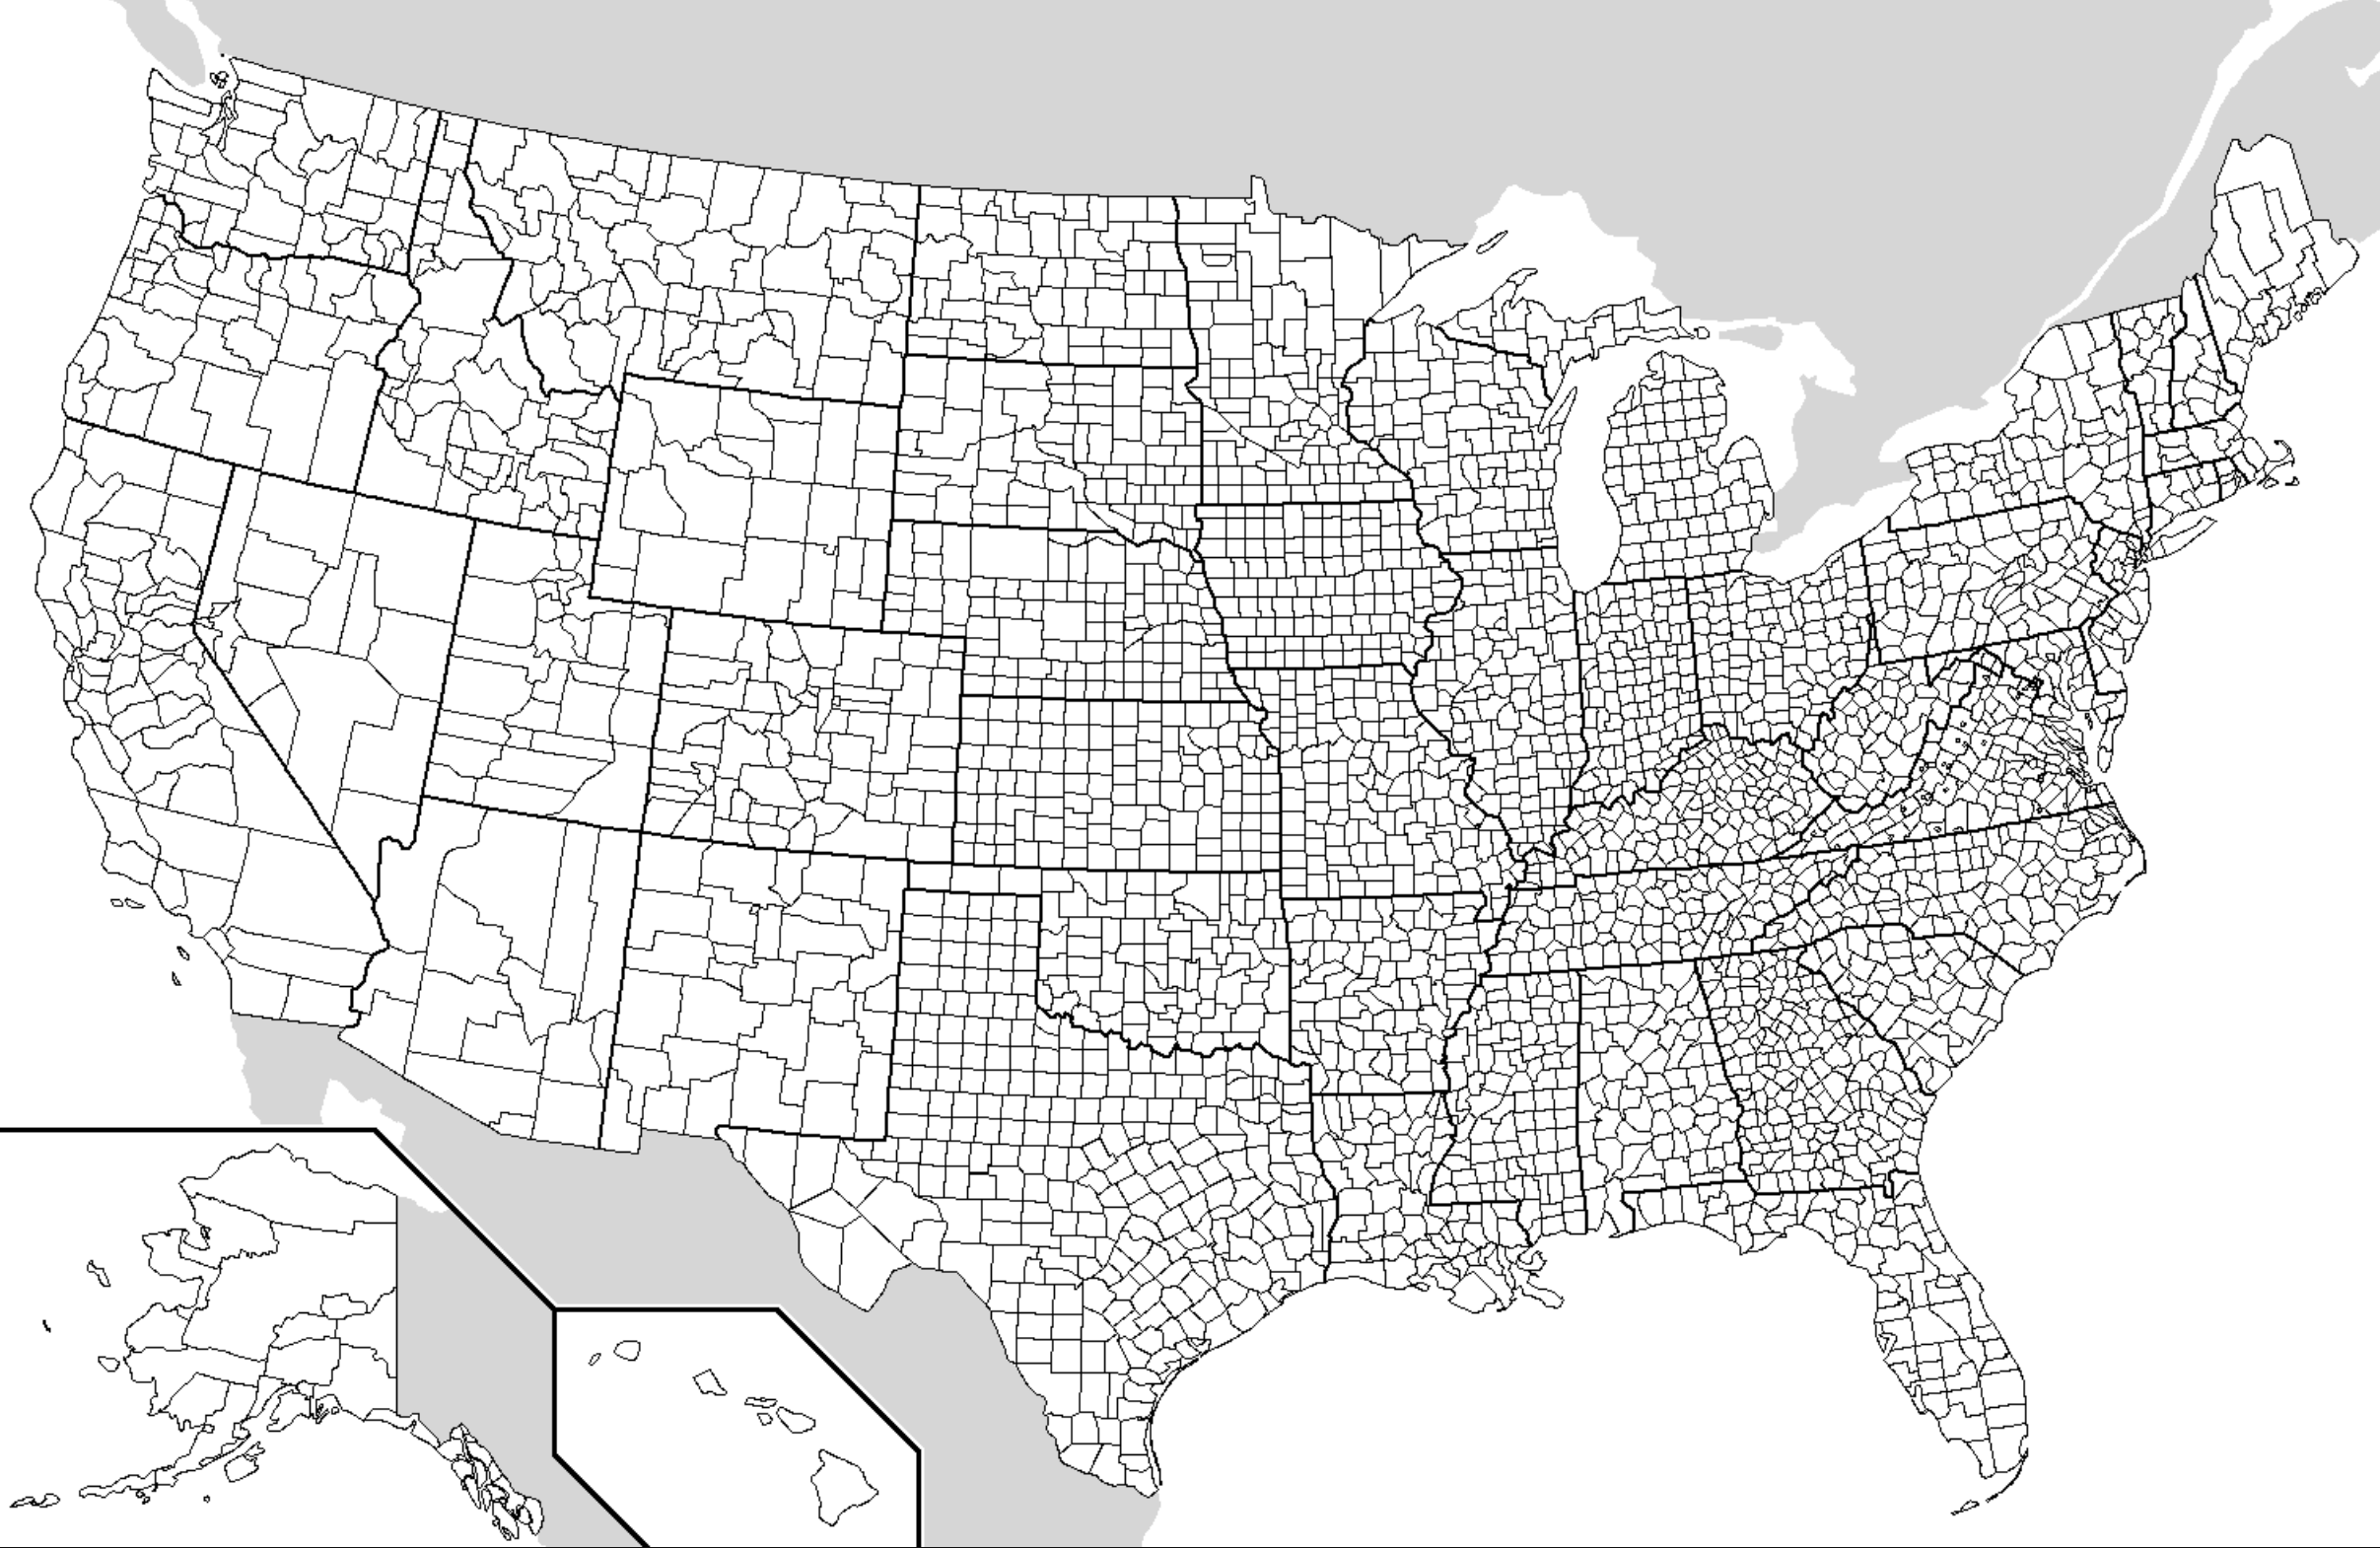
Whole population Multistage (and probabilistic) sampling
Select a committed “panel” for repeat surveys
Notes:
Probability sampling:
Every U.S. household has a known, non-zero probability of inclusion
Enables valid confidence intervals and population estimates
Survey weights correct for deviations between sample and population

Slide 29

AmeriSpeak Panel
Probability-based panel operated by NORC at the University of Chicago
Households selected via area probability + address-based sampling
Multi-mode recruitment: mail, telephone, in-person field interviewers
Covers ~97% of U.S. household population
Used by major government-funded studies
Notes:
Why AmeriSpeak specifically? - Multi-mode recruitment captures populations that online-only panels miss (elderly, low-income, rural) - Statistical weights adjust for panel design, differential non-response, and sampling frame limitations - Widely considered among the highest-quality survey panels in the U.S.
Reasons for caution: - Even with probability sampling, non-response is a concern. If non-responders differ in cybercrime experiences, weights may not fully correct the bias. - Survey fielded July–September 2020 — during the COVID-19 pandemic, which may have affected both cybercrime rates (more people online) and participation. - English-only, limiting representation of non-English-speaking populations.

Slide 30
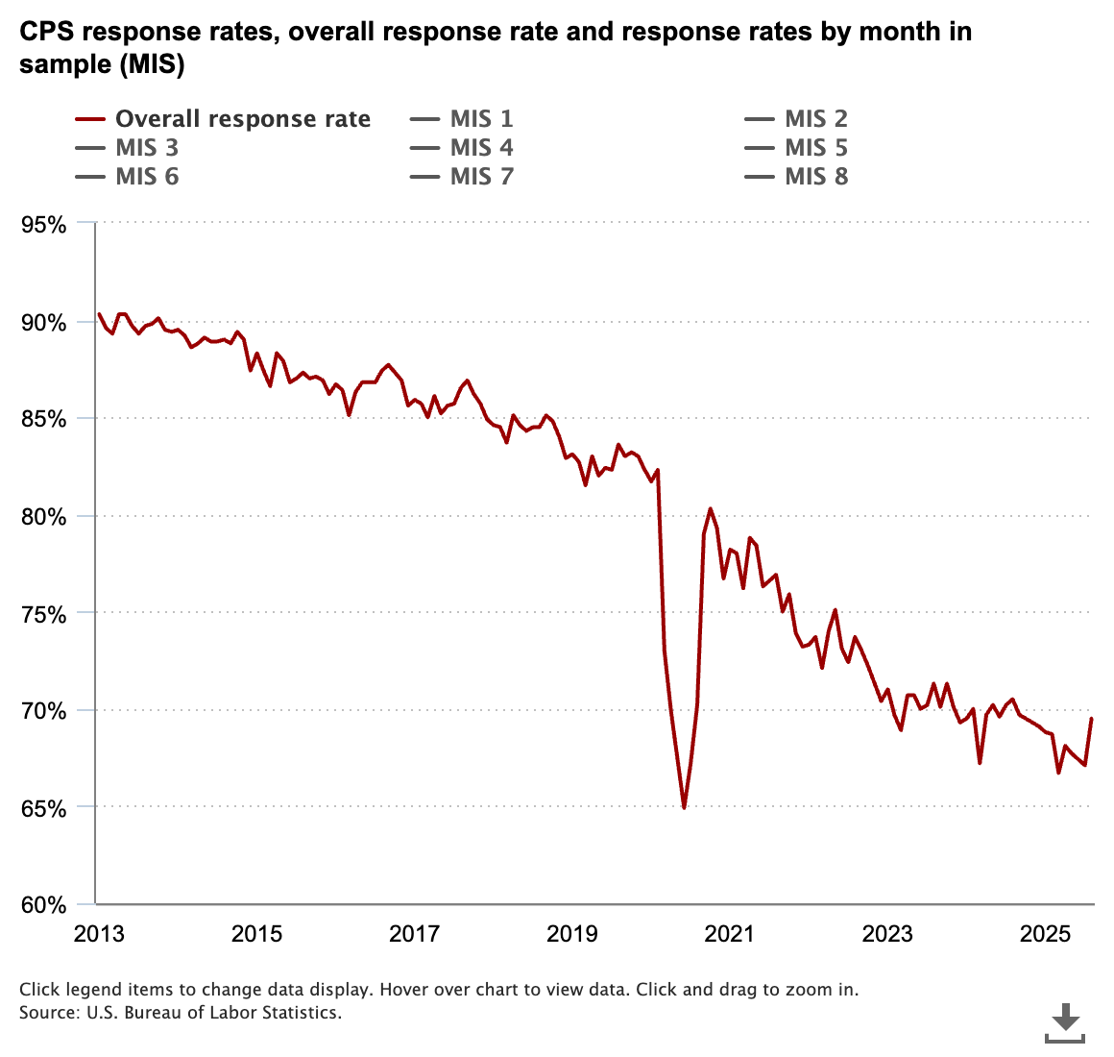
Aside: Concern with response rate

Slide 31
Two Samples, One Study
 | General Sample | “Rare Event” Sample
N | 1,002 | 10,951
Purpose | Estimate common crimes | Estimate rare crimes
Crime base rates | High enough (~6–23%) | Very low (<1%)
Why two sizes? Statistical power for rare events
A 0.5% crime in N=1,002 → ~5 victims (too few)
A 0.5% crime in N=10,951 → ~55 victims (enough for basic estimation)

Slide 32
Mapping Samples to Research Questions
Research Question | Sample Used | Why
RQ1/RQ2: Common crimes (banking, nondelivery) | General (N=1,002) | Base rates ~6–23% — sufficient
RQ1/RQ2: Rare crimes (nonpayment, extortion, etc.) | Total (N=10,951) | Base rates <1% — need larger N
RQ3: Demographics of common crimes | General (N=1,002) | Enough events for logistic regression
RQ3: Demographics of rare crimes | Total (N=10,951) | Need more events per demographic cell
RQ4: NSUM estimates | Both | Matches direct-estimate sample per crime
Notes:
Each sample comes from the same AmeriSpeak panel with probability-based sampling. They differ in size, and each has its own survey weights calibrated to the U.S. population.
The design is intentional: don’t waste resources oversampling for common crimes, but ensure you have enough observations to say something meaningful about rare ones.
This is a practical response to the power problem that arises with rare events.

Slide 33
RQ1: Cybercrime Prevalence
Roughly 1 in 8 U.S. adults per year.
Crime Type | Annualized Prevalence
Banking / Credit Card Fraud | ~12%
Non-Delivery Scam | ~3%
Non-Payment | ~0.3%
Overpayment | ~0.2%
Extortion | ~0.1%
Advance Fee | ~0.1%
Rates are much higher than FBI IC3 data
Based on the general sample
Notes:
Base rates ~6–23% — sufficient
Statistics used: survey-weighted proportions with confidence intervals computed via the beta proportion method (srvyr package in R). This connects to confidence intervals from the course, but with the added wrinkle of survey weighting.
The weighted proportion is computed as: Σ(weight × victimization indicator) / Σ(weight), not a simple count/total. The survey design object ensures standard errors account for the complex sampling design.
Banking/credit card fraud at ~12% is striking — roughly 1 in 8 U.S. adults per year. This dwarfs what complaint-based reporting systems suggest.

Slide 34
How Probability Sampling Changes Statistics
Without survey weights (e.g., DeKoven et al.):
Proportion = count / total
Standard CI formulas apply directly
With survey weights (Breen et al.):
Weighted proportion = Σ(weight × indicator) / Σ(weight)
CI must account for survey design (not just sample size)
Notes:
This is perhaps the most important methodological difference between the two papers. DeKoven et al. has a census of a network — every device is observed — so no weighting is needed. Breen et al. has a sample of a population, so weights are essential for valid inference.
In practice, the replication code creates a survey design object via as_survey_design(weight = weight), then computes survey-weighted means with CIs using survey_mean(proportion = TRUE, prop_method = “beta”).
For the logistic regression (RQ3), they pass survey weights to glm() via the weight argument. This gives weighted point estimates but uses quasi-likelihood standard errors rather than full design-based variance estimation — a pragmatic choice that gives approximately correct inference.
This was not covered in our statistics lectures, so worth emphasizing: if you’re analyzing survey data, ignoring the weights and design can give you wrong answers.

Slide 35
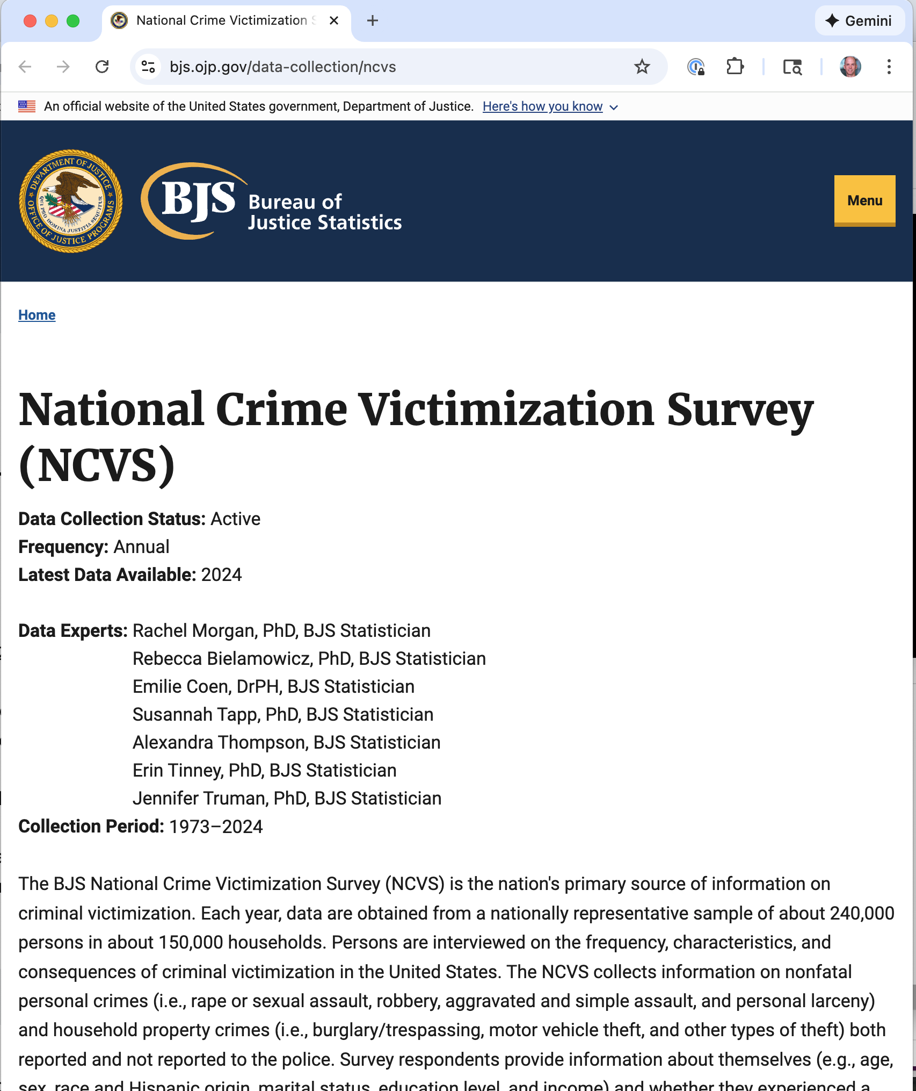
Source: National Crime Victimization Survey
Annual interview of representative sample of about 240,000 persons in about 150,000 US households
Non-fatal personal crimes, officially reported or not

Slide 36
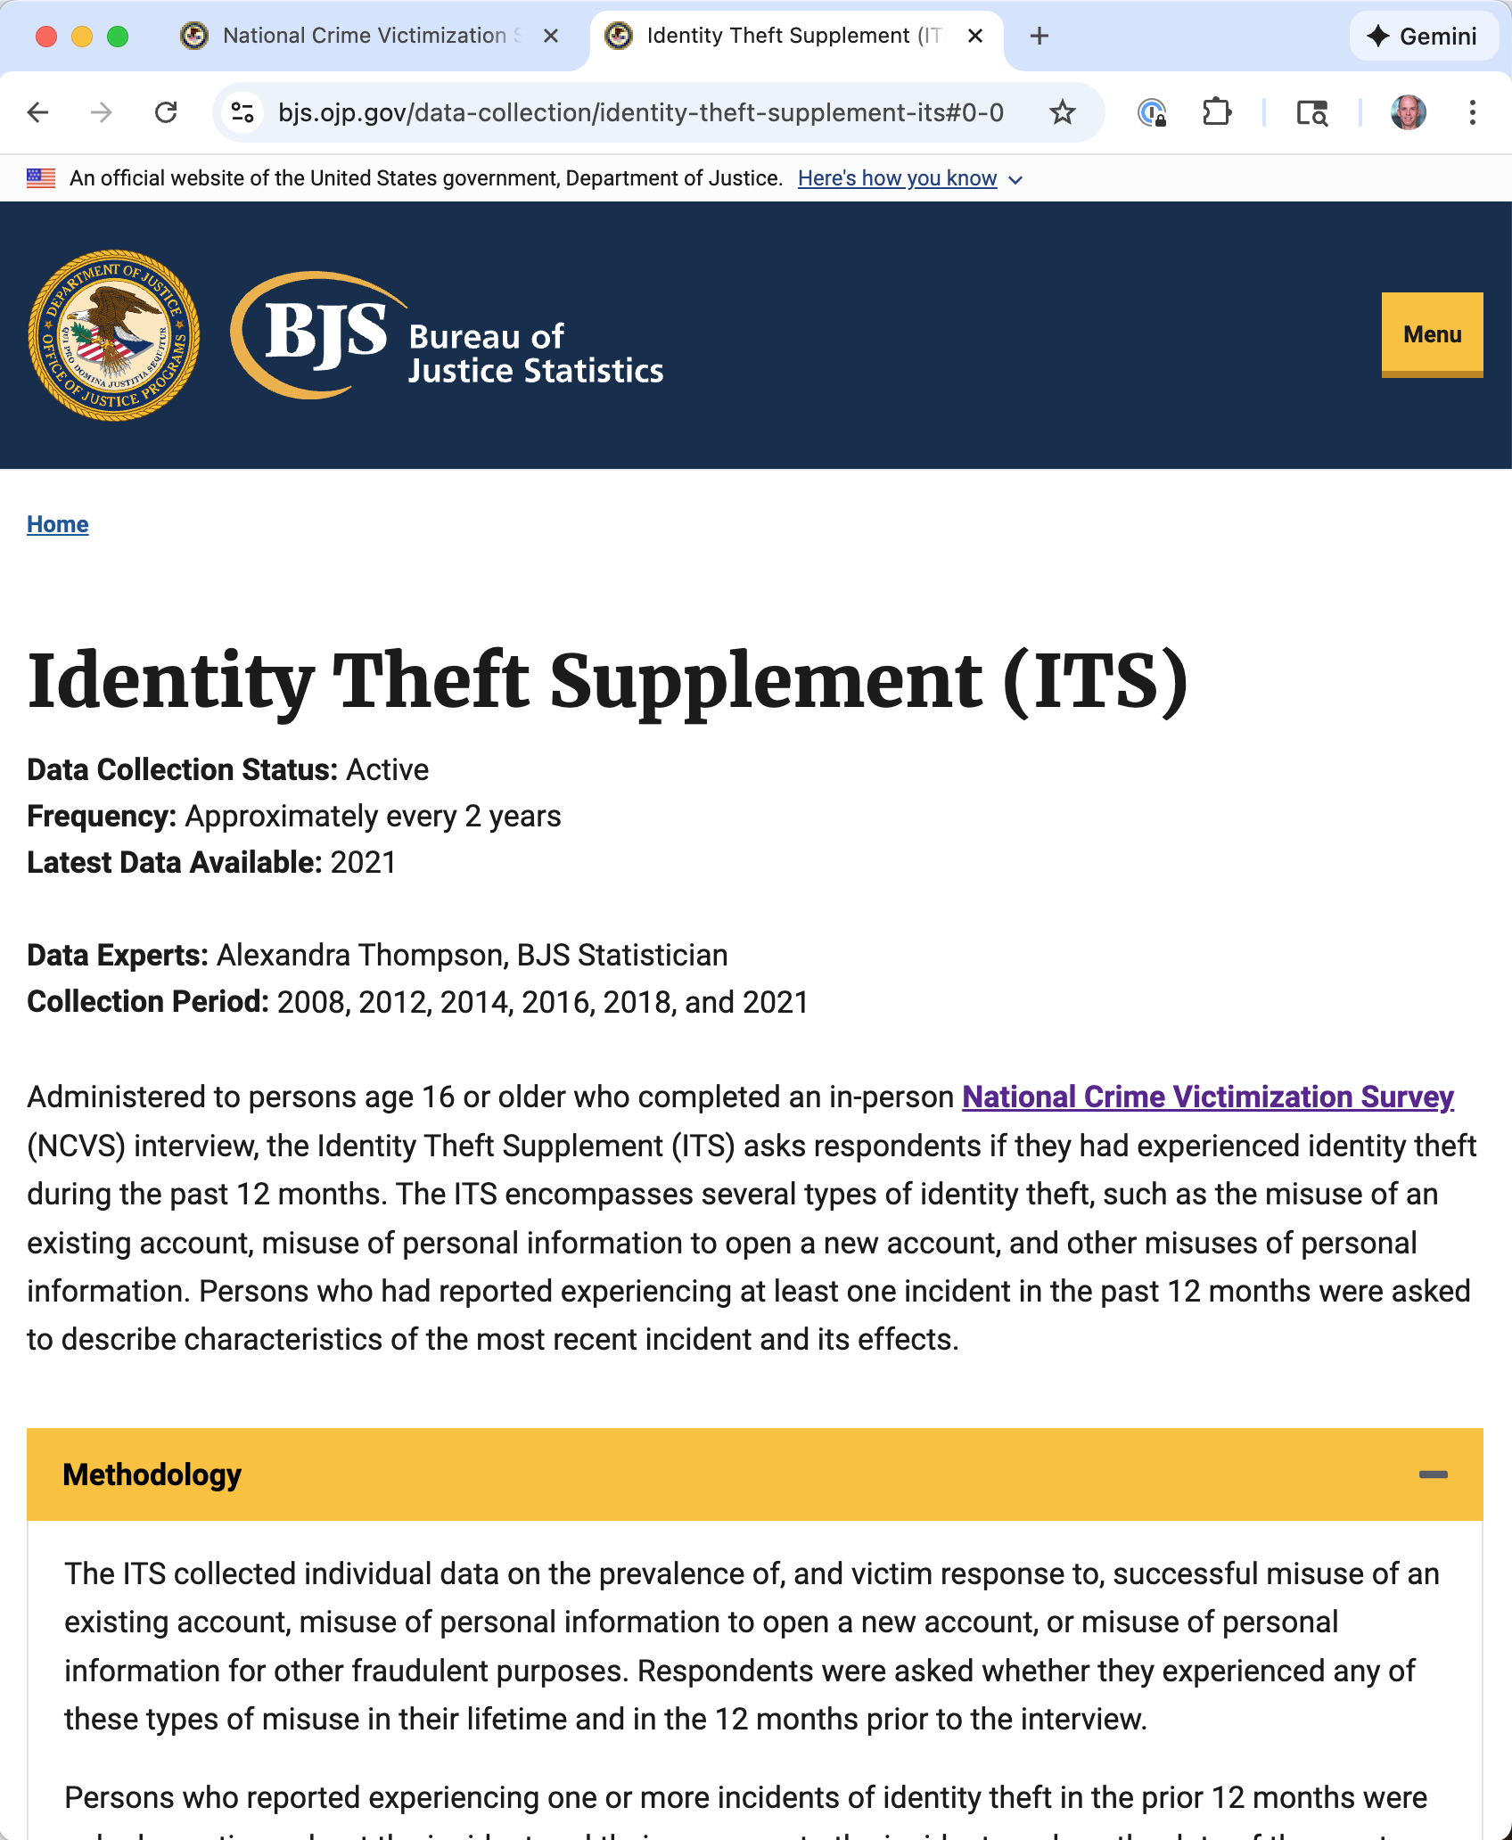
Source: National Crime Victimization Survey Identity Theft Supplement
Followup questionnaire to NCVS
Done roughly every two years
Last done in 2021

Slide 37
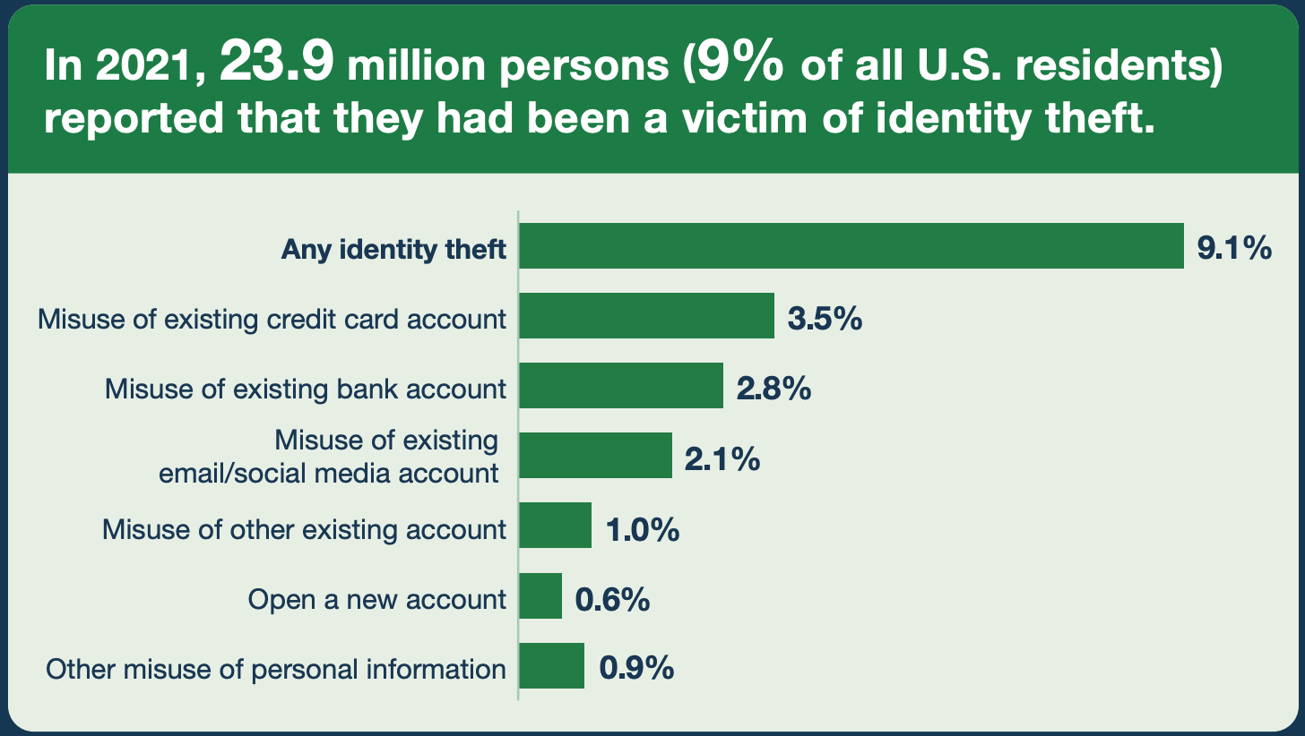
Victims of Identity Theft, 2021
Lower prevalence (but not the same methodology, questions)

Slide 38
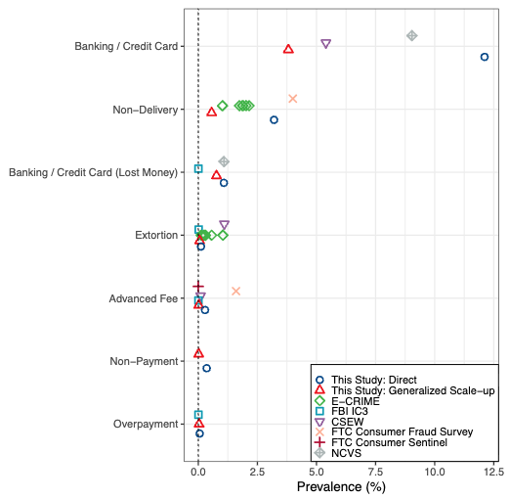
Comparing other data sources

Slide 39
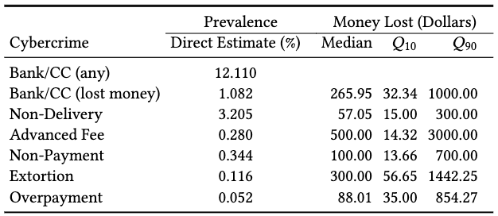
RQ2: Monetary Impact
Median losses are modest
Distribution is heavily right-skewed
Notes:
This connects directly to Florêncio & Herley’s critique of inflated cybercrime cost estimates. When you compute a mean over a heavy-tailed distribution, a handful of extreme losses dominate the result. The median gives a much more representative picture of what a typical victim experiences.
Policy implication: communicating risk to users using mean-based statistics can be alarmist and misleading. Allocating defensive resources based on means may prioritize rare extreme cases over the common experience.
Statistics used: survey-weighted medians and means with confidence intervals. Again, all estimates are weighted to be nationally representative.

Slide 40
RQ3: Demographic Inequities
Look ma! No LASSO!
Weighted logistic regression with demographic predictors: age, race/ethnicity, gender, income, education, internet skills
Key findings:
No single “victim profile” across all crime types — patterns vary
Internet skills matter: higher skill associated with different victimization patterns
Some crimes show income/education associations, but direction isn’t always intuitive
All associations are observational, not causal!
Notes:
The logistic regression here is the same framework from Lecture 2 and from DeKoven et al.’s §6 — binary outcome, binomial family, odds ratios for interpretation.
The wrinkle: the regressions pass survey weights to glm() via the weight argument. An odds ratio of 1.5 for a demographic group means that group has 50% higher odds of victimization compared to the reference group, holding other factors constant — same interpretation as Lecture 2.
Caution: higher-income people may report more cybercrime because they recognize and label more events as crime, not because they’re targeted more often. Recognition bias is a real concern.
Contrast with DeKoven: DeKoven uses LASSO for variable selection among hundreds of behavioral features. Breen uses standard logistic regression with a small set of demographic predictors — no regularization needed because the feature space is much smaller.

Slide 41
Limitations
COVID-19 timing (July–September 2020) may have affected both cybercrime rates and survey participation
English-only survey misses non-English-speaking populations
Recall and recognition bias — victims may not accurately recall or identify experiences
Cross-sectional — single snapshot, no ability to measure trends
NSUM (not covered) underperformed — barrier effects made it produce underestimates rather than the hoped-for improvement
Notes:
The recall window is 24 months — a long time to accurately remember cybercrime experiences. Telescoping (misplacing events in time) is a known concern.
Recognition bias is particularly relevant for cybercrime: if your credentials were stolen but you never noticed, you can’t report it. This means survey-based estimates are still lower bounds, just better lower bounds than complaint-based data.
The cross-sectional design means we can’t tell if cybercrime is getting worse or better. Repeating the survey annually would address this.
The NSUM limitation is discussed in detail in the backup slides.

Slide 42
Some Takeaways
Cybercrime on individuals had modest effect — Most crimes are rare, but some are common (credit card fraud), and in general cost users little
“a typical consumer stands to lose $22.90 (= $6.87 ÷0.3) and in the worst 90th percentile case a consumer stands to lose $111.87 annually”
Corporate estimates of crime seem much higher — Gartner, McAfee, Norton, …
Notes:
Each of these lessons has direct practical implications:
We need sustained, repeated measurement — ideally an annual probability-based cybercrime survey analogous to the NCVS.
When you see a cybercrime statistic, always ask: how was this measured? The answer determines whether you should trust the number.
Policy should be based on median impact (what the typical victim experiences), not mean impact (which is dominated by outliers).
Study design must anticipate the base rate of what you’re measuring. This applies broadly — not just to surveys but to any rare-event measurement (including DeKoven’s 4.5% compromise rate).

Slide 43
Backup: Network Scale-Up Method (NSUM)

Slide 44
NSUM: What It Is & Why You’d Want It
Problem: Direct surveys only capture victimization the respondent recognizes and is willing to report.
NSUM idea: Ask people about people they know instead of themselves:
“How many people do you know who experienced [cybercrime X]?”
Why this might help:
Even if you wouldn’t report your own victimization, friends/family might mention theirs
Aggregating across many respondents’ networks could capture hidden victimization
Has worked in public health for estimating hard-to-count populations (IV drug users, sex workers)
Notes:
NSUM has been used successfully to estimate populations where stigma makes direct enumeration unreliable. The question is whether it transfers to cybercrime.
The fundamental assumption: even if you personally wouldn’t report a crime, your social network has information about victimization that isn’t captured by direct questions. By tapping into the collective knowledge of everyone’s social network, you might get a more complete picture.

Slide 45
How NSUM Works
Estimate each respondent’s network size — “How many people do you know named Emily? Walter? Ralph?” (12 calibration names with known population frequencies)
Ask about the target — “How many people do you know who experienced [crime X]?”
Basic estimate: Prevalence ≈ (reported crime contacts) / (total network size)
Correction factors (Generalized NSUM):
Degree ratio: Do victims have larger/smaller networks?
Visibility factor: What fraction of a victim’s network knows about the crime?
Notes:
The name calibration is clever: since we know the true population frequency of names like Emily and Walter, if a respondent says they know 3 Emilys and Emily represents 0.2% of the population, we can estimate their network is roughly 3/0.002 = 1,500 people. Averaging across all 12 names gives a more robust estimate.
The visibility factor is the critical correction. If only 10% of your network knows you were scammed, the basic NSUM underestimates by a factor of ~10. The authors measure this by asking confirmed victims: “How many people in your social network know about this incident?”
Small errors in the visibility estimate propagate into large errors in the final prevalence estimate.

Slide 46
What We Expected vs. What Happened
Expectation: NSUM estimates should be higher than direct self-reports (capturing hidden victims, like in public health).
Reality: NSUM estimates were lower in every crime category.
Crime Type | Direct Estimate | NSUM Estimate
Banking / Credit Card | ~12.1% | ~3.9%
Non-Delivery | ~3.2% | ~0.6%
Non-Payment | ~0.3% | ~0.02%
Extortion | ~0.1% | ~0.06%
Notes:
This is the opposite of what the authors and most researchers would have predicted. In public health applications, NSUM typically produces higher estimates than direct surveys because it captures people who wouldn’t report their own status.
The reason: barrier effects. Cybercrime victimization is not very visible within social networks.
People don’t share their victimization. Being a victim of credit card fraud is private. If you were phished, you might feel embarrassed. Your friends and family may never learn about it.
The visibility factor is very low. When the authors asked confirmed victims how many people in their network knew, the numbers were small. This means the correction factor (1/visibility) should be large, but estimating a very low visibility rate from a small sample introduces enormous uncertainty.

Slide 47
What NSUM’s Failure Tells Us
NSUM is not a universal fix for under-reporting. It requires that network members know about each other’s status.
Why it works in public health: Being an IV drug user or sex worker is often known/observable to close contacts.
Why it fails for cybercrime: Victimization is private, brief, embarrassing — invisible even to close contacts.
The silver lining: This is itself a finding — cybercrime is a largely private experience, which means:
Social support for victims may be lacking
Community-based interventions face adoption challenges
Future NSUM attempts could focus on closer contacts (family, close friends)
Notes:
The key scope condition for NSUM: the target behavior must be reasonably visible within respondents’ social networks. When it isn’t, NSUM underestimates rather than capturing the hidden population.
This is a cautionary tale about borrowing methods across domains without checking whether assumptions hold. The technique is sound in principle, but the specific social dynamics of cybercrime victimization violate the key assumption.
Possible improvements: asking about closer contacts (family, close friends) who might be more likely to know about victimization; focusing on more visible crime types; combining NSUM with other indirect estimation techniques.
Even a “failed” application teaches us something: the low visibility of cybercrime within social networks is itself informative for designing interventions and support systems.

