Slide 1


Empirical Security & Privacy, for Humans
UPenn CIS 7000-010
10/21/2025
The
Building Security In Maturity Model (BSIMM)

Slide 2

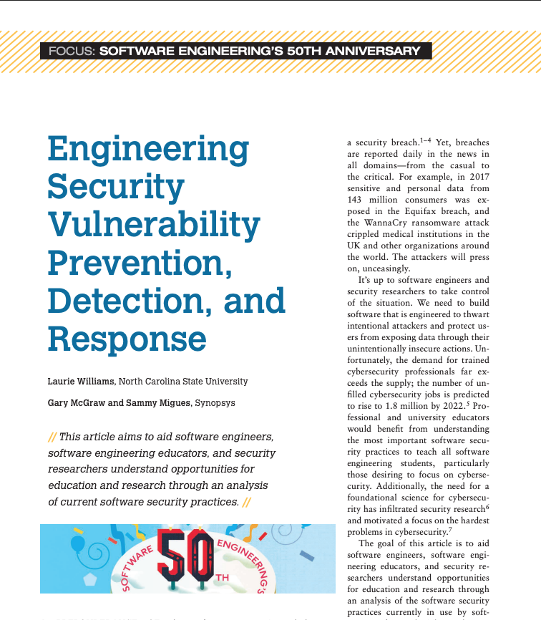
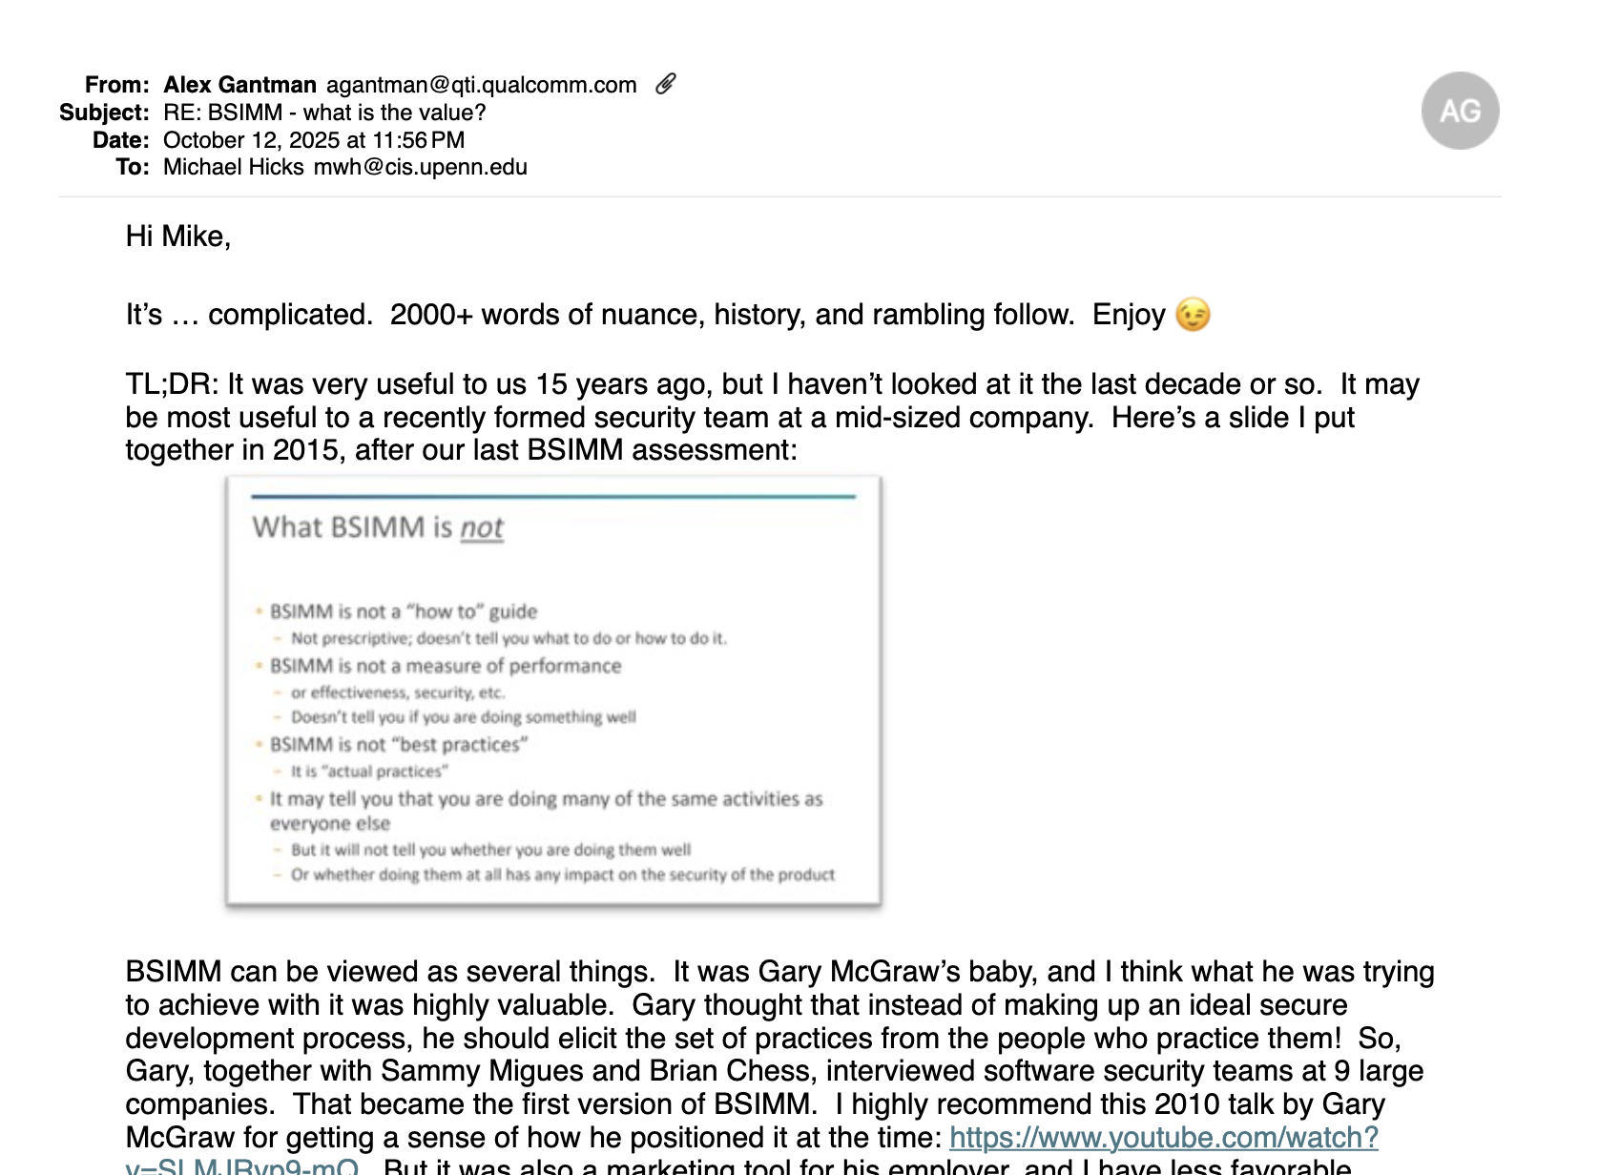
Readings

Slide 3
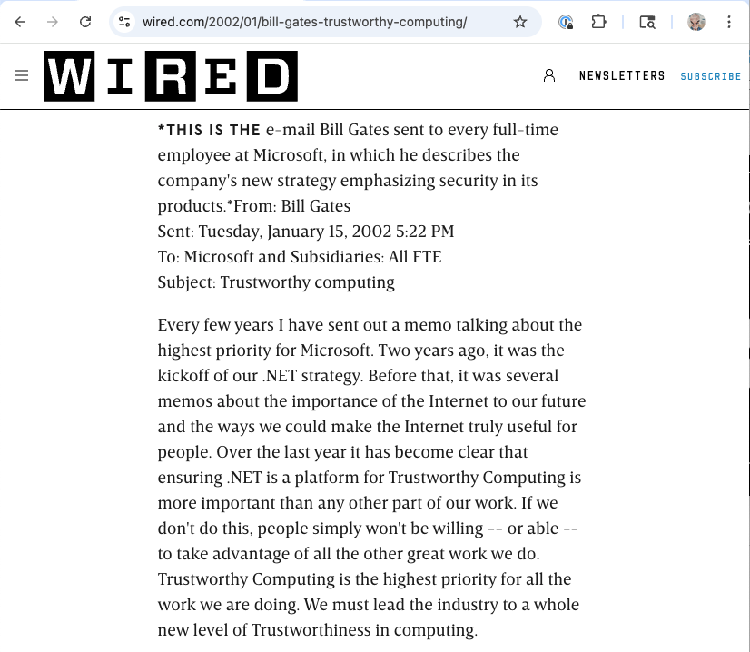
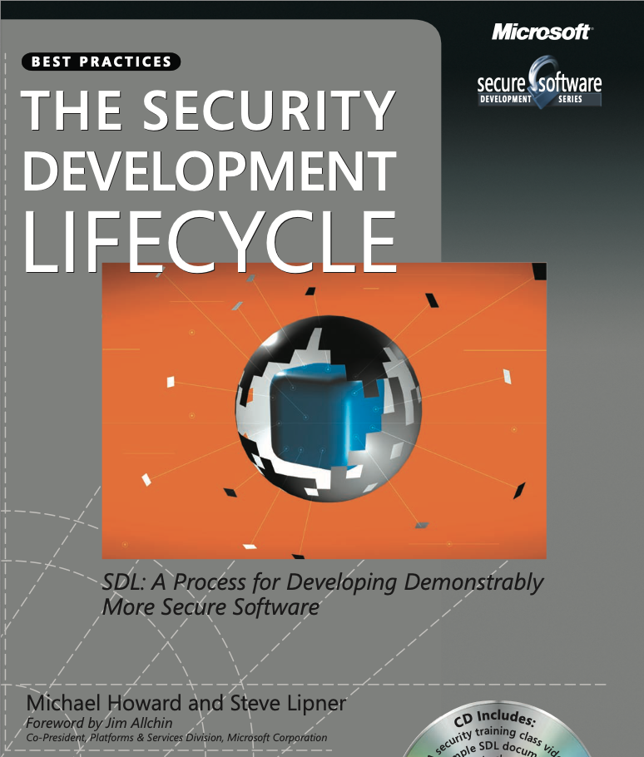
In 2008, software security was a young field
January 2002
July 2006

Slide 4
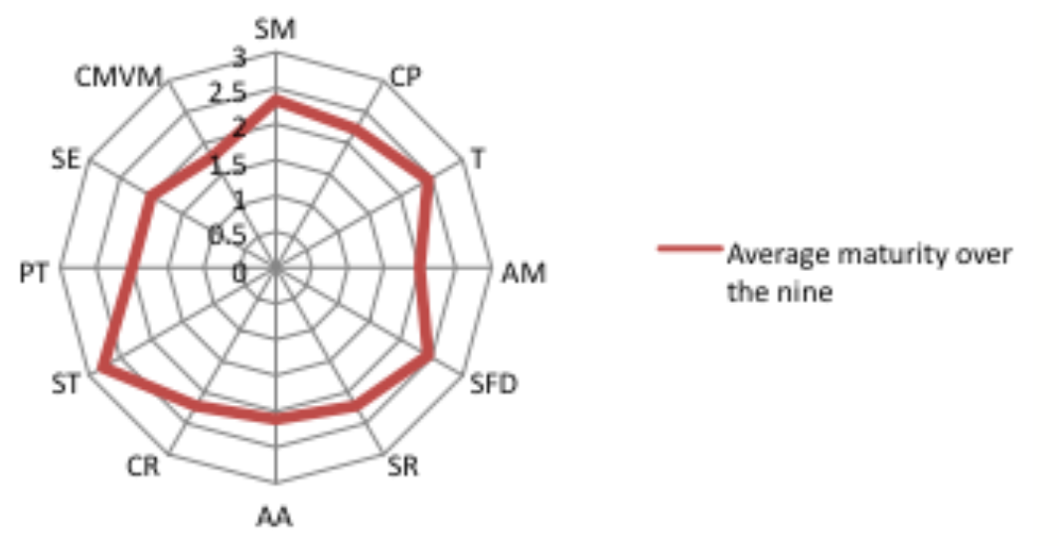
BSIMM arrived in early 2009. What was it?
“Our aim with BSIMM is to document the activities common to all of the leading software security initiatives”

Slide 5
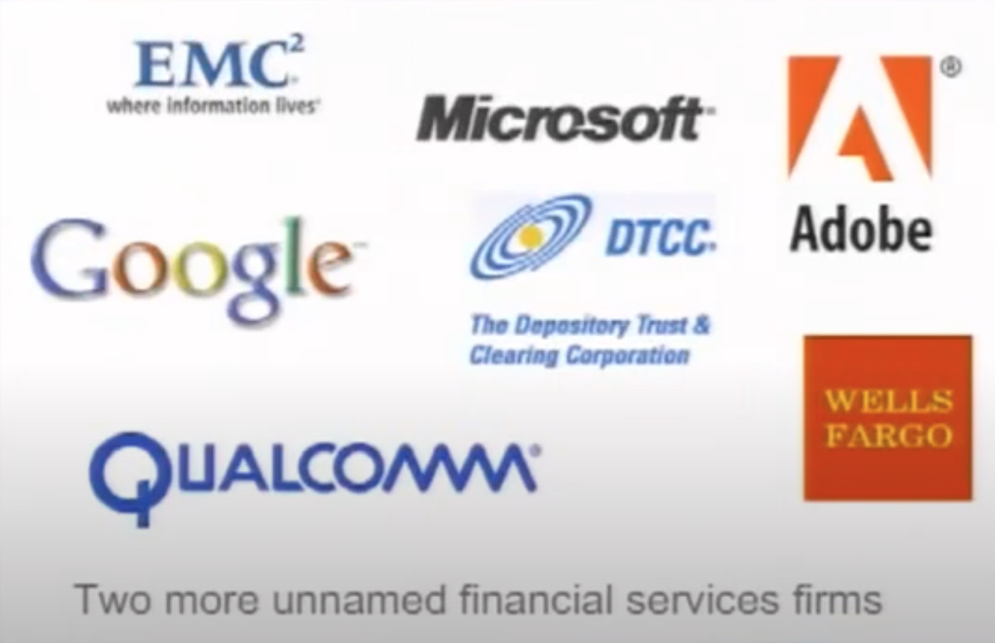

BSIMM arrived in early 2009. What was it?
“Our aim with BSIMM is to document the activities common to all of the leading software security initiatives”
Subjects: 9 large companies
Alex Gantman, now VP of Security Engineering, directly participated
Notes:
Alex: Established a 6-person security team in 2006

Slide 6
What BSIMM is not
Slide written in 2015
BSIMM is not a “how to” guide
Not prescriptive; doesn’t tell you what to do or how to do it
BSIMM is not a measure of performance
Or effectiveness, security, etc.
Doesn’t tell you if you are doing something well
BSIMM is not “best practices”
It is “actual practices”
It may tell you that you are doing many of the same activities as everyone else
But it will not tell you whether you are doing them well
Or whether doing them at all has any impact on the security of the product

Slide 7
How was the BSIMM constructed?
1. Interviews | An investigator carries out a multi-hour interview with each participant.
2. Coding | Each investigator creates twelve “bullet lists” for each of the nine organizations, one bullet list for each practice identified by the Software Security Framework (SSF).
3. Unification | Investigators fuse practice lists for each company into per-practice lists for all companies; note prevalence.
4. Leveling | Investigators rate maturity level of each individual practice, given its difficulty and context.
Notes:
“… we introduce and use a Software Security Framework (SSF),… which provides a common vocabulary for describing the elements of a software security initiative.” This is a (predefined) code book.
“we conducted a series of in-depth fact-finding interviews with executives in charge … Our construction process was driven top down by the SSF and bottom up by the raw interview data.”
---
Not clear how levels were determined. Presumably based on the judgment of the interviewers. From the video (38:30 or so) “we also came up with levels, and here’s where it gets a little bit messy … level one things are easier than level two things ”
“The breakdown of activities into levels for each practice is meant only as a guide. The levels provide a natural progression through the activities associated with each practice. However, it is not at all necessary to carry out all activities in a given level before moving on to activities at a higher level in the same practice.” – he contradicts this statement in the video “you should probably do level 1 stuff before level 2 stuff”

Slide 8
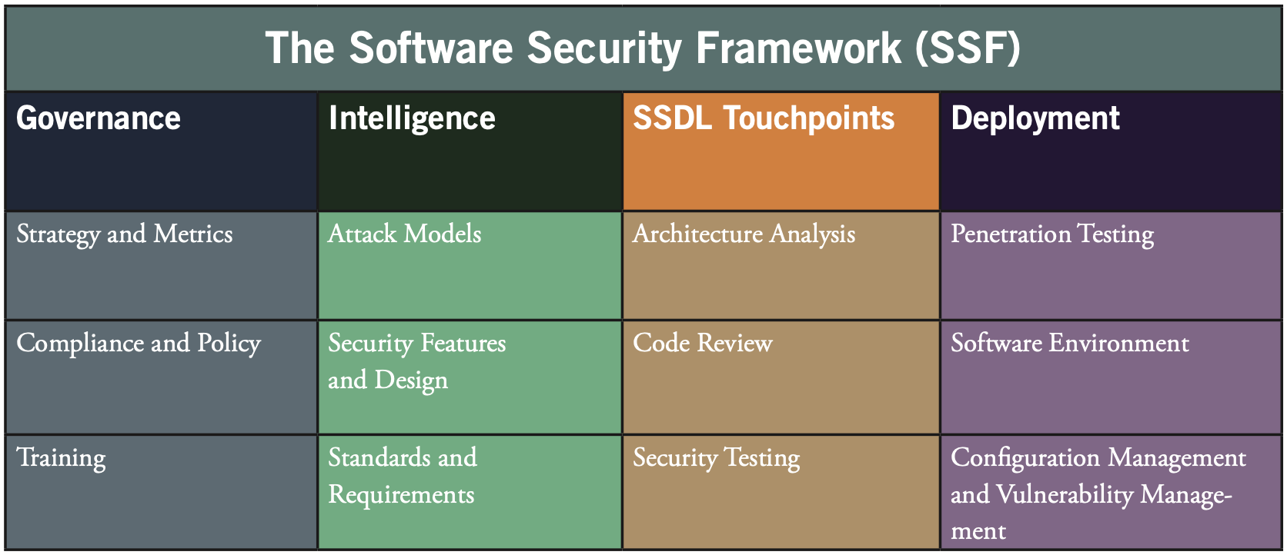
What is the Software Security Framework?
Notes:
In the governance domain,
the strategy and metrics practice encompasses planning, assigning roles and responsibilities, identifying software security goals, determining budgets, and identifying metrics and gates.
The compliance and policy practice is focused on identifying controls for compliance regimens such as PCI and HIPAA, developing contractual controls such as Service Level Agreements to help control COTS software risk, setting organizational software security policy, and auditing against that policy.
Training has always played a critical role in software security because software developers and architects often start with very little security knowledge.
The intelligence domain is meant to create organization-wide resources. Those resources are divided into three
practices.
Attack models capture information used to think like an attacker: threat modeling, abuse case development and refinement, data classification, and technology-specific attack patterns.
The security features and design practice is charged with creating usable security patterns for major security controls (meeting the standards defined in the next practice), building middleware frameworks for those controls, and creating and publishing other proactive security guidance.
The standards and requirements practice involves eliciting explicit security requirements from the organization, determining which COTS to recommend, building standards for major security controls (such as authentication, input validation, and so on), creating security standards for technologies in use, and creating a standards review board.
The SSDL Touchpoints domain is probably the most familiar of the four. This domain includes essential software
security best practices that are integrated into the SDLC. The two most important software security practices are architecture analysis and code review.
Architecture analysis encompasses capturing software architecture in concise diagrams, applying lists of risks and threats, adopting a process for review (such as STRIDE or Architectural Risk Analysis), and building an assessment and remediation plan for the organization.
The code review practice includes use of code review tools, development of customized rules, profiles for tool use by different roles (for example, developers versus analysts), manual analysis, and tracking/measuring results.
The security testing practice is concerned with pre-release testing including integrating security into standard quality assurance processes. The practice includes use of black box security tools (including fuzz testing) as a smoke test in QA, risk driven white box testing, application of the attack model, and code coverage analysis. Security testing focuses on vulnerabilities in construction.
By contrast, in the deployment domain,
the penetration testing practice involves more standard outside→in testing of the sort carried out by security specialists. Penetration testing focuses on vulnerabilities in final configuration, and provides direct feeds to defect management and mitigation.
The software environment practice concerns itself with OS and platform patching, Web application firewalls, installation and configuration documentation, application monitoring, change management, and ultimately code signing.
Finally, the configuration management and vulnerability management practice concerns itself with patching and updating applications, version control, defect tracking and remediation, and incident handling.

Slide 9
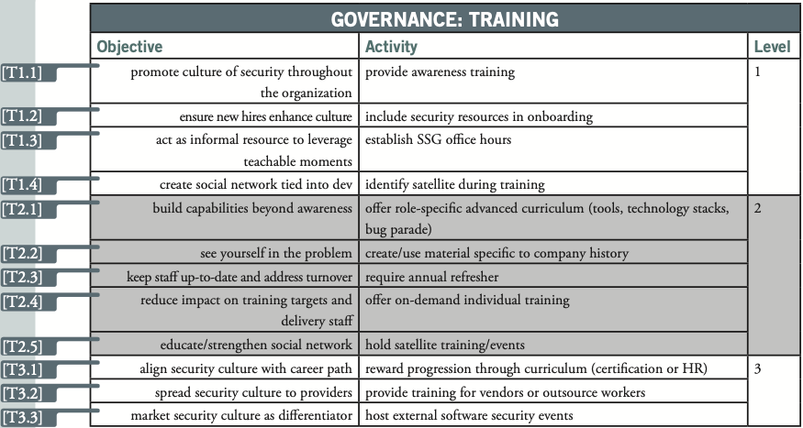
What data is in the BSIMM?
110 activities among the 12 practices, categorized into three levels. Ex:

Slide 10
What data is in the BSIMM?
110 activities among the 12 practices, categorized into three levels. Ex:
Establish SSG office hours. The SSG offers help to any and all comers during an advertised lab period or regularly scheduled office hours. By acting as an informal resource for people who want to solve security problems, the SSG leverages teachable moments and emphasizes the carrot over the stick. Office hours might be held one afternoon per week in the office of a senior SSG member.

Slide 11
How, per its motivation, is BSIMM scientific?
BSIMM doesn’t develop predictive theories based on reality, like physics. It categorizes observations, like anthropology (or ethnography).
“BSIMM is a collection of good ideas and activities that are in use today … BSIMM provides waypoints like a trail guide rather than recipes like a cookbook.”
But beware:
Gary pulls a bit of a sleight of hand when positioning BSIMM as “science” in contrast to “faith-based” or “cargo cult” approaches. It may be a scientific(ish) anthropological study of practices, but those practices themselves remain faith-based. It’s like surveying the average height of cargo-cult wood radio tower imitations or length of fallow runway replicas, which wouldn’t get us any closer to the science of air travel.

Slide 12

BSIMM is qualitative research
It codes a model for how companies carry out software security initiatives
Notes:
People are willing to be forthcoming to a trusted person, when they are likely to get something from it and feel protected
Notes:
Not open coding – fixes SSF in advance
No inter-rater agreement; each interviewer is trusted to categorize in the same way (some agreement probably happens during fusing)

Slide 13
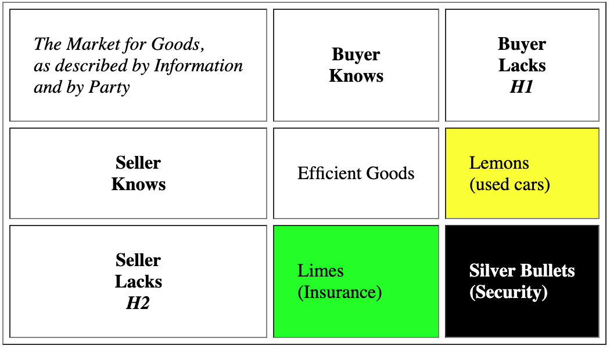
BSIMM supports the market for silver bullets?
Security is hard to assess
Leads to information insufficiency
Investment decisions not based on good metrics, but rather on signals
“best practices”
If cost of breaches > cost of products, all parties herd around the same products
https://iang.org/papers/market_for_silver_bullets.html
“By using the SSF and BSIMM as a guide for your own software security initiative, you can leverage the many years of experience captured in the model.”– BSIMM1
“But there was another use for BSIMM. How can I demonstrate progress to the higher ups if I am operating in a market for silver bullets?” – Alex G.
Notes:
BSIMM first came out in March 2009, one year after the silver bullets blog post.
From Alex: “But there was another use for BSIMM. How can I demonstrate progress to the higher ups if I am operating in a market for silver bullets?”

Slide 14
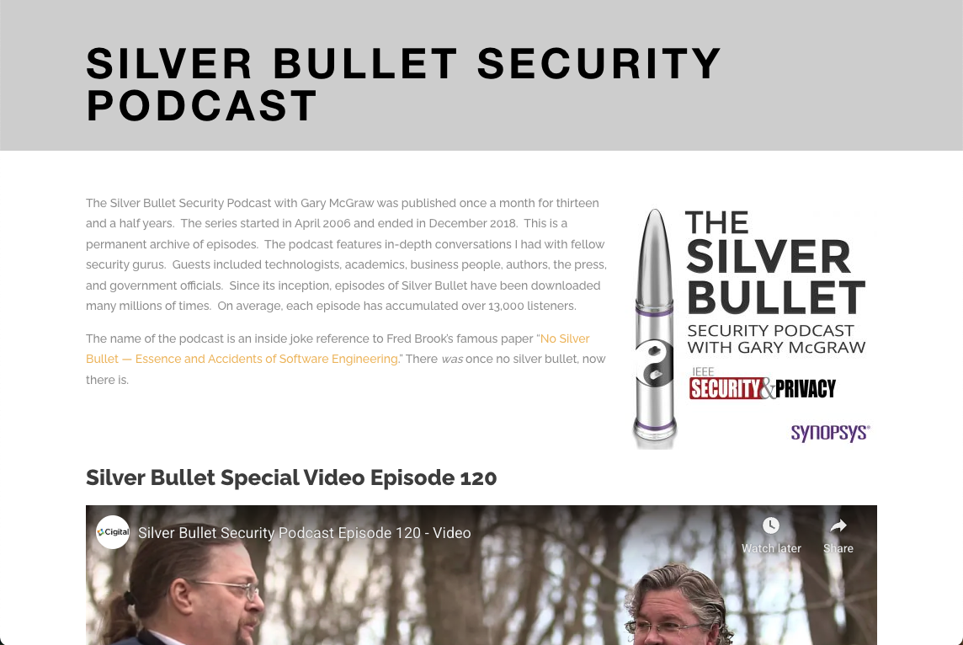
Coincidence?
Gary’s Silver Bullet Security Podcast ran from 2006 to 2018
‘The name of the podcast is an inside joke reference to Fred Brooks’ famous paper “No Silver Bullet – Essence and Accidents of Software Engineering”’

Slide 15
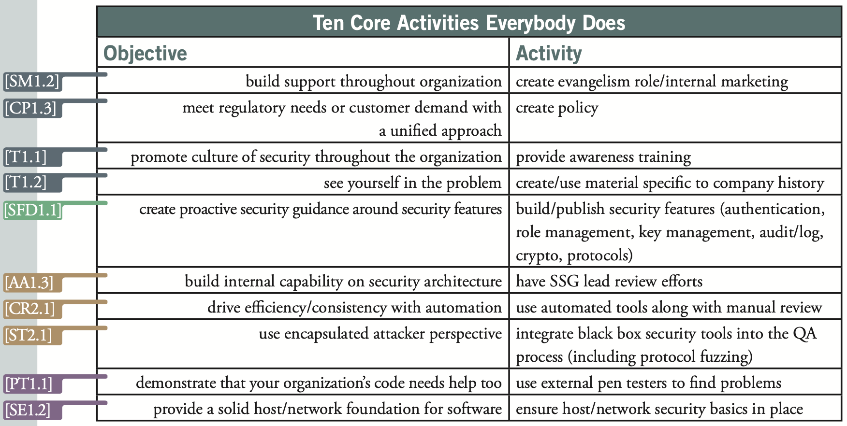
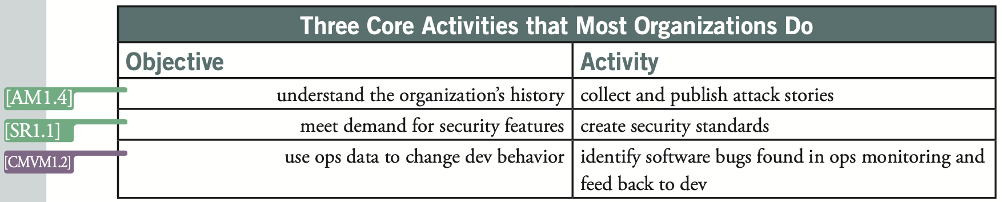
Observed commonalities, BSIMM1
SSG = centralized Software Security Group. Observed to be 1% the number of developers
Notes:
Pen testing is convincing – demonstrates real bugs – comes up in later data analysis too
“Sticks don’t work” e.g., with training, evangelist role, …

Slide 16
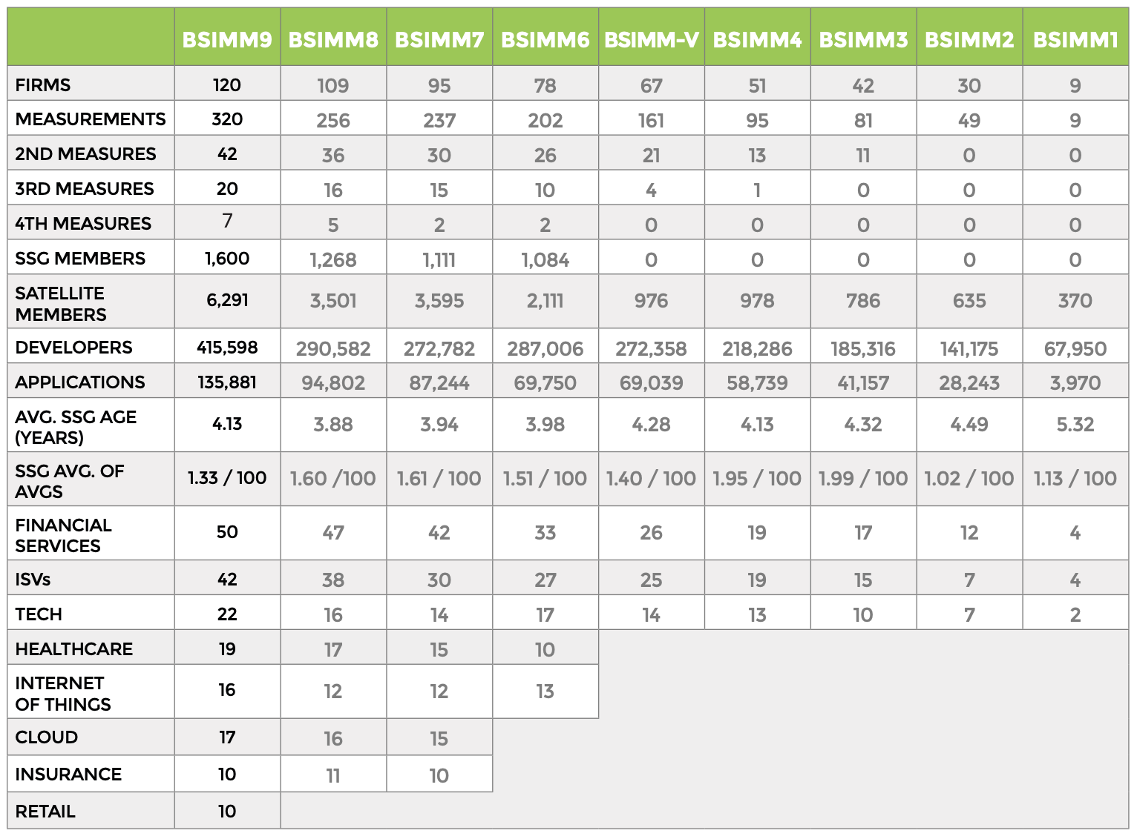
BSIMM over time
More companies, with more verticals represented
Avg dev/SSG team size shrunk
More experienced companies carried less weight
From BSIMM9 report
Notes:
Alex: By this 2015 it was clear that BSIMM has become a sales tool for Cigital, whatever Gary’s nobler goals for it. You could see it in the demographics of BSIMM participants. After the initial launch, the average participating company quickly stabilized at 1,000-1,500 developers and a security team of half a dozen that’s about 4 years into their software security initiative

Slide 17
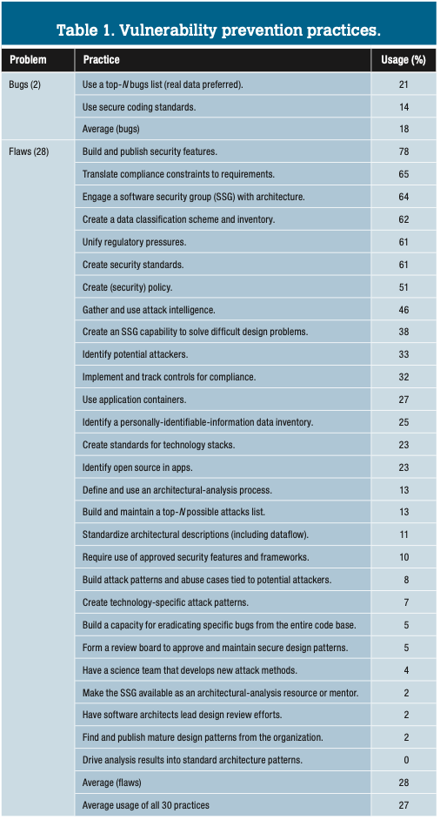
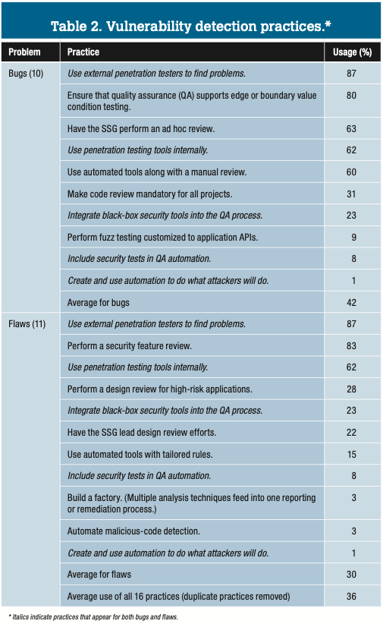
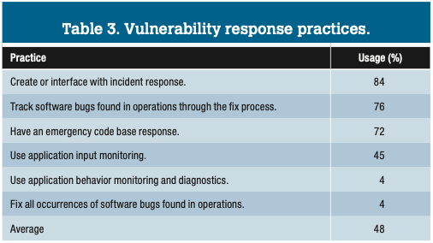
BSIMM8 observations
7 prevention practices are used by more than half the firms; more motivated by compliance than impact? Could firms better use their SSG for for prevention?
Pen testing, external and internal, extremely popular
In general, more activities followed for detection rather than prevention – implies reactive rather than proactive security?
For response, few firms use app behavior monitoring – missed opportunity?
Notes:
Fallacy of the paper: That carrying out more practices in an area means more resources dedicated to that area. But the data doesn’t say that. It would have to be the case that each activity takes roughly the same amount of resources. This comes into their recommendations too.

Slide 18
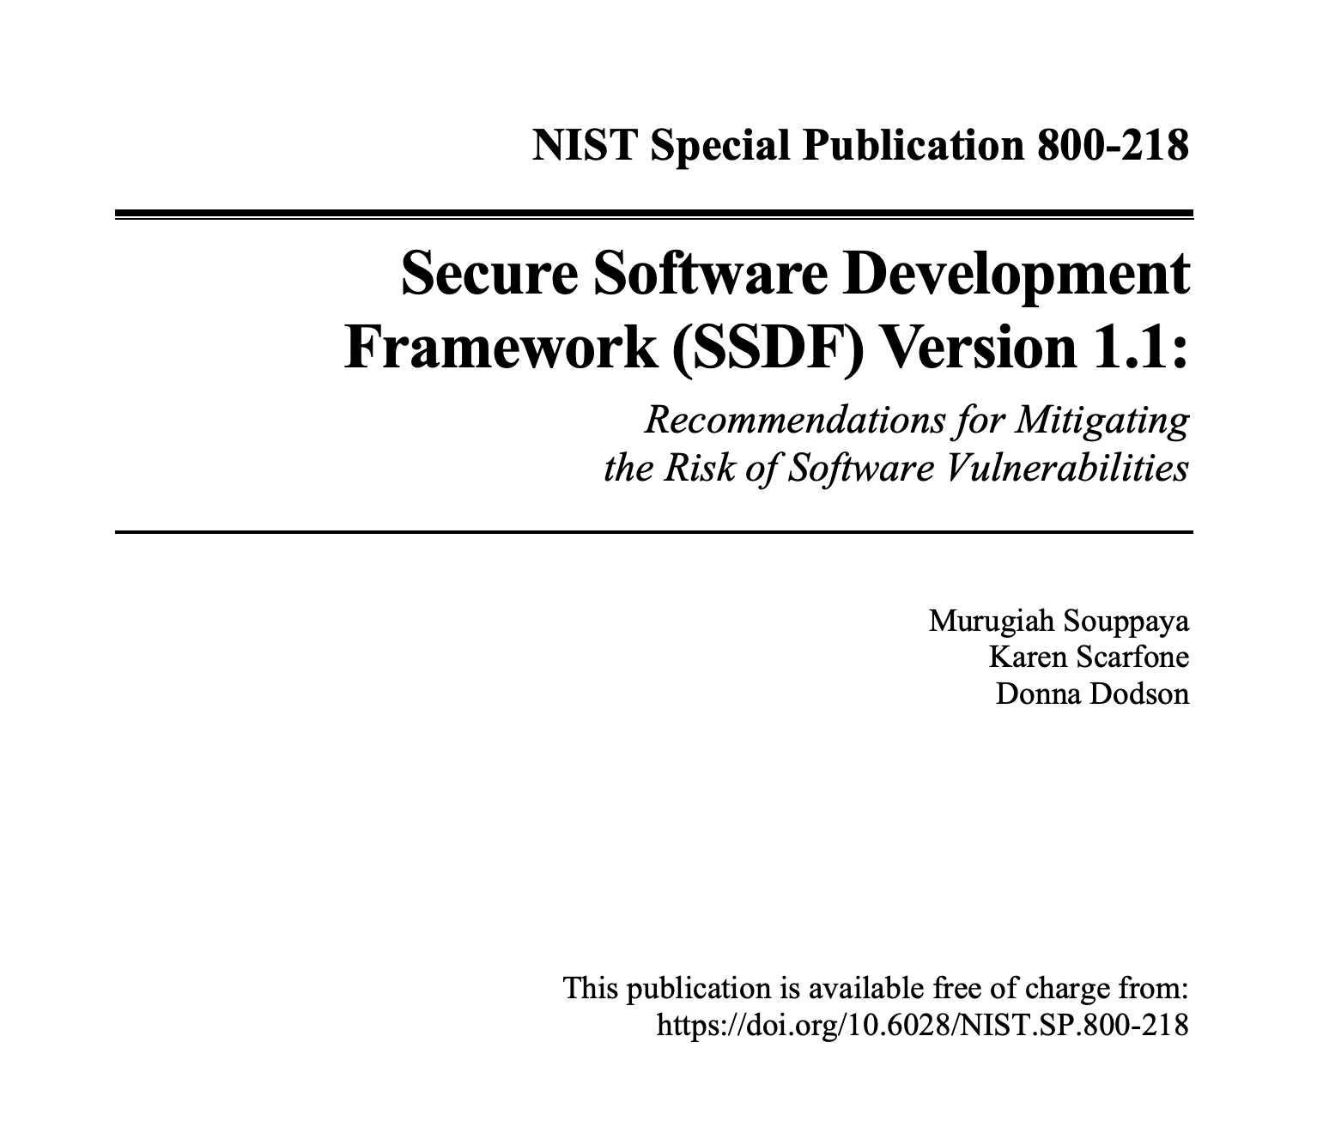
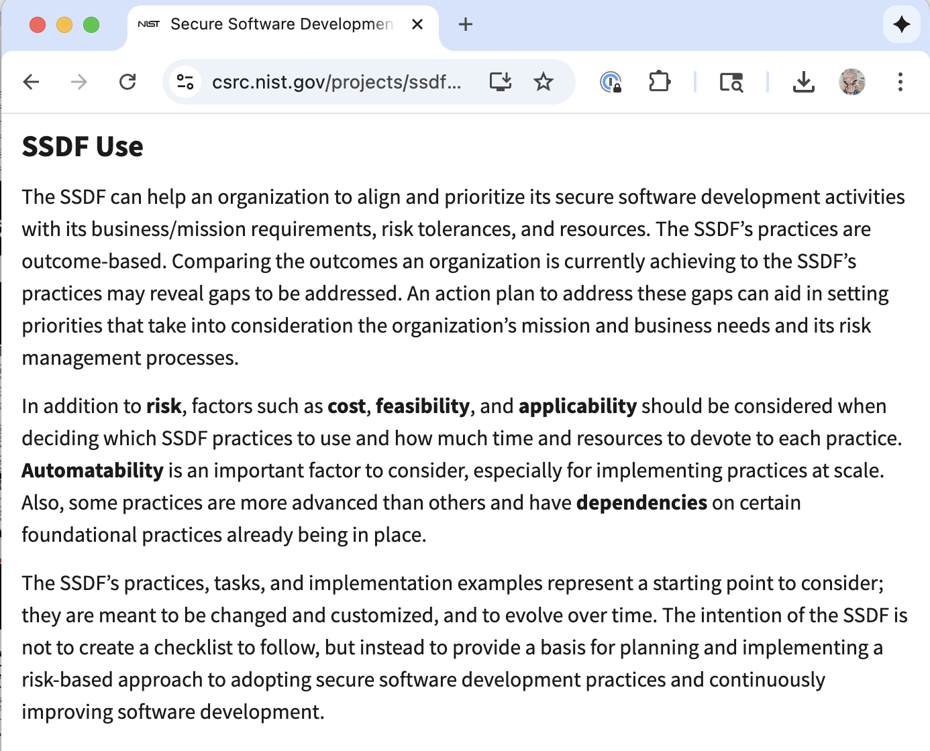
NIST SSDF – Collecting best practices today
The intention of the SSDF is not to create a checklist to follow, but instead to provide a basis for planning and implementing a risk-based approach to adopting secure software development practices and continuously improving software development.

Slide 19
Why did we even bother
Slide written in 2015
3 BSIMM assessments for 3 different reasons
2009
First inventory of software security activities across multiple industries
Eye-opening, therapeutic
Created a community of product security professionals
2011
Re-measurement
Attempt to evaluate progress
Disappointing checklist approach
2015
Required to remain in BSIMM community
Third party assessment
Marketing
“Being able to refer to the behavior of the rest of the herd is great as long as you are trailing and trying to catch up. The problem comes when you have caught up and try to lead.”

Slide 20
Discussion
What BSIMM practices/SSF areas did you find interesting?
Which ones might most easily transfer from big companies to smaller ones?
What do you make of the trends observed in BSIMM1 and the IEEE paper?
The paper claims that BSIMM will help achieve the following – do you believe it?
Informed risk management decisions
Clarity on the “the right thing to do” for those involved in software security
Cost reduction through standard, repeatable processes
Increased code quality
What do you think about the BSIMM development methodology? Tweaks or improvements possible?
E.g., they did not use open coding, nor take steps toward calibrating judgment
What is the relevance of BSIMM today? How could we improve it?
How might you measure the impact of particular practices?
How does it relate to DevSecOps? How does it apply to small companies?
Notes:
SSF chart on next slide: Motivates its parts – good to fix it in advance?
GEM on his WWW: “BSIMM9 was the last version I was directly involved in. BSIMM seems to have degenerated into a generic marketing exercise in the years since I retired from Synopsys. YMMV.”
Alex: “Although we now have NIST SSDF, I still think that a well-done, semi-regular (every 5 years or so) survey of security practices could have significant value
BSIMM as a community of practitioners (Qualcomm now organizes their own)
BSIMM needs an expert SS person, and a sympathetic anthropologist/interviewer. Not a sales person
BSIMM is useful for self-assessment, not assessment of others

Slide 21
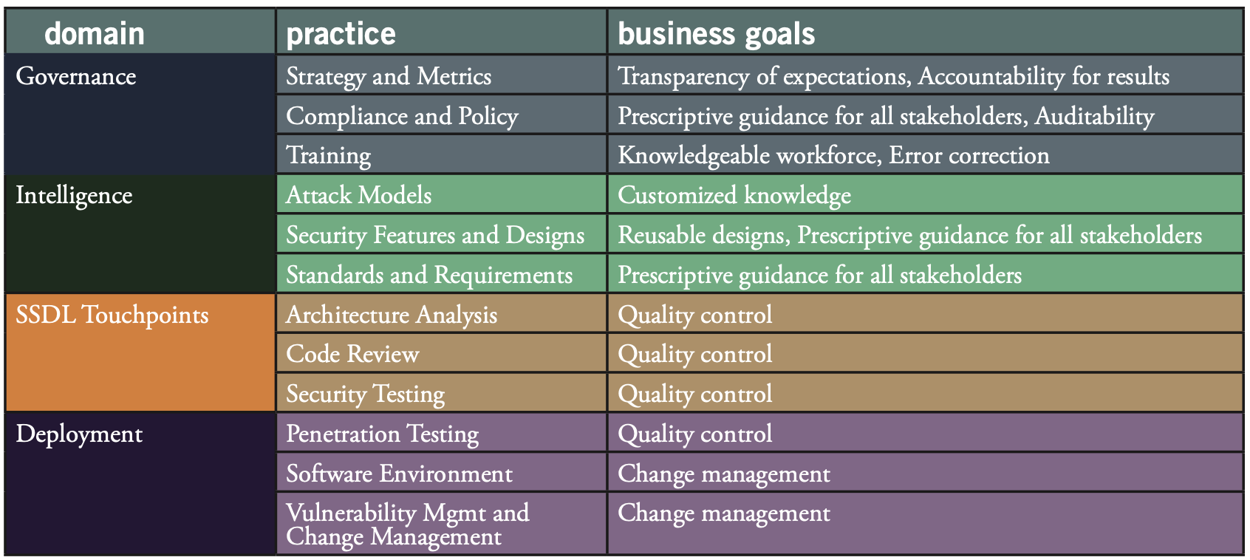
What do SSF practices aim to achieve?

