Slide 1


Empirical Security & Privacy, for Humans
UPenn CIS 7000-010
11/06/2025
Lessons for Cybersecurity from the
American Public Health System

Slide 2
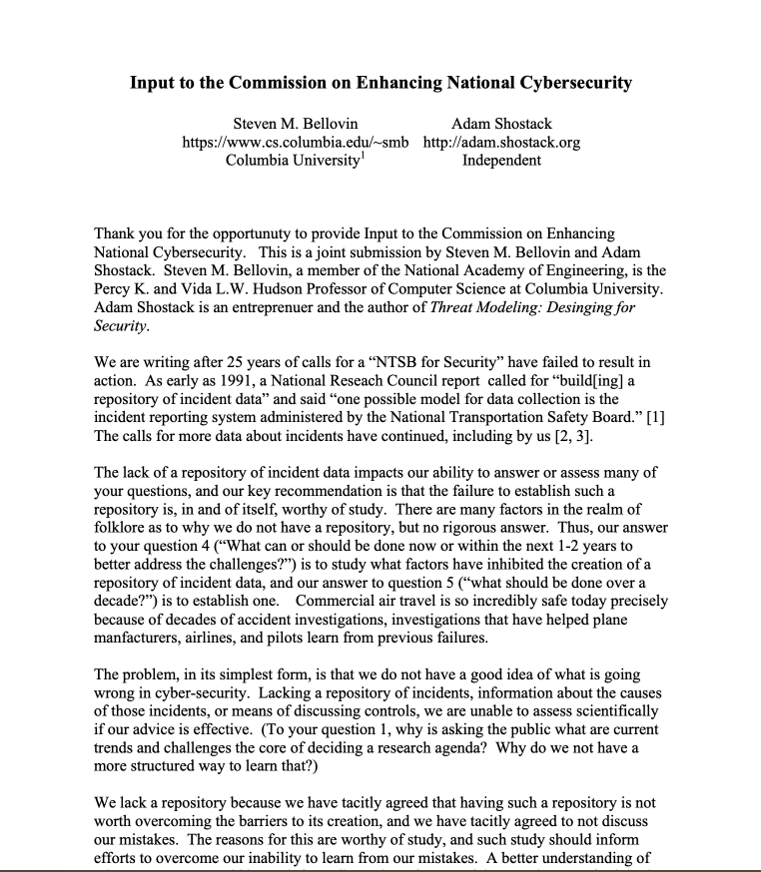
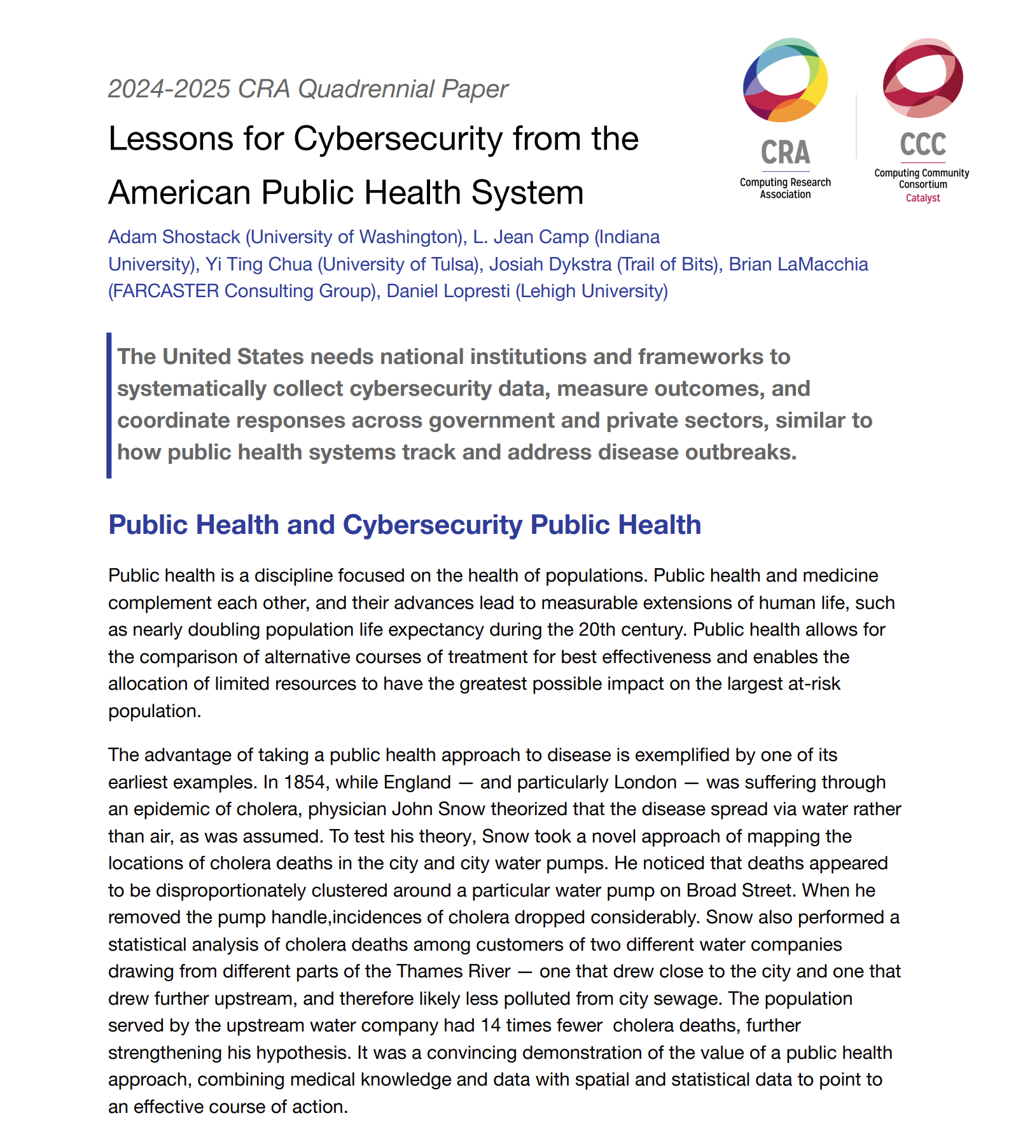
Readings
September 2016
March 2025

Slide 3
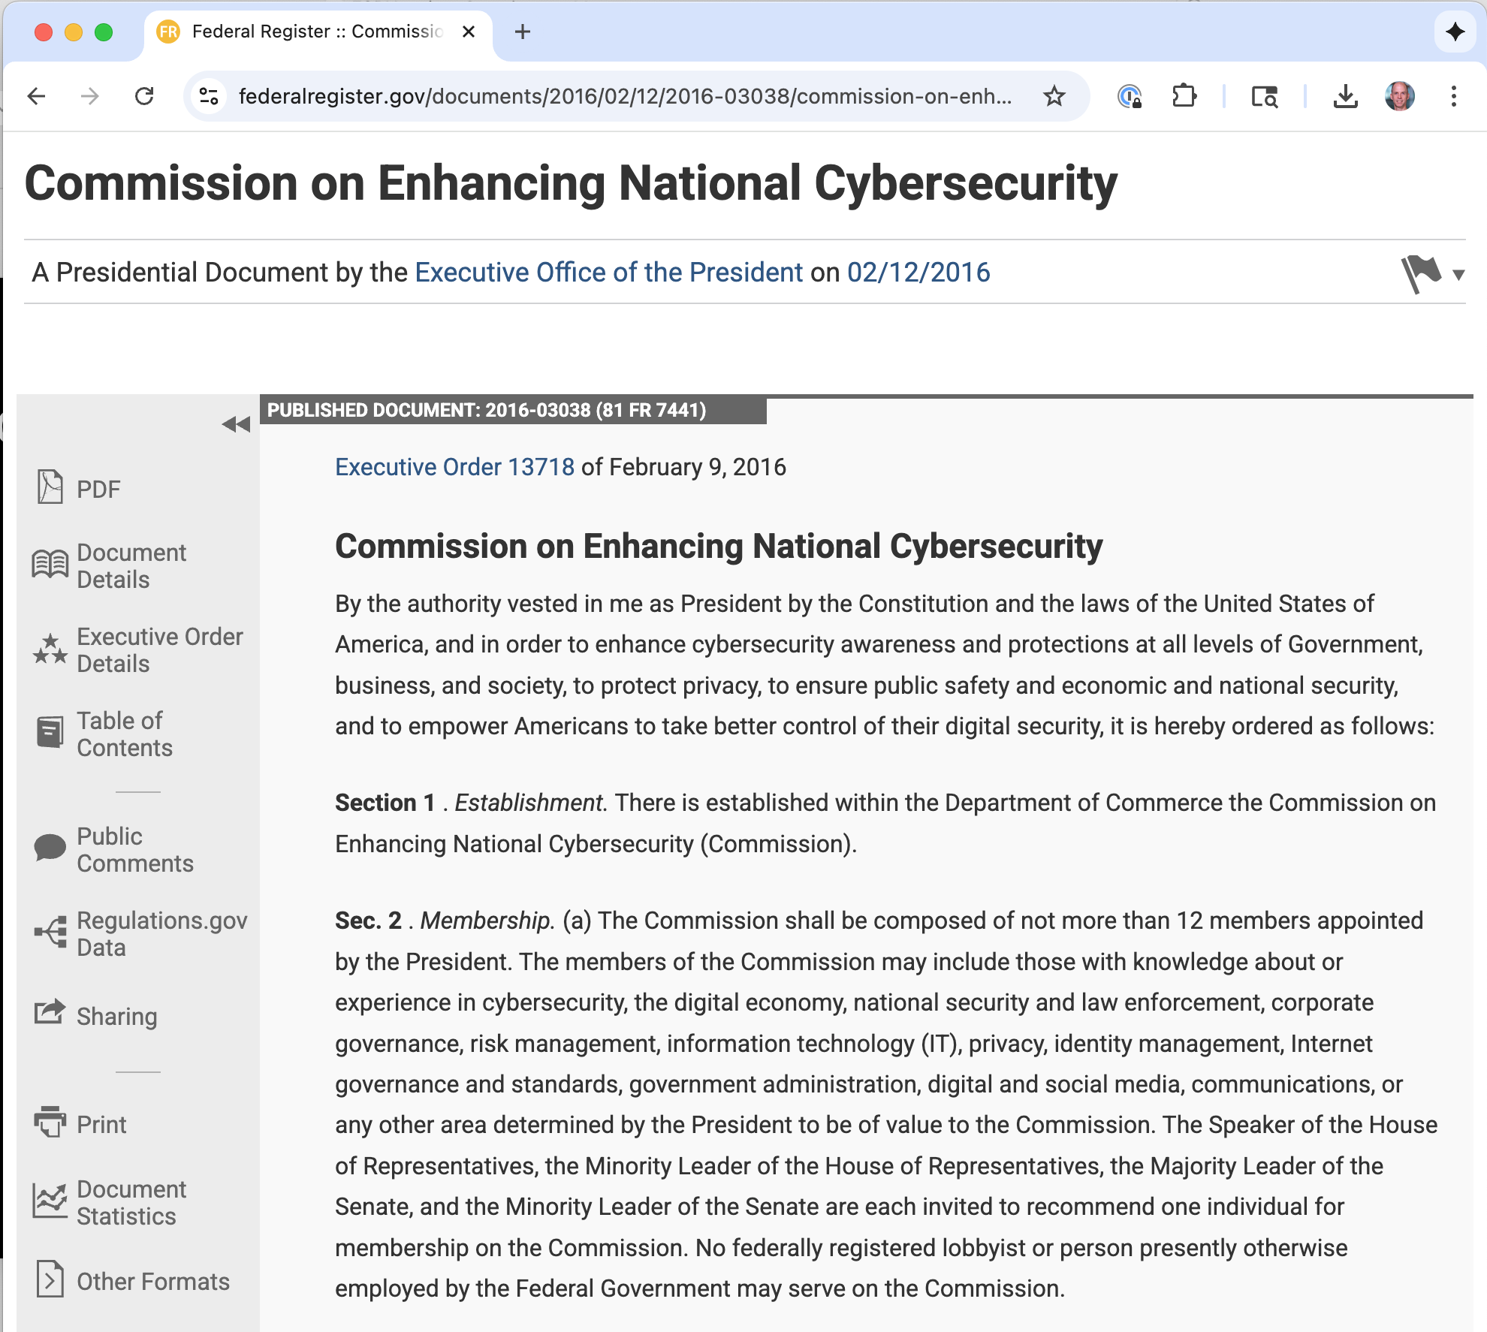
Commission on Enhancing National Cybersecurity
February 2016
September 2016
The Commission will make detailed recommendations to strengthen cybersecurity in both the public and private sectors while protecting privacy, ensuring public safety and economic and national security, fostering discovery and development of new technical solutions, and bolstering partnerships between Federal, state, and local government and the private sector in the development, promotion, and use of cybersecurity technologies, policies, and best practices.
https://en.wikipedia.org/wiki/Commission_on_Enhancing_National_Cybersecurity

Slide 4

How do you know you are “enhancing” ?
Bellovin & Shostack:
“Lacking a repository of incidents, information about the causes of those incidents, or means of discussing controls, we are unable to assess scientifically if our advice [on improving cybersecurity] is effective.”
Comparison: Safety improvements in air travel are, in part, due to careful analysis of failures

Slide 5

Org data presents an incomplete picture

Slide 6
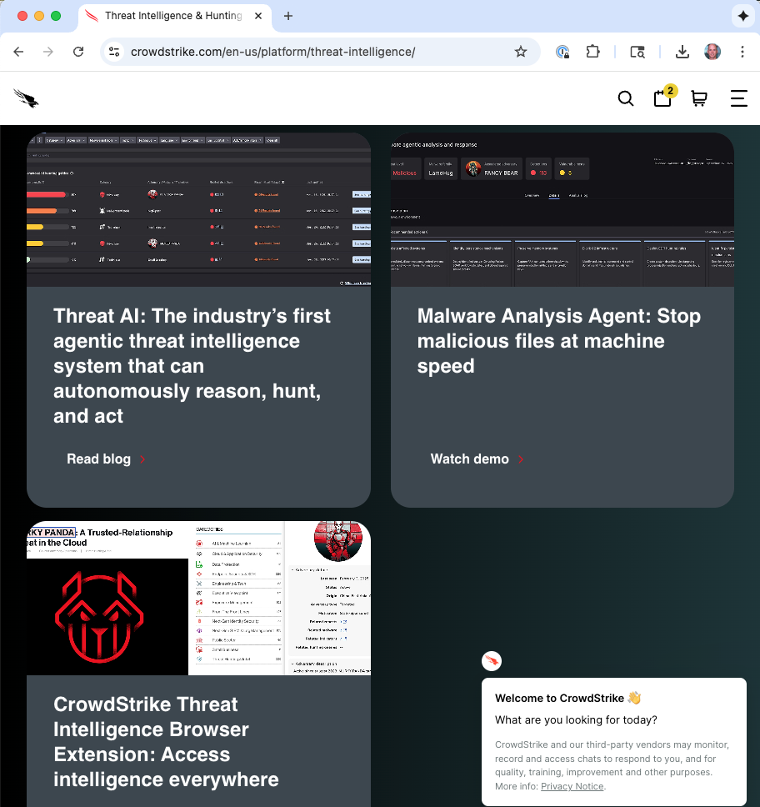
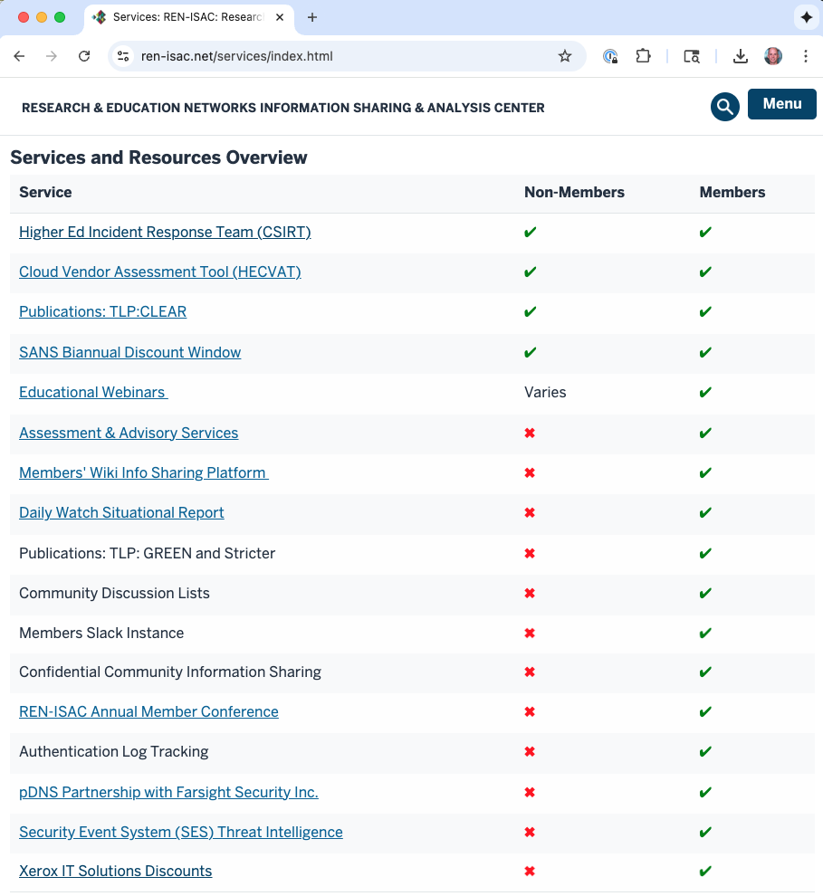
Today: Collecting data within communities
Threat intelligence aggregated from on-premise monitoring capabilities (e.g., Crowdstrike)
Consortia organized for information sharing and improvement (e.g., REN-ISAC)
Some national events publicized, due to law or policy, but often without much detail. So: Can’t learn from them. Can’t see trends

Slide 7
Outside org/comm: Q but no A
breach of 10/31:
“social engineering” of well-placed account holder
Did the attacker use a vulnerability or convince someone to take action?
What controls were in place which might be expected to prevent the attack?
Was there a failure to act on information because of too many alarms?
A mis-configuration?
Did some control simply fail?
✓
?
?
?
?
Some national events publicized, due to law or policy, but often without much detail. So: Can’t learn from them. Can’t see trends
Notes:
(Perhaps revealing such information invites additional attacks, but that hypothesis is untested.)

Slide 8
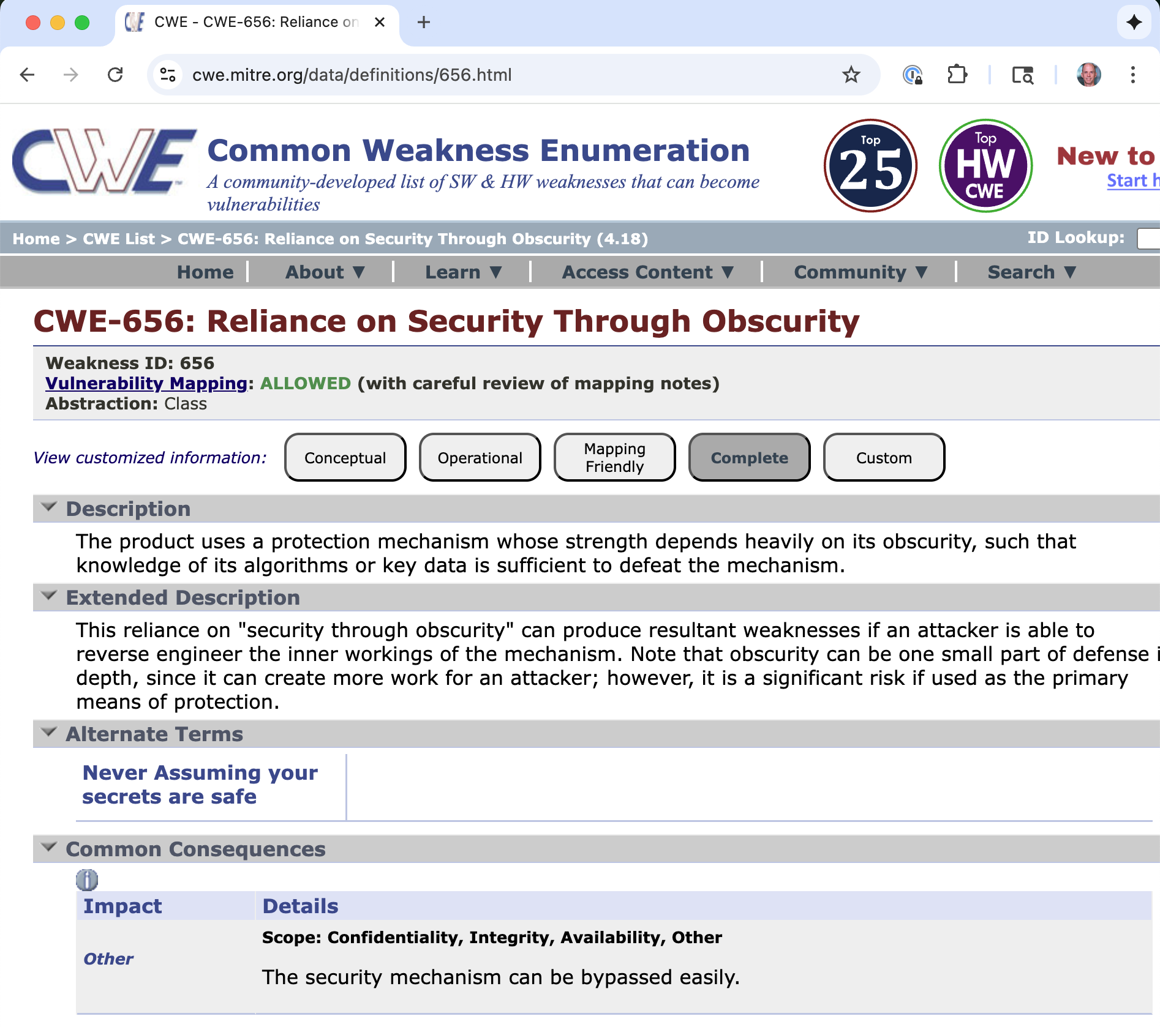

Slide 9
A national incident database
In general, we want to know “what has gone wrong recently” and “how is that changing?”
Can then
Assess expert advice (SANS top 20 vs. Australian DSD top 35?)
Cyber-insurance companies could use it to help set rates, and regulators can mandate (and assess) best practices

Slide 10
How can we get there?
We have tacitly agreed to not discuss our mistakes. Why?
In the short term:
Anonymous reporting system, like NASA’s Aviation Safety Reporting System https://asrs.arc.nasa.gov/ and for railways https://c3rs.arc.nasa.gov/
Or: System used by the government for its own lapses. Similar to the intent of the Privacy Act of 1974
Longer term:
Should there a body chartered and funded to gather information about cyber-security incidents?
Would research into what methods for analyzing incident root causes generates the best results (and what metrics should be used for assessing best)?
What are the tradeoffs between aggregated, anonymized or other approaches to sharing information?

Slide 11
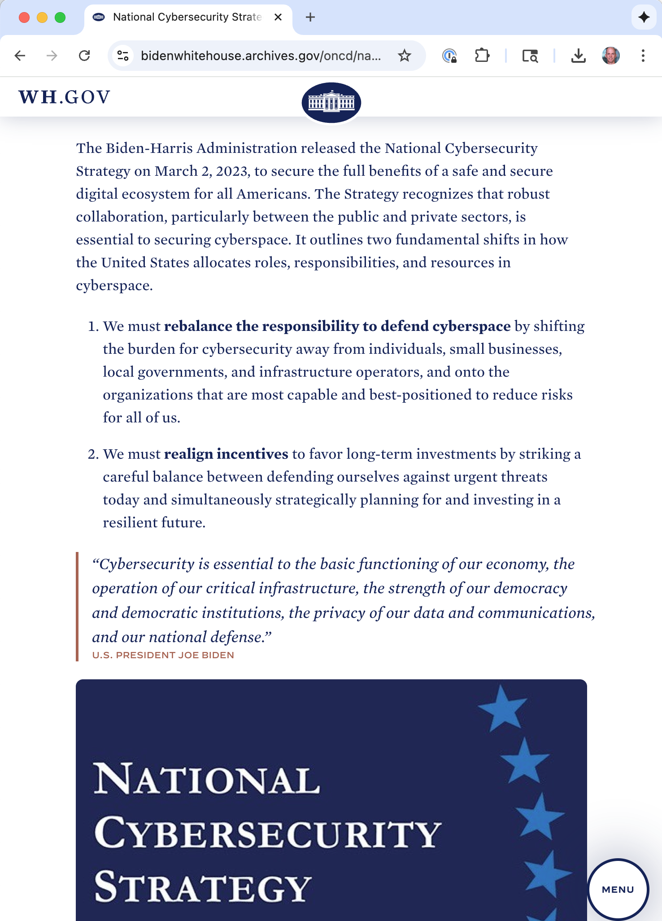
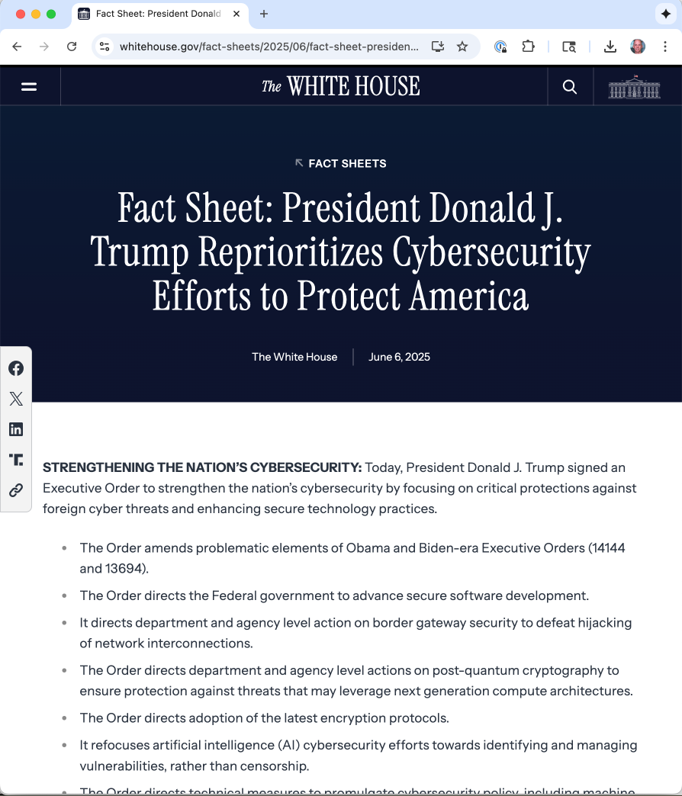
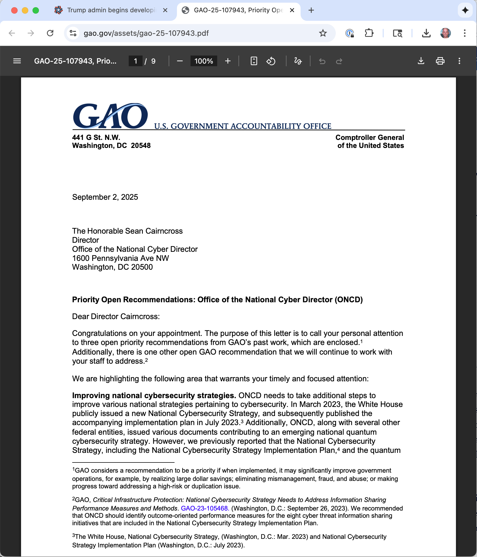
National cybersecurity utterances, since
June 2023
June 2025
September 2025
Cairncross said the private sector should have to meet minimum standards for cybersecurity. Which things should be standard? How do we know they work at scale?

Slide 12
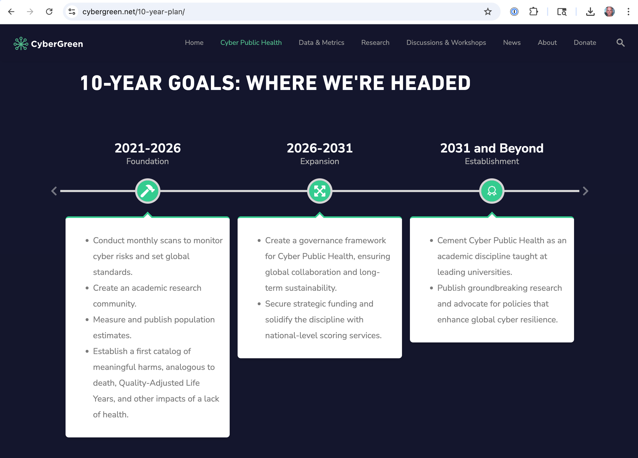
Cyber public health
According to the CDC Foundation, “Public health is the science of protecting and improving the health of people and their communities. ... Overall, public health is concerned with protecting the health of entire populations.”
Classic models of cybersecurity have focused on outcomes for the individual or a firm, and the work we’re doing to create a science and discipline of Cyber Public Health aims to use tools inspired by public health to bring those population level measurements and improvements to the cyber realm.
Cairncross said the private sector should have to meet minimum standards for cybersecurity. Which things should be standard? How do we know they work at scale?

Slide 13
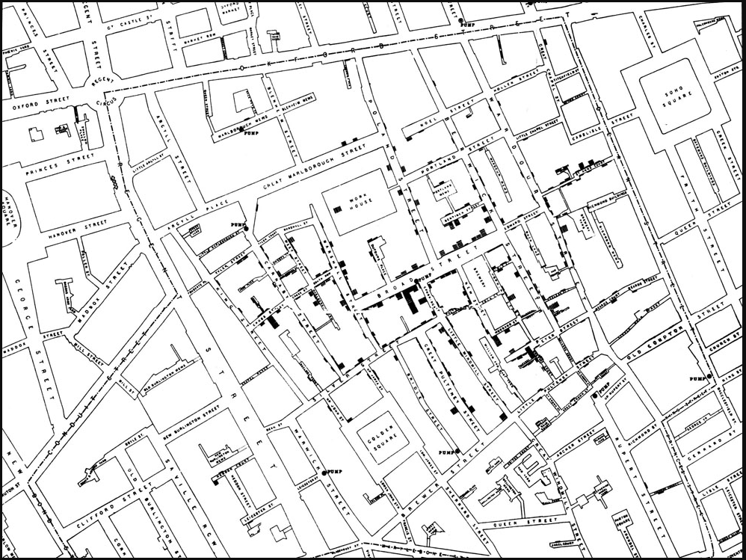
John Snow: Cholera outbreak in 1854
Medicine: How disease works, and how it can be treated on individuals
Public health: Understanding disease risks and treatments at population level, to maximize benefits
Notes:
It was a convincing demonstration of the value of a public health approach, combining medical knowledge and data with spatial and statistical data to point to an effective course of action.
The baseline measurements were cases on the map – this is incident data. It was the basis for assessing interventions.

Slide 14
Cyber public health in action
Analysis
What are the (still) successful vectors of attack?
Where is risk (still) greatest?
What interventions could be deployed cost-effectively?
What we should see:
A decline in successful attacks, according to a consistent data collection system
Updated standards to remove demonstrably ineﬀective techniques, like password rotation
Outcomes
Data breaches,
Vulnerabilities exploited,
Financial losses,
Humans harmed, …
Intervention
Engineering,
Operations,
Policy,
Education, …
Notes:
PH, measures
Outcomes on a Population (All people in Mississippi, deaths or quality-adjusted years of life lost)
Vectors (Bird flu and bubonic plague)
Analysis of these measurements drives research and deployment in medicine
If it’s working, there should be telltale signs

Slide 15
Proposals for the Fed. Government’s role
Bureau of Cyber Public Health Statistics
Enable the government to measure and improve cyber controls
Focus on whole-of-government efforts
Focus on institutions and data
Create a National Cybersecurity Data Repository
Implement Cybersecurity Health Reporting Standards
Incorporate Long-Term Learning
Focus on Research
Develop Stress Tests for Cybersecurity Public Health in Critical Infrastructure
Focus on Creating Community and Collaboration
Create Incentives for Private Sector Participation
Notes:
It should have one: It coordinates public health efforts; cyber public health makes sense, too
Why? Cybersecurity challenges transcend individual organizations and industries, and no other entity has the same reach or responsibility
The government can
Allocate funds for research, infrastructure, and implementation (over the long term)
Facilitate collection and sharing of cybersecurity data (just as the CDC does for health data)

