Slide 1

The CISO Role at Penn
April 2026
Nick Falcone, University Chief Information Security Officer

Slide 2
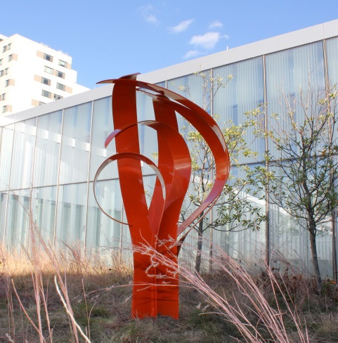
Agenda
Introductions
CISO roles
OIS Overview & Numbers
Metrics

Slide 3
Introduction
Nick Falcone
University Chief Information Security Officer
Prior:
CISO at Einstein Health
Enterprise Information Security Officer at Jefferson University and Hospitals
Security Engineer at Children’s Hospital of Philadelphia
Manager at Protiviti Risk Consulting
Intern at Department of Defense

Slide 4
Introduction
Specialized into low to medium maturity environments, culture change, and corporate politics
Applied adversarial mindset/hacker mindset
Hacking computers
Hacking people
Hacking organizations
Structured and planned soft skills
“People buy on emotion and justify with fact”
A learned skillset

Slide 5
CISO Roles Generally
Generic executive responsibilities:
Set priorities
Remove barriers
Obtain resources
Generic CISO role:
Be right about risks (set priorities)
Convince people you are right (remove barriers; obtain resources)

Slide 6
What does that look like day to day?
Building Relationships (quick wins, solving problems, delivering on small promises, empathetic responses)
Assess Risks (network with peers, keep up with media, technical and non-technical assessments, scans and metrics)
Manage the Team (set direction, coach, paperwork)
Change Culture (stakeholder analysis, presentations, one on one persuasion, shenanigans)
Hands on Activity (smallest category, exec. communications during incident response, pinch hitting as needed)

Slide 7
What about during incident response?
Prepare (prep execs not to panic, guide playbooks, maintain access and visibility)
Response Scale (24x7 vs business hours, making the call on when to bring in third party responders, legal support, insurance, etc.)
Communications (keep execs away from team so they can work, message to campus & media with support from University Communications)
Manage Team Emotional State (avoid panic and apathy, ensure no off the cuff actions/communications)
Accountability (make and own most major decisions, protect staff from misdirected consequences)

Slide 8
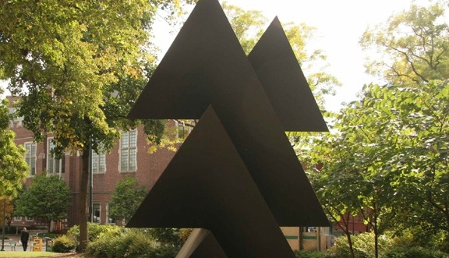
Penn’s IT Overview

Slide 9
High Level Org Chart for Penn
Most of these areas run their own IT shop
Plus additional IT shops for additional areas like the Penn Museum, the Institute for Contemporary Art or Wellness

Slide 10

IT Community Committee Presence
Campus Collaboration
Common
Solutions
AirPennNet
Advisory
Data
Warehouse
Audio-Visual (AV-SIG)
Cloud Computing (Cloud-SIG)
Firewall
Governance
Data Visualization (DataViz-SIG)
Developer (Dev-SIG)
IT Jobs
@Penn
Identity & Access Management (IAM) Governance
HireIT Client Advisory Group
(CAG)
High-Performance Computing (HPC-SIG)
Mission Continuity
Planners Group
Instructional Technology
Linux
IT Roundtable (ITR)
IT Policy
Committee (ITPC)
Macintosh Networking (MacNet)
Technology Services & Information Security
ISC Committees
Special Interest Groups (SIGs)
IT Research
@Penn
IT Learning Solutions
Mobile Technologies (Mobile-SIG)
O365
Advisory
PennO365
PC Networking (PC-Net)
Privacy & Security
Executive
Committee (PSEC)
Project Partners
IT Security
@Penn
(ITSEC)
Strategy
Review Board
Penn Technology Investment Committee (PTIC)
Security
SPLUNK
Transparency & Accountability Working Group
Super Users Group (SUG)
Web
6

Slide 11
OIS Overview

Slide 12
Goals
Security Operations
Consultations
Risks & Threats
Information Assurance
Awareness & Outreach
Point of Contact
Mission Continuity
Identity & Access
Major Incident Response

Slide 13
OIS Overview
Nick Falcone, CISO
Andre Jenkins, Deputy CISO
Anita Gelburd, Director
Valerie Morgan
Sr. Project Leader
Wiam Younes, Training and Awareness Officer
Mike Sanker, SOC Director
Bob Desilets, Sr. Sec. Analyst
Garry Frenkel, Sr. Sec. Analyst
Tina Tran, Sec. Analyst
Melissa Muth, Security Architect
Sam Jenkins, Security Engineer
Chris Kurzyna, Security Engineer
Doug Cawley, Sr. Sec. Analyst
Luke Hagendorf, Infosec Ops Analyst
Sherry Michael, ISC Dir. Info Sec

Slide 14
OIS Overview
Nick Falcone, CISO
Andre Jenkins, Deputy CISO
Anita Gelburd, Director
Valerie Morgan
Sr. Project Leader
Wiam Younes, Training and Awareness Officer
Mike Sanker, SOC Director
Bob Desilets, Sr. Sec. Analyst
Garry Frenkel, Sr. Sec. Analyst
Tina Tran, Sec. Analyst
Melissa Muth, Security Architect
Sam Jenkins, Security Engineer
Chris Kurzyna, Security Engineer
Doug Cawley, Sr. Sec. Analyst
Luke Hagendorf, Infosec Ops Analyst
Sherry Michael, ISC Dir. Info Sec
ISC Assurance Team
Security Operations Center
Information Assurance
Security Operations Team
Security Architecture and Engineering

Slide 15
OIS Overview
Information Assurance: Governance, risk and compliance, policy, mission continuity, training and awareness
Security Operations Center: Tier 2/3 incident response, alert response, consulting
Security Architecture and Engineering: Tool builders and maintainers, automation
Security Operations Team: Tier 1/2/3 incident response, alerting, technical consulting
ISC Assurance Team: policy, projects, process, risk and compliance, mission continuity

Slide 16
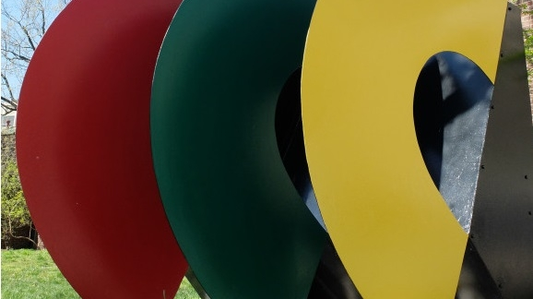
By the Numbers

Slide 17
Incident Counts FY20-24

Slide 18
Incidents by Type FY20-24

Slide 19
Host Compromise Incidents FY21-FY25

Slide 20
Host Compromise Incidents by Source

Slide 21
Host Compromise (non-UPHS) FY24 by Affiliation

Slide 22
Credential Compromise FY21-25

Slide 23
Board reporting
Typically once or twice per year in person, with a written update for other quarters
Semi-standardized approach:
Top risks and updates on how they are being addressed
Project updates for major efforts
Metrics – Penn wide and focused on top ten applications
Review of high impact incidents

Slide 24

University-Wide Information Security Metrics
Metric | Previous | Current
Patching (Target: less than 30 days) Measure adjusted to quarterly vs annual. | 12.3 days average (Q1 FY26) | 13.6 days average (Q1 FY26)
Serious Incident Detection Time (Target: less than 3 days) | 30 Days (2 serious events) | NA (0 serious events)
Phishing Simulation Outcomes (Target: less than 15%) | 32% (Fiscal YTD) | 28% (Fiscal YTD)
Security Budget as a Percent of IT Budget | xxx (FY24) | xxx (FY25)

Slide 25
Security Risks & Projects Update
Risks | Actions | Action Status
Identities and Accounts | IAM Project | Removed hundreds of thousands of stale accounts from Kite Active Directory. Upgraded password reset support implemented for most PennKeys.
Decentralization | Penn SecureIT | Penn SecureIT project to consolidate SEVP IT functions in progress.
Ransomware | ISC CrowdStrike Complete pilot | Pilot success; expanding to SEVP centers as part of the above effort.
State Sponsored Hackers | CrowdStrike Complete pilot
<location specific> | <improvement plan> | <progress>
Program Maturity/Scale | Accepted risk | See Penn SecureIT slides
Unmanaged Devices | Accepted risk | Accepted risk

