Slide 1


Secure Systems Engineering and Management
A Data-driven Approach
Security analytics:
Intro to data analysis (part 2)
Michael Hicks
UPenn CIS 7000-003
Spring 2026
Hypothesis Testing, Effect Sizes, and Regression

Slide 2
Lecture 2: Regression Models — Linear and Logistic

Slide 3
Lecture 2 Overview
Topics:
Linear regression fundamentals
Categorical predictors (dummy coding)
Model comparison (likelihood-ratio tests)
Logistic regression for binary outcomes
Odds ratios and predicted probabilities
Common regression pitfalls
Notes:
Learning objectives:
Fit and interpret linear regression models
Handle categorical predictors using dummy coding
Compare nested models using likelihood-ratio tests
Fit and interpret logistic regression models
Convert between log-odds, odds ratios, and probabilities
Avoid common regression pitfalls
This lecture builds toward Part 5 of your project: predicting whether vulnerabilities get actively exploited.

Slide 4
Part 1: Linear Regression Foundations

Slide 5

The Linear Model
Goal: Explain aspects of some empirical data
How? Model a continuous outcome (Y)
as a linear function of predictors (X)
Equation:
$$Y=β_{0}+β_{1}X_{1}+β_{2}X_{2}+...+ε$$
where
β₀ = intercept
βᵢ = slope (change in Y per unit X)
ε = residual error
Notes:
Linear regression is the workhorse of statistical modeling. It assumes the relationship between predictors and outcome is linear (a straight line in simple regression, a hyperplane in multiple regression).
For your project: you might model CVSS base score as a function of exploitability and impact subscores.
Franke Section 12.1 covers the fundamentals.

Slide 6

Ordinary Least Squares (OLS)
Objective: Fit data to a linear model
Approach: Find coefficients that minimize the sum of squared residuals
$$RSS=\sum_{i=1}^{n}{(}y_{i}−{\hat{y}}_{i})^{2}$$
Residual
Real data
Predicted by the model
Notes:
OLS finds the line (or hyperplane) that makes the residuals (vertical distances from points to line) as small as possible, in a sum-of-squares sense.
This has a nice closed-form solution and many desirable statistical properties under certain assumptions.

Slide 7
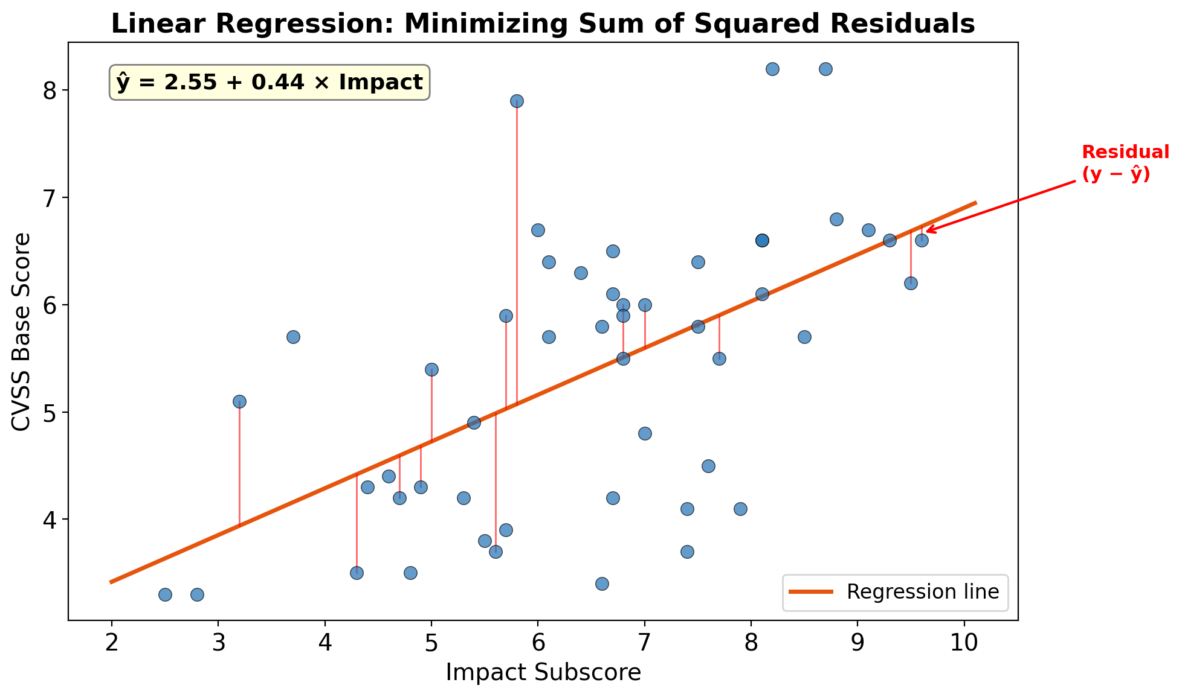

Slide 8
Key Regression Outputs
Output | Meaning
β̂ (coefficients) | Estimated slopes and intercept
Standard errors | Uncertainty in coefficient estimates
t-statistics | β̂ / SE — tests if coefficient ≠ 0
p-values | Significance of each coefficient
R² | Proportion of variance explained
Adjusted R² penalizes for adding more predictors and is often preferred.
Notes:
When you run a regression, you get a table of coefficients with their standard errors, t-statistics, and p-values.
Standard Error (of a coefficient): How much would this coefficient estimate wobble if we repeated the study many times? Smaller SE = more precise estimate.
(Recall: The standard error is simply the standard deviation of that sampling distribution.)
t-statistic: How many standard errors away from zero is our coefficient? It's simply:
$$t=\frac{{\hat{β}}_{j}}{SE\left({\hat{β}}_{j}\right)}$$
p-value: If the true coefficient were actually zero, what's the probability of seeing a t-statistic this extreme (or more) by chance? Small p-value = evidence against "no effect."
R²: What fraction of the variance in the outcome does the model explain? Ranges from 0 (model explains nothing) to 1 (perfect fit).
R²=1−RSS/TSS​ =1−∑(yi​−y^​i​)² / ∑(yi​−yˉ​)²
(TSS based on the average of y)
R² tells you how well the model fits — R² = 0.60 means 60% of the variance in Y (dependent var) is explained by the predictors.
Adjusted R² penalizes for adding more predictors and is often preferred.
Radj2​= 1 − (RSS/(n−p)​) / (TSS/(n−1))

Slide 9

Interpreting Coefficients
Example: Predicting CVSS from subscores
$$CVSS=β_{0}+β_{1}×Exploitability+β_{2}×Impact$$
Coefficient | Interpretation
β₀ (Intercept) | Predicted CVSS when Exploitability = 0 and Impact = 0
β₁ | Expected change in CVSS for 1-unit increase in Exploitability, holding Impact constant
β₂ | Expected change in CVSS for 1-unit increase in Impact, holding Impact constant
Notes:
The “holding constant” language is crucial. β₁ tells you the effect of Exploitability after accounting for Impact.
This is what makes multiple regression powerful — you can isolate the unique contribution of each predictor.

Slide 10

Actual CVSS: Not linear
For CVSS v2, the base score is computed as:
$$CVSS= \text{round}((0.6×\text{Impact}+0.4×\text{Exploitability}−1.5)×f\left(\text{Impact}\right))$$
where:
$f\left(\text{Impact}\right)=1.176$ if Impact > 0, otherwise 0
The result is rounded to 1 decimal place
Notes:
This is non-linear because the use of multiplicative factor of 1.176, which appears non-linearly (when Impact > 0).

Slide 11
Linear Regression in R
# Fit linear model: CVSS ~ exploitability + impact
model <- lm(cvss_base ~ exploitability + impact, data = data)
# View comprehensive summary
summary(model)
# Extract specific components
coef(model) # Coefficients only
confint(model) # 95% CIs for coefficients
summary(model)$r.squared # R²
summary(model)$adj.r.squared # Adjusted R²
Notes:
Line-by-line explanation:
lm(cvss_base ~ exploitability + impact, data = data) - fits a linear model
Formula syntax: outcome ~ predictor1 + predictor2
data = data tells R where to find the variables
R automatically includes an intercept (add - 1 to remove it)
summary(model) - comprehensive output including:
Coefficients with SEs, t-values, p-values
R² and Adjusted R²
F-statistic for overall model significance
coef(model) - extracts just the coefficient estimates (named vector)
confint(model) - 95% confidence intervals for each coefficient
5-6. Extract R² values from the summary object
Reading: Seltman Chapter 9

Slide 12
Linear Regression in Python
import statsmodels.formula.api as smf
# Fit linear model using formula interface
model = smf.ols('cvss_base ~ exploitability + impact', data=data).fit()
# View comprehensive summary
print(model.summary())
# Extract specific components
print("Coefficients:")
print(model.params) # Coefficients
print("\n95% CIs:")
print(model.conf_int()) # Confidence intervals
print(f"\nR² = {model.rsquared:.3f}")
print(f"Adjusted R² = {model.rsquared_adj:.3f}")
Notes:
Line-by-line explanation:
import statsmodels.formula.api as smf - imports statsmodels with formula interface (like R)
smf.ols('cvss_base ~ exploitability + impact', data=data) - specifies the model
Formula syntax identical to R
.fit() actually estimates the model (don’t forget this!)
model.summary() - comprehensive output table similar to R’s summary()
model.params - pandas Series of coefficient estimates
model.conf_int() - DataFrame with confidence intervals
model.rsquared and model.rsquared_adj - R² values
Documentation: https://www.statsmodels.org/stable/regression.html

Slide 13
Running Linear Regression on Sample Data
Model: cvss_base ~ exploitability + impact
coef std err t P>|t| [0.025 0.975]
Intercept 0.4157 0.092 4.50 <0.001 0.235 0.597
exploitability 0.3698 0.011 34.38 <0.001 0.349 0.391
impact 0.3886 0.012 33.78 <0.001 0.366 0.411
R² = 0.588, Adjusted R² = 0.587
. . .
Interpretation:
Each 1-point increase in exploitability → +0.37 CVSS (holding impact constant)
Each 1-point increase in impact → +0.39 CVSS (holding exploitability constant)
Model explains 81% of variance in CVSS
Notes:
This is what you should see when running on the sample data (values may vary slightly).
For real data R² would probably be higher, but our data is synthetic and didn’t follow the formula. That’s because CVSS base score is actually computed FROM exploitability and impact in a specific formula
In real analyses, R² values are often much lower (0.1-0.3 is common in social science).
This is showing confidence intervals. Both linear and logistic regression produce standard errors for each coefficient as a byproduct of fitting. Confidence intervals follow directly:
CI=β^​ ± t_(α/2) ​× SE(β^​)
uses a t-distribution (with n − p degrees of freedom)
For logistic regression, it uses a normal (z) distribution because the estimates are based on asymptotic maximum likelihood theory.

Slide 14
Part 2: Categorical Predictors

Slide 15
The Problem
Regression requires numeric predictors.
But CWE category is categorical:
“Memory”
“InputValidation”
. . .
“Crypto”
“Auth”
Solution: Convert to numeric using dummy coding
Notes:
You can’t just assign numbers (1, 2, 3, 4) to categories — that implies an ordering and specific distances between categories that don’t exist.
Dummy coding creates binary indicators that capture categorical information without imposing false structure.
Franke Sections 14.1-14.2 cover this well.

Slide 16
Dummy Coding (Treatment Coding)
Convert a k-level categorical variable into k−1 binary indicators:
CWE Category | Is_InputVal | Is_Memory | Is_Crypto
Auth (reference) | 0 | 0 | 0
InputValidation | 1 | 0 | 0
Memory | 0 | 1 | 0
Crypto | 0 | 0 | 1
Notes:
Notice we use k-1 dummies for k categories. The “missing” category (Auth here) is the reference level — it’s captured by the intercept.
The reference level is what all other categories are compared to. Choosing it carefully makes your coefficients interpretable.

Slide 17
Why k−1 Dummies?
Including all k dummies creates perfect multicollinearity:
If Is_InputVal = Is_Memory = Is_Crypto = 0, it must be Auth
The reference category is already fully determined by the others
Notes:
This is sometimes called the “dummy variable trap.” Including all dummies means the columns sum to 1 for every observation, creating linear dependence.
R and Python handle this automatically — they drop one category to serve as the reference.

Slide 18

Interpreting Dummy Coefficients
Model:
$$CVSS=β_{0}+β_{1}×Is_Memory+β_{2}×Is_Crypto+...$$
Example output:
Coefficient | Estimate | p-value
Intercept | 5.10 | <0.001
Is_Memory | 0.42 | 0.001
Is_Crypto | -0.21 | 0.082

Slide 19
Coefficient | Estimate | p-value
Intercept | 5.10 | <0.001
Is_Memory | 0.42 | 0.001
Is_Crypto | -0.21 | 0.082
Interpretation:
Auth vulnerabilities (reference) have mean CVSS = 5.10
Memory vulnerabilities have CVSS 0.42 higher than Auth
Crypto vulnerabilities do not significantly differ from Auth
Notes:
This is crucial: dummy coefficients are DIFFERENCES from the reference, not absolute values.
“CWE_Memory = 0.42” does NOT mean memory vulnerabilities have CVSS = 0.42. It means they’re 0.42 points higher than the reference category (Auth).
PITFALL: Forgetting what the reference category is! Always state it explicitly.

Slide 20
Choosing the Reference Level
Defaults:
R: Alphabetically first, or lowest numeric value
Python (statsmodels): Same
Better approach: Choose a meaningful baseline
Most common category
Control/baseline condition
Theoretically neutral category
Notes:
The default (alphabetical) is often not the most meaningful choice.
For your project, you might want to use the most common CWE category as reference, so other categories are compared to the “typical” vulnerability.
Or use “Auth” if it’s a theoretically neutral baseline.

Slide 21
Setting Reference Level in R
# Check current levels (alphabetical by default)
levels(data$cwe_category)
# Set "Auth" as the reference level
data$cwe_category <- relevel(factor(data$cwe_category), ref = "Auth")
# Fit model with categorical predictor
model <- lm(cvss_base ~ exploitability + impact + cwe_category,
data = data)
summary(model)
Notes:
Line-by-line explanation:
levels(data$cwe_category) - shows current ordering of factor levels. First level is the reference.
relevel(factor(data$cwe_category), ref = "Auth") - two things happening:
factor() converts to factor if not already
relevel(..., ref = "Auth") makes “Auth” the first (reference) level
Model specification with categorical predictor:
R automatically creates dummy variables for cwe_category
You’ll see coefficients for all categories EXCEPT Auth (the reference)
summary(model) - now shows cwe_categoryMemory, cwe_categoryCrypto, etc., each relative to Auth

Slide 22
Setting Reference Level in Python
import statsmodels.formula.api as smf
# Method 1: Specify reference in formula using C()
model = smf.ols(
'cvss_base ~ exploitability + impact + C(cwe_category, Treatment(reference="Auth"))',
data=data
).fit()
print(model.summary())
# Method 2: Reorder categories in DataFrame first
data['cwe_category'] = pd.Categorical(
data['cwe_category'],
categories=['Auth', 'Crypto', 'InputValidation', 'Memory', 'Other']
)
model2 = smf.ols('cvss_base ~ exploitability + impact + cwe_category',
data=data).fit()
Notes:
Line-by-line explanation:
Method 1 (inline specification): 1. C(cwe_category, Treatment(reference="Auth")) - the C() function controls coding - Treatment(reference="Auth") specifies dummy coding with Auth as reference - This is the most explicit and readable approach
Method 2 (reorder DataFrame): 2. pd.Categorical(..., categories=[...]) - creates ordered categorical - First category in the list becomes the reference - Useful if you’ll fit multiple models with same reference
Documentation: https://www.statsmodels.org/stable/contrasts.html

Slide 23
Running Linear Regression with Categorical Predictor
Model: cvss_base ~ exploitability + impact + C(cwe_category, ref=“Auth”)
coef std err t p>|t| [0.025 0.975]
Intercept 0.4176 0.112 3.73 <0.001 0.198 0.637
cwe_category[Crypto] -0.0422 0.069 -0.61 0.539 -0.177 0.093
cwe_category[InputVal] -0.0202 0.060 -0.34 0.738 -0.139 0.098
cwe_category[Memory] 0.0495 0.061 0.82 0.415 -0.070 0.169
cwe_category[Other] 0.0671 0.071 0.95 0.343 -0.072 0.206
exploitability 0.3692 0.011 34.31 <0.001 0.348 0.390
impact 0.3871 0.013 30.71 <0.001 0.362 0.412
R² = 0.589, Adjusted R² = 0.588
Notes:
Interpretation:
Exploitability and impact remain strong predictors (p < 0.001)
No CWE category differs significantly from Auth (all p > 0.3)
Adding CWE category barely changes R² (0.589 vs 0.588)
None of the CWE category dummies are significant — CWE category does not appear to predict CVSS base score once exploitability and impact are accounted for.
This makes sense: CVSS is computed from exploitability and impact subscores, so CWE category adds little additional information.

Slide 24
⚠️ Pitfall: Forgetting the Reference Category
Bad:
Better:
Predictor | Coefficient
Is_Memory | 0.42
Is_Crypto | -0.21
Predictor | Coefficient
Is_Auth | –
Is_Memory | 0.42
Is_Crypto | -0.21

Slide 25
⚠️ Pitfall: Forgetting the Reference Category
. . .
Wrong: “Memory vulnerabilities have severity 0.42”
Also wrong: “Memory vulnerabilities are 0.63 more severe than Crypto”
. . .
Right: “Memory vulnerabilities have CVSS 0.42 higher than the reference (Auth). Crypto vulnerabilities have CVSS 0.21 lower than Auth.”
Notes:
The coefficients are always relative to the reference, not absolute and not relative to other non-reference categories.
To compare Memory to Crypto, you’d compute: 0.42 - (-0.21) = 0.63 points difference, and you’d need a separate test for that comparison (not automatically provided).
ALWAYS state what the reference category is when reporting results.

Slide 26
Part 3: Model Comparison

Slide 27
The Problem
You’ve fit two models:
Model 1 (simple): cvss ~ exploitability + impact
Model 2 (complex): cvss ~ exploitability + impact + cwe_category
Question: Does adding CWE category significantly improve the model?
Notes:
Model 2 will ALWAYS have higher R² than Model 1 (adding predictors can’t hurt fit). But that doesn’t mean the added complexity is justified.
We need a formal test to determine if the improvement is statistically significant.

Slide 28

Likelihood-Ratio Test
Logic: Compare how well each model fits the data via their likelihoods
Test statistic:
$$LR=2×(LL_{full}−LL_{reduced})$$
Under H₀ (reduced model is adequate):
$$LR∼χ_{df}^{2}$$
where df = difference in number of parameters
Notes:
The likelihood-ratio test asks: “Does the fuller model fit significantly better than the simpler model?”
The test statistic follows a chi-square distribution if the simpler model is actually adequate. Large values of LR indicate the fuller model fits much better. The degrees of freedom equal to the number of extra parameters.
Franke Section 16.6.6 covers this.
LL is the log likelihood of the model. Which is the log of the likelihood that the model describes the data (is a better predictor). Log likelihood converts products into sums. It’s negative: Less negative (bigger) means better fit.
The LR-test first and foremost applies to the comparison of nested models, A frequentist model Mi is nested inside another frequentist model Mj iff Mi can be obtained from Mj by fixing at least one of Mj’s free parameters to a specific value.
If the simpler (nested) model is true, the sampling distribution of this test statistic approximates a χ2-distribution with d if we have more and more data. The degrees of freedom d are given by the difference in free parameters, i.e., the number of parameters the nested model fixes to specific values, but which are free in the nesting model.
The p-value of this test quantifies the evidence against the assumption that the data was generated by the simpler model. A significant test result would therefore indicate that it would be surprising if the data was generated by the simpler model.

Slide 29
LR Test in R
# Fit nested models
model1 <- lm(cvss_base ~ exploitability + impact, data = data)
model2 <- lm(cvss_base ~ exploitability + impact + cwe_category,
data = data)
# Compare R² values
summary(model1)$r.squared # e.g., 0.812
summary(model2)$r.squared # e.g., 0.821
# Likelihood-ratio test
anova(model1, model2, test = "LRT")
Notes:
Line-by-line explanation:
1-2. Fit the reduced (simple) model without cwe_category
3-4. Fit the full model with cwe_category
5-6. Compare R² values to see how much variance is explained by adding cwe_category
anova(model1, model2, test = "LRT") - likelihood-ratio test
Models must be nested (model1’s predictors must be a subset of model2’s)
Output shows: Residual df, RSS, Df difference, LR statistic, p-value
Significant p-value → fuller model is better
Note: For linear models, you can also use F-test: anova(model1, model2) without test=“LRT”

Slide 30
LR Test in Python
import statsmodels.formula.api as smf
# Fit nested models
model1 = smf.ols('cvss_base ~ exploitability + impact', data=data).fit()
model2 = smf.ols('cvss_base ~ exploitability + impact + C(cwe_category)',
data=data).fit()
# Compare R² values
print(f"Model 1 R²: {model1.rsquared:.3f}")
print(f"Model 2 R²: {model2.rsquared:.3f}")
# Likelihood-ratio test
lr_stat, p_value, df_diff = model2.compare_lr_test(model1)
print(f"LR = {lr_stat:.2f}, df = {df_diff}, p = {p_value:.4f}")
Notes:
Line-by-line explanation:
Import statsmodels with formula API
2-3. Fit reduced model
4-5. Fit full model with categorical predictor - C(cwe_category) creates dummy variables automatically
6-7. Print R² values to see practical improvement
model2.compare_lr_test(model1) - performs LR test
Returns three values: LR statistic, p-value, degrees of freedom difference
p < 0.05 → fuller model fits significantly better
The df_diff tells you how many parameters were added (= number of categories - 1).

Slide 31
Interpreting LR Test Results
Significant (p < 0.05):
The additional predictors improve model fit
Keep the fuller model
Non-significant (p ≥ 0.05):
The simpler model is adequate
Prefer parsimony (fewer predictors)
Notes:
A significant LR test doesn’t mean the added variables explain a LOT of variance — just that they explain significantly more than zero.
Always report the change in R² alongside the LR test to give a sense of the practical improvement.
Example: “Adding CWE category significantly improved model fit (LR = 45.2, df = 4, p < 0.001), though the increase in R² was modest (ΔR² = 0.009).”

Slide 32
LR Test: Does CWE Category Improve Our Model?
Model 1 (reduced): cvss_base ~ exploitability + impact
Model 2 (full): cvss_base ~ exploitability + impact + cwe_category
Model 1 R²: 0.588 Model 2 R²: 0.589
LR = 4.68, df = 4, p = 0.3223
Result: Not significant (p = 0.32 >> 0.05)
Adding CWE category does not significantly improve model fit
The simpler model is adequate — prefer parsimony
R² increase is negligible (0.588 → 0.589)
Notes:
This is a clear case where the simpler model wins. The LR test is far from significant, and the R² barely budges.
This makes intuitive sense: CVSS base score is computed from exploitability and impact subscores, so once those are in the model, knowing the CWE category adds almost no predictive information.
Report as: “Adding CWE category did not significantly improve model fit (LR = 4.68, df = 4, p = 0.32, ΔR² = 0.001).”

Slide 33
Part 4: Logistic Regression

Slide 34
Predicting Binary Outcomes
Goal: Predict whether a vulnerability is actively exploited (in KEV catalog)
Outcome: Binary (0 = not exploited, 1 = exploited)
Why linear regression fails:
Can predict values outside [0, 1]
Residuals cannot be normally distributed
Violates constant variance assumption
Notes:
Linear regression assumes a continuous outcome with normally distributed errors. With a binary outcome (0/1), neither is possible.
If you try linear regression on a binary outcome, you might get predictions like -0.3 or 1.5, which are nonsensical as probabilities.
We need a different approach: logistic regression.
Note, our encoding of binary predictors was different: These were predictor variables, not the outcome variable.

Slide 35

The Logistic Model
Solution: Model the log-odds of the outcome as a linear function:
$$log\left(\frac{p}{1−p}\right)=β_{0}+β_{1}X_{1}+β_{2}X_{2}+...$$
where p = P(Y = 1)
Logistic function maps log-odds to probabilities:
$$p=\frac{1}{1+e^{−(β_{0}+β_{1}X_{1}+...)}}$$
Notes:
We rearrange the S-curve equation into the log-odds equation, in order to make it into a linear function
The left side, log(p/(1-p)), is called the “logit” or “log-odds.” It can range from -∞ to +∞.
This gets modeled as a linear function of predictors, which is convenient because linear functions can take any value.
The logistic function then squashes the result back to the (0, 1) range for probabilities.
Seltman 16.3 covers this

Slide 36
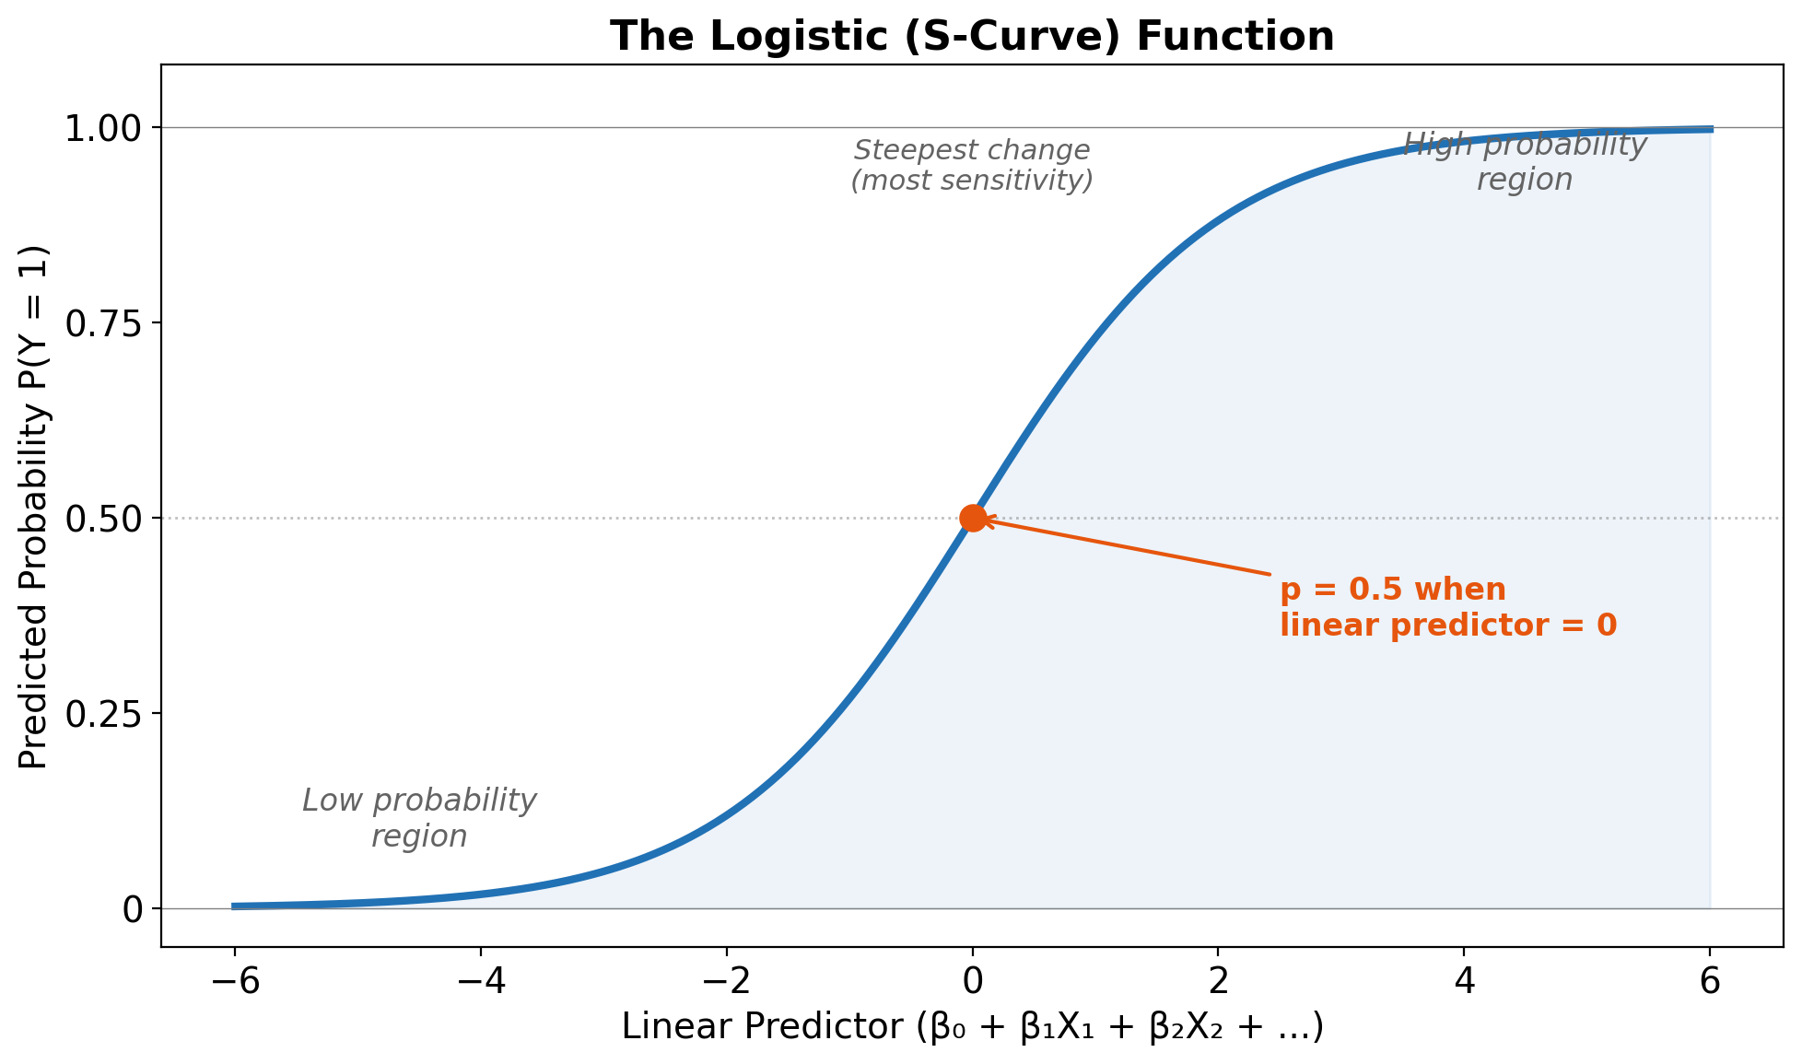

Notes:
Properties:
Probability always between 0 and 1
Steepest change around p = 0.5
Asymptotes at 0 and 1
The S-curve shows how the linear predictor (the β₀ + β₁X₁ + … part) maps to probability.
When the linear predictor is very negative, p approaches 0. When it’s very positive, p approaches 1. Near 0, small changes in the linear predictor produce larger changes in probability.

Slide 37

Odds and Log-Odds
Odds:
$$\text{odds}=\frac{p}{1−p}$$
If p = 0.75, odds = 0.75/0.25 = 3:1 (“3 to 1”)
Log-odds (logit):
$$\text{logit}(p)=log(\text{odds})=log\left(\frac{p}{1−p}\right)$$
If p = 0.5, log-odds = 0
If p = 0.75, log-odds = 1.1
Notes:
Odds express probability as a ratio: “3 to 1” means 3 times as likely to happen as not happen.
Log-odds are convenient mathematically because they’re symmetric around 0 and unbounded.
The logistic regression coefficients are in log-odds units, which aren’t intuitive. We usually convert to odds ratios.

Slide 38
Interpreting Coefficients: Log-Odds
Log-odds coefficient (β):
“A one-unit increase in X is associated with a β change in the log-odds of the outcome.”
Example:
β₁ = 0.5 for CVSS score
“Each 1-point increase in CVSS is associated with a 0.5 increase in the log-odds of exploitation.”
Problem: This is not intuitive!
Notes:
Log-odds are mathematically convenient but don’t match how people think about probabilities.
Nobody says “the log-odds of rain tomorrow are 1.2.” We need to convert to more interpretable quantities.

Slide 39

Interpreting Coefficients: Odds Ratios
Odds ratio (OR):
$$OR=e^{β}$$
“A one-unit increase in X multiplies the odds by OR.”
Odds Ratio | Interpretation
OR = 1 | No association
OR > 1 | Higher odds (positive association)
OR < 1 | Lower odds (negative association)
Notes:
Odds ratios are the exponential of log-odds coefficients. They’re multiplicative, not additive.
Example: OR = 2.5 means “each unit increase in X makes the outcome 2.5 times as likely.”
OR = 0.5 means “each unit increase in X cuts the odds in half.”

Slide 40
Odds Ratio Example
Coefficient: β_{CVSS} = 0.5
Odds ratio: e^{0.5} = 1.65
Interpretation:
“Each 1-point increase in CVSS is associated with 1.65 times the odds of being exploited.”
Or equivalently:
“Each 1-point increase in CVSS increases the odds of exploitation by 65%.”
Notes:
The 65% comes from (1.65 - 1) × 100% = 65%.
Be careful with language: “1.65 times the odds” is correct. “65% more likely” is close but technically imprecise (odds ≠ probability).
For OR < 1, say “0.7 times the odds” or “30% lower odds.”

Slide 41
Logistic Regression in R
# Fit logistic regression
log_model <- glm(in_kev ~ cvss_base + cwe_category,
data = data, family = binomial)
# View summary (coefficients are log-odds)
summary(log_model)
# Convert to odds ratios
exp(coef(log_model))
# 95% CIs for odds ratios
exp(confint(log_model))
Notes:
Line-by-line explanation:
glm(..., family = binomial) - generalized linear model with binomial family
family = binomial specifies logistic regression
Other families: poisson (count data), Gamma, etc.
Formula syntax same as lm()
summary(log_model) - shows log-odds coefficients, SEs, z-values, p-values
Note: uses z-tests, not t-tests (no residual df in logistic regression)
exp(coef(log_model)) - exponentiates coefficients to get odds ratios
exp() is the exponential function (inverse of log)
exp(confint(log_model)) - 95% CIs for odds ratios
Computed on log scale then exponentiated (called profile likelihood CIs)
Report odds ratios and their CIs for interpretation.

Slide 42
Logistic Regression in Python
import statsmodels.formula.api as smf
import numpy as np
# Fit logistic regression
log_model = smf.logit('in_kev ~ cvss_base + C(cwe_category)',
data=data).fit()
# View summary (log-odds coefficients)
print(log_model.summary())
# Convert to odds ratios
print("\nOdds Ratios:")
print(np.exp(log_model.params))
# 95% CIs for odds ratios
print("\n95% CIs for Odds Ratios:")
print(np.exp(log_model.conf_int()))
pd.DataFrame({
'OR': np.exp(log_model.params),
'2.5%': np.exp(log_model.conf_int()[0]),
'97.5%': np.exp(log_model.conf_int()[1])
})
Notes:
Note: Unlike linear regression (which minimizes squared errors), logistic regression uses maximum likelihood estimation. It finds the coefficients that make the observed data most probable. The logit function does that for us
Line-by-line explanation:
smf.logit(...) - statsmodels logistic regression function
Note: logit() not ols()!
.fit() estimates the model
log_model.summary() - shows log-odds coefficients
Includes pseudo-R² (McFadden’s), AIC, BIC for model comparison
np.exp(log_model.params) - converts log-odds to odds ratios
np.exp() is numpy’s exponential function
np.exp(log_model.conf_int()) - exponentiated confidence intervals
Returns DataFrame with lower and upper bounds
Tip: Create a nice output table:
pd.DataFrame({
'OR': np.exp(log_model.params),
'2.5%': np.exp(log_model.conf_int()[0]),
'97.5%': np.exp(log_model.conf_int()[1])
})

Slide 43
Running Logistic Regression on Sample Data
Model: in_kev ~ cvss_base + cwe_category (reference = Auth)
coef OR [95% CI OR] p
Intercept -8.07 0.00 <0.001
cvss_base 0.60 1.82 [1.39, 2.39] <0.001
C(cwe_category)[Crypto] 0.74 2.10 [0.49, 8.96] 0.317
C(cwe_category)[InputVal] 0.72 2.06 [0.56, 7.59] 0.278
C(cwe_category)[Memory] 0.99 2.69 [0.77, 9.32] 0.119
C(cwe_category)[Other] -0.10 0.91 [0.15, 5.52] 0.915
Key interpretation:
Each 1-point increase in CVSS → 1.82× the odds of exploitation (p < 0.001)
Notes:
Note: The sample data has only a small number of exploited vulnerabilities, so CWE category effects are not significant (wide CIs, large p-values).
The CVSS effect is significant: OR = 1.82 means each point of CVSS multiplies the odds by 1.82 (82% higher odds per point).
Intercept = -8.07 gives the log-odds when CVSS = 0 for the reference category (Auth). This is outside the realistic CVSS range, so not very interpretable.

Slide 44

Converting to Predicted Probabilities
Most interpretable: What’s the probability for a specific scenario?
$$\hat{p}=\frac{1}{1+e^{−({\hat{β}}_{0}+{\hat{β}}_{1}x_{1}+...)}}$$
Example predictions from our model:
CVSS | CWE Category | P(exploitation)
4.0 | Auth | 0.3%
6.0 | Auth | 1.1%
8.0 | Auth | 3.6%
8.0 | Memory | 9.2%
Notes:
Predicted probabilities are the most intuitive way to communicate logistic regression results.
You can compute them for “average” observations, or for theoretically interesting scenarios.
Compare probabilities between groups: “The predicted probability of exploitation is 0.3% for CVSS = 4 vs. 3.6% for CVSS = 8 (both Auth).”
Also compare across categories: “At CVSS = 8, a Memory vulnerability (9.2%) is about 2.5× more likely to be exploited than an Auth vulnerability (3.6%).”

Slide 45
Predicted Probabilities in R
# Create scenarios for prediction
new_data <- data.frame(
cvss_base = c(4.0, 6.0, 8.0, 8.0),
cwe_category = c("Auth", "Auth", "Auth", "Memory")
)
# Predict probabilities
predictions <- predict(log_model, new_data, type = "response")
# Display
cbind(new_data, prob = round(predictions, 3))
Notes:
Line-by-line explanation:
data.frame(...) - creates new data with scenarios to predict
Must have same column names as original data
Here: varying CVSS and CWE category
predict(log_model, new_data, type = "response") - generates predictions
type = "response" gives probabilities (default would give log-odds)
type = "link" would give log-odds
cbind(...) - combines scenarios with predictions for display
Expected output: - CVSS 4, Auth: ~0.5% - CVSS 6, Auth: ~1.5% - CVSS 8, Auth: ~4% - CVSS 8, Memory: ~8%

Slide 46
Predicted Probabilities in Python
# Create scenarios for prediction
new_data = pd.DataFrame({
'cvss_base': [4.0, 6.0, 8.0, 8.0],
'cwe_category': ['Auth', 'Auth', 'Auth', 'Memory']
})
# Predict probabilities
predictions = log_model.predict(new_data)
# Display
new_data['prob'] = predictions.round(3)
print(new_data)
Notes:
Line-by-line explanation:
pd.DataFrame({...}) - creates DataFrame with prediction scenarios
Dictionary syntax: {‘column_name’: [values]}
log_model.predict(new_data) - generates predicted probabilities
Returns probabilities by default (unlike R)
For log-odds, use log_model.predict(new_data, linear=True)
Adds predictions as new column and displays
For confidence intervals on predictions:
pred = log_model.get_prediction(new_data)
pred.summary_frame(alpha=0.05) # Shows mean, SE, CI

Slide 47
⚠️ Pitfall: Incorrect Scale in Logistic Regression
The coefficient is 0.52…
❌ “Higher CVSS increases exploitation by 0.52”
❌ “Higher CVSS increases exploitation by 52%”
✓ “The log-odds coefficient is 0.52, corresponding to an odds ratio of 1.68”
✓ “Each 1-point CVSS increase is associated with 1.68× the odds of exploitation”
✓ “Predicted probability rises from 1.5% at CVSS=6 to 4% at CVSS=8”
Notes:
This is one of the most common errors in interpreting logistic regression!
Log-odds coefficients cannot be interpreted directly as changes in probability. The relationship is nonlinear.
Always convert to odds ratios or predicted probabilities for interpretation.

Slide 48
Part 5: Regression Pitfalls

Slide 49
⚠️ Caution: Class Imbalance in Your Data
KEV catalog: ~1,200 actively exploited CVEs
Total CVEs: ~250,000+
Exploitation rate: < 0.5%
In our sample data: 37 exploited out of 2,000 (1.8%)
Notes:
Most vulnerabilities are NOT actively exploited (thankfully!). But this creates challenges for prediction.
Similar issues arise in fraud detection, disease screening, and other rare event prediction problems.

Slide 50
Why Rare Events Are Challenging
Accuracy is misleading: Predicting “not exploited” for everything gives 98%+ accuracy
Coefficients may be unstable: Few positive cases → high variance
Predicted probabilities may be miscalibrated: Systematically under- or over-estimated
Notes:
With 1.8% positives, a model that predicts “no” for everything is 98.2% accurate but completely useless for finding exploited vulnerabilities.
We need different evaluation metrics that account for the imbalance.

Slide 51
Better Metrics for Rare Events
Metric | Meaning
Sensitivity (Recall) | Of exploited CVEs, what % did we catch?
Precision | Of CVEs we flagged, what % are actually exploited?
F1 score | Harmonic mean of precision and recall
AUC-ROC | Overall discriminative ability
Notes:
Sensitivity/recall answers: “If a vulnerability IS exploited, would my model have flagged it?”
Precision answers: “If my model flags something, how likely is it actually exploited?”
There’s a tradeoff between these — you can catch more true positives, but you’ll also get more false positives.
AUC-ROC measures how well the model ranks positives above negatives overall.

Slide 52
✓ Practical Guidance
Report sensitivity and specificity, not just accuracy
Consider whether the base rate makes prediction meaningful
Acknowledge class imbalance as a limitation
Use the logistic model to understand associations, not for operational prediction
Notes:
In your project reflection, discuss the limitations of trying to predict rare events.
The logistic model is still useful for understanding what factors are ASSOCIATED with exploitation — just be cautious about using it for prediction/screening.

Slide 53
⚠️ Pitfall: Not Reporting Model Fit
The problem: Coefficients can be “significant” even if the model explains almost nothing.
Example of misleading results:
“CWE category significantly predicts CVSS (p < 0.001)”
But if R² = 0.02… the model explains only 2% of variance!
Always report
Model Type | Report
Linear | R², Adjusted R²
Logistic | Pseudo-R² (McFadden), comparison to null model
Notes:
A “significant” coefficient with terrible model fit means the variable has a real but tiny effect.
Pseudo-R² for logistic regression is not identical to R² for linear regression, but provides a similar measure of fit. McFadden’s pseudo-R² of 0.2-0.4 indicates good fit.
Always include model fit in your reporting.

Slide 54
⚠️ Pitfall: Unclear Model Specification
Ambiguous: “We ran a logistic regression to predict exploitation.”
Clear: “We fit a logistic regression predicting KEV inclusion (1 = in catalog, 0 = not) from:
CVSS base score (continuous)
CWE category (dummy-coded, reference = Auth)
Publication year (continuous, centered at 2020)
No interactions were included.”
Notes:
Readers cannot evaluate or replicate your work without knowing exactly what you did.
Always specify: - The outcome variable and how it’s coded - All predictors and their types - Reference levels for categorical variables - Any transformations (log, centering, etc.) - Whether interactions are included

Slide 55
⚠️ Pitfall: Regression ≠ Causation
The problem: Regression shows association, not causation.
❌ “Our regression shows that higher CVSS scores cause vulnerabilities to be exploited.”
✓ “Higher CVSS scores are associated with greater likelihood of exploitation. However, this association may reflect confounding factors rather than a causal relationship.”
Notes:
This is a fundamental principle: observational data cannot establish causation.
Possible confounds in your project: - Media attention → both higher CVSS and more exploitation attempts - Vendor resources → both better scoring and more researcher attention - Time trends → scoring practices and attack patterns both change
Use causal language (“causes,” “affects,” “leads to”) only for experimental data with random assignment.

Slide 56
⚠️ Pitfall: Selectively Reporting Coefficients
The problem: Reporting only “significant” predictors gives incomplete picture.
Wrong:
“We found that Memory vulnerabilities (p = 0.02) predict higher CVSS.”
Better:
“We report all coefficients in Table 3. Memory (+0.42, p = 0.001) showed significantly higher CVSS than Auth (reference). Crypto (-0.21, p = 0.08) and InputValidation (-0.08, p = 0.52) did not significantly differ.”
Notes:
Selective reporting: 1. Makes it look like you’re fishing for significant results 2. Hides potentially interesting null results 3. Prevents readers from fully evaluating the model
Report ALL coefficients. Interpret non-significant ones with appropriate caveats about power.

Slide 57
Regression Reporting Checklist
Model Specification:
☐ All predictors listed
☐ Reference categories specified
☐ Transformations described
☐ Interactions noted
Model Fit:
☐ R² or pseudo-R² reported
☐ Comparison to null model
Coefficients:
☐ All coefficients reported
(not just significant ones)
☐ Odds ratios for logistic regression
☐ Confidence intervals for key estimates
Interpretation:
☐ Coefficients interpreted relative to ref.
☐ Association, not causation, language
Notes:
Use this checklist when writing up regression analyses for your project.
Going through each item systematically will help you avoid the common pitfalls.
Note: the null model is the one with just the intercept, and no predictors. R² is literally measuring how much better you do than the null model, as a proportion of the null model's error. But you could use LR comparison of the linear model against the null one.

Slide 58
Complete Regression Reporting Example
“We fit a logistic regression predicting KEV inclusion from CVSS base score and CWE category (dummy-coded, reference = Auth). Results are shown in Table 2.
The model significantly outperformed the null model (LR = 28.5, df = 5, p < 0.001), though McFadden’s pseudo-R² was modest (0.08). Higher CVSS was associated with increased exploitation odds (OR = 1.68 per point, 95% CI [1.34, 2.12]). CWE categories did not significantly differ from the Auth reference (all p > 0.10), though Memory showed a trend toward higher odds (OR = 2.07, 95% CI [0.85, 5.06]).
These associations do not imply causation; unmeasured confounders may explain the observed relationships.”
Notes:
This example includes:
- Model specification
- Model fit metrics
- LR test for overall significance
- Odds ratios with confidence intervals
- All categories mentioned
- Causal disclaimer
This is what complete reporting looks like.

Slide 59
Lecture 2 Summary
Concept | Key Takeaway | Example Use
Linear regression | Model continuous outcome from predictors | CVSS ~ subscores
Dummy coding | Convert categorical to numeric | CWE category
Reference level | Coefficients are differences from reference | Specify explicitly
LR test | Compare nested models | Does CWE help?
Logistic regression | Model binary outcome via log-odds | Predict exploitation
Odds ratios | e^β — multiplicative effect | Interpret coefficients
Rare events | Accuracy misleading; use sensitivity | KEV prediction
Notes:
Key readings: - Franke: Sections 12.1, 14.1-14.2, 15.2, 16.6.6 - Seltman: Chapters 9, 10.3, 16.3

Slide 60
Appendix: Quick Reference

Slide 61
Sample Data Summary
File: sample_vuln_data.csv
Variable | Type | Description
cve_id | string | CVE identifier
pub_year | int | Publication year (2018-2024)
cwe_category | categorical | Memory, InputValidation, Crypto, Auth, Other
cvss_base | numeric | CVSS score (0-10)
impact | numeric | Impact subscore
exploitability | numeric | Exploitability subscore
severity | ordered | Low < Medium < High < Critical
in_kev | boolean | TRUE if actively exploited
Notes:
Use this data for all lecture demonstrations.
Generate with: python generate_sample_data.py or source("generate_sample_data.R")
Key properties: - n = 2,000 vulnerabilities - 1.8% exploitation rate - CVSS mean ≈ 5.2, SD ≈ 1.3 - Associations built in between CWE, CVSS, and exploitation

Slide 62
R Function Reference
Task | R Function
Chi-square test | chisq.test()
t-test | t.test()
Mann-Whitney U | wilcox.test()
Cohen’s d | effsize::cohen.d()
Vargha-Delaney A | effsize::VD.A()
Linear regression | lm()
Logistic regression | glm(..., family=binomial)
LR test | anova(..., test="LRT")
Multiple comparison correction | p.adjust()
Notes:
Install effsize with: install.packages(“effsize”)
boot package comes with R (no install needed).

Slide 63
Python Function Reference
Task | Python Function
Chi-square test | scipy.stats.chi2_contingency()
t-test | scipy.stats.ttest_ind()
Mann-Whitney U | scipy.stats.mannwhitneyu()
Mann-Whitney + effect size | pingouin.mwu()
Cohen’s d | pingouin.compute_effsize()
Linear regression | statsmodels.formula.api.ols()
Logistic regression | statsmodels.formula.api.logit()
LR test | model.compare_lr_test()
Multiple comparison correction | statsmodels.stats.multitest.multipletests()
Notes:
Key packages: - scipy (general statistics) - statsmodels (regression) - pingouin (effect sizes)
Install with: pip install scipy statsmodels pingouin

Slide 64
Effect Size Interpretation Guide
Cohen’s d (parametric):
d | Interpretation
0.2 | Small
0.5 | Medium
0.8 | Large
Vargha-Delaney A (non-parametric):
A | Interpretation
0.56 | Small
0.64 | Medium
0.71 | Large

Slide 65
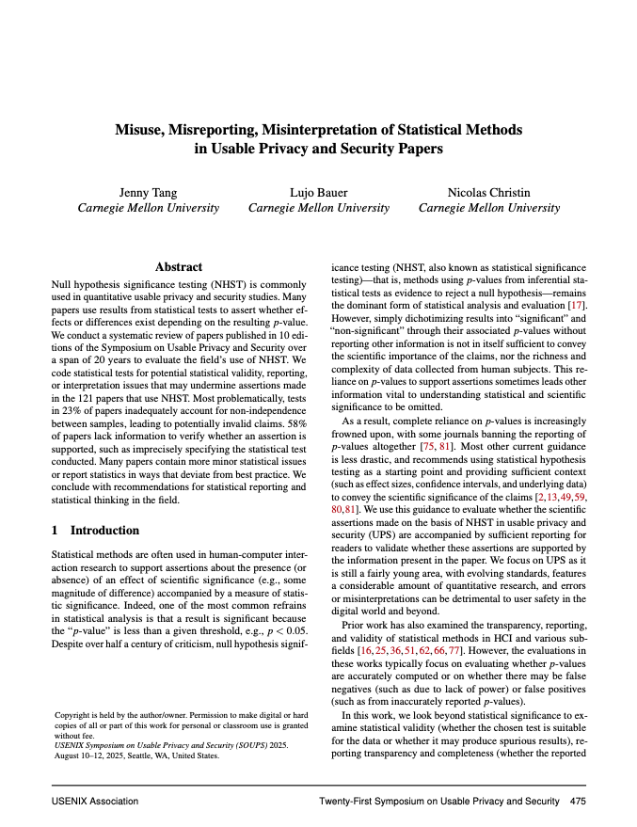
Recommended Readings
Primary Textbook (Franke):
Section 16.2 — p-values
Section 16.6.1 — Chi-square
Section 12.1 — Linear regression
Section 15.2 — Logistic regression
(Seltman better)
Secondary Textbook (Seltman):
Chapter 6.2 — Hypothesis testing
Chapter 9 — Linear regression
Chapter 16.2-16.3 — Chi-square and logistic regression
Notes:
These are the key readings. The full reference list is in your course outline.
Tang et al. (SOUPS 2025) is also highly recommended for understanding statistical pitfalls.

