Slide 1
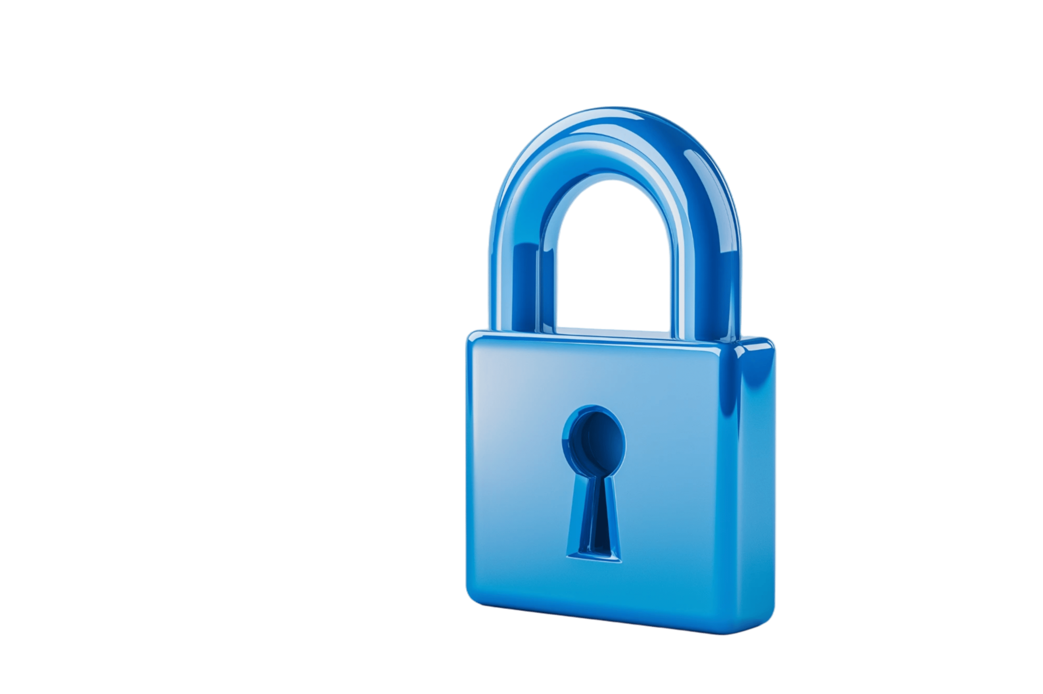

Empirical Security & Privacy, for Humans
UPenn CIS 7000-010
10/14/2025
Ethics in security research;
Password managers & security

Slide 2
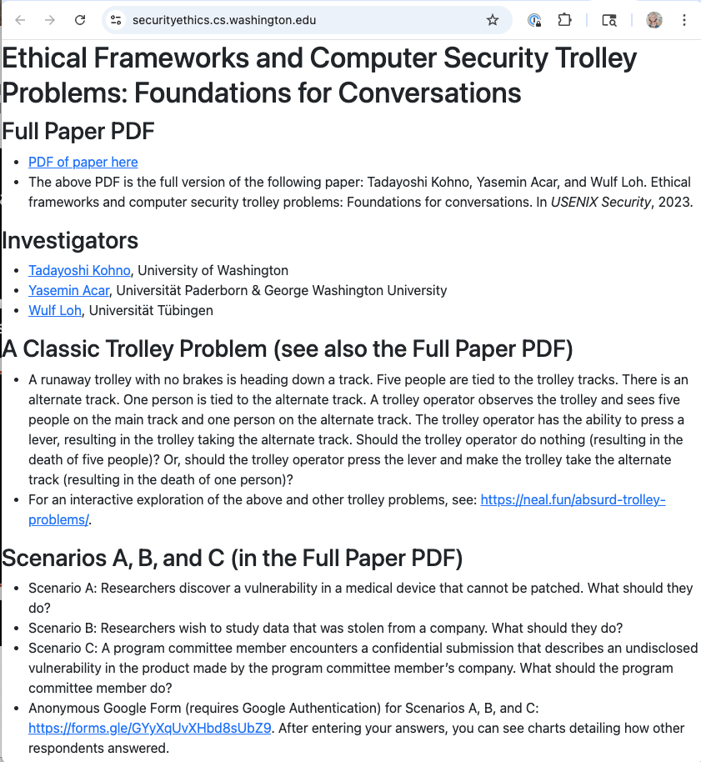
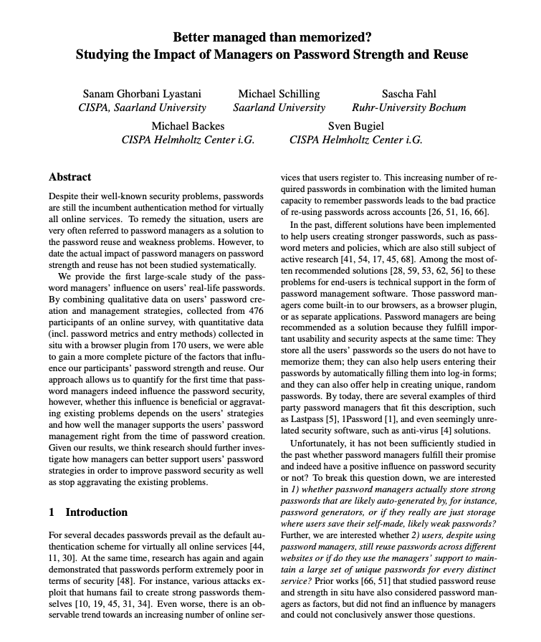
Readings

Slide 3
Readings

Slide 4



A Classic Dilemma: The Trolley Problem
Do Nothing
Trolley Heading Down Track
Trolley Operator Must Decide
Change Tracks
The Trolley Problem is a classic thought experiment / ethical dilemma (Philippa Foot).
A runaway trolley with no brakes is heading straight. Five people are tied to those tracks. One person is tied to an alternate set of tracks.
Should the operator do nothing (five people die) or change the path of the trolley (one person dies)?
These slides based on slides by the paper’s authors; used with permission
https://securityethics.cs.washington.edu/

Slide 5

Scenario A: Medical Device Vulnerability
(some details may not reflect reality)
Not Disclose
Vulnerability Discovered by Researchers; company is out of business
Researchers deem vuln not exploitable
Disclose
If not disclosed: Patients have no awareness that their device is vulnerable; patients keep and/or proceed with obtaining device and receive significant health benefits
If disclosed: Patients have the choice to not receive or to remove the device; risk of psychological harm if patients know they have a vulnerable device (even if chance of exploitation is zero); risk of health harm if patients do not receive / remove the device
Notes:
Company A produces a lifesaving wireless implantable medical device. It is the only device of its type on the market. When a patient receives this device, it will (on average) extend their lifespan by 10 years
Company A goes bankrupt because the condition is rare and not many people use the device. However, there are many devices still available (already produced), many devices are already implanted in patients, and doctors still implant the (now unsupported) device in new patients that need it
Later, researchers discover a software vulnerability in the device. If exploited, the vulnerability could cause significant harm to the patients. Since Company A no longer exists, the software cannot be updated to address this vulnerability
The likelihood of security compromise is zero (regardless of whether disclosed or not)
Question: What should the researchers do? Disclose the vulnerability to the public? Not disclose the vulnerability to anyone? Talk with the FDA?

Slide 6

Scenario B: Immorally-Obtained Data
(some details may not reflect reality)
Do Not Study
Stolen Jobs Data Becomes Public
Researchers want to study it
Study
If not studied: The stolen data is from people; in choosing this option, the researchers would not have further violated their privacy and their right to informed consent
If studied: Result will help prevent future job applicants from being harmed by biased or a vulnerable job-to-applicant AI matching system
Notes:
Company B matches employers (jobs) with job applicants; the company is growing rapidly and will have 100x more job applicants in five years
Job application packets are confidential, as are some job-specific questions
Company B’s AI job-to-applicant matching system is suspected to have racial and gender biases
Company B is compromised and the entirety of their data (all past jobs, all past application packets, internal ML model) is stolen
Researchers wish to study the stolen data, to scientifically measure racial and gender biases and, if biases are found, measure the impacts of biases on past job applicants
The researchers also wish to study the data and assess whether the AI system is vulnerable to adversarial manipulation, which could also negatively impact future job applicants
The researchers plan to propose technical and policy mechanisms to mitigate any issues (e.g., biases, vulnerabilities) that they uncover; removing biases means that more people will be connected with jobs (for our analysis, we assume that removing biases does not make it harder for other people to get jobs)
Many job applicants have publicly stated a desire that the stolen data be permanently erased, everywhere
The researchers obtained a copy of the data while still publicly available and, if they study the data, must retain a copy for use in results validation in case their results are challenged (e.g., challenged by Company B)
Question: Should the researchers study this data?

Slide 7

Scenario C: Inadvertent “Disclosure”
(some details may not reflect reality)
Do Not Report
Undisclosed Vulnerability Submitted in Research Paper
Report
Vuln owner on PC reads the paper
If not reported: Confidentiality of PC process preserved; authors have agency over when and how they disclose
If reported: Company C checks to see if the vulnerability is already being exploited; Company C can immediately begin working on solutions to protect their users; users’ security, privacy, and safety will be protected before the vulnerability becomes public
Notes:
A research paper is submitted to a top peer-reviewed conference; the paper details the discovery of a previously undisclosed vulnerability in the product from Company C
The authors write in their paper that they will soon disclose to Company C
The authors do not want to disclose to Company C until after the paper has been officially accepted
A person from Company C is on the program committee
The program committee chairs required all program committee members to explicitly agree to maintain the confidentiality of submissions and not discuss them outside of the program committee; Company C agreed that the employee could agree to this program committee membership requirement
That person (not necessarily a reviewer) reads the paper and realizes that the vulnerability can lead to serious harms if exploited
Question: What should the person from Company C do? Disclose the vulnerability internally? Search to see if it is actively being exploited? Wait until the paper is accepted? What should they do if the paper is rejected? Does the answer change if they were asked to be a reviewer? Should they be asked to review the paper? Should they be allowed to review it?

Slide 8
How to evaluate these choices?
Review them using moral / ethical frameworks
Ethics: The academic / professional engagement with moral questions
Morality: The scope of this engagement, i.e., the sum of all moral considerations, what we owe each other, e.g., not to harm others, respect their rights
E.g., use ethics to determine if something (e.g., an action) is moral

Slide 9
Consequentialist Ethics (Utilitarianism)
Focuses on consequences of actions, policies, institutions
Utilitarianism: example of consequentialism in which consequences are measured with respect to well-being
Different instances of utilitarianism take different definitions for well-being:
Hedonic utilitarianism: Actions are morally right if they promote the greatest happiness for the greatest number of people
Objective list utilitarianism: Actions are morally right if they promote the greatest benefits from an objective list for the greatest number of people (e.g., health, wealth, access to resources)
To assess, count numbers and weigh benefits / harms, e.g., five deaths are worse than one → consequentialists would change the trolley’s tracks

Slide 10
Deontological Ethics (Fundamental Rights)
Deontological ethics focuses on the moral duties of a moral actor, e.g., an individual or institution
People have fundamental rights; moral actors have a duty to respect those rights
Example rights: The right to privacy, the right to self-agency, the right to informed consent
Kantian deontological ethics: One should not violate any single person’s rights in order to accomplish another objective
Kant in describing this “Categorical Imperative”: human beings should be treated as “ends and never purely as means”
Changing the trolley tracks would violate one person’s right (their right to live) in order to accomplish the saving of five other lives; changing the track would use that single person as an “means”, not as an “ends”; under Kantian deontological ethics → do not change the trolley’s tracks
Notes:
One historical example is Divine Command and the duty to fulfill God’s will.
Most famously, Kantian ethics derives the moral duties from the faculty of reason that human beings have: because we can reason about what to do and thus control our desires, we have the obligation to do so in order to become autonomous (giving ourselves the moral law). And, since we are all potentially autonomous, we have a duty to treat all other human beings as such, i.e., as “ends and never purely as means” in Kant’s words.
Natural rights theories, on the other hand, take the idea that human beings as moral actors have certain faculties and justify natural (i.e., unalienable) rights
Paper makes the simplified assumption that deontological ethics conducts moral evaluation in the form of (individual or collective) duties and corresponding (individual) rights, that are spelled out in (absolute) terms of right or wrong

Slide 11
Scenario A: Medical Device Vulnerability
(some details may not reflect reality)
Not Disclose
Vulnerability Discovered by Researchers; company is out of business
Researchers deem vuln not exploitable
Disclose
Researchers find a vulnerability in a medical device; device manufacturer is out of business. Should the researcher disclose the vulnerability to doctors, patients, and the public? Should the researchers keep the vulnerability secret?

Slide 12
Scenario A: Medical Device Vulnerability
(some details may not reflect reality)
Not Disclose
Vulnerability Discovered by Researchers; company is out of business
Researchers deem vuln not exploitable
Disclose
Consequentialist Ethics: Likelihood of exploit is zero; harms if patients informed (health: remove device / not get device; happiness: live with knowledge that the device has faults) → do not disclose vulnerability

Slide 13
Scenario A: Medical Device Vulnerability
(some details may not reflect reality)
Not Disclose
Vulnerability Discovered by Researchers; company is out of business
Researchers deem vuln not exploitable
Disclose
Deontological Ethics: Duty to respect people’s right to informed consent (e.g., warnings on medicine ads) and right to self-agency (make their own decisions about what is best for them) → disclose vulnerability

Slide 14
Scenario B: Immorally-Obtained Data
(some details may not reflect reality)
Do Not Study
Stolen Data Becomes Public
Researchers want to study it
Study
Adversaries stole data from a job-to-applicant matching system, which includes significant private information about job applicants. Should researchers study that data if doing so doing so can benefit future job applications (e.g., decrease future racial and gender biases and the risk of manipulation in the job-to-applicant matching AI)?
Notes:
Company B matches employers (jobs) with job applicants; the company is growing rapidly and will have 100x more job applicants in five years
Job application packets are confidential, as are some job-specific questions
Company B’s AI job-to-applicant matching system is suspected to have racial and gender biases
Company B is compromised and the entirety of their data (all past jobs, all past application packets, internal ML model) is stolen
Researchers wish to study the stolen data, to scientifically measure racial and gender biases and, if biases are found, measure the impacts of biases on past job applicants
The researchers also wish to study the data and assess whether the AI system is vulnerable to adversarial manipulation, which could also negatively impact future job applicants
The researchers plan to propose technical and policy mechanisms to mitigate any issues (e.g., biases, vulnerabilities) that they uncover; removing biases means that more people will be connected with jobs (for our analysis, we assume that removing biases does not make it harder for other people to get jobs)
Many job applicants have publicly stated a desire that the stolen data be permanently erased, everywhere
The researchers obtained a copy of the data while still publicly available and, if they study the data, must retain a copy for use in results validation in case their results are challenged (e.g., challenged by Company B)
Question: Should the researchers study this data?

Slide 15
Scenario B: Immorally-Obtained Data
(some details may not reflect reality)
Do Not Study
Stolen Data Becomes Public
Researchers want to study it
Study
Consequentialist Ethics: Benefits of studying the data to society and to future job applicants is high; the data was already made “public”, which itself caused harms, but the study of the data does not create new harms → study the data
Notes:
Company B matches employers (jobs) with job applicants; the company is growing rapidly and will have 100x more job applicants in five years
Job application packets are confidential, as are some job-specific questions
Company B’s AI job-to-applicant matching system is suspected to have racial and gender biases
Company B is compromised and the entirety of their data (all past jobs, all past application packets, internal ML model) is stolen
Researchers wish to study the stolen data, to scientifically measure racial and gender biases and, if biases are found, measure the impacts of biases on past job applicants
The researchers also wish to study the data and assess whether the AI system is vulnerable to adversarial manipulation, which could also negatively impact future job applicants
The researchers plan to propose technical and policy mechanisms to mitigate any issues (e.g., biases, vulnerabilities) that they uncover; removing biases means that more people will be connected with jobs (for our analysis, we assume that removing biases does not make it harder for other people to get jobs)
Many job applicants have publicly stated a desire that the stolen data be permanently erased, everywhere
The researchers obtained a copy of the data while still publicly available and, if they study the data, must retain a copy for use in results validation in case their results are challenged (e.g., challenged by Company B)
Question: Should the researchers study this data?

Slide 16
Scenario B: Immorally-Obtained Data
(some details may not reflect reality)
Do Not Study
Stolen Data Becomes Public
Researchers want to study it
Study
Deontological Ethics: People have a right to privacy and informed consent; rights extend to data intended to be private even if researchers have access; impacted job applicants explicitly requested the data to be deleted; while studying data could improve the rights of future job applicants, doing so would be at the expense of the rights of those impacted by the data breach → do not study the data
Notes:
Company B matches employers (jobs) with job applicants; the company is growing rapidly and will have 100x more job applicants in five years
Job application packets are confidential, as are some job-specific questions
Company B’s AI job-to-applicant matching system is suspected to have racial and gender biases
Company B is compromised and the entirety of their data (all past jobs, all past application packets, internal ML model) is stolen
Researchers wish to study the stolen data, to scientifically measure racial and gender biases and, if biases are found, measure the impacts of biases on past job applicants
The researchers also wish to study the data and assess whether the AI system is vulnerable to adversarial manipulation, which could also negatively impact future job applicants
The researchers plan to propose technical and policy mechanisms to mitigate any issues (e.g., biases, vulnerabilities) that they uncover; removing biases means that more people will be connected with jobs (for our analysis, we assume that removing biases does not make it harder for other people to get jobs)
Many job applicants have publicly stated a desire that the stolen data be permanently erased, everywhere
The researchers obtained a copy of the data while still publicly available and, if they study the data, must retain a copy for use in results validation in case their results are challenged (e.g., challenged by Company B)
Question: Should the researchers study this data?

Slide 17
Scenario C: Inadvertent “Disclosure”
(some details may not reflect reality)
Do Not Report
Undisclosed Vulnerability Submitted in Research Paper
Report
Vuln owner reads the paper
Researchers submit a paper with an undisclosed vulnerability in the product from Company C to a peer-reviewed conference. An employee at Company C is on the conference program committee. Should the employee disclose the vulnerability to their company?
Notes:
A research paper is submitted to a top peer-reviewed conference; the paper details the discovery of a previously undisclosed vulnerability in the product from Company C
The authors write in their paper that they will soon disclose to Company C
The authors do not want to disclose to Company C until after the paper has been officially accepted
A person from Company C is on the program committee
The program committee chairs required all program committee members to explicitly agree to maintain the confidentiality of submissions and not discuss them outside of the program committee; Company C agreed that the employee could agree to this program committee membership requirement
That person (not necessarily a reviewer) reads the paper and realizes that the vulnerability can lead to serious harms if exploited
Question: What should the person from Company C do? Disclose the vulnerability internally? Search to see if it is actively being exploited? Wait until the paper is accepted? What should they do if the paper is rejected? Does the answer change if they were asked to be a reviewer? Should they be asked to review the paper? Should they be allowed to review it?

Slide 18
Scenario C: Inadvertent “Disclosure”
(some details may not reflect reality)
Do Not Report
Undisclosed Vulnerability Submitted in Research Paper
Report
Vuln owner reads the paper
Consequentialist Ethics: Possible harms to authors if employee of Company C discloses vulnerability to Company C; significant benefits to Company C’s users if the employee discloses vulnerability to Company C; the benefits / harms must be weighed → Employee of Company C should report the vulnerability to Company C
Notes:
A research paper is submitted to a top peer-reviewed conference; the paper details the discovery of a previously undisclosed vulnerability in the product from Company C
The authors write in their paper that they will soon disclose to Company C
The authors do not want to disclose to Company C until after the paper has been officially accepted
A person from Company C is on the program committee
The program committee chairs required all program committee members to explicitly agree to maintain the confidentiality of submissions and not discuss them outside of the program committee; Company C agreed that the employee could agree to this program committee membership requirement
That person (not necessarily a reviewer) reads the paper and realizes that the vulnerability can lead to serious harms if exploited
Question: What should the person from Company C do? Disclose the vulnerability internally? Search to see if it is actively being exploited? Wait until the paper is accepted? What should they do if the paper is rejected? Does the answer change if they were asked to be a reviewer? Should they be asked to review the paper? Should they be allowed to review it?

Slide 19
Scenario C: Inadvertent “Disclosure”
(some details may not reflect reality)
Do Not Report
Undisclosed Vulnerability Submitted in Research Paper
Report
Vuln owner reads the paper
Deontological Ethics: The program committee member may feel a sense of duty to Company C and their users; program committee members also have duty to respect the autonomy of authors and the confidentiality of the peer review process; the employee agreed to respect this duty when they joined the program committee, as did Company C’s leadership team; if breaking the confidentiality of the peer review process is allowed, the whole institution of the peer review process would not be possible → Company C employee should not report the vulnerability to Company C
Notes:
A research paper is submitted to a top peer-reviewed conference; the paper details the discovery of a previously undisclosed vulnerability in the product from Company C
The authors write in their paper that they will soon disclose to Company C
The authors do not want to disclose to Company C until after the paper has been officially accepted
A person from Company C is on the program committee
The program committee chairs required all program committee members to explicitly agree to maintain the confidentiality of submissions and not discuss them outside of the program committee; Company C agreed that the employee could agree to this program committee membership requirement
That person (not necessarily a reviewer) reads the paper and realizes that the vulnerability can lead to serious harms if exploited
Question: What should the person from Company C do? Disclose the vulnerability internally? Search to see if it is actively being exploited? Wait until the paper is accepted? What should they do if the paper is rejected? Does the answer change if they were asked to be a reviewer? Should they be asked to review the paper? Should they be allowed to review it?

Slide 20
Discussion
What do you think about the scenarios, and how they were made?
How would you approach these situations? What would you decide?
How has reading about these problems made you think about ethical choices or judgments you might make
as a researcher / paper author
as a research reviewer / committee member
as a reader
What are the limitations of what’s presented?
Is this methodology useful in other fields?

Slide 21
Their recommendations
Researchers: Ethics modeling, to help decisionmaking
Identify stakeholders, identify assets, specifically identify benefit/harm, rights/duties.
PC members: Not only whether right/wrong, but why
Community: How to build supports for good decisions

Slide 22
Readings

Slide 23
Activities of password management
Password creation – with algorithm, by hand, using service, ...
Password storage – memorized, in file, in service, …
Password entry – typed, cut&paste, auto-filled, …
Password managers can handle some/all of these activities, potentially improving security
Creating passwords that are difficult to guess (and hard to remember)
Reducing password reuse

Slide 24
Impact of password managers on security
RQ: Impact of password managers on password strength and reuse?
Data collected: Survey on Mechanical Turk, then data collection from some of these about password management using a Chrome plugin
Plugin used for four days
Data analysis: Correlate factors against measures of password strength and occurrences of reuse
Factors include how exactly password managers were used or not used
Allows relating to baselines, identifying key aspects of success

Slide 25
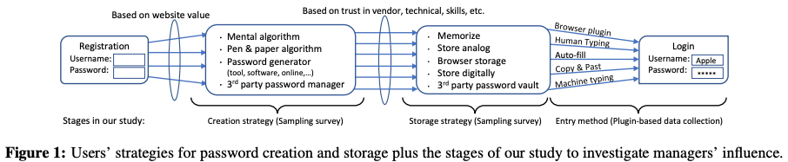
Activities of password management
Password creation – with algorithm, by hand, using service, ...
Password storage – memorized, in file, in service, …
Password entry – typed, cut&paste, auto-filled, …

Slide 26
Survey questions
31-34 questions, in six groups
general privacy attitude,
their attitude towards passwords,
their skills and strategies for creating and managing passwords, including
an assessment of the strength of a sample of passwords
whether they admit to reusing passwords
which password manager they use (if any)
basic demographic questions
attention check questions
Qualitative answers independently coded

Slide 27
Plugin implementation: Measuring effects
To determine password strength, measured:
Shannon entropy
NIST entropy
zxcvbn score, ranges 0 to 4 – intends to correlate with “crackability”
To determine (partial) reuse: Stored keyed hashes of passwords
Key stored locally
Hash on full password and on every 4-character substring
Notes:
Plugin collects the hash of the entered password as well as the hash of every 4-character sub-string of the password. We use a keyed hash (i.e., PBKDF2 with SHA-256), where the key is generated and stored at the client side and never revealed to us. This allows identification of (partially) reused passwords per participant. We use the notions introduced in [51]: Exactly reused passwords are identical with another password, partially reused passwords share a sub-string with another password, and partiallyand-exactly reused passwords have both of those characteristics
Zxcvbn estimates every password’s strength on a scale from 0 (weakest) to 4 (strongest) using pattern matching (e.g., repeats, sequences, keyboard patterns), common password dictionaries (including leaked passwords, names, English dictionary words), and mangling rules (e.g., leetify).
To participants: request to re-login to all websites where they have an account in order to ensure a sufficient enough quantity of collected data.

Slide 28
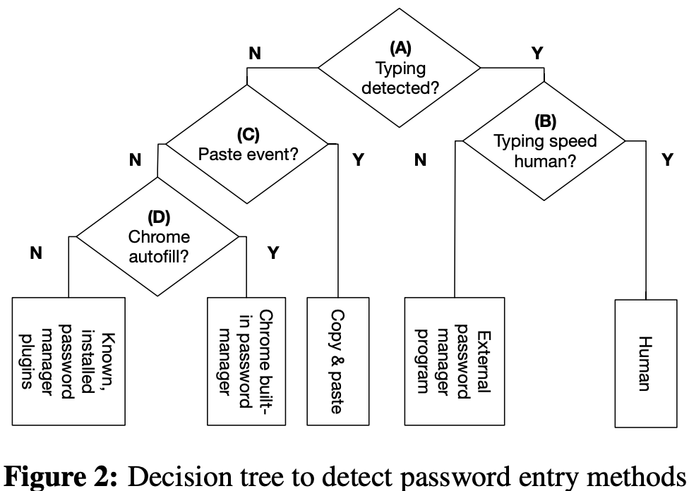
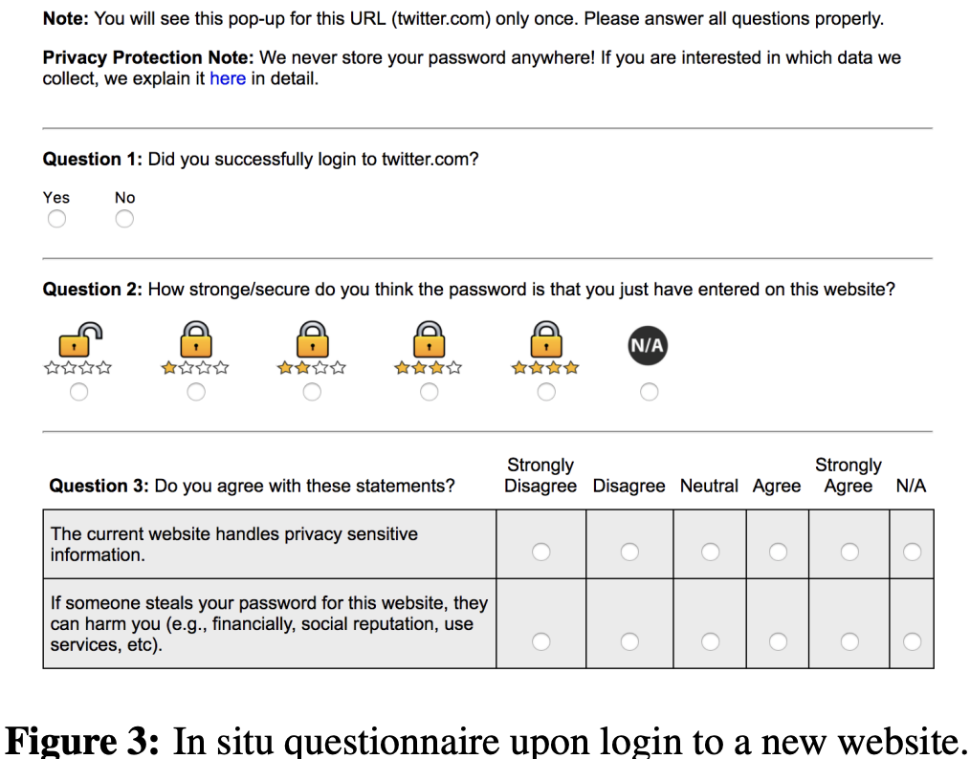
Plugin implementation: Measuring factors

Slide 29
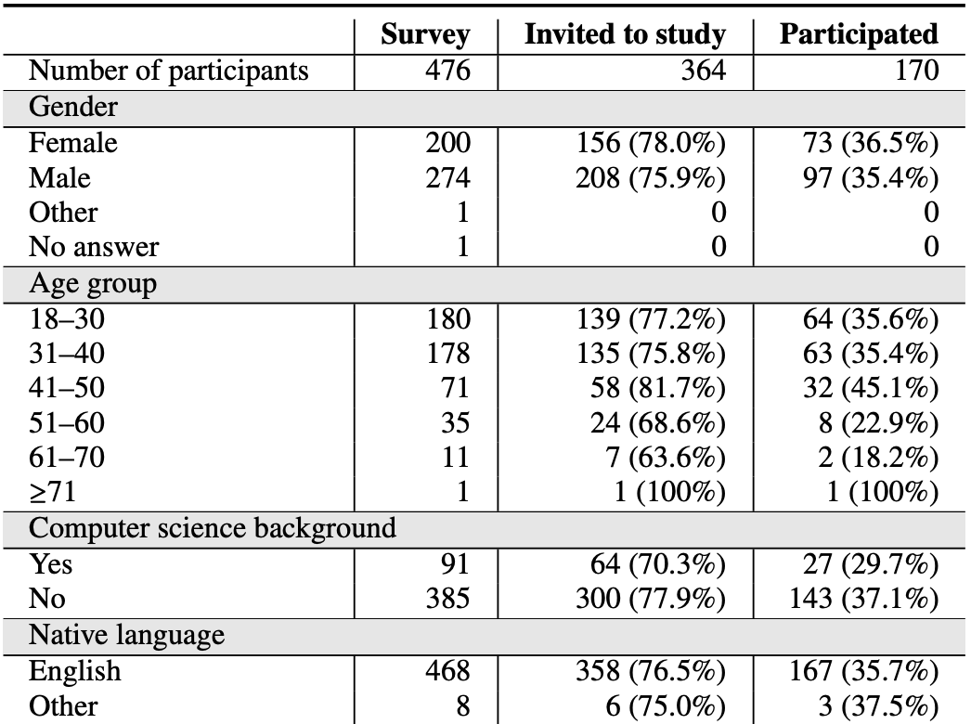
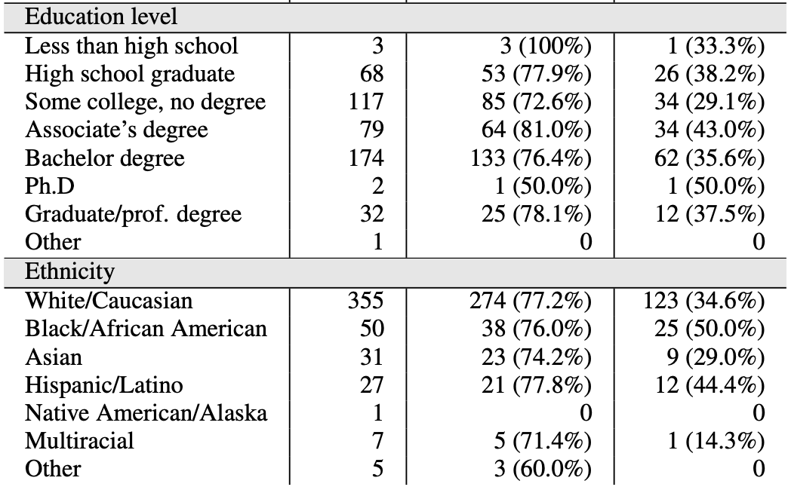
Study participants from Mechanical Turk
Notes:
No statistically significant differences between survey pop and plugin study group
Closer to University demographics, rather than 2010 US Census
Based on a couple of measures, not concerned about participants in plugin study being overly concerned

Slide 30
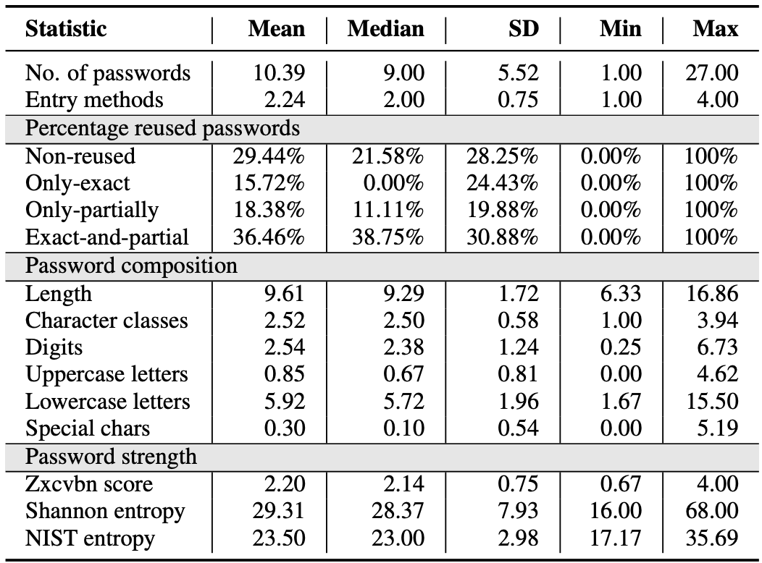
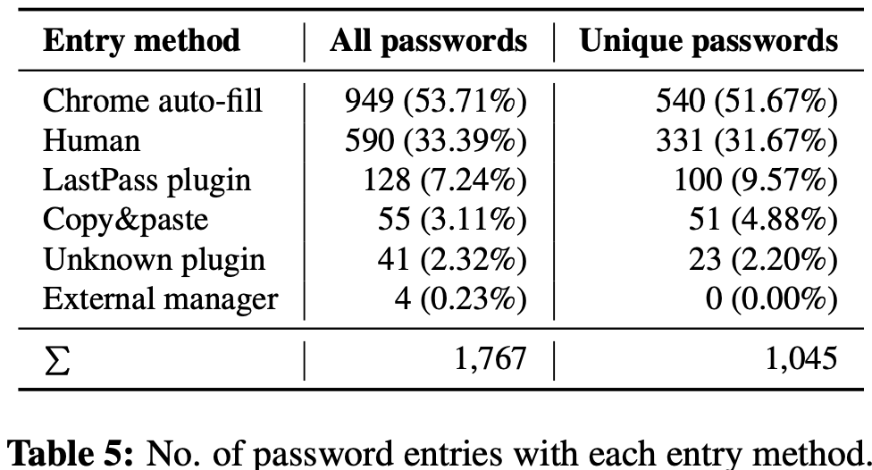
Summary statistics
Notes:
For table on left: We first computed means for each participant and then computed the mean, median, standard deviation, and min/max values of those means.
we observe a significant correlation between password strength and reuse (chi-square test: χ2 = 75.48, p < .001).
Only LastPass was used by our participants.

Slide 31
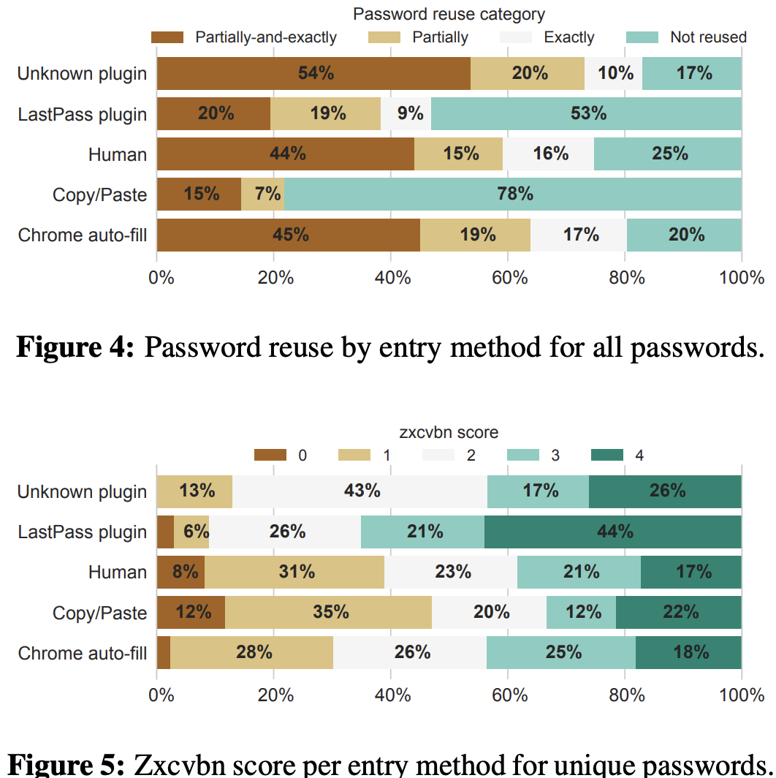
By entry method: Strength and reuse

Slide 32
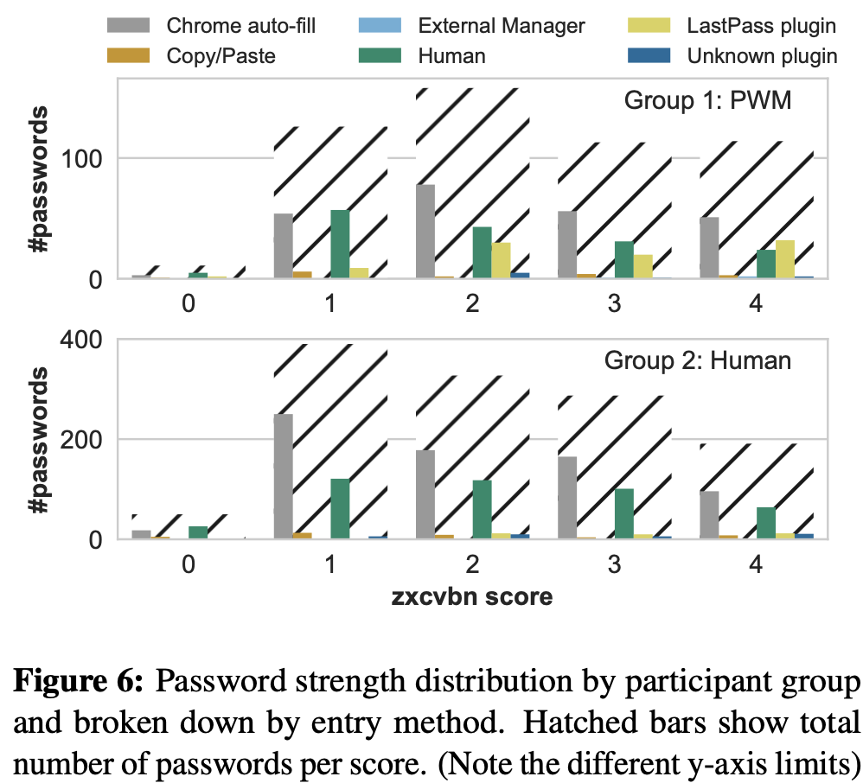
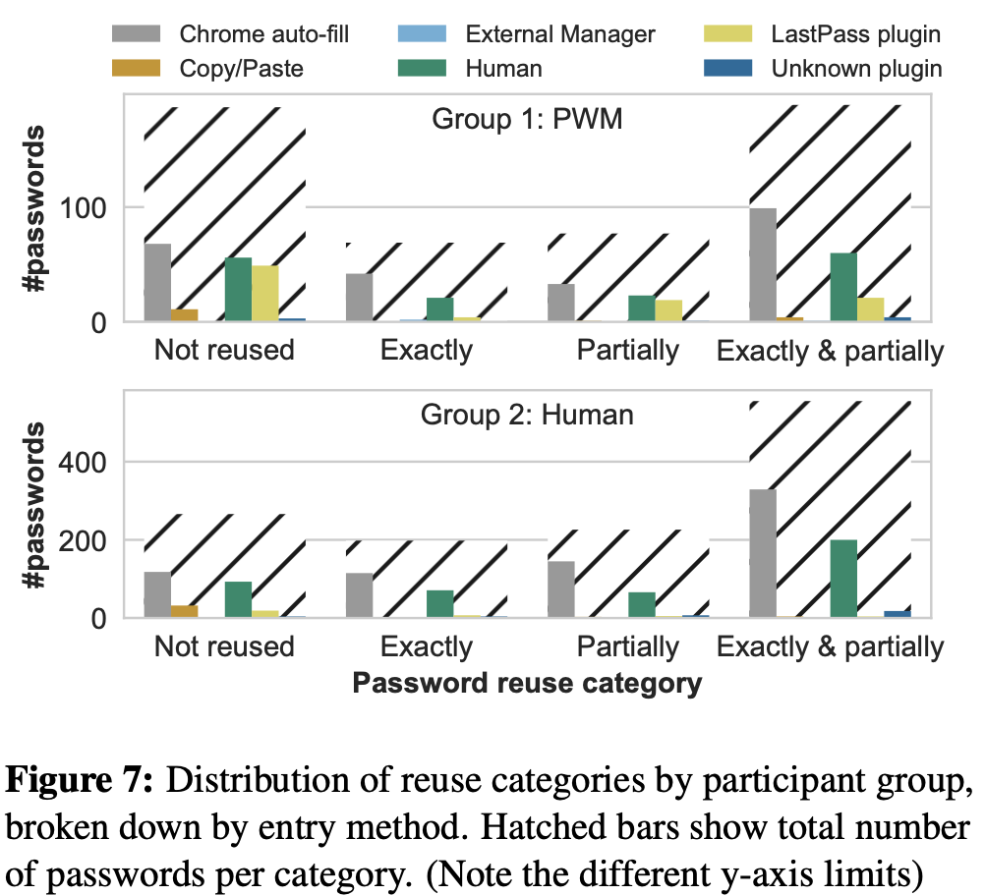
By participant group: Strength and reuse
45
ppl
121
ppl
Notes:
45 used a password generator (not always LastPass)
Remaining 121 (?) used ‘human’ (non-technical) strategy
GroupHuman shows a clear tendency towards weaker passwords.
Our analyses showed that our participants significantly differ from each other in their average password strength (Kruskal-Wallis one-way analysis of variance, χ2 =779.19, df =169, p <.001) as well as in their average probability of password reuse (χ2 = 692.70, d f=169, p <.001).
GroupPWM shows a bimodal distribution in which not-reused passwords are almost as frequent (n =187) as exactly-and-partially reused ones.
The vast majority of reused passwords can be attributed to manual entry and Chrome auto-fill.

Slide 33
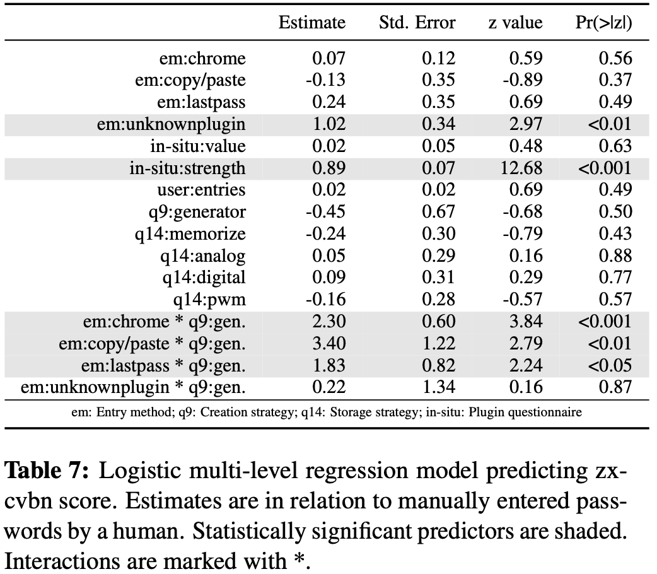
Modeling strength
Creation strategy + EM significant together, but not individually
So: using such a password management tool only leads to significant improvement in the password strength when users also employ some supporting techniques (password generator) for the creation of their passwords
Self-reported password strength was a significant predictor of the measured password strength
Ordinal
Notes:
Did a correlation analysis to figure out which factors to drop, up front
In three steps we included a) entry methods, self-reported value, and strength; b) the number of individually submitted passwords per participant, the creation and storage strategy of the user; in a final step c) the interaction between creation strategy and detected entry method (two-way interaction).
we computed the model fit and used log likelihood model fit comparison (AIC?) to check whether the new, more complex model fit the data significantly better than the previous one. Kept the best one.
For zxcvbn, the ordinal model with all predictors and also the mentioned interaction described our data best

Slide 34
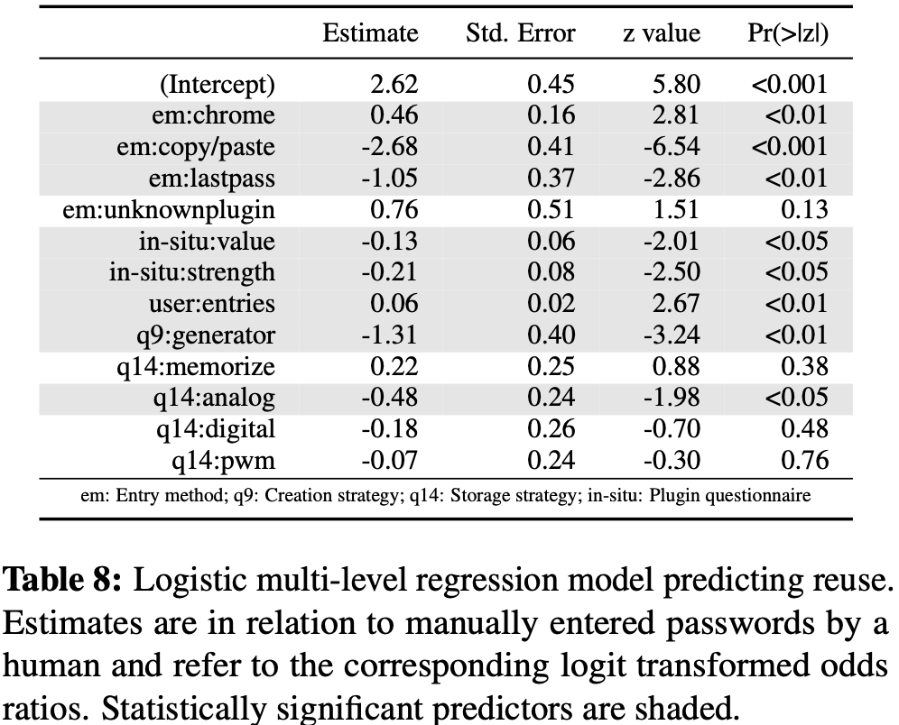
Modeling reuse
Reuse was significantly influenced by the entry method of the password
Odds for reuse were 2.85 times lower by LastPass, 14.29 times lower if C&P
odds for reuse were 1.65 times higher by Chrome auto-fill
Creation by alg: odds of non-reuse 3.70 times higher
More passwords → greater odds of reuse
Higher-value website → lower odds of reuse
Notes:
For password reuse a logistical model with all predictors but without interactions described our data best.
Paper reported odds ratios but these are not shown in the table. Not obvious how to compute them from the numbers reported in the table either. Sigh.

Slide 35
Bottom line
Users that rely on technical support for password creation had both stronger and more unique passwords
Even if entered through other channels than a manager
Chrome’s auto-fill option increased password reuse – more than 80% of Chrome auto-filled passwords were reused
Chrome at the time did not have password generation enabled by default

Slide 36
Discussion points
Do you relate to the usage profiles given in the paper?
Partial or full reuse of passwords?
Different creation strategies and entry strategies?
What has changed since 2018 as far as password managers go, which might affect the results?
Do you have doubts about the validity or generalizability of some of these results? Why?

