Slide 1


Empirical Security & Privacy, for Humans
UPenn CIS 7000-010
10/30/2025
Are Cyber Defenders Winning?

Slide 2
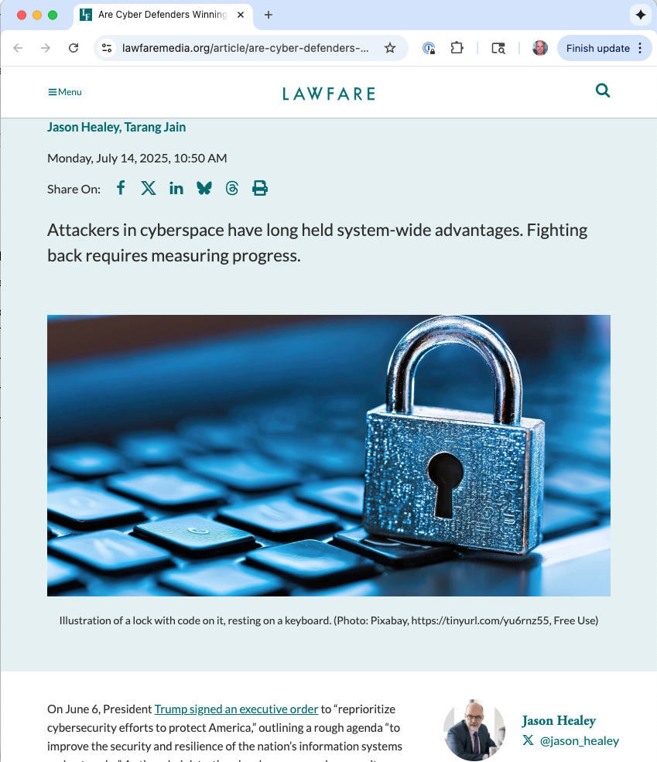
Reading

Slide 3
Are cyber defenders winning?
Definition of winning: Shifting systemic advantages away from attackers
Problem: How to measure it?
Notes:
Click:
Before networking, defenders had the advantage: Lock the door and vet those with access and your computer would be “acceptably resistant to external attack, accidental disclosures, [and] internal subversion.”
The internet exacerbated network-facing vulnerabilities, and as early as 1988 security experts realized that “to a first approximation, every computer in the world is connected with every other computer.”
Other system-wide disadvantages compounded the problem, e.g., no real consequences for bad software
---
Claim: Most metrics are geared toward individual enterprises, not the whole playing field
Whole-field metrics lack context
Google observed 97 zero-day vulnerabilities in 2023, over 50 percent more than 2022. Does such an increase of zero-days mean defenders are doing better, or worse? What was the consequence of the exploitations? How many exploits vs. attempted exploits?

Slide 4
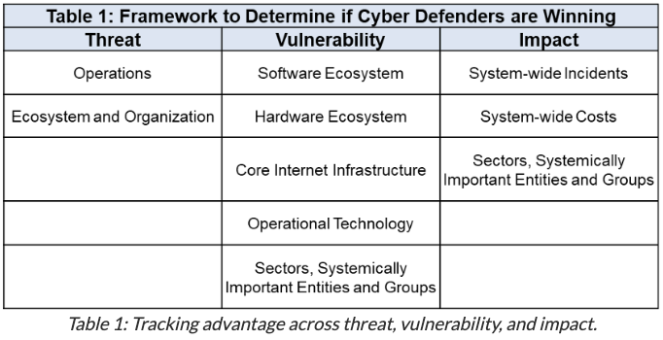
Two principles, and a framework
Rely on data from those who are already collecting it, with scale and quality
Place that data into a context of logical propositions, to present a narrative of shifting advantages over time
Connect data to explanatory hypotheses, getting closer to proper science
Notes:
What would defenders expect to observe if advantages in threat, vulnerability, and consequence are shifting their way?

Slide 5
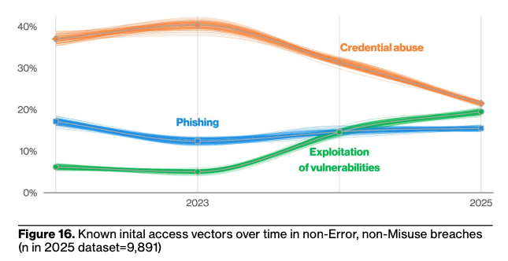
Threat: Operations
Prop: Adversaries need to shift from easier to harder tactics, techniques, and procedures (TTPs)
Source: 2025 Verizon Data Breach Investigation Report

Slide 6
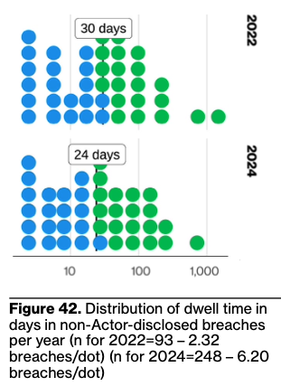
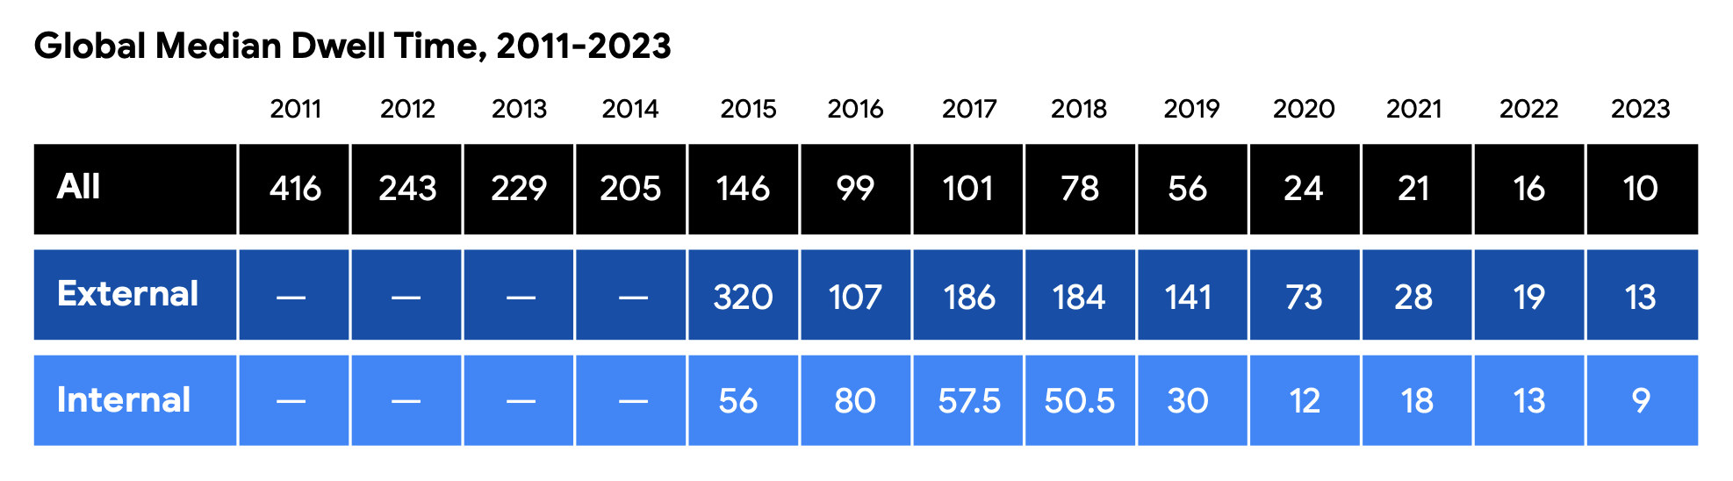
Threat: Operations
Adversaries are more quickly detected and ejected from their footholds within enterprises
Source: 2024 Mandiant M-Trends Special Report
Source: 2025 Verizon Data Breach Investigation Report

Slide 7
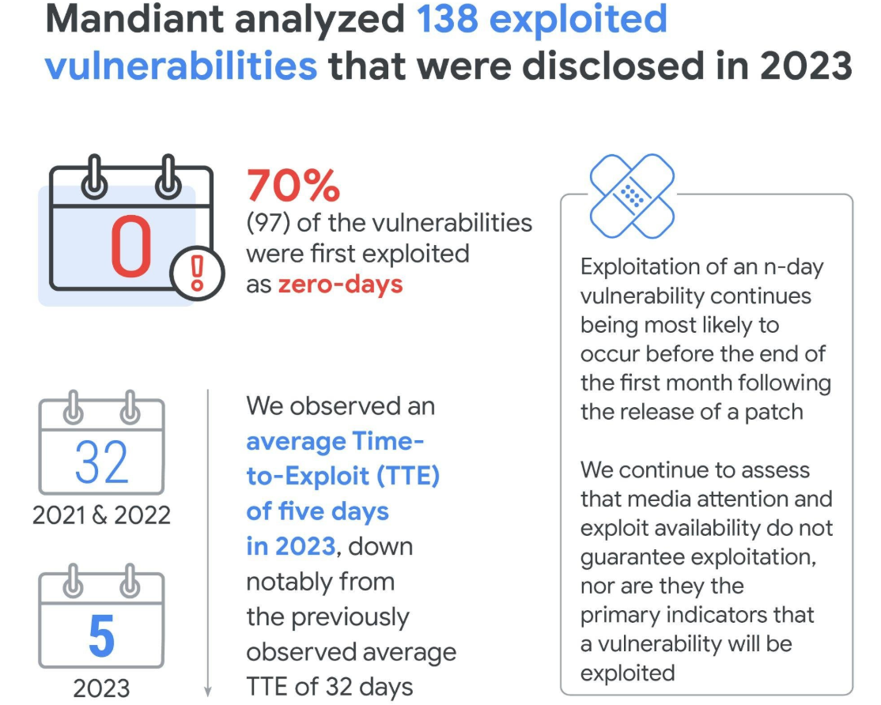
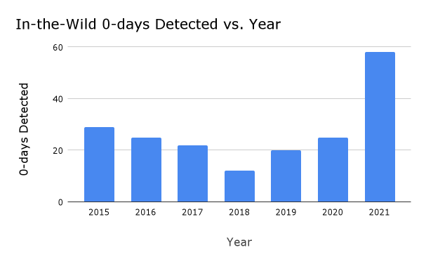
Threat: Operations
Adversaries need to shift from easier to harder tactics, techniques, and procedures (TTPs)
Source: Mandiant 2024 Threat Intelligence Report
Attackers cannot keep exploiting the same vulnerabilities year after year
Source: Google Project Zero

Slide 8
Threat: Operations Other logical properties
Adversaries need to rapidly update their TTPs
Attackers must constantly rebuild their infrastructure
More enterprises (and their key security vendors) detect adversaries themselves
DATA

Slide 9
Threat: Organization and Ecosystem
If defenders are succeeding, then threat actors have lower profits.
As a consequence of lower profits, threat actors become consolidated into larger, more capable groups.
There is decreased trust between threat-actor groups, as they are targeted and infiltrated.
Threat actors struggle to find talent: too risky
DATA
Notes:
For example, reporting in early 2024 found that ransomware gangs were struggling, “recruit[ing] highly skilled (and scarce) contractors” and “almost desperate in terms of the ability to continue operations.”
- But this could be because there is so much money to be made, and not enough people for different groups to recruit?
Unable to compete, the weakest adversaries will go “extinct,”

Slide 10
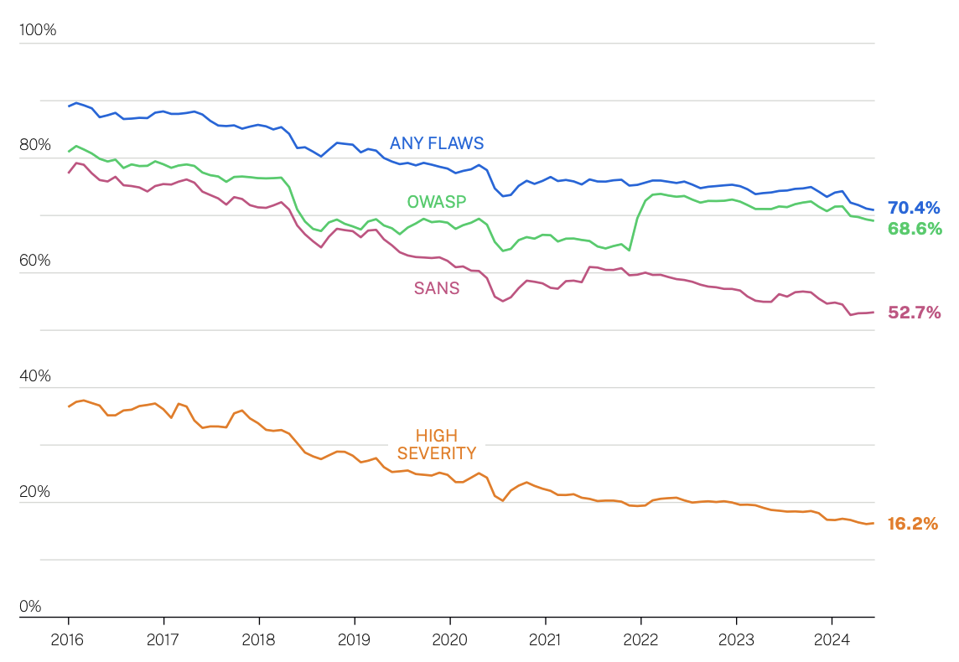
Vulnerability: Software
Vulnerabilities will be less stubborn as users patch more quickly, at scale
Vulnerabilities will be less severe and less easily exploited by adversaries
Cobalt (pen testing co.):
The proportion of serious findings in pentests has declined from 20% to 11% over 10 years
Since 2017, the median time to resolve serious vulnerabilities has decreased from 112 days down to 37 days
Source: Veracode 2025 Annual Report on the State of Application Security
Notes:
30 percent reductions in the number of applications with high-severity flaws and in software without a “flaw in an open-source library when they are first scanned.”
Cobalt: However, this progress appears to have plateaued. When we look at the rate for serious findings being resolved in each calendar year, it remains stuck at just 55%.

Slide 11
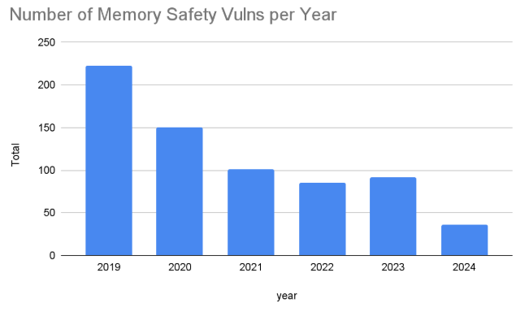
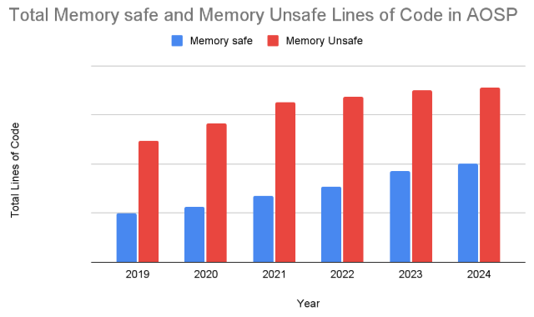

Vulnerability: Software
Vulnerabilities will be more diverse, as vendors improve security-by-design
Source: Google Security Blog

Slide 12
Vulnerability Other logical properties, areas
Software: There will be a reduced tail of abandoned code still used in critical systems
DATA
Notes:
30 percent reductions in the number of applications with high-severity flaws and in software without a “flaw in an open-source library when they are first scanned.”
Cobalt:
However, this progress appears to have plateaued. When we look at the rate for serious findings being resolved in each calendar year, it remains stuck at just 55%.

Slide 13
Impact
Fewer overall cyber incidents.
Fewer records stolen in each incident and in aggregate.
Fewer one-on-multitude and cascading cyber incidents.
Fewer national-security-relevant incidents.
Reduced monetary losses from individual cyber incidents and cumulative economic impact.
Fewer catastrophic cyber incidents.
Fewer direct and indirect deaths from cyber incidents.
Notes:
Metrics for incidents have often mistakenly focused solely on the raw number of them.
The most serious cyber incidents rarely punish just one victim (like North Korea’s attack against Sony Pictures Entertainment in 2014), but thousands or tens of thousands at once (such as with the SQL Slammer, NotPetya, or SolarWinds incidents). As defense improves, these should become rare.
Even if economic costs are decreasing, the consequences may still be high if the remaining incidents have greater national security effects.
There should not just be fewer incidents and lower losses, but fewer high-cost incidents.

Slide 14
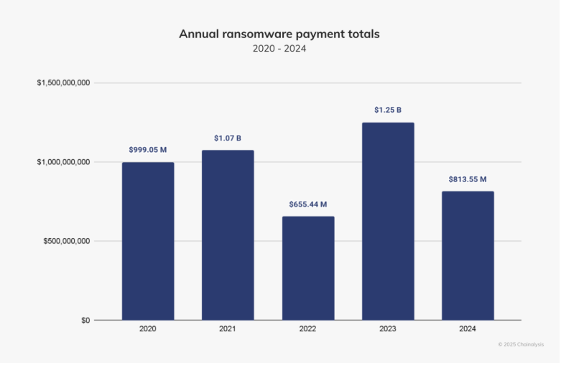
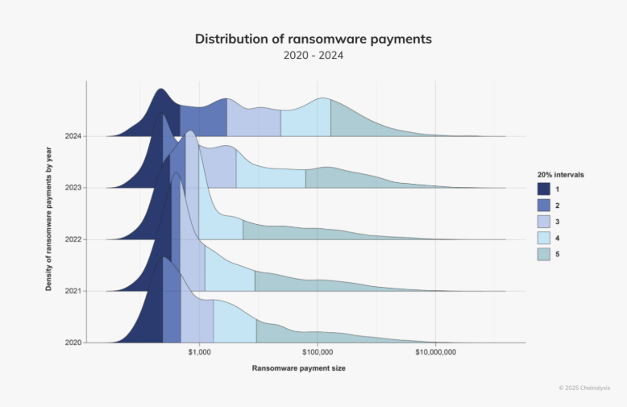
Impact
: Costs
Reduced monetary losses from individual cyber incidents and cumulative economic impact.
Source: Chainanalysis 2025 report
Notes:
Cytentia report: Roughly 30% of all publicly reported security incidents from 2019 through 2023 involved ransomware, earning it a #2 ranking for frequency. Ransomware also ranks #1 for financial impact,
But: Since 2008, the largest companies (the “security one percent” mentioned above) are a third less likely to experience an incident, while small businesses are two times as likely (see Figure E).
companies are reporting 6.5 times more incidents each quarter, a typical firm is 3.7 times more likely to have an incident, median losses per incident are 15.2 times higher, and median losses relative to a firm’s revenue are nearly eight times higher

Slide 15
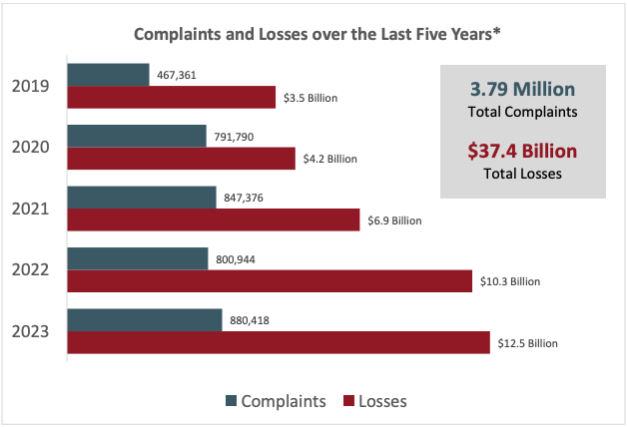
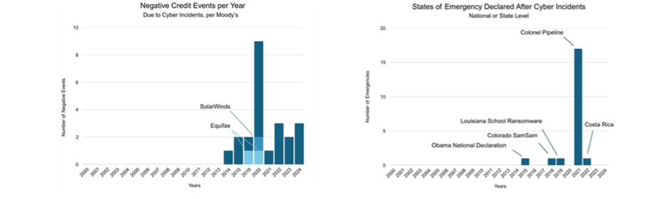
Impact
: Costs
Reduced monetary losses from individual cyber incidents and cumulative economic impact.
Source: Moody’s data, 2025
Source: FBI 2023 Internet Crime Report
Notes:
The number of declared emergencies by a nation or a U.S. state. As shown in Figure H, no emergencies were declared before 2015, but there have been a growing number since, with most declared to mitigate impact to energy distribution from the Colonial Pipelines ransomware attack.

Slide 16
Summing up
Indicators gathered in this report seem to be going both directions:
Vulnerabilities are harder to exploit, with some counts are going down
Some costs are going down, but overall incidents and per-incident costs, remain high
There is a lack of data for many of the logical propositions
Next steps:
Create a more complete catalog of indicators across threat, vulnerability, and consequence
Encourage cybersecurity companies (and others with data) to report defensibility-relevant statistics in time-series, mapped to the catalog
Drive improved analysis and reporting

Slide 17
Discussion questions
What do you think of the overall goal of the work?
How could it be improved, both strategically and tactically?
What data is missing, or most suspect?
Notes:
“shifting advantages” – good idea? Measurement of it the right thing?
- Seems like we are not developing a model that predicts success. Not scientific
“logical propositions” – good idea? Are these the right propositions?
Do we believe these data sources? I wonder how trustworthy the collection methods are, how complete, etc.

