Slide 1
Cyber Risk Engineering
Amanda Draeger
Principal Cyber Risk Engineer @ Liberty Mutual Insurance

Slide 2
Disclaimer
Our risk control services are for informational purposes only. In providing any information or recommending the services of others, we assume no responsibility for management or control of your systems or activities nor for implementation of any recommended corrective measures. Nor do we warrant that any system owned or used by you, directly or indirectly, is secure or that any system or practice complies with any laws, regulations, codes, or standards. We may refer you to one of our trusted service partners. In doing so, we do not warrant or guarantee the work of any provider or third-party. Any information we offer or recommend are not intended to replace any risk control measures you have or should have in place. We will have no liability to you or others in connection with providing or failure to provide information, referring or recommending the services of others, or for your failure to implement any recommended courses of action.

Slide 3

Whoami
Fiber arts enthusiast
Cat mom
Retired Army Sergeant Major
GIAC Security Expert (GSE)
Cyber Risk Engineer

Slide 4
Risk Management
Risk Reduction
Risk Avoidance
Risk Acceptance
Risk Transfer

Slide 5
Risk Transfer
Transfer portion of potential financial consequences from one party to another
Idea started with “mutuals”
Not related to idea of outsourcing risk when you outsource functions
Still obligated to ensure functioning correctly
Expertise may reduce risk, but risk inherently yours

Slide 6
Cyber Insurance Process

Slide 7
Players
Insurance customer
Insurance broker
Insurance carrier(s)
Underwriters
Risk engineers (that’s me!)
Usually CRO, CFO, GC
(not CISO)
Connect customers to carriers
Advocate for customer

Slide 8
Insurance Tower
Less risk, premium, influence
More risk, premium, influence
3rd Excess (31-41M)
1st Excess (11-21M)
Primary (1-11M)
2nd Excess (21-31M)
Retention (0-1M)

Slide 9
Insurance Types
Cyber Insurance
Tech Errors and Omissions (E&O)
1st Party Coverage
3rd Party Coverage

Slide 10

The Challenge
Data is key for making (risk) decisions
Data comes in many forms
Public data vs. Private data
Data quality issues
How do you use data to make better decisions without blindly following the data?

Slide 11
Data-Informed Risk Management

Slide 12
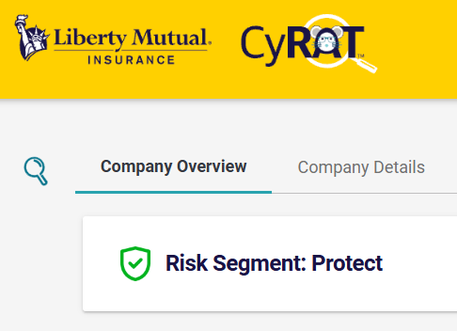
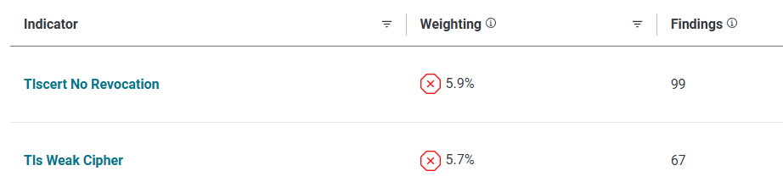
Correlation
Predictive Modeling: five years of data trained to predict claims so that we can learn how things we can see predict the things we can’t

Slide 13
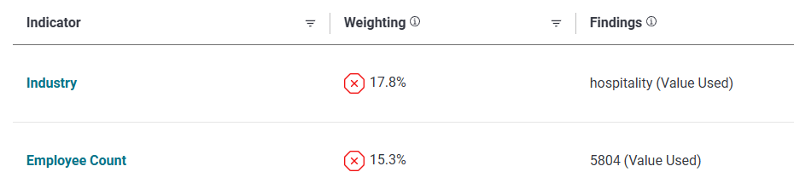
Correlation Challenges
Firmographics Impact: revenue, industry, employee count often the most predictive factors

Slide 14


Correlation Challenges
Visibility: limited to the data that is currently being collected
Lack of Direction: can be difficult to say what organizations should do based on this data, inconsistent model weightings

Slide 15

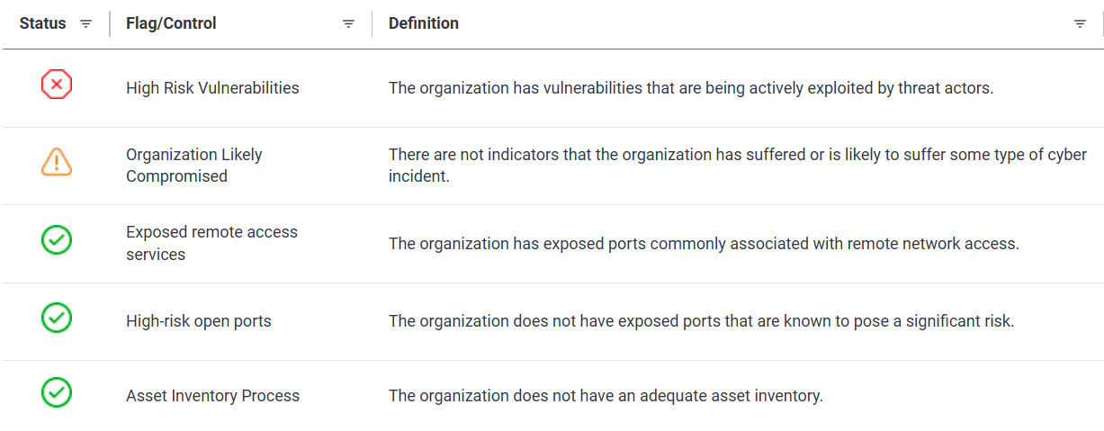
Causation
Consider both Frequency and Severity

Slide 16
Causation Challenges
Automatability: Different data sources are more or less automatable depending on their consistency and format

Slide 17

Expert Opinion
Data exists in conflict with itself; correlation and causation may give different answers
Data lives in the context in which it was generated
Organizational features
Data collection method
Qualitative data (e.g., leadership attitudes)

Slide 18
Correlation
Expert Opinion
Causation
Data-Informed Risk Management

Slide 19
What does the data say???

Slide 20
Frequency
Root cause: read any of the major industry reports
Marsh self-assessment questionnaire: ability to apply critical vulnerabilities in less than 1 week
Firmographics count for a lot
Modeling based on outside-in scans (e.g., by Gallagher Re) tend to focus on correlation, not causation

Slide 21
Severity
Business Interruption
Extended downtime
Fragile supply lines
Consider billing, ERP, other support systems
Data Breach
Regulatory fine vs. trial w/ jury (especially US)
Costs of notification, credit monitoring per person
Possible wrongful collection

Slide 22

How I look at organizations

Slide 23
Liberty Lenses
Threat access
Security Planning & Engineering
Culture
Partner Security
Security Ops & Resilience
Notes:
Enter the Liberty Lenses: Current state of the art is to model on firmographics
And external technographic scans of a company
We think there’s opportunities to improve
Our approach at Liberty Mutual:
Handles complexity well
Handles uncertainty
Handles inconsistency
Works with any data
Informed by data
Shaped by experience
This makes it perfect for large organizations
Though it scales down to small
These are the five lenses through which we see cyber risk

Slide 24
Focus Areas
Threat access
Security Ops & Resilience
Security Planning & Engineering
Partner Security
Culture
Credentials
Corporate Culture
Incident Response
Standards
Who you rely on
Phishing
Corporate Capability
Disaster Recovery
Plan to Standard
Who relies on you
Asset Mgmt. Vulns
Errors
Tactical Intelligence
Measurement to Plan
Bots
Security Engineering

Slide 25
Observables
Keeping in mind our limited inputs
What can we observe?
Self reported vs. externally observable
Correlation vs. causation
Not mutually exclusive
Expectations based on org type, size
Examples:
MFA use
Exposed ports
Exposed vulnerabilities
Security Leader
Budget
IR, BC, DR plans exercised
Policies up-to-date
Roadmap

Slide 26

Conclusions
Risk Management all the way down
Data is a liability
Important to be able to make decisions in the absence of perfect data
Never stop learning

Slide 27

Questions?
https://www.linkedin.com/in/adraeger
@TindrasGrove@infosec.exchange
@tindrasgrove.com
https://tindrasgrove.com/pages/links.html

