Slide 1


Empirical Security & Privacy, for Humans
UPenn CIS 7000-010
11/18/2025
Quantifying Cyber Risk

Slide 2
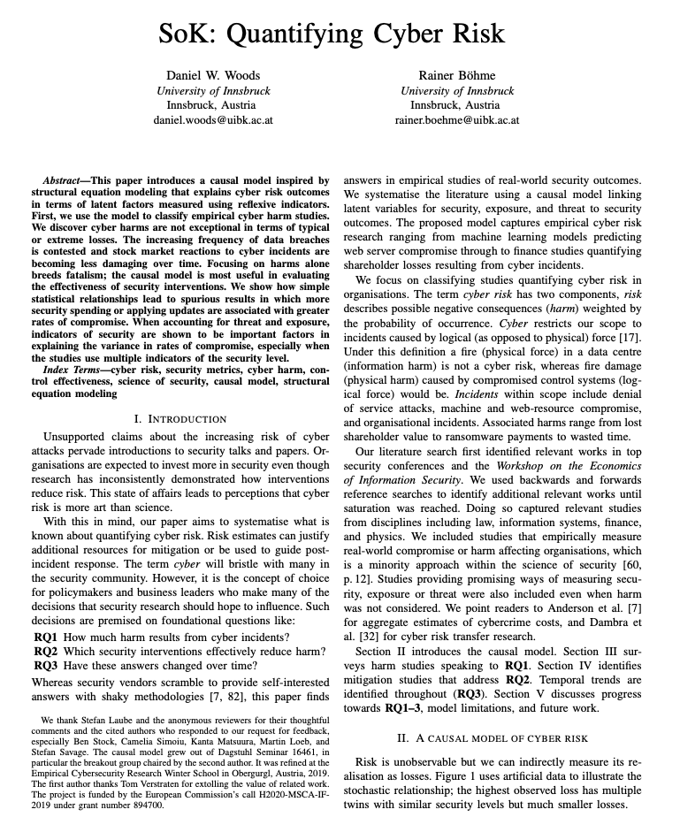
Reading

Slide 3
The problem
Unsupported claims about increasing cyber risk are common
Research inconsistently demonstrates how interventions reduce risk
"Cyber risk is more art than science"
Need: Systematize what we know about quantifying cyber risk

Slide 4
Three research questions
RQ1: How much harm results from cyber incidents?
RQ2: Which security interventions effectively reduce harm?
RQ3: Have these answers changed over time?

Slide 5
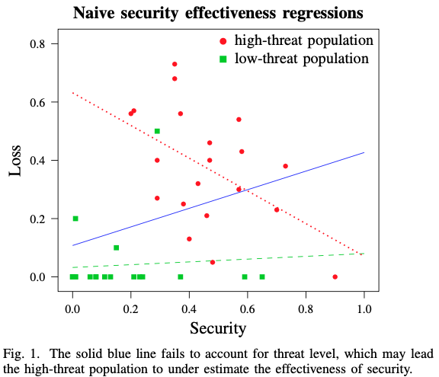
A naïve model relating loss to security level
Simple regression (blue line): more security implies more losses?!
Problem: Confounding variables (especially threat level)
Notes:
Dotted red line is security level’s influence on loss, conditioned on the high threat scenario
The green line is low threat

Slide 6
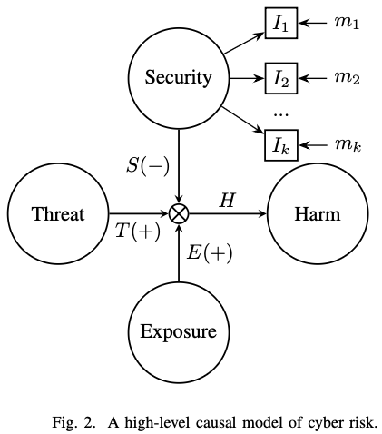
A simple causal model of cyber risk
Threat: The motivation, capability and activity of adversaries
Harm: Negative consequences resulting from compromise
Exposure amplifies E(+) the relationship between Threat and Harm
Security moderates S(−) the relationship between Threat and Harm
Security has reflexive indicators I₁, I₂, … I_{k}, which have corresponding measurements m₁, m₂, … m_{k}
Notes:
Why Latent Variables?
Single indicators are insufficient (e.g., security budget, certifications)
Reflexive indicators I₁, I₂, ..., Iₖ measure underlying constructs
Example: Multiple mismanagement symptoms better predict compromise

Slide 7
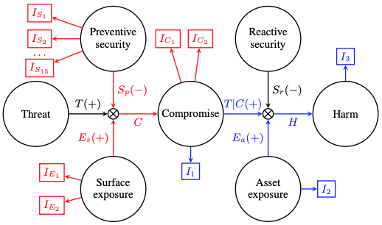
A more sophisticated model of cyber risk
Introduces Compromise: Violation of victim security goal
Subdivides Security
Preventive: Interventions reducing the ease of compromise
Reactive: Interventions reducing the impact of compromise
Subdivides Exposure
Surface: Factors increasing potential vectors of compromise
Asset: Factors increasing the value of what can be compromised
Adds more reflexive indicators
Notes:
Threat conditioned on compromise (T|C)

Slide 8
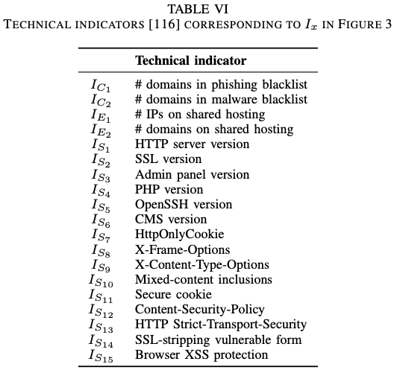
A more sophisticated model of cyber risk
Parts in red modeled in a prior study. S. Tajalizadehkhoob, T. Van Goethem, M. Korczyinski, A. Noroozian, R. Boehme, T. Moore, W. Joosen, and M. van Eeten. Herding vulnerable cats: A statistical approach to disentangle joint responsibility for web security in shared hosting. In CCS, 2017.
Notes:
Threat conditioned on compromise (T|C)

Slide 9
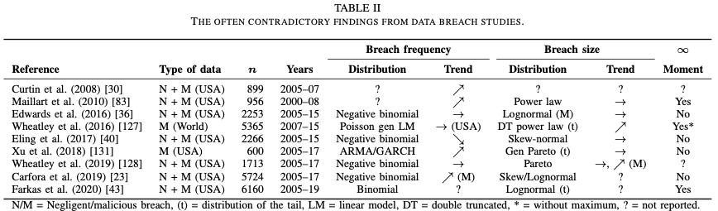
[RQ1: Harm] Data breach studies
10 years of studies, same data, contradictory results
Frequency trends: decreasing, stable, or increasing?
Size trends: stable or increasing?
Heavy-tailed distributions, but unclear mapping to financial cost
Notes:
Power law distributions (mentioned for several studies) are heavy-tailed
Lognormal distributions are also heavy-tailed
Most breaches are small (thousands of records)
But mega-breaches (100+ million records) happen more often than a normal distribution would predict
Example: Yahoo! breach (3 billion records) exceeded the "maximum" predicted by models [127] by an order of magnitude in the same year
Problem with heavy tails:
If finite expected value: You can meaningfully budget for "average breach cost"
If infinite expected value: The next breach could dwarf all previous ones; no stable average exists

Slide 10
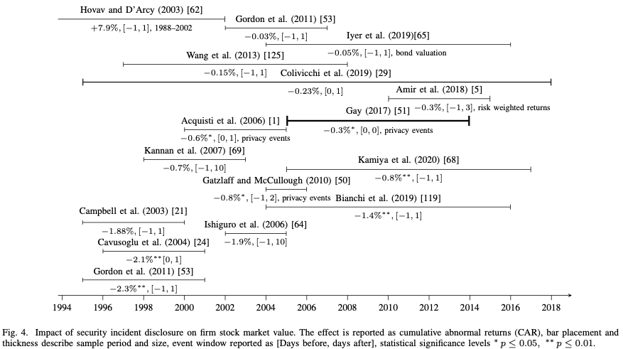
[RQ1: Harm] Stock market reactions
Effect decreasing over time (from -7.9% to -0.05%)
Firms learned to manipulate announcements
Evidence of strategic timing and insider trading
19 studies from 1988-2019

Slide 11
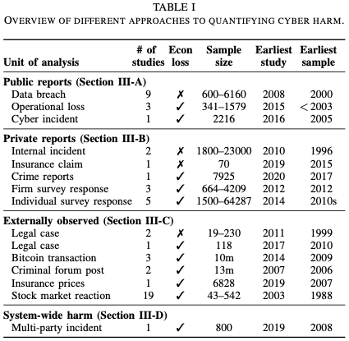
[RQ1: Harm] Are cyber harms exceptional?
No.
Mean cyber loss: $4.1M-$43M (varies by sample)
Cyber losses smaller and less heavy-tailed than non-cyber operational losses
Compare to fraud, theft, bad debt
Typical breaches less extreme than media reports suggest
Notes:
Cyber losses are more "well-behaved" statistically
Mean cyber loss is also smaller: challenges the narrative that cyber risk is uniquely catastrophic
Multiple data sources: public reports, surveys, legal cases, insurance
Inconsistent across samples and jurisdictions
Jurisdictional example: 0.1% of Italian firms lost >€200k
Survey data shows most victims report no/small losses
--

Slide 12
[RQ2: Effect] Measuring security is hard
Single indicators fail:
Certifications: 86% of PCI-DSS certified sites violated requirements
Security $$ budgets: positively correlated with breaches
Need: Multiple technical indicators
Self-reported indicators (SeBIS scale) for individuals predict behavior but not linked to harm outcomes. Costly to collect at organization-level
Notes:
A security certification is a single indicator wrapping up a bunch of practices.
No study demonstrates that certification is linked to better risk outcomes.
Even when controlling for firm characteristics in a logistic regression, Biancotti [12] find that defense expenditure in 2016 is positively correlated with the probability of experiencing an incident in 2017.
The 1990 Straub model showed organisational commitment to security correlates with better self-reported harm outcomes, such as the frequency and cost of incidents.

Slide 13
[RQ2: Effect] Measuring threat: 3 approaches
Time-based: Track malicious activity over time
Target-based: Study who gets attacked
E.g., larger banks targeted more
Researcher intervention: Honeypots, controlled experiments
Challenge: Rational attackers use undetectable malware
Notes:
We identify approaches to controlling for threat level that vary across time, target, and research intervention.
Wot: user adoption of 2-factor authentication or a recovery mechanism is positively associated with phishing targeting.

Slide 14
[RQ2: Effect] Measuring exposure
Unit of analysis matters (AS vs. hosting provider)
Exposure can be highly influential in predicting harm. Example:
1 variable of hosting provider explains 20% of phishing abuse, but 4 variables explain 84% of abuse
Can train a classifier to identifier compromised website with 66%/17% true/false positive rates
Notes:
Constructing a measurement model for exposure seems intuitively simple because exposed assets are also exposed to measurement.
This leads the authors to ask: if so much can
be explained by exposure alone, what are we studying when
we study abuse?

Slide 15
[RQ2: Effect] Structural relationships
Between-subject designs can be misleading
Example: Updated software associated with more compromise
Until you control for threat level
Then: 22.6% of updated sites re-compromised vs. 33.5% never-updated
Within-subject designs help control confounders
The relative infrequency of compromise undermines statistical power
Notes:
Connections between values of latent factors
Between-subject designs compare outcomes for subjects with differing levels of security.
- more security is associated with lower rates of compromise only in the high-risk population.
Within-subject designs track the same subject’s security level over time using longitudinal data.

Slide 16
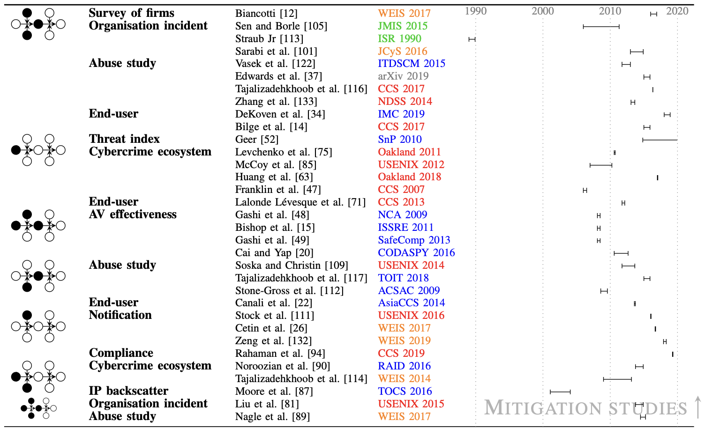
[RQ2] Evidence for security effectiveness
Notes:
Two blocks: Mitigation studies (top) vs. Harm studies (bottom)
- Mitigation includes prevention
Color coding shows interdisciplinary nature
Recent trend: More studies exploring multiple structural relationships
Traditional security venues (red) focus on threat/security measurement

Slide 17
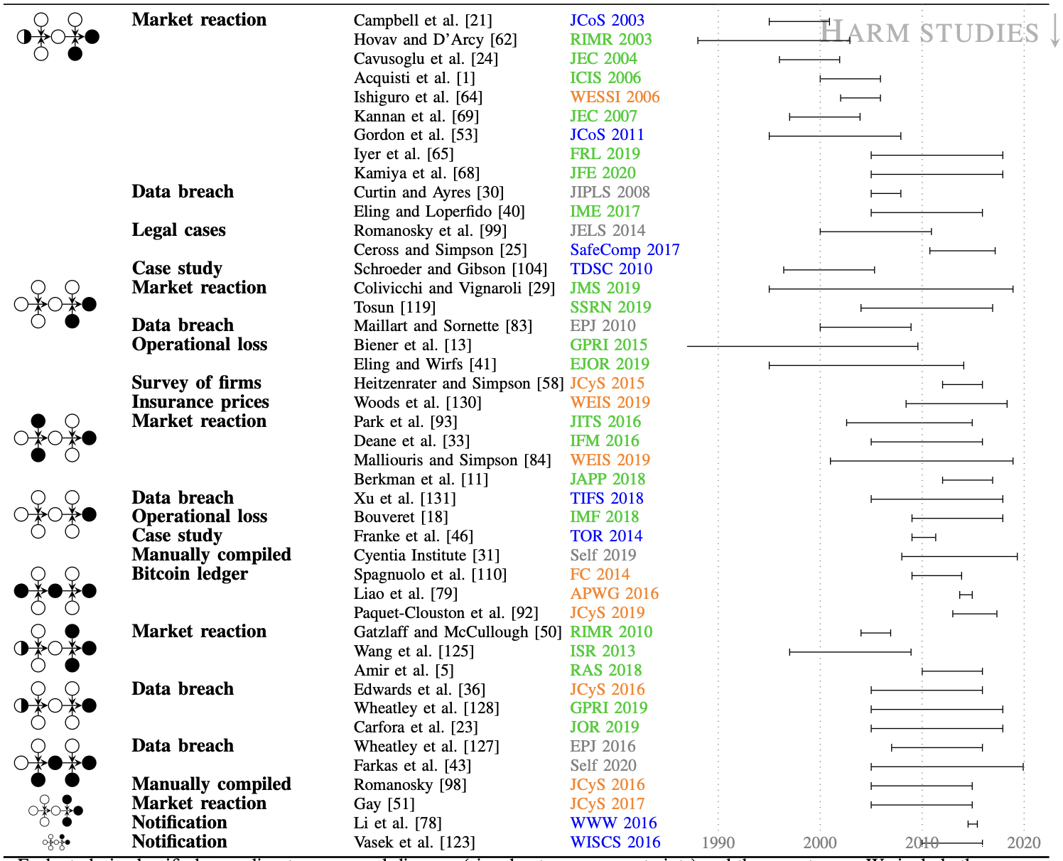
[RQ2] Evidence for security effectiveness

Slide 18
RQ3: Temporal trends
Harm studies: longer time windows (up to 20 years)
Mitigation studies: brief windows (often <3 years)
Stock market reactions: decreasing over time
Cyber insurance prices: trending downward 2008-2018
Data breach frequency: stable overall, increasing for malicious breaches

Slide 19
Key findings
RQ1: Cyber harms not exceptional; typical losses smaller than claimed
RQ2: Security effective only when controlling for threat and exposure
RQ3: Some evidence of decreasing stock market impact; otherwise limited temporal data
Single indicators misleading; multiple indicators essential
But lots we don’t know
Systemic cyber risk: insufficient observations
Causal effects of specific interventions
How to prioritize security investments
Long-term trends in mitigation effectiveness

Slide 20
Implications
For practice
Don't underestimate exposure (very predictive)
Avoid single-indicator solutions from vendors
Security teams need resources for diverse tasks
Be skeptical of exceptional harm claims
For research
Use the causal model framework
Include threat and exposure controls
Use multiple indicators of security
Longer time windows needed for mitigation studies
Consider randomized controlled trials (notification studies)

Slide 21
Limitations
Model applies to observational studies of organizations
Cannot capture systemic risk (e.g., NotPetya)
Goodhart's Law: Metrics get gamed (certifications, insider trading)
Data is political: Focuses on measurable, reported harms
Representative sampling extremely difficult
Notes:
Systemic = Correlated risks.
- NotPetya attack exploited a flaw in Windows to cause an estimated $10 billion of damage across hundreds of companies.
The ‘cost of a data breach’ skews towards direct costs to the firm as determined by accountants and not indirect harms suffered by victims of identity theft.

Slide 22
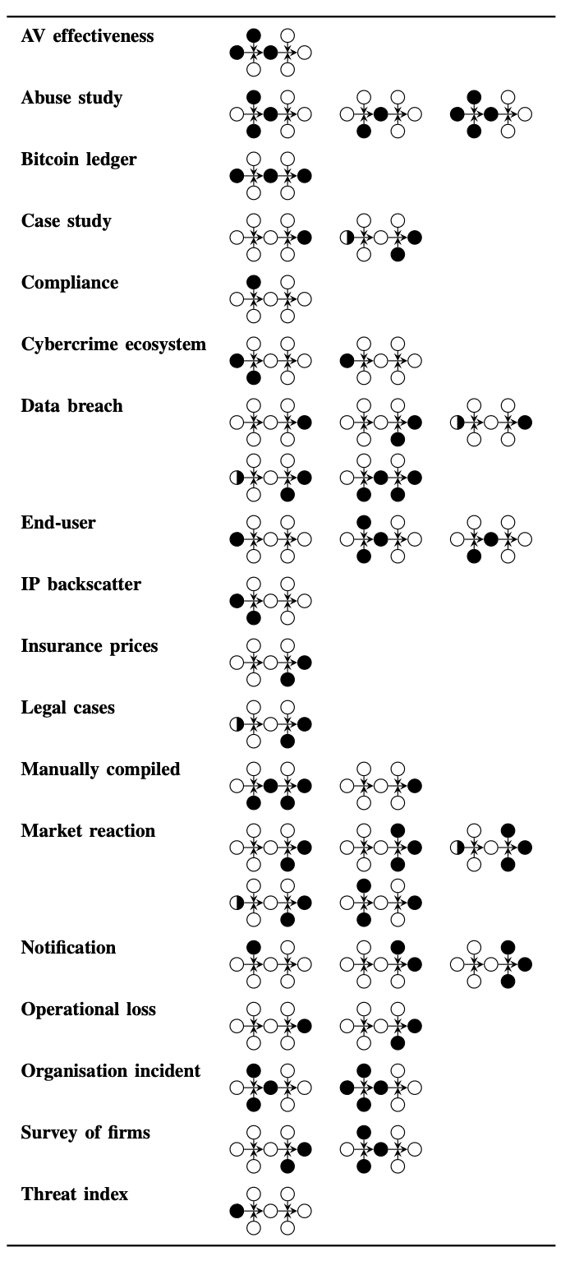
Future directions
No data breach studies link security to compromise/harm
Need better methods for systemic risk
Institutional data collection and sharing
Move beyond prediction to causal understanding

