Slide 1


Secure Systems Engineering and Management
A Data-driven Approach
Michael Hicks
Secure Design: Principles and Controls (part 1) Protecting Data and Proving Identity
UPenn CIS 7000-003
Spring 2026

Slide 2
From Threats to Mitigations
We enumerate threats against our security objectives using STRIDE.
For each threat, we propose a response: a control and implementation guidance.
These two lectures build the technical vocabulary and the design thinking for that.
Notes:
Connect to where students are: they’ve done the SbD lecture, learned threat modeling with STRIDE, and are working on their own threat models (GlucoGuard). These lectures answer the next question: once you’ve found a threat, what do you actually build to stop it?
Recall the four response strategies: mitigate, eliminate, transfer, accept. Most of our time focuses on mitigation through design – the controls you build into the system.

Slide 3
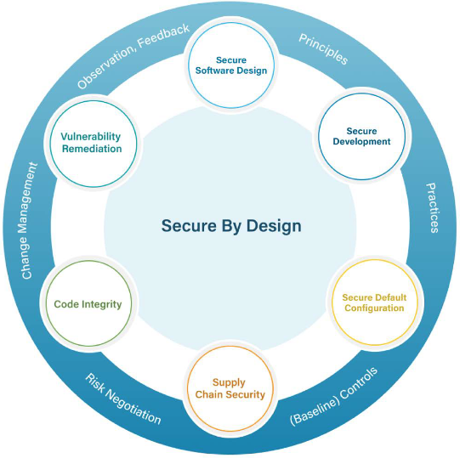
Recall: Security Objectives
Requirement | Definition
Confidentiality | Protect information from unauthorized disclosure
Integrity | Protect information from unauthorized modification
Availability | Provide access when required
Accountability | Non-repudiation via permanent audit records
Requirements expressed in terms offered by these features
Feature | Intent
Authentication | Reliably identifying users
Authorization | Granting access based on roles and rights
Notes:
These are the fundamental security requirements from the paper (p.9). Every system needs to think about all four, but the relative priority depends on the system.
For our CMS:
- Confidentiality is critical: student grades, FERPA-protected records, personal information. A breach here has legal consequences.
- Integrity is critical: if grades can be tampered with, the academic system breaks down. This includes both malicious tampering (a student changing their grade) and accidental corruption.
- Availability matters especially at peak times: during registration, exam periods, assignment deadlines. A system that goes down during finals week has real consequences.
- Accountability is essential: if a grade is changed, there must be an immutable record of who changed it and when. This protects both students and instructors.
For a different system – say, a hospital monitoring system – availability might dominate (lives depend on it). For a voting system, integrity is paramount. The priorities shape everything that follows.

Slide 4




Principles vs. Controls
A principle is a high-level design goal with many possible manifestations
A control is a specific practice consonant with sound design principles
Design phase → principles for avoiding flaws (design-level problems)
Implementation phase → controls for avoiding bugs (code problems)

Slide 5









Three Categories of Security Principles
Prevention
Harm reduction
Detection & recovery
Eliminate defects entirely
Limit damage from unknown defects
Identify attacks and undo damage
Notes:
“Harm reduction” is what other frameworks sometimes call “mitigation at the design level.” We use a different word to avoid confusion with threat-level mitigation (the response to a specific threat in a threat model).
As we go through topics, we’ll tag each with its category so students can see how the categories work together.

Slide 6
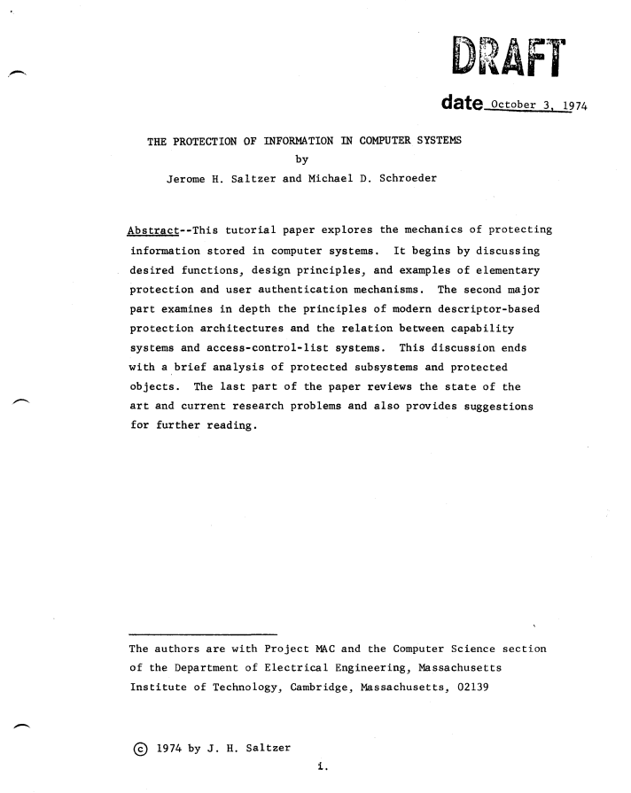
Secure Design Principles
Favor simplicity
Use fail-safe defaults
Do not expect expert users
Trust with reluctance
Small trusted computing base
Grant least privilege
Compartmentalize
Promote privacy
Defend in depth
Use community resources
Monitor and trace
Economy of mechanism
Fail-safe defaults
Psychological acceptability
(several S&S principles)
Least common mechanism
Least privilege
Separation of privilege
(modern addition)
(modern addition)
Open design
Compromise recording
Notes:
This is our reorganization of Saltzer & Schroeder’s 1975 principles plus modern additions. Post this slide or hand it out – students will reference it throughout both lectures and when working on their threat models.
The table shows how the classical S&S principles map to our three categories. Some principles span categories (e.g., “trust with reluctance” is both prevention and harm reduction).

Slide 7
Outline for Today
Principles and Controls
Confidentiality (by encryption)
Authentication – proving identity
Four principles:
Do not expect expert users
Fail-safe defaults
Favor simplicity
Defend in depth (throughout)
Next time
Authorization
Integrity and Accountability
Remaining principles:
Trust with Reluctance (all)
Monitoring and Traceability
Putting it all together
Use community resources

Slide 8
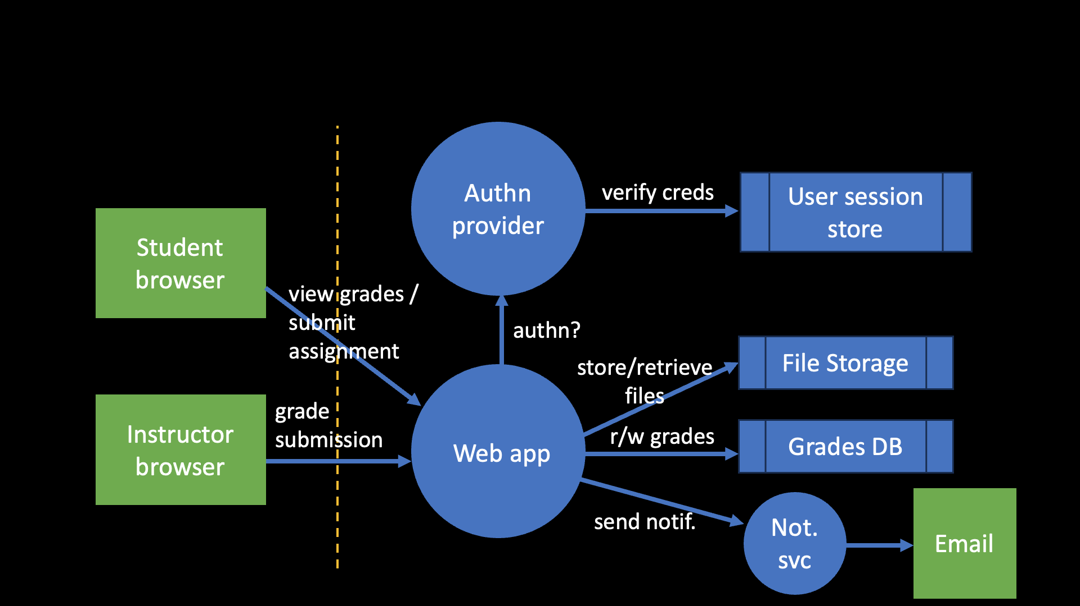
Payment app: DFD

Slide 9
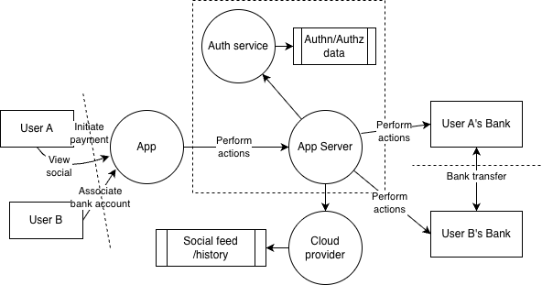
CMS: DFD

Slide 10
Confidentiality by Encryption

Slide 11

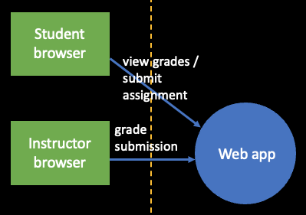
The Threat: Eavesdropping and Data Theft
STRIDE category: Information Disclosure
An attacker eavesdrops on or modifies data as it moves between components – or accesses stored data directly.
CMS: Grades travel from app server to browser over campus Wi-Fi
Payment app: Bank credentials and transfer instructions travel between app and server
Notes:
This section covers two complementary defenses: encryption in transit (protecting data as it moves) and encryption at rest (protecting data where it’s stored). Together they form defense in depth for data confidentiality.

Slide 12
Encryption 101
Symmetric key encryption
Cipher
Message authentication code (MACs)
Public key encryption – helps with proof of identity
Cipher
Signature
Challenge: Key management

Slide 13
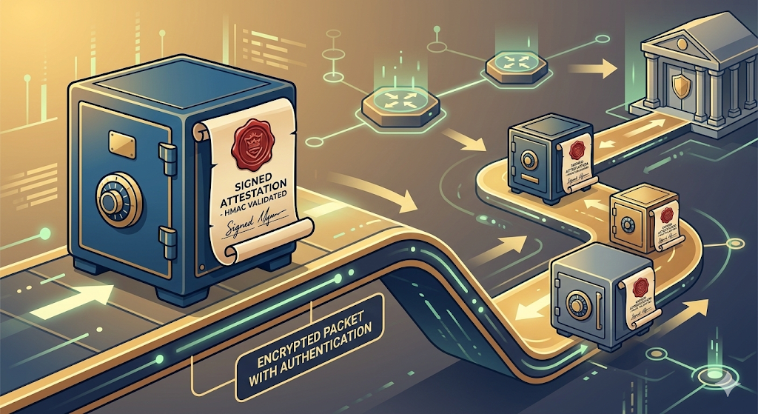
Encryption in Transit: Transport Layer Security
What TLS provides
Confidentiality — encryption of all traffic
Integrity — MACs detect modification
Server authentication — certificates prove identity
Notes:
Without TLS, anyone on the network path can read and modify traffic. For the payment app, that means intercepting bank credentials; for the CMS, reading grades or hijacking sessions.
Walk through briefly: after the handshake, all traffic is encrypted with a shared symmetric key. The asymmetric crypto (RSA/ECDH) is only used for key exchange; the bulk encryption uses AES.

Slide 14
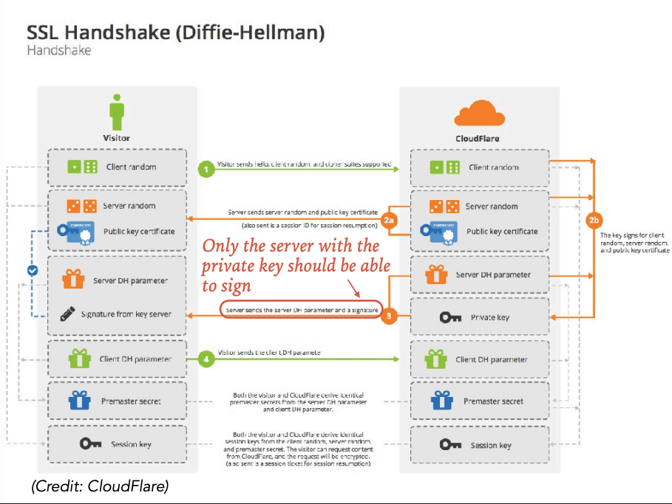
The handshake: client hello → server certificate → key exchange → symmetric session key
Notes:
when a client first connects, the client and server complete a TLS handshake during which the server presents an X.509 digital certificate, which is used to help identify and authenticate the server to the client. This certificate includes the identity of the server (e.g. website domain), a temporal validity period, a public key, and a digital signature provided by a trusted third party. The client checks that the certificate’s identity matches the requested domain name, that the certificate is within its validity period, and that the digital signature of the certificate is valid. The certificate’s public key is then used by the client to share a session secret with the server in order to establish an end-to-end cryptographic channel.

Slide 15
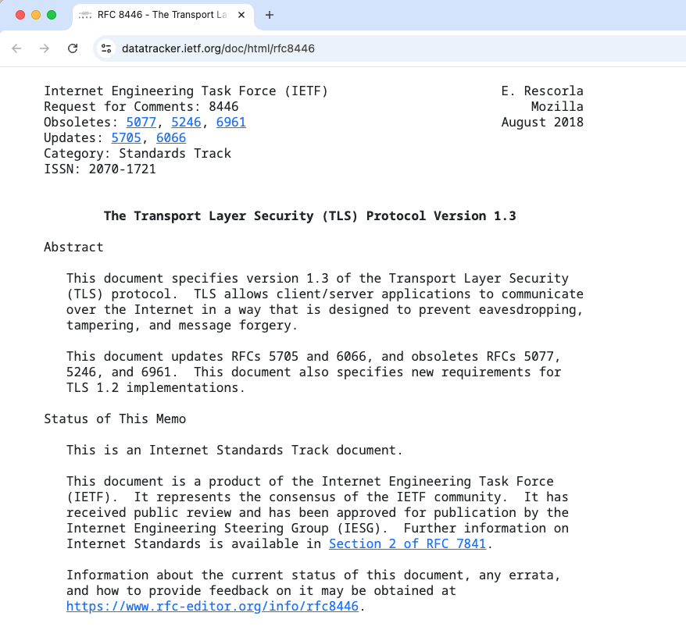
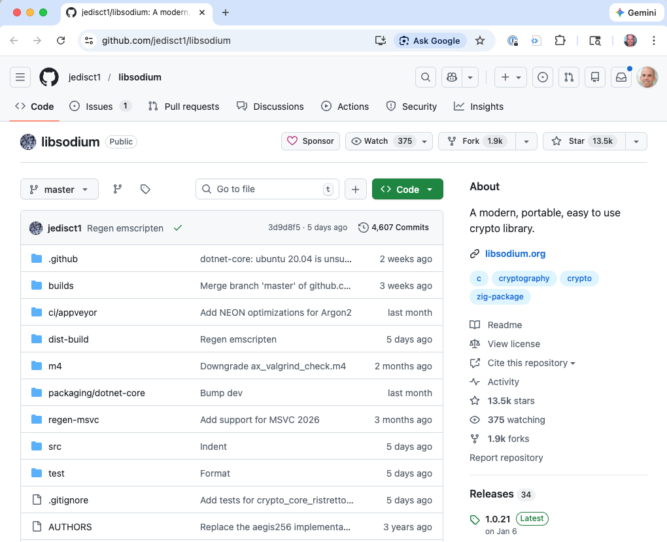
Use Standards, and Standard Implementations
TLS is a formal standard
Went through rigorous review for many years. Now ubiquitous.
Saltzer & Schroeder’s open design principle:
Security should depend on the secrecy of keys, not of algorithms or code
Use vetted libraries (community resource)
libsodium, OS-provided crypto APIs, cloud KMS
Notes:
Certificate pinning is especially important when the stakes are financial. Without pinning, an attacker who compromises any certificate authority can issue a valid-looking certificate for your domain.
Development-mode bypass is a classic mistake: during development, developers disable certificate validation to work with self-signed certs, then forget to re-enable it before shipping. This has happened in major apps and libraries.

Slide 16
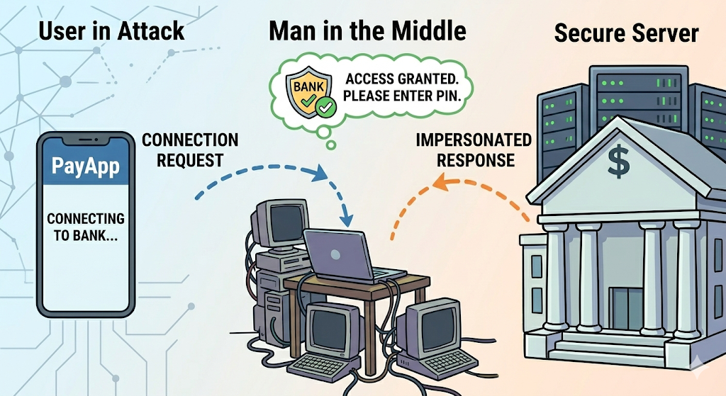
TLS in Practice
Certificate pinning: The payment app can pin the server’s certificate (or its CA) so a compromised CA or rogue cert can’t intercept traffic.
Common mistakes:
Allowing fallback to older TLS versions
Not validating certificates
Shipping with development-mode certificate bypass left in
Notes:
Certificate pinning is especially important when the stakes are financial. Without pinning, an attacker who compromises any certificate authority can issue a valid-looking certificate for your domain.
Development-mode bypass is a classic mistake: during development, developers disable certificate validation to work with self-signed certs, then forget to re-enable it before shipping. This has happened in major apps and libraries.

Slide 17

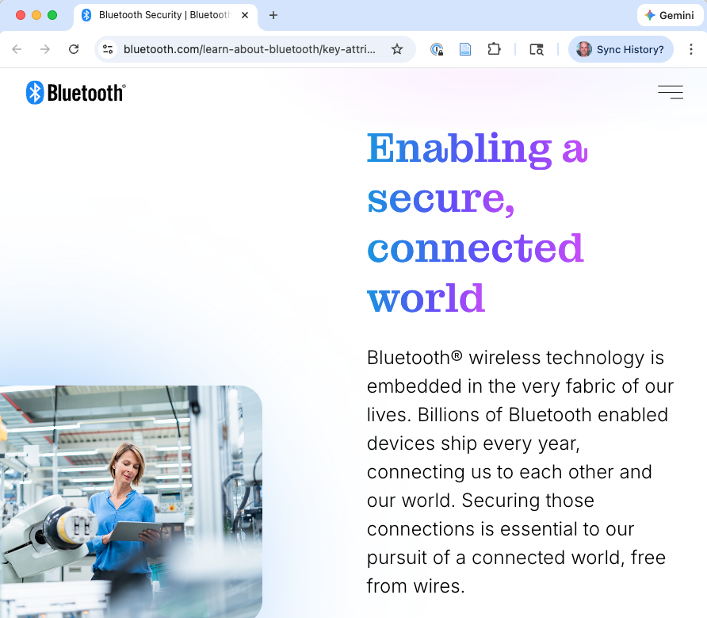
Not All Comms are HTTP: BLE Security
Bluetooth Low Energy (BLE) is used by IoT devices, wearables, and medical devices.
BLE Secure Connections (Bluetooth 4.2+): ECDH key exchange + AES-CCM encryption
Pairing modes for levels of protection
Notes:
Not all communication is HTTP. IoT devices, wearables, and medical devices commonly use BLE. BLE has its own security model handled by the Security Manager Protocol (SMP).
Mode | MITM Protection | How It Works
Just Works | None | Default for many devices – insufficient for high-stakes use
Passkey Entry | Yes | One device displays code, other enters it
Numeric Comparison | Yes | Both devices display code, user confirms match
Out-of-Band (OOB) | Strongest | Pairing via separate channel (e.g., NFC)
“Just Works” provides encryption but no MITM protection – a nearby attacker can intercept the pairing. This is the default for many devices and is insufficient for high-stakes applications like medical devices or payment peripherals.
For high-stakes systems: mandate LE Secure Connections with a MITM-resistant pairing mode. Don’t accept “Just Works.”

Slide 18
Application-Layer Encryption: Defense in Depth
Encrypt the payload inside the transport connection.
Even if BLE (or TLS) security is bypassed, the data is still protected.
General principle: For every communication channel in your DFD:
Determine whether the transport provides adequate protection
Add application-layer encryption where it doesn’t
Notes:
This is defense in depth applied to communication. The transport layer (TLS, BLE) provides one layer of protection; application-layer encryption provides a second, independent layer.
This is especially important for BLE connections where the security model has known weaknesses, and for any situation where you don’t fully control the network path (e.g., data passing through third-party infrastructure).

Slide 19
Encryption at Rest
The threat: An attacker gains access to stored data – in a database, on a device, in a backup.
What if the database is behind a firewall?
Defense in depth assumes outer layers can be breached:
Compromised application server
Insider with network access
Stolen backup tape
Encryption at rest is the next layer.
Notes:
In most architectures, the database is not directly exposed to the internet – it sits behind network controls, firewalls, and application servers. The natural question is: why encrypt it?
Because defense in depth assumes that outer layers can be breached. An attacker who pivots through a compromised application server, or an insider with network access, or a stolen backup tape, bypasses the network controls entirely. Encryption at rest is the next layer of defense.

Slide 20
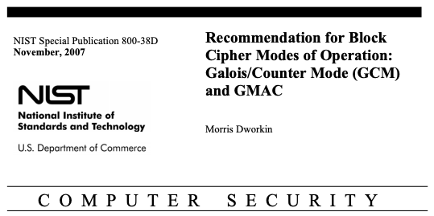
Symmetric Encryption: AES-GCM
AES is the standard. Key sizes: 128 or 256 bits.
AES-GCM (Galois/Counter Mode) is the modern default:
Provides both confidentiality and integrity (authenticated encryption)
Encrypting without integrity (e.g., AES-ECB, AES-CBC without MAC) lets attackers flip bits and thereby corrupt plaintext without detection
Notes:
The key point about AES-GCM is authenticated encryption: it provides both confidentiality AND integrity in a single operation. If you use a mode that only provides confidentiality (like AES-CBC without a separate MAC), an attacker can modify the ciphertext and the resulting plaintext will change in predictable ways.
This is not a theoretical concern – practical attacks against unauthenticated encryption modes have been demonstrated repeatedly (padding oracle attacks against CBC, etc.).

Slide 21
Symmetric Encryption: AES-GCM
Examples
Payment app: linked bank account numbers encrypted in DB
CMS: student records subject to FERPA encrypted at rest
(DB not shown)

Slide 22
Key Management: The Hard Part
Encryption is only as good as the key management
Never hardcode keys in application source or binaries – decompiling a mobile app is trivial
Mobile devices: use the OS keychain/keystore (iOS Keychain, Android Keystore)
Servers: use a KMS (Key Management Service)
Hardware: secure elements and TPMs store keys in tamper-resistant hardware
Encrypt with per-entity keys so compromise of one key doesn’t expose everything
Notes:
Key management is consistently the hardest part of encryption. The algorithm might be perfect, but if the key is hardcoded in the source code (which an attacker can decompile), stored in a config file alongside the database, or shared across all users, the encryption is effectively worthless.
Per-entity keys: instead of one master key for the entire database, use per-user or per-record keys. If one key is compromised, only that user’s data is exposed, not everyone’s. This is more complex to manage but dramatically limits blast radius.

Slide 23
Broken Crypto: Implementation Mistakes
The most common encryption failures aren’t algorithm breaks – they’re implementation mistakes.
Timing side channels:
Minerva (2020): recovered ECDSA private keys by measuring timing of nonce generation
Raccoon (2021): exploited non-constant-time DH processing in TLS 1.2
KyberSlash (2024): timing side channels in post-quantum crypto implementations
Also: poor randomness, nonce reuse in AES-GCM
Notes:
Timing side channels: a comparison function that returns early on the first mismatched byte leaks information about the correct value. The Minerva attack recovered ECDSA private keys by measuring tiny timing differences during nonce generation – just the bit-length of the nonce leaked enough to reconstruct the key after a few hundred signatures.
KyberSlash is particularly noteworthy: it shows that even next-generation post-quantum cryptography implementations can have timing side channels. The problem is not the algorithm but the implementation.
Poor randomness: if the random number generator used to create keys or nonces is predictable, the encryption is worthless regardless of the algorithm.
Nonce reuse in AES-GCM: reusing a nonce with the same key completely breaks both confidentiality and authenticity. This is a catastrophic failure mode.
Lesson: getting crypto right is hard even for experts. Use battle-tested implementations.
Category: Prevention.

Slide 24
Authentication – Proving Identity

Slide 25
Why Authentication Is Foundational
Authentication answers: who are you?
Payment app authentication points:
User → App (Server)
App Server → Bank API
App Server → Cloud API
Primary STRIDE threat: Spoofing
Notes:
Authentication is foundational because every other security mechanism depends on it. Authorization (“what can you do?”) requires knowing who you are first. Audit logging (“who did this?”) requires authenticated identity. Even encryption depends on authentication to establish who holds which keys.
The payment app example shows that authentication isn’t just “user logs in” – it happens at every trust boundary in the system. Each arrow in the DFD that crosses a trust boundary needs its own authentication mechanism.

Slide 26
Client/Server authentication
User → App (Server)
Typical approach: Username/password
How? Store database of username/password pairs, authenticate claimed username against provided password
Use encryption to protect the password in transit
More protection needed …

Slide 27
The Password Database Threat
Need for Defense in Depth: An attacker obtains the password database (SQL injection, cloud misconfiguration, insider).
How should passwords be stored?
Storage Method | Vulnerability
Plaintext | Catastrophic – attacker reads every password
Simple hash (SHA-256) | Rainbow tables, brute force at billions/sec
Salted hash | Defeats rainbow tables, but fast hashes still brute-forceable
Slow/memory-hard hash | Deliberately expensive – the right answer
Notes:
Walk through the progression. Each step addresses a specific weakness:
Plaintext is obviously terrible, but it still happens (see data breaches).
Simple hashing: identical passwords produce identical hashes, enabling rainbow table attacks where the attacker pre-computes a lookup table of common password → hash mappings.
Salted hashing: each password gets a unique random salt prepended before hashing. Same password with different salts produces different hashes, defeating rainbow tables. But fast hashes (SHA-256) can be brute-forced at billions of attempts per second on a GPU.
Slow/memory-hard hashing: the answer to GPU brute force.

Slide 28
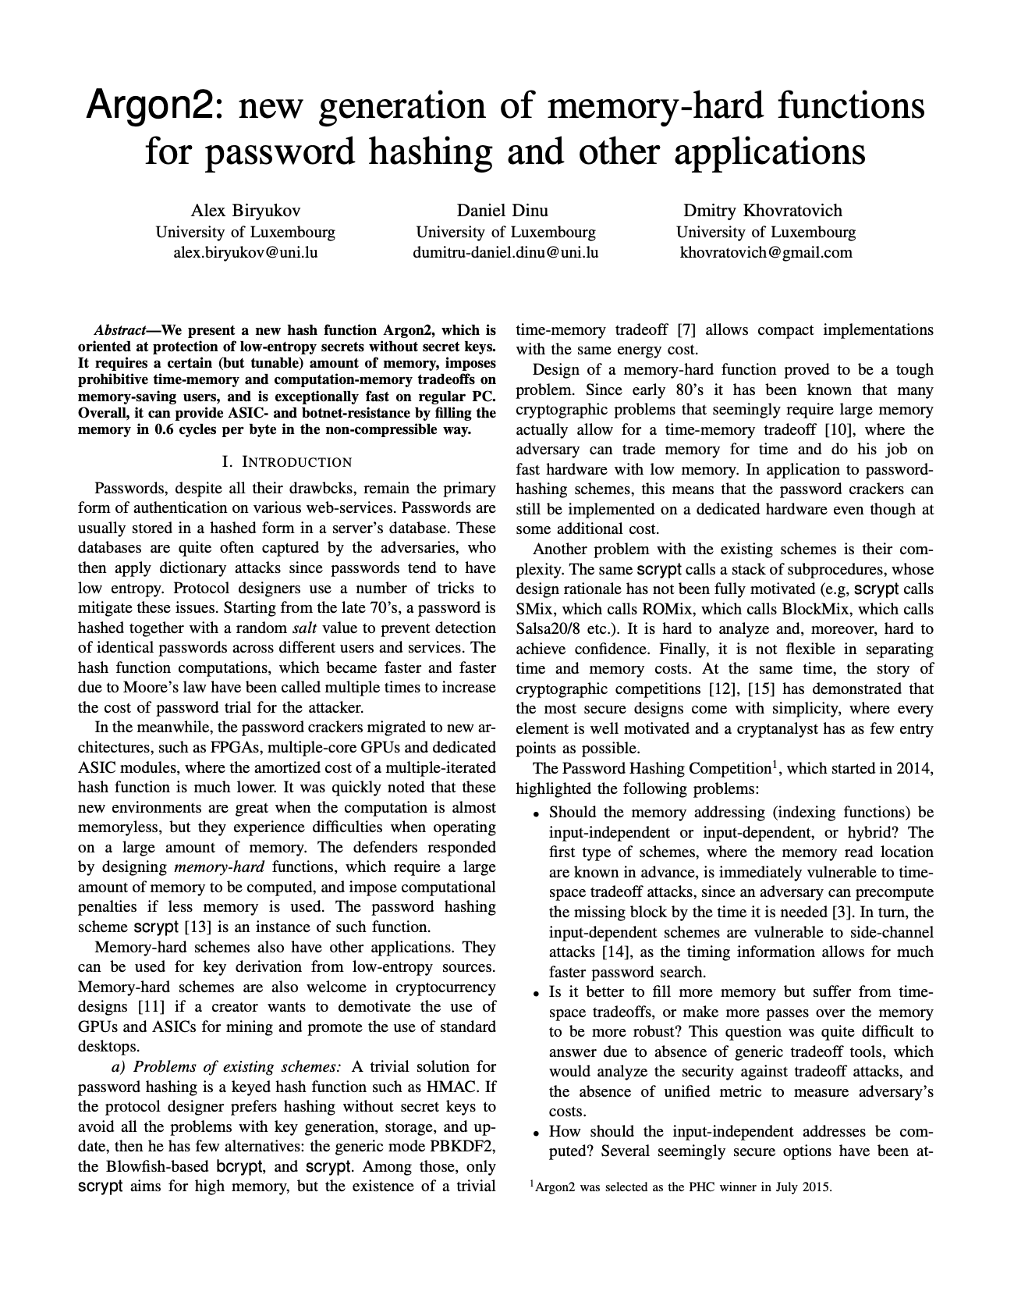
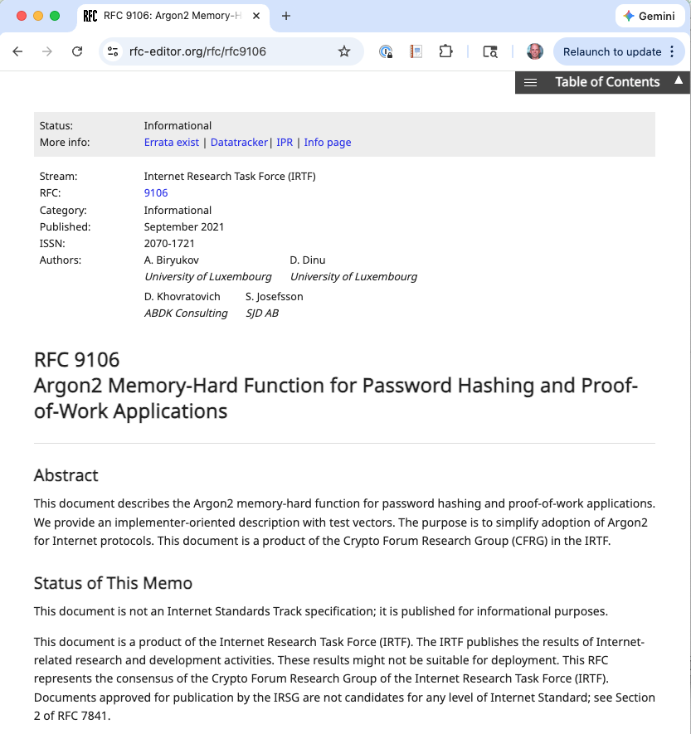
Password Hashing
Notes:
Argon2id won the Password Hashing Competition in 2015. The “id” variant combines resistance to both side-channel attacks and GPU attacks.

Slide 29
Password Hashing: Argon2id
Argon2id is the current best practice. Bcrypt, scrypt alternatives.
Tunable cost parameters: time cost, memory cost, parallelism.
Practical guidance:
Store: salt || hash (salt is not secret, just unique per user)
Don’t truncate or limit password length unreasonably
Check passwords against breach databases (HaveIBeenPwned API)
Notes:
Argon2id won the Password Hashing Competition in 2015. The “id” variant combines resistance to both side-channel attacks and GPU attacks.
The math:
GPU doing SHA-256: ~10 billion hashes/sec
GPU doing Argon2id: ~10,000 hashes/sec
8-char mixed password (~6.7 quadrillion possibilities):
SHA-256: falls in days
Argon2id: takes millennia
OWASP's current recommendation for Argon2id is something like 46 MiB of memory, 1 iteration, and 1 degree of parallelism, which takes roughly 100–200 milliseconds on a modern server CPU.
The key insight: the million-fold difference in hash rate means an attacker needs a million times more time/resources. This makes brute-force impractical even for relatively weak passwords.
This is defense in depth applied to authentication: even when the database is compromised, the passwords remain protected.
bcrypt is an acceptable fallback if Argon2id isn’t available in your framework. scrypt is also good but has more complex tuning parameters.

Slide 30
Multi-Factor Authentication
something you know + something you have + something you are
Factor | Examples | Notes
Knowledge | Password, PIN | Can be phished
Possession | Phone, authenticator, FIDO2 key | FIDO2/WebAuthn is phishing-resistant
Biometric | Fingerprint, face | Can’t be changed if compromised

Slide 31
Multi-Factor Authentication and Sessions
Payment app: MFA required – you’re protecting money
TOTP or FIDO2 preferred; SMS good, but vulnerable to SIM swap.
CMS: MFA for instructors (who can change grades) is higher priority than for students
But MFA-for-all makes sense once you have it
Session tokens must be random, transmitted only over TLS, time-limited, revocable.
Notes:
MFA is one of the most effective security controls available. Even if a password is phished or brute-forced, the attacker still needs the second factor.
FIDO2/WebAuthn deserves special attention: it binds credentials to a specific origin, making phishing structurally impossible. The credential for “bank.com” simply won’t work on “bank-login.com.” This is a fundamental improvement over passwords + TOTP, where a sophisticated phishing page can relay the TOTP code in real time.
SMS-based MFA is vulnerable to SIM swap attacks (attacker convinces the carrier to transfer the phone number) and SS7 interception, but it’s still dramatically better than no second factor.
For session management: the payment app should use short session lifetimes. Sensitive actions like transferring money should require step-up re-authentication even within an active session.

Slide 32
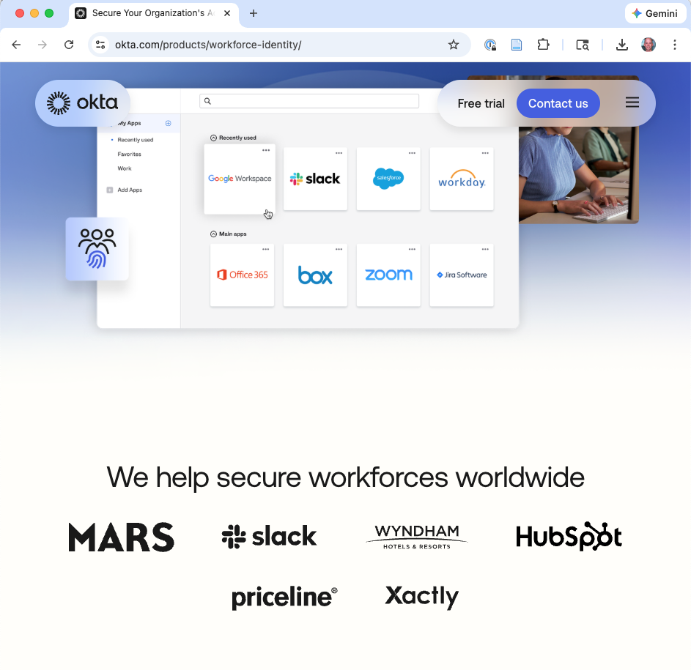
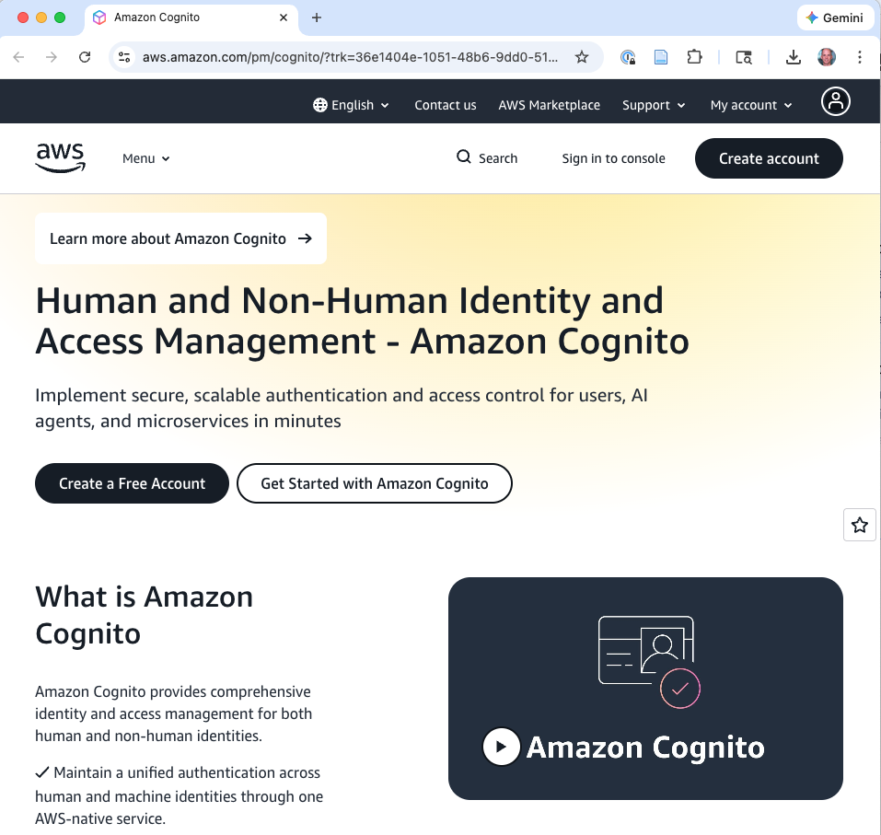
Identity Providers: Don’t Roll Your Own Auth
Just as you shouldn’t roll your own crypto, consider not rolling your own auth.
Identity providers (IdPs) handle the hard parts
Credential storage (bcrypt/Argon2, auto-updated)
MFA management (TOTP, FIDO2, push, SMS)
Session management (secure tokens, refresh, expiration, revocation)
SSO via SAML or OpenID Connect
Breached password detection
Rate limiting and bot detection
Compliance certifications (SOC 2, HIPAA, PCI-DSS)
Notes:
Examples: Okta, Auth0, AWS Cognito, Azure AD B2C, Google Identity Platform.
CMS example: integrate with the university’s SSO via SAML. Students and instructors authenticate with their existing university credentials. The CMS never touches passwords at all.
Payment app example: use an IdP for customer authentication. MFA enrollment, session management, and breached-password checking come out of the box. The payment team focuses on payment logic, not auth infrastructure.
When to roll your own: when you have unusual constraints (embedded devices with no internet connectivity, air-gapped systems, custom hardware authentication) or when the IdP itself would be part of the attack surface you’re trying to minimize. Even then, use vetted libraries (e.g., Passport.js, Spring Security) rather than writing auth from scratch.

Slide 33
Identity Providers: Don’t Roll Your Own Auth
Just as you shouldn’t roll your own crypto, consider not rolling your own auth.
Identity providers (IdPs) handle the hard parts:
Credential storage (bcrypt/Argon2, auto-updated)
MFA management (TOTP, FIDO2, push, SMS)
Session management (secure tokens, refresh, expiration, revocation)
SSO via SAML or OpenID Connect
Breached password detection
Rate limiting and bot detection
Compliance certifications (SOC 2, HIPAA, PCI-DSS)
Notes:
Examples: Okta, Auth0, AWS Cognito, Azure AD B2C, Google Identity Platform.
CMS example: integrate with the university’s SSO via SAML. Students and instructors authenticate with their existing university credentials. The CMS never touches passwords at all.
Payment app example: use an IdP for customer authentication. MFA enrollment, session management, and breached-password checking come out of the box. The payment team focuses on payment logic, not auth infrastructure.
When to roll your own: when you have unusual constraints (embedded devices with no internet connectivity, air-gapped systems, custom hardware authentication) or when the IdP itself would be part of the attack surface you’re trying to minimize. Even then, use vetted libraries (e.g., Passport.js, Spring Security) rather than writing auth from scratch.

Slide 34
Mutual Authentication and API Identity
In client-server systems, the server authenticates to the client (TLS certificate) and the client authenticates to the server (password/token).
But what about server-to-server?
Mutual TLS (mTLS): Both sides present certificates. Payment app server ↔ bank API: both sides verify each other.
Mobile app → API server: OAuth 2.0 tokens, device attestation (Google Play Integrity, Apple App Attest). Never a hardcoded API key
For every arrow in your DFD that crosses a trust boundary:
How does each side know who it’s talking to?
Notes:
Mutual authentication is often overlooked. Standard TLS only authenticates the server to the client. The client authenticates separately (password, token, etc.). But in server-to-server communication, both sides need to verify each other.
Payment app → bank API: the bank needs to know the request is from the real payment app; the payment app needs to know the response is from the real bank. mTLS achieves this.
In mTLS, an additional step occurs: the server sends a CertificateRequest message during the handshake, asking the client to identify itself. The client then responds with its own certificate and a CertificateVerify message — a signature over the handshake transcript, proving it holds the private key corresponding to that certificate. The server validates the client's certificate against its own trust store
For mobile apps: hardcoded API keys are a common mistake. Mobile app binaries can be decompiled trivially, and any API key embedded in the binary will be extracted. Use OAuth 2.0 with proper token management, and device attestation to verify the request comes from a genuine app installation.
API keys give you simple client identification, but they're static bearer credentials with no scoping or expiration. OAuth 2.0 adds scoped, short-lived, revocable tokens issued through controlled flows, but the tokens are still bearer credentials that work from any machine. Device attestation adds hardware-bound proof that the request originates from a trusted device, closing the gap where a stolen credential can be replayed from an attacker's machine. Each layer addresses a limitation of the one before it, and in high-security environments you'll often see all three concepts working together.
The general principle at the bottom of the slide is a powerful design tool: go through your DFD, find every trust boundary crossing, and verify that authentication exists in both directions.

Slide 35
Do Not Expect Expert Users

Slide 36
The Principle: Psychological Acceptability
Saltzer & Schroeder: Security mechanisms should not make the system harder to use than it would be without them.
If security is annoying, users will bypass it.
Software designers should consider how the mindset and abilities of the least sophisticated users will affect security.
The overarching lesson:
If your security depends on users doing something reliably, and evidence says they won’t, the mitigation must be a design change, not a policy change.
Category: Prevention
Notes:
“Only computer scientists and drug dealers have users” (R. David Lankes). Favor simple, natural interfaces where the obvious choice is the secure choice – or avoid security-relevant choices entirely.
We’ve built a strong authentication toolkit: password hashing, MFA, identity providers, mutual authentication. But these mechanisms assume users engage with them correctly – choosing strong passwords, enrolling in MFA, recognizing phishing. The evidence says otherwise.
This principle connects back to the human-in-the-loop discussion from the threat modeling lecture. When we place a human in a security-critical role, we need to evaluate whether the task is one that humans can reliably perform.

Slide 37
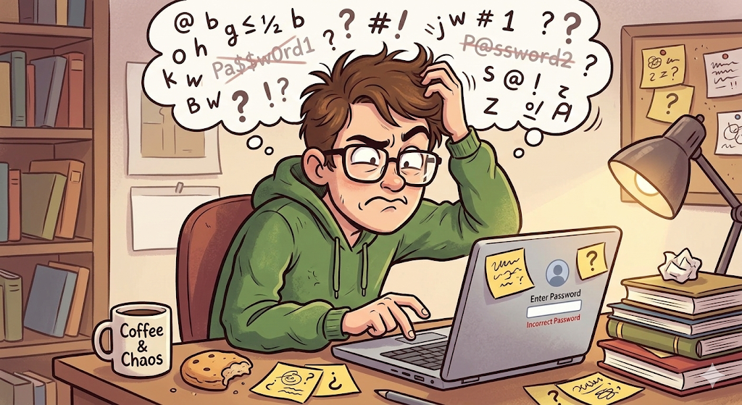
Passwords and User Behavior
Goal: Easy to remember but hard to guess. In practice, these are contradictory.
The evidence:
Users reuse passwords across accounts → credential stuffing
Users choose predictable passwords despite complexity requirements
Password cracking tools train on leaked datasets
The top passwords every year: 123456, password, qwerty, …
Notes:
The compounding problem is password reuse. Users pick one memorable password and use it everywhere. When one site is breached, credential stuffing attacks succeed on others. This means a breach at a low-security site (a forum, a small e-commerce shop) can lead to compromise of high-security accounts (email, banking).
Password cracking tools don’t just try random combinations – they train on leaked password datasets and use sophisticated rules to generate likely passwords. They know that people substitute “3” for “e”, append “!” to meet complexity requirements, and capitalize the first letter. This makes even “complex” passwords much weaker than their character space suggests.

Slide 38
Password strength meter
Gives user feedback on the strength of the password
Intended to measure guessability
Research shows that these can work, but the design must be stringent
Ur et al, “How does your password measure up? The effect of strength meters on password creation”, Proc. USENIX Security Symposium, 2012.
Some password requirements now debunked – people use odd characters in a predictable way!
password
P@ssw0rd!

Slide 39




Password manager
A password manager (PM) stores a database of passwords, indexed by site
Encrypted by a single, master password chosen (and remembered) by the user, used as a key
PM can generate complicated per-site passwords
Hard to guess, hard to remember, but the latter doesn’t matter!
Benefits
Only a single password for user to remember
User’s password at any given site is hard to guess
Compromise of password at one site does not permit immediate compromise at other sites
But:
Must still protect and remember strong master password

Slide 40
Phishing: The Authentication Failure Users Can’t Solve
The user is tricked into thinking a site/email is legitimate and hands over credentials.
This is a fundamental failure: the site is not authenticated to the user.
Design responses – don’t rely solely on user vigilance:
MFA: Phished passwords are useless without the second factor
FIDO2/WebAuthn: Binds credentials to a specific origin – phishing becomes structurally impossible
Notes:
The internet’s email and web protocols were not originally designed for remote authentication. HTTPS helps (the lock icon), but domain look-alikes and sophisticated phishing pages fool even technical users.
FIDO2/WebAuthn is the gold standard here: the credential for “bank.com” literally cannot be used on “bank-login.com” because the browser binds it to the origin. A phishing page can perfectly replicate the visual appearance of the login page, but it can’t use the credential because it’s on a different domain. This makes phishing structurally impossible, not just harder.
This illustrates the principle perfectly: instead of training users to spot phishing (which decades of evidence shows doesn’t work reliably), we design an authentication mechanism that makes phishing impossible at the protocol level.

Slide 41
Fail-safe Defaults and the Safety-Security Tension

Slide 42
The Fail-safe Defaults Principle
S&S: Base access decisions on permission rather than exclusion. The default is “denied.”
Applied broadly:
Configuration choices that affect security should default to the secure option
Define what is permitted (allowlist) rather than what isn’t (denylist)
Attackers only need to find something the denylist missed
With an allowlist, they must find something already on the list
Category: Prevention
Notes:
This is one of the most powerful and frequently violated design principles. The key insight: if you enumerate what’s forbidden, you will inevitably miss something. If you enumerate what’s permitted, anything you miss is denied by default.
This extends beyond access control to all configuration choices: default key lengths, default session timeouts, default visibility settings, default enabled features. In every case, the secure choice should be the default.

Slide 43
Secure Default Configurations
Setting | Insecure Default | Secure Default
Course visibility (CMS) | Public | Private
API access (CMS) | Enabled | Disabled, requires admin opt-in
Session timeout | “Forever” | Reasonable duration
File uploads (CMS) | All types | Allowlisted types only
Encryption | Optional | Required (TLS everywhere)
Social feed (Payment app) | Public | Private
Default credentials | admin/admin | No default – must set on first use
What are some secure defaults for our CMS? Payment app?
Notes:
The long history of databases, routers, and IoT devices shipping with default credentials (or no authentication at all) is one of the clearest illustrations of this principle being violated. The Mirai botnet in 2016 compromised hundreds of thousands of IoT devices using a list of just 62 default username/password combinations.
The “80% rule” from the Secure by Design paper: if a feature, privilege, or interface is not required by 80% of users, disable it by default. Every enabled feature is a potential attack vector.
The CMS admin panel: should it be accessible from the public internet by default? No. Restrict to campus network or VPN by default, with explicit opt-in for remote access.

Slide 44
Designing for Failure
Fail-secure: When a component fails, deny access.
CMS auth service goes down → no one can view grades until it’s back
Protects confidentiality and integrity
Fail-safe (safety sense): When a component fails, protect human welfare.
If the payment app’s fraud detection is unreachable: block all transactions (secure but availability-destroying) or allow them (available but risk-accepting)?
These can conflict.
Notes:
For most software, fail-secure is the right default. But for systems where availability has safety or critical welfare implications, the tradeoffs must be made explicitly and documented.
Graceful degradation: design so that failure of one component doesn’t cascade to the entire system.
Payment app: if push notifications go down, transfers still process. If the social feed fails, the core payment flow is unaffected.
CMS: if plagiarism detection is down, students can still submit (submissions queued for later checking).
Each failure mode should be planned: what happens when X goes down? What’s the security posture during the degraded state?

Slide 45
Availability, DoS, and the Safety-Security Tension
Denial-of-Service mitigations:
Rate limiting: Limit requests per user/IP. But don’t lock out legitimate users during peak usage.
Account lockout tradeoffs: Lock after N failed attempts? This prevents brute force but lets an attacker lock out any user. Alternatives: progressive delays, CAPTCHA.
The safety-security tension:
A hospital records system that locks out an ER doctor during a critical procedure because of a session timeout
Design principle: make these tradeoffs explicit and documented
Provide “break glass” mechanisms – emergency access that is granted immediately but logged and reviewed after the fact
Notes:
This tension is especially relevant for the GlucoGuard project: a networked insulin pump that locks out during a safety-critical operation because of a security policy failure is potentially lethal.
When you encounter this tension in a threat model, flag it. Saying “this is a tradeoff between X and Y, and here’s why we chose Z” is exactly the kind of reasoning that distinguishes a good security architecture from a checklist.
“Break glass” mechanisms are a design pattern for this tension: grant access immediately to prevent harm, but create a strong audit trail so that misuse can be detected and addressed after the fact.

Slide 46
Favor Simplicity

Slide 47
Economy of Mechanism
Keep the design so simple that it is obviously correct, rather than so complex that it has no obvious errors.
S&S: Keep the security-critical code as small and simple as possible – every line is a potential source of flaws.
“The more complex a system is – the more options it has, the more functionality it has, the more interfaces it has, the more interactions it has – the harder it is to analyze its security.”
– Bruce Schneier
Category: Prevention
Notes:
This principle is often in tension with feature requests. The business wants more features; every feature increases complexity; complexity is the enemy of security.
The goal is not to build trivial systems – real systems are complex. The goal is to keep complexity out of the security-critical path. Push complexity to non-security-critical components.
We’ll see this concretized as the Trusted Computing Base concept in Lecture 2.

Slide 48
Simplicity in the External Interface
The question is not just “is this feature useful?” but “is this feature worth the security cost?” Every feature is attack surface.
Complex API | Simple API
CMS grade API: 15 optional parameters (format, encoding, timezone, locale, override flags, …) | Three required fields: student_id, assignment_id, grade
Payment transfer: dozens of optional fields (memo, scheduled date, recurring, split, currency conversion, promo code, …) | One thing: move amount X from A to B
The simpler API has a smaller attack surface and is easier to validate.
Notes:
Each parameter in an API is an input the attacker can manipulate. More parameters means more validation logic, more edge cases, more potential for inconsistent state, and more opportunities for bugs.
This doesn’t mean you can never add features. It means every feature should be evaluated for its security cost. A memo field on a transfer is relatively low risk. A “schedule for future date” field introduces temporal attack surface. A “currency conversion” field introduces financial rounding attacks. Each one should be a conscious decision.

Slide 49
Simplicity in Design and Implementation
If the security-critical code path fits on a whiteboard, you can reason about its correctness.
If it spans multiple services, event queues, and caches – good luck.
The goal: Keep complexity out of the security-critical path.
Push complexity to non-security-critical components
Prefer well-understood mechanisms over clever ones
When in doubt, choose the boring technology
Next lecture: We’ll concretize this as the Trusted Computing Base concept.
Notes:
Tension: real systems are complex. The goal is not to eliminate complexity but to keep it out of the security-critical path.
Example: the CMS might have a complex recommendation engine for suggesting courses, a rich text editor with real-time collaboration, and a video conferencing integration. None of those are security-critical. The security-critical path is: authenticate the user, check authorization for the requested resource, return the resource if authorized, log the access. That path should be simple.
“Choose the boring technology” is a principle from Dan McKinley’s influential essay. In security, it’s even more important: well-understood, widely-used mechanisms have had more eyes on them, more bugs found and fixed, and more real-world validation.

Slide 50
Defense in Depth

Slide 51
Recap in one slide
DID: No single mechanism is sufficient. Layer defenses so that a failure in one doesn’t compromise the system
Payment app examples we’ve seen so far
Attacker steals session token → per-transaction re-authentication prevents transfers
TLS (transport encryption) bypassed → database is encrypted at rest
Password database is stolen → passwords hashed
Notes:
Defense in depth is the meta-principle that ties everything together. It’s the reason we teach multiple mechanisms rather than just “use TLS and you’re done.”
Today: protecting data (encryption) and proving identity (authentication). Next time: controlling access, limiting damage, and detecting attacks. Across both lectures, we’ll see defense in depth at every level.

Slide 52
Lecture 1 Summary
Topic | Techniques | Key Principles
Confidentiality | TLS, BLE security, AES-GCM, key management | Open design, Defense in depth
Authentication | Argon2id, MFA, IdPs, mTLS | Separation of privilege, Defense in depth
Usable security | Password managers, FIDO2 | Don’t expect expert users
Fail-safe defaults | Secure defaults, break glass, graceful degradation | Fail-safe defaults
Simplicity | Minimal APIs, boring technology | Economy of mechanism
Next time: Authorization, integrity, trust minimization, compartmentalization, monitoring – and pulling it all together into a security architecture.
Notes:
Recap the key themes:
Encryption protects data in transit and at rest, but only if the implementation and key management are correct. Use vetted crypto.
Authentication has multiple layers (passwords, MFA, IdPs, mutual auth) and must happen at every trust boundary.
Users will not reliably perform security-critical tasks. Design the system so the secure path is the easy path, or eliminate the choice entirely.
Defaults should be secure. When failure happens, fail secure (with documented exceptions for safety).
Simplicity makes everything easier to get right.
Students should be thinking about how these apply to their GlucoGuard threat model responses.

Slide 53
References
Saltzer, J.H. & Schroeder, M.D. “The Protection of Information in Computer Systems” (1975)
Schneier, B. Secrets and Lies: Digital Security in a Networked World (2000)
Ur, B. et al. “Does My Password Go Up To Eleven?” (USENIX Security ’12)
Cranor, L.F. “A Framework for Reasoning About the Human in the Loop” (UPSEC 2008)
NIST SP 800-63B: Digital Identity Guidelines – Authentication and Lifecycle Management
OWASP Authentication Cheat Sheet
Biryukov, A. & Khovratovich, D. “Argon2” (Password Hashing Competition, 2015)
Notes:
Additional references for students who want to go deeper:
The NIST SP 800-63B document is the authoritative reference for authentication requirements in the US federal context, but its guidance is widely applicable.
The OWASP cheat sheets provide practical implementation guidance for developers.
The original Saltzer & Schroeder paper is well worth reading in full – it’s remarkably prescient for a 1975 paper.
For BLE security: Bluetooth SIG “Bluetooth Core Specification” v5.x, and Ryan, M. “Bluetooth: With Low Energy Comes Low Security” (WOOT ’13).

