Slide 1


Secure Systems Engineering and Management
A Data-driven Approach
Michael Hicks
Memory Safe Programming
UPenn CIS 7000-003
Spring 2026

Slide 2
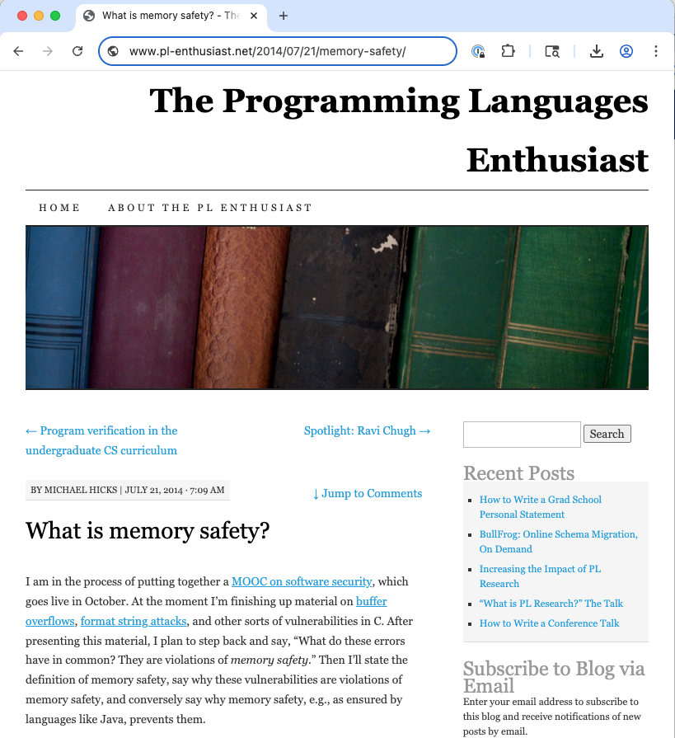
http://www.pl-enthusiast.net/2014/07/21/memory-safety/

Slide 3
Low-level attacks enabled by a
lack of Memory Safety
A memory safe program execution:
only creates pointers through standard means
p = malloc(…), or p = &x, or p = &buf[5], etc.
only uses a pointer to access memory that “belongs” to that pointer
Combines two ideas:
temporal safety and spatial safety

Slide 4
Spatial safety
View pointers as triples (p,b,e)
p is the actual pointer
b is the base of the memory region it may access
e is the extent (bounds) of that region
Access allowed iff b ≤ p ≤ e-sizeof(typeof(p))
Operations:
Pointer arithmetic increments p, leaves b and e alone
Using &: e determined by size of original type

Slide 5
Examples
int x; // assume sizeof(int)=4
int *y = &x; // p = &x, b = &x, e = &x+4
int *z = y+1; // p = &x+4, b = &x, e = &x+4
*y = 3; // OK: &x ≤ &x ≤ (&x+4)-4
*z = 3; // Bad: &x ≤ &x+4 ≤ (&x+4)-4
struct foo {
char buf[4];
int x;
};
struct foo f = { “cat”, 5 };
char *y = &f.buf; // p = b = &f.buf, e = &f.buf+4
y[3] = ‘s’; // OK: p = &f.buf+3 ≤ (&f.buf+4)-1
y[4] = ‘y’; // Bad: p = &f.buf+4 ≤ (&f.buf+4)-1

Slide 6
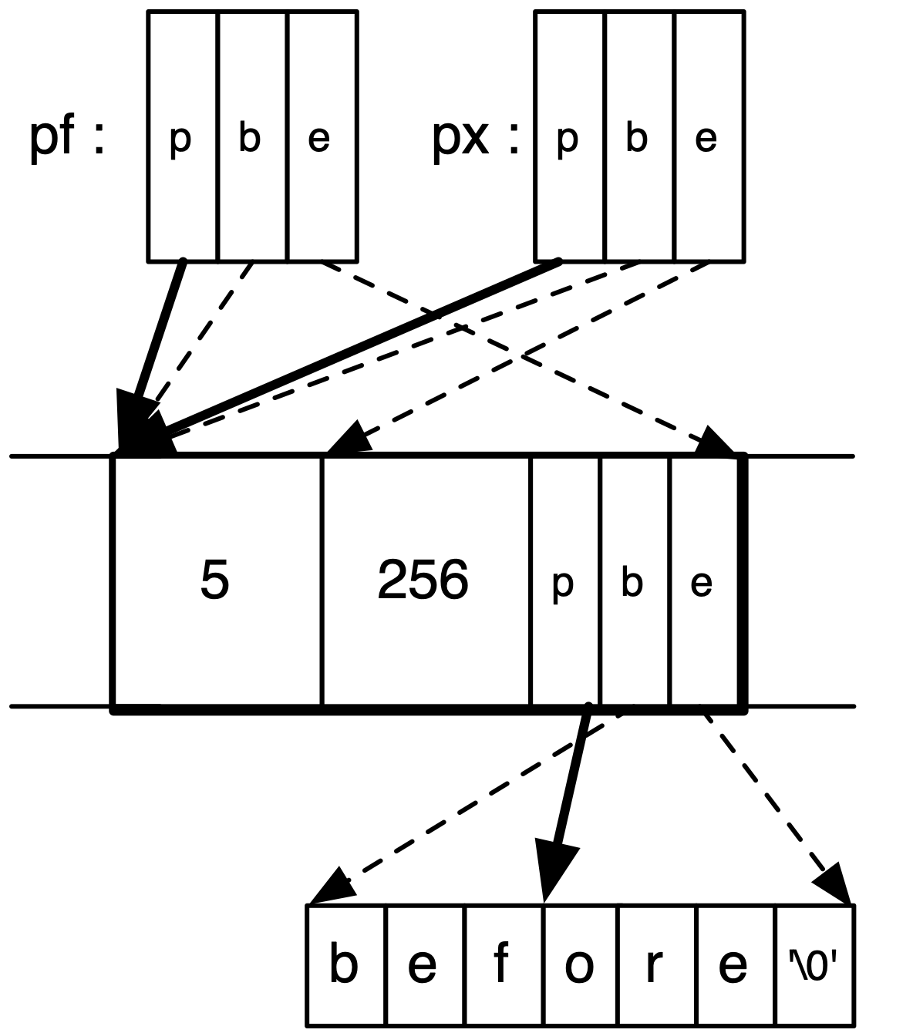
Visualized example
struct foo {
int x;
int y;
char *pc;
};
struct foo *pf = malloc(...);
pf->x = 5;
pf->y = 256;
pf->pc = "before";
pf->pc += 3;
int *px = &pf->x;

Slide 7
No buffer overflows
A buffer overflow violates spatial safety
Overrunning the bounds of the source and/or destination buffers implies either src or dst is illegal
void copy(char *src, char *dst, int len)
{
int i;
for (i=0;i<len;i++) {
*dst = *src;
src++;
dst++;
}
}

Slide 8
No format string attacks
The call to printf dereferences illegal pointers
View the stack as a buffer defined by the number and types of the arguments it provides
The extra format specifiers construct pointers beyond the end of this buffer and dereference them
Essentially a kind of buffer overflow
char *buf = “%d %d %d\n”;
printf(buf);

Slide 9
Temporal safety
A temporal safety violation occurs when trying to access undefined memory
Spatial safety assures it was to a legal region
Temporal safety assures that region is still in play
Memory regions either defined or undefined
Defined means allocated (and active)
Undefined means unallocated, uninitialized, or deallocated
Pretend memory is infinitely large (we never reuse it)

Slide 10

No dangling pointers
Accessing a freed pointer violates temporal safety
The memory dereferenced no longer belongs to p.
Accessing uninitialized pointers is similarly not OK:
int *p = malloc(sizeof(int));
*p = 5;
free(p);
printf(“%d\n”,*p); // violation
int *p;
*p = 5; // violation
Goes for NULL
pointers too

Slide 11
Integer overflows?
Allowed as long as they are not used to manufacture an illegal pointer
int f() {
unsigned short x = 65535;
x++; // overflows to become 0
printf(“%d\n”,x); // memory safe
char *p = malloc(x); // size-0 buffer!
p[1] = ‘a’; // violation
}
Integer overflows often enable buffer overflows
Happens often enough we think of them independently

Slide 12

Most languages are memory safe
The easiest way to avoid all of these vulnerabilities is to use a memory safe language
Modern languages are memory safe
Java, Python, C#, Ruby
Haskell, Scala, Go, Objective Caml, Rust
In fact, these languages are type safe, which is even stronger

Slide 13
Type Safety

Slide 14
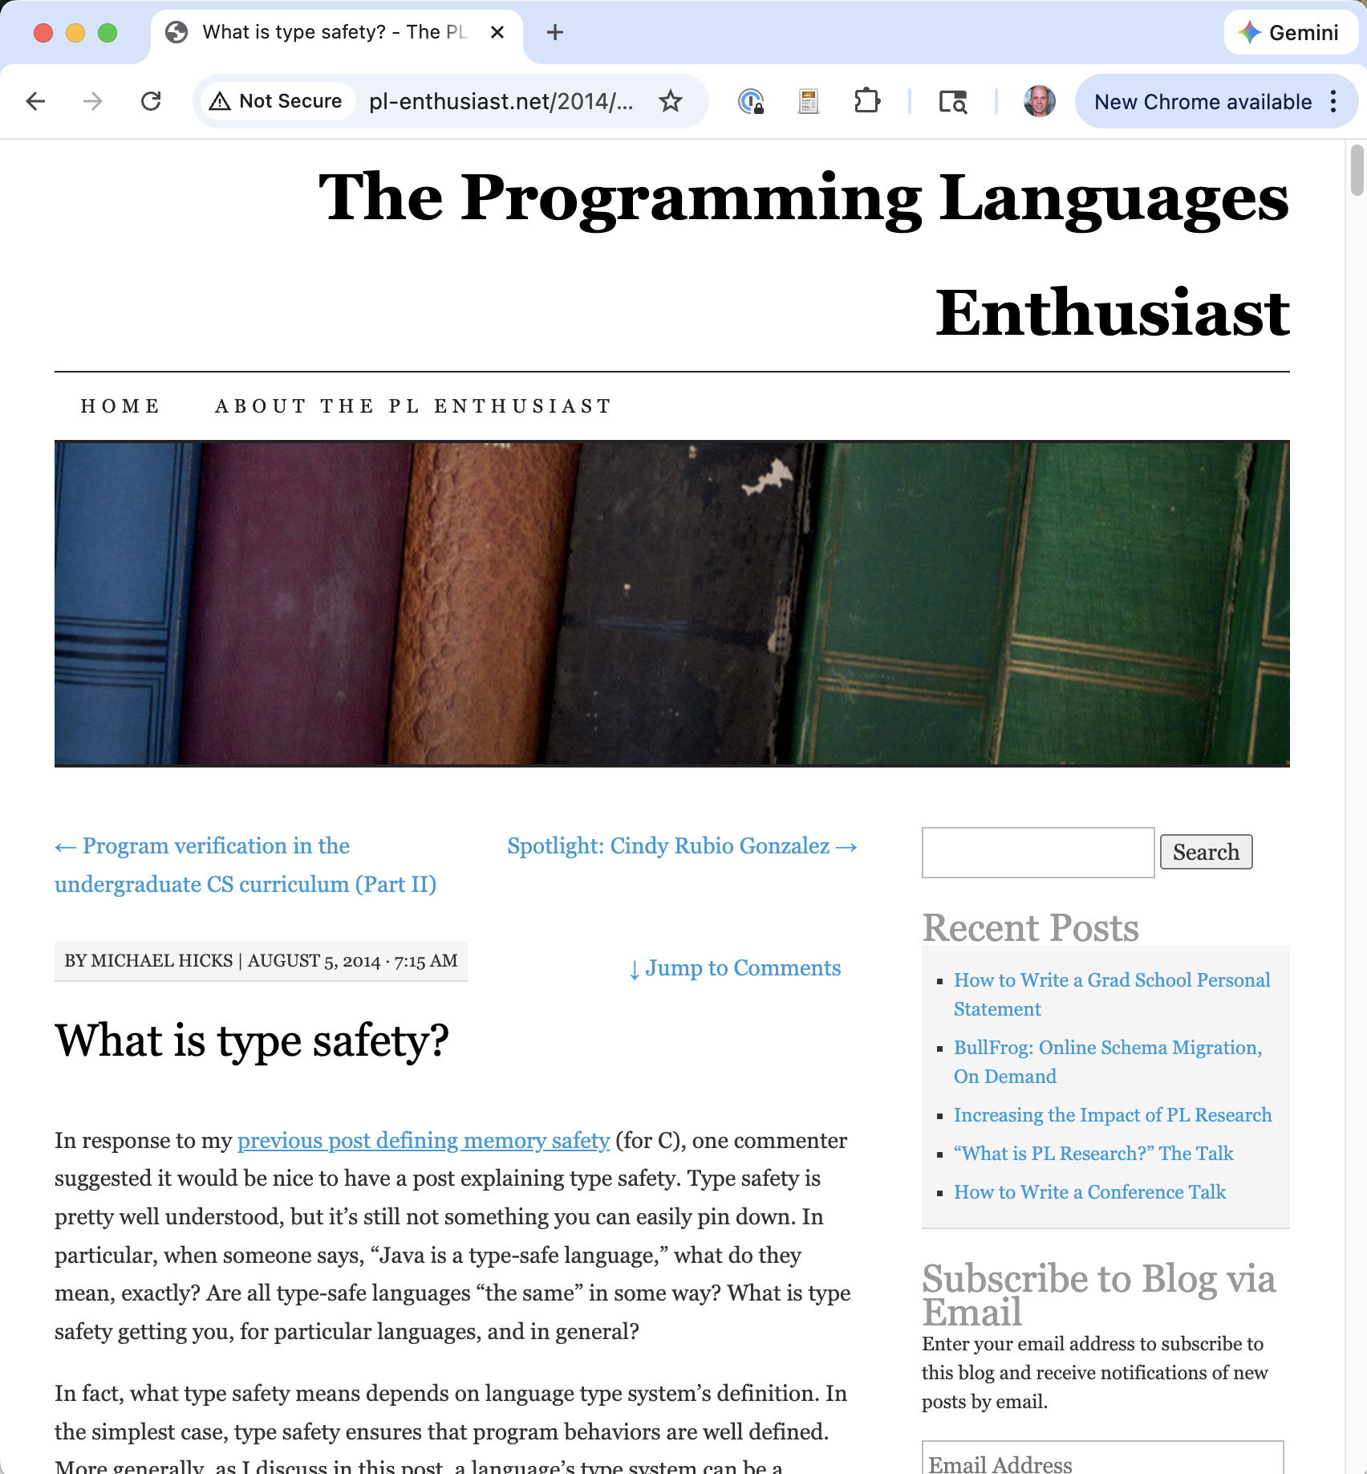
http://www.pl-enthusiast.net/2014/08/05/type-safety/

Slide 15
Type safety
Each object is ascribed a type (int, pointer to int, pointer to function, …), and
Operations on the object are always compatible with the object’s type
Type safe programs do not “go wrong” at run-time
Type safety is stronger than memory safety
int (*cmp)(char*,char*);
int *p = (int*)malloc(sizeof(int));
*p = 1;
cmp = (int (*)(char*,char*))p;
cmp(“hello”,”bye”); // crash!
Memory safe,
but not type safe

Slide 16
Dynamically typed languages
Dynamically typed languages, like Ruby and Python, which do not require declarations that identify types, can be viewed as type safe as well
Each object has one type: Dynamic
Each operation on a Dynamic object is permitted, but may be unimplemented
In this case, it throws an exception
Well-defined (but unfortunate)

Slide 17
Enforce invariants
Types really show their strength by enforcing invariants in the program
Notable here is the enforcement of abstract types, which characterize modules that keep their representation hidden from clients
As such, we can reason more confidently about their isolation from the rest of the program

Slide 18
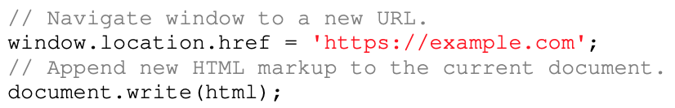
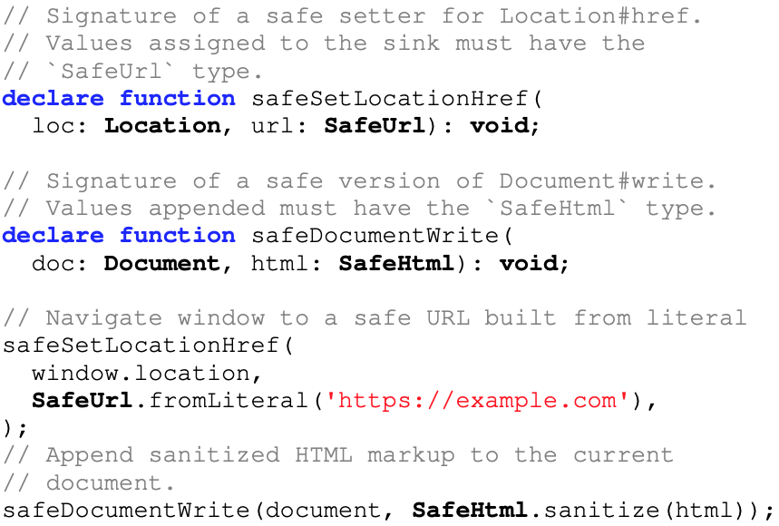
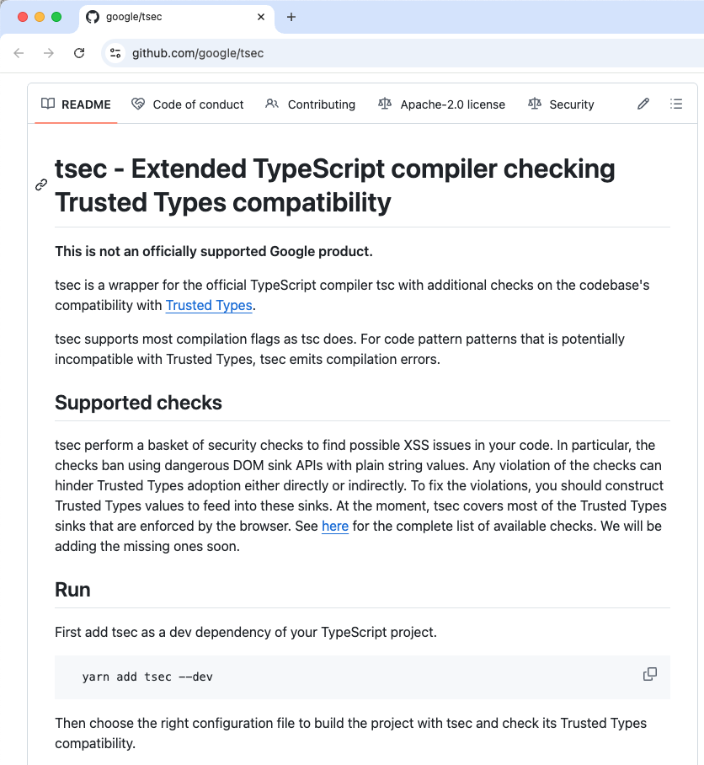
Type safety ensures safe coding
Type error! Requires SafeURL
Type error! Requires SafeHTML
Ok! A literal is a SafeURL
Ok! Surely-sanitized SafeHTML
Notes:
Source: github.com/google/safevalues (TypeScript).
https://storage.googleapis.com/gweb-research2023-media/pubtools/5955.pdf

Slide 19
Exotic types for security
Type-enforced invariants can relate directly to security properties
By expressing stronger invariants about data’s privacy and integrity, which the type checker then enforces
Example: Java with Information Flow (JIF)
int{Alice→Bob} x;
int{Alice→Bob, Chuck} y;
x = y; //OK: policy on x is stronger
y = x; //BAD: policy on y is not
//as strong as x
Types have security labels
Labels define what information flows allowed
http://www.cs.cornell.edu/jif

Slide 20
Why memory and type safety matter

Slide 21
Other defensive strategies
Against the possibility of memory safety exploits
Reduce chances of introducing a bug
Secure coding practices
Advanced code review and testing
E.g., program analysis, penetrating testing (fuzzing)
Make a bug harder to exploit
Examine necessary steps for exploitation, make one or more of them difficult, or impossible
Limit the damage of exploitation
Examine necessary steps for exploitation, make one or more of them difficult, or impossible

Slide 22
Challenge exploitability
Stack canaries
Address-space layout randomization (ASLR)
“write xor execute” (W⊕X)
Control-flow integrity (CFI)
Are these defenses working?
Limit the damage
Process-level isolation
Within-process compartments (eg., RLbox)

Slide 23
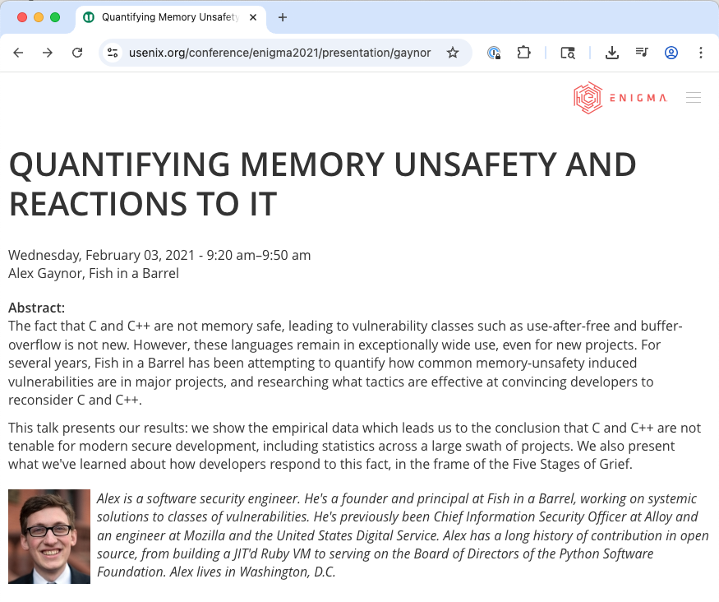
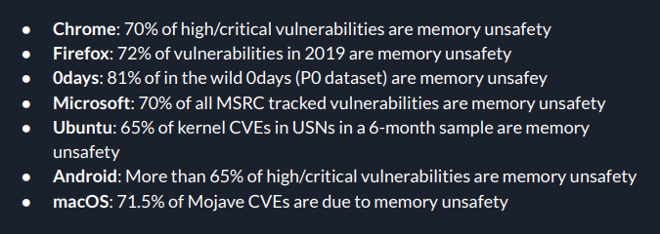

Slide 24
The 70% Statistic
Microsoft (2006–2018): ~70% of CVEs are memory safety issues [Miller, BlueHat IL 2019]
Google Chromium (2015–2020): ~70% of high/critical security bugs [chromium.org]
Mozilla Firefox (2002–2019): 32 of 34 critical/high style-component bugs [Hosfelt, Mozilla Hacks 2019]
Zero-days in the wild (2021): 67% memory corruption [Stone, Project Zero 2022]
CISA (2024): 52% of critical OSS projects use memory-unsafe languages
Notes:
These are independent findings from different organizations, all converging on the same conclusion. The consistency is striking — this is not one company’s problem, it’s a systemic issue with how we build software.
Sources: - Microsoft: Matt Miller, “Trends, Challenges, and Strategic Shifts in the Software Vulnerability Mitigation Landscape,” BlueHat IL, February 2019. Covers ~12 years of Microsoft CVEs (2006–2018). - Chromium: “Memory Safety,” chromium.org/Home/chromium-security/memory-safety/. Analysis of 912 high/critical-severity bugs since 2015. About half were use-after-free. - Mozilla: Diane Hosfelt, “Implications of Rewriting a Browser Component in Rust,” Mozilla Hacks, February 2019. Examined 69 bugs in Firefox’s CSS style component since 2002; 51 of 69 would have been impossible in Rust. - Project Zero: Maddie Stone, “The More You Know, The More You Know You Don’t Know,” April 2022. Of 58 in-the-wild 0-days detected in 2021, 39 (67%) were memory corruption. - CISA: “Exploring Memory Safety in Critical Open Source Projects,” June 2024 (joint with FBI, ASD ACSC, CCCS). Examined 172 critical open-source projects; 55% of total lines of code were in memory-unsafe languages.

Slide 25
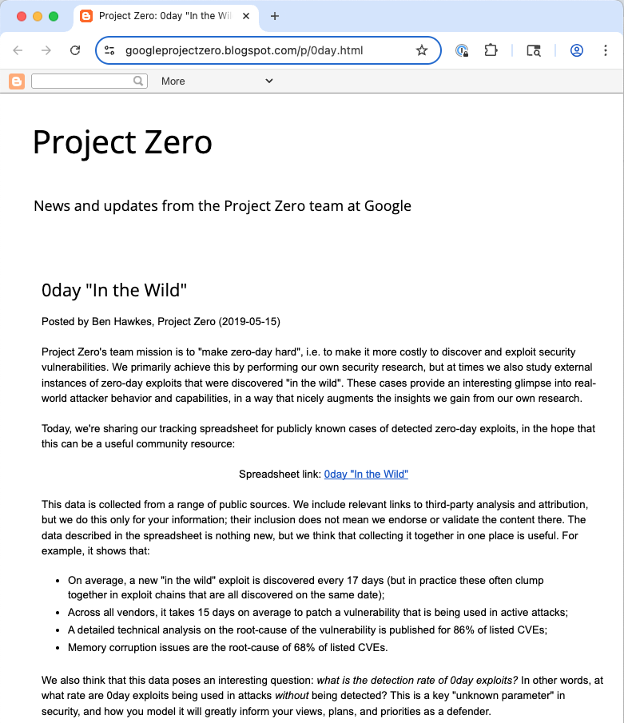
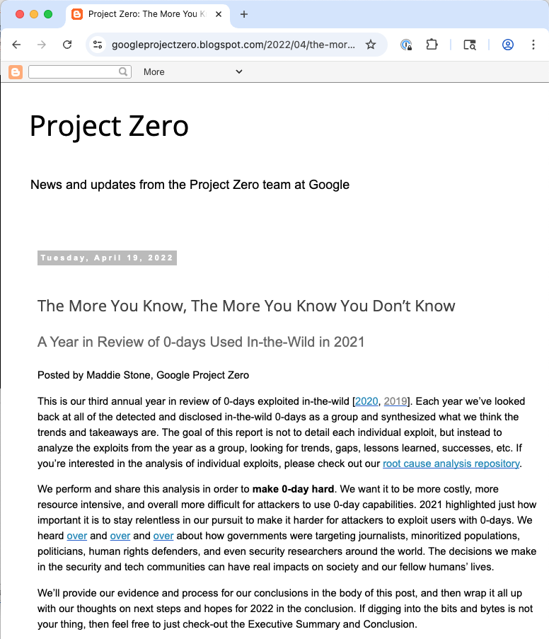

Slide 26
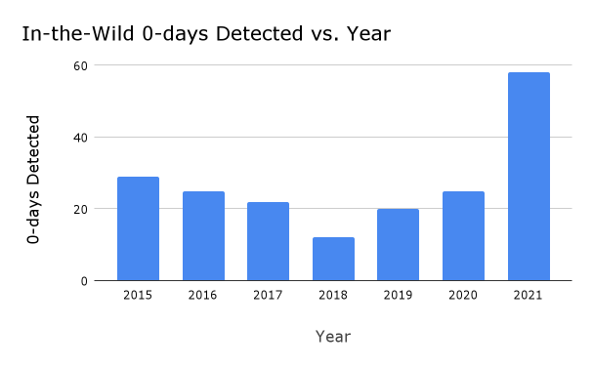

Slide 27
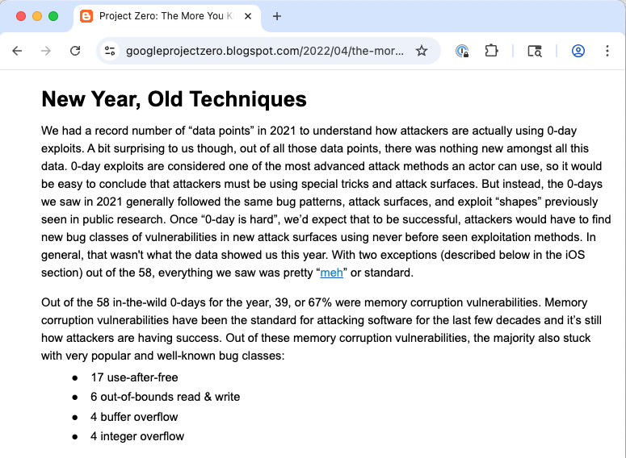
Out of the 58 in-the-wild 0-days for the year, 39, or 67% were memory corruption vulnerabilities.

Slide 28
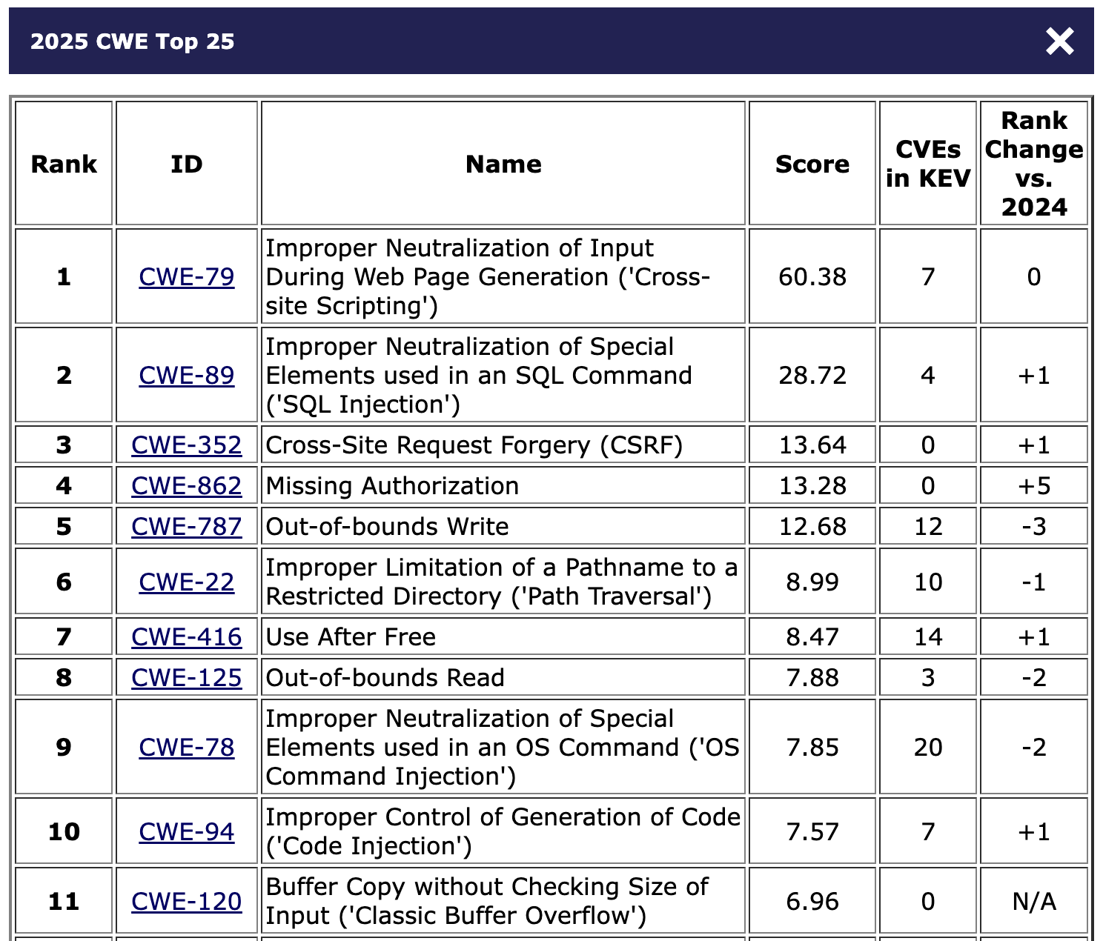
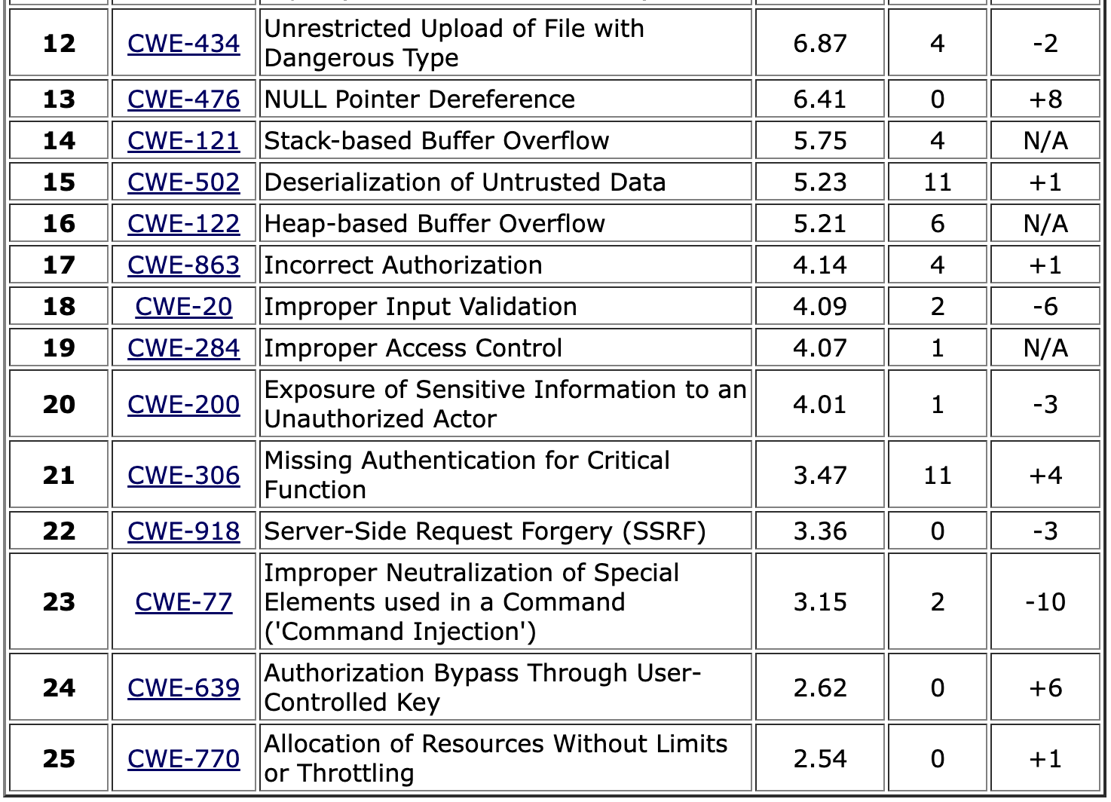
MITRE Top 25 CWEs
Spatial vulnerabilities (buffer overflow)
Temporal memory safety vulnerabilities
Notes:
This year’s dataset included 39,080 CVE Records for vulnerabilities published between June 1, 2024 and June 1, 2025.
https://cwe.mitre.org/top25/archive/2025/2025_methodology.html
Note: CVSS scores are between 0 and 10
The 2025 CWE Top 25 was the first to also employ CWE mapping suggestions from an LLM tool developed by Chris Madden (Yahoo!) as part of the CWE Root Cause Mapping Working Group (RCM WG).

Slide 29
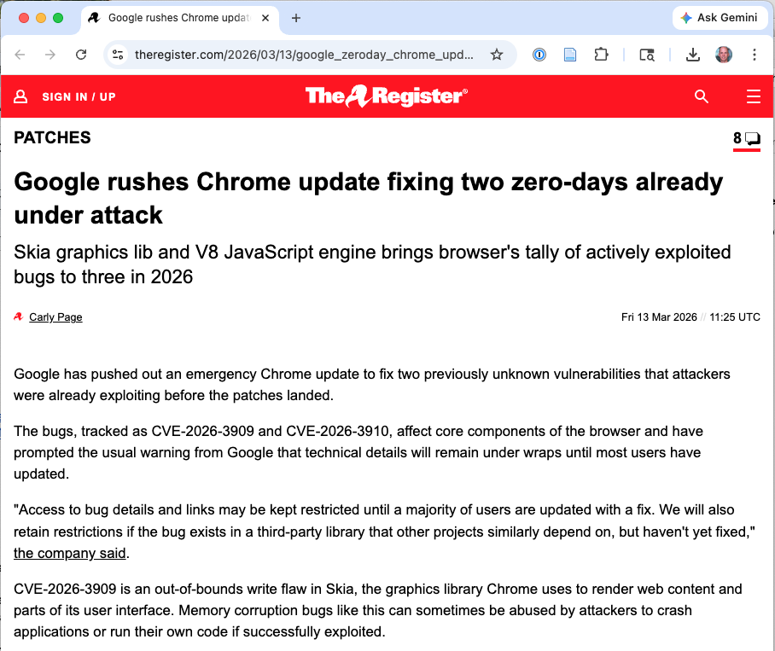
March 13, 2026
CVE-2026-3909 is an out-of-bounds write flaw in Skia, the graphics library Chrome uses to render web content and parts of the user interface

Slide 30
Why Has Memory Safety Been So Hard?

Slide 31
The Performance objection
Historic argument: memory safety costs too much performance
Garbage collection pauses (Java, Go)
Runtime bounds-check overhead
Fat-pointer overhead in C retrofits
The C/C++ position: direct memory control is essential for systems code (kernels, game engines, embedded)
Notes:
This was a legitimate concern for decades. Java’s GC pauses made it unsuitable for real-time or systems work. Bounds-checking C programs could see 10-30% overhead. C/C++ programmers were asked to choose between safety and performance.
Rust changed the equation: its ownership system manages memory at compile time with zero GC overhead and performance comparable to C/C++.

Slide 32
The Legacy Code problem
An enormous amount of critical software is C/C++: Linux kernel, network stacks, browser engines, embedded firmware
Complete rewrites are expensive, risky, and can introduce new bugs
Example: gitoxide (Rust reimplementation of git) — multi-year effort, still working toward feature parity

Slide 33
The Interoperability problem
Memory-safe and memory-unsafe code must coexist
FFI (Foreign Function Interface) calls cross language boundaries
A Rust program calling C via FFI requires unsafe blocks
The safety boundary is only as strong as its unsafe perimeter
Notes:
This is a practical constraint on any gradual transition. New safe components must interoperate with legacy unsafe components. The CACM 2025 article “It Is Time to Standardize Principles and Practices for Software Memory Safety” discusses the need for standardized interop practices.

Slide 34
Ergonomics and ecosystem maturity
Early memory-safe languages (Java, Go) weren’t suited for systems programming
Claim: Rust has a steep learning curve (the borrow checker takes time)
Tooling, libraries, and developer familiarity take years to mature

Slide 35
The “Just write better code” fallacy
“Skilled programmers should not need safety guardrails”
No historical precedent for a step-function improvement in human error rates from deciding to “try harder”
Improvements come from better tools and processes
We do not rely on pilots to “just be more careful” — we build checklists, automation, and redundant systems
Notes:
The ACM Queue article “Memory Safety for Skeptics” calls this out directly as “anti-intellectual nonsense.” Decades of data show that error rates in complex systems are driven by system design, not by individual skill. The aviation analogy is apt: commercial aviation became safe not by hiring better pilots, but by redesigning cockpits, adding checklists, and building redundant systems.

Slide 36

Is Rust the answer?
Performance: Rust provides low-level control and good performance
Legacy code: There are paths between “accept unsafety forever” and “rewrite everything immediately”
Interoperability: Rust tools help with this
Ergonomics and maturity: Rust tools, ecosystem are excellent, and LLMs provide further help
Notes:
The ACM Queue article “Memory Safety for Skeptics” calls this out directly as “anti-intellectual nonsense.” Decades of data show that error rates in complex systems are driven by system design, not by individual skill. The aviation analogy is apt: commercial aviation became safe not by hiring better pilots, but by redesigning cockpits, adding checklists, and building redundant systems.

Slide 37
Type- and Memory- Safety in Rust

Slide 38
The core insight
Make unsafe programs inexpressible in the type system
Bounds checks often removed (access proved safe)
Zero runtime overhead for ownership/borrowing
No garbage collector
Concurrency safety too!
Notes:
This is Rust’s key innovation. Instead of detecting or preventing errors at runtime, or requiring expensive formal proofs, Rust encodes safety rules into the type system. The compiler rejects programs that could violate memory safety. Safe Rust programs cannot have use-after-free, double-free, or data races — these are compile errors, not runtime errors.

Slide 39
Ownership: Every value has one owner
fn main() { let s1 = String::from("hello"); let s2 = s1; // ownership moves to s2 // println!("{}", s1); // COMPILE ERROR: // value borrowed here after move println!("{}", s2); // OK — s2 owns the data }
Notes:
In C, the equivalent would be two pointers to the same heap allocation. If you free through one pointer and then use the other, you have a use-after-free. In Rust, after the move, s1 is no longer valid — the compiler enforces this.
This also prevents double-free: drop (Rust’s equivalent of free) is called exactly once, when the unique owner goes out of scope.
See: examples/ownership_move.rs

Slide 40
Ownership: Automatic deallocation (RAII)
fn main() { { let s = String::from("hello"); println!("{}", s); } // s is dropped here — memory freed automatically // println!("{}", s); // COMPILE ERROR: // not found in this scope }
Manual drop() ok in some cases, as checked by compiler
Notes:
This is RAII (Resource Acquisition Is Initialization), a pattern borrowed from C++. But unlike C++, Rust’s ownership rules guarantee that the resource is freed exactly once. In C, you might forget to call free() (memory leak) or call it twice (double-free). Rust makes both impossible.
See: examples/ownership_drop.rs

Slide 41
Borrowing: The exclusivity invariant
At any point, you may have either:
Any number of immutable references (&T), OR
Exactly one mutable reference (&mut T)
Never both simultaneously
Notes:
This is the heart of Rust’s aliasing control. The rule prevents a whole class of bugs where one part of the code reads data while another part is modifying it. It also prevents data races in concurrent code.
The rule may seem restrictive, but it captures a fundamental truth: shared mutable state is the root cause of many bugs.

Slide 42
Borrowing in action
fn main() { let mut data = vec![1, 2, 3]; let r1 = &data; // immutable borrow — OK let r2 = &data; // another immutable borrow — OK println!("{:?} {:?}", r1, r2); let r3 = &mut data; // mutable borrow — OK (r1,r2 done) r3.push(4); println!("{:?}", r3); }
Notes:
The borrow checker tracks when each reference is last used (its “lifetime”) and ensures the rules aren’t violated. Here, r1 and r2 are both immutable borrows — that’s fine. After they’re last used, the mutable borrow r3 is allowed.
See: examples/borrowing.rs

Slide 43
Borrowing prevents Iterator invalidation
fn main() { let mut numbers = vec![1, 2, 3]; for n in &numbers { // numbers.push(42); // COMPILE ERROR: // cannot borrow `numbers` as mutable // because it is also borrowed as immutable println!("{}", n); } }
Notes:
In C++, modifying a container while iterating over it is undefined behavior — the iterator may be invalidated by a reallocation. This is a classic source of bugs. In Rust, the borrow checker prevents this at compile time: the for loop holds an immutable borrow of numbers, so you cannot simultaneously take a mutable borrow to push.
See: examples/iterator_invalidation.rs

Slide 44
Lifetimes: No dangling references
// This does NOT compile: fn dangling() -> &String { let s = String::from("hello"); &s // ERROR: s is dropped here, } // reference would dangle! // The safe version — return the owned value: fn not_dangling() -> String { let s = String::from("hello"); s // ownership moves to caller }
Notes:
The borrow checker tracks the lifetime of every reference and ensures it doesn’t outlive the data it points to. Returning a reference to a local variable is a compile error — the reference’s lifetime would exceed the variable’s scope.
When lifetimes can’t be inferred, Rust requires explicit lifetime annotations (’a). This is a known ergonomics pain point, but it makes the safety guarantees explicit.
See: examples/lifetimes.rs

Slide 45
Spatial safety: Bounds checking
fn main() { let data = vec![10, 20, 30, 40, 50]; // Runtime panic — NOT undefined behavior: // println!("{}", data[10]); // panicked at 'index out of bounds: // the len is 5 but the index is 10' // Safe alternative with .get(): match data.get(10) { Some(val) => println!("{}", val), None => println!("Out of bounds!"), } }
Notes:
Unlike C, where an out-of-bounds access silently reads or writes arbitrary memory (leading to bugs like Heartbleed), Rust panics — a controlled crash, not undefined behavior. No secrets are leaked, no code is executed.
Where the compiler can prove bounds statically (e.g., iterators), the check is elided entirely — zero overhead. Where it can’t, the O(1) check is the cost of safety.
See: examples/bounds_checking.rs

Slide 46
The unsafe escape hatch
unsafe allows:
Dereferencing raw pointers
Calling unsafe functions (e.g., FFI)
Accessing mutable globals
Implementing unsafe traits
unsafe does not disable the borrow checker for surrounding safe code
Notes:
Some correct programs can’t be expressed within safe Rust’s aliasing model. For example, split_at_mut returns two mutable references into the same slice — the borrow checker can’t verify they don’t overlap, even though the implementation guarantees it.
The principle: unsafe code should be isolated into small, well-audited modules that present a safe public interface. This is how Rust’s standard library is built.
Unsound unsafe blocks can introduce the same bugs Rust prevents. The Rust ecosystem has had real unsafe-related vulnerabilities. The unsafe boundary requires the same care as any security boundary.
See: examples/unsafe_example.rs

Slide 47
The unsafe escape hatch
let mut data = vec![1, 2, 3, 4, 5]; // split_at_mut needs unsafe internally because // the borrow checker can't verify non-overlapping // mutable slices — but it presents a safe API: let (left, right) = data.split_at_mut(3); left[0] = 10; right[0] = 40; println!("After split_at_mut: {:?}", data); // prints [10, 2, 3, 40, 5]
Notes:
Some correct programs can’t be expressed within safe Rust’s aliasing model. For example, split_at_mut returns two mutable references into the same slice — the borrow checker can’t verify they don’t overlap, even though the implementation guarantees it.
The principle: unsafe code should be isolated into small, well-audited modules that present a safe public interface. This is how Rust’s standard library is built.
Unsound unsafe blocks can introduce the same bugs Rust prevents. The Rust ecosystem has had real unsafe-related vulnerabilities. The unsafe boundary requires the same care as any security boundary.
See: examples/unsafe_example.rs

Slide 48
Rust vs. prior objections: Scorecard
Objection | Before Rust | Rust
GC pauses | Java, Go | No GC; RAII deallocation
Runtime overhead | Bounds-checked C | Elided where proven
Performance | “Use C/C++” | Comparable to C/C++
Systems programming | C only | Linux kernel, Android
C interop | Hard (Java) | FFI with explicit unsafe boundary
Notes:
Rust has addressed each of the major objections that prevented earlier memory-safe languages from being adopted for systems programming. It’s not perfect — the learning curve is real, and unsafe code is sometimes necessary — but it represents a qualitative shift in what’s possible.

Slide 49
Making Memory Safety Mainstream

Slide 50
Four steps of systemic change
Google’s four-generation framework [Vander Stoep & Rebert, Google Security Blog, Sept 2024]:
Reactive patching — fix after exploitation
Proactive mitigations — ASLR, canaries, CFI
Proactive discovery — fuzzing, sanitizers
Safe-by-design languages — prevent the bug class entirely
Safe Coding
Notes:
Each generation is better than the last, but only the fourth breaks the cycle. Generations 1-3 are all forms of ongoing cost: you must keep patching, keep tuning mitigations, keep fuzzing — forever. Generation 4 eliminates the class of bugs at the source.
Source: Jeff Vander Stoep and Alex Rebert, “Eliminating Memory Safety Vulnerabilities at the Source,” Google Online Security Blog, September 25, 2024. This post also presented the Android data showing memory safety CVEs dropping from 76% to 24%.
Key insight from Google’s Android data (we’ll see this in Section 6): the highest-leverage strategy is not to find and fix bugs but to stop introducing new ones.

Slide 51
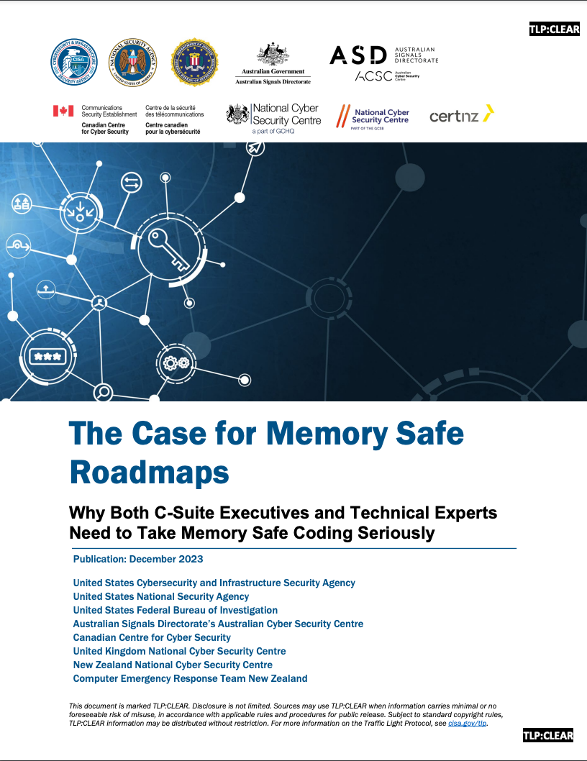
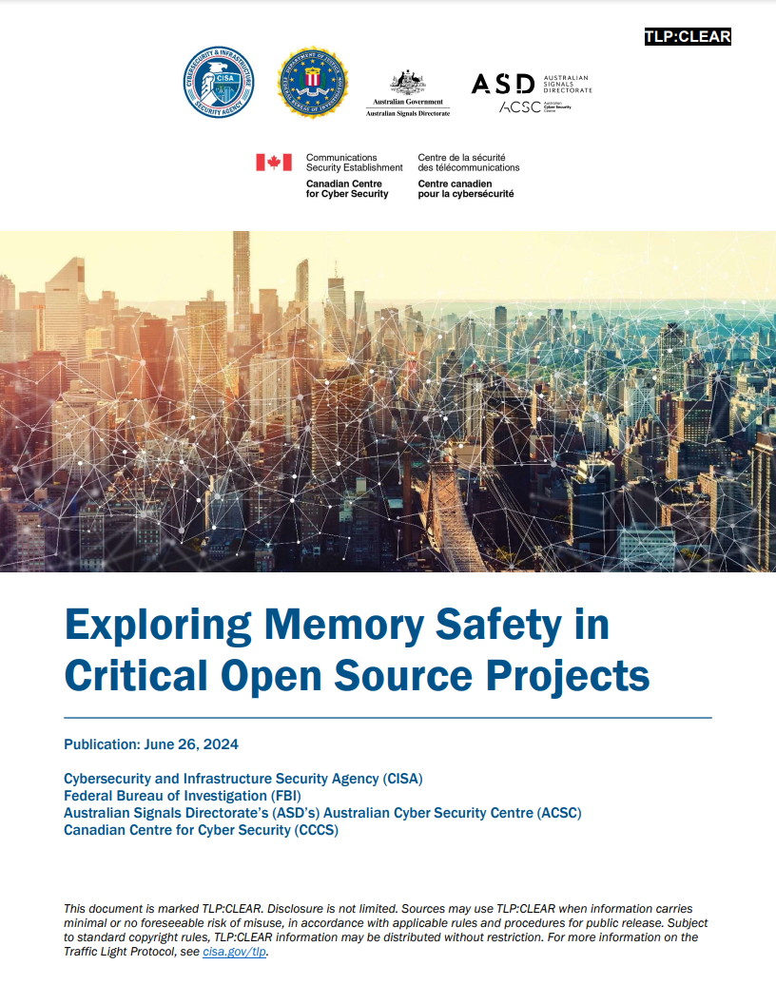
December 2023
June 2024
Notes:
2022-2024: CISA, NSA, Five Eyes — called for Memory Safe Roadmaps
White House (2024): “Back to the Building Blocks” — recommended memory-safe languages for new development
CISA “Secure by Design”: legacy mitigations are insufficient; prevention at the source is required
This is unprecedented: government agencies are now making specific technology recommendations about programming language choice. The signal is clear — memory safety is no longer just a technical preference, it’s becoming a policy expectation for critical infrastructure.

Slide 52
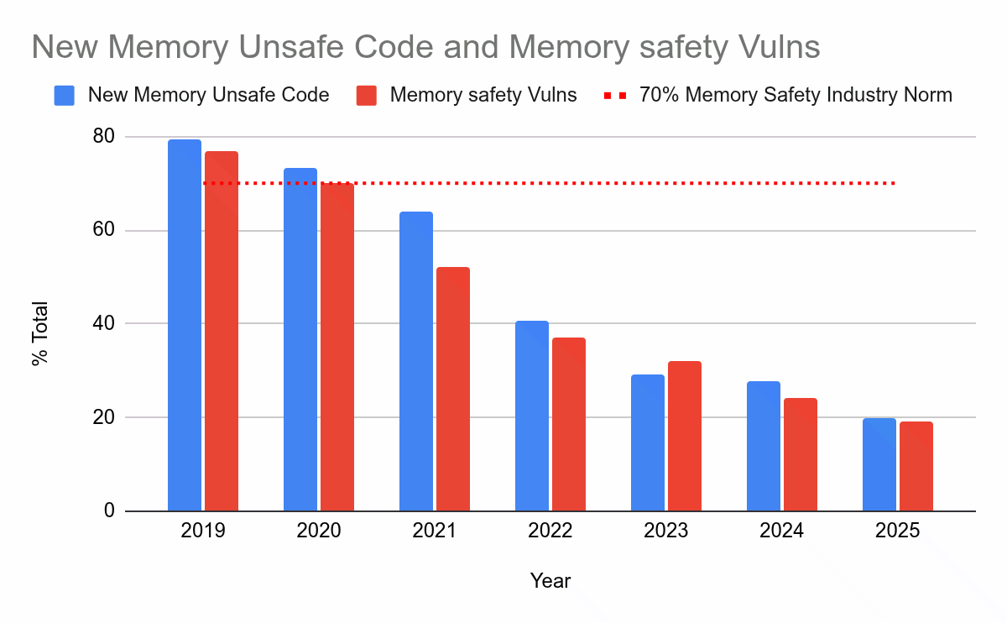
Android: Showing it can work
Android team began using Rust for new code in 2019
No mass rewrite of existing C/C++
Memory safety CVEs: 76% → 20% (74% reduction)
https://security.googleblog.com/2025/11/rust-in-android-move-fast-fix-things.html
Notes:
This is arguably the most important empirical result in the memory safety debate. Google didn’t rewrite Android in Rust — they just started writing new code in Rust. The dramatic reduction validates a key insight: bugs have a half-life. Older code has had its bugs found and fixed through years of testing and fuzzing. New code carries the highest concentration of vulnerabilities. Writing new code in a safe language has compounding benefits.
The ACM Queue “Practical Guide to Transitioning” describes a multi-stage adoption model: organizational alignment → enablement team → initial support → pilots → “Rust by exception” → “Rust by default.”

Slide 53
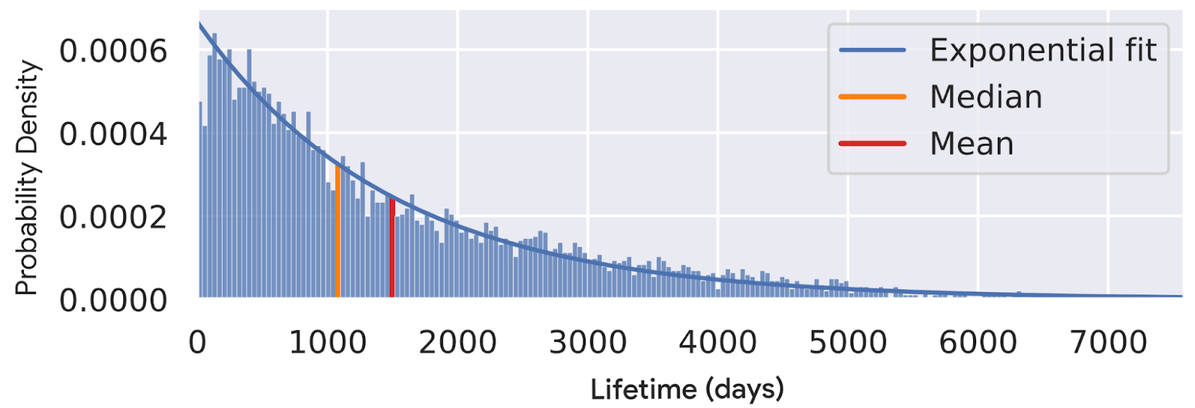
The bug half-life insight
“Bugs have a half-life — older code has had its bugs found and fixed”
New code has the highest vulnerability density
Writing new code safely has compounding benefit
You don’t need to rewrite everything — just stop introducing new bugs
https://www.usenix.org/conference/usenixsecurity22/presentation/alexopoulos
Notes:
This is the key insight from Google’s Android data. It reframes the problem: the legacy code question (“how do we fix all our old C?”) is less important than the new code question (“what are we writing new code in?”). Over time, the proportion of safe code grows, and the vulnerability rate drops — without any rewriting.

Slide 54
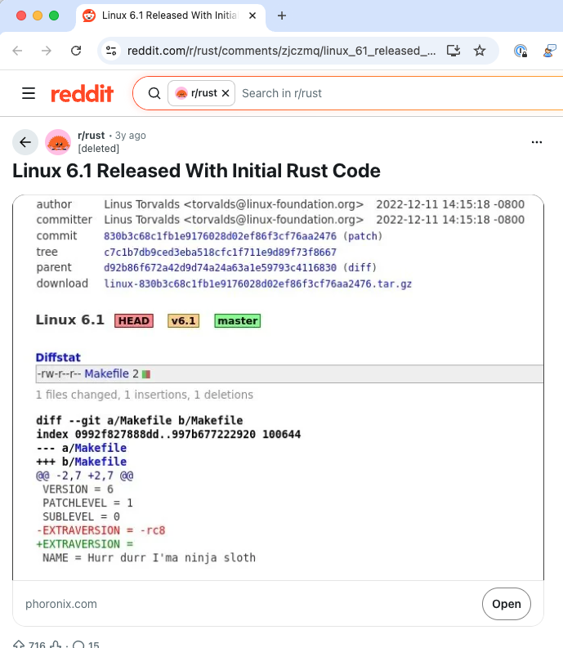
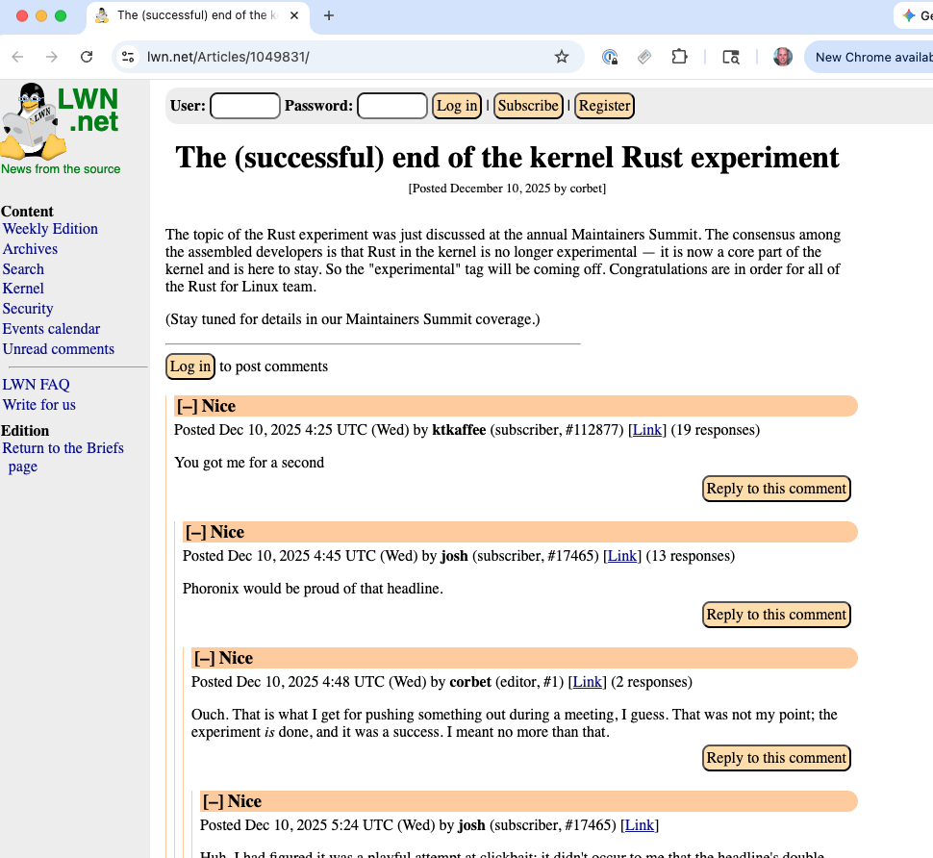
Rust in the Linux kernel
October 2022
December 2025
Challenge: kernel patterns (shared mutable state, cyclic structures) push against Rust’s ownership model
Notes:
Initial merge: Linus Torvalds merged Rust infrastructure into Linux 6.1 on October 3, 2022 (commit 8aebac82933f). ~12,500 lines of new code providing basic Rust support; building with Rust remained optional.
End of experimental status: On December 10, 2025, at the Linux Kernel Maintainers Summit, Miguel Ojeda (Rust-for-Linux lead maintainer) posted a patch titled “rust: conclude the Rust experiment” to remove the experimental designation. His statement: “the experiment is done, i.e. Rust is here to stay.” By this time, Android 16 devices running the 6.12 kernel were already shipping a Rust-written ashmem (anonymous shared memory) module on millions of devices.
New drivers and modules can be written in Rust
Android 16 devices already shipping Rust kernel modules in production
Multiple companies (Google, Arm, Microsoft) have full-time engineers on Rust-for-Linux. The kernel uses patterns that are difficult to express in safe Rust — unsafe blocks are needed in glue code, requiring careful auditing. The goal is pragmatic: make new driver development safer, not rewrite the kernel.

Slide 55
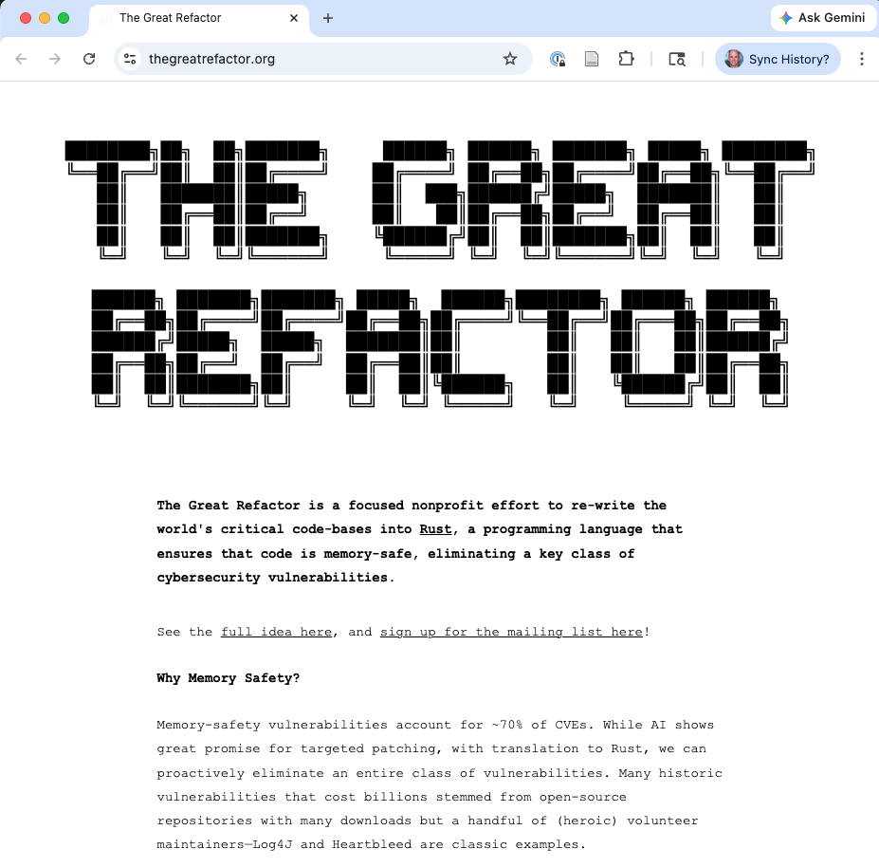
The Great Refactor
Proposal: government-funded AI-assisted translation of critical C/C++ → Rust
Target: ~100 million lines of OSS code by 2030
Estimated cost: $100 million
Builds on DARPA’s TRACTOR program (Translating All C To Rust)
Priority: parsing libraries, network protocols, system utilities
Notes:
The Institute for Progress (IFP) proposed establishing a Focused Research Organization (FRO) to use AI tools to translate critical open-source C/C++ libraries into Rust. This is ambitious but reflects the scale of the problem.
Key challenge: translated code must be idiomatic Rust, not just mechanically converted C. A direct translation would use unsafe extensively and miss the safety benefits. Functional equivalence must be formally validated.
DARPA’s TRACTOR program, launched in 2024, explores AI-assisted C-to-Rust translation. Early results are promising but the problem is far from solved.

Slide 56
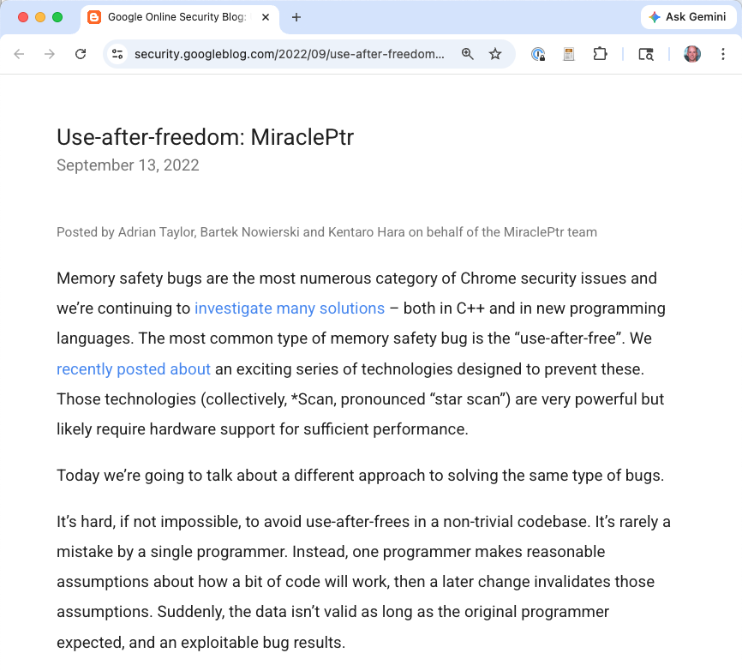
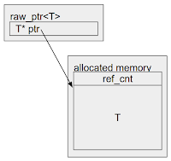
Gradual hardening of existing code
MiraclePtr (Chrome): smart pointer reducing use-after-free by >50%
class A { ... };
class B {
B(A* a) : a_(a) {}
void doSomething() { a_->doSomething(); }
raw_ptr<A> a_; // MiraclePtr
};
std::unique_ptr<A> a = std::make_unique<A>();
std::unique_ptr<B> b = std::make_unique<B>(a.get());
…
a = nullptr; // The free is delayed because the MiraclePtr
// is still pointing to the object.
b->doSomething(); // Use-after-free is neutralized.
Notes:
These are “middle path” strategies for code that won’t be rewritten. Each addresses a piece of the problem:
MiraclePtr (a.k.a. BackupRefPtr / raw_ptr<T>) is a smart pointer that makes use-after-free safely detectable (crash instead of exploit) with modest overhead: Taylor, Nowierski, and Hara, "Use-after-freedom: MiraclePtr," Google Online Security Blog, September 2022. Mitigated 57% of use-after-free vulnerabilities in privileged Chrome processes. A follow-up in January 2024 expanded to more platforms.

Slide 57
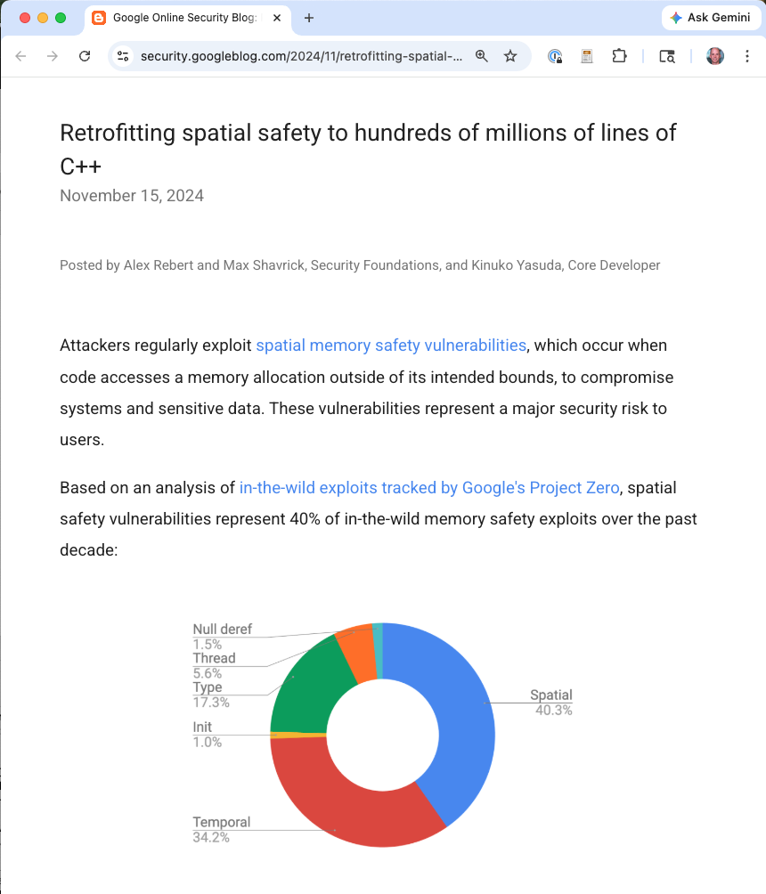
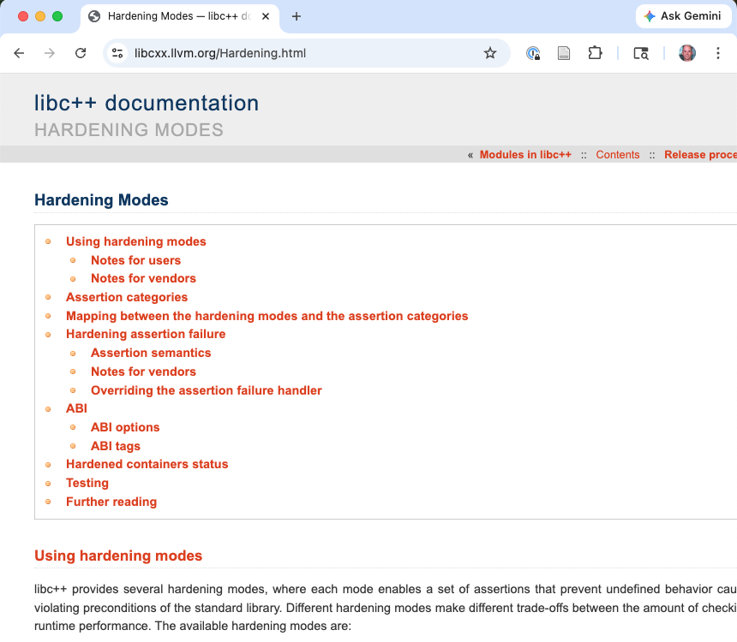
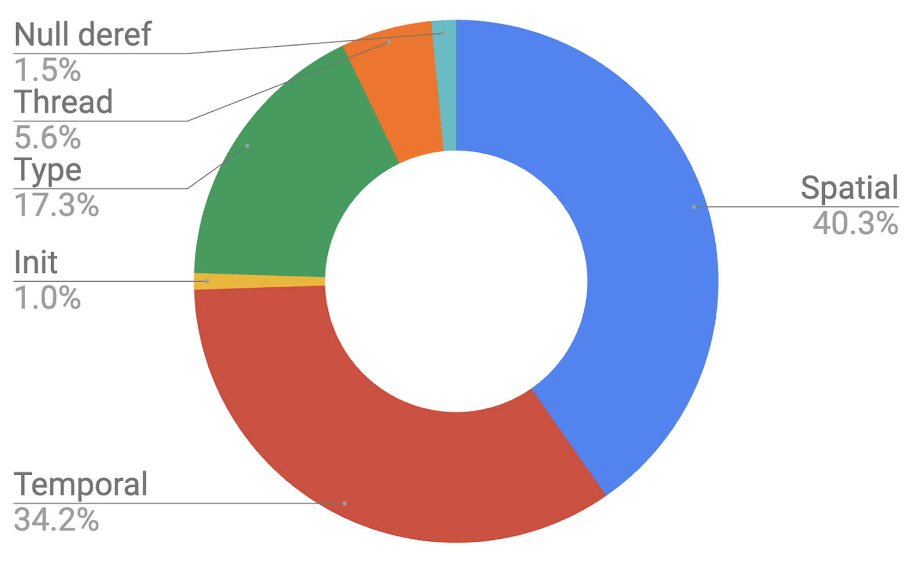
Gradual hardening of existing code
MiraclePtr (Chrome): smart pointer reducing use-after-free by >50%
Bounds-checking in C++ stdlib (Google, MSVC hardened mode)
Notes:
Bounds-checking in C++ stdlib: Rebert, Shavrick, and Yasuda, "Retrofitting spatial safety to hundreds of millions of lines of C++," Google Online Security Blog, November 2024. Deployed hardened libc++ across Chrome (since 2022) and Google's server-side production with average 0.30% overhead. Built on LLVM's "RFC: C++ Buffer Hardening" (2022). Microsoft's equivalent: MSVC STL Hardening (github.com/microsoft/STL/wiki/STL-Hardening), enabled via _MSVC_STL_HARDENING=1. Both efforts feed into WG21 paper P3471R1, "Standard library hardening."
ARM MTE in Android: Mark Brand, "First handset with MTE on the market," Google Project Zero Blog, November 2023. The Pixel 8 / Pixel 8 Pro were the first production handsets with user-mode MTE support.
C++ Profiles: Bjarne Stroustrup, P3081R2, "Core safety profiles for C++26," WG21, February 2025. Also P3651R0, "Profiles are essential" (March 2025). Inspired by Rust's borrow rules; controversial in the C++ community but represents recognition that the status quo is untenable.
The practical strategy combines these: new code in Rust, existing code hardened with the best available tools.

Slide 58
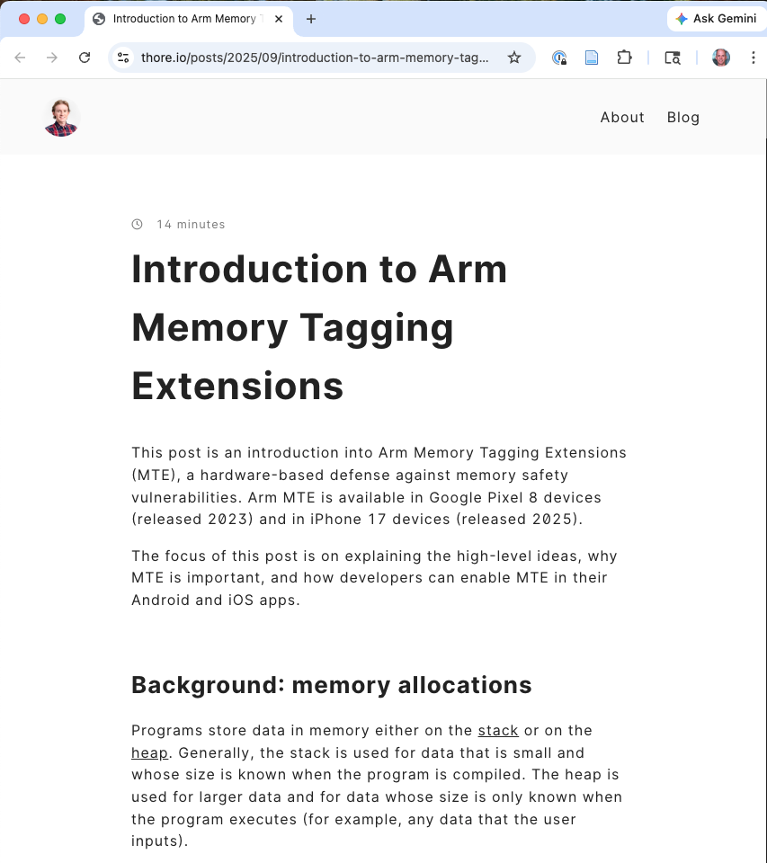
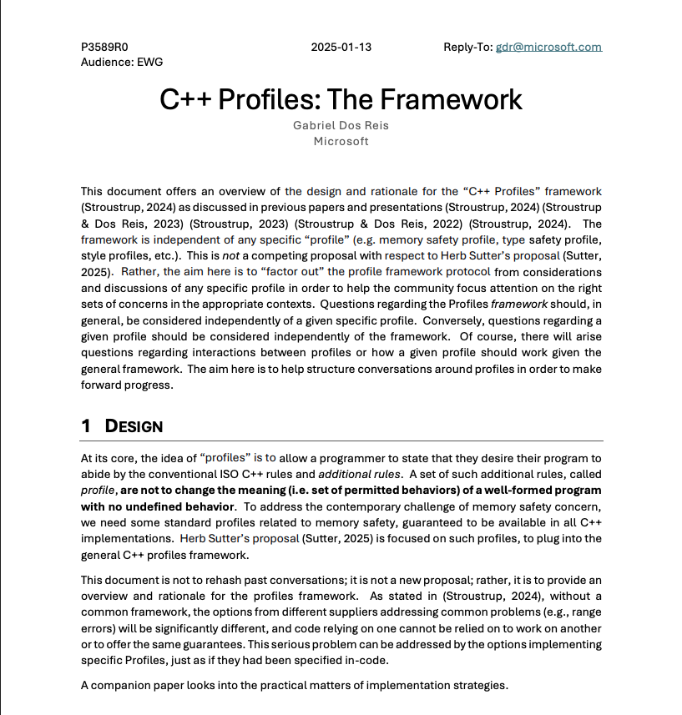
Gradual hardening of existing code
MiraclePtr (Chrome): smart pointer reducing use-after-free by >50%
Bounds-checking in C++ stdlib (Google, MSVC hardened mode)
ARM MTE in Android: hardware use-after-free detection
C++ Profiles (C++26 proposed): compiler-enforced safe subset
Notes:
ARM MTE in Android: Mark Brand, "First handset with MTE on the market," Google Project Zero Blog, November 2023. The Pixel 8 / Pixel 8 Pro were the first production handsets with user-mode MTE support.
C++ Profiles: Bjarne Stroustrup, P3081R2, "Core safety profiles for C++26," WG21, February 2025. Also P3651R0, "Profiles are essential" (March 2025). Inspired by Rust's borrow rules; controversial in the C++ community but represents recognition that the status quo is untenable.
The practical strategy combines these: new code in Rust, existing code hardened with the best available tools.

Slide 59
Key Takeaways
Notes:
Implication for practitioners: new code should use a memory-safe language by default. Legacy code should be hardened with the best available combination of sanitizers, hardware mitigations, and incremental safe-language introduction at the boundary.

Slide 60
Key Takeaways
Memory safety = access only defined memory through legitimate pointers
~70% of security vulnerabilities are memory safety bugs
“Write better code” doesn’t work; better tools and languages do
Rust enforces safety at compile time with low runtime overhead
Write new code safely; harden legacy code with available tools
The transition is happening: Android, Linux kernel, government policy
Notes:
Implication for practitioners: new code should use a memory-safe language by default. Legacy code should be hardened with the best available combination of sanitizers, hardware mitigations, and incremental safe-language introduction at the boundary.

Slide 61
Discussion
The definition frames pointers as capabilities. How does this explain why C is unsafe but Java is safe, even though both use heap objects?
ASan detects spatial and temporal errors. Why not ship everything with ASan enabled?
Give an example of a safe pattern Rust’s borrow checker rejects. How does unsafe address this, and what are its risks?
Android reduced memory CVEs without rewriting C/C++. What does this tell us about where to invest?
What would CHERI need to become as widespread as ASLR?

