Slide 1

Applied Security Operations at Penn
Sam Jenkins
Sr it security engineer
Isc office of information security
Email: security@isc.upenn.edu
P: (215) 898-2172
URL: https://www.isc.upenn.edu/security/
Notes:
Introduce myself:
* At Penn since 2014
* In government two years prior to that
* In an information security master’s program like this one before that.
So I can better understand where what perspectives you all are bringing to this class, can I ask by a show of hands who among you:
Have a degree in computer science or something similar?
Have worked in operational IT? (setting up servers, network appliances, running services that others use?)
Have worked in tech making the tools that people like me set up and run?
Who plans to get a job in operational IT? Developing tools for operational IT?
Have managed Windows? Macs? Linux? FreeBSD? Any BSD?
Know what SSH is? RDP? SMTP? HTTP? DNS? Kerberos? NTP?
Have worked in the defense industry? Aerospace? Healthcare? Finance? Tech?
Heard of chess? Go? Played either? Played either in a tournament? Are nationally or internationally ranked player?

Slide 2
Penn is Not Normal
Decentralization!
12 schools, 36 administrative centers
About 2000 departments
5 campuses
60,000 active users
We had Tor exit nodes!
Security is even decentralized
Office of Information Security
Information Security Officers in the Schools/Centers
System security is a responsibility of system owners
Secure IT is IT done well
Notes:
I will be discussing some challenges we face
I’m really only going to talk in-depth about vulnerability management, detection tools, and the incident response process.
Those things are done in the larger context of many other structures, controls and constraints.
To the outside, Penn is a big institution with 60,000 students and employees on campus every day.
Functionally, we’re a collection of small IT shops. I’m imbedded in our largest one, ISC, which has about 300 people. Some of smaller schools and centers have only one IT person on staff.
The CISO has the ethos secure IT is IT done well. To that end, he puts a lot of effort into initiatives outside the CISO’s office. He pushes for funding for newer technologies that other operational departments will deploy, and for policies on how IT as a whole should be run.

Slide 3
Security operations is about workflows, not tools
Notes:
This is my key message.

Slide 4
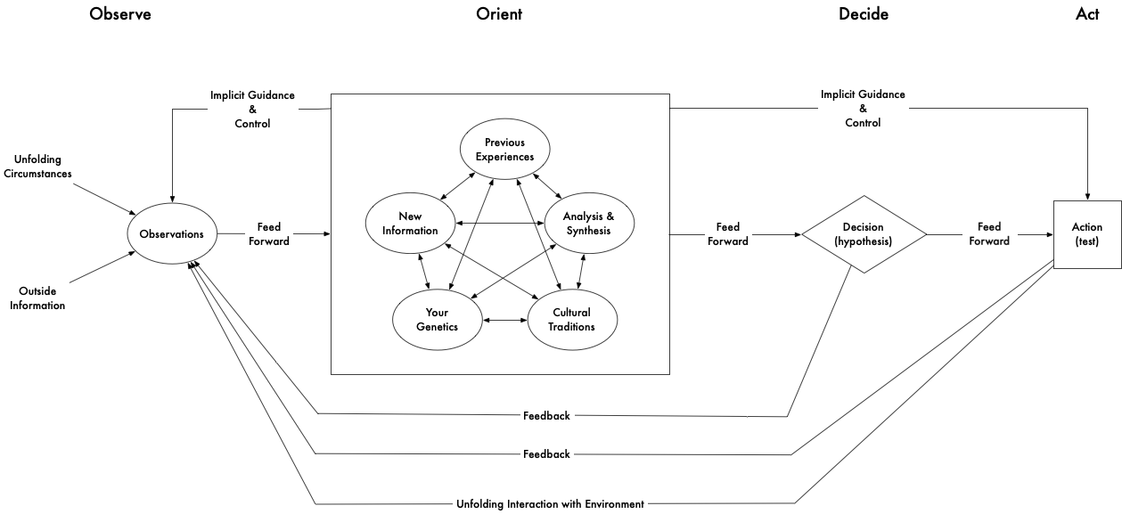
Orient me to the class
Notes:
Does anyone recognize this diagram?
When I was starting out in infosec 16 years ago, this was the talk of the philosophically inclined.
It’s the OODA loop, from John Boyd.
Boyd: fighter pilot, maverick, instrumental in making the F-16 a superior dogfighter
Those of us who like to think about how we do our work like to bring this up in discussions like those we’ll have today
It’s a model for describing your ability to make decisions during an adversarial engagement.

Slide 5
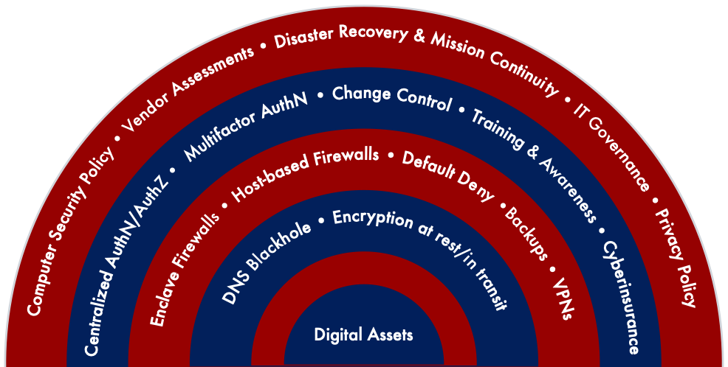
Penn does a lot…
Notes:
Penn does far more in the realm of security planning and operations than what I’m about to go into depth talking about. Instead I’m going to demonstrate how some of our tools work together during incident response.
Most of the things on this page are things you’ve been learning about as security controls, but here at Penn, they’re implemented outside of the security department. I’ll focus this talk on the things I spend more of my time on and that drive incident detection and response.
< walk through list explaining who does each, especially how OIS doesn’t run firewalls and IAM, operational IT teams do>
Policies:
IT governance on how we should do IT policy making
IT Security Policy for the controls we all must use
Data Risk Classification to spell out what data are public, sensitive, and regulated.
Standards and guidelines for things like password complexity requirements, what to log, etc.
Change control: the effort to coordinate the schedule of major changes and reconfigurations so that we don’t cause an outage.
Not part of OIS, managed by the operations teams deploying our infrastructure
Continuous improvement:
YubiKey roll-out
YubiKey + PIN

Slide 6
Asset Inventory

Slide 7
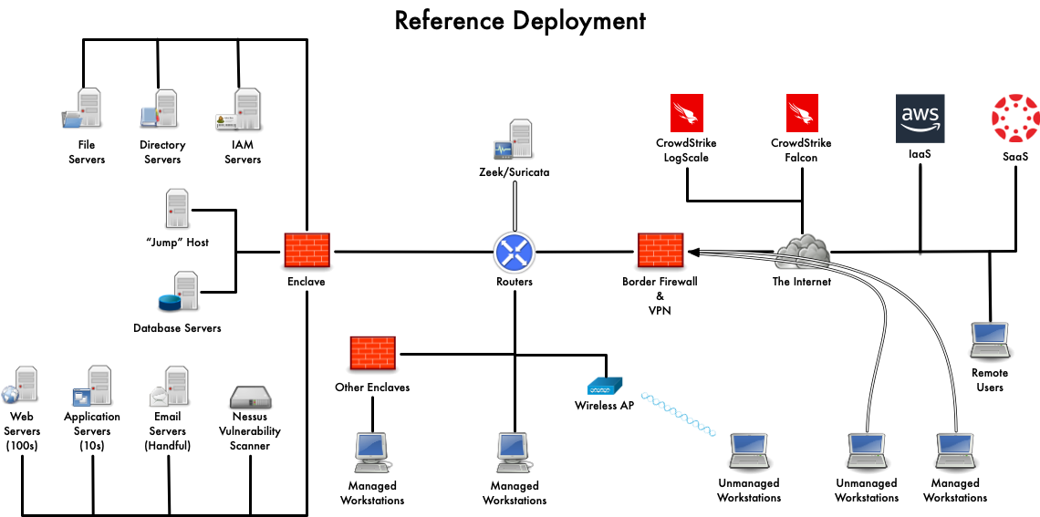
Notes:
This is a simplified representation of a network like Penn’s. Some things to keep in mind.
Every network is the product of your company’s history, geography, budget, in-house expertise, and management style. They’re truly socio-technical systems.
Anyone know what an Autonomous System is? Penn registered for one in 1985.
Enclave:
These are your typical on-prem, enterprise services (web, apps, email), and services for those services (file share, AD, IAM)
A shop like ISC will systems like this.
Other enclaves:
It’s pretty typical for enterprises to segment off workstations from their shared services
At Penn, this is often done at the School or Center level
And by the way: for those Schools and Centers with big IT shops, this can also be a set of enclaves, replicating a lot of the Enclave
Outside of enclaves:
Managed workstations
Unmanaged workstations (personal devices)
Border firewall
This didn’t exist when I started!
It made the local news when it was deployed.
It’s best practice to use default deny.
Cloud services:
Crowdstrike
Have you seen Iaas and Saas? Anyone know which logo that is?
VPN links
Remote users

Slide 8
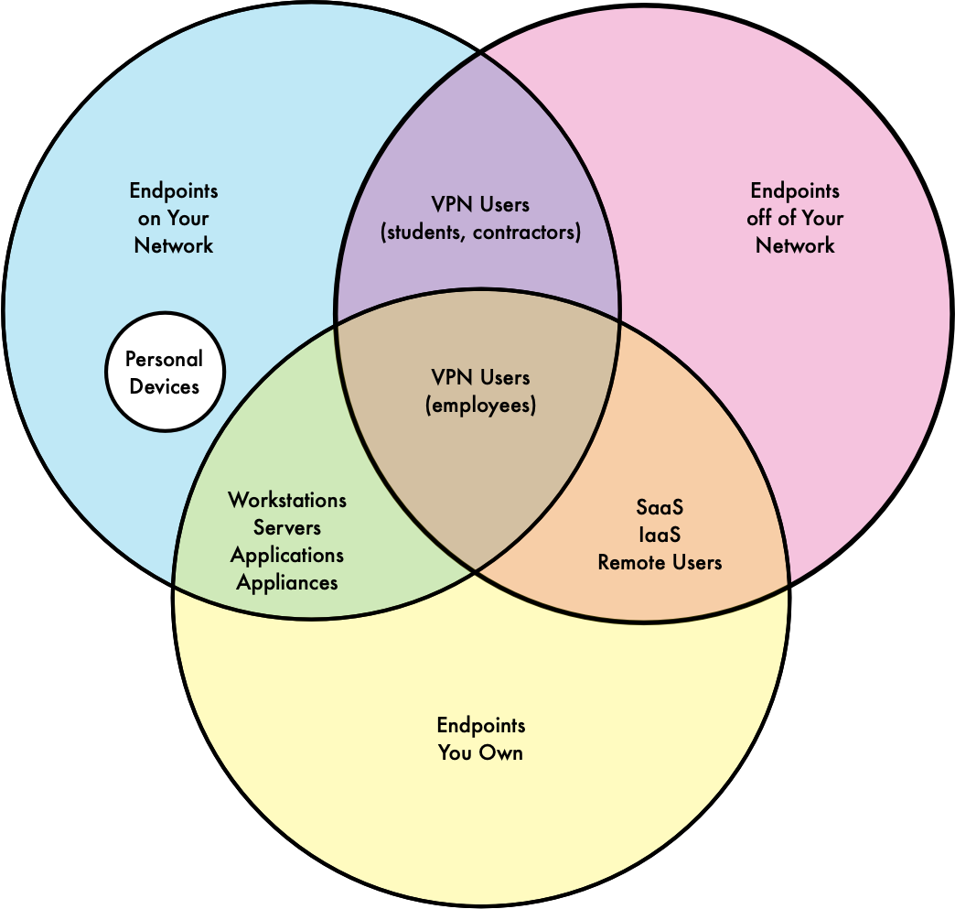
Notes:
This diagram captures the exciting challenge of inventorying your IT assets at a university.
Penn operates four IPv4 /16 CIDR networks, so we have 260k public IPv4 addresses.
Additionally, we NAT portions of the network into RFC 1918 space, giving us even more IPv4 addresses.
We operate an IPv6 /32 CIDR network, giving us 2^96 or 7.9 * 10^28 IPv6 addresses.
Clockwise:
* Endpoints on your network
* Endpoints off of your network
* Endpoints you own
We have IaaS assets run by different IT operations teams that coordinate at a high level, but that generally do their own thing.
Some network endpoints are extremely sticky. I’m sure we’ve had some endpoints that have been using the same IP address for decades. My team just decommissioned a host that had been using the same IP address for over a decade.
At the same time, some hosts are extremely transient. Personal devices, virtual machines.

Slide 9
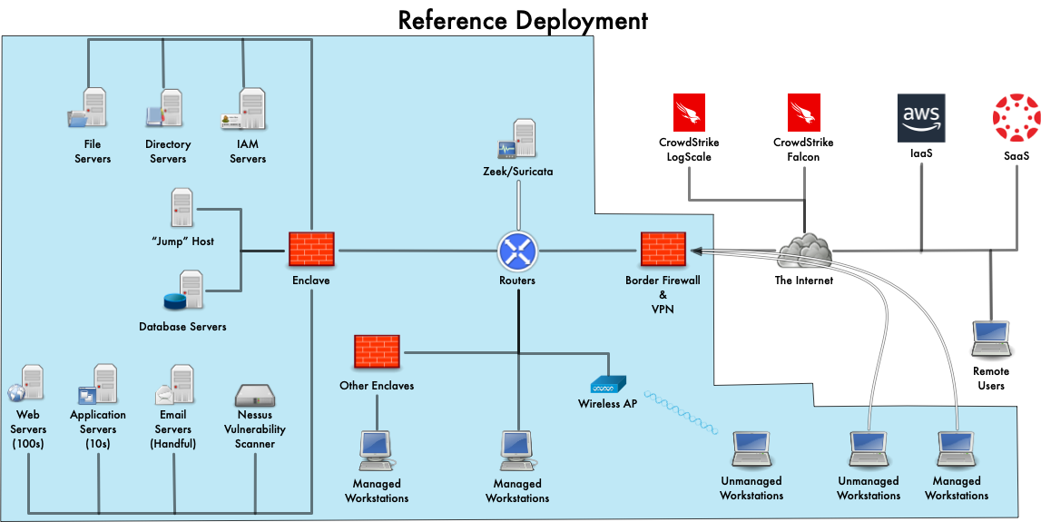

Slide 10
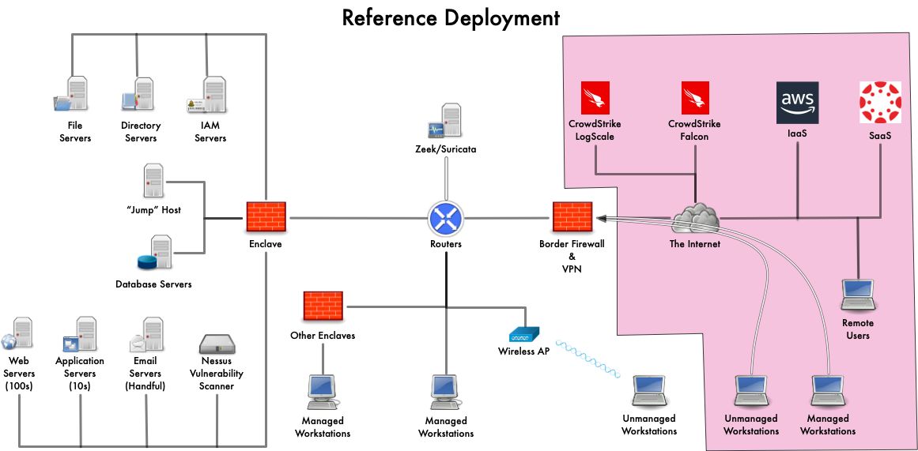

Slide 11
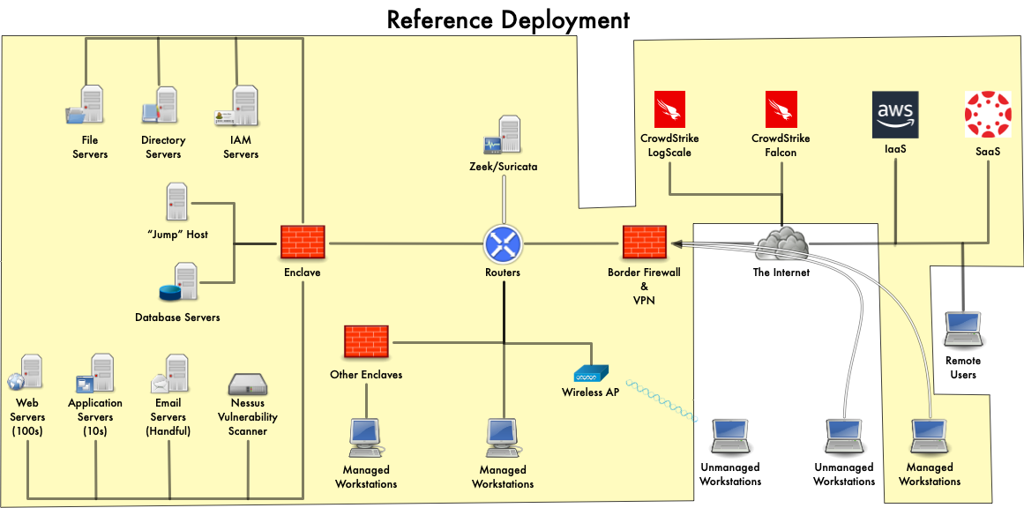

Slide 12
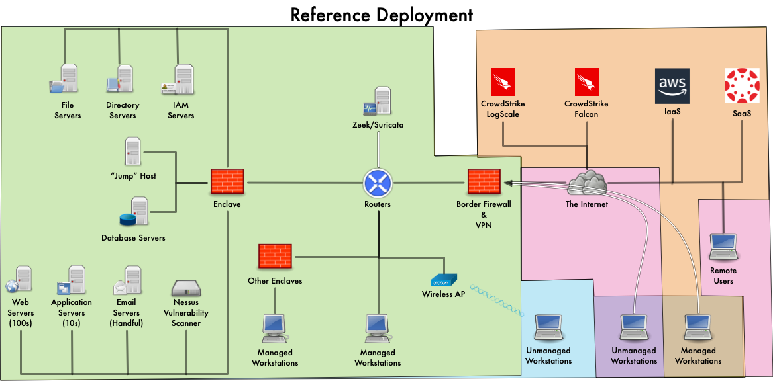
Notes:
Putting together our reference network and our Venn diagram: these are the things we have to keep track of.

Slide 13
Inventories: three approaches
Data-oriented:
Data Risk Classification
Annual inventory of data (Security & Privacy Impact Assessment, aka SPIA) by schools & centers
Criticality-oriented:
System owners register hosts and applications in central repository (Critical Components)
Operations-oriented:
IP Address Management (IPAM) captures metadata on IP addresses and domain names
Continuous improvement
As you deploy/discover/delete datasets, update SPIA
As you deploy/discover/decommission assets, update Critical Components.
Results of threat hunting, penetration testing, and audits.
Risk Cloud starting to replace Critical Components and SPIA in FY27.
Notes:
I’ve only heard of one kind of environment (healthcare) in which there’s a single source of truth for asset inventory, a single CMDB. And I bet it’s incomplete.
Each time we’ve looked into what it would take to purchase a single-pane of glass product, we run into the headwinds of cost and complexity. Complexity being a special form of cost.
We’re starting to make headway on this. Crowdstrike Falcon, our EDR tool, runs as an agent installed on our workstations and servers, and has the ability to probe its network neighbors to learn if they’re hosts with the agent installed.

Slide 14
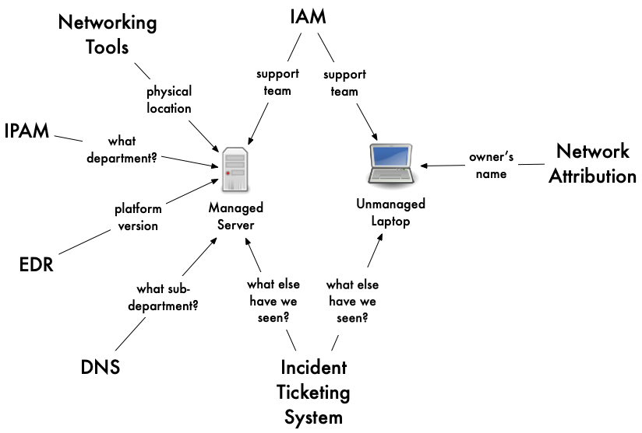
Source Systems as “Inventories”
Notes:
Unless you’re in a start up, you will inherit infrastructure, rather that build it. Here are some the things you’ll probably find in-place.

Slide 15
Asset Inventory Challenges
Multiple departments
Different naming conventions
Different patch cycles
Different kinds of devices (workstations, servers, appliances, IaaS, SaaS, OT, etc.)
Different deployment tools
Ephemerrality:
Of presence ( Local today, remote tomorrow; on/off; crashed?)
Of identity
Notes:
<Talk through this slide>

Slide 16
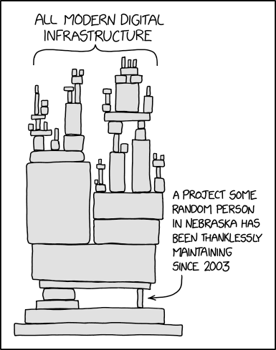
Vulnerability Management
https://xkcd.com/2347/
Notes:
Having belabored the importance of knowing what you have, let’s talk about why it’s so important….

Slide 17
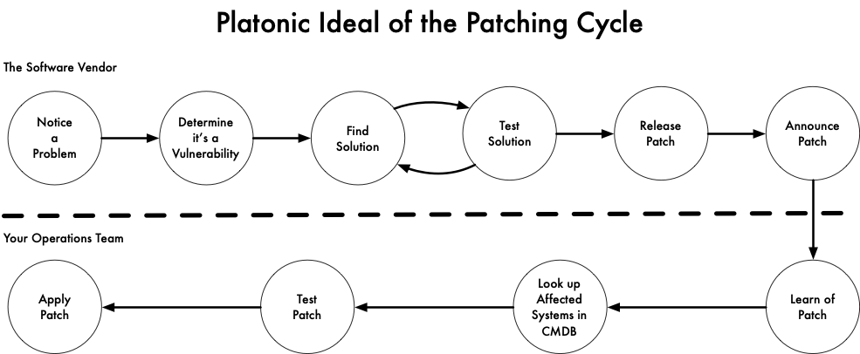
Notes:
This is what patching a software vulnerability would look like in Plato’s realm of the forms.
In terms of volume, I’d say most vulnerabilities are discovered and remediated in this way.
How many of you run Windows? Have you ever gone to shutdown your computer, only to find that Windows wants to install a few score of updates? That’s this, and you’re doing a good job!

Slide 18
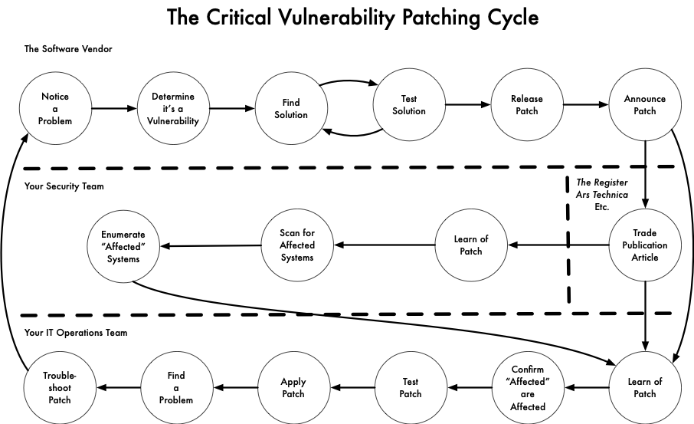
Notes:
From the realm of the forms we move to the realm of enterprise software.

Slide 19
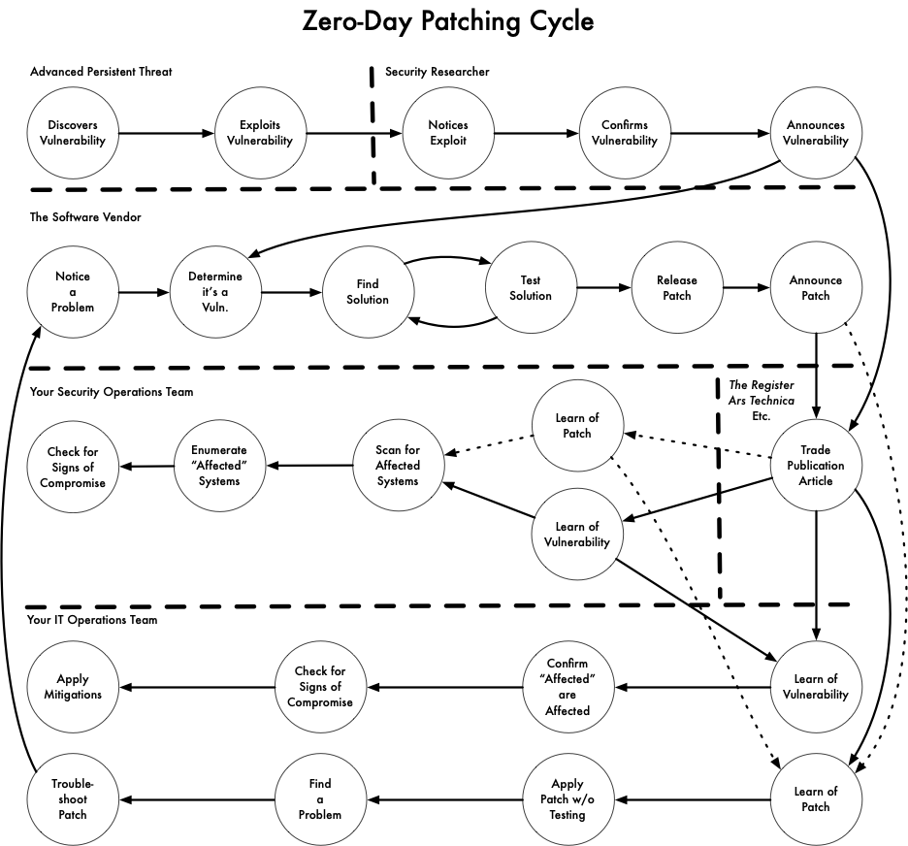
Notes:
This happens on the order of every few years. Heartbleed, WannaCry, etc.
Sometimes you learn of the vulnerability before a patch is available. Then you’re in a mad rush to first find affected systems, make sure compensating controls are in-place, and look for signs of compromise. Then, the patch comes out, and you need to patch and test.
Might need to apply a patch to the patch if you learn that the first one didn’t fully solve the vulnerability, or introduced a new one!

Slide 20
Patch Management Practices
Prompt patching: 2 business days for critical vulnerabilities.
Scheduled scans:
Daily for Critical Components
Weekly for all of campus for Critical vulnerabilities
Weekly review for situational awareness and to chase down stragglers.
Defense-in-depth for when you can’t patch fast enough
IP access restrictions
Force authentication
Inbound traffic filtering
Endpoint Detection & Response
Logging
Run less software, or shift risk to SaaS
Notes:
How many of you set your personal laptop or phone to automatically install updates?
Now, how many of you have done that on a server?
It would be nice to do automated patching on servers, but doing so carries risk.
Enterprise applications in particular are very finicky. They tend to be built for a particular release of a platform and expect little to change.

Slide 21
Detection Tools
Notes:
Now, the last thing I want to do is scare you out of an exciting career! There is hope!
I’ll talk about four tools for security incident detection, each aimed at different layers of the stack:
Zeek, a “network security monitoring” tool for visibility into what took place on the network in broad terms.
Suricata, an IDS, to look for specific patterns indicating compromise.
Crowdstrike Falcon, an eXtended Detection and Response (XDR) tool, for detecting OS-level compromises.
Crowdstrike LogScale, a log analysis tool, for detecting signs of intrusion in logs (firewall, application, etc.)

Slide 22
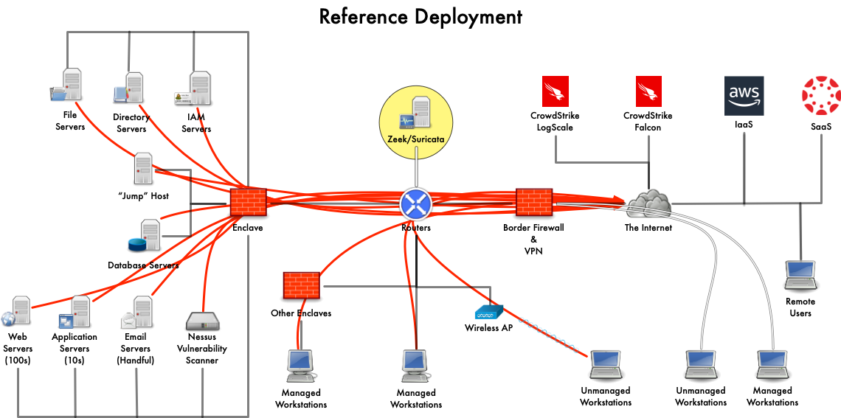
Notes:
Zeek:
Vantage
Encryption: we don’t break it.

Slide 23
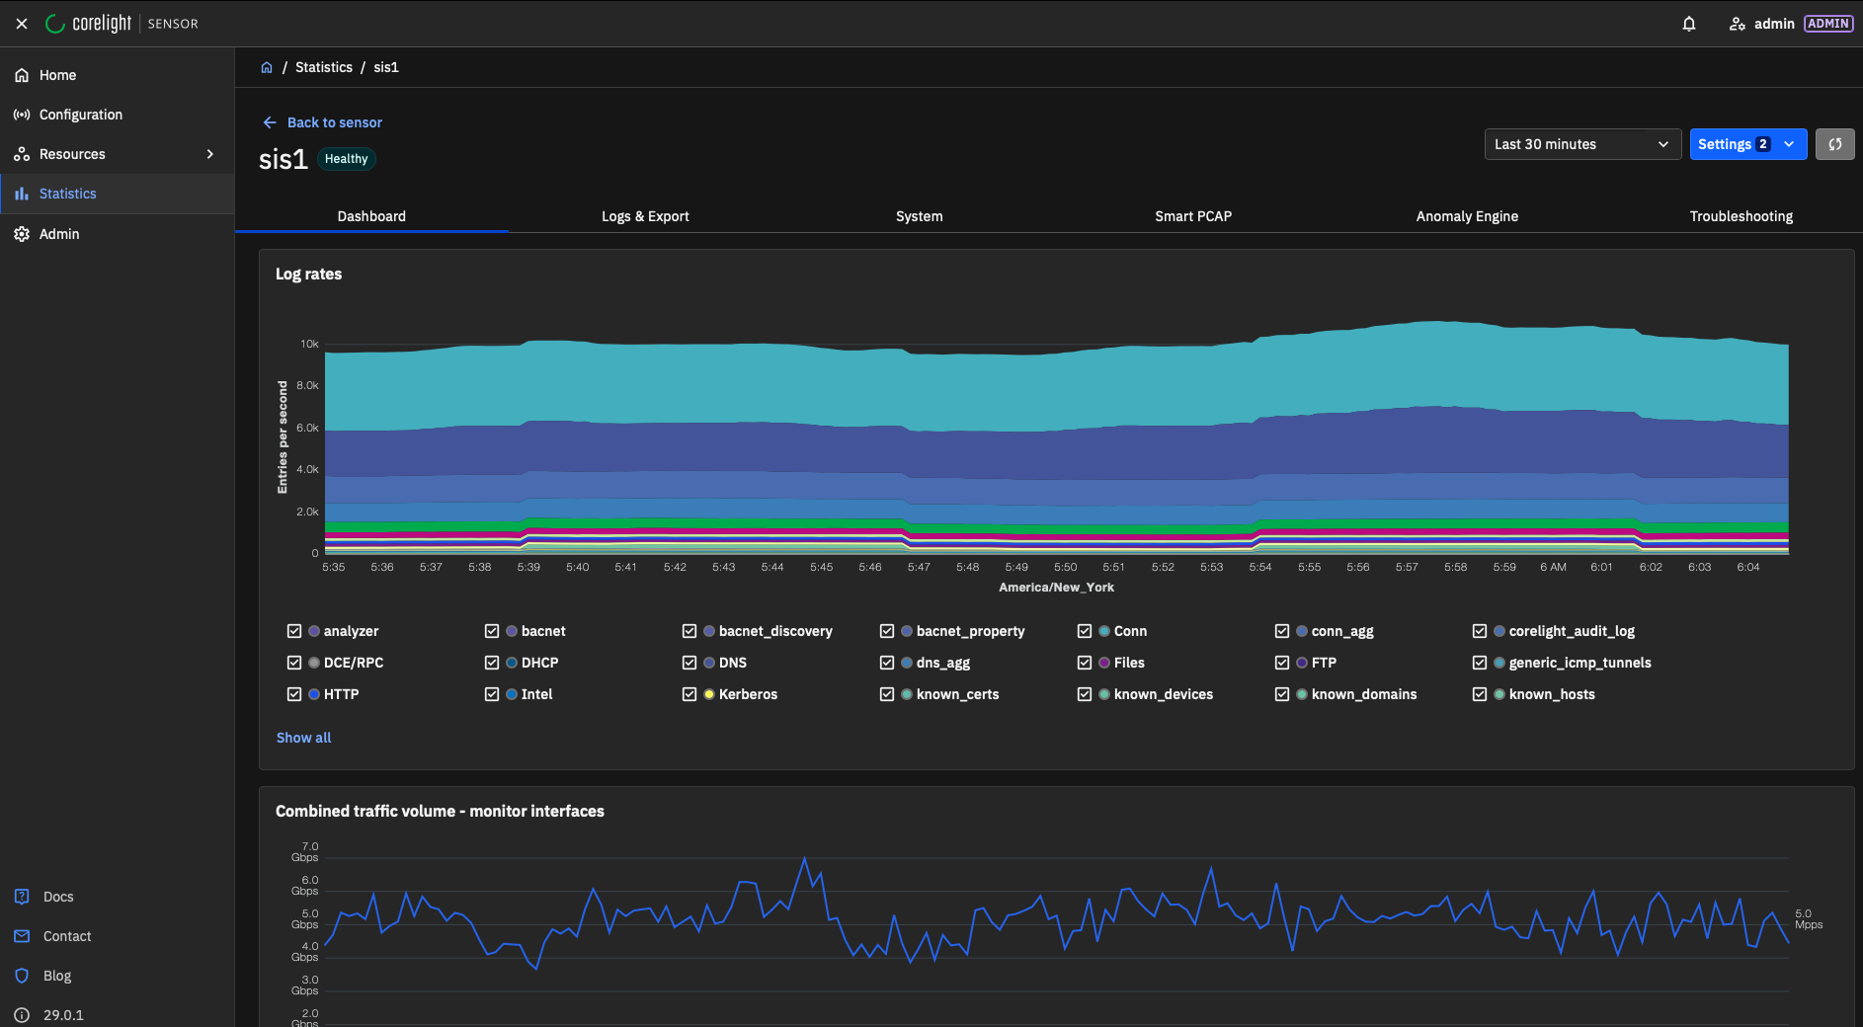
Network Security Monitoring (Zeek)

Slide 24
Zeek Example: visiting a website
{"_path":"dns_agg","_system_name":"sis5","_write_ts":"2026-03-05T20:04:51.586164Z","answers":["3.12.1.154"],"count":1,"id.orig_h":"2607:f470:6:4001:408d:ae6f:2603:7b2e","id.resp_p":53,"qtype":1,"qtype_name":"A","query":"www.samjenk.com","rcode":0,"rcode_name":"NOERROR","rejected":[false],"ts":"2026-03-05T19:59:50.352067Z","ts_last":"2026-03-05T19:59:50.352067Z","uids":["CQvNgO3BAEb1JLKB9"]}
{"_path":"ssl","_system_name":"sis1","_write_ts":"2026-03-05T20:08:35.779048Z","established":false,"id.orig_h":"10.103.99.115","id.orig_p":55827,"id.resp_h":"3.12.1.154","id.resp_p":443,"ja3":"2bab0327a296230f9f6427341e716ea0","resumed":false,"server_name":"www.samjenk.com","ssl_history":"C","ts":"2026-03-05T20:03:35.695199Z","uid":"CUgHCJ31DcL0G0OMSc"}
Notes:
Here’s what Zeek saw for a visit to www.samjenk.com in my we browser.
(1) DNS request from my workstation 2607:f470:6:4001:408d:ae6f:2603:7b2e asking for the A record for www.samjenk.com. Zeek records the metadata about the request and the response, so we see it resolved to 3.12.1.154.
(2) Zeek ssl log records metadata about the TLS session between my workstation at 10.103.99.115 to the server resolved via DNS at 3.12.1.154, observed in the Zeek connection CUgHCJ31DcL0G0OMSc. Note that the DNS request was made on IPv6, but that my workstation connected via IPv4. Such is the nature of dual-stack networking.

Slide 25
Zeek Example: visiting a website
{"_path":"conn_agg","_system_name":"sis1","_write_ts":"2026-03-05T20:11:48.584732Z","community_ids":["1:bCp6bkheP0Qvz6P2XkYHW80LtEY=","1:cYmXxCTZwdnd94UyfZpeyBc9uEI=","1:v7/hW3/krUDpzfXwyy3wBp2in2k=","1:A3J48BqIt6WmFdb2dcXvzSaaAKk=","1:pyi4kUgXgmbOsfg41fkMYx6uGPs=","1:18Z7xbFRBGgP54j7KOkMsWzyo6c="],"conn_state":"S1","count":6,"duration":0.579904317855835,"history":"^hADaGd","id.orig_h":"10.103.99.115","id.resp_h":"3.12.1.154","id.resp_p":443,"local_orig":true,"local_resp":false,"missed_bytes":3329,"orig_bytes":3190,"orig_ip_bytes":5244,"proto":"tcp","resp_bytes":16914,"resp_ip_bytes":12363,"service":["ssl"],"ts":"2026-03-05T20:01:47.926410Z","ts_last":"2026-03-05T20:05:22.440561Z","uids":["CC3FIC3nJ4ir7ulczb","CwvGwP3sTnmUn1YpC8","CXT2du4k3UodNWZ6lj","CUXj4rny5TIdTtS51","C7N6OD1LJh6c1NuXKg","CUgHCJ31DcL0G0OMSc"]}
Notes:
Here’s the last event you’d use when considering what this traffic did: look at metadata for the whole connection.
(3) Here, in the aggregate conn log, we see a roll-up of all connections that took place between my workstation (10.103.99.115) and the webserver (3.12.1.154) on port 443, using TCP, including the one we were looking at in the ssl log (CUgHCJ31DcL0G0OMSc). This gets you high-level metadata on how much information was exchanged between my workstation and the webserver, Information on individual flows is accessible in the regular conn.log file; we send conn and DNS logs to LogScale in aggregate form to save on licensing costs in LogScale.

Slide 26
Network Monitoring (Zeek)
Encryption is blinding. We look at metadata.
Forensics!
As a passive inventory tool for other workflows
Notes:
When I started in InfoSec, application-aware firewalls were considered “next-generation”.
Zeek, then Bro, was just getting traction outside of Berkeley, where it was developed.
Really took off in 2018 when it got a name change.
Aimed at analyzing massive networks.
Before Zeek, the best tools were in a category called network flow analyzers. They organized traffic into “flows” (connections), and recorded metadata about it. Useful, but Zeek’s added ability to do application-layer protocol decoding was game changing for forensics and detection.
Best in class for network security monitoring.
Zeek is great for (at least) three things:
Detecting atomic indicators of compromise (traffic to a bad IP address, DNS request for a malicious domain, requesting a particular URL, etc).
Detecting behaviors indicating compromise or misuse (opening SSH/SMTP connections to many off-site hosts, scans)
As a discovery tool (you say A, B, and C are the only webservers, but we see D, E, and F over here responding to requests on port 80 and 443…)

Slide 28
Intrusion Detection System (Suricata)
Straight-forward to implement, hard to tune.
suricata_eve.log is WAY more useful than suricata.log
Useful for:
Emerging threats
Detecting commodity malware
When you can break TLS
Tightly-controlled networks
Flow data, if you have no other options.
Drawbacks, for Penn:
Pay for a lot of stuff that we don’t need
Used to spend a lot of time tuning
Detect only, no inline block
We don’t break TLS
Notes:
Suricata is a network intrusion detection system (IDS). Our Suricata system is implemented inside the same appliances as our Zeek deployment, so they have the same vantage point in our network.
When we say “IDS” in industry, it’s usually short-hand for a network IDS. There are also tools called host-based intrusion detection systems that run on a workstation and either match known-malicious traffic passing through the network interfaces on the host, or inspect system logs on the host looking for problems. OSSEC is probably the most well-known, as it’s open-source. You could also argue that antivirus software (Symantec, McAfee) are a form of host-based IDS, as they do some network inspection these days, too. The category of host-based IDS tools has largely been supplanted by endpoint detection and response systems, which we’ll get to.

Slide 29
Example: High Confidence
alert dns $HOME_NET any -> any any (msg:"ET MOBILE_MALWARE APT-C-23 Related CnC Domain in DNS Lookup (javan-demsky .website)"; dns.query; content:"javan-demsky.website"; nocase; bsize:20; reference:md5,dd4596cf68c85eb135f7e0ad763e5dab; reference:url,twitter.com/malwrhunterteam/status/1437498154501480451; reference:url,blog.cyble.com/2021/09/15/apt-c-23-using-new-variant-of-android-spyware-to-target-users-in-the-middle-east/; classtype:domain-c2; sid:2033980; rev:1; metadata:attack_target Mobile_Client, created_at 2021_09_17, deployment Perimeter, former_category MOBILE_MALWARE, signature_severity Major, updated_at 2021_09_17;)
Items in blue (5), plus no false positives (1), plus active in the rule feed (1) = 7
Email: security@isc.upenn.edu
P: (215) 898-2172
URL: https://www.isc.upenn.edu/security/
Notes:
When we migrated from Snort to Suricata, I came up with a scheme for keeping the ruleset tuned for reducing false positives.
Automated scripts rank each rule against a scoring system. Each rule gets points for confidence-increasing features like how easy it is for us to collect metadata (e.g. DNS protocol), certain keywords in the description, whether it has high-quality write-ups linked in the reference fields, is of high enough severity, and is recently updated. (At the time this rule was analyzed, 2021_09_07 was recent.)

Slide 30
Example: Medium Confidence
alert http $HOME_NET any -> $EXTERNAL_NET any (msg:"ET WORM Win32.Socks.s HTTP Post Checkin"; flow:established,to_server; http.method; content:"POST"; http.uri; content:".php"; http.request_body; content:"proc=[System Process]|0a|"; depth:22; reference:url,doc.emergingthreats.net/2008020; classtype:trojan-activity; sid:2008020; rev:6; metadata:created_at 2010_07_30, updated_at 2020_08_18;)
Items in blue (2) + no false positives (1) + active in rule feed (1) = 4
Email: security@isc.upenn.edu
P: (215) 898-2172
URL: https://www.isc.upenn.edu/security/
Notes:
Here, a rule we’d still turn on, but that it more likely to cause a false-positive for us.

Slide 31
Example: Low Confidence
alert http $HOME_NET any -> $EXTERNAL_NET any (msg:"ET POLICY Data POST to an image file (gif)"; flow:established,to_server; http.method; content:"POST"; http.uri; content:".gif"; fast_pattern; endswith; content:!"__utm.gif"; endswith; http.host; content:!".tealiumiq.com"; content:!"snackly.co"; content:!"otf.msn.com"; reference:url,doc.emergingthreats.net/2010066; classtype:trojan-activity; sid:2010066; rev:17; metadata:created_at 2010_07_30, former_category POLICY, updated_at 2020_09_16;)
Item in blue (1) + active in rule feed (1) = 2
Email: security@isc.upenn.edu
P: (215) 898-2172
URL: https://www.isc.upenn.edu/security/
Notes:
This is a rule that looks like it will generate false positives. First off, it’s a POLICY rule that’s been reclassified as trojan-activity. Sure, trojans may use gif files, but in an environment like ours, we have to assume there’s benign use of gif files!
Still, even if this were aimed at finding an IoC for a particular malware, we’d only turn on rules with features like this for emerging threats, like a zero-day or especially wide-spread campaign.
This rule looks for HTTP POST requests that contain “.gif”. Unless the URI ends with “__utm.gif”. Or the host is a subdomain of “tealiumiq.com”. Or contains ”snackly.co”. Or contains otf.msn.com.
That’s too many exceptions, and indicates the rule is matching on traffic too general. This would create false positives.
There are a lot of rules like this in the rule set, unfortunately.

Slide 32
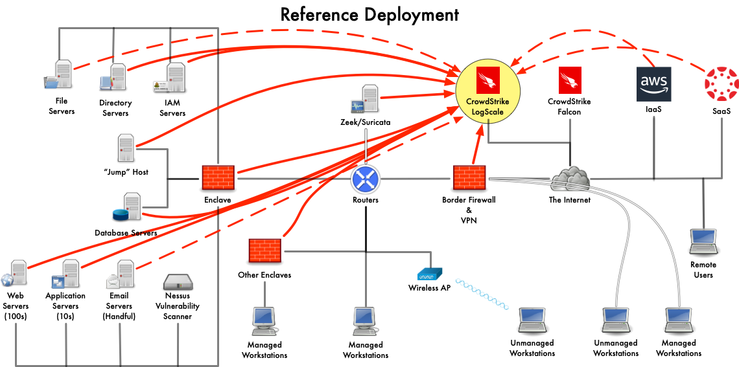
Notes:
Here, we see our systems sending data to LogScale.
In solid red are systems sending all their logs.
I put these in dashed red as a reminder that there are some systems so verbose in their logs that we can’t collect everything in LogScale.
Note: there are systems not sending to LogScale at all. You will need to make choices about what to log, and you use other controls to protect those systems where you can (e.g. XDR, lock them down more, etc.).

Slide 33
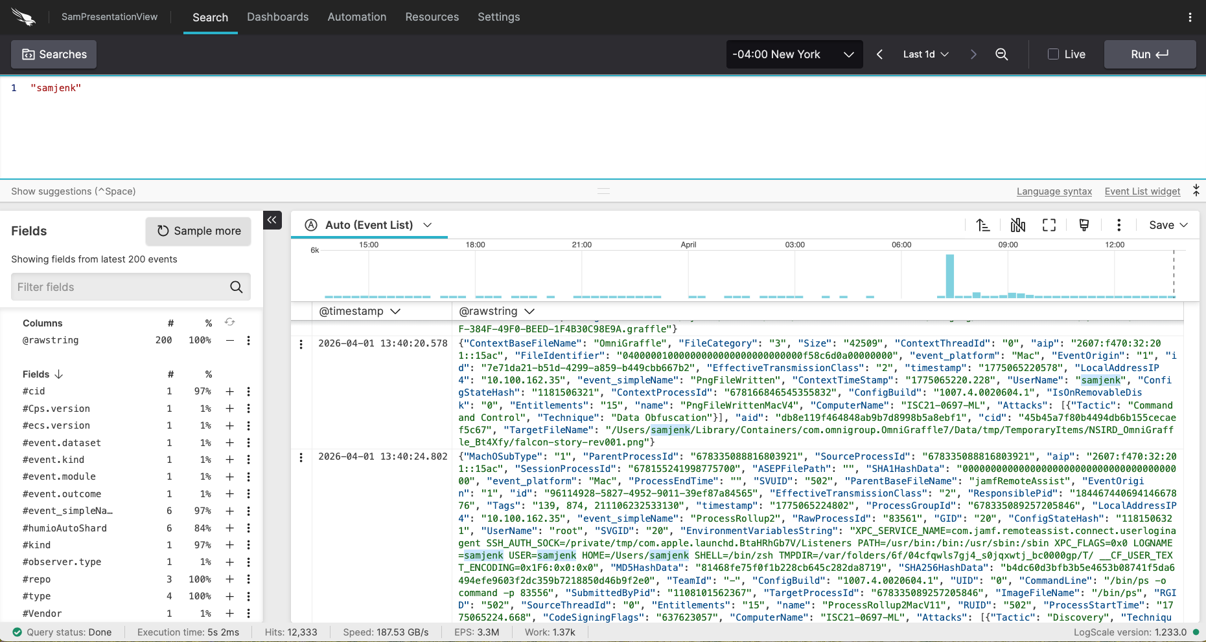
Log Analysis (LogScale)
Notes:
Our log analysis tool is what we use to correlate events across the datasets we’ve discussed
Having a flexible tool has been more important than a tool with bells & whistles. Often, the bells & whistles don’t mesh well with our decentralized IT environment.

Slide 34
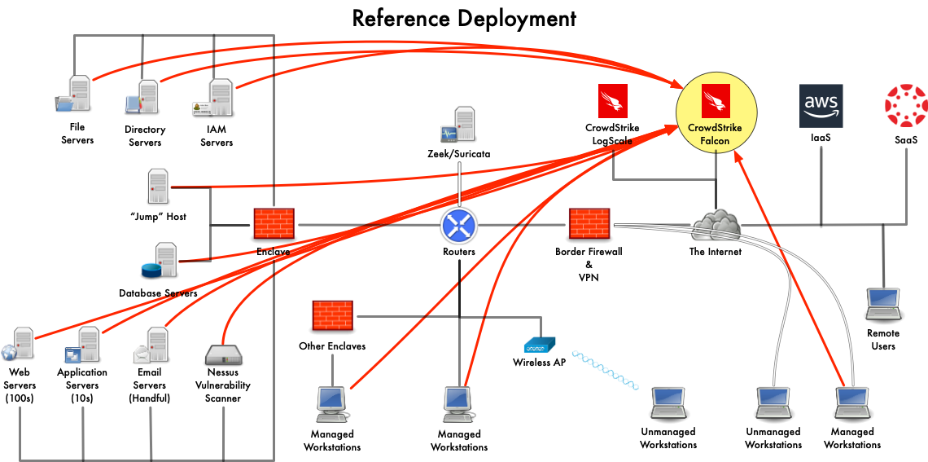
Notes:
Discuss how Falcon is deployed.

Slide 35
Endpoint Detection & Response (Falcon)
Pros:
Assists with asset discovery
Monitors the endpoint when it leaves your network
Much more sophisticated that A/V
Usually bundled with MSSP services (paid experts)
Cons:
Needs a ton of management: roll-out, alert tuning, response tuning
Expensive

Slide 36
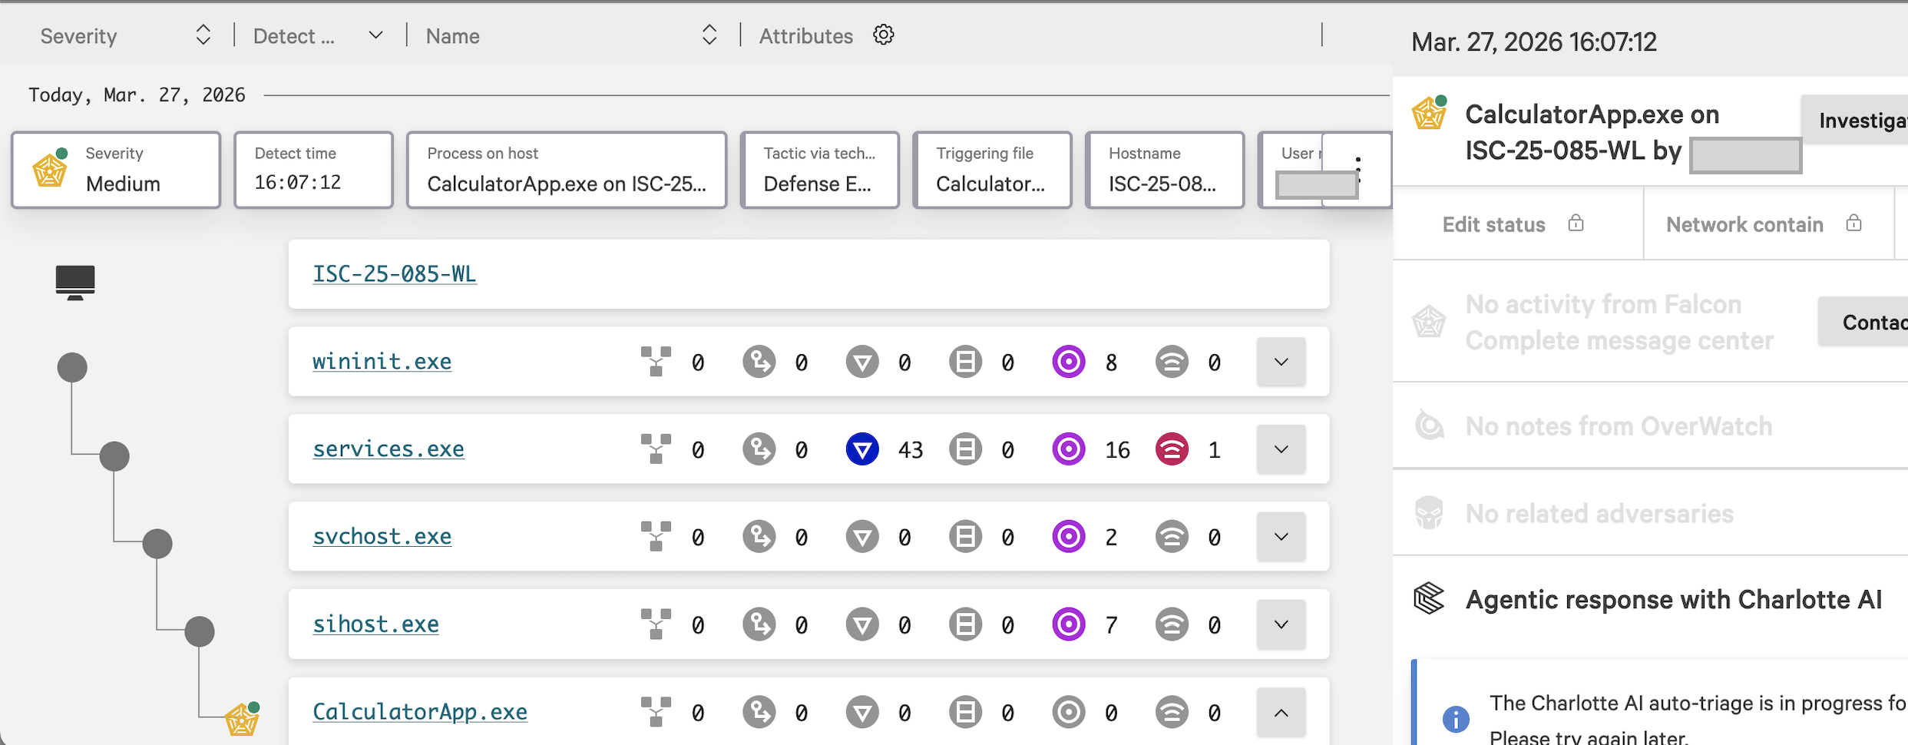
Notes:
Anyone care to guess what happened here?
Crowdstrike Falcon doesn’t like it when my coworker launches the Windows calculator app from the Run prompt! Just him, though!
An XDR tool is great for OS-level detection because it focuses on looking at the behavior among processes. Here, you see the call history from the system init process all the way to CalculatorApp.exe.

Slide 37
{"ProcessStartTime":1774641939,"ProcessEndTime":1774641939,"ProcessId":296730478583,"ParentProcessId":253651058402,"Hostname":"ISC-25-085-WL","UserName":”<Sam’s Co-worker>","Name":"Suspicious Activity","Description":"A suspicious process injected into another process in an unusual way. Investigate the process trees for the injector and injectee.","Severity":50,"SeverityName":"Medium","FileName":"CalculatorApp.exe","FilePath":"\\Device\\HarddiskVolume3\\Program Files\\WindowsApps\\Microsoft.WindowsCalculator_11.2508.4.0_x64__8wekyb3d8bbwe\\CalculatorApp.exe","CommandLine":"\"C:\\Program Files\\WindowsApps\\Microsoft.WindowsCalculator_11.2508.4.0_x64__8wekyb3d8bbwe\\CalculatorApp.exe\"","SHA256String":"62b532a855b1151331937cc1dedd94e22bbaca76086d688422e5cb7f9c6b4b05","MD5String":"c189760c967ba93d2dfbccb41804df48", "LocalIP":"10.100.128.111","Tactic":"Defense Evasion","Technique":"Process Injection","Objective":"Keep Access","PatternDispositionDescription":"Prevention, process killed.","PatternDispositionValue":16,"ParentImageFileName":"sihost.exe","ParentCommandLine":"sihost.exe","GrandParentImageFileName":"svchost.exe","GrandParentCommandLine":"C:\\windows\\system32\\svchost.exe -k netsvcs -p -s UserManager”,SourceVendors":"CrowdStrike","SourceProducts":"Falcon Insight","DataDomains":"Endpoint","AggregateId":"aggind:10fa6536f73c4ecd8690526031e37e6d:60132758769","Type":"ldt","ParentImageFilePath":"\\Device\\HarddiskVolume3\\Windows\\System32\\sihost.exe","GrandParentImageFilePath":"\\Device\\HarddiskVolume3\\Windows\\System32\\svchost.exe","PlatformName":"Windows","RiskScore":22,"UTCTimestamp":1774642060,"AgentIdString":"10fa6536f73c4ecd8690526031e37e6d","timestamp":"2026-03-27T20:07:40Z","EventType":"Event_ExternalApiEvent","ExternalApiType":"Event_EppDetectionSummaryEvent"}
Notes:
This is an example of one of the raw events produced by the Crowstrike Agent on my colleague’s host.
It records facts about the doomed calculator process. This is an excerpt of the final one, in which the Falcon agent decides to kill the process.
These are all things you could audit with traditional auditing tools, but here, determining what to turn on and what patterns to look for is conveniently abstracted away for us.
Bottom line: when my co-worker launches the Windows calculator app from the Windows run command feature, Crowdstrike kills it. When he navigates to it in Explorer and double-clicks the icon, it’s fine. There’s ML going on that we can’t explain.

Slide 38
Incident Response Stories
Notes:
Here, I’ll walk through a few examples of how we’d use the tools I’ve talked about in security investigations.

Slide 39
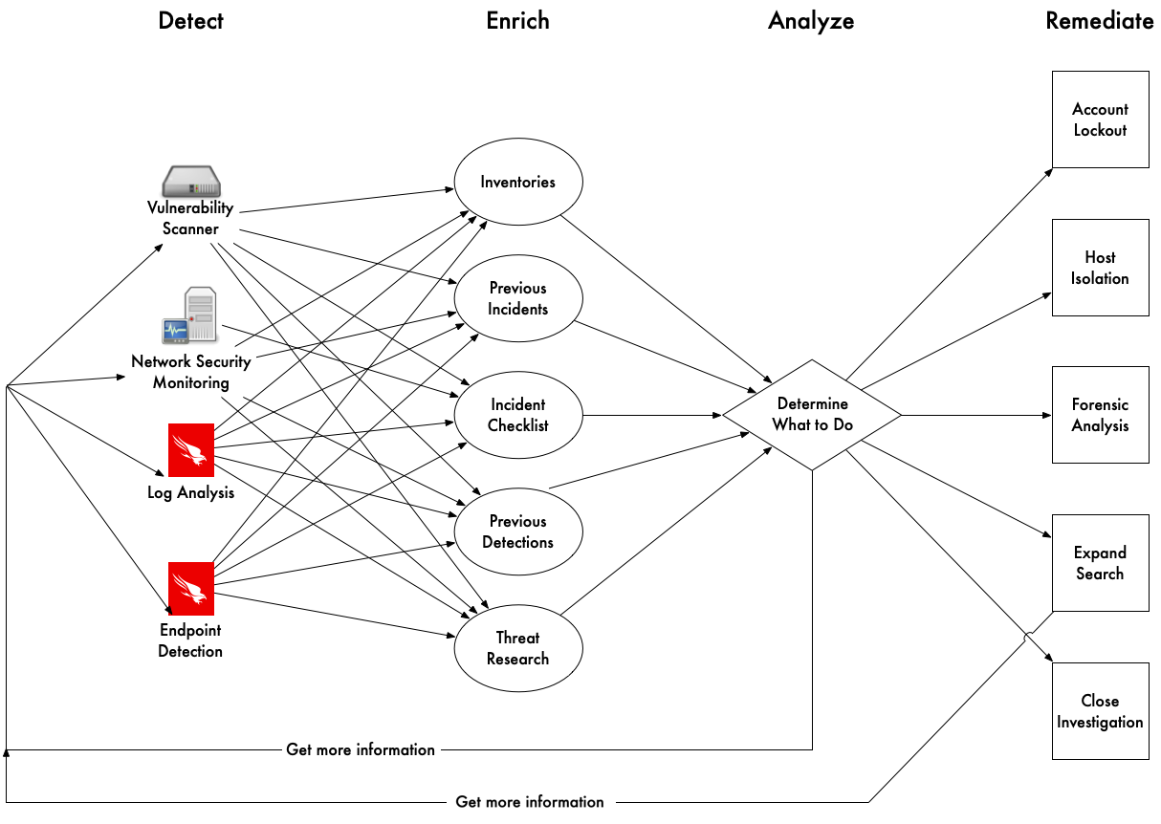
Tools & Inventories = Workflows

Slide 40
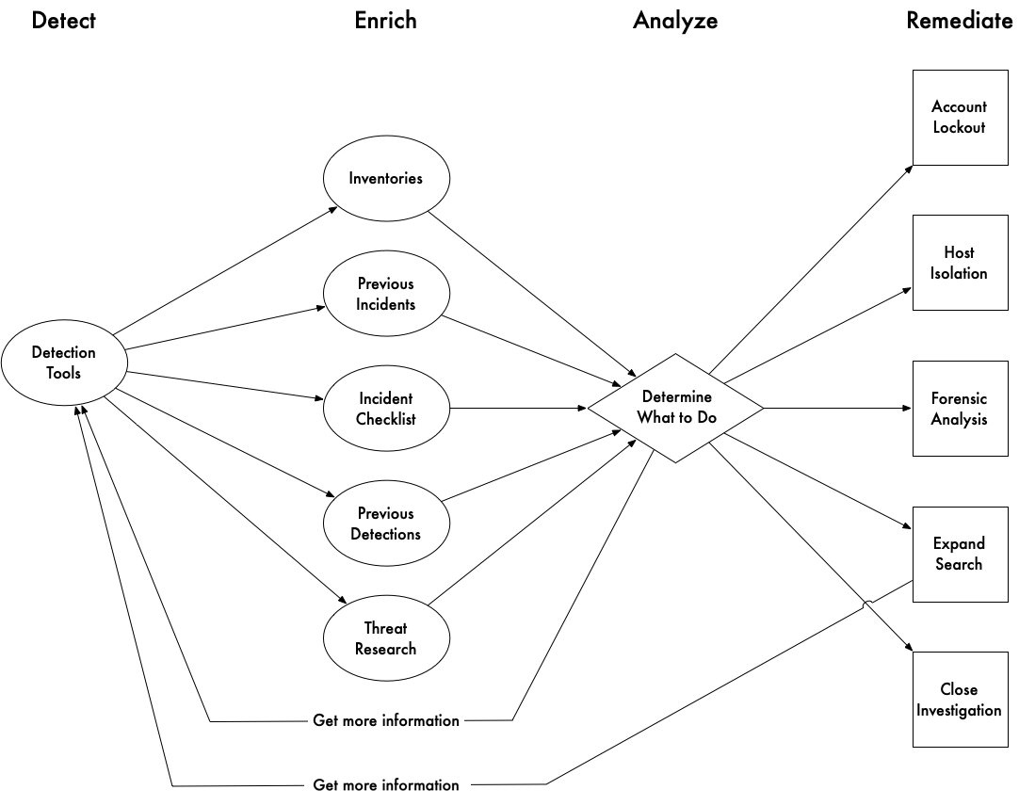
Tools & Inventories = Workflows

Slide 41
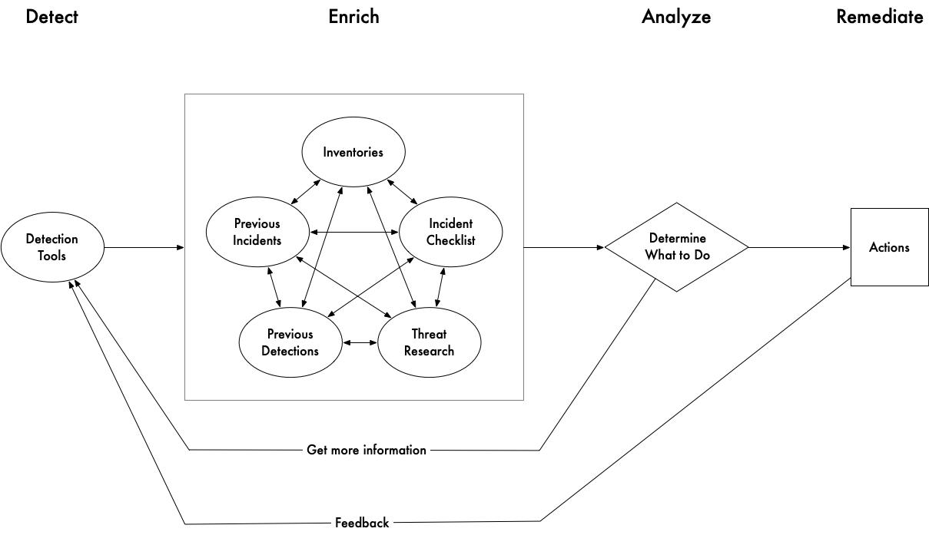
Tools & Inventories = Workflows

Slide 42
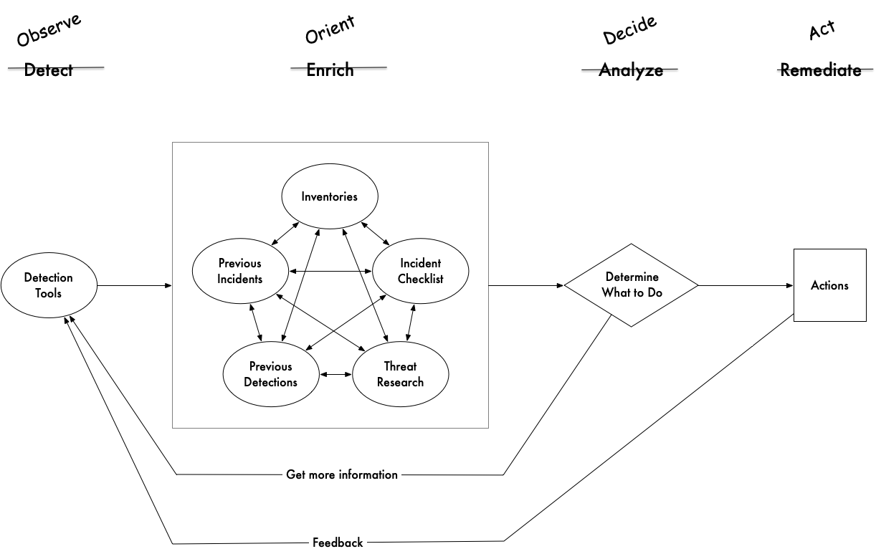
Tools & Inventories = Workflows

Slide 43
Suricata Rule
alert http $HOME_NET any -> $EXTERNAL_NET any (msg:"ET MALWARE Jupyter Stealer CnC Checkin M2"; flow:established,to_server; http.start; content:"POST / HTTP/1.1|0d 0a|Host|3a 20|"; startswith; http.host.raw; pcre:"/^\d{1,3}\.\d{1,3}\.\d{1,3}\.\d{1,3}$/"; http.header_names; content:"|0d 0a|Host|0d 0a|Content-Length|0d 0a|Expect|0d 0a|Connection|0d 0a 0d 0a|"; bsize:46; fast_pattern; http.content_len; byte_test:0,>=,200,0,string,dec; byte_test:0,<=,999,0,string,dec; http.connection; content:"Keep-Alive"; bsize:10; http.request_body; content:!"|0d 0a|"; pcre:"/^[\x20-\x7e\r\n]{0,20}[^\x20-\x7e\r\n]/"; reference:md5,772816f913a48aabe00ab1e7db8aa48e; reference:url,blogs.vmware.com/security/2023/11/jupyter-rising-an-update-on-jupyter-infostealer.html; classtype:trojan-activity; sid:2050051; rev:1; metadata:affected_product Windows_XP_Vista_7_8_10_Server_32_64_Bit, affected_product Windows_11, attack_target Client_Endpoint, created_at 2024_01_12, deployment Perimeter, malware_family Stealer, malware_family Jupyter, confidence Medium, signature_severity Major, updated_at 2024_01_12, mitre_tactic_id TA0009, mitre_tactic_name Collection, mitre_technique_id T1005, mitre_technique_name Data_from_local_system; target:src_ip;)
Notes:
Here, we got an alert, forwarded it to the user’s IT support, they worked with the user to find the machine (their personal device), run A/V on it, find and remove malware.
This is a good example of a rule you can have high enough confidence in.
A protocol we can inspect.
Backed up by a reference to a technical write up on the threat
This happened in June 2024, so it was created and last updated recently
On by default in the rule set

Slide 44
Suricata Detection: eve log snippet
alert.action: allowed
alert.signature: ET MALWARE Jupyter Stealer CnC Checkin M2
alert.category: A Network Trojan was detected
alert.severity: 1
alert.source.ip: 146.70.80.66
alert.source.port: 80
alert.target.ip: 10.103.43.173
alert.target.port: 50525
direction: to_server
event_type: alert
files.filename: /
files.gaps: False
files.state: CLOSED
files.stored: False
files.size: 710
http.hostname: 146.70.80.66
http.url: /
http.http_content_type: text/html
http.http_method: POST
http.protocol: HTTP/1.1
http.status: 503
http.length: 190
proto: TCP
Notes:
This was for the malware infection on a staff member’s personal device.

Slide 45
Zeek Detections
As threat intelligence on external hosts:
Probing RDP, ARD and VNC (rdp.log, rfb.log)
Attempting Log4j/jndi exploits (http.log)
Scanning campus hosts.
As alerting on Penn hosts:
conducting unauthorized scans
mining cryptocurrencies (students exempted)
RDP connections between schools/centers (noisy)
Threat hunting during incident response
Notes:
We use Zeek for three types of detection workflows: threat intel, host compromise, threat hunting.
By threat intelligence, I mean creating lists of malicious indicators that you can then go block or look for in your other tools.
When we land on a pattern of behavior whose actors we want to block, we have to test it rigorously to make sure it won’t produce false positives.
Second, we’ll use Zeek to detect malicious patterns of behavior on our network to investigate.
Unauthorized scans: Penn attacking the internet
Cryptomining: misuse of Penn resources when it’s benign, but can be a sign of host compromise as well.
Cross-Org RDP suggests lateral movement from one host to the next.

Slide 46
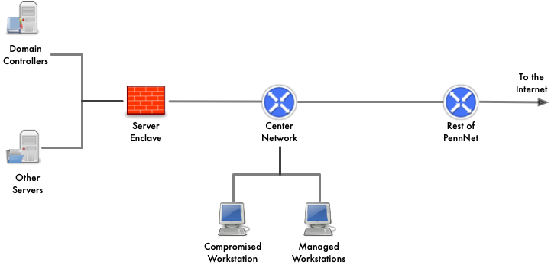
Crowdstrike Falcon
Notes:
A few years ago, one of centers was in the midst of deploying Falcon when Falcon saved the day.
Falcon had been deployed to end-user workstations, but not their Windows domain servers.
Compromise workstation pivoted to servers, then the domain controller, where they were about to push out ransomware scripts.
When the scripts were deployed to the workstations running Falcon, they alarmed, and we were able to contain the entire environment, eject the intruder, disrupting their OODA loop!

Slide 47
Philippines Login Incident
Detect: A medium-confidence alert fired (multiple logins from same IP address)
Enrich: Looking into it, I saw that none of the users were enrolled in multifactor auth.
Analysis:
All of the logins were from the Philippines
All of the logins were for users in the same department
All of the users were not enrolled in MFA
Conclusion: lock and remediate the accounts, notify their IT support
Detect: two days later, same alert for the same people!
Enrich: the users had all reset their passwords!
Conclusion: users needed to input data to a rickety old app with no impersonation feature, shared passwords with a contractor to input the data
Notes:
The problems are technical, but the challenges are organizational.

Slide 48
Security operations is about workflows, not tools
Notes:
This is my key message.

Slide 49
Backup Slides
Notes:
This and all slides after are contingency material for likely questions

Slide 50
AI in everything
Done well: Expert systems
Put the AI in the tool to help you make decisions within a confined domain.
Powerpoint helped me design the “Vulnerability Management” slide
Online-go (given what I’ve seen of this host, what’s the current probability that it will be compromised?)
Agents are promising for workflow automation
Done poorly:
The “Who is Chris Hyzer?” problem
Colleague who takes longer to answer a simple question because he insists on running my query through AI.
Generate inaccurate diagrams with confidence!
Make it available, but licensing and token costs are barriers to use
What do you all think? What have you seen work well?

Slide 51
Career advice
Enjoy the challenge of adapting what you learn to real-world constraints.
Be good at managing lists.
Documentation is always behind reality.
The problems are technical, but the challenges are organizational.
Become comfortable with ambiguity, but don’t put up with it.
Join your industry’s Information Sharing & Analysis Center (ISAC)

Slide 52
Career advice 2
If you’re going into operations:
Enjoy solving problems
Be comfortable with ambiguity
Keep learning new things
Treasure your good COTS tools
If you’re going to make security products:
Do as little as possible really really well. (Corelight, Splunk/LogScale)
Make underlying data as accessible as possible (Corelight, Falcon)
Don’t assume you know how your tool will be deployed

Slide 53
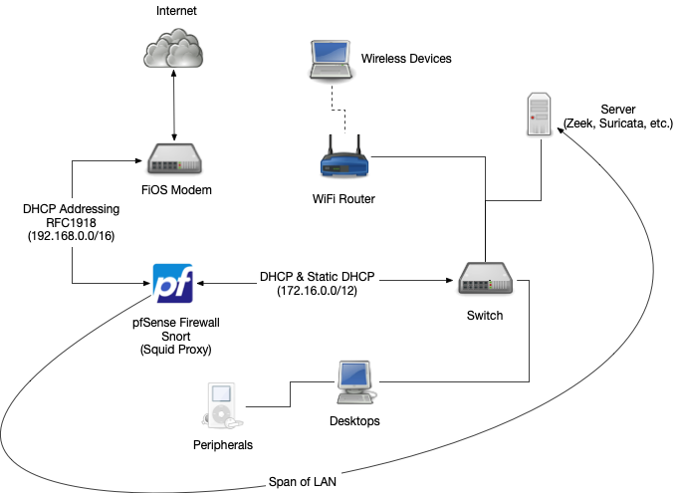
Notes:
One thing a mentor encouraged me to do is to build a home lab so you can practice using the technologies you use at work.
This is a model of my home network.
There are open source and free solutions you can use to implement this stuff at home, and I encourage you to do this.

Slide 54
Recommended Reading
The Practice of Network Security Monitoring (Bejtlich)
The Unix and Linux System Administration Handbook (Nemeth, et al)
The TCP/IP Guide (Kozierok)
The Cuckoo’s Egg (Stoll)
Notes:
Richard Bejtlich was an early proponent of bringing the practice of network security monitoring out of government for all networks, not just government networks. His first book, The Tao of Network Security Monitoring describes his methodology, but The Practice of Network Security Monitoring explains the concept as it shows you how to deploy tools like Zeek.

