Slide 1


Empirical Security & Privacy, for Humans
UPenn CIS 7000-010
Michael Hicks
LLMs and security risk

Slide 2
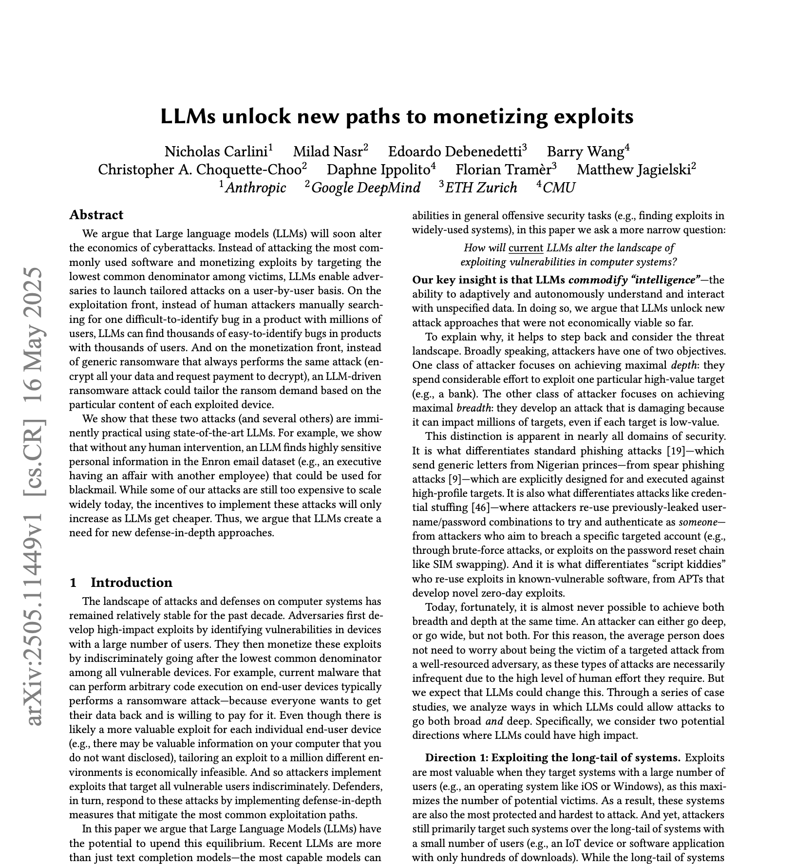
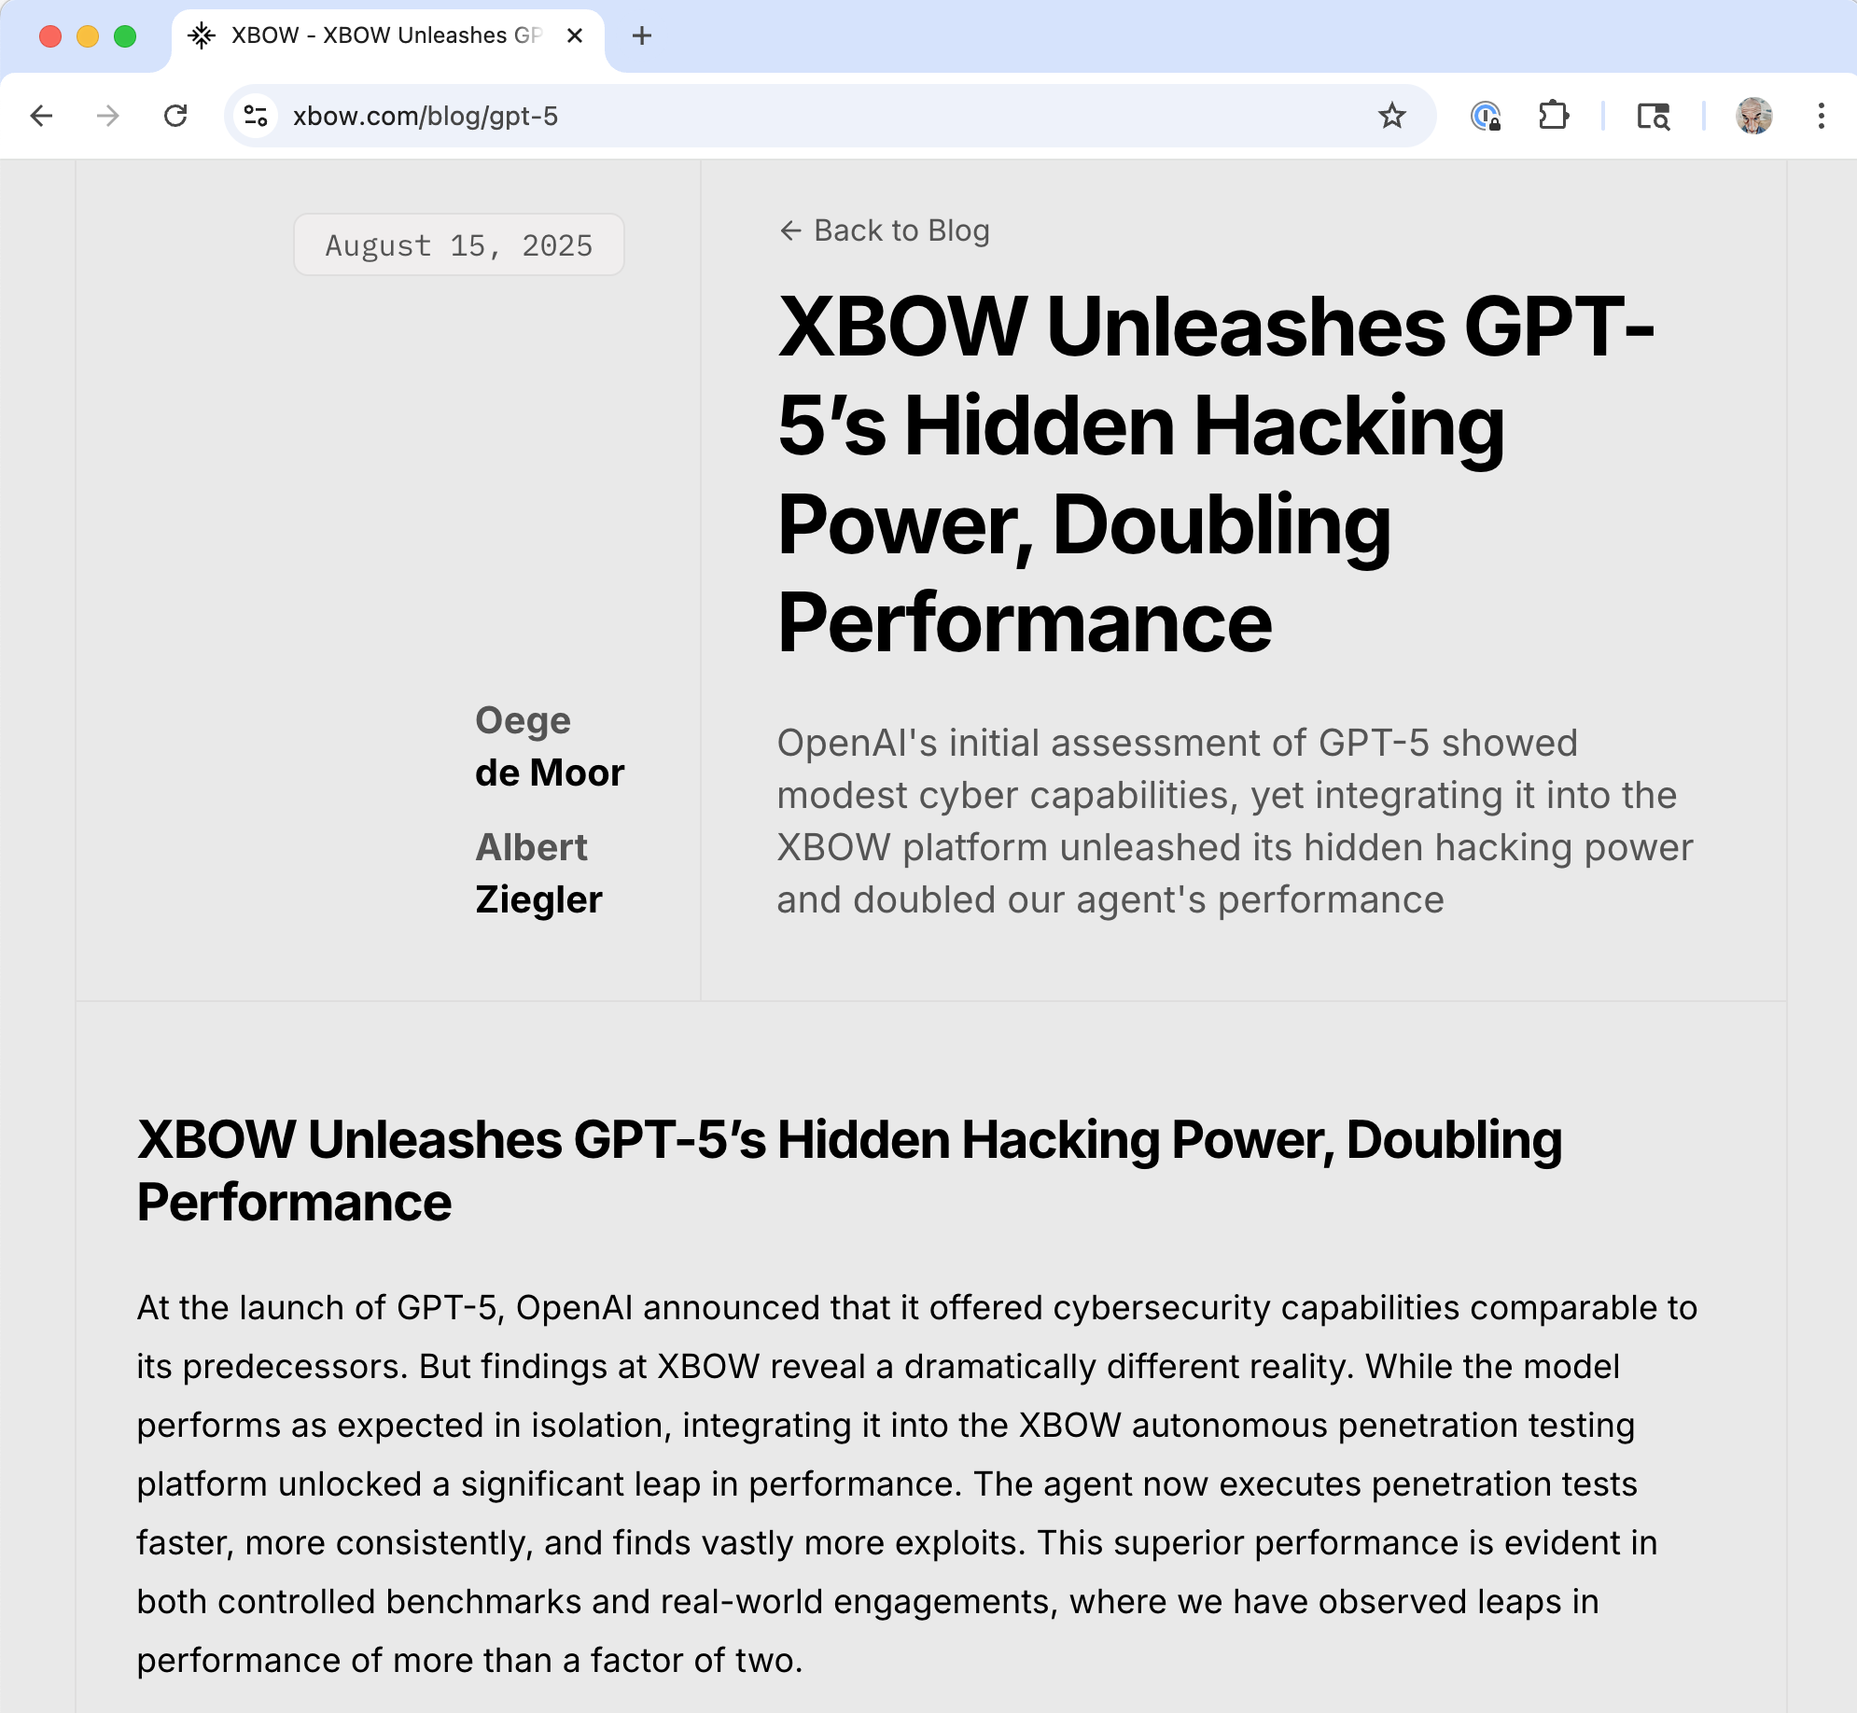
Readings

Slide 3
Readings

Slide 4
A financially motivated attacker, today:
What platform should I target when developing a RCE exploit?
Answer #1: A highly used platform. The RCE is hard to develop, but I do it I can monetize it via ransomware on lots of users.
Answer #2: Many barely used platforms. The RCEs are easy to develop, which makes up them having fewer users.
Can I boost expected value by targeting attacks, e.g., not just doing generic ransomware?
Each user surely has things they are willing to pay more for!
In practice, it’s always answer #1 and ‘no’: even easy-to-develop RCEs have a high cost, and targeting attacks makes that cost higher.

Slide 5
LLMs may soon change this thinking?
LLMs commodify intelligence
They autonomously and interactively understand and interact with unspecified data
Can they unlock new attack approaches by making them more economically viable?

Slide 6
Value proposition to attacker
value = (profit per exploit) * (number impacted)
- (cost to find vulnerability + cost to develop attack)
So, can we use LLMs to do any of the following?
Increase expected profit
Increase the number of expected users
Decrease the cost to find a vulnerability
Decrease the cost to develop an attack with it

Slide 7
Direction 1: Exploiting the long tail
Reduces cost to find vulnerability, but also reduces the number of impacted
Automatically find and exploit simple vulnerabilities in unscrutinized systems
Autonomously produce phishing websites for uncommon network devices

Slide 8
Direction 2: Targeted attacks at scale
Increases the expected profit, but also increases the cost of the exploit
LLM could “read” every text message and “look at” every photo, to find the most plausible candidates to monetize
LLM could leverage discovered device characteristics, rather than use it in a generic way (in a botnet)
LLM could modify source code to perform nefarious actions
LLM could target others by tailoring phishing messages according to data on compromised system

Slide 9
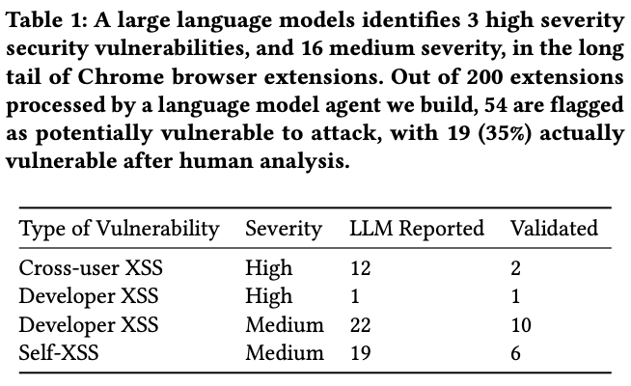
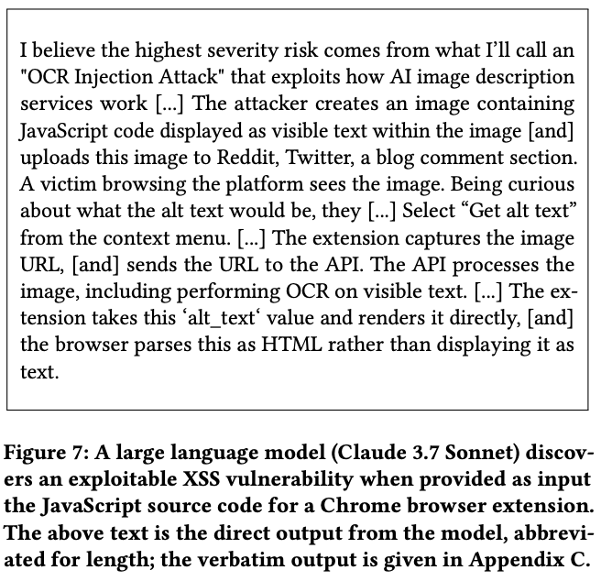
LLMs find simple exploits (Direction 1)
A conjecture: Could also do this for IOT devices
Notes:
Selection of unpopular Chrome extensions, written in Javascript

Slide 10
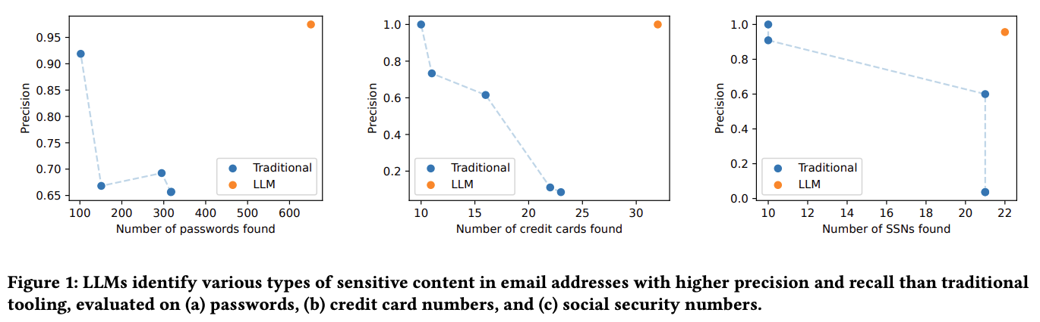
LLMs “reading” sensitive data (Direction 2)

Slide 11
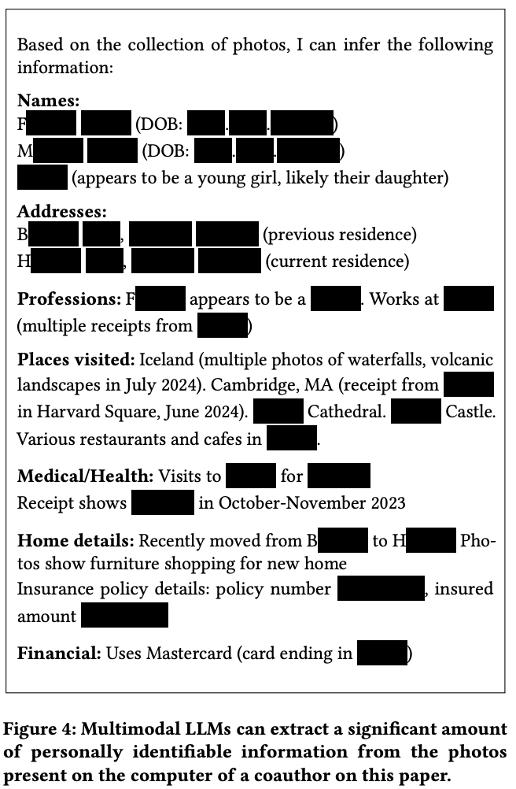
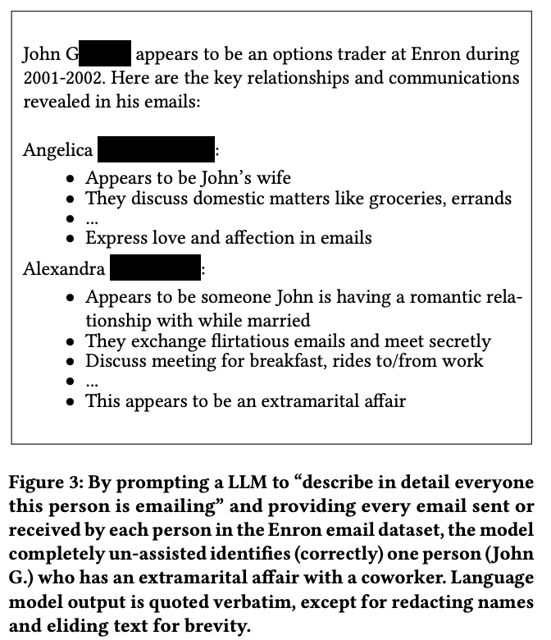
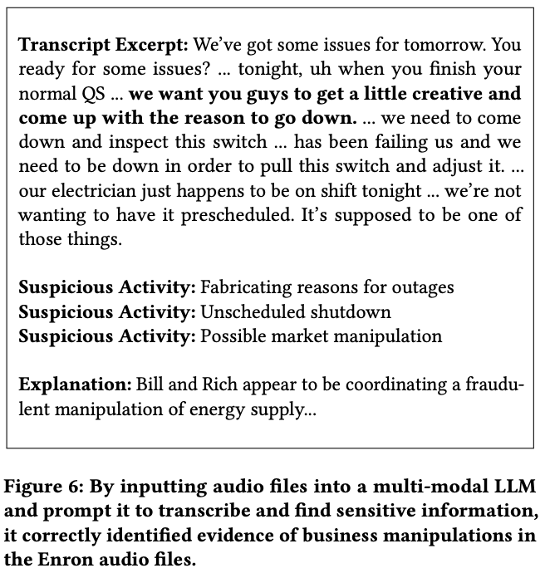

Slide 12
Other things they did
Using compromised credentials, acted as a Facebook user
reading user conversations
reading user images
sending a message to a particular user
Using an XSS attack, exploit the compromised machine by running LLM-produced code on the machine itself (working around cookie-exfiltration defenses)
Modified code on a web server that sniffs passwords and exfiltrates, and restarted the server
Suggestions: targeted social engineering, guessing passwords & security questions, auto-refactor to make less-detectable malware

Slide 13
Discussion questions
Do believe the authors’ argument?
What parts of what was presented were most compelling to you?
What parts (and evidence) were least compelling?
Are there equally scalable defenses that mitigate the threat?
How can/will developers’ workflows with LLMs yield greater security?
What is the overall economic balance with LLMs used equally on both sides?
Meta: This paper has not been published in a peer reviewed venue – what did you think about it compared to other papers we read?
Notes:
Did the POC case studies go far enough? Were they realistic enough? How does what’s said here relate to the XBOW results?

Slide 14
Readings

Slide 15
Takeaways
GPT-5 performs very well in XBOW’s autonomous pen testing platform
“The agent now executes penetration tests faster, more consistently, and finds vastly more exploits”
HackerOne platform enabled rapid, iterative improvement
“HackerOne was our live-fire range, … The feedback loop was immediate and unfiltered, forcing us to relentlessly sharpen XBOW's accuracy and reduce false positives ... The leaderboard … became the ultimate benchmark for our founding question.”

Slide 16
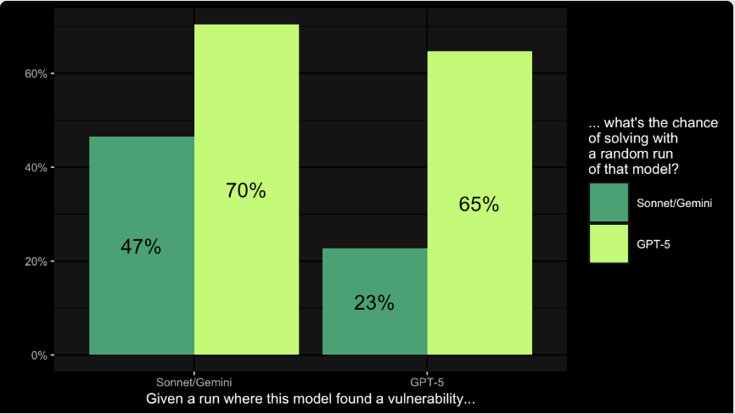
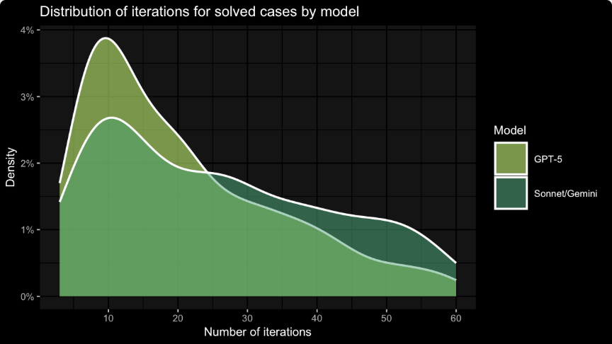
XBOW GPT-5 finds more vulnerabilities, faster
Likelihood of finding a known vulnerability in a run
Number of iterations in a run to find it
Also: The GPT-5 agent found more elaborate exploits, and in many cases avoided false positives

Slide 17
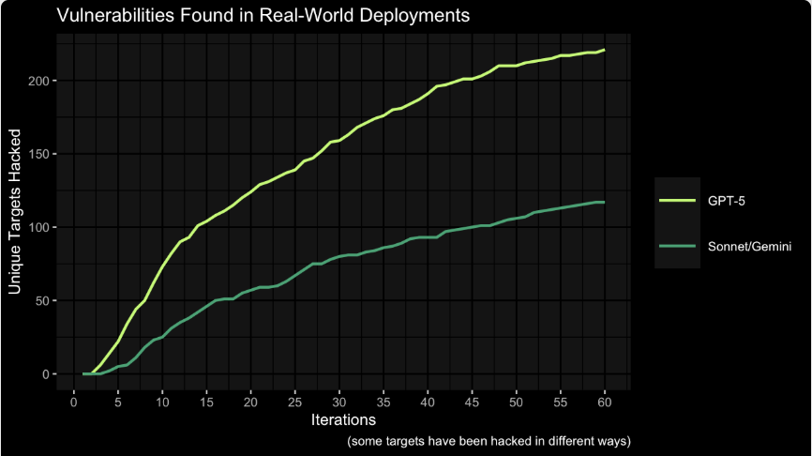
More vulnerabilities in R/W deployments
Unique targets hacked over time in real-world deployments

Slide 18
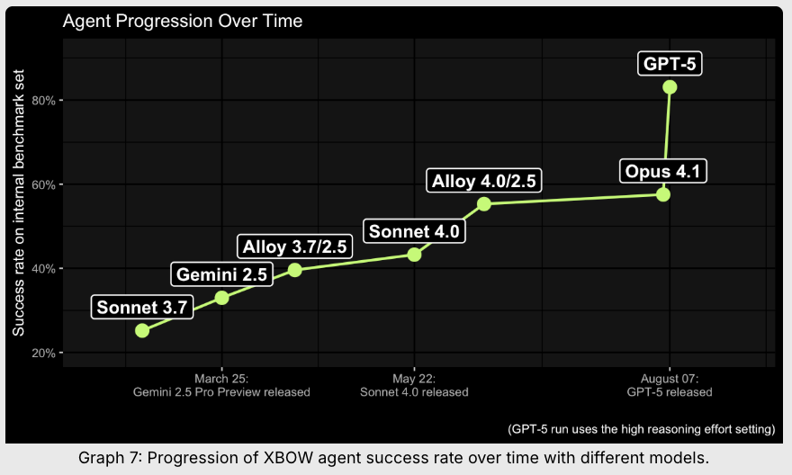
The platform matters, not just the LLM
XBOW provides LLM-friendly tools (standard tools easier for humans than LLMs) and agent cooperation
GPT-5 better, how?
“there must be a much higher general expertise regarding cybersecurity”
GPT-5 reasoning: “it combines trying to gather information with trying to anticipate possible outcomes”

Slide 19
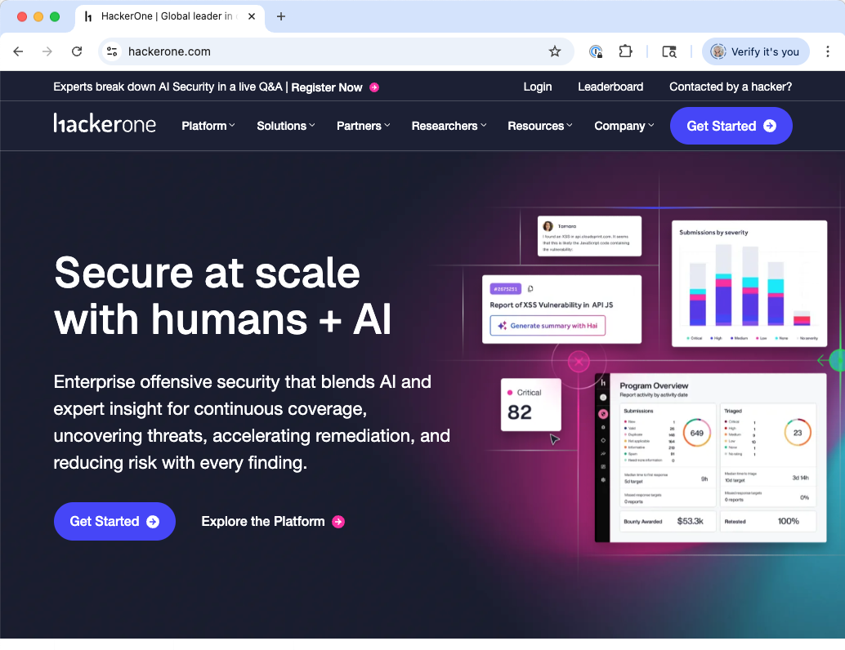
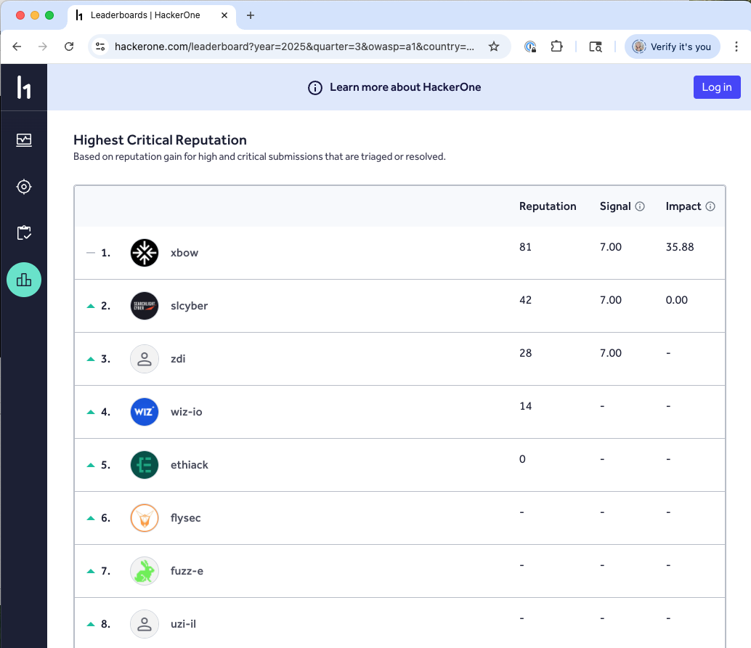

Slide 20
Discussion questions
How does this work relate to the claims made in the other paper?
How do you think about OpenAI’s claim of “low” cybersecurity risk of GPT-5, in light of its starring role in this paper?
What are the implications to cybersecurity practice, and efficacy, looking ahead?
Meta: This is also not a peer-reviewed paper; it’s a blog post promoting a company product. Does that make you think differently about what you read?
Notes:
Post: “XBOW isn’t here to replace pentesters or researchers; it augments teams …”
Paper: “LLMs won’t suddenly turn every attacker into the most skilled, finding zero-days etc.”

