Slide 1


Empirical Security & Privacy, for Humans
UPenn CIS 7000-010
10/2/2025
Misuse of statistical analysis

Slide 2
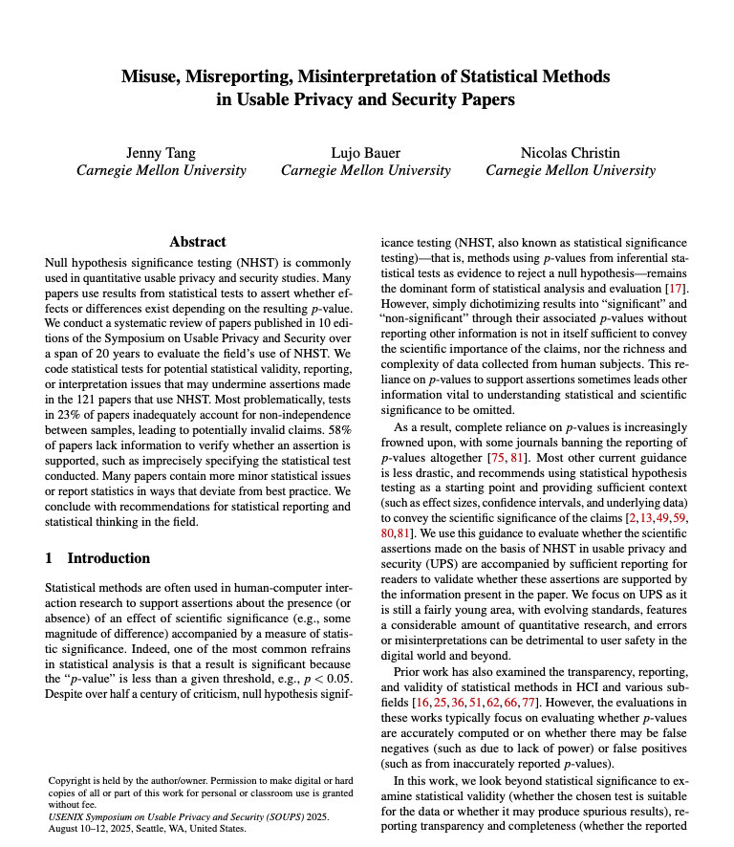

Readings

Slide 3
Regression models: Charateristics
Categorical vs. numeric variables
Degrees of freedom
Aikake Information Criterion (AIC): for judging relative quality of two models based on precision and parsimony
Prefers higher precision, and lower number of parameters

Slide 4
Regression models: Effect size
Coefficient of determination (R²), aka effect size: measures how well a model’s predicted outcomes compare against real outcomes
Nagelkerke R² used for logistic regression
Cohen’s f² (local effect size): measures the impact of one parameter on the model effect size
Cohen’s d: quantifies the magnitude of a difference between two group means in terms of standard deviations
Notes:
For simple linear regression, R^2 is the square of the sample correlation coefficient (r), between the observed outcomes and the observed predictor values. For MLR, it is the square of the coefficient of multiple correlation. R2 is an element of [0, 1] and represents the proportion of variability in computed outcomes that may be attributed to some linear combination of the regressors. An R^2 of 1 means a perfect fit.
The “adjusted R2” is almost the same as R2 but it penalizes the statistic as extra variables are included in the model. R2 is often interpreted as the proportion of response variation "explained" by the regressors in the model.
Nagelkerke’s R2 for logistic regression: derived from the likelihood ratio test statistic, which compares the likelihood of the fitted model to that of a null model with only an intercept.
Cohen's d is a statistical measure of effect size that quantifies the magnitude of a difference between two group means in terms of standard deviations. It standardizes the difference, allowing for the comparison of results across different studies and contexts. Common benchmarks for Cohen's d are 0.2 for a small effect, 0.5 for a medium effect, and 0.8 for a large effect.
f2 is the impact of a particular parameter on the R^2 of the whole model (i.e., effect if you remove it). often categorized as small (0.02), medium (0.15), or large (0.35).

Slide 5
Statistical tests: Terms
Alpha and p values of a statistical test, confidence intervals
Statistical power, power analysis
Type I vs. type II errors
Paired sample test vs. a two-sample hypothesis tests, for comparing sampled measurements
t test, χ2 test, MW test, etc.
One-sided vs. two-sided (“tailed”) null hypothesis test
Notes:
Alpha is a threshold that tells us when to reject the null hypothesis in a test.
A p-value shows the probability that the observed data happened by chance if the null is true.
If the p-value is less than alpha, we say the result is statistically significant.
Type I error, or a false positive, is the erroneous rejection of a true null hypothesis in statistical hypothesis testing. A type II error, or a false negative, is the erroneous failure in bringing about appropriate rejection of a false null hypothesis.
Statistical power is the probability that a hypothesis test will correctly reject the null hypothesis when the alternative hypothesis is true (i.e., it detects a true effect). A common target is 80% power. For BIBIFI we did 75%. From Cohen: “The power of a statistical test of a null hypothesis is the probability that it will lead to the rejection of the null hypothesis”
Statistical power is one minus the type II error probability
Chi2 test is primarily used to examine whether two categorical variables about a population are independent. E.g. “The null hypothesis is that each person's neighborhood of residence is independent of the person's occupational classification.”
Paired sample t-test: a statistical method to determine if the mean difference between two related measurements is zero, typically for the same subjects at two different times or matched pairs (e.g., useful for before/after measurements of a within-subjects test)
A two-sample t-test, or independent samples t-test: a statistical method used to determine if the unknown population means of two independent groups are statistically different (e.g., useful to compare means of a control group vs. a treated group)
Directional tests: If you're not sure about the direction and just want to see if there's any difference, go for a two-tailed test. Keep in mind, this choice affects your p-values and how you interpret statistical significance. One-tailed tests put all their statistical muscle into detecting an effect in the predicted direction but won't catch effects going the other way. Two-tailed tests, on the other hand, cover both directions but might need more data to reach significance because the alpha level is shared between both tails.
Prospective Power Analysis
Purpose:
To determine the appropriate sample size for a future study before it begins, ensuring enough participants are recruited to detect a statistically significant effect.
Key Inputs:
Effect Size (f2): The researcher hypothesizes an f2 based on prior research or theoretical considerations, often categorized as small (0.02), medium (0.15), or large (0.35).
Desired Power: The probability of correctly rejecting a false null hypothesis (i.e., finding a significant effect when it truly exists), typically set at 0.80 (80%) or higher.
Significance Level (alpha): The probability of incorrectly rejecting a true null hypothesis (Type I error), commonly set at 0.05 (5%).

Slide 6
P Hacking
Jacks up the false positive rate (type I errors) by carrying out multiple tests on the same data
How to do it
Test while you sample, stop when you get the result you want
Data tampering: Remove outliers
Change variables of results based on results
Too many hypothesis tests
Model selection based on p value
Cherry-picking the outcomes, failing to discuss nonsignificant results
Bonferroni correction
Notes:
The Bonferroni correction is a statistical method that adjusts the significance level (alpha) for multiple hypothesis tests performed on the same dataset, thereby reducing the probability of making a Type I error (a false positive). It is calculated by dividing the original significance level by the number of tests performed. “type I error rate equals the significance level for a single test, it grows as you increase the number of tests”
Bonferroni correction = α / n where n is the number of hypothesis tests. For example, if your original, single test alpha is 0.05 and you have a set of five hypothesis tests, your adjusted significance level of 0.05 / 5 = 0.01. Your results are statistically significant when your p-value is less than or equal to the adjusted significance level.
When to use it: e.g., Comparing group means: You might run a series of t-tests to compare group means. For example, if your experiment has six groups, comparing all their means involves 15 t-tests.

Slide 7
Discussion points
What did you think of the paper’s methodology?
Can you explain the results the paper found in terms of incentives? What are other explanations/causes?
Despite exhibiting these issues, how might a paper nonetheless be providing value?
Is the value sufficient, most times?
How might the review process change to help adjust these issues?
How to encourage correction even post publication?
Notes:
Require one stats literate reviewer
Have a template for stats evals
Review process changes

Slide 8
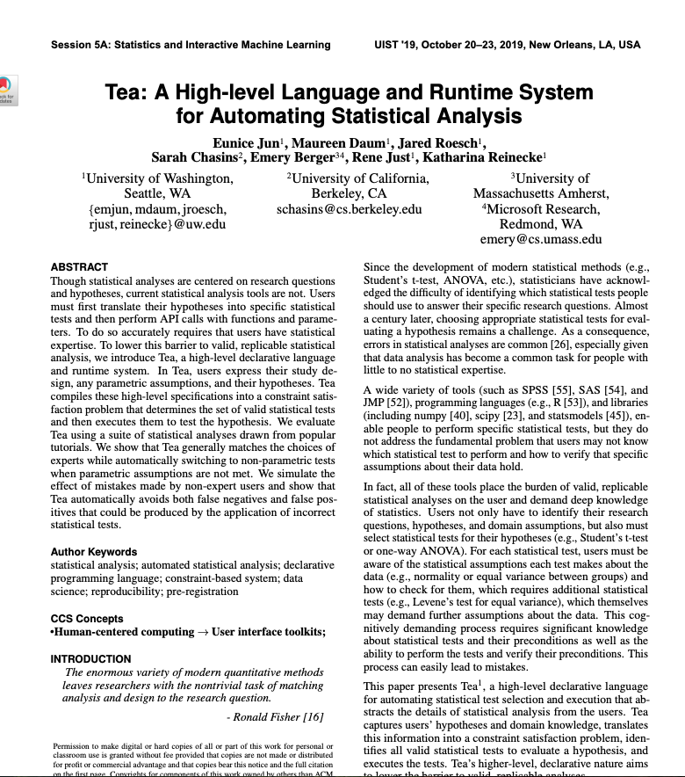
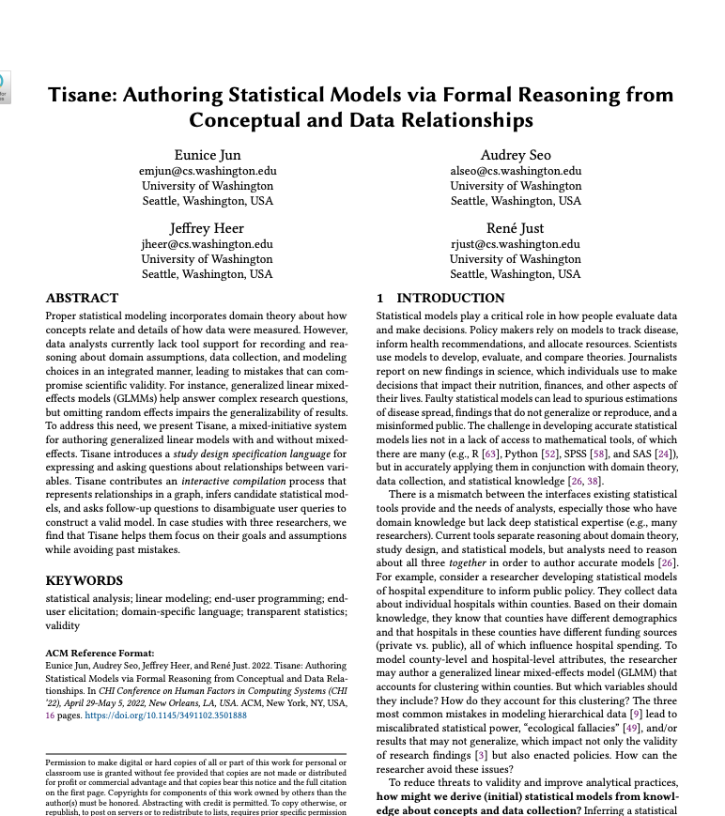
How to do better?

