Slide 1


Empirical Security & Privacy, for Humans
UPenn CIS 7000-010
9/11/2025
Security – Passwords

Slide 2
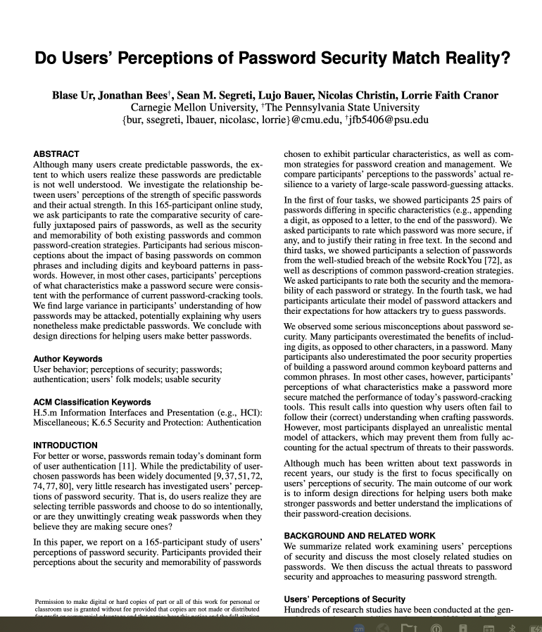
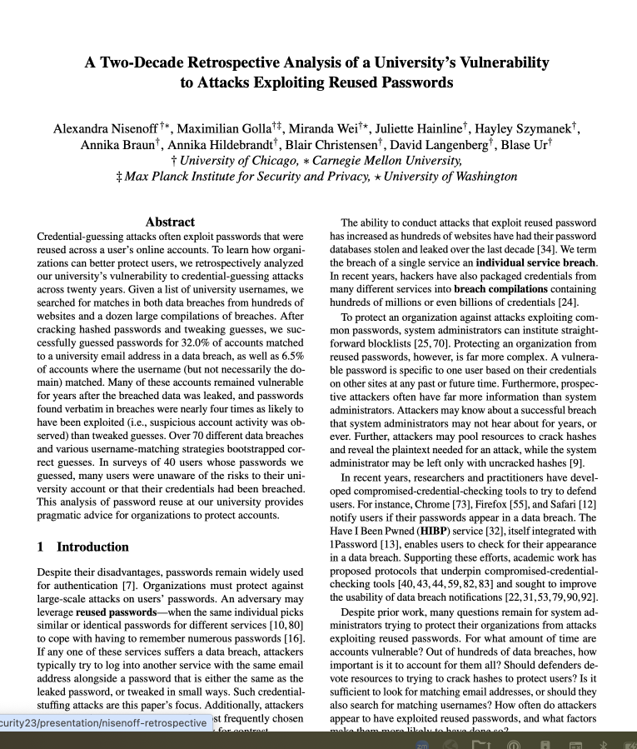
Readings
(optional)

Slide 3
Readings

Slide 4
Password security: Perception vs. reality
Notes:
Where did the “billion hours” level of reliability come from? Paper observes that this is basically “certainty”

Slide 5
Themes, discussion points
Thoughts?
Notes:
If nuclear reliability is inherently unknowable, should regulation shift from predicting accidents to planning for resilience (i.e., prepping for failure as if it’s inevitable)?
Aviation achieves recursive practice because accidents are investigated, charted, and (mostly) publicly shared. Is there even a possibility of nuclear energy building an equivalent culture of open learning and sharing of info?
About the paper itself
What about the Boeing MAX failures?
Footnote p. 15 talks about Concorde airworthiness certificate being withdrawn, but I think that happened with the MAX too, right?
Paper assumes that “fly by wire” is sufficiently similar to prior designs: Is that really a good assumption - Software is complex! See Boeing MAX failures …
About the connection to cybersecurity
How is cybersecurity like ultra-high reliability? See pps. 5-6, and apply to cybersecurity instead. Perhaps gives some explanation for the confusion around induction and deduction?
What about data and measuring outcomes?
At least civil aviation is carefully tracked. We know about crashes, their reasons, etc. Is that because they are so few, and thus so easy to track?

Slide 6
Readings
(optional)

Slide 7
Themes
Thoughts?

Slide 8
END

