Slide 1


Empirical Security & Privacy, for Humans
UPenn CIS 7000-010
9/23/2025
Measuring secure software development practices

Slide 2
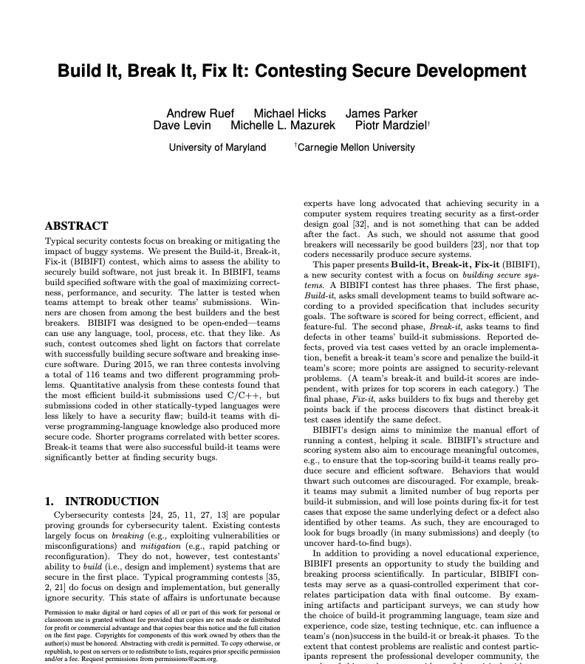
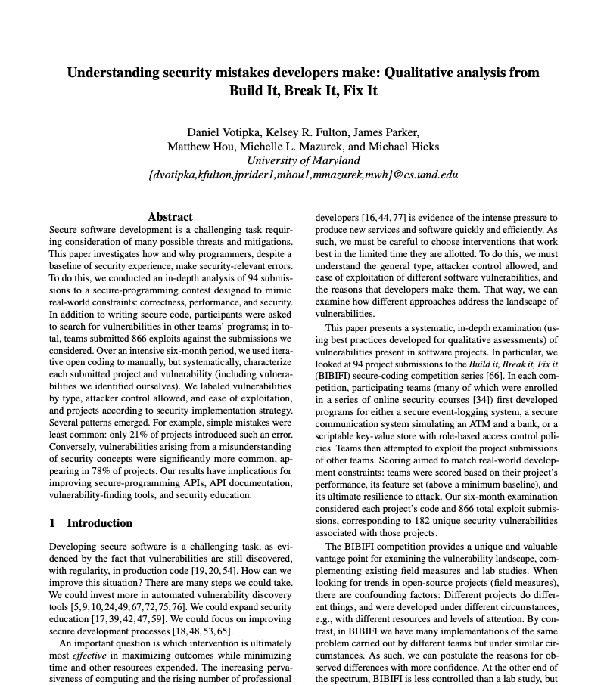
Readings

Slide 3
Readings

Slide 4
Overview
Round 1: Build-it
Teams build software to specification
Round 2: Break-it
Teams report
bugs in submissions
Round 3: Fix-it
Teams fix bugs found in their software
2 weeks
2 weeks
1 week
Must satisfy
basic correctness
requirements; optional features and good performance for more points
Bug reports are (failing) executable test cases, including exploits
Doing so may wipe out many bug reports in one go: all count as the same bug
Last: Judges tally final results

Slide 5
Scoring System
Build-it Score
Break-it Score
Winners in both categories
Gains points for good performance
Gains points for implementing optional features
Loses points for unique bugs found
More points for (obviously) security-relevant bugs
Build-it Score
Break-it Score
Gains points for unique bugs found
Scaled by how many other teams found the same bug

Slide 6
Build-it Round
Build software according to the posted specification
Make it correct, feature-ful, efficient, and secure
The first three are assessed by (our) test cases (build-it round score)
The last is assessed by Break-it teams in round 2
For many elements of the task, teams may choose
The software’s internal design and algorithms
Which optional features to implement
What programming language to use
What development and testing tools to use
How to divide tasks among team members, etc.

Slide 7
Break-it Round
Find bugs and vulnerabilities in submitted code
Provide an exploit, as defined by particular problem
Teams will be given access to the source code
We provide scripts that teams can use to test projects against the standard tests, using a VM
How teams go about this task is up to them, e.g.,
How to divide up the task among team members, and
whether (or how much) testing to use,
manual code reviews,
automated dynamic/static analysis, etc.

Slide 8
Fix-it Round
Different teams may submit different test cases that identify the same underlying bug
Build-it teams should only lose points for each bug, not for each test case that reveals it
How to tell that test cases are “the same” ?
void foo(char *str) {
char buf[10];
strcpy(buf,str);
}
str = “this is too long”
str = “this is too long too”
str = “and so is this string”

Slide 9
Fix-it Round
Teams will receive the test cases during the fix-it round, and they can then fix each bug identified
All test cases that pass are unified to be the same underlying bug
Judges consider whether the fix is to a single bug
If not, the affected test cases will be scored individually
void foo(char *str) {
char buf[10];
strlcpy(buf,str,10);
}
str = “this is too long”
str = “this is too long too”
str = “and so is this string”
void foo(char *str) {
char buf[10];
strcpy(buf,str);
}
str = “this is too long”
str = “this is too long too”
str = “and so is this string”

Slide 10
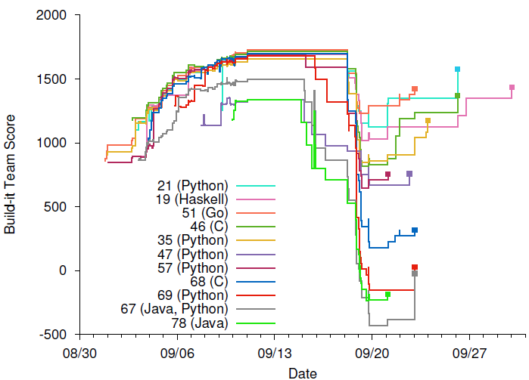
Builder score, as the contest progresses
Build-it
Break-it
Fix-it
Notes:
And here are the builders scores, visualized, during a contest run. We have 11 teams implementing in a variety of languages. The x-axis represents time over the entire contest, while the y-axis is the teams current build-it score.
There is some incentive for fix it here: some teams went from really bad, to only kind of bad

Slide 11
BIBIFI incentives approximate the real world
Build-it teams are incentivized to
meet near-term requirements (correctness and performance)
Under time pressure, and ”no points for no submission” pressure
but while not neglecting security
Which will soon matter
Break-it teams are incentivized to
find unique security bugs (more points than correctness)
Duplicate submissions consume exploit budget
that are hard to find or in neglected submissions
no point sharing if others miss
Upshot: Aim to cover all submissions, in depth
But only bugs that are exploitable via contest infrastructure

Slide 12
Contest problems
Secure log of events at an art gallery
Commands to append records and query the log contents
Threat model:
Attacker has access to the log
Should be tamperproof and protect confidentiality
Secure ATM
ATM communicates with Bank server to carry out transactions
Threat model: MITM can observe, send, drop messages, and simulate the ATM
Multi-user DB [in extended version of paper]
Scriptable key-value store with RBAC policies with delegation
Threat model: Attacker as client; writes scripts to try to break RBAC implementation

Slide 13
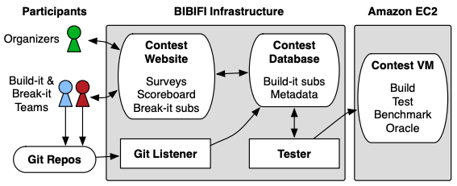
Contest implementation
Website written in Yesod, Haskell-based web framework
www.yesodweb.com
Extended with a custom version of LIO, for security enforcement

Slide 14
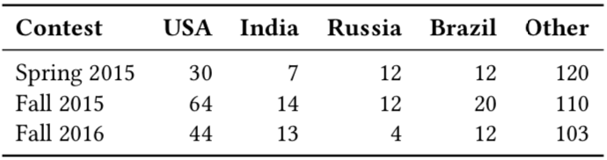
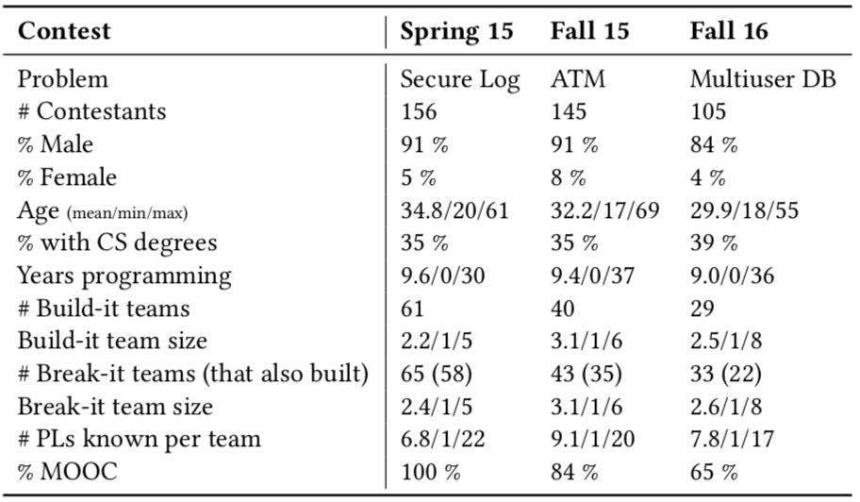
Participant demographics
Worldwide participant pool (mostly non-US)
156 teams, 406 people
Average 9 years programming experience
1/3 have CS degree
Most participants part of MOOC
Four courses of security training
Average team size: ~2

Slide 15
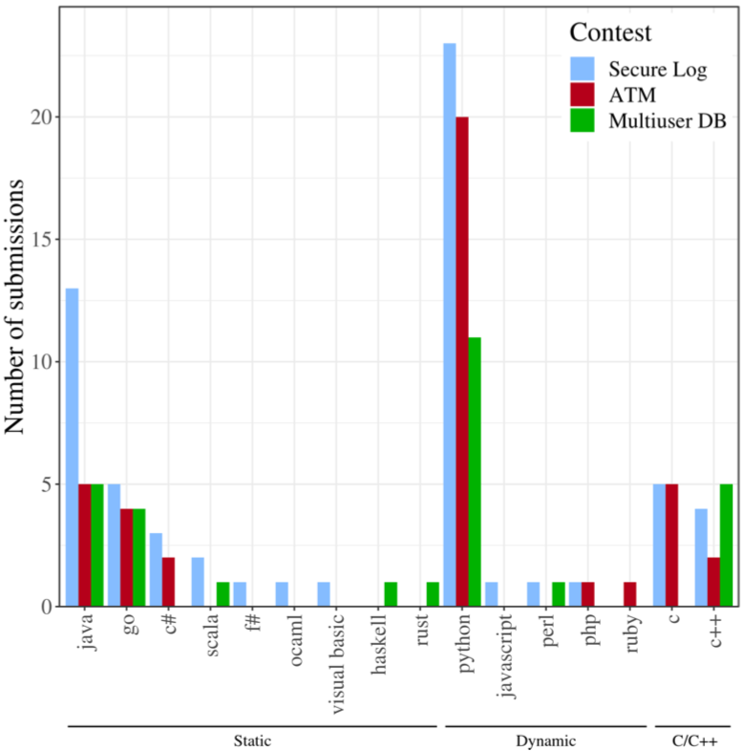
Submission features
Count by language
Grouped by category
Statically type-safe (49)
Dynamically typed (60)
54 are Python!
C/C++ (21)

Slide 16
Summary of data analysis
Build-it
Best performance: coded in C/C++
Lower chance of a security flaw (11x): coded in statically type-safe language
Diverse programming background, shorter code, team size, knowledge of C factor in less significantly
Break-it
Increased chance of finding security bug: Larger team
Higher overall bug count: Larger team, took part in build-it
Advanced techniques made no measurable difference

Slide 17
Discussion
How does this format of study compare to alternatives?
What variations on the contest design that might improve it?
Why might we trust, or not trust, these results?
E.g., non-fixed breaks could overpenalize teams in a certain category
Could not assess availability problems (hangs)
Lack of data does not imply non-effect
Could this contest setup be applied to other problems?

Slide 18
Readings

Slide 19
Approach
Examined each project and vulnerability in detail
94 projects
Breaker-identified (866 submitted exploits) and researcher-identified (manual analysis)
In total, 182 distinct vulnerabilities
Iterative open and axial coding
Two+ independent coders
High agreement: Krippendorff’s α > 0.8
Qual and quant analysis on resulting categories

Slide 20
Vulnerability classes
No Implementation
Misunderstanding
Mistake
Bad Choice
Conceptual Error
Intuitive
Unintuitive

Slide 21
Vulnerability classes
Missed something “Intuitive”
No encryption
No access control
No Implementation
Intuitive

Slide 22
Vulnerability classes
Missed something “Unintuitive”
No MAC
Side channel leakage
No replay prevention
45% of projects
No Implementation
Unintuitive

Slide 23
Vulnerability classes
Made a “bad choice”
Weak algorithms
Homemade encryption
strcpy()
Misunderstanding
Bad Choice

Slide 24
Vulnerability classes
Misunderstanding
Made a “conceptual error”
Insufficient randomness
Disabling default protections
44% of projects
Conceptual Error

Slide 25
Vulnerability classes
Made a programming “mistake”
Control flow error
Skipped algorithmic step
21% of projects
Mistake

Slide 26
Summary of data analysis
No implementation & misunderstanding more common (78%) than mistake (21%)
Mistake: control error, skipped step
Unintuitive requirements missed or implemented incorrectly much more often (45%) than intuitive ones
Unintuitive: MAC; avoiding side channels and/or replays
Intuitive: Encryption for privacy; access control
Implementation complexity breeds mistakes
Failure to localize functionality, minimize TCB, completely mediate
Mistakes readily exploited
Almost always result in contestant attacks

Slide 27
Recommendations
Simplify API design
Build in security primitives and focus on common use-cases
Indicate security impact of non-default use in API documentation
Explain the negative effects of turning off certain things
Expand capabilities of vulnerability analysis tools
More emphasis on design-level conceptual issues

Slide 28
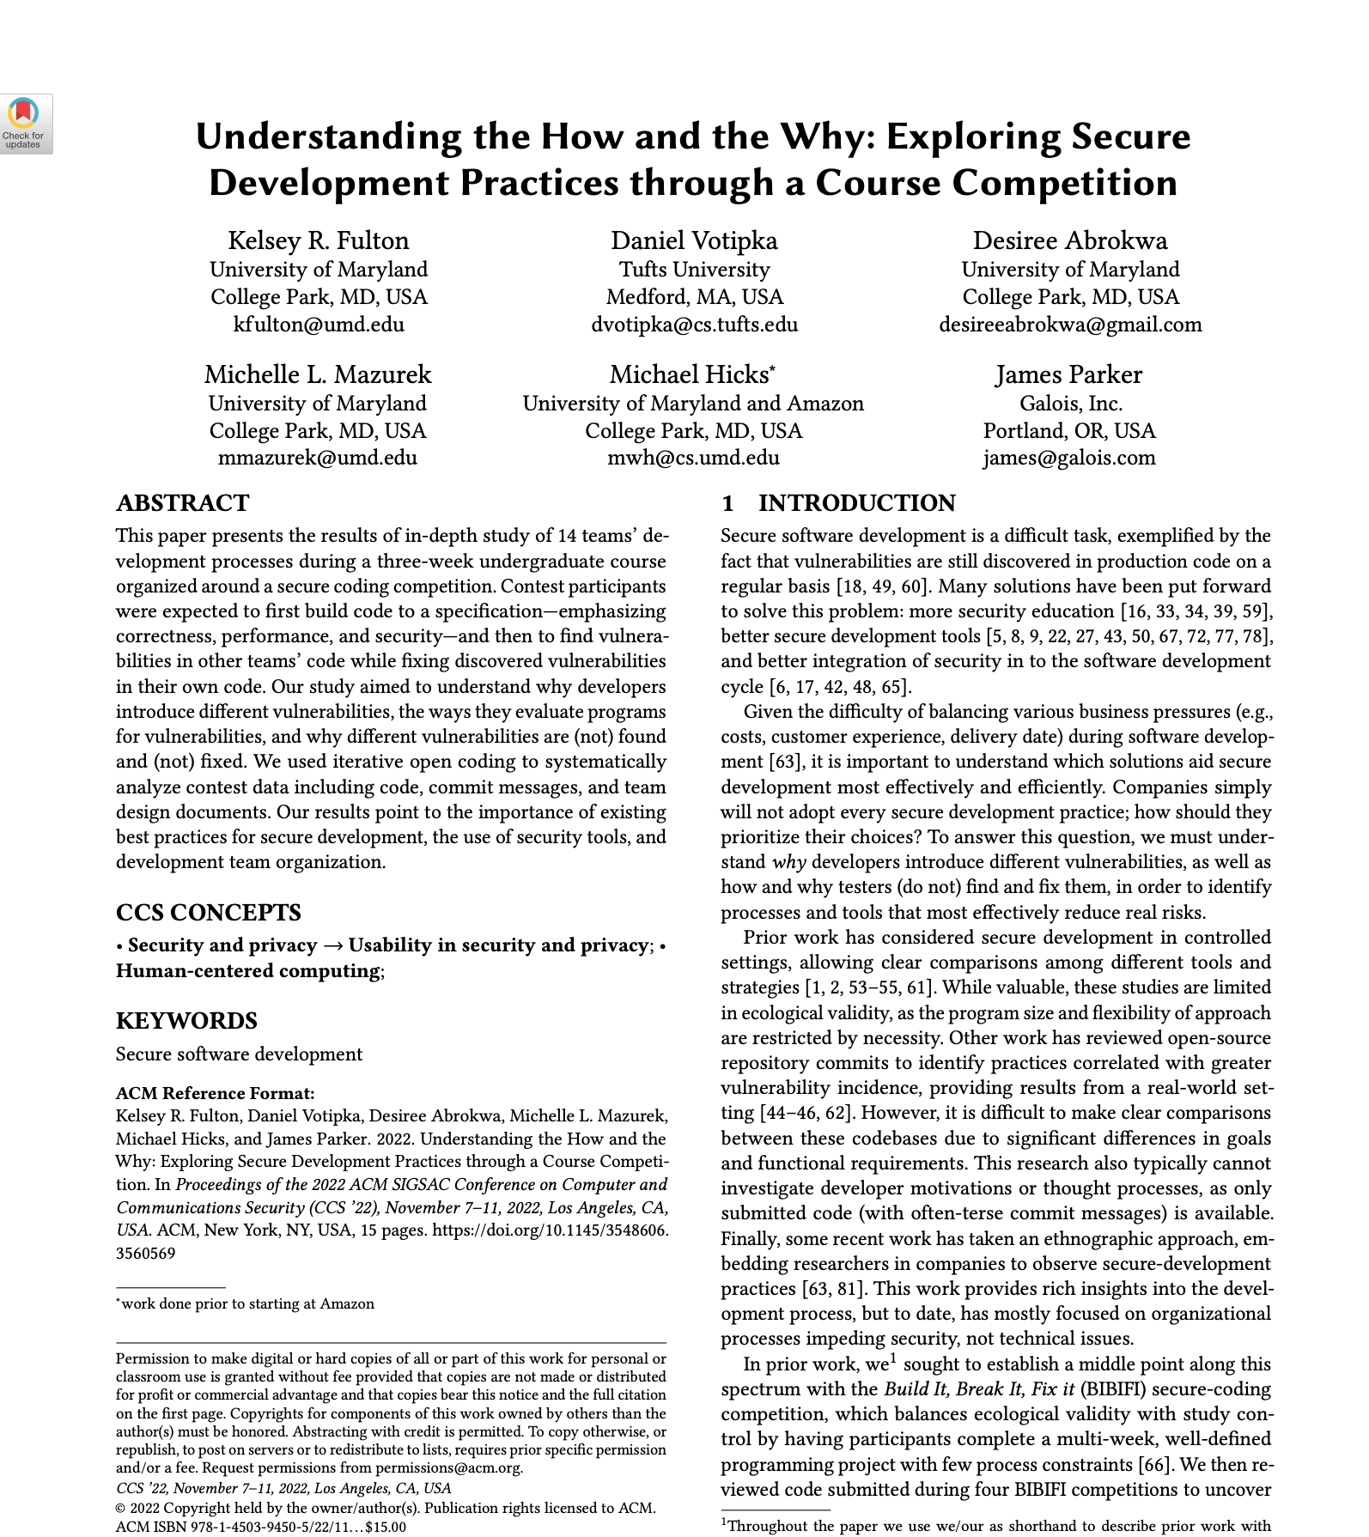
Discussion
What is your take on what the data seems to be saying?
What sort of follow-on studies could we do to support or refute the stated conclusions?
How does this study’s results speak to the big picture of securing software?
What technical next steps do you think might be worth pursuing, to improve the state of affairs?
One more paper in this series!

