Slide 1


Empirical Security & Privacy, for Humans
UPenn CIS 7000-010
8/28/2025
Security – An economic perspective

Slide 2
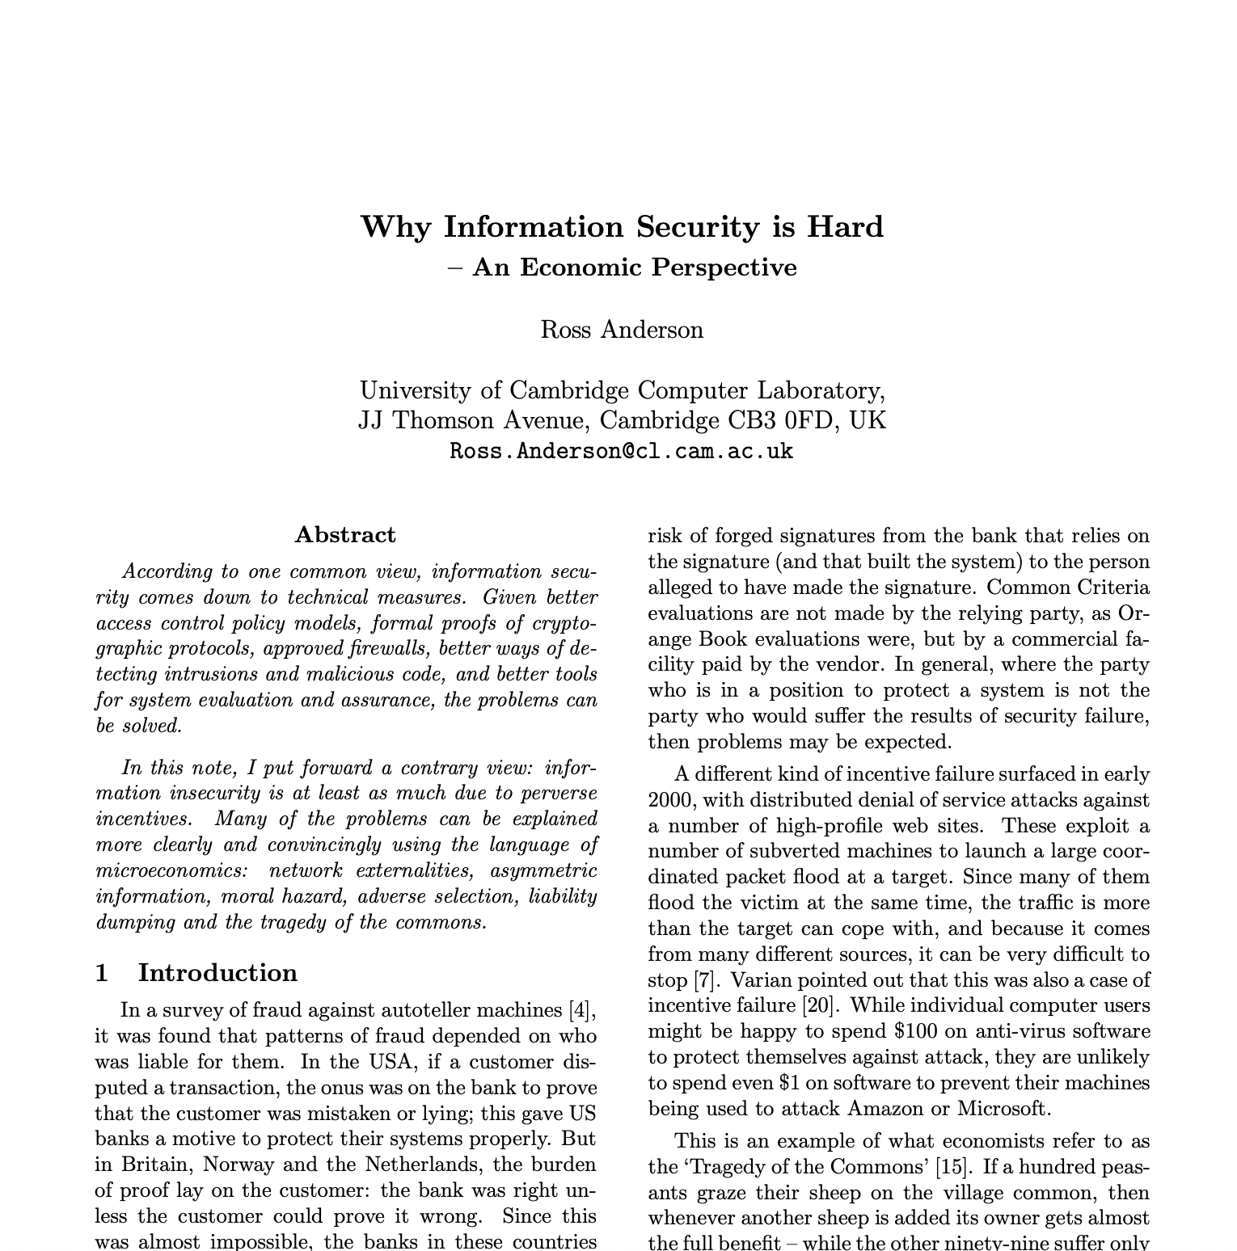
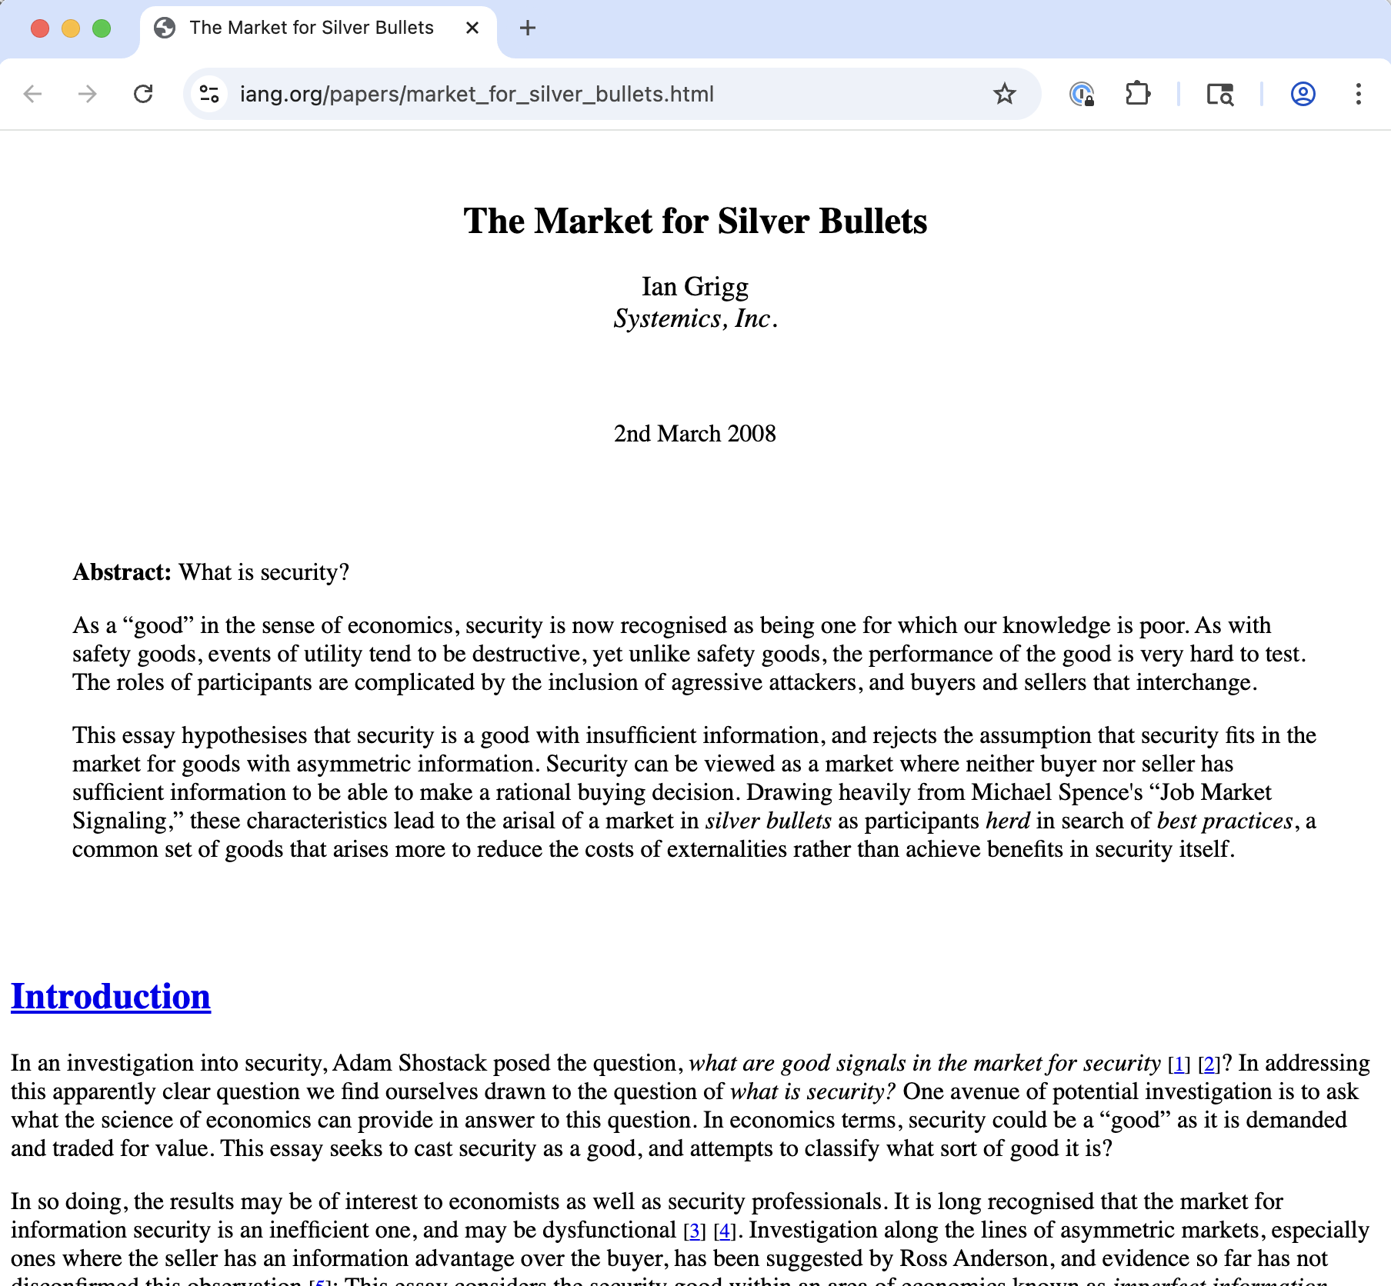
Readings
Plus: “How to Read a Paper?”

Slide 3
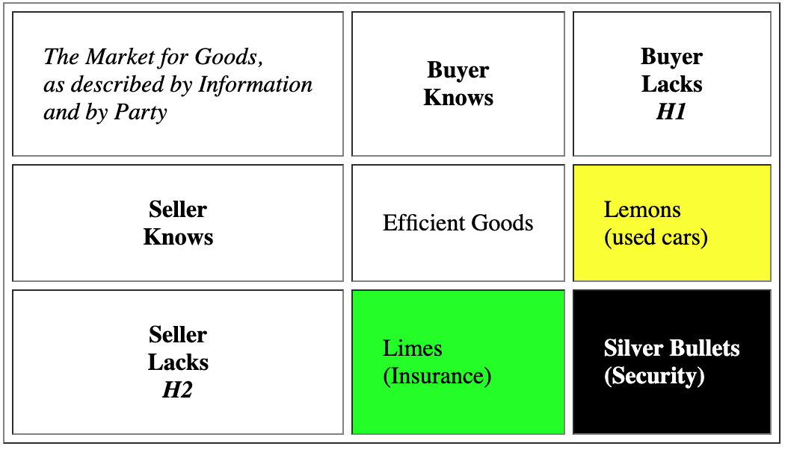
Security is a silver bullet
Security is a good
Security is hard to assess
Leads to information insufficiency
Investment decisions not based on good metrics, but rather on signals
Cf. higher education and the market for hiring – how different than this?
Security is a negative-sum game
If cost of breaches > cost of products, all parties herd around the same products
Anti-incentive to expand them
Ian Grigg – The Market for Silver Bullets https://iang.org/papers/market_for_silver_bullets.html

Slide 4
Why Information Security is Hard An Economic Perspective
Party best-placed to improve security should be incentivized to do so
Liability
Tragedy of the commons
First-mover and network externalities vs. security
3rd party evaluators paid by seller vs. direct user evaluation
Costs of attack vs. defense
“Even a very moderately resourced attacker can break anything that’s at all large and complex”.
Market forces: end-user security vs. developer pain
“In an ideal world, the removal of perverse economic incentives to create insecure systems would depoliticize most issues.”
Ross Anderson https://ieeexplore.ieee.org/stamp/stamp.jsp?tp=&arnumber=991552

Slide 5
END

