Slide 1
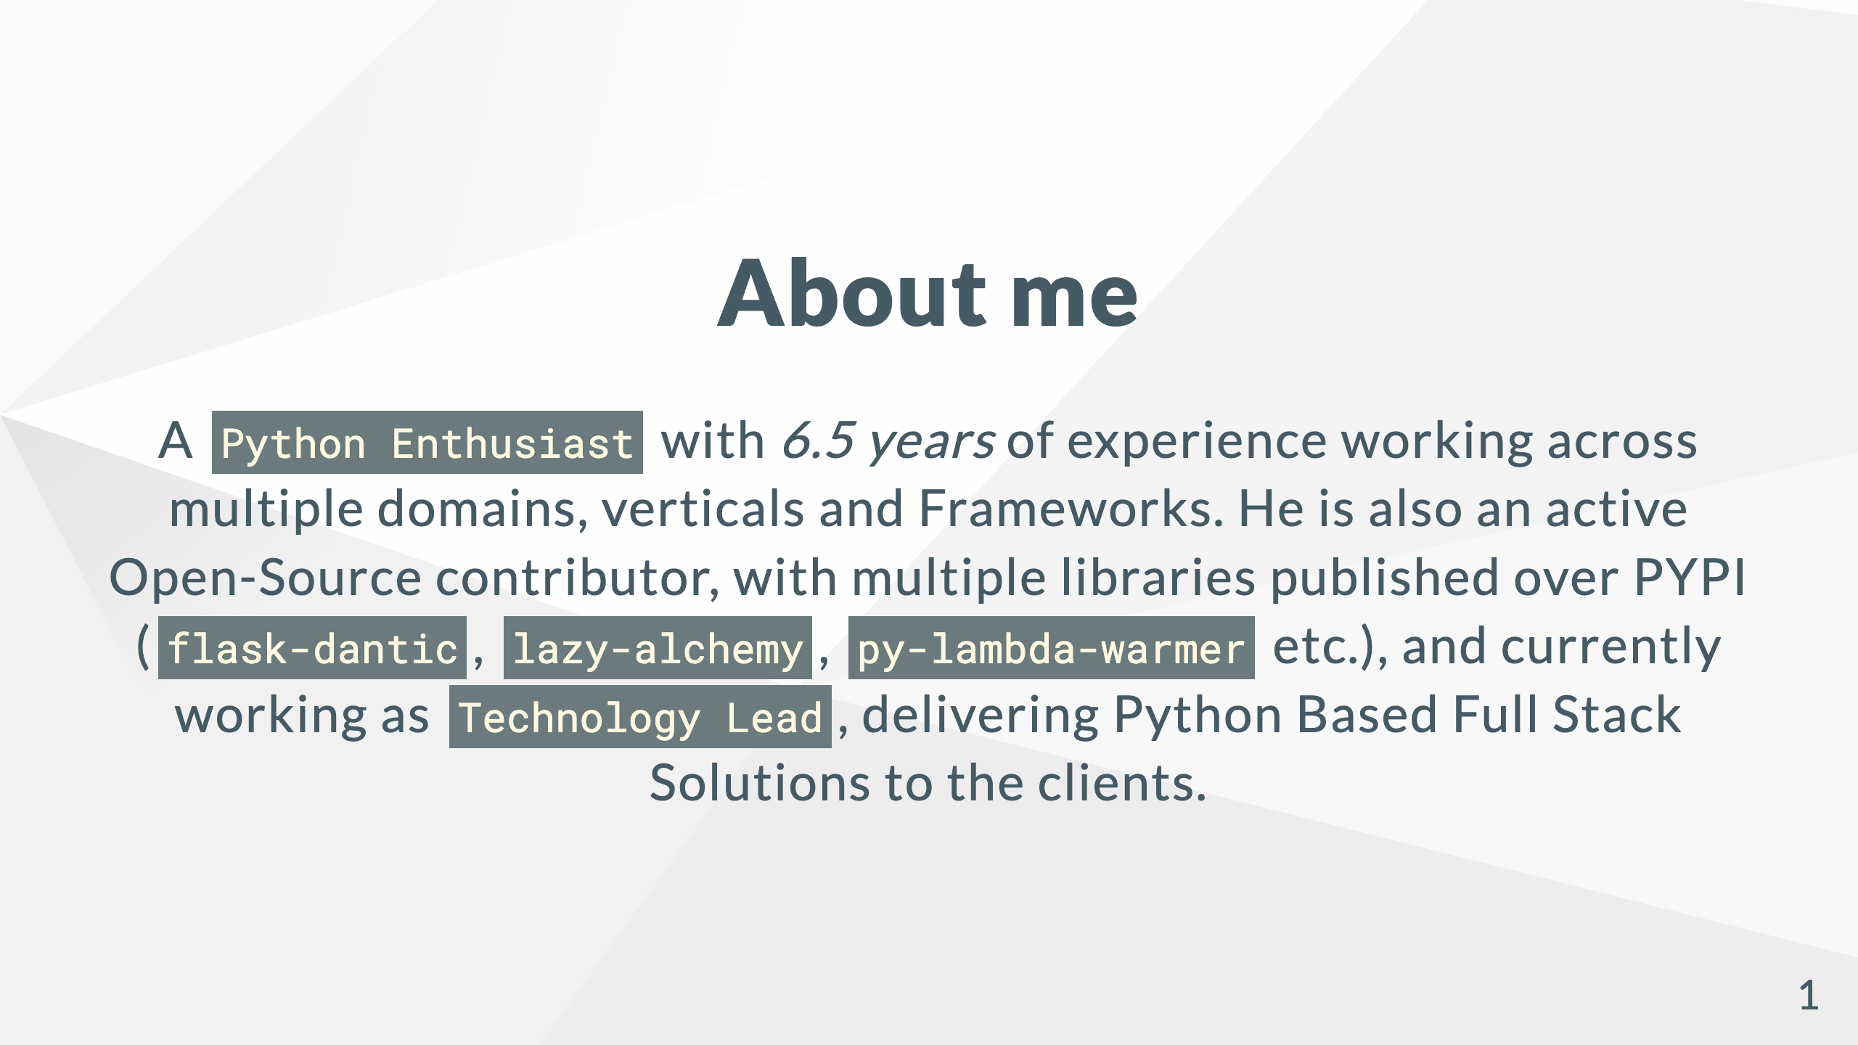

Slide 2
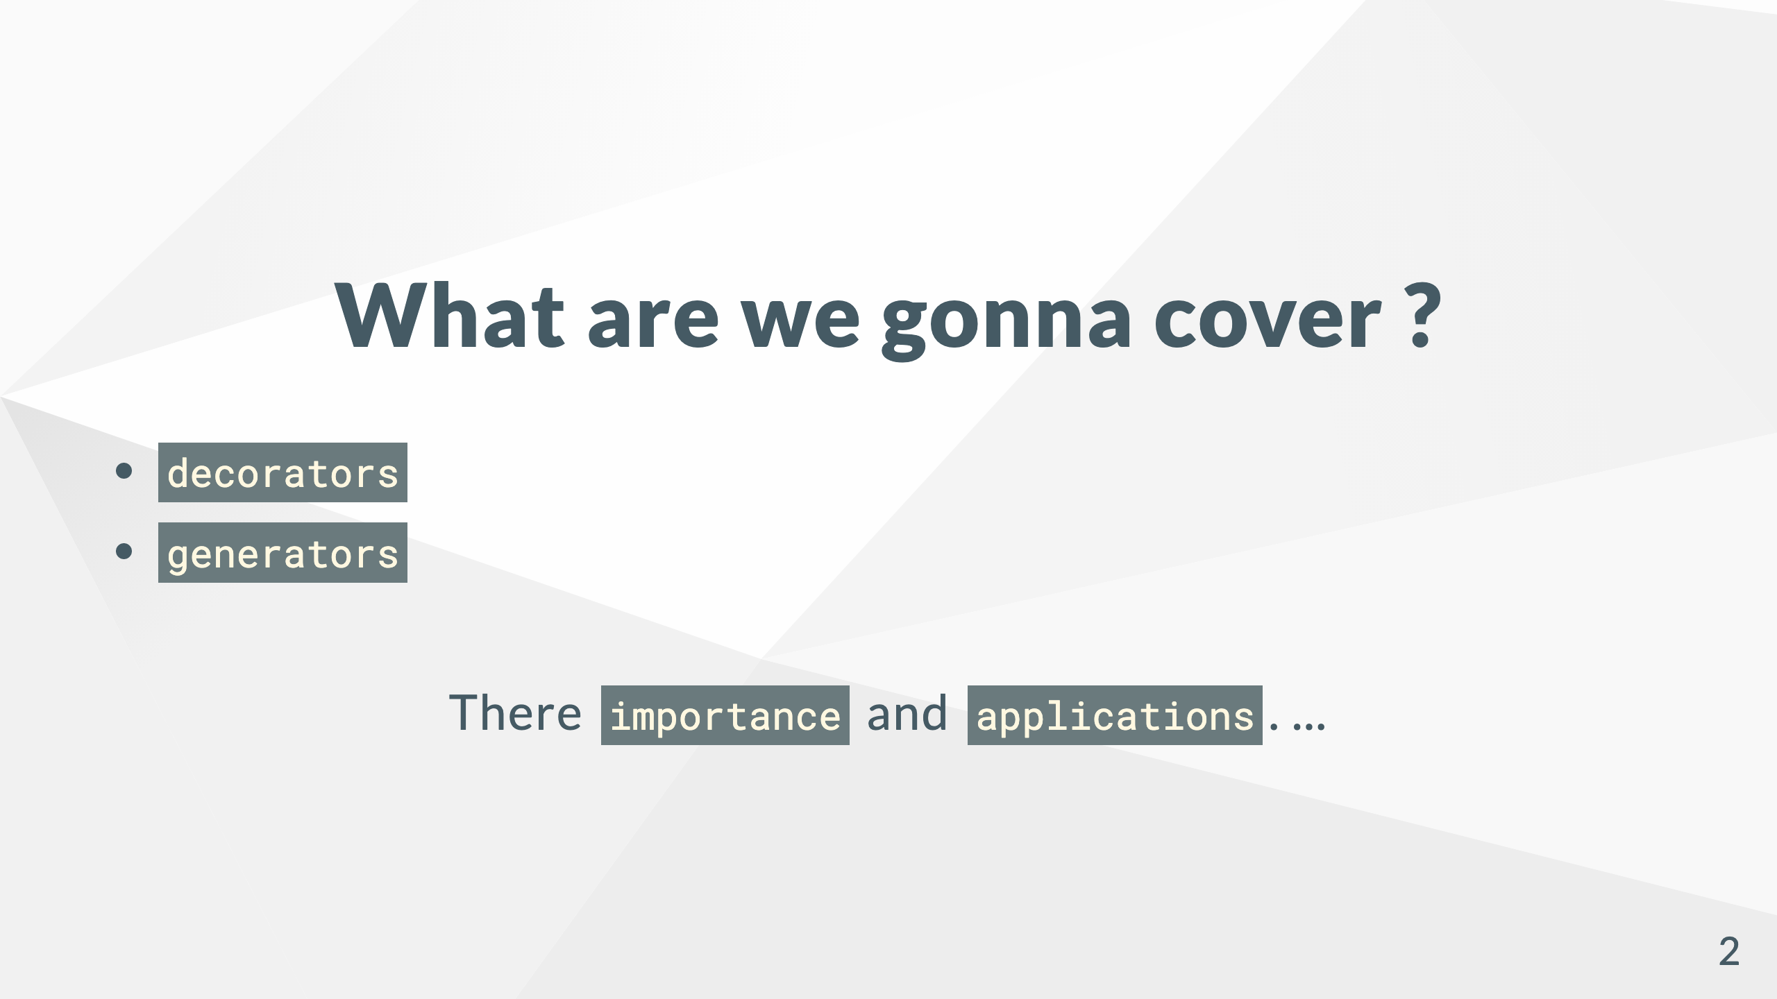

Slide 3
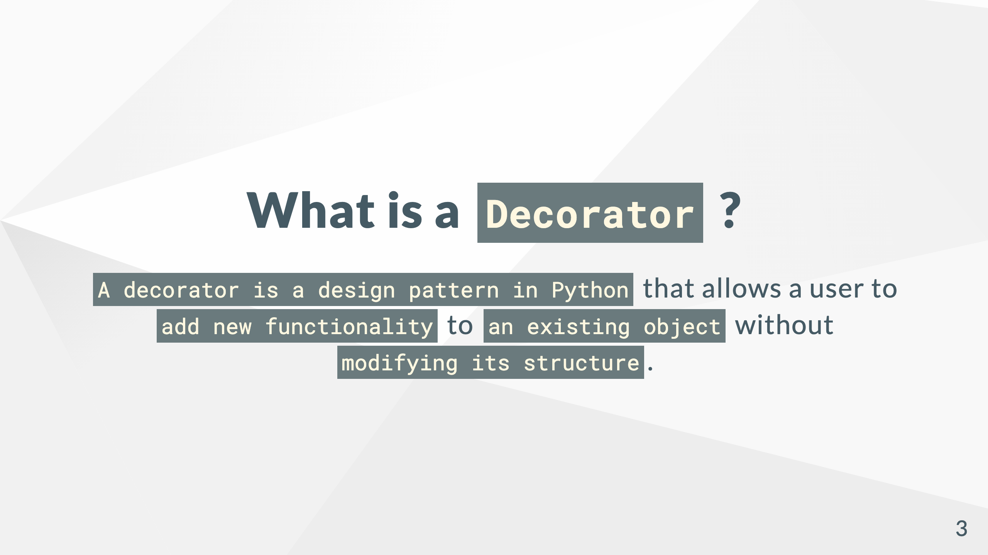

Slide 4
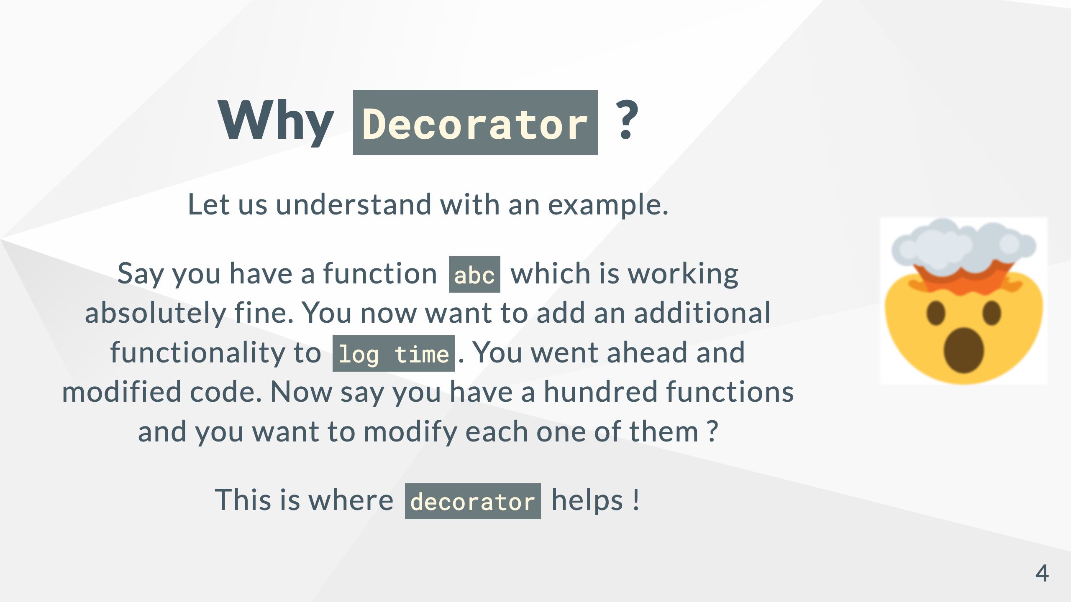

Slide 5
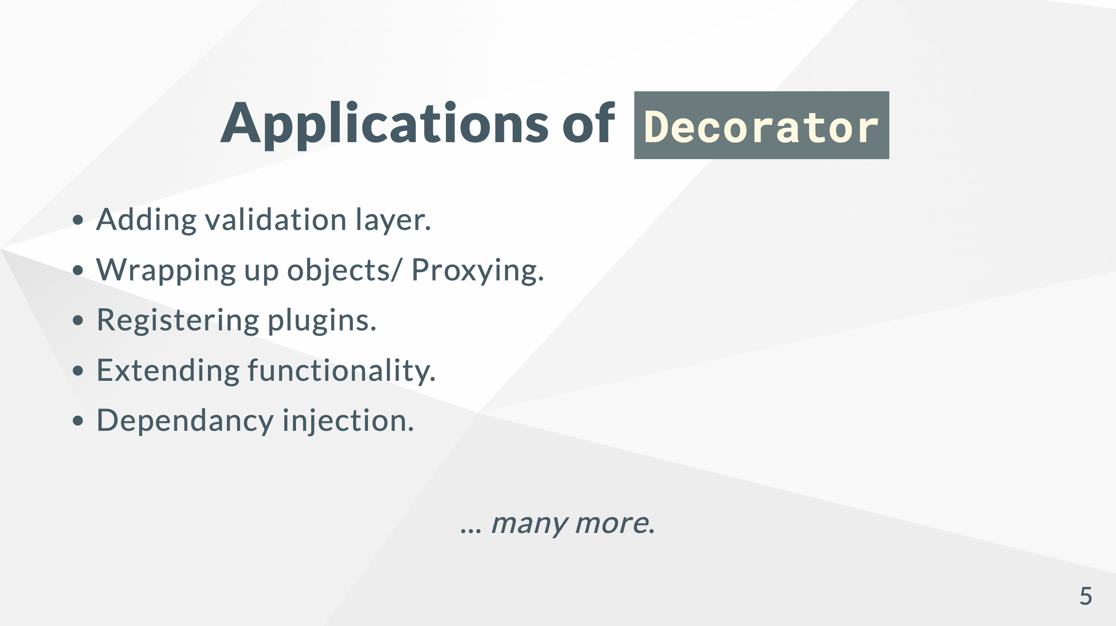

Slide 6
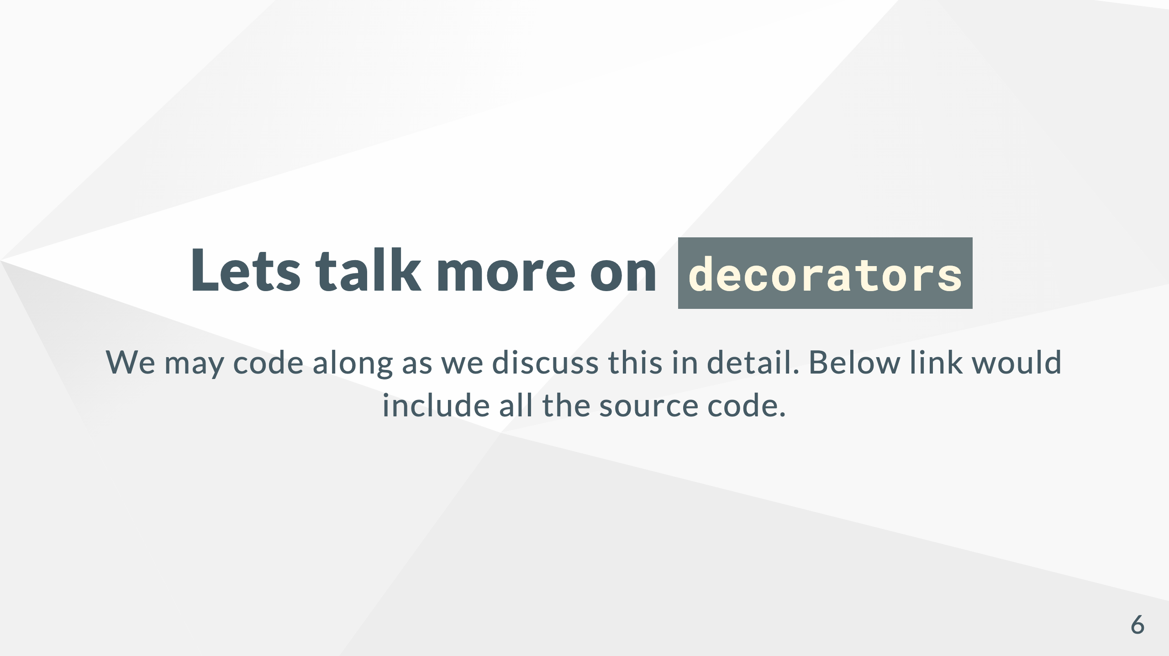
PyConf 2022 Workshop - Decorators
Notes:
[Pyconf 2022 Workshop - Decorators](https://github.com/satyamsoni2211/pyconf_2022_decorators_generators_workshop/tree/main/decorators)

Slide 7
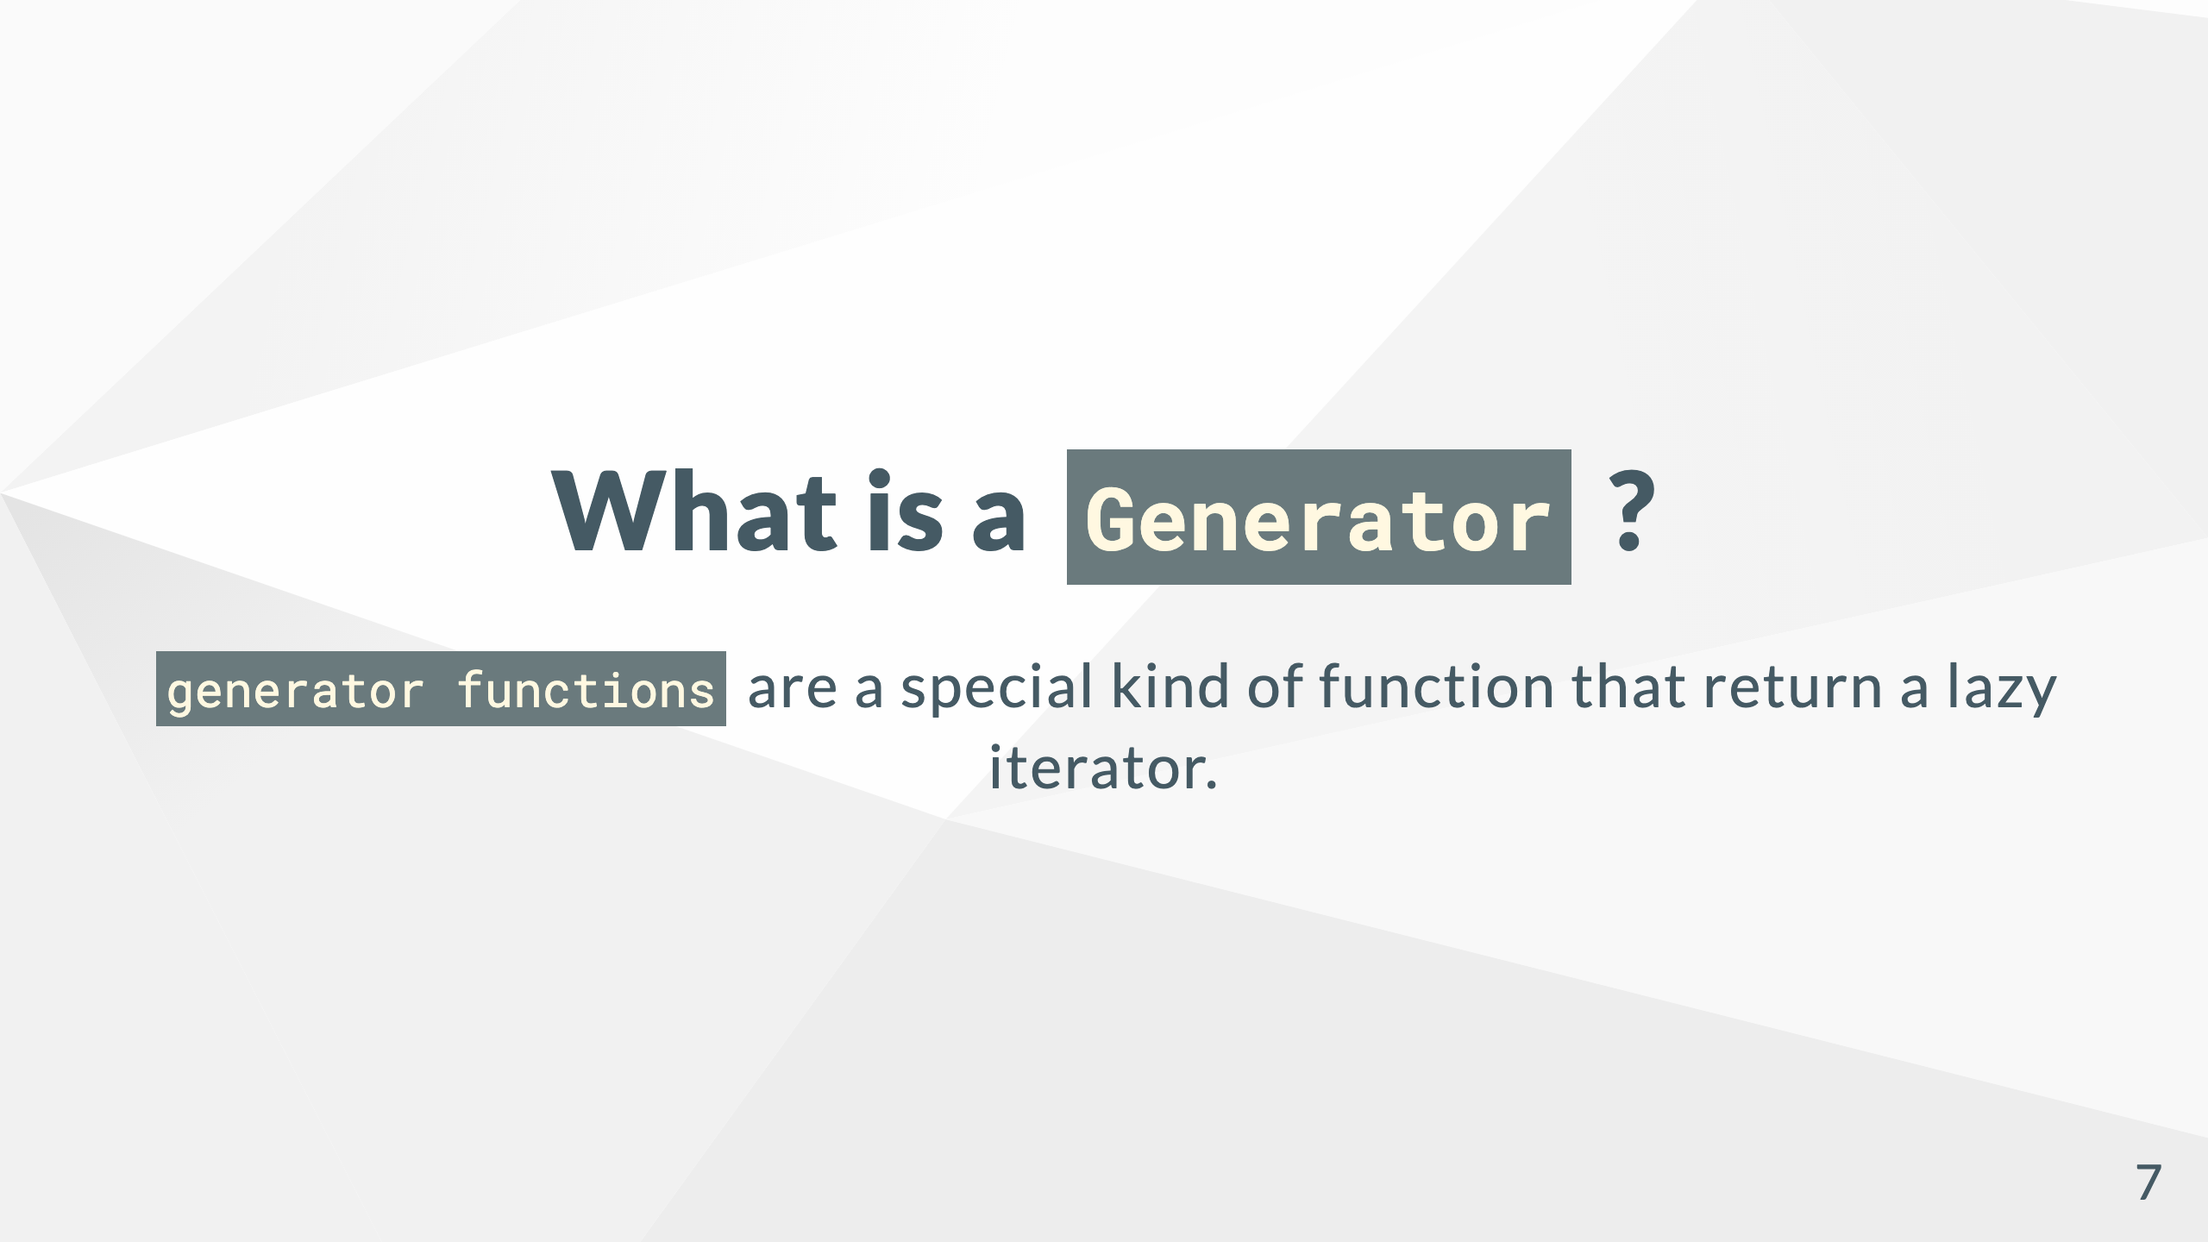

Slide 8
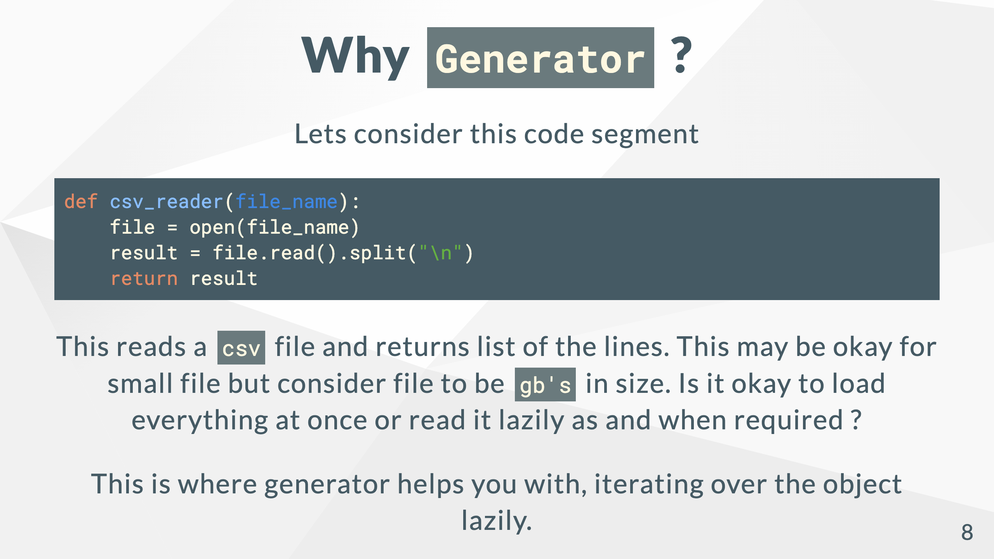

Slide 9
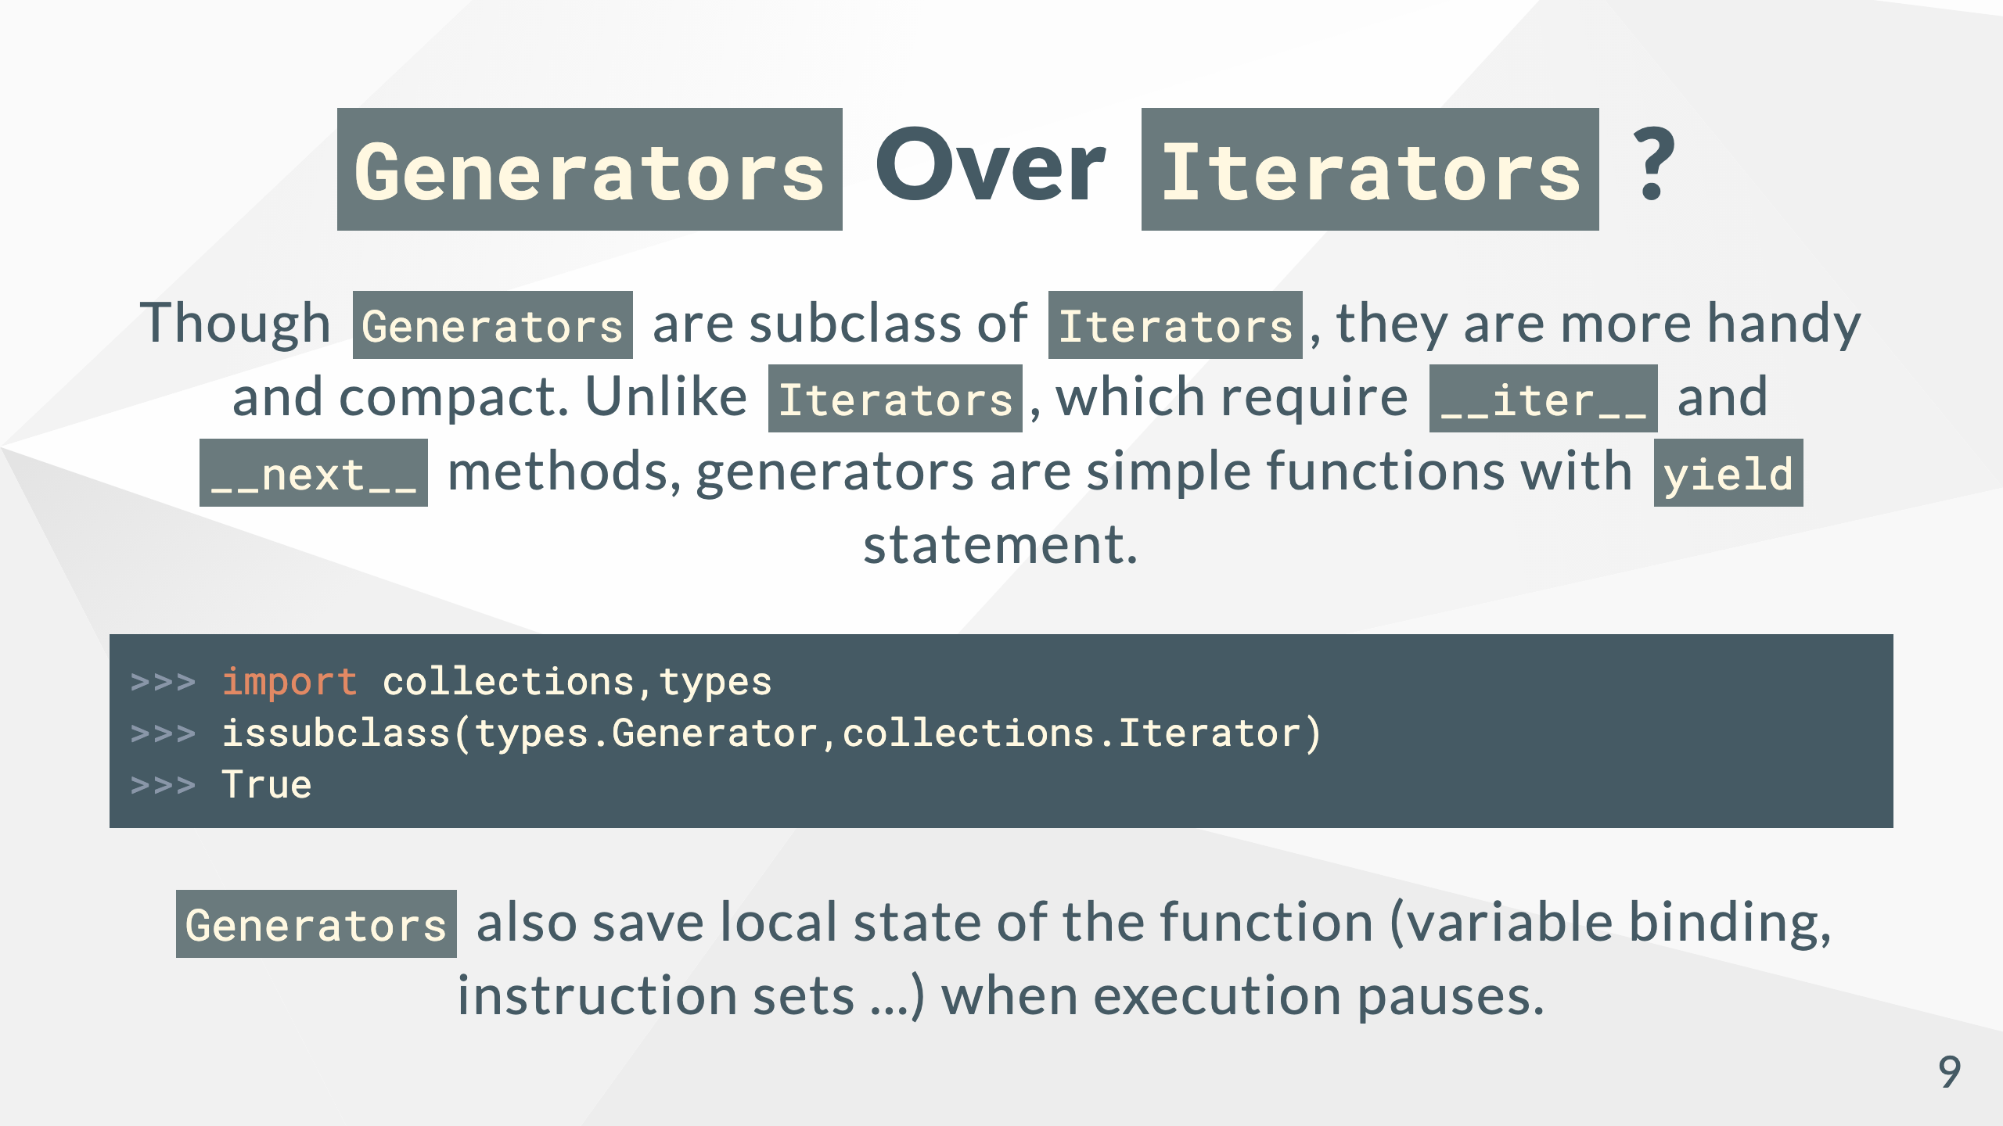

Slide 10
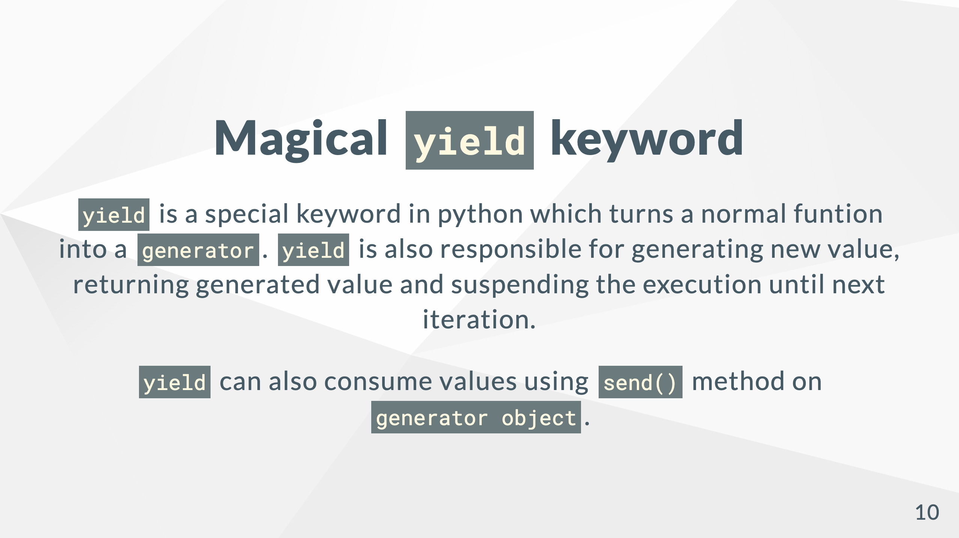

Slide 11
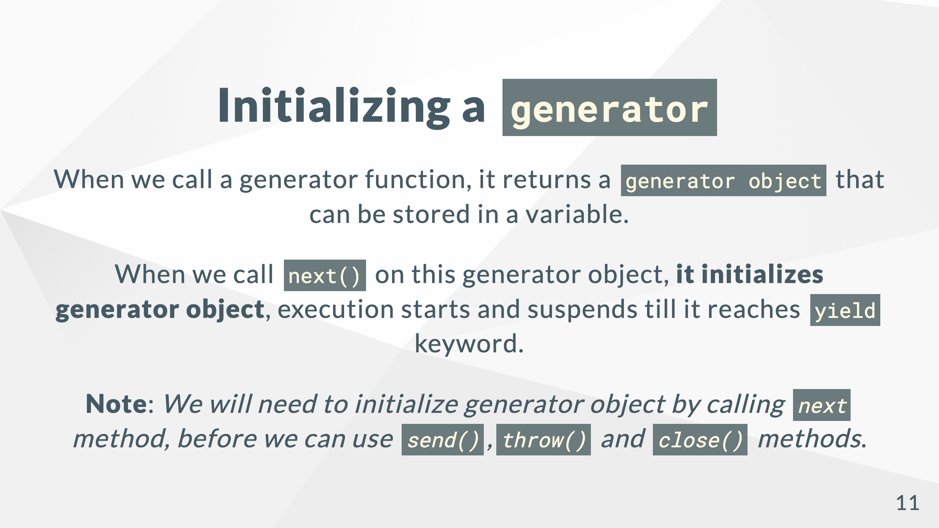

Slide 12
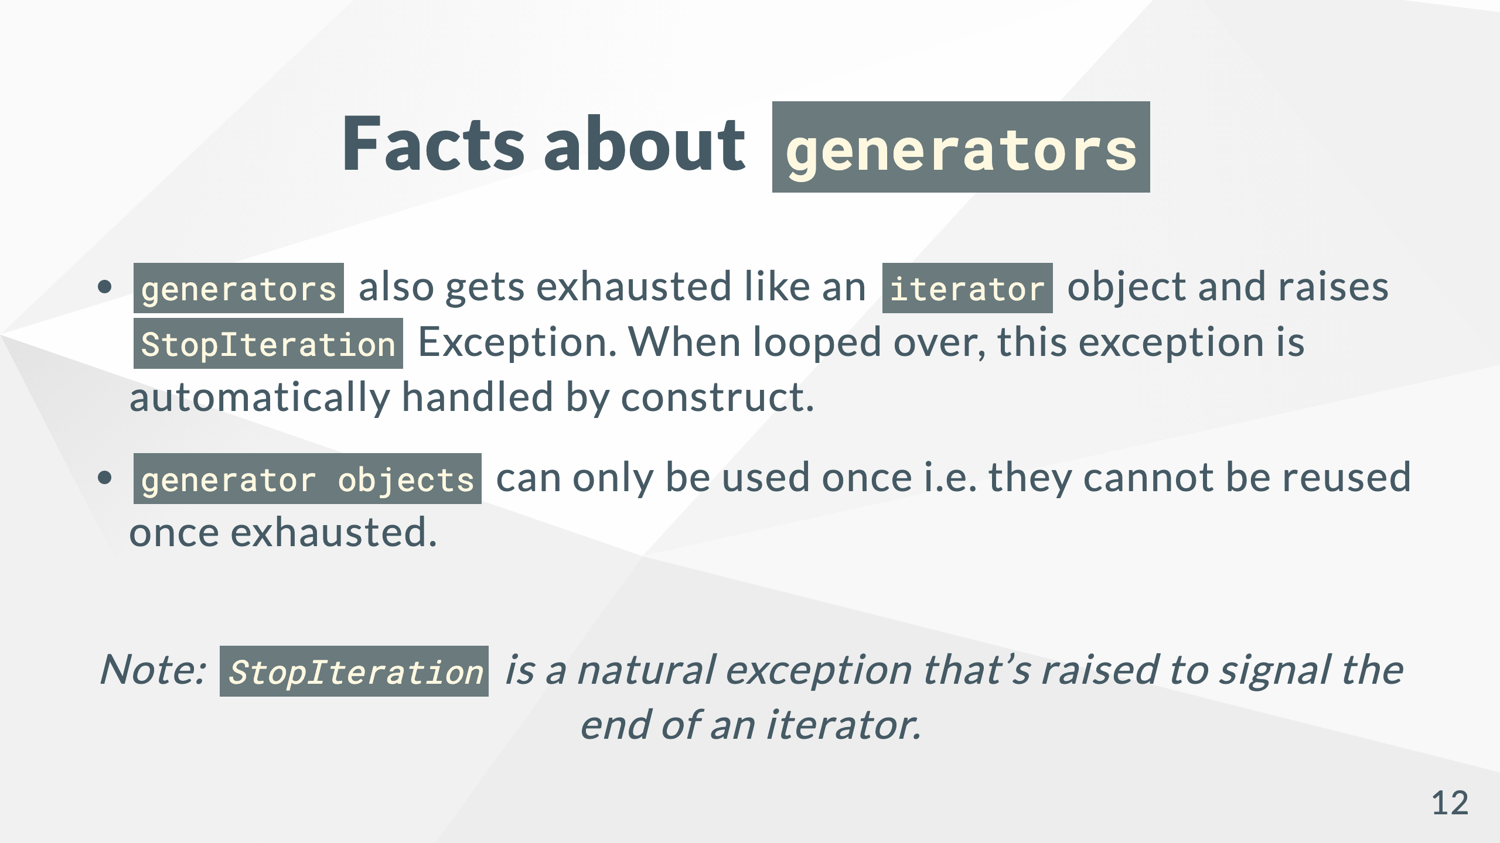

Slide 13
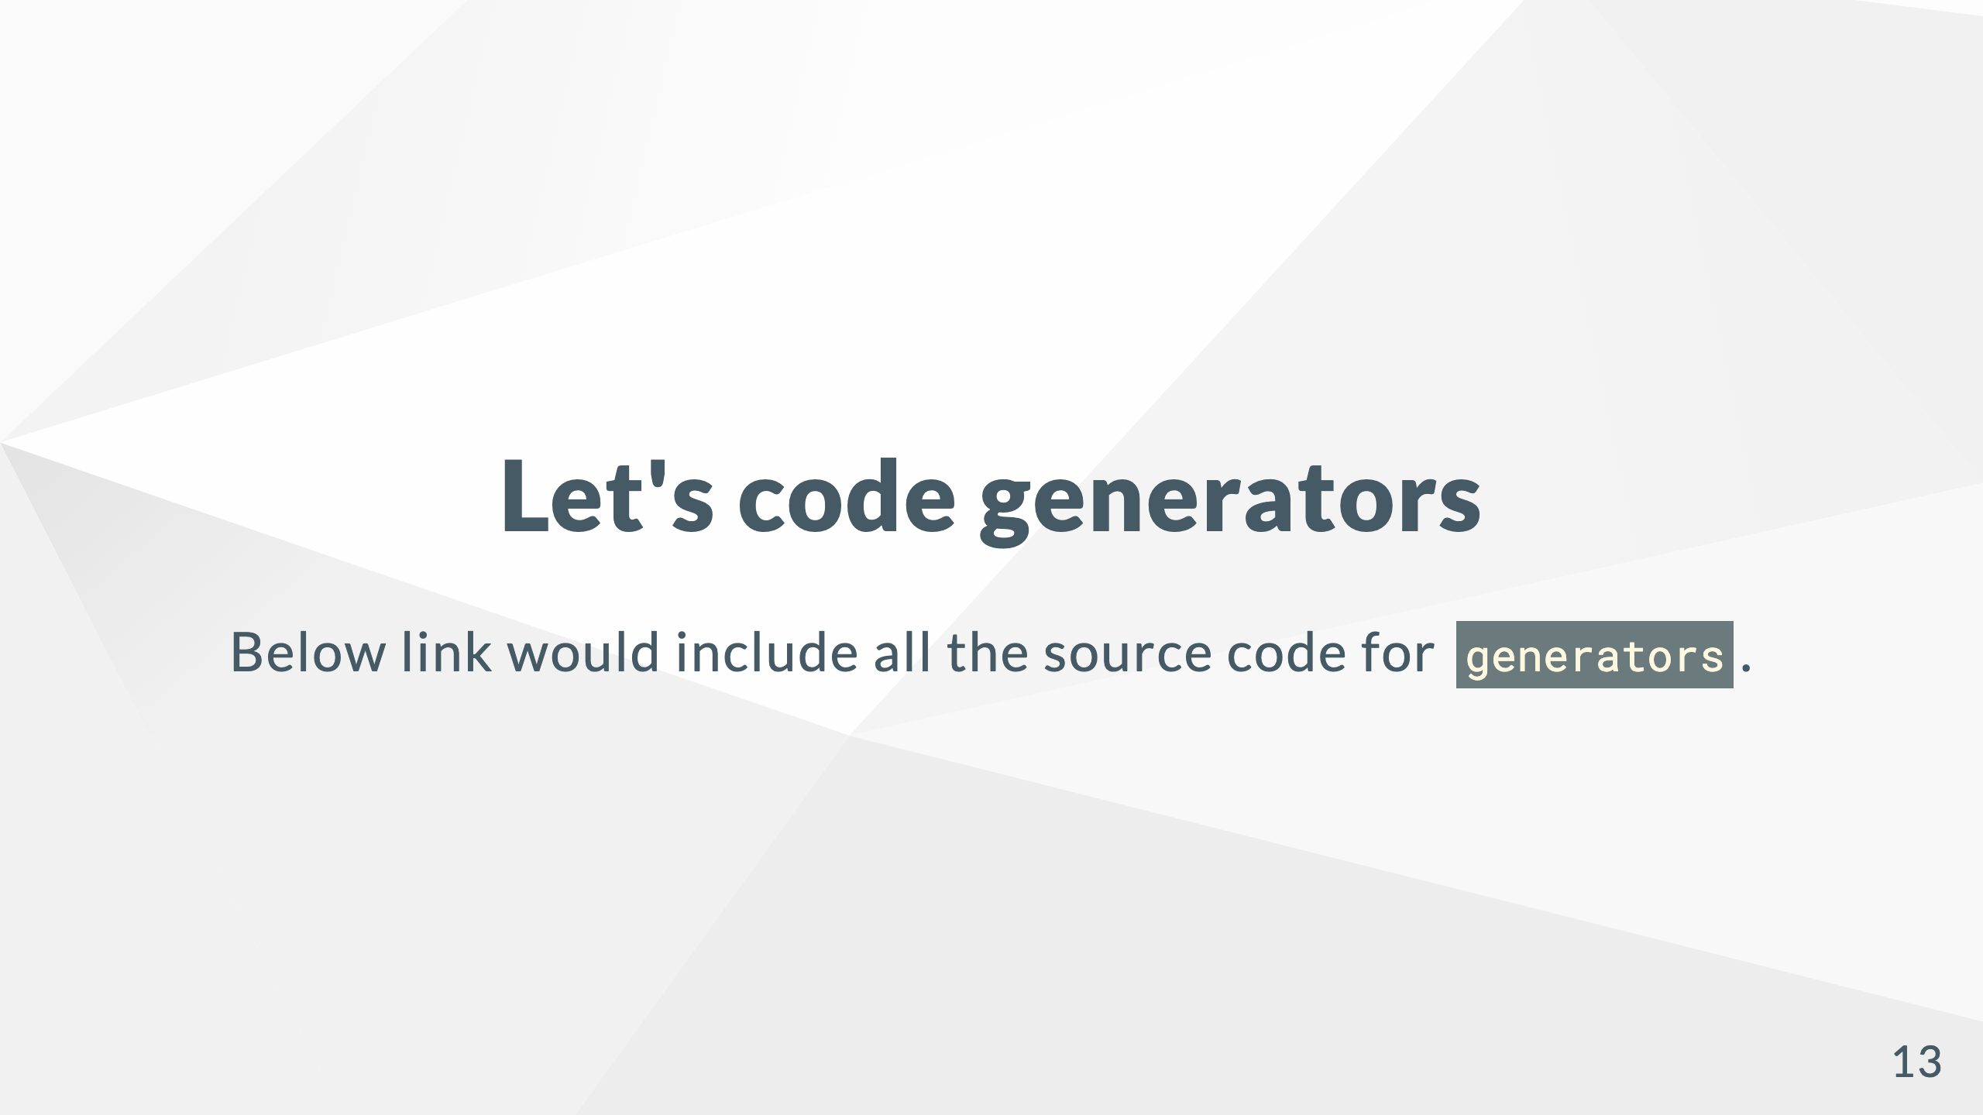
PyConf 2022 Workshop - Generators
Notes:
[Pyconf 2022 Workshop - Generators](https://github.com/satyamsoni2211/pyconf_2022_decorators_generators_workshop/tree/main/generators)

Slide 14


Slide 15


