Slide 1
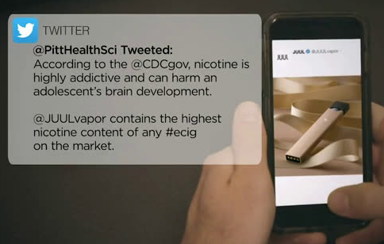
Discovering Predictors of Retweets Referencing JUUL
Marissa Wiener
12/5/2018

Slide 2

Facts about JUUL
One JUULpod contains as much nicotine as a pack of cigarettes
7% of teens 15-17 and 12% of young adults 18-24 use JUUL
63% of teens do not understand JUUL products contain nicotine
The FDA required JUUL Labs and other e-cigarette companies to address the widespread youth use of their products
Notes:
JUUL is an electronic cigarette which uses nicotine salts as its key ingredient
Uses cartridges (JUULpods) which contain the amount of nicotine as one pack of cigarettes
The amount of nicotine per cartridge is substantially higher than the majority of e-cigarettes
JUUL usage is highly prevalent amongst teens
7% of teens ages 15-17 and 12% of young adults ages 18-24 use JUUL
63% of teens do not understand that JUUL products contain nicotine
Easily disguised as a flash drive, low volume of smoke emitted
FDA Investigation
FDA required JUUL Labs and other e-cigarette companies to deliver plan to address widespread youth use of their products
Inspected JUUL headquarters to gather information on marketing methods
As of November 13, 2018, JUUL announced it would stop accepting retail orders for mango, fruit, crème, and cucumber JUUL pods
Sources:
https://en.wikipedia.org/wiki/JUUL
https://www.wsj.com/articles/schools-parents-fight-a-juul-e-cigarette-epidemic-1522677246
https://truthinitiative.org/sites/default/files/Recognition-use-and-perceptions-of-JUUL-among-youth-and-young-adults.pdf

Slide 3
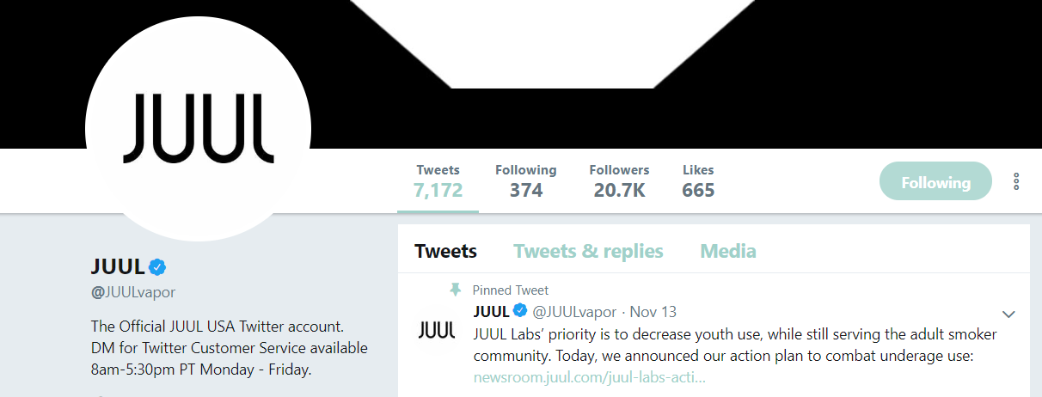
Research Questions
Assuming retweeting is a proxy for agreement and support, can tweets referencing JUUL provide any insight recent trends related to JUUL use?
Are there clear topics within the text of tweets and are these important variables in a model to predict whether a tweet is retweeted?

Slide 4
Methodology
Pull and Clean Tweets
Isolate Text from Tweet and Fit Topic Model (LDA)
Gather most representative tweets for four major topics
Build a model to predict topic
Apply this model to the entire corpus of tweets
Add To Clean Tweet Data to Replace Tweet Text Column
Build Retweet Classification Model
Notes:
Pull twitter data containing ‘juul’, ‘#juul’, ‘juuling’, and other variants of the word JUUL
Use LDA to cluster tweets into topics
Select subset of topics and pull most representative tweets from each topic
Use this labeled data to create a model to predict topic based on tweet text
Apply this classification model to entire corpus of tweet text to assign a topic to each tweet
Use other features from twitter API data (# followers, likes, geo-enabled, etc) in addition to topics to predict if tweet would be retweeted
See how retweeting varies by topic, location (if populated), number of followers, and other features

Slide 5
Twitter Data
Twitter API Features
ID (tweet)
Created Date (tweet)
Tweet Text
Tweet Language
Screen Name
Location (user)
Protected
Profile Description
Followers Count (user)
Friends Count (user)
Listed Count (user)
Favourites Count (user)
Geo Enabled
Verified
Statuses Count (user)
Retweet Count (tweet)
Favorite Count (tweet)
Latitude and Longitude (tweet)
Pulled ~40K tweets from the Twitter API from 10/20/2018 through 11/26/2018
Created scripts to pull, clean, and deduplicate twitter data and ran script over a period of days
Calculated Features
Extracted date, hour, day of week, time of day from timestamp
Retweet and Favorite tweet indicator (tweet)
Limitations
Two holidays included in timeframe
There could be some biases in sampling methods
Location data was sparse

Slide 6
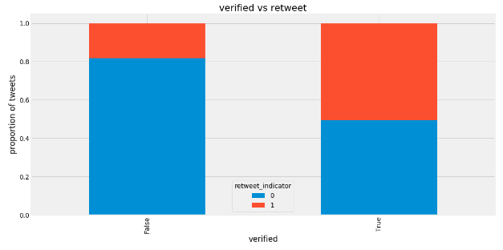
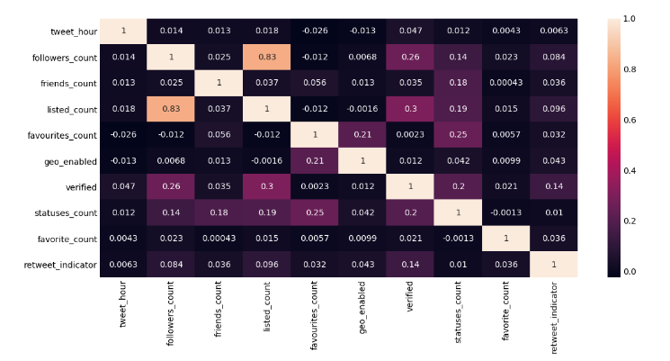
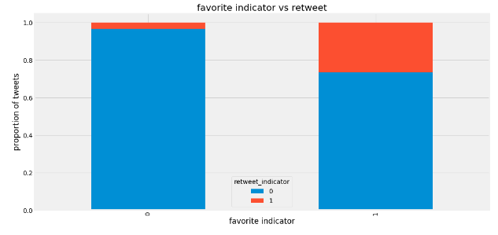
Exploratory Data Analysis
Categorical Variables
The strongest relationships with retweet indicator seem to be verified and favorite indicator
Continuous Variables
Not many strong linear correlations with retweet indicator
Substantial correlation is between followers and listed count

Slide 7
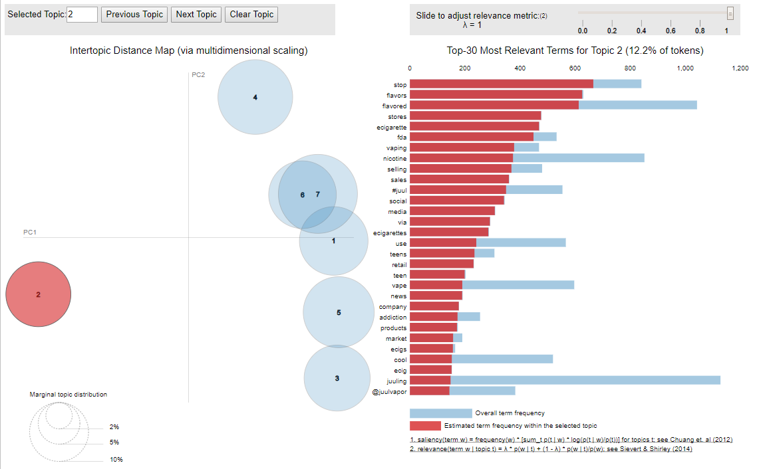
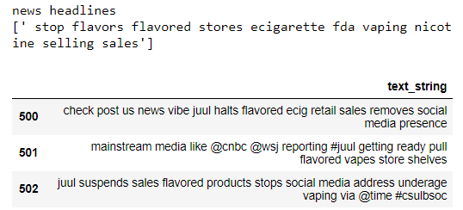
Topic Modeling
Topic 1: JUUL Usage & Experience
Topic 2: News Headlines
Topic 3: JUULpods and Flavors
Topic 4: Cigarettes, Nicotine, & Addiction

Slide 8
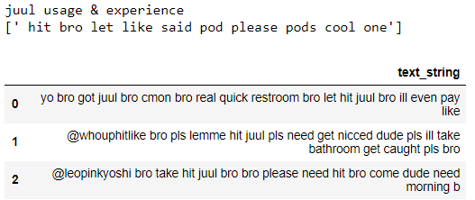
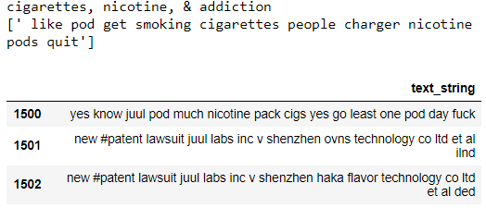
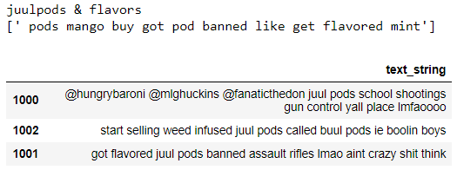
Top Tweets for each Topic
Notes:
Not a ton of differentiation between juul usage and experience and cigarettes, nicotine, and addiction

Slide 9
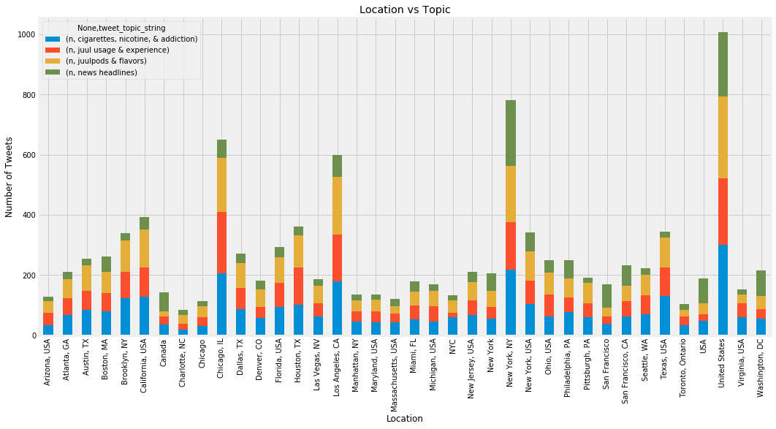
Topics by most Frequent Locations
Notes:
This is self-reported information, so there is some messiness with the data
New York, Washington DC, San Fransisco, and Canada seem to have a high percentage of news oriented tweets

Slide 10
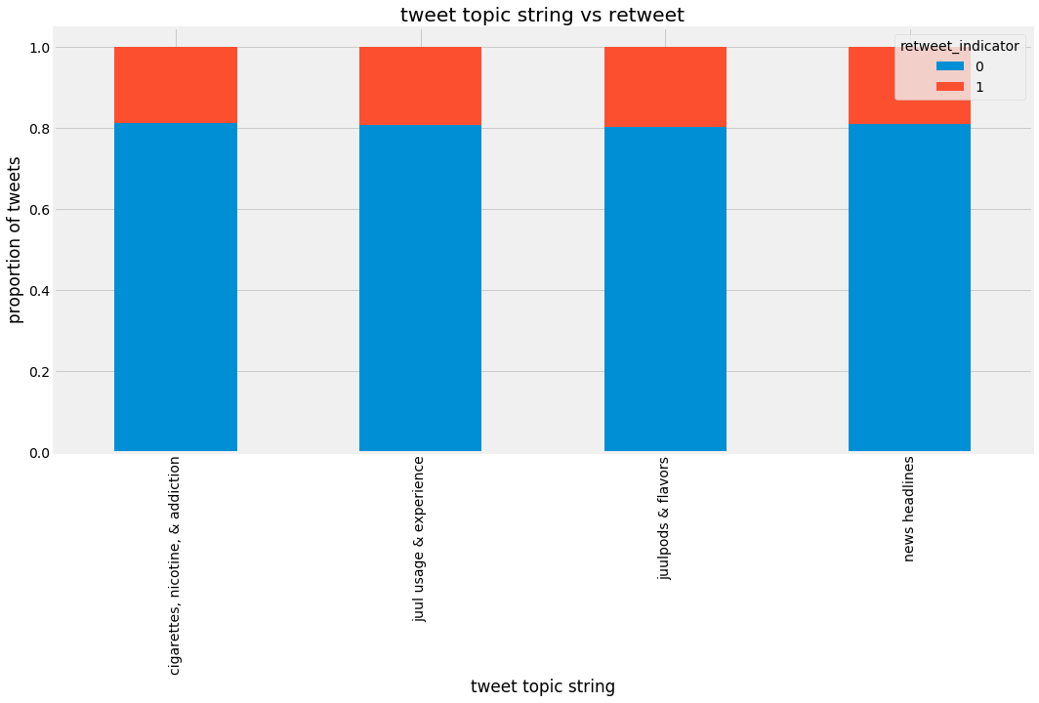
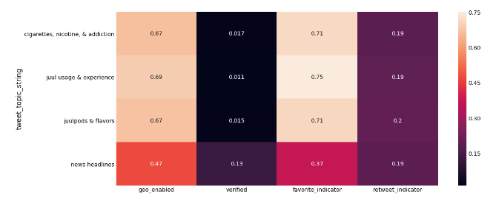
Don’t get too excited….
On a one-way basis, retweet frequency seems pretty constant across topics
It does seem to have some differentiation across levels of other variables, so maybe it will matter more in a multi-variate model
Cigarettes, Nicotine, & Addiction
JUUL Usage & Experience
JUUL pods & Flavors
News Headlines

Slide 11
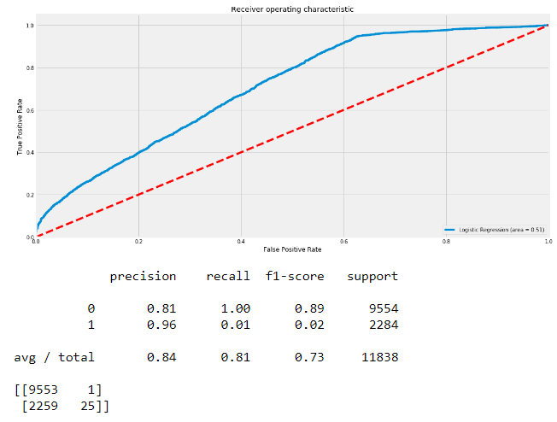
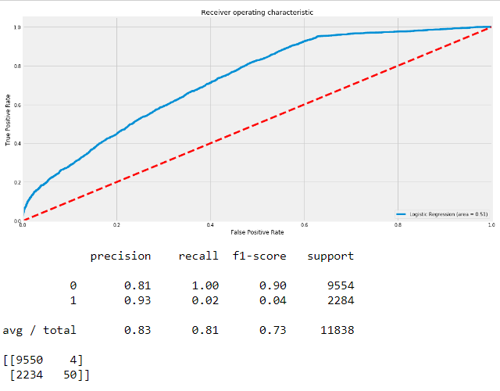
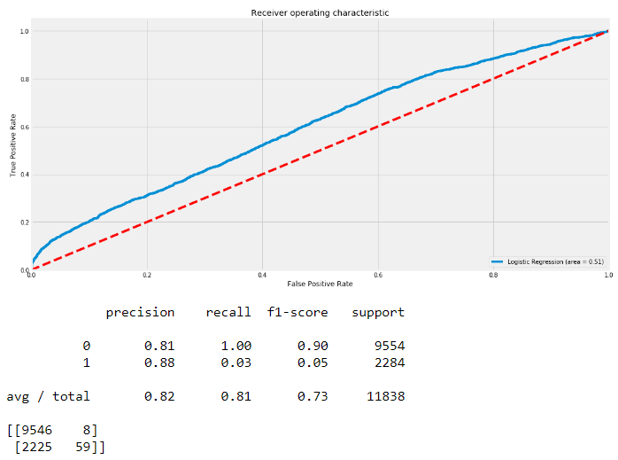
Retweet Model
Fit cross-validated Logistic Regression, Support Vector Classifier, and Random Forest Classifier
Results:
Logistic Regression Random Forest Classifier Support Vector Classifier

Slide 12
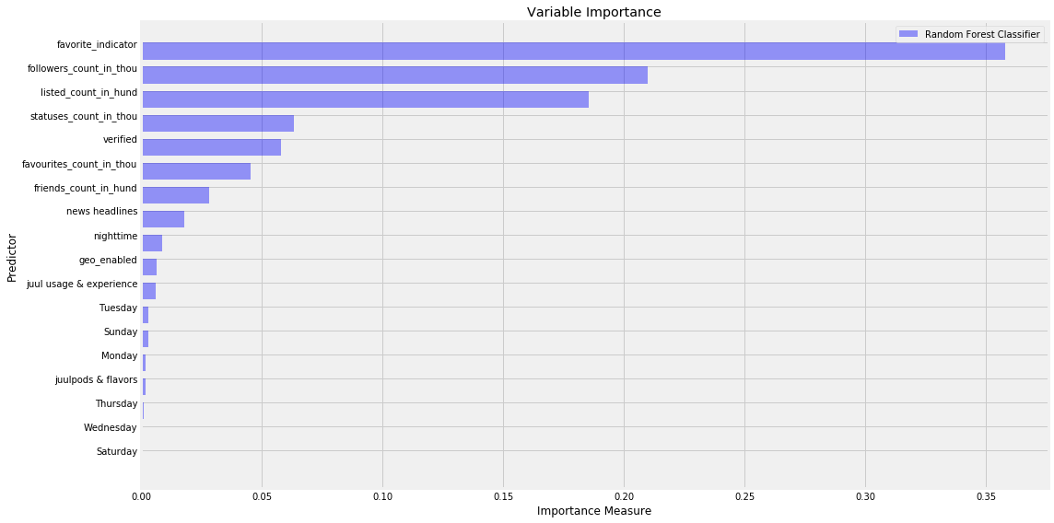
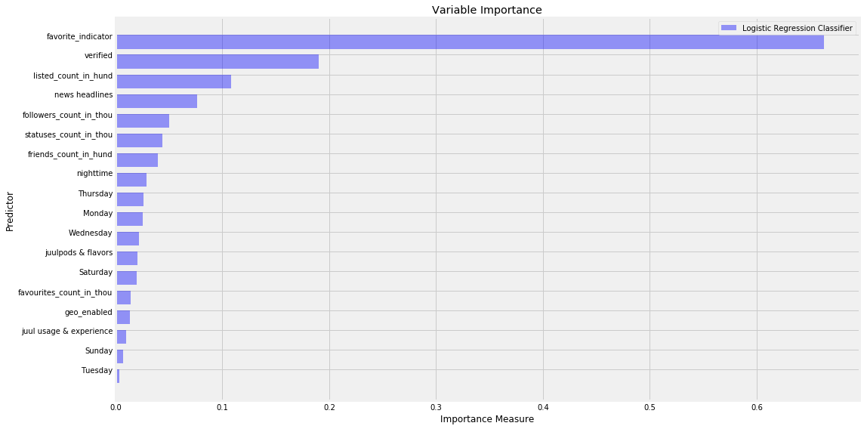
Variable Importance

Slide 13
Conclusion
Whether a tweet was favorited, the number of followers and connectivity in the Twitter network is more predictive than the topics from tweet text
The News Headline topic is the most predictive of retweet out of all four, but some actual news organizations are in the data, so this may be a contributor to its importance
Juul usage & experience is much less important than other variables in the model

Slide 14
Next Steps
Collect more data to obtain less overlapping topics
Experiment with removing hashtags before tokenizing
Attempt to use other algorithms for building retweet model (XGBoost, Naïve Bayes) topic predictor (CNN)

