Slide 1

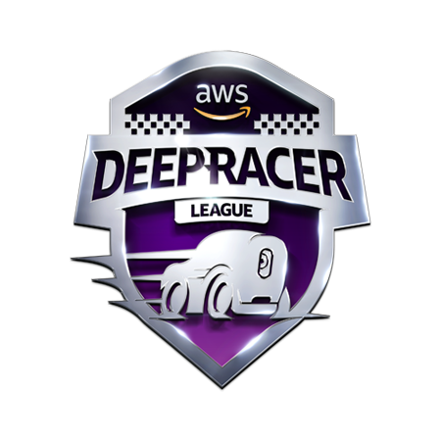
AWS DEEP RACER
GWU CLOUD COMPUTING FINAL PROJECT Presentation
BY: MATT WILCHEK

Slide 2

AGENDA
About AWS DeepRacer and re:Invent 2020
Review of Reinforcement Learning
AWS Components Used
Building a Vehicle
Iteration 1 – A Default Model
Iteration 2 – Breaking down Configurations
Iteration 3 – Trial and Error
Tournament Ranking

Slide 3
Deepracer & re:invent 2020
AWS DeepRacer is platform to develop, deploy and test Machine Learning Models for the purpose of creating a self-driving car
Reinforcement Learning is the cornerstone how the DeepRacer works
Also the common Machine Learning concept used for robotics
After training models, they need to be deployed to simulations for evaluation and hyper-parameter tuning
Best Reinforcement Models are then used to compete in AWS Sponsored Competitions
Re:Invent 2020 Knockout Round 1 Begins Nov 30 at 7pm
Wildcard Qualifications Start Nov 1-30: Top 5 Racers in Time Trial, Object Avoidance, and Head-to-Head Racing get spots

Slide 4
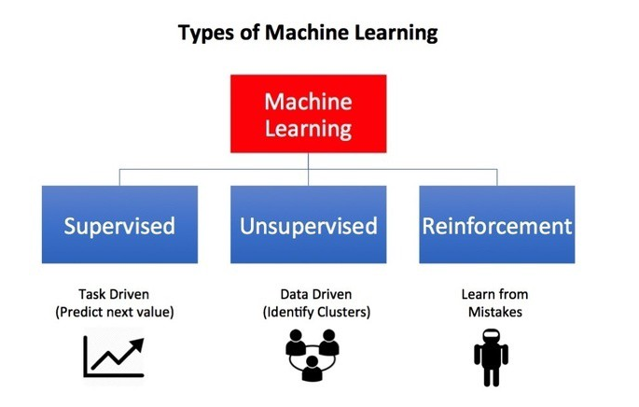
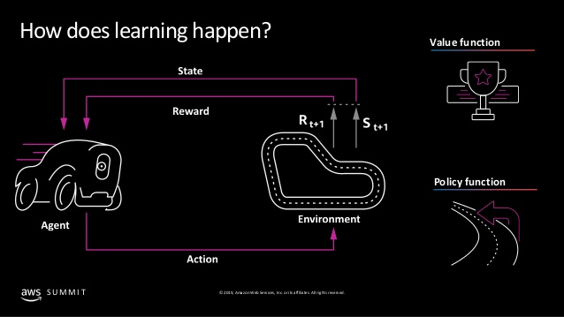
Reinforcement learning
Machine learning technique that enables an agent to learn in an interactive environment by trial and error using feedback from its own actions and experiences
Must find a suitable action model that would maximize the total cumulative reward of the agent
Algorithm concept encompasses an action-reward feedback loop, like the diagram to the left depicts

Slide 5





AWS Components
AWS Kinesis Video
(Evaluation)
AWS DeepRacer Console
AWS SageMaker
(Training)
AWS S3
(Storage)
AWS RoboMaker
(Evaluation)

Slide 6
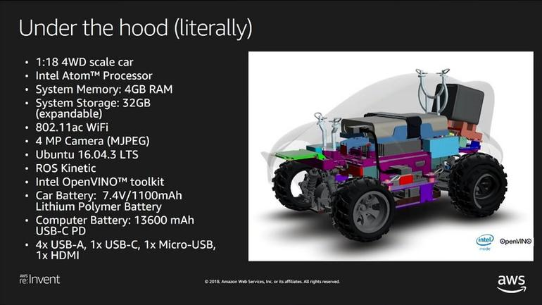
Building a vehicle

Slide 7
EXPECTED OUTCOMES
The agent can successfully navigate an environment, without going off the track
The agent learns over time how to increase it’s time around the track through the rewards it achieves
Ideally, learn how to avoid stationary or moving objects, such as other racers on the track

Slide 8
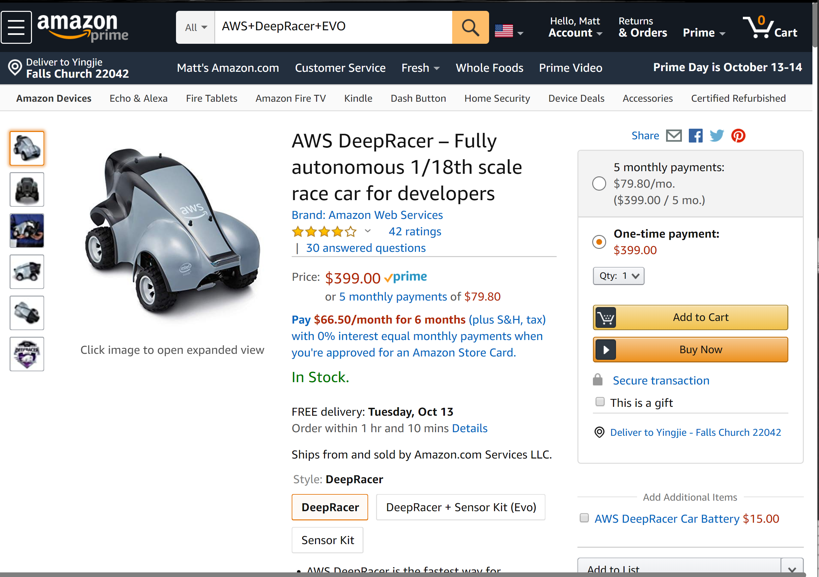
AWS ARCHITECTURE
The following are different AWS services that will be used:
DeepRacer Console: includes model training, evaluation/simulation
S3: used for model artifact storage
IAM: permissions needed for DeepRacer to save artifacts to S3
SageMaker: DeepRacer Console is integrated with Sagemaker for model training
RoboMaker: provides the simulations of trained models
Kinesis Video Streams: video streaming of virtual simulation footage
Notes:
Model training and evaluation is charged at a flat fee of $3.50 per hour and model storage is $0.023 per Gigabyte per month.
The AWS DeepRacer Free Tier provides 10 free hours to train or evaluate models and 5GB of free storage during your first 30 days to create, train, evaluate, and submit your first model to the Virtual Circuit.

Slide 9
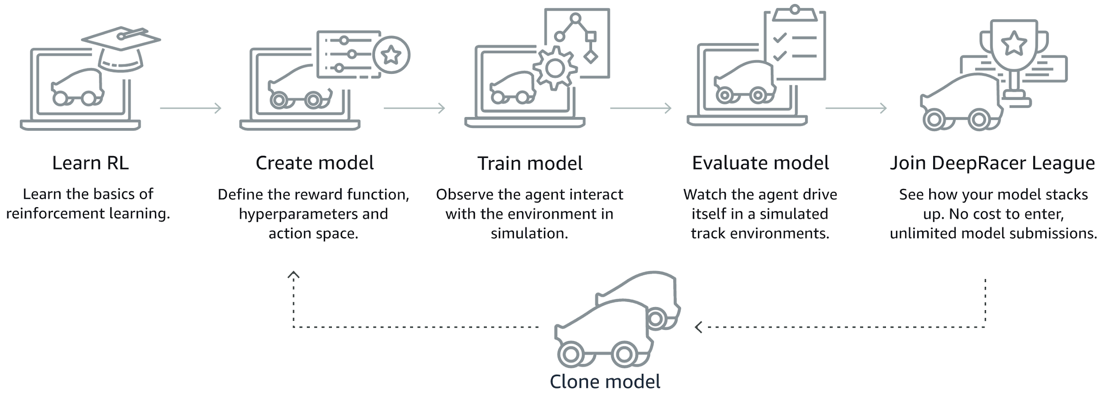
WORKFLOW
AWS DeepRacer Console
AWS SageMaker
(Training)
AWS S3
(Storage)
AWS RoboMaker
(Evaluation)
AWS Kinesis Video
(Evaluation)

Slide 10
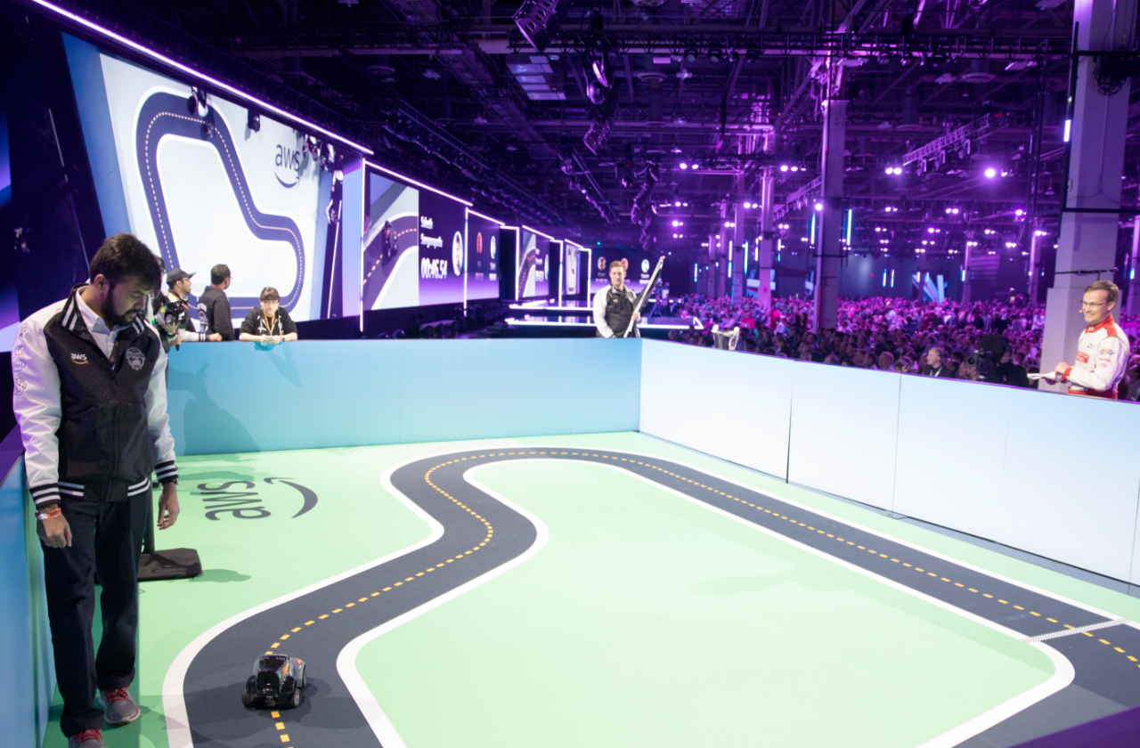
QUESTIONS?

