Slide 1


AWS DEEP RACER
GWU CLOUD COMPUTING FINAL PROJECT Presentation
BY: MATT WILCHEK

Slide 2

AGENDA
About AWS DeepRacer and re:Invent 2020
Review of Reinforcement Learning
AWS Components Used
Iteration 1 – A Default Model
Building a Vehicle
Iteration 2 – Breaking down Configurations
Iteration 3 – Trial and Error
Tournament Ranking

Slide 3
Deepracer & re:invent 2020
AWS DeepRacer is platform to develop, deploy and test Machine Learning Models for the purpose of creating a self-driving car
Reinforcement Learning is the cornerstone how the DeepRacer works
Also the common Machine Learning concept used for robotics
After training models, they need to be deployed to simulations for evaluation and hyper-parameter tuning
Best Reinforcement Models are then used to compete in AWS Sponsored Competitions
Re:Invent 2020 Knockout Round 1 Begins Nov 30 at 7pm
Wildcard Qualifications Start Nov 1-30: Top 5 Racers in Time Trial, Object Avoidance, and Head-to-Head Racing get spots

Slide 4
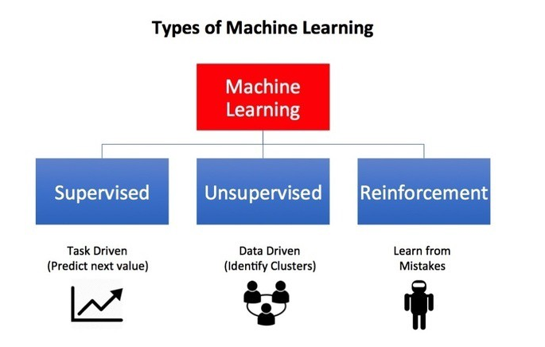
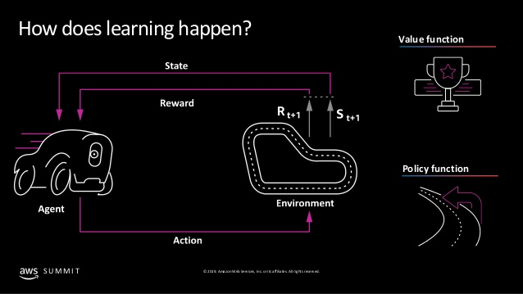
Reinforcement learning
Machine learning technique that enables an agent to learn in an interactive environment by trial and error using feedback from its own actions and experiences
Must find a suitable action model that would maximize the total cumulative reward of the agent
Algorithm concept encompasses an action-reward feedback loop, like the diagram to the left depicts

Slide 5





AWS Components
AWS Kinesis Video
(Evaluation)
AWS DeepRacer Console
AWS SageMaker
(Training)
AWS S3
(Storage)
AWS RoboMaker
(Evaluation)

Slide 6
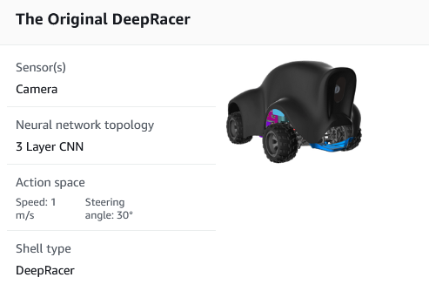
Iteration 1 Accepting Default Parameters
RANKED
795/841
re:Invent 2020

Slide 7
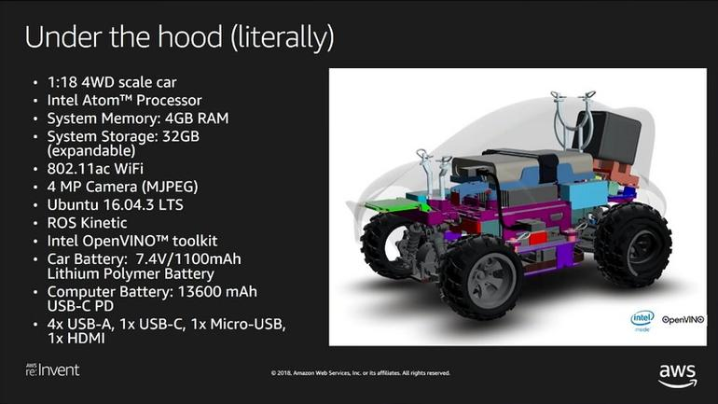
Building a vehicle

Slide 8
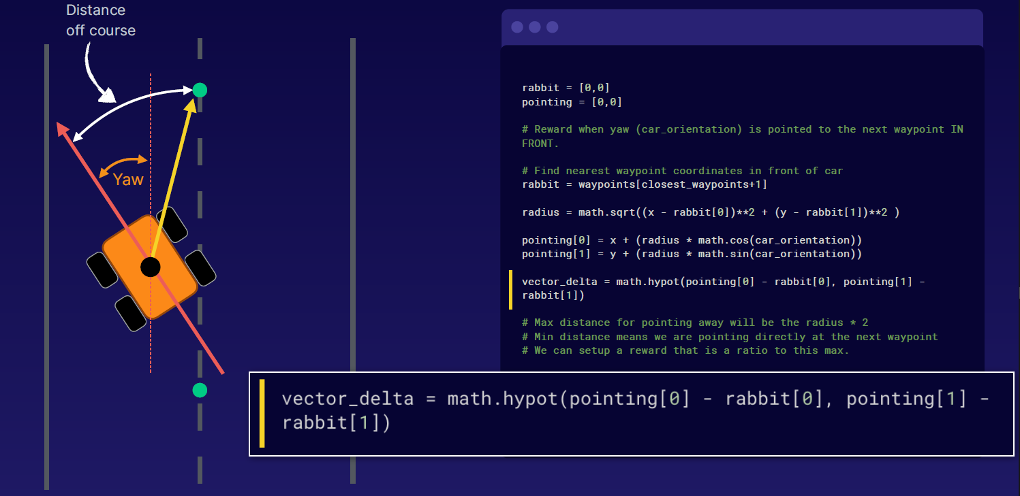
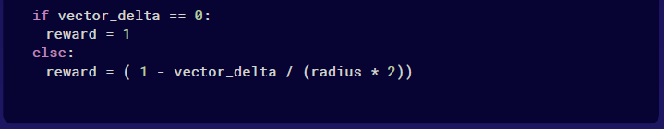
Reward function
AWS offers 3 default reward functions as options for the agent:
Rewards the agent to follow the track’s center line
Rewards the agent to stay inside the two borders of the track
Rewards the agent for less randomness; penalize steering which helps mitigate zig-zag behaviors
Popular Custom Reward Function uses “Waypoints”
Inspired by CMU Robotics Institute Paper: “Implementation of the Pure Pursuit Path Tracking Algorithm” (By: R. Craig Coulter, 1992)
(Example of Waypoint Reward Function by Scott Pletcher, AWS)

Slide 9
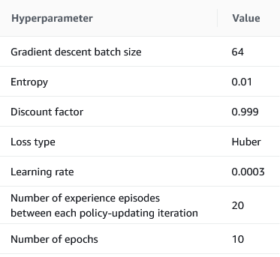
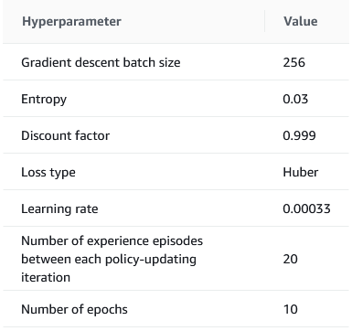
Hyper-parameters
AWS DeepRacer offers several different parameters to configure for training of the agent
Batch Size (default is 64)
Epochs (default is 10)
Learning Rate (default is 0.0003)
Entropy (default is 0.1)
Discount Factor (default is 0.999)
Loss Type (default is Huber)
Number of Episodes between Policy Updates (default is 20)
Total Training Time (default is 60 minutes) – Note AWS Charges $3.50/hr in training
ITERATION 1
ITERATION 2
(Trained for 60 Minutes)
(Trained for 150 Minutes)

Slide 10
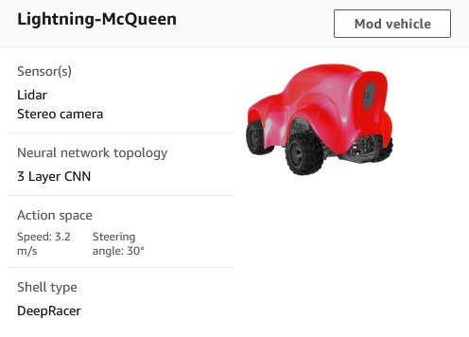
Iteration 2 Mixing it up
RANKED
332/841
re:Invent 2020

Slide 11
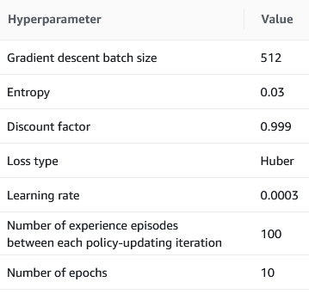
Iteration 3 – trial & error
ITERATION 1
ITERATION 2
ITERATION 3
(Trained for 60 Minutes)
(Trained for 150 Minutes)
(Trained for 720 Minutes)
Iteration 2 did significantly better with a “Waypoint” reward function and adjusted hyperparameters.
Now what if I add double the data and made it train even longer…

Slide 12
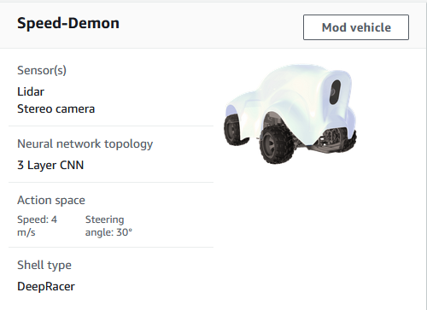
Iteration 3 trial & error
RANKED
…/841
re:Invent 2020

Slide 13
Re:invent 2020 Tournament video

Slide 14
Thank you https://github.com/mwilchek/DeepRacer-2020

