Slide 1
DRG Virome Profiling: Preliminary Results
Dual-database Kraken2 / PathSeq viral detection across 160 human DRG and TG bulk RNA-seq samples
Lab update — August 2026
1

Slide 2
Background & motivation
• Latent neurotropic viruses are hypothesized to reactivate within sensory ganglia and contribute to chronic pain and sensory neuron dysfunction
• Direct evidence to date comes mainly from CNS and trigeminal ganglion (TG) tissue — not dorsal root ganglion (DRG)
• Goal: systematically survey the DRG virome from existing bulk RNA-seq data, with rigorous cross-validation before any biological interpretation
2

Slide 3
Approach
• 160 bulk RNA-seq samples across 11 cohorts (10 DRG-focused, 1 TG)
• Host-depleted (STAR-unmapped) reads classified by Kraken2 against two independent viral reference databases in parallel
• Every candidate cross-checked with GATK PathSeq — an independent, alignment-based classifier
• Result is a confidence spectrum, not a single yes/no call:
  – High confidence — dozens to hundreds of reads, agreement across both Kraken2 databases and PathSeq
  – Moderate confidence — detected by a single database or method
  – Exploratory — low-read, cohort-specific signals, flagged but not yet interpreted
3

Slide 4
Taxa of interest
Taxon | One-sentence description
HERV-K | Human endogenous retrovirus K — an ancient retroviral element fixed in the human genome, normally transcriptionally silent, known to become derepressed under cellular stress or other viral infection.
HSV-1 | Herpes simplex virus 1 — establishes lifelong latency in sensory neurons, with well-characterized episodic reactivation.
Simplexvirus atelinealpha1 | A spider-monkey alphaherpesvirus — the closest database reference for a divergent alphaherpesvirus-like signal distinct from HSV-1 itself.
Simplexvirus paninealpha3 | A chimpanzee alphaherpesvirus — tracked for the same cross-species-reference reason as atelinealpha1.
Rhadinovirus saimiriinegamma2 | A squirrel-monkey gammaherpesvirus — the closest reference our database has to human HHV-8/KSHV; detections here are treated as a candidate KSHV signal pending confirmation.
AAV | Adeno-associated virus (Dependoparvovirus primate1) — a common gene-therapy/lab vector, tracked partly to rule reagent contamination in or out.
Molluscum contagiosum virus | A poxvirus causing benign skin lesions — not previously linked to DRG tissue; flagged here as a candidate finding.
The 7 taxa tracked in the project detection-tracking workbook, in Excel row order.
4

Slide 5
Detection landscape
• Cross-validated HSV-1 detections in ~10% of samples overall, at a higher rate in TG than DRG — consistent with known TG latency biology, now extended into DRG
• Additional lower-confidence neurotropic candidates present: an HHV-8/KSHV-like signal, an AAV-like signal, and two divergent simplexvirus-like signals
• Complete absence of Epstein-Barr virus (EBV) and varicella-zoster virus (VZV) across all 160 samples, despite high expected population seroprevalence
  – Consistent with deep, transcriptionally silent latency rather than absence of the virus itself
  – Motivates paired DNA sequencing on the same samples, to distinguish actively transcribed virus from latent viral genome that is present but silent
5

Slide 6
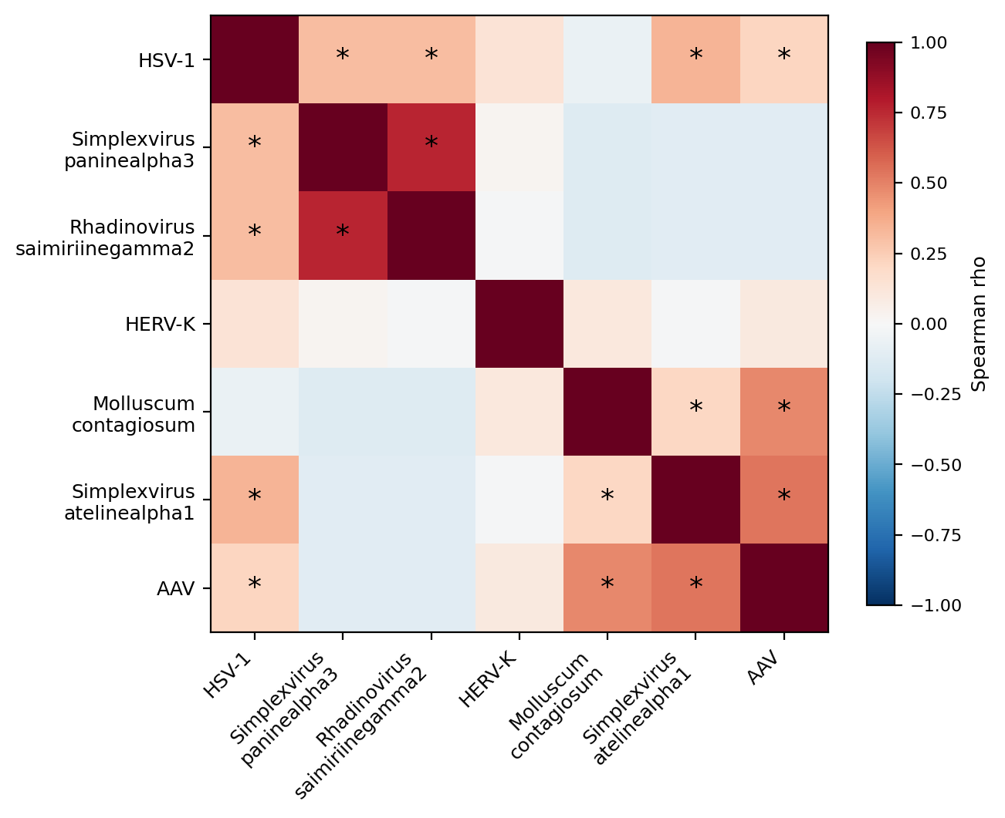
How the tracked taxa relate to each other
• Correlation across the 7 tracked taxa, all 160 samples, within-cohort normalized
• 8 of 21 pairwise relationships significant (BH-FDR<0.05)
• HSV-1, AAV, and Molluscum sit in different parts of the clustering, not next to each other
* = significant at BH-FDR<0.05. Several taxa are present in very few samples (atelinealpha1 n=4; paninealpha3, Rhadinovirus, AAV each n=1) — read correlations involving those with caution.
6

Slide 7
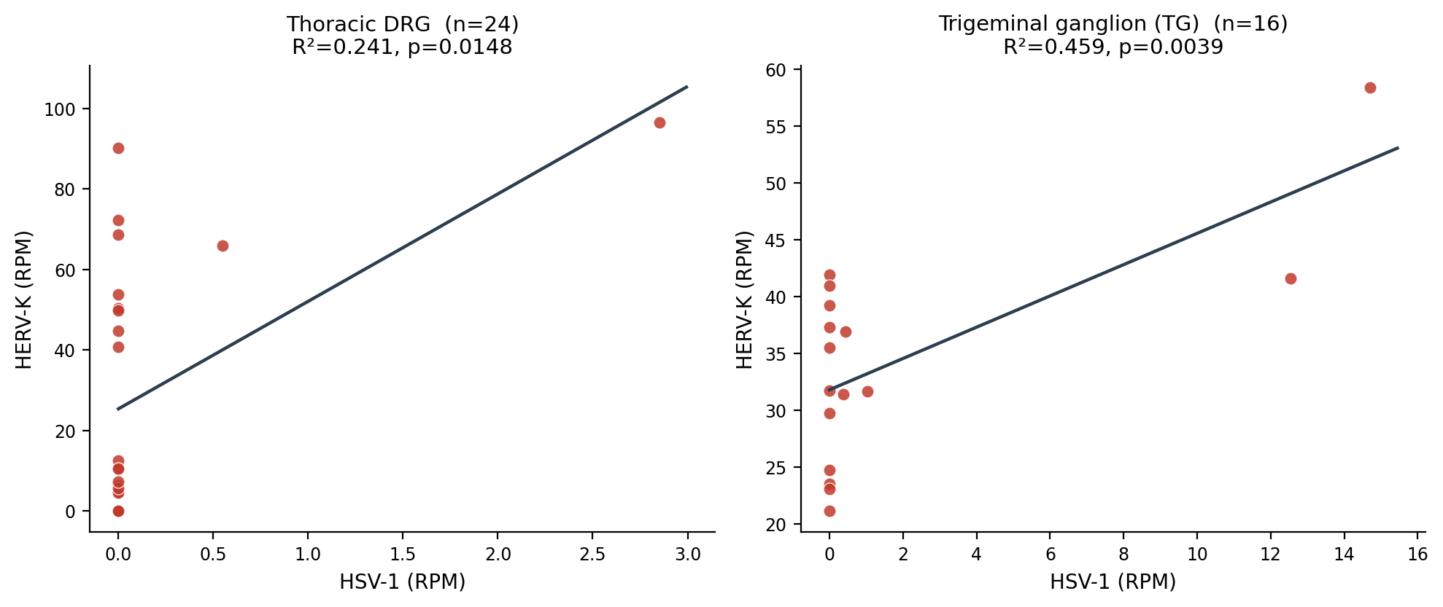
HERV-K tracks HSV-1 — replicated in DRG
• HERV-K derepression alongside HSV-1 is mechanistically established in CNS; shown here in DRG for the first time
• Every cohort with more than one dual-database HSV-1 detection shows a positive, significant relationship
7

Slide 8
HERV-K tracks more than just HSV-1
• Tested every combination of the tracked taxa as a joint predictor of HERV-K
• Strongest combination: HSV-1 + AAV + Molluscum contagiosum (r=0.243, R²=0.059, p=0.002) — survives BH-FDR correction (q≈0.05)
• These three are not simply “HSV-1 under three names”: on the correlation map (previous slide) they sit in different clusters, and HSV-1 vs. Molluscum alone is not correlated
• Suggests HERV-K may track a broader category of viral-reactivation-associated activity, not one specific virus
8

Slide 9
Working interpretation
• HERV-K derepression proposed as a candidate convergent marker (“canary”) of viral-reactivation-associated host response in human DRG
• Fits independently with known biology for two of the candidate hits:
  – An HHV-8/KSHV-like signal is biologically plausible, and potentially important, in non-HIV-associated Castleman’s disease
  – A Molluscum contagiosum-like signal is consistent with a working hypothesis that some viruses may emerge specifically under ex vivo neuron culture conditions
• Open question raised by the absent EBV/VZV signal: could cellular stress itself — e.g. tissue dissociation — be enough to trigger detectable reactivation?
9

Slide 10
Next steps
• BLAST-level confirmation of candidate hits (KSHV-like, AAV-like, Molluscum, and the two simplexvirus proxies) to resolve genuine detection vs. cross-mapping
• Paired DNA sequencing on already RNA-sequenced samples — separates active transcription from latent genome presence, and opens a path toward a systemic pain biomarker
• Genome-wide host antiviral/inflammatory transcriptional signature analysis, using the full n=160 for statistical power
• Candidate functional follow-up: sample culture supernatant post-dissociation, to test whether dissociation stress alone can trigger detectable reactivation
• Given ~10% HSV-1 prevalence and ~50% expected EBV/CMV seroprevalence in donors, sample depth may support an exploratory ML approach linking latent viral serostatus to host transcriptional signatures
10

Slide 11
Summary
• Built and cross-validated a dual-database viral RNA-seq detection pipeline across 160 human DRG/TG samples
• HSV-1 detected in ~10% of samples; EBV and VZV entirely absent — argues for deeper sequencing
• HERV-K derepression replicates a TG-established HSV-1 relationship in DRG for the first time, and extends to a broader multi-taxon signal that survives correction
• Sets up host-response and paired DNA-sequencing follow-up work
11

