Slide 1
DRG Virome Pipeline
Cohort Evolution: Start to Finish
TJP Group · UT Dallas · 2026
DRG Virome Pipeline v1.5.0 10 cohorts · 112 ganglion samples · 2 tissue types

Slide 2
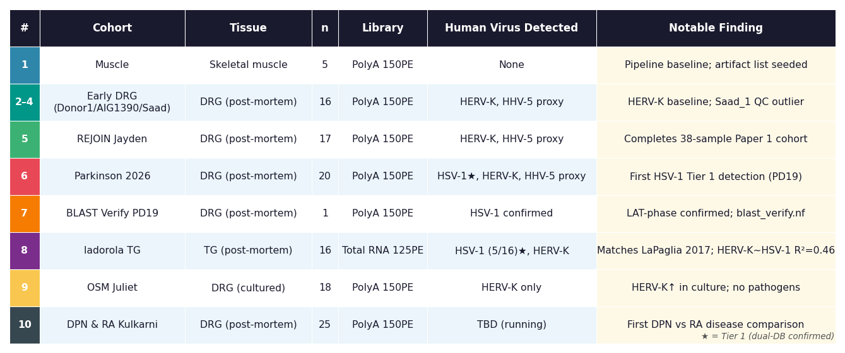
Cohort Overview
All pipeline runs · final data only · non-contiguous cohort numbers reflect registry order

Slide 3
1
Muscle
Skeletal muscle · n=5 · v1.0
Samples
Key Findings
Sample_19–23
• Pipeline baseline run — first cohort processed end-to-end
• Established artifact exclusion list (k-mer cross-mapping from ruminant/insect viruses)
• HERV-K detected at low level (mean 31.3 RPM); confirmed pan-sample signal
• No human pathogens; clean tissue as expected for skeletal muscle
• Saad_1 equivalent: no QC outliers in this cohort
n
5
Tissue
Skeletal muscle
Library
PolyA, 150 bp PE
Sequencer
Illumina
Pipeline
v1.0
Virus Detected
None detected
DRG Virome Pipeline · Cohort 1 of 10 · TJP Group UT Dallas

Slide 4
2
Early DRG (Donor1 · AIG1390 · Saad)
DRG (post-mortem) · n=16 · v1.0–1.2
Samples
Key Findings
donor1_L1–L5/T12, AIG1390_L1–L4/T12, Saad_1–5
• Three donors, multi-level sampling (L1–L5/T12) — first DRG virome profiles
• HERV-K confirmed as pan-sample DRG signal; forms baseline for all future cohorts
• HHV-5 proxy (Cytomegalovirus papiinebeta3 → remapped to 'Human CMV [HHV-5] proxy')
• Saad_1: QC outlier — 10× sequencing depth, extreme contamination profile; retained for pipeline assessment
• Saad_2: known library failure — retained for QC characterization
• Taxon display-name remapping (taxon_remap.tsv) introduced to address misleading NCBI labels
n
16
Tissue
DRG (post-mortem)
Library
PolyA, 150 bp PE
Sequencer
Illumina
Pipeline
v1.0–1.2
Virus Detected
HERV-K (all), HHV-5 proxy (subset)
DRG Virome Pipeline · Cohort 2 of 10 · TJP Group UT Dallas

Slide 5
5
REJOIN Jayden
DRG (post-mortem) · n=17 · v1.2–1.3
Samples
Key Findings
473-1 – 473-17
• 17-sample REJOIN cohort; completes the 38-sample full cohort used for Paper 1
• Paper 1 analysis: all_cohort_pluspf run consolidates cohorts 1–5
• Dual-database framework (v1.3) introduced: viral-only DB + PlusPF DB in parallel
• Three-tier output: Tier 1 (both DBs agree), Tier 2 (viral-only only), Tier 3 (PlusPF only)
• No novel human pathogens; HERV-K and CMV proxy confirmed across cohort
n
17
Tissue
DRG (post-mortem)
Library
PolyA, 150 bp PE
Sequencer
Illumina
Pipeline
v1.2–1.3
Virus Detected
HERV-K (all), HHV-5 proxy (subset)
DRG Virome Pipeline · Cohort 5 of 10 · TJP Group UT Dallas

Slide 6
6
Parkinson 2026
DRG (post-mortem) · n=20 · v1.5.0
Samples
Key Findings
PD2–PD20, 023–028
• 14 Parkinson's disease patients + 6 non-PD controls; sequenced by Psomagen
• PD19: first-ever HSV-1 Tier 1 detection in the dataset — landmark finding
• PD1/7/8/11/12/13 absent from sequencing delivery (not run)
• No significant HERV-K difference between PD cases and controls (p=0.397)
• Dual-database validation: HSV-1 in PD19 confirmed Tier 1 (both DBs agree)
• Triggered blast_verify.nf offshoot to confirm identity and latency phase
n
20
Tissue
DRG (post-mortem)
Library
PolyA, 150 bp PE
Sequencer
Illumina (Psomagen AN00028264)
Pipeline
v1.5.0
Virus Detected
HSV-1 Tier 1 (PD19), HERV-K (all), HHV-5 proxy (subset)
DRG Virome Pipeline · Cohort 6 of 10 · TJP Group UT Dallas

Slide 7
7
BLAST Verify PD19
DRG (post-mortem) · n=1 · v1.5.0 (blast_verify.nf)
Samples
Key Findings
PD19
• Offshoot pipeline (blast_verify.nf) — post-hoc re-analysis of PD19
• Extracted Kraken2-assigned HSV-1 reads → BLAST against NCBI nt database
• Confirmed identity: Human herpesvirus 1 (NC_001806.2), >98% identity
• Read distribution consistent with latency: enriched at LAT locus
• Established blast_verify.nf as reusable module for future Tier 1 candidates
• save_kraken2_output and save_unmapped_reads params added to main pipeline
n
1
Tissue
DRG (post-mortem)
Library
PolyA, 150 bp PE
Sequencer
Illumina
Pipeline
v1.5.0 (blast_verify.nf)
Virus Detected
HSV-1 confirmed
DRG Virome Pipeline · Cohort 7 of 10 · TJP Group UT Dallas

Slide 8
8
Iadorola TG
Trigeminal ganglion (post-mortem) · n=16 · v1.5.0
Samples
Key Findings
TG1–TG22 (non-contiguous)
• Public dataset (LaPaglia et al. 2017, SRP113004) — pipeline validation benchmark
• HSV-1 detected in 5/16 samples: exact match to published results
• Two high-level samples (TG12: 14.7 RPM, TG3: 12.5 RPM) match paper's 'two high-level' report
• 6th seropositive sample missed by both our pipeline and MAGIC — consistent non-detection
• Linear regression: HERV-K ~ HSV-1 RPM, R²=0.459, p=0.0039 (novel finding)
• VZV absent across all samples — consistent with known low LAT expression in TG
n
16
Tissue
Trigeminal ganglion (post-mortem)
Library
Total RNA, 125 bp PE
Sequencer
Illumina HiSeq 2500
Pipeline
v1.5.0
Virus Detected
HSV-1 Tier 1 (5/16), HERV-K (all), HHV-5 proxy (subset)
DRG Virome Pipeline · Cohort 8 of 10 · TJP Group UT Dallas

Slide 9
9
OSM Juliet
DRG (cultured, in vitro) · n=18 · v1.5.0
Samples
Key Findings
D1–D3 × O/V × rep1–3
• 3 donors × OSM vs vehicle × 3 replicates — first in vitro DRG cohort
• Clean virome: no human pathogens detected in any sample
• HERV-K significantly elevated vs all post-mortem cohorts (p<0.001)
• OSM treatment has no effect on HERV-K (OSM vs vehicle p=0.791)
• Culture context itself drives HERV-K elevation — stress/passaging, not cytokine
• Confirms Gihfavirus/Kinglevirus as post-mortem DRG artifact (absent in culture)
n
18
Tissue
DRG (cultured, in vitro)
Library
PolyA, 150 bp PE
Sequencer
Illumina
Pipeline
v1.5.0
Virus Detected
HERV-K only
DRG Virome Pipeline · Cohort 9 of 10 · TJP Group UT Dallas

Slide 10
10
DPN & RA Kulkarni
DRG (post-mortem) · n=25 · v1.5.0
Samples
Key Findings
JE81, WE52, PA71, J1M2, T0M2, 2AC1, 1AN1, 8EN1, RO52, S1D1, 2OE1, N4N2, ME61, LE41, L1V1, FL0A2, FL0B1, 1VYA1, 1VYB2, CA7A2, CA7B1, 4LIA1, 4LIB2, G1NA1, G1NB2
• 10 shared healthy controls + 5 DPN cases + 10 RA specimens (5 donors × A/B)
• First disease-comparative DRG cohort: diabetic peripheral neuropathy vs rheumatoid arthritis
• A/B specimen designation unconfirmed (L/R DRG or technical replicates — to clarify)
• 5 metadata donors without FASTQ files (M4X, L3O, J4N, M3L, T1F — separate batch)
• Pipeline currently running on Juno — results pending
• Will enable first cross-disease virome comparison in human sensory ganglia
n
25
Tissue
DRG (post-mortem)
Library
PolyA, 150 bp PE
Sequencer
Illumina
Pipeline
v1.5.0
Virus Detected
TBD (pipeline running)
DRG Virome Pipeline · Cohort 10 of 10 · TJP Group UT Dallas

Slide 11
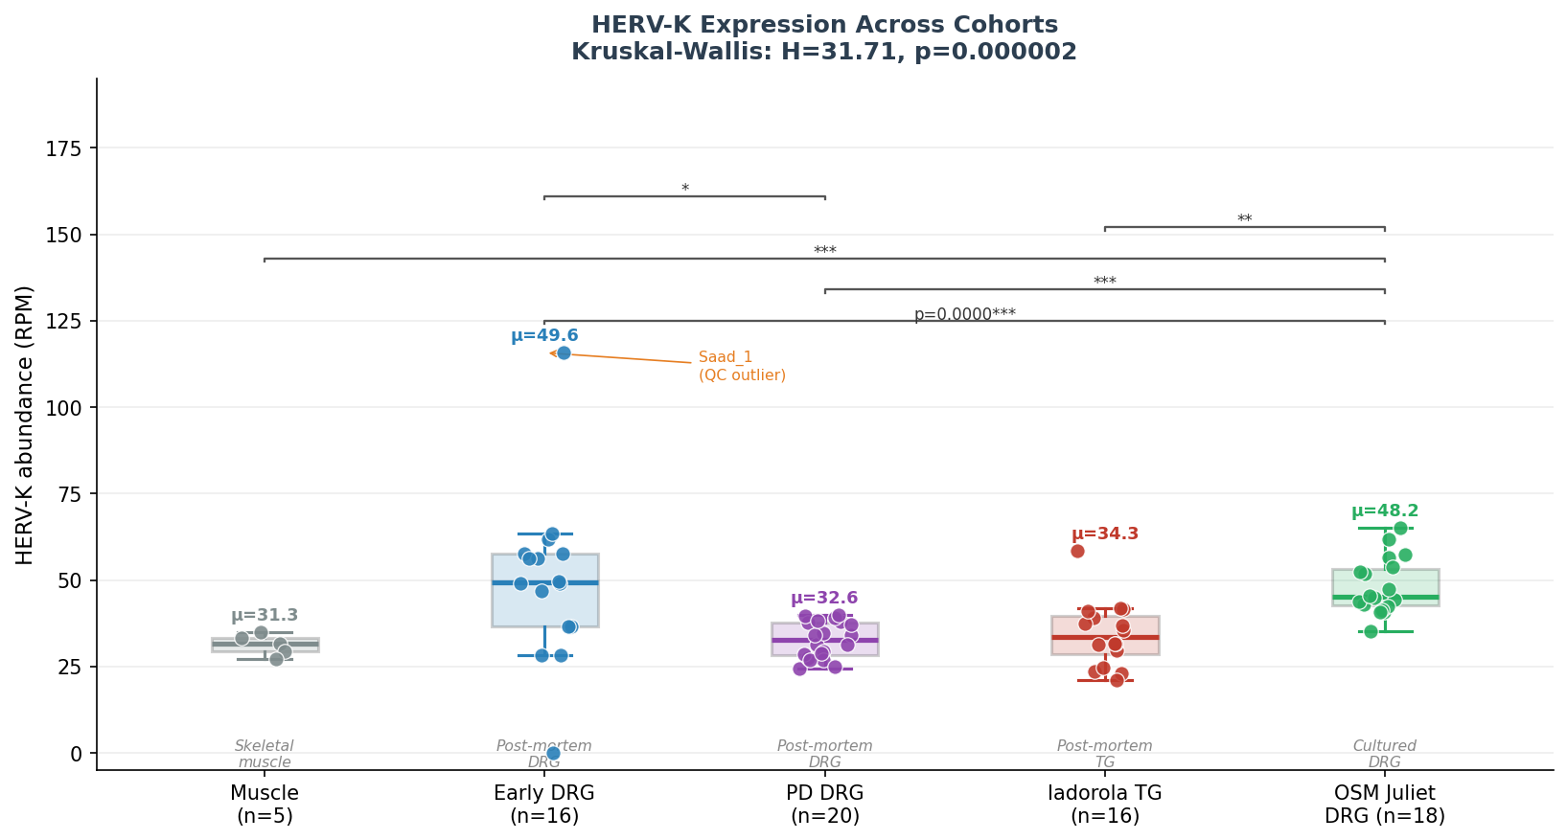
★
Cross-Cohort Analysis: HERV-K Expression
Kruskal-Wallis H=31.71, p=0.000002 · Pairwise Mann-Whitney with Bonferroni correction
OSM Juliet (cultured DRG) significantly higher than all post-mortem cohorts
Effect is culture context, not OSM treatment (OSM vs vehicle: p=0.79)
Post-mortem tissue consistent: Muscle, PD DRG, TG statistically equivalent
No HERV-K elevation in PD vs controls (p=0.40) at current n
HERV-K > 50 RPM → suspect in vitro processing (QC anchor for new cohorts)
DRG Virome Pipeline · Cross-cohort HERV-K analysis · TJP Group UT Dallas

