Slide 1
Profiling the Human DRG Virome from Bulk RNA-seq
Michael Wilde · CAPS · UT Dallas · April 2026
Outline:
① Why — neurotropic viruses, the DRG, and an uncharacterized virome
② How — dual-database competitive classification from existing RNA-seq
③ Results — two cohorts, 36 donors, and the first Tier 1 detection
④ Future — compiling the lab's data, beginning with bulk

Slide 2
01
Why
The DRG is a natural viral reservoir and nobody has systematically profiled it

Slide 3
Why look for viruses in the dorsal root ganglion?
Neurotropic viruses establish latency in sensory ganglia — and may drive pain long after acute infection
The Biology
The Clinical Need
The Opportunity
▸ DRG = primary sensory neurons; gateway for all somatosensory input
▸ VZV establishes latency in DRG — reactivation → shingles / PHN
▸ HSV-1/2 latent in trigeminal & sacral DRG
▸ CMV, HHV-6 detected in neural tissue under immunosuppression
▸ DRG has interferon-response satellite glial cells — constitutive immune surveillance
▸ No systematic profiling of the DRG virome has been reported
▸ Viral triggers implicated in PHN, diabetic neuropathy, HIV neuropathy
▸ HSV-1 linked to neurodegeneration (Parkinson's, Alzheimer's)
▸ HERV-K transcriptional activation in ALS motor neurons
▸ Antiviral therapy associated with reduced PD risk in registry studies
▸ The world’s largest (and objectively best) Bulk RNA-seq from DRG already exists in this lab — 100–200 donors
▸ Computational pipeline can screen all of it with one command
▸ No new sequencing required for the first virome atlas pass
▸ Establish baseline → compare disease cohorts → identify viral associations

Slide 4
The challenge: viral signal in a sea of host RNA
Bulk RNA-seq is >99.95% human — k-mer classifiers with viral-only DBs create systematic false positives
Typical bulk RNA-seq library composition
Two failure modes
Problem 1: Viral-only database — the closed-world assumption
Viral reads: <0.05%
▸ No non-viral reference — every read must land somewhere viral
▸ Human transcripts sharing k-mers with viral genomes → misassigned
▸ HERVs, CMV k-mers, and neural lncRNAs are common offenders
▸ Result: 100% false positive rate in our baseline cohort
Host (human) ~99.95% of reads
Problem 2: Sensitivity — latent viruses leave few traces
▸ VZV/HSV maintain latency with minimal transcription (LAT only)
▸ Empirical detection floor: ~10 reads per taxon at 60–75M read depth
▸ Below this, cannot distinguish signal from stochastic noise

Slide 5
02
How
virome-pipeline: competitive dual-database classification from existing RNA-seq

Slide 6
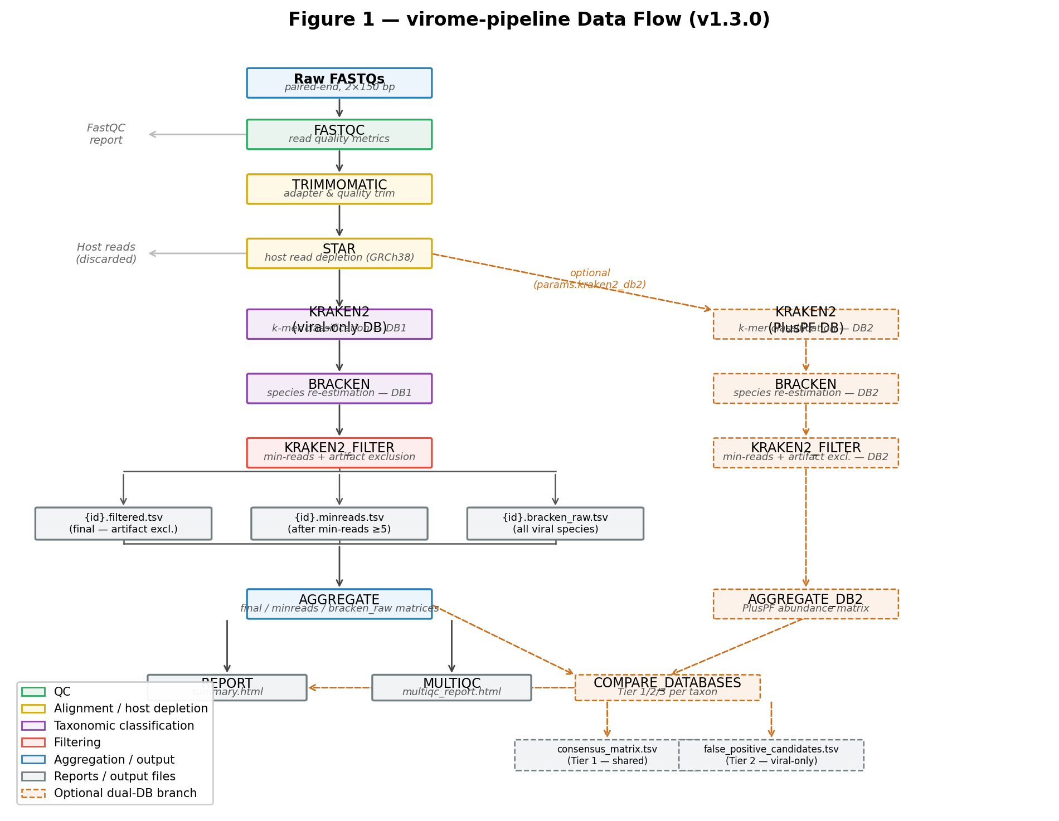
Pipeline architecture — v1.5.0
7-step Nextflow DSL2 workflow + dual-database branch + BLAST verification offshoot
All steps containerized (Apptainer) | SLURM-ready | Each process in its own .sif container | stageInMode = 'copy' for Apptainer symlink compatibility

Slide 7
The core innovation: dual-database competitive classification
Run every sample through two Kraken2 databases simultaneously — only signals surviving both are real
Database 1: Viral-only
Three-tier confidence scoring
Database 2: PlusPF (standard)
▸ ~10,000 viral genomes
▸ No non-viral sequences
▸ Closed-world: every read forced into a viral bin
▸ Maximizes sensitivity
▸ But: 100% FP rate in baseline cohort
▸ Full bacterial, archaeal, viral, fungal + human
▸ ~100 GB — human genome included
▸ Open-world: reads compete against host
▸ HERV-K → reclassified to Homo sapiens
▸ CMV proxy → looking like an artifact
Tier 1 — Shared
HSV-1 in PD19
Detected in BOTH databases High-confidence viral candidate Use for biology
Tier 2 — Viral-only
HERV-K, CMV proxy, MCV
Viral-only DB exclusive False positive candidates Investigate before interpreting
Tier 3 — PlusPF only
10–826 taxa / sample
PlusPF-only Non-viral contaminants Quality Control

Slide 8
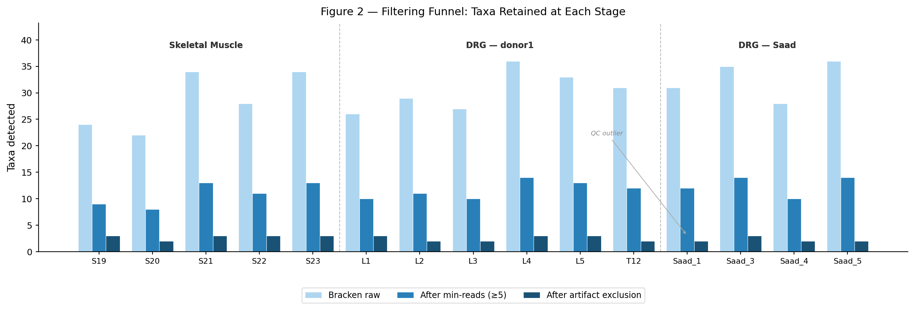
Multi-stage filtering + curated artifact exclusion
Bracken raw → min-reads threshold (≥5) → 24-entry artifact exclusion list
Three output matrices per cohort
bracken_raw
All viral species from Bracken No threshold — baseline for QC
minreads
≥5 reads per taxon per sample Validated: noise floor ~10 reads at 60–75M depth
final (filtered)
Curated artifact exclusion applied 24 taxa: phages, reagent contaminants, env. metagenome, cross-mapping
Artifact categories
Reagent contaminants · ruminant orthobunyaviruses · insect baculoviruses · phages (ICTV-reclassified) · DRG-specific env. metagenome cross-mapping · avian herpesviruses · giant amoeba viruses · hantaviruses (Oxbow)

Slide 9
03
Results
Two cohorts, 36 donors, and the first confirmed viral detection in human DRG

Slide 10
Study cohorts — 36 unique donors across two runs
Non-PD baseline (n=16 unique) + Parkinson's DRG cohort (n=20)
Non-PD Baseline (v1.3.0)
n = 16 unique
Parkinson's DRG (v1.5.0)
n = 20
▸ Skeletal muscle (n=5): independent donors, non-neural control
▸ DRG — donor1 (n=6): single donor, 6 spinal levels (L1–L5, T12)
▸ DRG — Saad cohort (n=4): independent donors, published cohort
▸ AIG1390 (n=5): excluded — confirmed donor1 duplicate by MD5
▸ Saad_2: excluded — library failure (0 final taxa)
▸ Key result: Tier 1 = 0 across ALL samples
▸ 100% false positive rate for viral-only Kraken2
▸ Established validated null baseline for DRG virome
▸ PD patients (n=14): PD2–PD6, PD9–PD10, PD14–PD20
▸ Unclassified controls (n=6): samples 023–028
▸ All DRG tissue — Psomagen order AN00028264
▸ Key result: Tier 1 = 1
▸ HSV-1 detected in PD19 — 46 reads, 1.89 RPM
▸ Confirmed in BOTH viral-only and PlusPF databases
▸ First Tier 1 detection across all 36 donors
▸ Absent from ALL other samples (0/35)

Slide 11
Tier results across both cohorts
36 donors processed · 1 Tier 1 detection · 3 Tier 2 taxa fully resolved as false positives
1
3
100%
24
~10
Tier 1 detection (HSV-1, PD19 only)
Tier 2 taxa
Viral-only FP rate (baseline cohort)
Curated artifact taxa excluded
RPM detection floor (empirical)
Tier 1 (confirmed)
Tier 2 (FP candidates)
Tier 3 (non-viral)
Non-PD baseline (n=16)
0
3: HERV-K, CMV proxy, MCV
10–179 taxa/sample
Parkinson's DRG (n=20)
1: HSV-1 in PD19 (46 reads)
3: HERV-K, CMV proxy, MCV
15–826 taxa/sample
Key interpretation
▸ The null result in the baseline cohort validates the pipeline — zero Tier 1 is the correct answer for these healthy donors
▸ HSV-1 in PD19 is the first Tier 1 detection — biologically plausible (HSV-1 latency in sensory ganglia), but n=1/14 PD (not statistically significant)
▸ All three Tier 2 taxa have fully characterized mechanisms: endogenous transcription (HERV-K), k-mer cross-mapping (CMV proxy), index hopping (MCV)

Slide 12
Tier 1: HSV-1 in PD19 — the first confirmed detection
46 reads, 1.89 RPM · detected in both viral-only and PlusPF databases · absent from all 35 other samples
The detection
Validation status
46
1.89
1/36
Completed
▸ Dual-database confirmation: detected in BOTH DBs
▸ Tier 1 classification: high-confidence viral candidate
▸ Absent from all 35 other donors (disease specificity)
▸ Absent from non-PD baseline (n=16 unique samples)
direct reads (Kraken2)
reads per million (RPM)
samples with this detection
Biological context
▸ HSV-1 naturally establishes latency in sensory ganglia (DRG, TG)
▸ Latency marker: LAT (latency-associated transcript) — only RNA during dormancy
▸ Reactivation markers: immediate-early/early/late genes
▸ Epidemiological precedent: antiviral therapy associated with reduced PD risk
▸ Three proposed mechanisms:
◦ Retrograde transport DRG → spinal cord → CNS
◦ α-synuclein aggregation triggered by viral proteins
◦ Neuroinflammation via STING/cGAS pathway
Pending
▸ BLAST verification (blast_verify.nf ready — awaiting run)
▸ Life cycle phase: LAT (latency) vs. IE/E/L (reactivation)?
▸ Coverage depth: uniform genome coverage or LAT-localized?
▸ Independent validation (PCR, ISH) on remaining tissue
Statistical caveat: n=1/14 PD vs. 0/26 non-PD — not statistically significant (Fisher's p ≈ 0.35). This is a hypothesis-generating finding, not a conclusion. BLAST validation required.

Slide 13
Tier 2: the three false positives — fully resolved
Each illustrates a different class of artifact in human tissue metagenomics
HERV-K (HML-2) taxon 45617
CMV proxy taxon 3050337
Molluscum contagiosum taxon 10279
Cohort total: ~80K reads
~1,100 reads across 28 samples
~190 reads, sporadic
Endogenous retroviral transcription
Database gap + k-mer cross-mapping
Index hopping / contamination
▸ Present in ALL 36 samples (100% prevalence)
▸ 5.8× enriched in DRG vs. muscle (p = 3.3×10⁻⁴)
▸ DRG mean: 42 RPM (non-PD), 32 RPM (PD)
▸ PlusPF: ALL reads → Homo sapiens
▸ Neural-lineage LTR transcription in sensory neurons
▸ Real biology, but endogenous — not infection
▸ Cytomegalovirus papiinebeta3 (baboon CMV)
▸ ICTV 2023 split HHV-5 into primate species
▸ Human reads routed via baboon CMV child node
▸ ~10× DRG-enriched (same k-mer source as HERV-K)
▸ PlusPF: ZERO reads — complete resolution
▸ Relabeled → 'Human CMV (HHV-5) [proxy]'
▸ Sporadic, tissue-independent distribution
▸ Absent from deepest library (Saad_1, 430K reads)
▸ Muscle-predominant (65%) — not DRG-specific
▸ Higher prevalence in PD cohort (11/14 vs. 24%)
▸ PlusPF: not detected — no genuine signal
▸ Consistent with patterned flow cell index hopping

Slide 14
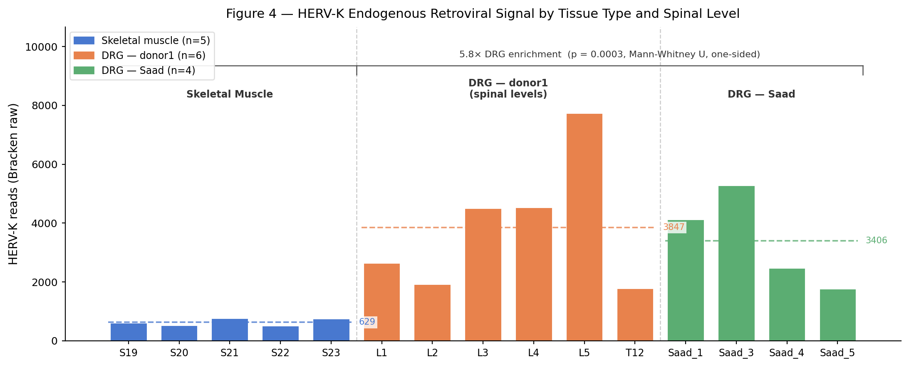
HERV-K — a real biological signal worth tracking
5.8× DRG enrichment over muscle · reproduced across cohorts · first quantification of HERV-K in human DRG
Cross-cohort HERV-K comparison
Muscle (non-PD)
n=5
31.3 RPM
DRG — donor1
n=6
45.8 RPM
DRG — Saad
n=4
72.7 RPM
DRG — PD patients
n=14
31.8 RPM
DRG — PD controls
n=6
34.5 RPM
Implications
▸ HERV-K is NOT a virus — it's endogenous retroviral chromosomal transcription
▸ DRG enrichment likely reflects neural-lineage chromatin accessibility
▸ ALS literature: HERV-K Env protein in motor neurons (Li et al. 2015)
▸ PD de-repression hypothesis NOT supported (PD RPM ≤ non-PD RPM)
▸ Could serve as internal control — HERV-K RPM as library quality metric

Slide 15
Viral diversity across cohorts — sparse and dominated by endogenous signal
Mean richness 2–4 taxa per sample · Shannon diversity <0.5 · HERV-K accounts for >90% of viral reads
Group
n
Richness
Shannon H'
Mean reads
What low diversity means
Non-PD Muscle
n=5
2.0
0.067
~630
▸ The DRG virome (from bulk RNA-seq) is extremely sparse so far
▸ HERV-K dominates: >90% of total viral reads in every sample
▸ After artifact exclusion, 2–4 taxa per sample — most are Tier 2
▸ This is expected: bulk RNA-seq is not designed for metagenomics
▸ Latent viruses (VZV, HSV) may be below detection floor in most donors
▸ HSV-1 in PD19 is the outlier. 46 reads is well above the ~10 read noise floor, and it survived competitive classification against the full genome
Non-PD DRG (donor1)
n=6
3.0
0.185
~3,670
Non-PD DRG (Saad)
n=4
2.8
0.390
~5,800
PD DRG patients
n=14
3.1
0.280
~800
PD controls (023–028)
n=6
2.8
0.226
~750

Slide 16
04
Future Directions

