Slide 1
DRG Virome Pipeline Update
Michael Wilde · CAPS · April 2026
Background
Pipeline
PD cohort results
Next steps

Slide 2
HPC Pipeline Framework
Three commands. Full reproducibility. Zero SLURM knowledge required.
1. SETUP
tjp-setup
One-time workspace init. Copies config templates to your work directory.
2. CONFIGURE
tjp-edit psoma
Fill in your paths: FASTQs, reference genome, output location.
3. LAUNCH
tjp-launch psoma
Validates config, creates run directory, submits job. You're done.
Every run is automatically tracked: config snapshot, reproducibility manifest, archived inputs & outputs.

Slide 3
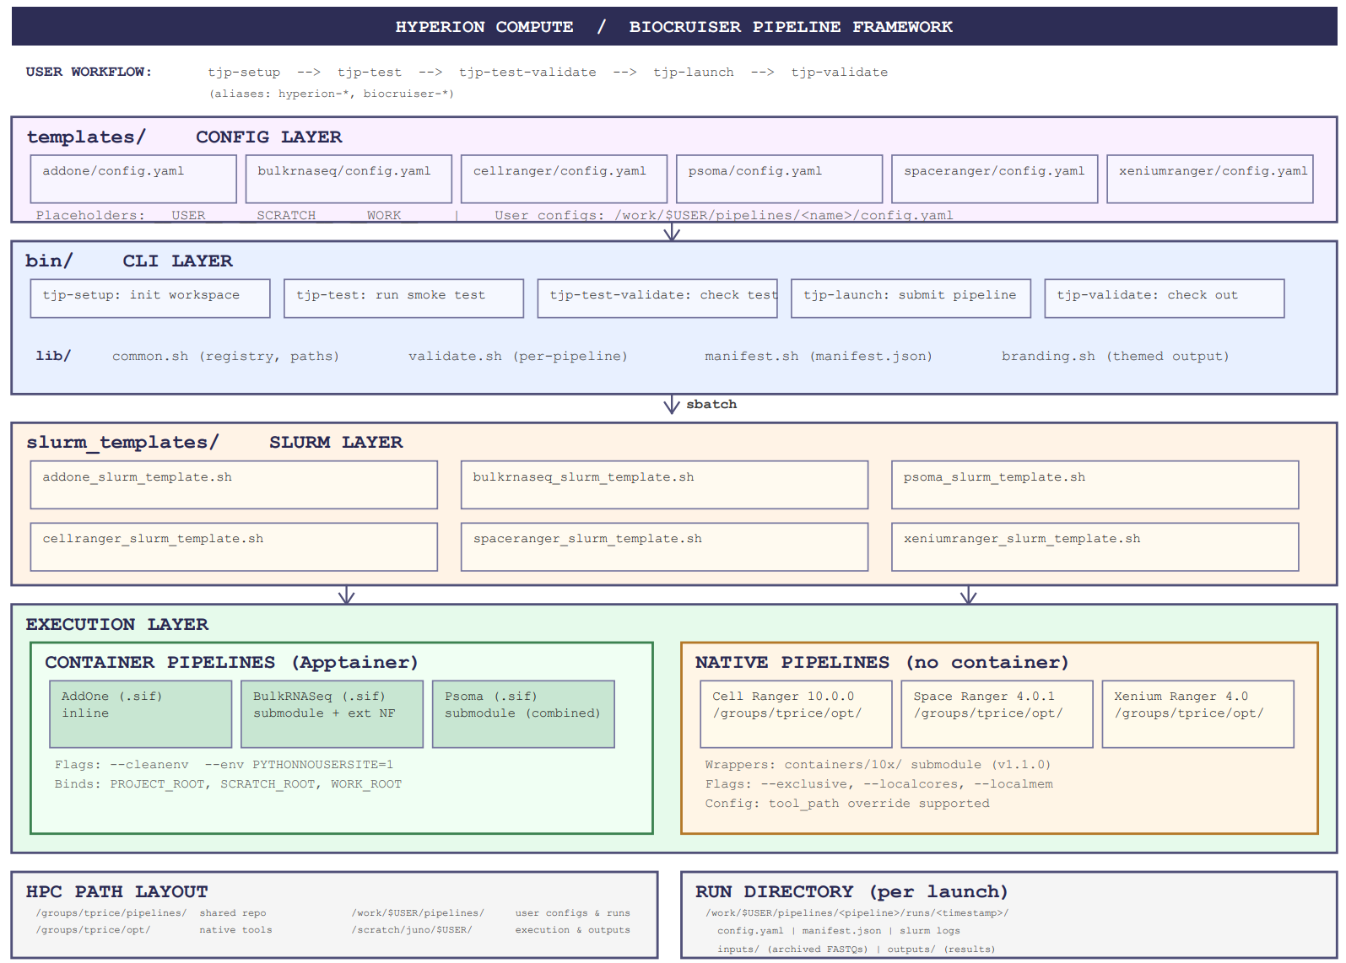
Architecture
Four layers, each with a single responsibility
CONFIG (templates/)
YAML files with user parameters (paths, references, resources)
CLI (bin/tjp-*)
Validates config, creates run dir, generates manifest, submits job
SLURM (slurm_templates/)
Allocates compute node, runs pre-flight checks
EXECUTION (containers/ or native)
Runs the science inside container or via native 10x binary

Slide 4
HPC Pipeline Framework
Three commands. Full reproducibility. Zero SLURM knowledge required.
1. SETUP
tjp-setup
One-time workspace init. Copies config templates to your work directory.
2. CONFIGURE
tjp-edit psoma
Fill in your paths: FASTQs, reference genome, output location.
3. LAUNCH
tjp-launch psoma
Validates config, creates run directory, submits job. You're done.
Every run is automatically tracked: config snapshot, reproducibility manifest, archived inputs & outputs.

Slide 5
Viral Expression in DRG
The question
The approach
▸ Neurotropic viruses (HSV-1, VZV, CMV) establish latency in DRG
▸ Viral reactivation implicated in neuropathic pain, neurodegeneration (ALS, MS)
▸ HSV-1 linked to Parkinson's in epidemiological studies
▸ No systematic virome profiling of human DRG has been reported
▸ Use existing bulk RNA-seq host-deplete with STAR, classify with Kraken2
▸ Dual-database classification: viral-only vs. PlusPF (full taxonomy)
▸ Only taxa detected in BOTH databases = Tier 1 (confirmed)
▸ Baseline cohort (16 non-PD donors): Tier 1 = 0 (null validation)
What's new: Parkinson's DRG cohort
▸ 20 new DRG samples: 14 PD patients + 6 unclassified controls
▸ Same pipeline, same dual-database classification — first application to a disease cohort
▸ Result: the first Tier 1 detection across all 36 donors profiled to date

Slide 6
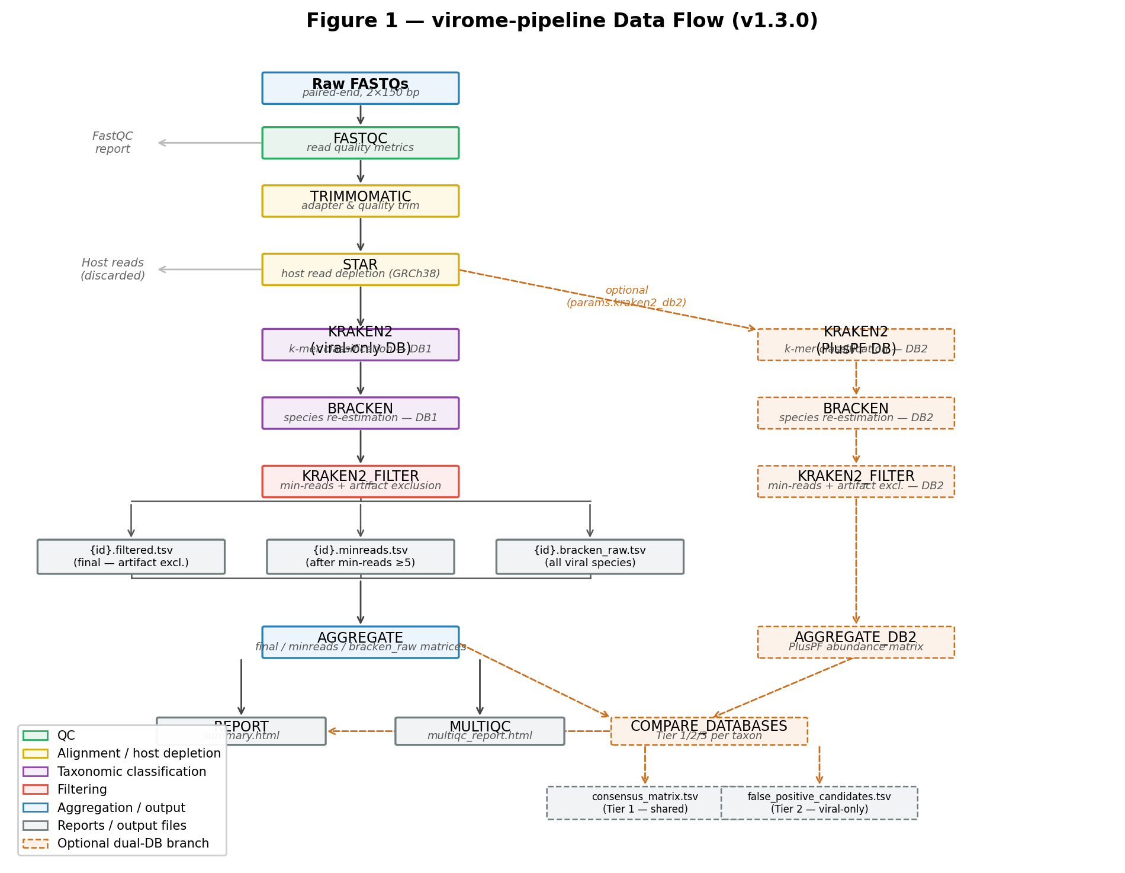
Virus Detection Pipeline architecture — v1.5.0
7-step Nextflow DSL2 workflow + dual-database branch + BLAST verification offshoot
All steps containerized (Apptainer) | SLURM-ready | Each process in its own .sif container | stageInMode = 'copy' for Apptainer symlink compatibility

Slide 7
The core innovation: dual-database competitive classification
Run every sample through two Kraken2 databases simultaneously — only signals surviving both are real
Database 1: Viral-only
Three-tier confidence scoring
Database 2: PlusPF (standard)
▸ ~10,000 viral genomes
▸ No non-viral sequences
▸ Closed-world: every read forced into a viral bin
▸ Maximizes sensitivity
▸ But: 100% FP rate in baseline cohort
▸ Full bacterial, archaeal, viral, fungal + human
▸ ~100 GB, human genome included
▸ Open-world: reads compete against host
▸ HERV-K → reclassified to Homo sapiens
▸ CMV proxy → looking like an artifact
Tier 1 — Shared
HSV-1 in PD19
Detected in BOTH databases High-confidence viral candidate Use for biology
Tier 2 — Viral-only
HERV-K, CMV proxy, MCV
Viral-only DB exclusive False positive candidates Investigate before interpreting
Tier 3 — PlusPF only
10–826 taxa / sample
PlusPF-only Non-viral contaminants Quality Control

Slide 8
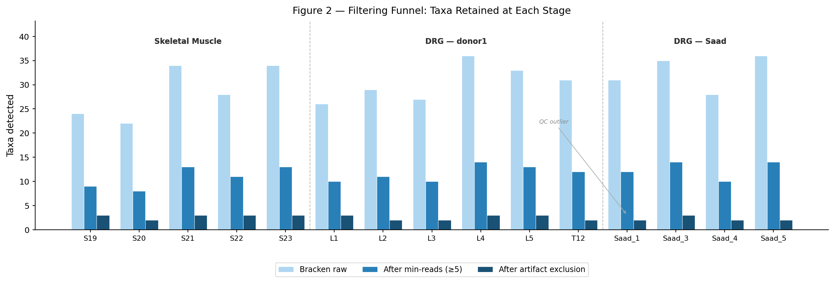
Multi-stage filtering + curated artifact exclusion
Bracken raw → min-reads threshold (≥5) → 24-entry artifact exclusion list
Three output matrices per cohort
bracken_raw
All viral species from Bracken No threshold as baseline for QC
minreads
≥5 reads per taxon per sample
final (filtered)
Curated artifact exclusion applied 24 taxa: phages, reagent contaminants, env. metagenome, cross-mapping
Artifact categories
Reagent contaminants · ruminant orthobunyaviruses · insect baculoviruses · phages (ICTV-reclassified) · DRG-specific env. metagenome cross-mapping · avian herpesviruses · giant amoeba viruses · hantaviruses (Oxbow)

Slide 9
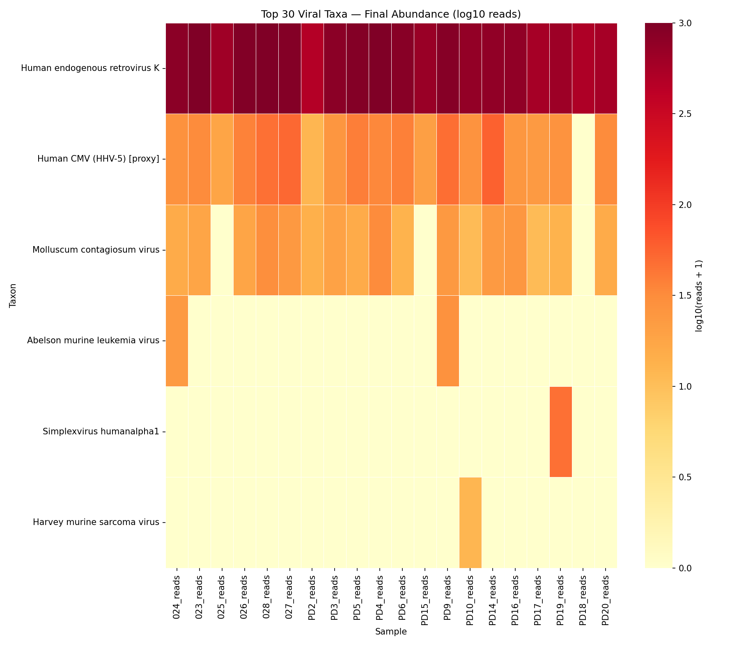
Viral abundance heatmap — PD cohort (n=20)
Key observations
▸ HERV-K dominant in all samples (endogenous, not infection)
▸ CMV proxy present but Tier 2 (k-mer artifact)
▸ MCV sporadic (index hopping)
▸ Simplexvirus humanalpha1 = HSV-1
▸ HSV-1 detected ONLY in PD19
▸ 46 reads, 1.89 RPM
▸ Absent from all other 19 samples
HSV-1 in PD19 is the only Tier 1 detection across all 36 donors
log10(reads + 1) scale | Final filtered matrix (post-artifact exclusion) | 'Human CMV (HHV-5) [proxy]' = k-mer artifact, not genuine CMV

Slide 10
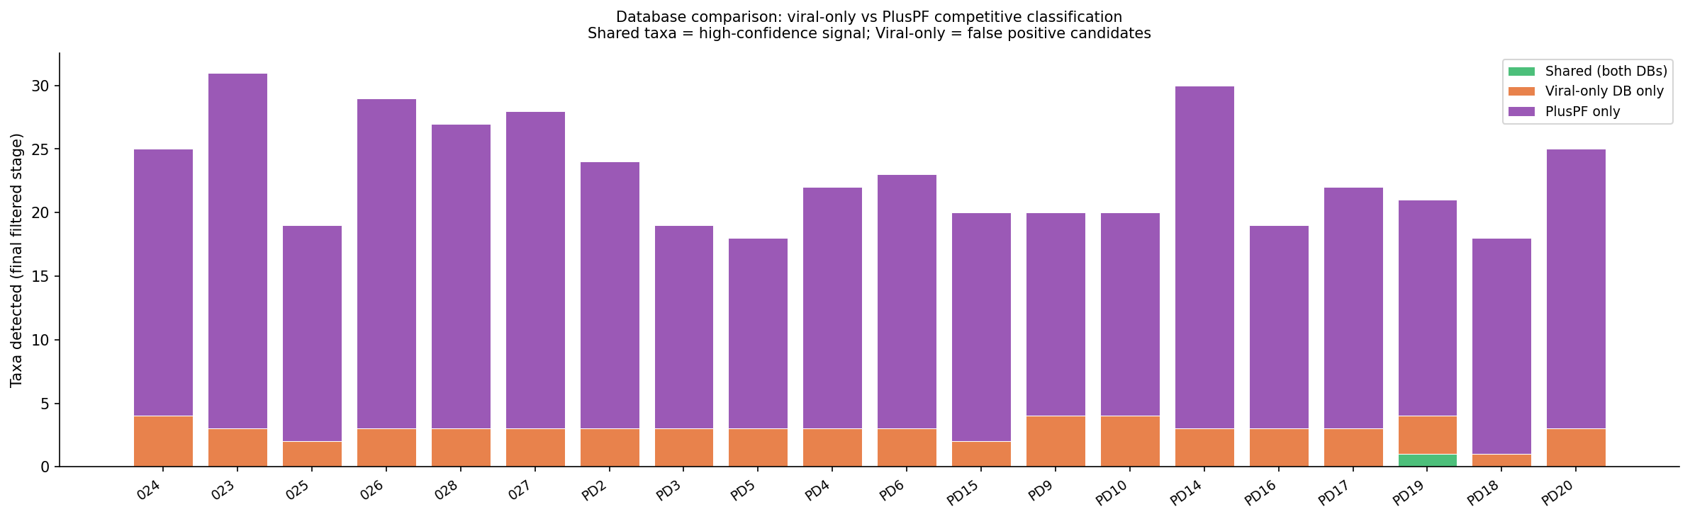
Dual-database tier classification — PD cohort
Shared (Tier 1)
Viral-only (Tier 2)
PlusPF only (Tier 3)
Detected in BOTH DBs = confirmed viral signal
Viral-only DB exclusive = false positive candidates
Non-viral background contaminants
1 taxon in 1 sample (HSV-1, PD19)
3 taxa per sample (HERV-K, CMV proxy, MCV)
15–30 taxa per sample (QC utility)
PD19 is the only sample with a green (Shared) segment | Baseline cohort (n=16 non-PD donors) had zero Tier 1 detections

Slide 11
PD19 HSV-1
46
1.89
1/36
0/22
1/14
reads (Kraken2)
RPM
donors with HSV-1
non-PD with HSV-1
PD with HSV-1
Why this is plausible
What's pending
▸ HSV-1 naturally establishes latency in sensory ganglia
▸ Antiviral therapy linked to reduced PD risk in registries (UK BioBank)
▸ Proposed mechanisms: retrograde transport, α-synuclein interaction, neuroinflammation
▸ 46 reads well above ~10 read noise floor
▸ Survived competitive classification against full human genome
▸ BLAST verification (blast_verify.nf ready to run)
▸ Life cycle phase: latency (LAT) or reactivation (IE/E/L)?
▸ Genome coverage profile against NC_001806.2
▸ Not statistically significant yet (Fisher's p ≈ 0.35, n=1)
This is a hypothesis, not a conclusion. BLAST validation and a larger cohort are required before any biological claim.

Slide 12
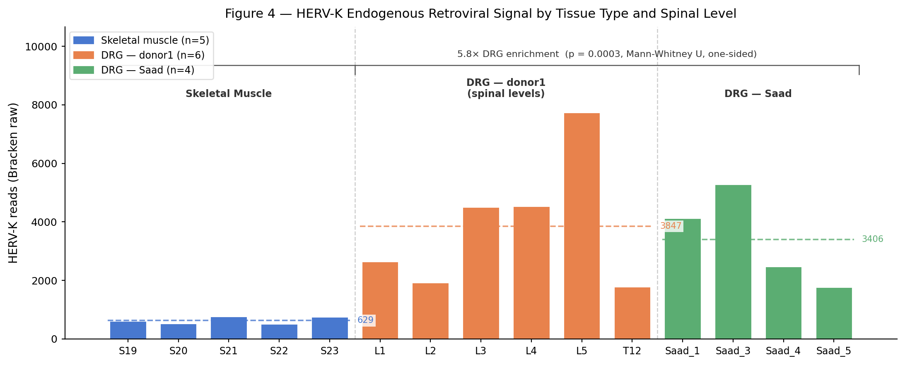
HERV-K — a real biological signal worth tracking
5.8× DRG enrichment over muscle · reproduced across cohorts · first quantification of HERV-K in human DRG
Cross-cohort HERV-K comparison
Muscle (non-PD)
n=5
11.3 RPM
DRG — donor1
n=6
45.8 RPM
DRG — Saad
n=4
72.7 RPM
DRG — PD patients
n=14
31.8 RPM
DRG — PD controls
n=6
34.5 RPM
Implications
▸ HERV-K is NOT a virus — it's endogenous retroviral chromosomal transcription
▸ DRG enrichment likely reflects neural-lineage chromatin accessibility
▸ ALS literature: HERV-K Env protein in motor neurons (Li et al. 2015)
▸ PD de-repression hypothesis NOT supported (PD RPM ≤ non-PD RPM)
▸ Could serve as internal control — HERV-K RPM as library quality metric

Slide 13
Next steps
This month
Soon
Longer term
▸ BLAST validation of PD19 HSV-1
▸ Determine latency vs. reactivation
▸ Begin compiling and cataloguing bulk seq
▸ Begin lab-wide bulk RNA-seq inventory
▸ Compile samplesheets for existing data
▸ Run across conditions (MS, COVID, etc)
▸ 100+ donor DRG virome atlas
▸ conditions comparison paper
▸ Expand to snRNA-seq / spatial (pseudobulk)
The ask
▸ I’ll be inventorying existing bulk RNA-seq (and all other sequencing data): which donors, tissues, and FASTQs are available?

Slide 14
DRG Virome Pipeline Update
Michael Wilde · CAPS · April 2026
Questions?
Michael.wilde@utdallas.edu

