Slide 1
Virome Expression Profiling of Human DRG & Neural Tissue
A Nextflow pipeline for competitive dual-database classification from bulk RNA-seq
Michael Wilde · CAPS · UT Dallas · April 2026
This talk covers:
① The method — solving sensitivity vs. specificity in virome profiling
② The findings — what preliminary data does (and does not) reveal
③ The tech — how this aligns with current technology standards
④ The ask — consolidating the lab's sequencing assets at scale

Slide 2
Why look for viruses in dorsal root ganglia?
Neurotropic viruses establish latency in sensory ganglia — and may drive pain long after acute infection
The Biology
The Clinical Need
The Opportunity
▸ DRG = primary sensory neurons; peripheral pain pathway entry point
▸ VZV (varicella-zoster) establishes latency in DRG — reactivation → shingles / postherpetic neuralgia
▸ HSV-1/2 latency in trigeminal & sacral DRG
▸ CMV, HHV-6 detected in neural tissue under immunosuppression
▸ HIV — peripheral neuropathy in 30–50% of patients
▸ SARS-CoV-2 long COVID: sensory neuropathy, small fiber neuropathy
▸ Chronic neuropathic pain affects ~8% of adults yet mechanisms incompletely illuminated
▸ Viral triggers implicated in: PHN, DPN, HIV neuropathy, MS nerve damage
▸ No systematic profiling of the DRG virome at transcriptomic resolution
▸ Human DRG tissue increasingly available via post-mortem & surgical programs
▸ GTEx, NABEC, and disease-specific biobanks now provide bulk RNA-seq data
▸ Our lab has 100–200 human donors across 12+ tissue types and hundreds of samples
▸ Bulk RNA-seq already in hand for DRG, spinal cord, muscle, and more
▸ Single-nucleus, spatial, and multi-omic modalities available for DRG
▸ Computational pipeline can answer this question at scale — if we use the data we have
▸ Paper 2 target: neuropathic pain vs. healthy DRG across all pain conditions

Slide 3
The challenge: finding viral signal in a sea of host RNA
Bulk RNA-seq is not designed for metagenomics — but it's what we have
Typical bulk RNA-seq library composition
Two failure modes for virome classification
Problem 1: Viral-only database — the closed-world assumption
Viral reads: <0.05%
▸ Classifier has no non-viral reference — every read must land somewhere viral
▸ Human transcripts sharing k-mers with viral genomes → misassigned
▸ HERVs, CMV k-mers, and neural lncRNAs are common offenders
▸ Result: systematic false positives in every sample
Host (human) ~99.95% of reads
Problem 2: Sensitivity — latent viruses leave few traces
▸ VZV/HSV maintain latency with minimal transcription — may fall below noise floor
▸ Bulk RNA-seq detection floor: ~10 reads per million host-depleted reads
▸ Targeted enrichment (VirCapSeq) or pseudobulk needed for latent detection
Detection floor ~10 RPM established empirically from this cohort

Slide 4
01
The Method
virome-pipeline: competitive dual-database classification for human neural tissue

Slide 5
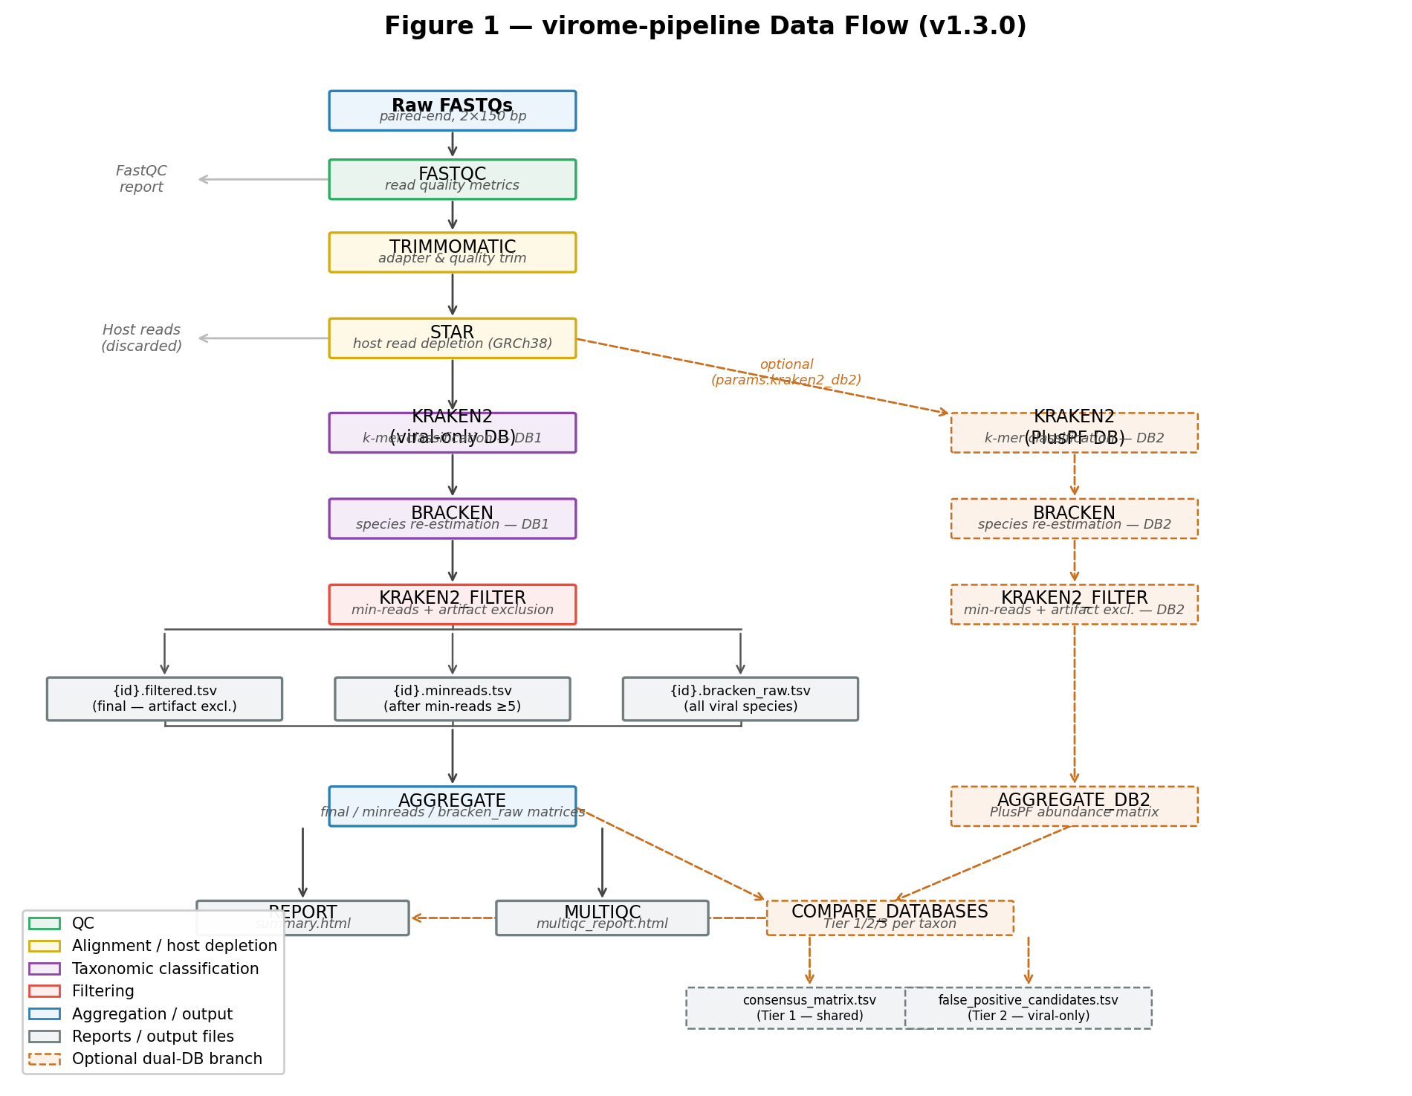
virome-pipeline v1.3.0 — architecture
Seven-step Nextflow DSL2 workflow with optional dual-database competitive classification
STAR host depletion → Kraken2 classification → Bracken re-estimation → multi-stage filtering → cohort aggregation | All steps containerized (Apptainer); SLURM-ready

Slide 6
The core innovation: competitive dual-database classification
Ask two questions simultaneously — does this virus survive competition with the full genome?
Database 1: Viral-only
Three-tier confidence scoring
Database 2: PlusPF (standard)
▸ ~10,000 viral genomes
▸ No non-viral sequences
▸ Closed-world: every read forced into a viral bin
▸ Result: detects HERV-K, CMV proxy, MCV as 'viruses'
▸ False positive rate: 100% in this cohort
▸ Full bacterial, archaeal, viral, fungal + human reference
▸ ~100 GB — human genome included
▸ Open-world: reads can land on the correct host sequence
▸ HERV-K → reclassified to Homo sapiens
▸ CMV proxy → 0 reads (k-mer artifact resolved)
Tier 1 — Shared
= 0 in our data
Detected in BOTH databases High-confidence viral candidate Use for biology
Tier 2 — Viral-only
= 3 taxa (all resolved as FP)
Viral-only DB exclusive False positive candidates Investigate before interpreting
Tier 3 — PlusPF only
= 10–179 taxa / sample
PlusPF-only Non-viral contaminants QC utility — not biology

Slide 7
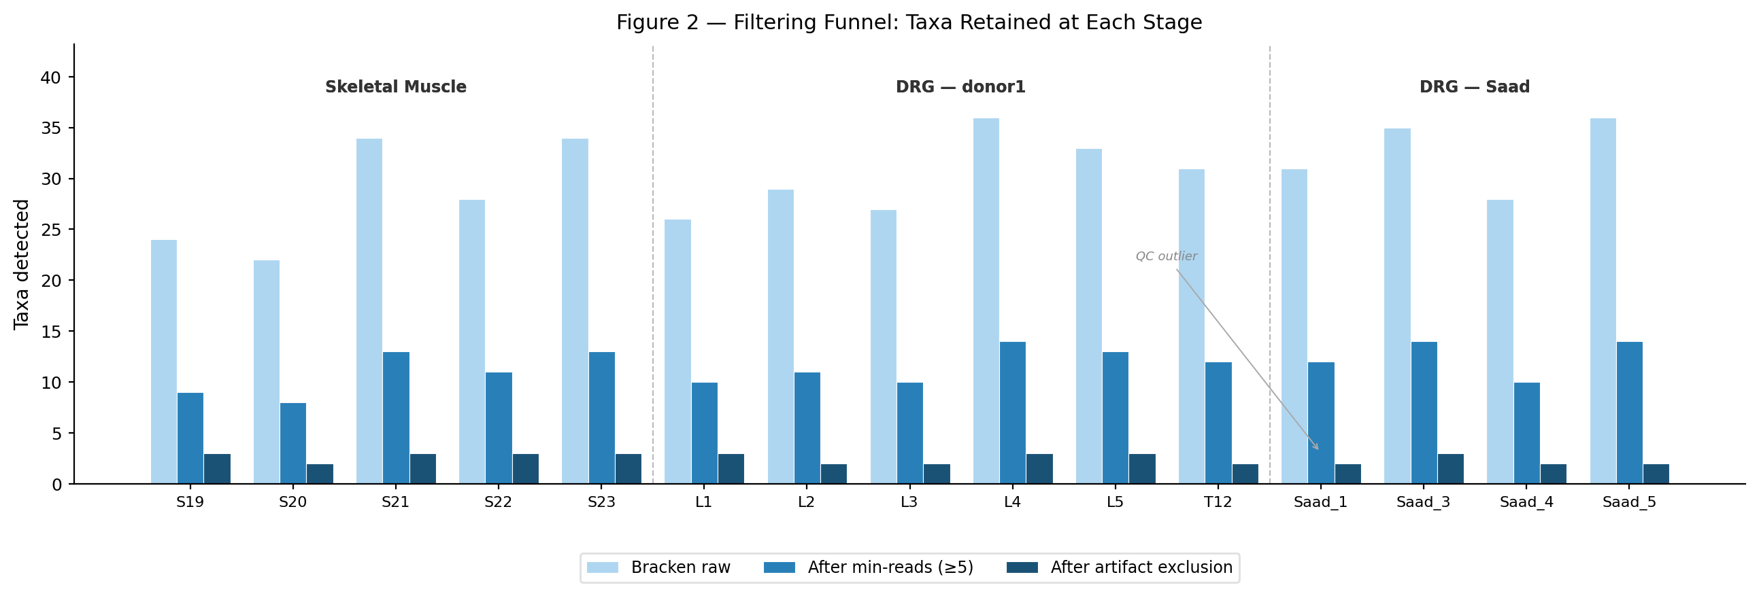
Multi-stage filtering funnel — 15 samples, 3 tissue groups
Systematic noise reduction: Bracken raw → min-reads threshold → curated artifact exclusion
24-entry artifact exclusion list | categories: reagent contaminants, ruminant bunyaviruses, insect baculoviruses, phages, environmental metagenome viruses, DRG k-mer cross-mapping

Slide 8
Curated artifact exclusion — 24 entries, versioned with the pipeline
Every false positive was investigated at the read level before being added to the exclusion list
Category
Example taxa
Mechanism
Diagnostic signature
Reagent contaminants
PhiX174, lambda phage
Library prep spike-in k-mers
All samples, all tissues
Ruminant orthobunyaviruses
Schmallenberg virus, Akabane orthobunyavirus
Cattle/sheep host k-mer overlap
DRG-enriched (neuronal transcripts)
Insect baculoviruses
Autographa californica MNPV
Invertebrate cell line contaminants
Sporadic; reagent-associated
Phages (ICTV-reclassified)
Ralstonia phage p12J → Porrectionivirus
Taxon ID superseded; old ID escapes list
Run after DB update = reappears
Environmental metagenome
Gihfavirus, Kinglevirus
DRG-specific lncRNA / ion channel k-mers
DRG-only; absent from muscle
Giant amoeba viruses
Colossusvirus, Pandoravirus
Environmental metagenome contamination
Sporadic, sample-independent
Hantaviruses (Oxbow)
Orthohantavirus oxbowense (2 taxon IDs)
Confirmed k-mer cross-mapping
Present in ALL samples/tissues
ICTV reclassification caveat: after each database update, audit for taxon ID supersession. Both old and new IDs listed where applicable.

Slide 9
02
The Findings
Zero confirmed viruses — and why that's the most important result

Slide 10
Study cohort — 15 human samples, two tissue types
5 skeletal muscle · 6 DRG (donor1, L1–L5 + T12) · 4 DRG (Saad cohort, independent donors)
Skeletal Muscle
n = 5
DRG — donor1
n = 6
DRG — Saad cohort
n = 4
Sample_19, 20, 21, 22, 23
L1, L2, L3, L4, L5, T12
Saad_1 (QC flag), Saad_3, Saad_4, Saad_5
▸ Independent donors
▸ Post-mortem vastus lateralis
▸ Non-neural control tissue
▸ QC: all pass
▸ Single donor; all spinal levels
▸ Intra-donor replication
▸ Allows spinal level stratification
▸ QC: all pass
▸ Independent donors; published cohort
▸ Saad_1: 430K bracken_raw reads (8× DRG median) — flagged, included
▸ Saad_2: excluded (library failure, 0 final taxa)
▸ AIG1390: excluded (confirmed donor1 duplicate by MD5)
⚠ AIG1390 (5 samples) excluded after MD5 checksum confirmed identical to donor1 FASTQs — duplicate submission under two donor IDs. Correct AIG1390 FASTQs to be obtained from provider.

Slide 11
The result: zero confirmed viral detections — so far (two DRG, muscle)
Tier 1 = 0 across all 15 samples and both tissue types · 100% false positive rate for viral-only Kraken2
0
3
100%
15/15
~10 RPM
Tier 1 taxa (confirmed viral)
Tier 2 taxa (all resolved as FP)
False positive rate of viral-only DB
Samples with Tier 1 = 0
Detection floor (host-depleted fraction)
What this means
The sensitivity vs. specificity trade-off — resolved
▸ We did not fail to detect viruses — we succeeded in distinguishing signal from noise
▸ The pipeline correctly returned zero: a scientifically valid null result at bulk RNA-seq sensitivity
▸ Three "signals" from viral-only classification were fully explained by endogenous transcription, k-mer cross-mapping, and index hopping
▸ This establishes a validated baseline: human DRG shows no active exogenous viral transcription above ~10 RPM in these donors
▸ Future cohorts with neuropathic pain patients are now interpretable against this baseline
Viral-only k-mer classifiers maximize sensitivity by forcing every read into a viral bin. This is correct behavior for environmental metagenomics — where host contamination is the exception. In human tissue RNA-seq, the assumption inverts: the vast majority of "viral" k-mer matches are host-derived. A classifier with no host reference cannot distinguish endogenous retroviral transcription from exogenous infection. Competitive dual-database classification restores specificity without sacrificing sensitivity to true positives. Tier 1 detections — reads that survive competition with the full genome — can be biologically interpreted.

Slide 12
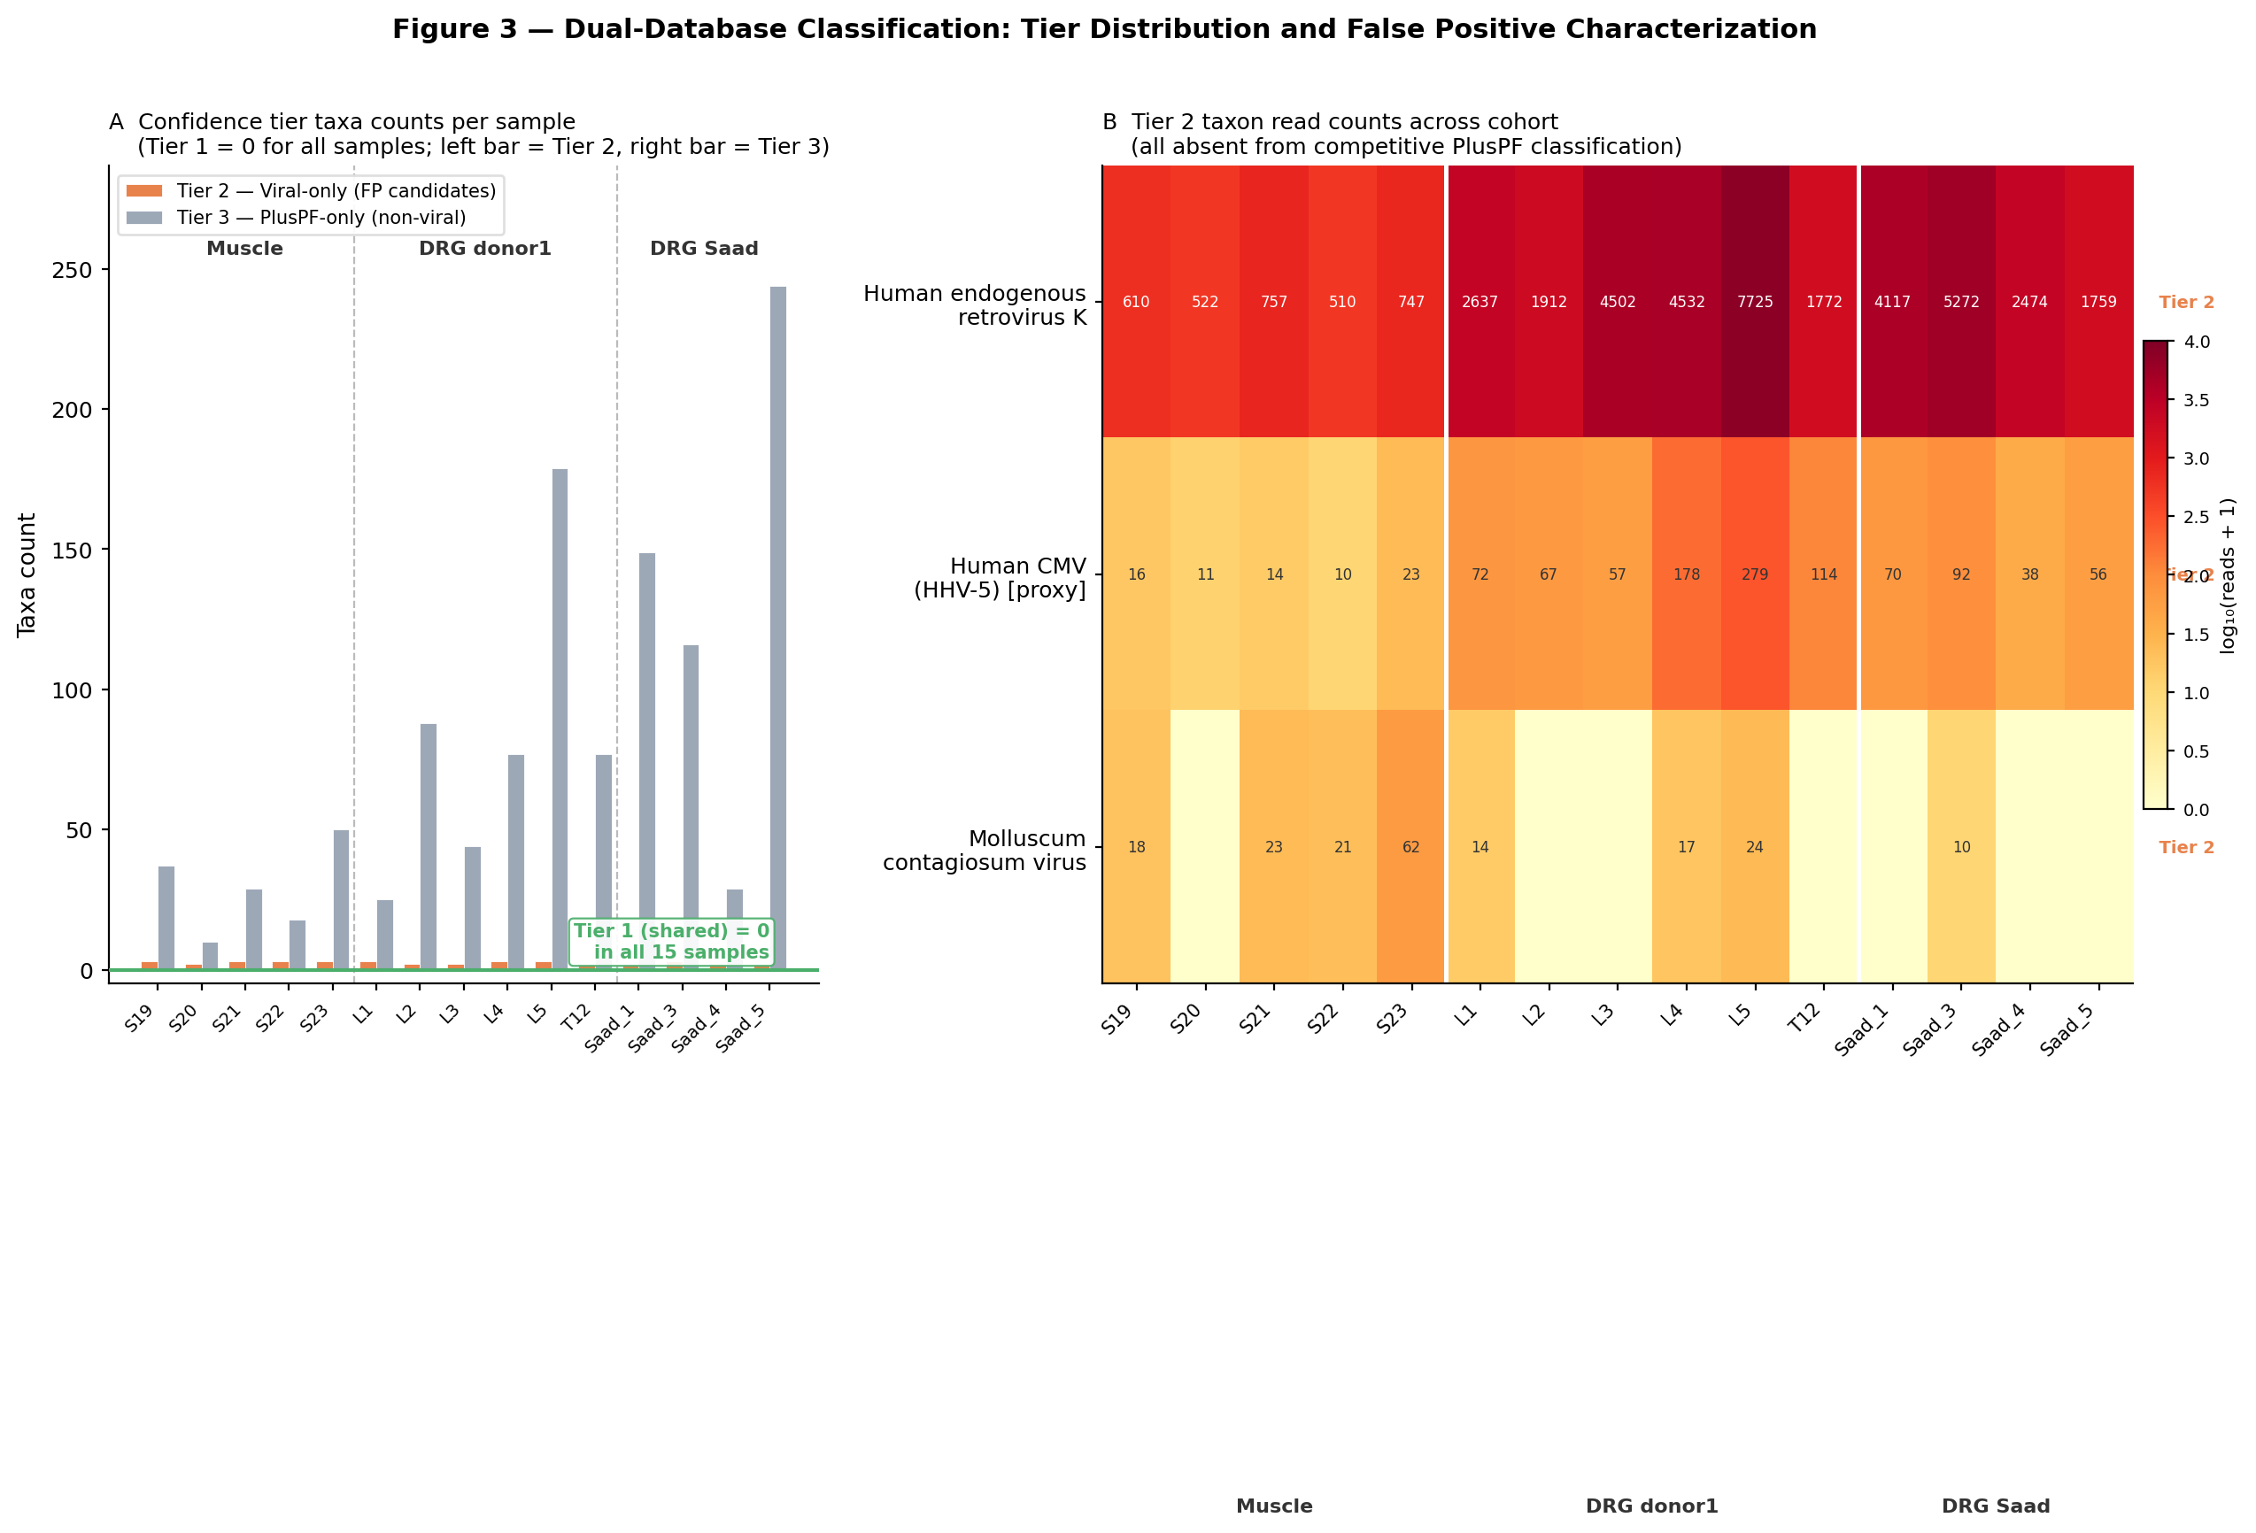
Dual-database tier classification across all 15 samples
Panel A: Tier 2 vs Tier 3 per sample · Panel B: The three Tier 2 taxa — all confirmed false positives
Tier 2 = viral-only exclusive · Tier 3 = PlusPF-only (non-viral background) · Tier 1 = 0 in all samples (green annotation)

Slide 13
The three Tier 2 taxa — fully resolved mechanisms
Each false positive explains a different class of artifact in human tissue metagenomics
HERV-K (HML-2) taxon 45617
Human CMV (HHV-5) [proxy] taxon 3050337
Molluscum contagiosum virus taxon 10279
39,848 reads cohort total
1,097 reads across 14 samples
189 reads total, sporadic
Endogenous retroviral transcription
ICTV reclassification k-mer cross-mapping
Index hopping / library prep contamination
▸ Present in all 15 samples
▸ 5.8× enriched in DRG vs. muscle (p < 0.0001 Mann-Whitney U)
▸ Reproduced across 2 independent DRG cohorts at 6 spinal levels
▸ PlusPF: ALL reads reclassified to Homo sapiens
▸ Biological signal: neural-lineage LTR promoter activity in post-mitotic sensory neurons
▸ NOT evidence of exogenous retroviral infection
▸ ICTV 2023 split HHV-5 into primate betaherpesvirus species
▸ LCA rollup routes reads via baboon CMV child node (2169863)
▸ ~10× DRG-enriched — mirrors HERV-K (same k-mer source)
▸ PlusPF: ZERO reads at this taxon in ALL samples
▸ Remediation: taxon_remap.tsv → '[proxy]' label; dual-DB confirms no genuine CMV signal
▸ Critical: do NOT interpret as CMV latency in DRG
▸ Absent from deepest library (Saad_1, 430K bracken_raw reads)
▸ Sporadic: muscle-predominant (65% of reads) — tissue-independent
▸ Distribution inconsistent with k-mer cross-mapping artifact
▸ Consistent with index hopping on patterned flow cell
▸ PlusPF: not detected — no genuine MCV transcription
▸ Does not require follow-up investigation

Slide 14
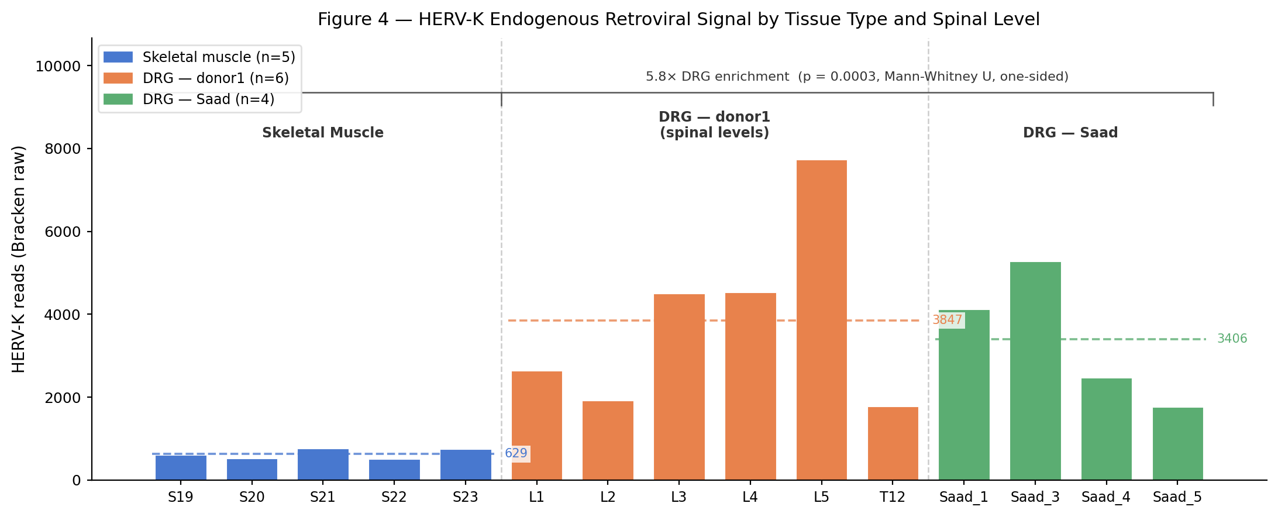
HERV-K — an unexpected biological signal worth pursuing
5.8× enrichment in DRG vs. skeletal muscle · reproduced across 2 independent cohorts · 6 spinal levels
Why does this matter?
▸ HERV-K/HML-2 is the most recently active HERV family in the human genome
▸ LTR retrotransposons de-repress via NF-κB in neuroinflammatory contexts
▸ ALS literature: TDP-43 pathology correlates with HERV-K envelope protein expression (Li et al. 2015, Science)
▸ MS literature: HERV-K and HERV-W elevated in MS plaques and CSF
▸ DRG-specific enrichment (5.8×) is consistent with neural-lineage LTR transcription in post-mitotic sensory neurons
▸ Hypothesis for Paper 2: does HERV-K expression differ between neuropathic pain vs. control DRG?
Under PlusPF: ALL 39,848 HERV-K reads reclassified to Homo sapiens. This is endogenous chromosomal transcription — not infection.
Mann-Whitney U, DRG vs muscle: p < 0.0001 · DRG mean 3,670 reads/sample · Muscle mean 629 reads/sample · donor1_L5 = 7,725 reads (largest DRG library)

Slide 15
03
The Standard
Where virome-pipeline sits in the field — and how it aligns with best practices

Slide 16
Tool comparison — how virome-pipeline positions in the field
Most existing tools were designed for environmental metagenomics or clinical pathogen detection — not bulk RNA-seq from human neural tissue
Tool
DB type
Host removal
FP handling
HPC-ready
Neural tissue use
virome-pipeline
Dual-DB: viral + PlusPF
STAR (splice-aware)
Dual-DB + 24-entry curated list
✓ SLURM + Apptainer
✓ Designed for this
MysteryMiner
Viral-only k-mer
Bowtie2 / custom
Prevalence filter only
Partial
No — general purpose
VirCapSeq-VERT
Capture + alignment
Targeted enrichment
Alignment-based (high specificity)
Partial
✓ High sensitivity
CZ ID (IDseq)
NCBI NT + NR
STAR + DIAMOND
Background correction (ERCC)
Cloud only
Yes — limited HPC
GATK PathSeq
Alignment-based
Human genome align
Coverage + alignment stringency
✓ GATK framework
Yes — designed for it
Centrifuge
Configurable
None (user-adds)
None built-in
Yes (fast, low mem)
Not neural-specific
VirCapSeq-VERT (Briese et al. 2015) — gold standard for sensitivity but requires targeted capture; not applicable to existing bulk RNA-seq · CZ ID best suited for clinical NGS · PathSeq: alignment-based, slower but high specificity

Slide 17
Technical standards — built to production genomics norms
Containerization, reproducibility, and HPC integration following nf-core and Nextflow community best practices
Nextflow DSL2
Containerization (Apptainer)
SLURM integration
▸ Module-based: each step is an independent, re-testable process
▸ Channel-based DAG: data dependencies explicit and visualizable
▸ Aligns with nf-core framework (nf-core/viralrecon, nf-core/taxprofiler)
▸ Every tool in its own .sif — no version conflicts, no environment drift
▸ Apptainer (formerly Singularity) — rootless, HPC-standard
▸ Reproducibility: same container on any cluster = same result
▸ slurm profile: automatic resource requests per process
▸ workDir on /scratch (not groups filesystem) — no quota exhaustion
▸ Interactive compute node workflow prevents login node memory issues
Versioned assets
MultiQC integration
Open source (MIT)
▸ artifact_taxa.tsv: version-controlled, ICTV-aware
▸ taxon_remap.tsv: misleading labels corrected, taxon_id preserved
▸ Samplesheet + config.yaml: full run reproducibility
▸ Per-sample QC metrics (FastQC, STAR alignment stats, Bracken counts)
▸ Filter funnel and diversity stats injected as custom content
▸ Single HTML report for cohort QC review
▸ github.com/mwilde49/virome-pipeline
▸ DOI via Zenodo (tag v1.2.0 — pending publication)
▸ All dependencies: open source, well-maintained biocontainers

Slide 18
04
The Ask
Consolidating the lab's sequencing assets — and where we go next

Slide 19
The lab's sequencing asset — an extraordinary resource
100–200 human donors · 12+ tissue types · 10+ sequencing modalities — most of it not yet systematically analyzed for virome
Tissue types (human, post-mortem or surgical)
Modalities available for DRG
The opportunity
▸ Dorsal root ganglia (DRG) — primary focus
▸ Spinal cord
▸ Trigeminal ganglia
▸ Vagus nerve
▸ Sympathetic ganglia
▸ Spinal meninges
▸ Nodose ganglia
▸ Adenoids / tonsil
▸ Blood (PBMC, whole blood)
▸ Bronchoalveolar lavage fluid (BAL)
▸ Vastus lateralis (skeletal muscle)
▸ + additional tissue types
▸ Bulk RNA-seq ← virome-pipeline now
▸ ATAC-seq (chromatin)
▸ Iso-seq (long-read)
▸ miRNA-seq
▸ Patch-seq (single cell + electrophys)
▸ PIP-seq (combinatorial barcoding)
▸ scRNA-seq
▸ snRNA-seq ← pseudobulk virome future
▸ Visium (spatial) ← pseudobulk virome
▸ Xenium (in situ) ← cell-type viral tropism
virome-pipeline is tissue-agnostic — the artifact exclusion list is swappable per tissue type. A systematic virome screen across all 100–200 donors and all tissue types would be the first comprehensive neural virome atlas of this scale. All that is needed: ① Consolidate FASTQs onto a shared location ② Run a single Nextflow command ③ Review the MultiQC report No new sequencing required for the first atlas pass.

Slide 20
Beyond bulk: pseudobulk virome from snRNA-seq, spatial, and multiome
Unmapped reads from single-cell/spatial modalities contain viral signal — with cell-type resolution
The principle
Technical challenges and solutions
▸ STARsolo / CellRanger generate BAMs with cell barcodes — even for unmapped reads
▸ Unmapped reads can be extracted per cell barcode → pseudobulk per cell type
▸ Kraken2 on these reads = cell-type resolved virome profiling
▸ Key question: if a virus is present, which cell type harbors it? (neurons? satellite glia? macrophages?)
⚠ Fewer reads per cell barcode → lower sensitivity
→ Aggregate by cell type (pseudobulk) to recover read depth
⚠ Host removal was not designed for 10x chemistry
→ STAR is already in the pipeline — same index, same logic
⚠ False positive rate increases at low depth
→ Same dual-DB competitive classification; artifact list still applies
Available in this lab for DRG
▸ snRNA-seq — pseudobulk per nucleus type
▸ scRNA-seq — pseudobulk per cell type (if low RNA degradation)
▸ Visium — spatial pseudobulk by tissue region
▸ Xenium — single-molecule, cell-type assignment at subcellular resolution
⚠ Cell-type assignment uncertainty
→ Use high-confidence clusters only; validate with canonical markers
⚠ Spatial data: spot contamination
→ Kraken2 confidence threshold ≥0.15 for spatial (stricter than bulk)

Slide 21
Paper 2: clinical cohort design — defining the study with the lab
The null result from healthy DRG is the baseline — now we need powered clinical groups
Conditions worth profiling
Minimum study design requirements
-
Postherpetic neuralgia (PHN)
VZV reactivation in DRG → chronic pain; VZV DNA detectable in DRG by PCR
✓ ≥20 DRG donors per group (statistical power for differential abundance)
✓ ≥2 clinical groups (neuropathic vs. healthy, or condition-specific)
✓ Tissue-paired samples: DRG + muscle from same surgical specimen
✓ Clinical metadata: diagnosis, age, PMI, tissue handling protocol
✓ Multiple spinal levels per donor where possible (intra-donor replication)
✓ Competitive PlusPF classification (virome-pipeline already implements this)
✓ Alignment-based validation for any signal above detection floor
Diabetic peripheral neuropathy (DPN)
Viral triggers (CMV, EBV) and metabolic inflammation; HERV-K de-repression?
Multiple sclerosis
HERV-W/K elevated in MS; demyelination and nerve damage mechanisms
HIV-associated neuropathy
Direct neurotropism + inflammatory neuropathy; retroviruses in DRG
Opioid-associated neuropathy
Chronic opioid exposure alters immune surveillance; HERV regulation?
Idiopathic small fiber neuropathy
Unknown etiology — viral/autoimmune trigger an open question

Slide 22
Next steps — and what I need from this lab
Immediate priorities, the data consolidation project, and the roadmap to a human neural virome atlas
Immediate (this quarter)
The ask — data consolidation
Roadmap (6–18 months)
▸ Jayden REJOIN cohort (473-1–473-17): 17 DRG samples — transfer FASTQs to Juno → run → 32 sample cohort
▸ T. gondii BLAST validation (1,330 reads surviving PlusPF — the only unresolved signal)
▸ Add HERV-K (taxon 45617) to artifact list formally
▸ Obtain correct AIG1390 FASTQs from sequencing provider
▸ SRA submission for the 15-sample cohort (paper 1 data availability)
▸ Inventory all existing bulk RNA-seq samples: which donors, which tissues, which runs are on Juno or local drives?
▸ Identify samples with existing STAR indices / host-removed BAMs — can skip re-alignment
▸ Agree on a central FASTQ storage location on /groups/tprice/
▸ Define a samplesheet standard so any lab member can trigger a virome run
▸ Share sequencing metadata (tissue type, disease status, cohort name) for the combined atlas
▸ Flag samples with paired tissue designs — DRG + muscle from same donor is especially valuable
▸ Paper 1 submission (Bioinformatics Application Note) — pending Zenodo DOI + SRA
▸ 32-sample cohort (Jayden) → expand to 50+ with lab bulk RNA-seq inventory
▸ Clinical cohort definition with lab input on pain conditions to prioritize
▸ Pseudobulk virome: snRNA-seq + Visium unmapped reads pipeline
▸ Tissue expansion: spinal cord, TG, vagus nerve, sympathetic ganglia
▸ Paper 2: DRG virome with clinical stratification (Journal of Virology / PLOS Pathogens)

Slide 23
Summary
▸ virome-pipeline solves the closed-world assumption problem for human neural tissue RNA-seq via competitive dual-database classification
▸ Applied to 15 DRG + muscle samples: zero confirmed viral detections — 100% false positive rate for viral-only Kraken2
▸ Three false positives fully resolved: HERV-K endogenous transcription (5.8× DRG enrichment), CMV k-mer artifact, sporadic contamination
▸ HERV-K tissue differential is a real biological signal worth pursuing — testable hypothesis for neuropathic pain vs. control cohorts
▸ Detection floor of ~10 RPM established — provides power calculation baseline for Paper 2
▸ Pipeline is production-ready, containerized, HPC-deployed, and aligned with nf-core standards
The vision
Questions?
A systematic human neural virome atlas — across 12 tissue types, 10 sequencing modalities, and multiple pain/somatosensory conditions — built from the sequencing data this lab already has.
github.com/mwilde49/virome-pipeline · virome-pipeline v1.3.0 · MIT License

