Slide 1

Scalper

Slide 2
What is TradeCompanion ?
It is a Trading software for the Forex Market.
TradeCompanion(TC) platform takes your TradeStation® strategy signals and automates their execution to FX trading platform.

Slide 3
What is Forex Market ?
The foreign exchange market (Currency, Forex, or FX) market is where currency trading takes place. It is where banks and other official institutions facilitate the buying and selling of foreign currencies.
The purpose of FX market is to facilitate trade and investment.

Slide 4
Trade-Companion at S7
Fix driver implementation [ Java => C# ]
S7 developed the TradeCompanion software.
Maintain the Website & Enhancement of TradeCompanion.
Handling client support issues for Trade Companion

Slide 5
Architecture
CurrenEx
DBFX
Gain
Icap
Fix 4.2
Ariel
API
Fix 5.0
Ariel
API
API
API
TradeCompanion
TradeStation
NeuroShell
MT4
Broker
Stategy Application

Slide 6
Features of TC
You can connect to any one of the broker.
Multiple account login.
Manual trading.
Automated trading.
Display market data.
Profit/loss calculations.

Slide 7
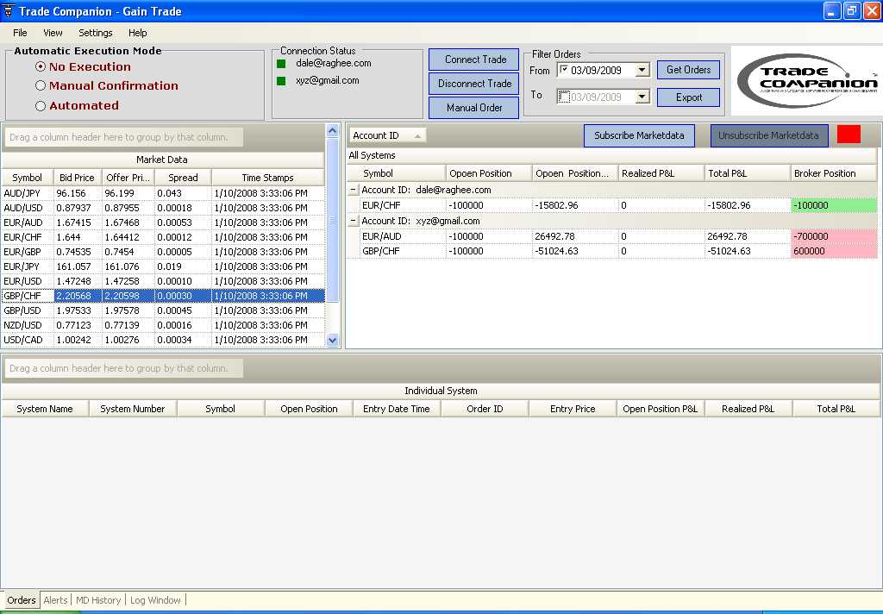
Screenshot of TC

Slide 8
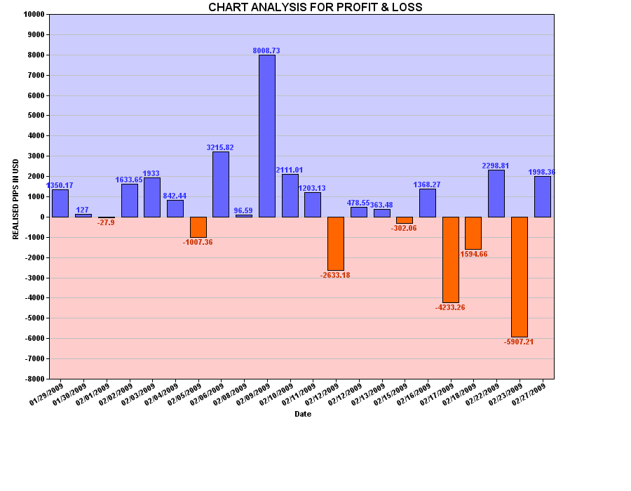

Slide 9
Challenges
Communication between the third party application and the TC.
Understanding the end-user needs.

Slide 10
Future plans
GUI changes.
Change in deployment.

Slide 11
????

