Slide 1
Capstone Project Week 5 Assignment
Matthew Wilkinson

Slide 2
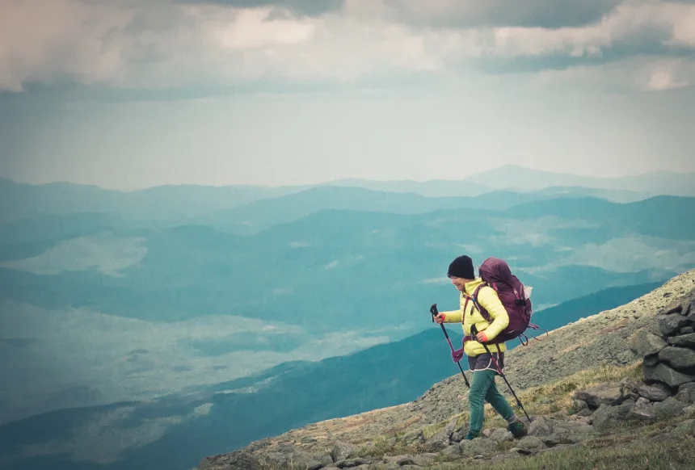
Introduction – part 1
Introduction – part 1
Business Problem
I am a keen outdoor enthusiast as are many others, and one of my favourite hobbies is hiking.
Whenever I am on holiday I will try to find local hikes which combine the right level of challenge, natural beauty, and solitude, but doing so based on random internet searches or individual recommendations often makes me wonder if I have made the most of the area I am visiting, or indeed whether I have visited the best area to pursue my hobby.
The problem this project will address is the challenge of selecting an appropriate location for a hiking holiday (and by appropriate I am talking about locations that have access to the right number of hikes, that are of the right quality and difficulty, and which are not too crowded).

Slide 3
Introduction – part 2
Target Audience
The target audience for this project's output would be a business that owned a website which aimed to help like-minded people identify their preferred hiking destination, and perhaps to identify a location that met their needs that was less well known.
The target audience could potentially also include:
Individuals using said website.
Local tourism agencies wishing to promote tourism in their area.
Healthcare providers wishing to encourage more active lifestyles.

Slide 4
Data – part 1
Data sources
Hiking Project: This is a website that offers a free-to-use API that will allow me to retrieve data relating to different hiking routes. I have given an example below that includes the type of data available. The web address is: https://www.hikingproject.com/data
US National Park Service (NPS) Data Store: I have chosen to use US National Parks and other areas managed by the US National Park Service as the potential locations for analysis as part of this project. Data relating to the visitor numbers for each location is available within the following downloadable document:
https://irma.nps.gov/DataStore/DownloadFile/620857#page=21&zoom=100,0,336
Geocoder location data: In order to identify proximity between NPS locations and hiking trails I will use the geopy geocoder as was done in other course labs.

Slide 5
Data – part 2
Data assumptions
Some assumptions have been made regarding the data, for example:
The Hiking Project database contains a sufficiently complete set of hiking trails to accurately reflect the typical hiking options in any given location in the USA.
Where latitude/longitude co-ordinates cannot be found for an NPS location using the geocoder these locations will not be included in the analysis.
Trails with missing characteristics will be excluded from average mean scores per NPS location, however total number of trails will include trails which omit other scores.
Visitor Days (recreation) represents 12 hours of time a recreational visitor spends at the NPS location and this is considered an appropriate measure of location popularity / businesses.

Slide 6
Data – part 3
Consolidated, Cleaned Dataset
The various data sources have been combined and cleaned to produce something that looks similar to the below (first 5 rows only out of 266 rows total).
Park ID | Park_Name | Num_Trails | Avg_Stars | Avg_Length | Avg_Difficulty | Visitor Days (Recreation)
1 | Aztec Ruins National Monument | 6.0 | 3.7 | 4.8 | 3.0 | 6867.0
3 | Belmont-Paul Women's Equality National Monument | 357.0 | 3.6 | 4.0 | 1.6 | 754.0
4 | Bent's Old Fort National Historic Site | 3.0 | 3.0 | 1.5 | 1.0 | 3436.0
6 | Big Bend National Park | 60.0 | 3.9 | 4.9 | 2.6 | 862798.0
7 | Big Cypress National Preserve | 2.0 | 4.0 | 0.4 | 1.0 | 203819.0

Slide 7
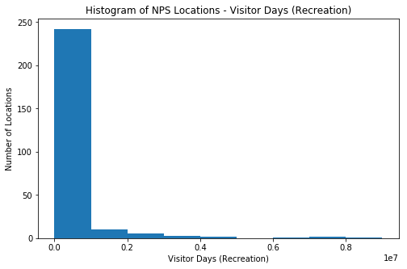
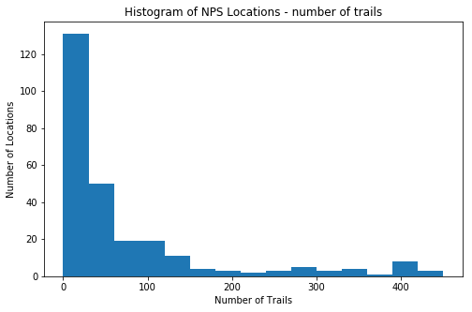
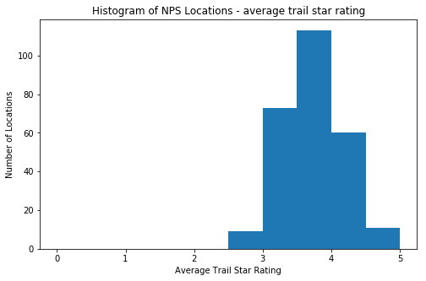
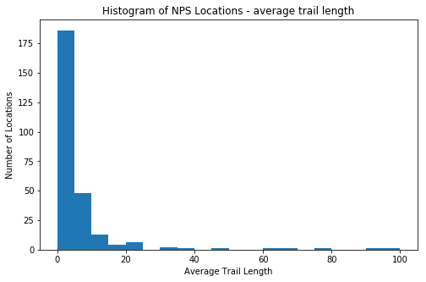
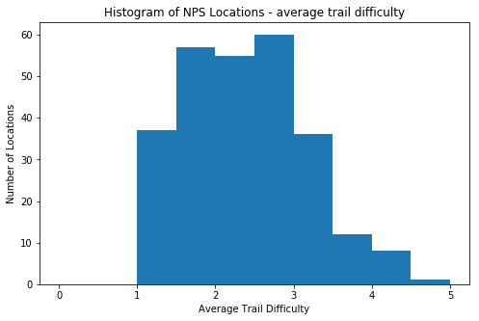
Data – part 4
Initial data analysis
The key features in the data that are relevant to this segmentation problem have been analysed to get a better understanding of the data. There is less distribution of the ‘number of trails’ and ‘visitor days’ features, so any segmentation on these is expected to generate some small segments (this is considered ok if meaningful).

Slide 8
Methodology
Approach
The following methodology has been applied to derive the desired location segmentation:
Source data as described.
Normalise data to zero mean and unit variance (for ML algorithm).
Apply k-means clustering ML algorithm.
Experiment – test outputs of different values of k to determine meaningful output.
Review output and define segment definitions based on average feature values per segment (non-normalised).

Slide 9
Results – part 1
Table of Aggregated Segment Features
The following was generated using k=5. This was the best output giving meaningful segments - see the next slide for segment definitions:
Cluster | Num_Trails | Avg_Stars | Avg_Length | Avg_Difficulty | Visitor Days (Recreation) | Num_Locations
0 | 1.7 | 4.0 | 69.3 | 2.2 | 201558.6 | 7
1 | 44.4 | 3.4 | 3.9 | 1.9 | 146503.1 | 118
2 | 339.7 | 3.5 | 3.0 | 2.0 | 170461.6 | 30
3 | 36.7 | 4.0 | 6.0 | 2.9 | 292439.7 | 104
4 | 89.0 | 4.0 | 8.0 | 3.1 | 5843829.5 | 8

Slide 10
Results – part 2
Segment definitions
Cluster 4 - 'Prestige Parks': Contains extremely popular destinations that typically have a relatively high number of impressive, challenging and lengthy hikes. There are only a few locations in this cluster but they are some of the most renowned and presitigous National Parks (including, for example, Yosemite and Yellowstone).
Cluster 3 - 'Secret Gems': This is the most interesting cluster (for many people). The hike types (in terms of rating, length and difficulty) are similar to the most prestigious National Parks in Cluster 4 - the min differences are each location has less hikes to choose from (but still dozens typically) and the locations are far less popular in terms of recreational Visitor Days.
Cluster 2 - 'Densely Packed Short Walk Locations': Contains locations which typically have a huge number of short walks nearby - this is because these tend to be in urban locations, so the hikes are generally less impressive, shorter and easier (although there are a lot of them!).
Cluster 1 - 'Easy Walk Locations': Another cluster of less popular locations - but the hikes here are less impressive, shorter and easier - thus distinguishing the cluster from Cluster 3. Some may also be in other urban locations where there are fewer defined trails.
Cluster 0 - 'Long Distance Touchpoints': There are a small number of locations that have very few nearby hikes, but those hikes are extremely long - these locations will typically be near long-distance hike trail-heads and would only be of interest if walking those specific trails.

Slide 11
Main conclusions – part 1
Cluster 4: There are a small number of ‘prestige’ parks that have great hiking options but which are very popular.
Cluster 1: There are many other locations that have a decent number of generally easier, less spectacular hikes.
Cluster 2: There are some locations with a huge number of trails to choose from, but these tend to be shorter, less interesting walks (often urban memorials rather than parks).
Cluster 3: There are many hidden gems – locations with similar hikes to the prestige parks, but with less visitors.
Cluster 0: There are a small number of locations with access to only one or two hikes, that tend to be long distance – i.e. trail heads.

Slide 12
Main conclusions – part 2
Cluster 3: There are many hidden gems – locations with similar hikes to the prestige parks, but with less visitors.
Cluster 3 is the one that is likely to interest most of the target audience as it identifies locations that are rich in challenging, high quality, lengthy hikes, but have relatively low visitation. While these locations are found predominantly in the Western USA, they are also dotted across the country, meaning there are options for many different people to visit these sites.

Slide 13
Main conclusions – part 3
Table of Top 5 Cluster 3 NPS Locations sorted by Average Trail Star Rating:
Park ID | Park_Name | Num_Trails | Avg_Stars | Avg_Length | Avg_Difficulty | Visitor Days (Recreation) | Latitude | Longitude | Cluster
294 | Voyageurs National Park | 35.0 | 5.0 | 10.0 | 2.5 | 99371.0 | 48.4 | -92.9 | 2
43 | Channel Islands National Park | 57.0 | 4.6 | 3.6 | 2.2 | 310422.0 | 34.0 | -120.1 | 2
108 | Gateway Arch National Park | 43.0 | 4.5 | 1.9 | 1.3 | 672061.0 | 38.6 | -90.2 | 2
162 | Kings Canyon National Park | 54.0 | 4.5 | 16.6 | 3.8 | 1906700.0 | 36.9 | -118.6 | 2
How about a trip to Voyageurs National Park in Minnesota?!

