Slide 1
XP is Extreme Programming
Planning XP
Mark Windholtz
ObjectWind Software Ltd

Slide 2
Delivering to Deadline
  XP is about delivering to deadline.
  Every two weeks you release something
  and every two weeks you check your plan.
  You get really good at getting stuff done.
        - James Grenning, ObjectMentor

Slide 3
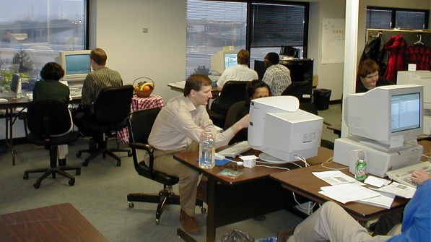
A Local XP Team

Slide 4
What Management Gets
Management gets …
  An Overall release plan (What, when, and how much)
  Most value out of each programming week
  Visible Progress: code running repeatable tests
  To Change direction as business changes
  Be informed early of schedule changes

Slide 5
What Programmers Get
Programmers are …
  told what is needed in priority order
  Allowed to produce quality work
  Allowed to ask for help
  Allowed to make and update estimates
  Allowed to accept responsibility

Slide 6
Business to Code Process
Product is a bunch of …
Release is a bunch of …
Iteration is a bunch of …
Acceptance Test is a bunch of …
Task is a bunch of …
Episode is a bunch of …
Test is a bunch of …
Code

Slide 7
Time Scale
Product: Years
Release: Month(s)
Iteration: Week(s)
Acceptance Test: Small piece of Biz value
Task: Technical task
Episode: 1-3 hours then integrate
Test: 1 to 5 minutes
Code: 0 to 20 minutes to satisfy test case

Slide 8
Release Planning Game
(Exploration )
Write a Story
(Customer)
“Too Big”
“Don’t Know”
Split
the Story
(Customer)
Estimate
a Story
(Programmers)
Spike
the Story
(Programmers)
Go to Planning
Goal
  Understand what the system is to do
Result
  A working set of estimates

Slide 9
Release Planning Game
(Planning )
Sort Stories
by Value
(Customer)
Declare
Velocity
(Programmers)
Choose
Scope
(Customer)
Goal
  Plan the next Release so it gives the most bang for the buck.
Input
  Set of estimated stories
Result
  A prioritized list of stories currently planned to by included in next release

Slide 10
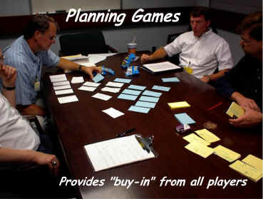
Iteration Planning Game
( finding a fit )
Biz
  Scope
  Priority
  Features per Release
  Date of Release
Tech
  Estimates
  Consequences
  Process
  Detailed Schedule
Feature Requests
Estimates & Budget
What’s in / What’s out

Slide 11
Time Scale
Product: Years
Release: Month(s)
Iteration: Week(s)
Acceptance Test: Small piece of Biz value
Task: Technical task
Episode: 1-3 hours then integrate
Test: 1 to 5 minutes
Code: 0 to 20 minutes to satisfy test case

Slide 12
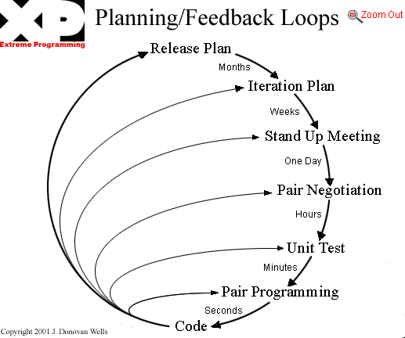

Slide 13
XP Episode Cycle
analysis
discuss with user
test
code
design
( refactor )
integrate or toss

Slide 14
Velocity
Tasks are estimated
  1 to 3 ideal days or hours
  Measured in relative task points
How many task points were delivered?
Historical velocity data
  Rough (but real) predictor future progress
  Cost, scope, schedule

Slide 15
What is Progress?
A Task is either Done or Not Done
  70% done is meaningless
Done means done!
  Done but not tested is meaningless
  Done but not integrated is meaningless
Code is written in small, running pieces
No large leaps forward in a fog …
… and falling off a cliff

Slide 16
Unit Tests
All production code is tested
Tests provide incremental certitude
Test graph
  Rough measure of accomplishment
  Quick indicator of a stalling project

Slide 17
Unit & Functional Tests: 7/30
Iteration 012 3 4 5 6 7 8 9 10 11 12 13 14 15 16 17 18

Slide 18
Unit & Functional Tests w/ Notes
Iteration 012 3 4 5 6 7 8 9 10 11 12 13 14 15 16 17 18

Slide 19
Unit & Functional Tests: Feb 2002

Slide 20
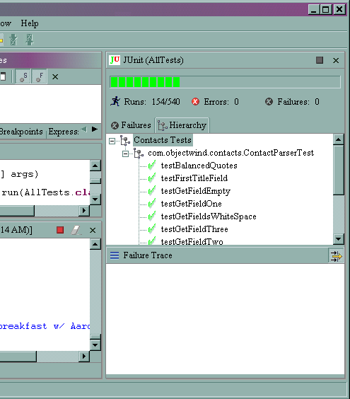
JUnit TestRunner in Eclipse

Slide 21
XP is Continous Feedback
Continuous…
  Code reviews (pair programming)
  Unit testing
  Integration testing
  User acceptance testing
Can you keep the customer happy with constant feedback, communication, and simplicity?
Feedback through estimation, testing, short releases
  Gives user confidence
  Gives developers confidence
  Gives Management confidence
  Prototype & build (blatant iterative process)

Slide 22
Ubiquitous Best Practices
If design is good, why not make it everyone’s job? (refactoring)
If simplicity is good, why not use the simplest design that supports the current desired functionality? (simple design)
If architecture is good, why not have everyone work at defining and refining the architecture continuously? (metaphor)
If short iterations are good, why not make iterations really short (hours and days) instead of weeks and months? (short iterations & planning game)

Slide 23
Ubiquitous Best Practices
If code reviews are good, why not do it all the time? (pair programming)
If testing is good, why not do it all the time…even customers? (continuous unit and functional testing)
If integration testing is good, why not do it several times a day? (continuous integration)

Slide 24
Xp Cons
Cultural shift can be difficult for Developers and Managers:
  Minor Culture Shift: Sustainable Pace, Coding Standards, Testing, Refactoring
  Major Culture Shift: On-Site Customer, Planning Game, Small Releases, Simple Design
  Extreme Culture Shift: Collective Ownership, Pair Programming, Metaphor
Requires experienced OO developers (but not gurus)
May not get a “customer” on-site
  May not get all of their time
  May not be a decision maker
  May break the internal culture

Slide 25
Challengers to XP success
Additional practices may be needed when attempting
  Large teams over 35 ^{[16]}
  Distributed “team” members
  Rigid organizations (controls instead of goals)
  Fearful organizations (shoot the messenger)
  Rewards based on input rather than results
    The time spent at work is primary measure of employee value.
  Prima Donna developers
    Sub-species: Information Hoarders (squirrels)
  Wrong physical environment (separated cubes)

Slide 26
Xp and the wider world
Documentation?
  Focus on cleaner, unit tested, peer reviewed code.
  Other documentation as needed. Be aware that it is an expense
XP & UML?
  Use UML if it helps. Be aware that it is an expense
  Don’t let “pictures” and models bog you down
  Don’t be afraid of reading the code
  See “Agile Modeling” ^{[14]}
Does XP work within context of CMM?
  XP practices can map to CMM processes ^{[12,13]}

Slide 27
Further Reading - 1
XP Cincinnati, Users Group www.objectwind.com/xp-cinci
  Local group to explore tools, techniques, and practices of XP
Beck, Kent. Extreme Programming explained, 2000
Fowler, Martin. “The New Methodology”. Nov 2001. www.martinfowler.com/articles/newMethodology.html
Jefferies, Ron. “They’re called practices for a reason”, Sept 2000. www.xprogramming.com/xpmag/PracticesForaReason.htm
www.junit.org - testing frameworks
www.refactoring.org
Fowler, Martin. Refactoring: Improving the Design of Existing Code. Addison-Wesley. 2000
www.pairprogramming.com - resources
www.extremeprogramming.org - on-line methodology manual
www.xprogramming.org - many articles
www.objectWind.com - articles on Lean Software Development and XP

Slide 28
Further Reading -2
Paulk, Mark (SEI). “XP from a CMM Perspective”. Invited Talk. XPUniverse, July 2001. Raleigh, NC.
http://c2.com/cgi/wiki?ExtremeProgrammingRoadmap - The Extreme Programming Roadmap on the Portland Pattern Repository. Where most of the discussions and good information take place in Wiki-style.
www.agilemodeling.com – Scott Ambler’s site
www.agilealliance.org - Non-profit organization dedicated to promote agile methodologies
Agile Software Development in the Large - Diving Into the Deep, by Jutta Eckstein; Dorset House, New York, 2004 ISBN 0-932633-57-9
The Central Florida Patterns Group http://groups.yahoo.com/group/cflpatternsgroup/

