Slide 1

Fit & FitNesse
Mark Windholtz
ObjectWind Software Ltd

Slide 2
Agenda
Testing Approaches
FitNesse tour
Fit Overview
Standard Fixtures
FitNesse
FitNesse Macros & Features

Slide 3
Manual Testing
Most expensive testing approach
  Test takes time and personnel to execute
  Valid only until the next environmental or code change occurs. And they occur constantly!
  Error prone as testers get fatigued
  Not executed often enough to help in development
  Instructions get outdated and are misunderstood

Slide 4
Acceptance Testing
Test Features at the end of production
Pro
  Bad defects don’t ship, fix or delay (both cost)
Cons
  Minor defects too late to fix, so they ship
  Too late to help during programming
  Expensive and often Manual
  Takes a long time

Slide 5
xUnit Testing
jUnit (xUnit for Java) is industry standard
Pros
  Test-first design is very powerful
  Allows for changing requirements
  Produces better modular design
  Reduces technical defects
Cons
  Most defects are in communication about specs
  xUnit helps the trees but not the forest

Slide 6
Fit & FitNesse
Fit
  Write tests for features directly from the requirements
  Test high-level and written as html tables
  Domain Expert can specify fitness criteria
  Domain Experts can verify fitness criteria
FitNesse
  Tool to write and organize fit tests
  Wiki based for Collaborative web building

Slide 7
Event Scheduling Calendar
An Event occurs on a date
An Event belongs to a group
Add an event to the calendar
  At startup, should be zero events
  Create an event
  Check that there is now one event

Slide 8
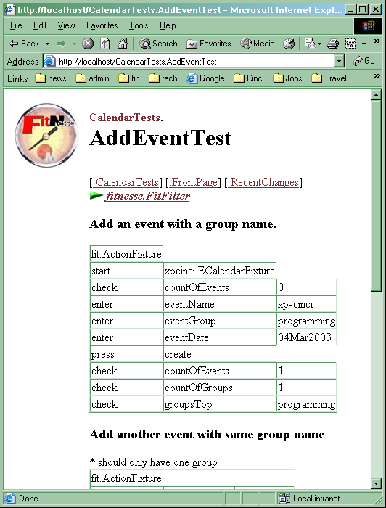
Basic

Slide 9
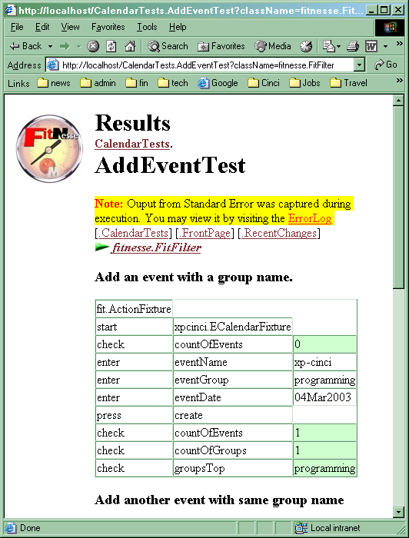
Green

Slide 10
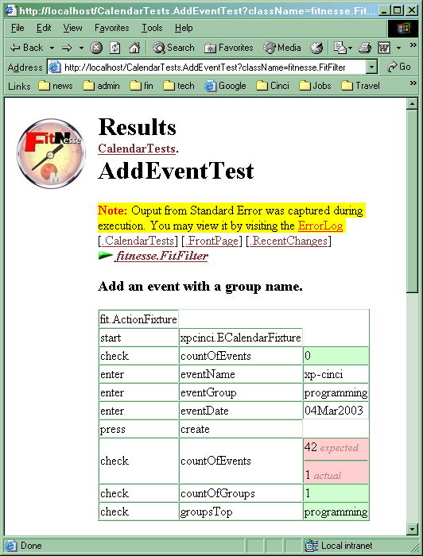
Fail

Slide 11
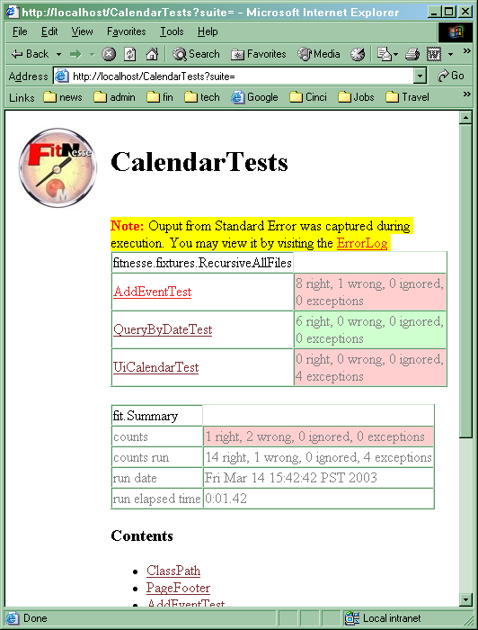
suite

Slide 12
Fit: Overview
Fixture to “hold” real code
Tests As
Html Tables
Production code

Slide 13
Web UI Testing
Web Html request & response

Slide 14
Testing the UI
GUI is most unstable component
Minimize Logic in the UI with solid OO design
Minimize things that can break
Target UI tests on only what can break
Test business logic directly elsewhere
Screen transitions?
Java Script? (see above)
Good OO design minimizes Logic in UI
All that’s left is the aesthetics

Slide 15
UI Testing libraries
HtmlFixture
  Link: TestUiCalendarDayNames
IeFixture
  Uses COM to direct a real IE browser
HttpUnit
  Allows low level control
HtmlUnit
  Page level control
jWebUnit / jWebUnitFixture
  (under development) high level control

Slide 16
Testing The Business Model
Address
Party
Location
Inventory
Address
Vendor
Destination
Trip
Carrier
Carrier
Load
Load
Palette
Palette
Palette
Item
Item
Produce
Produce
Item
Item
Item
Item
Produce
Produce
Item
Item

Slide 17
Business Domain Testing
Business language
  Not tech talk
Focus on testing the business rules
  Not loop counters and exception catching
  Low level stuff is better tested by unit tests
Scalable
  Tests scale when they remain atomic
  No dependencies between test order
  UI driven testing is more Fragile & Expensive
    Need to keep windows in sequence.
    Full Database set-up

Slide 18
Standard Fixtures
Column Fixture
  Each row loads a data structure and then invokes functions upon it.
Row Fixture
  Each row is a query into an array of objects
Action Fixture
  Write a script that emulates a user interface.
Summary Fixture
  Report of all tests on a page

Slide 19
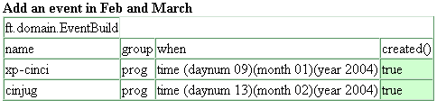
EventBuild is a Column Fixture
Column Fixture
  Operates on a Domain Objects directly
  Each row loads a data structure and then invokes functions upon it.
  Uses Domain methods and instance variables
  Often used for test object creation

Slide 20
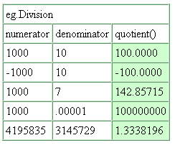
Eg.Division
Make sure division that works with positive and negative numbers
public class Division extends ColumnFixture
{
public float numerator;
public float denominator;
public float quotient() {
return numerator / denominator;
}
}
← Famous Pentium Bug

Slide 21
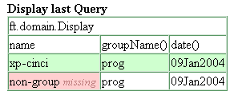
Display is a Row Fixture
Row Fixture
  Operates on a group of Domain Objects
  Each row is the data of an object
  Often used to display results of a query
    Query either built into the fixture
    Or preserved in a known static location

Slide 22
ValueObjects
An Important Idea in Object Oriented Modeling
like numbers, dates, monies
Small objects which are used widely

Slide 23
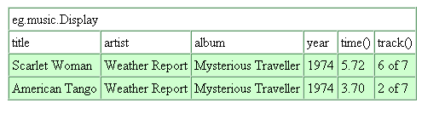
Row Fixture Example

Slide 24
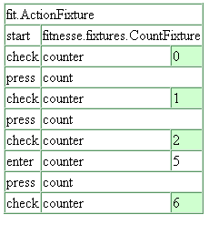
ActionFixture
Like a Control panel
press buttons that have particular names
enter values into registers that have certain names.
check the values of named meters

Slide 25
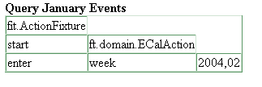
ECalAction is an ActionFixture
Action Fixture
  Write a script that emulates a user interface
  Add a subclass and Use it directly
  Define your commands in subclass

Slide 26
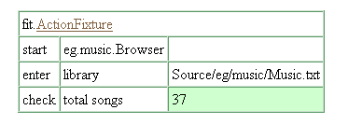
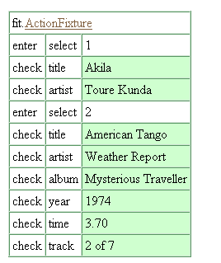
Example ActionFixture

Slide 27
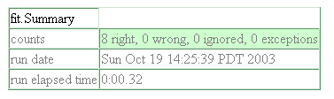
Summary Fixture
Displays summary of results of Page
Add it to TearDown and forget it.
  | fit.Summary |

Slide 28
Putting it all together
BOC: Build-Operate-Check Pattern
    Link to locally running FitNesse server
    Testing the eCal application
CalendarTests.TestQueryByWeekNumbers

Slide 29
FitNesse File Structure
FrontPage
  FitNesse
    UsersGuide
    (Self tests)
  CalendarPaths (macros defined here)
    ClassPath (classpath set here)
    CalendarTests (root of all tests)
      PageFooter
      PageHeader
      SetUp
      TearDown
      TestMoveScheduler
      TestMoveSchedulerYearBoundry

Slide 30
Test Suite
Executes all tests in the Sub-Wiki (Tree of Pages)
SetUp and TearDown pages invoked for each page of the suite.
To wrap an entire suite, define the operations on pages named SuiteSetUp and SuiteTearDown.
SuiteSetUp
  SetUp TestOne TearDown
  SetUp TestTwo TearDown
  SetUp TestThree TearDown
SuiteTearDown

Slide 31

Editing FitNesse Pages
Simple syntax
Tables can be created very easily.
Vertical stroke as the first character of the line, and separate each table cell with it:
|Alpha|
|Beta|gamma|Delta|
|1|2|3|
Link: FitNesse.MarkupTable

Slide 32
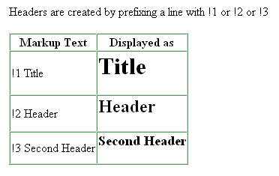
Headers

Slide 33
FitNesse Macro Language
!contents
  Expands into links to sub pages
!include
  Include other pages
  Handy when building test objects
!path
  Used in ClassPath page to define a path to class and jar files
!define
  Defines macros that can be referred to in sub pages

Slide 34
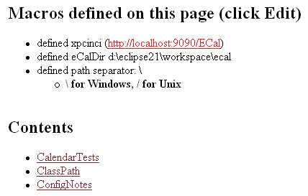
Example of Macros
!2 Macros defined on this page (click Edit)
!define xpcinci (http://localhost:9090/ECal)
* defined xpcinci (${xpcinci})
!define eCalDir {d:\eclipse21\workspace\ecal}
* defined eCalDir ${eCalDir}
!define I {\}
* defined path separator: ${I}
* '''\ for Windows, / for Unix'''
!2 Contents
!contents
Link: CalendarPaths

Slide 35
Installation
Download from www.Fitnesse.org
Unzip into a directory
Cd to directory and type:
  C:> run
Open a web browser on:
  http://localhost
Note: You can pick a different port with the -p command line option

Slide 36
Command line or Ant script
<exec executable="java" resultproperty="fit.result">
<arg line="-cp ${lib}/fitnesse.jar
fitnesse.TestRunner
http://localhost/CalendarTests?suite="/>
</exec>

Slide 37
Additional FitNesse Features
Page Versioning
Recent Changes
Search for keyword
Search for page references
Refactor (rename & delete)
Virtual Wiki
  Run local code still under development
  Using a central set of shared Test pages
  Helpful in testing code before check-in

Slide 38
Big Picture Stuff
Plays well with other Best Practices
  Automated build systems
  OO Design Patterns
  jUnit
  Domain Driven Design
  Iterative development

Slide 39
Summary
FitNesse allows for Testing of UIs
  However, UI testing is fragile and late
FitNesse also allows Domain Object Testing which is not fragile
Provides migration path from UI to Domain testing
FitNesse allows human readable comments to be mixed in with test tables
And allows easy interpretation by domain experts

Slide 40
Getting Started
FitNesse as a Wiki
  Excellent group communication device
FitNesse testing of new project
  Concurrent with requirements gathering
  And Domain design
FitNesse testing existing projects
  UI driven with IeFixture and other UI techniques and fixtures
FitNesse 2-day Workshop or Mentoring

Slide 41
Perfection: Fitness Testing

