Slide 1
Change Sorter Overview
Full Documentation provided in
    Changes.doc
Smalltalk
Express
Add in feature

Slide 2
Introduction
Change Sorter distributed for free by Knowledge Systems Corp. http://www.ksccary.com/
Manages code changes to the image.
Allows sharing changes with other images.
Other add-ons available at:
http://www.objectshare.com/se/stexpUser.htm

Slide 3
Contents
Items in the new Transcript Window.
Change Sorter when empty
Make Some Changes
Sorting and Saving a Change Set
Loading a Change Set.

Slide 4
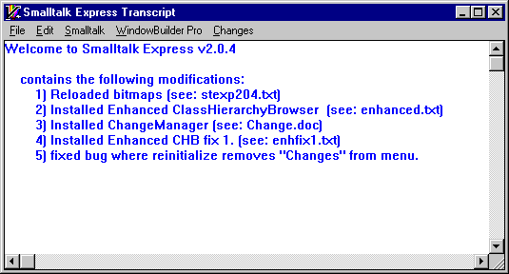
Items in the new Transcript
These changes are found in stexmod6.zip

Slide 5
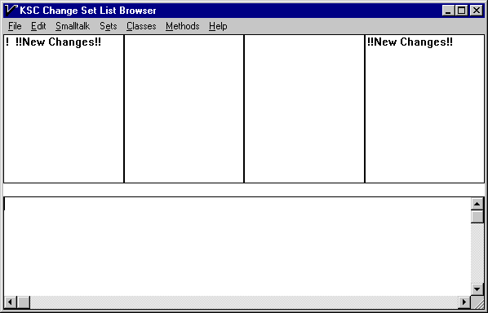
Change Sorter when empty
From the Transcript select the menu:
      Changes | Change Sorter

Slide 6
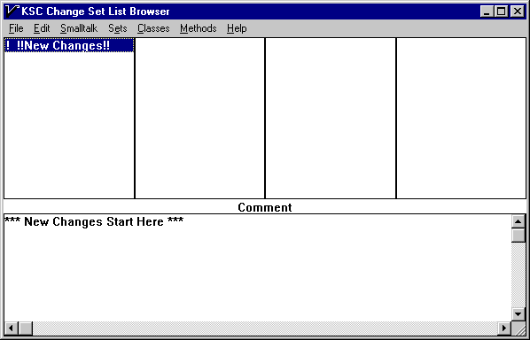
Change Sorter select
Select New Changes in top right listbox

Slide 7
Make Some Changes
Added MyNewClass & MyNewClass02
With myNewInstanceVar01 and myNewInstanceVar02
With MyNewClassVar01
With myNewMethod01

Slide 8
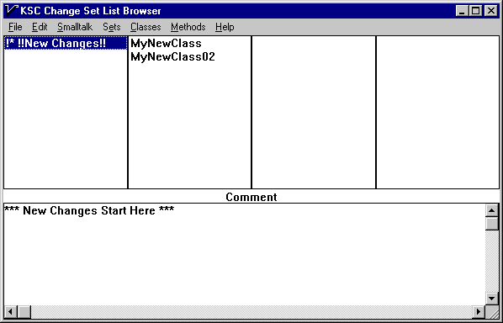
Sorting & Saving Change Set - 1
Select New Changes

Slide 9
Sorting & Saving Change Set - 2
Always Use the Dialog Menus
Pop-up menus have a bug.
Left is the MOVE-FROM change set
Right is the MOVE-TO change set.
First, Create a new MOVE-TO change set.
  Sets | New Set
Your last name & assignment number under 8 characters.
Example : Wind01

Slide 10
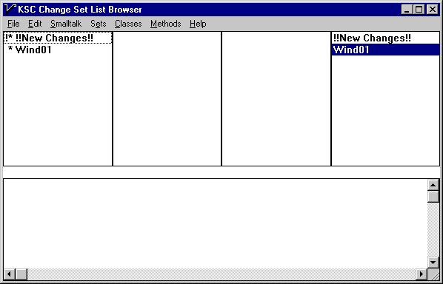
Sorting & Saving Change Set - 3
MOVE-FROM on Left. MOVE-To on the right.

Slide 11
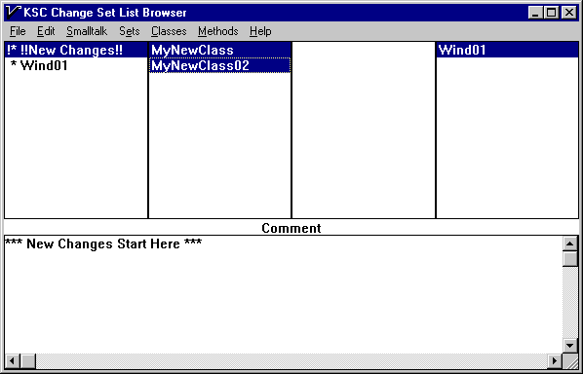
Sorting & Saving Change Set - 4
Select MOVE-FROM NewChanges
Wind01 auto selects as MOVE-TO
Select the changes to move: MyNewClass & MyNewClass01

Slide 12
Sorting & Saving Change Set - 5
From the Window Menu select
  Classes | Move
The changes are now in the new set.
Now select the new set on the Left and File it out
  Sets | File Out
Use the default name
Do not save the Image. Exit the image

Slide 13
Loading a Change Set.
Open the Change Sorter
From the Window Menu select:
  Sets | File In
Change Sets should have an extension of *.CS
The changes from the change set are loaded into your image.

Slide 14
Summary
Change Set Manager is used to group changes and share them with other images.
Full Documentation provided in Changes.doc

